Slide 1
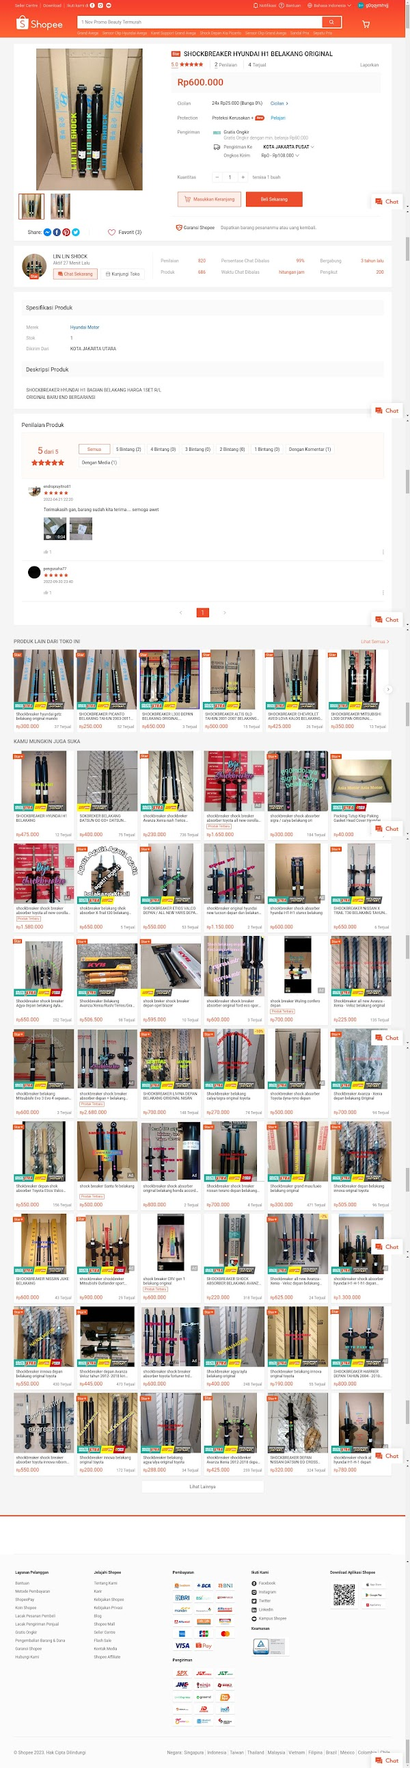
상품 URL 전체 스크린샷
(중요) 크롤링 대상 사이트인 쇼피는 shopee.co.id (인도네시아) 와 shopee.푸 (베트남) 으로 디자인은 동일하나 도메인과 국가만 상이한 상황.

Slide 2
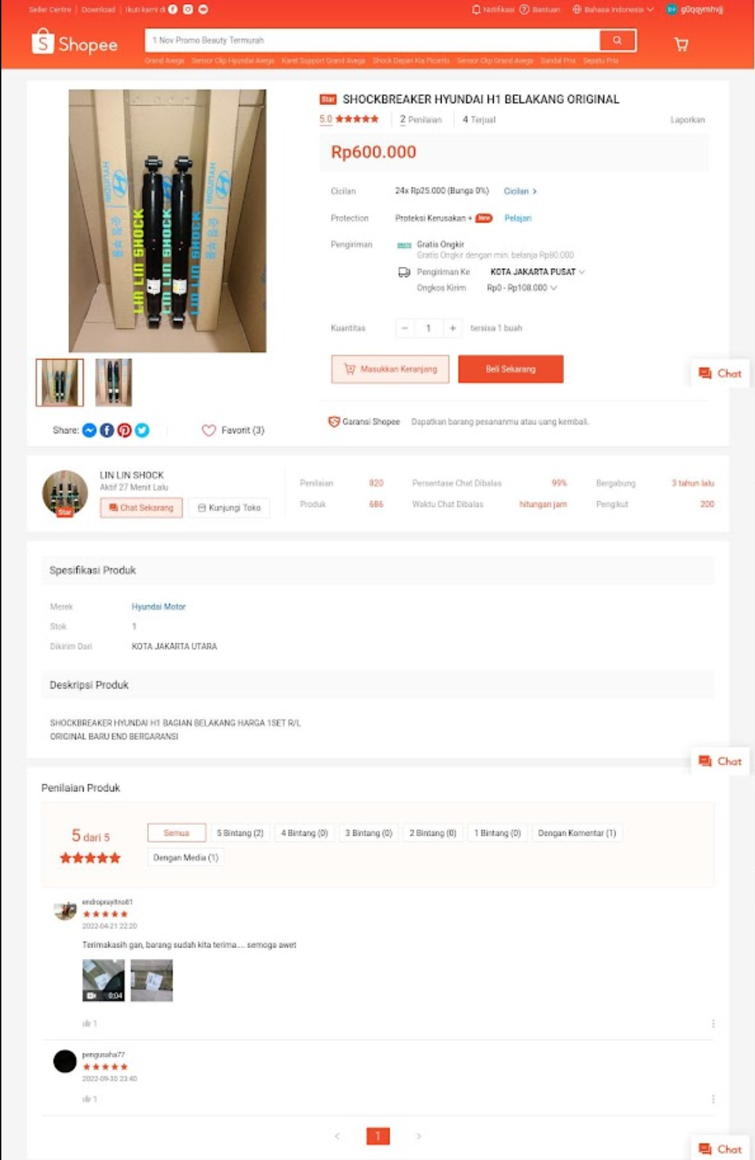
상품 URL 수집 대상 정보
4. 상품명
5. 판매 건수
3. 대표 이미지
6. 댓글 건수
7. 가격 / 통화
8. 슬라이드로 이미지 여러장
9. 스토어명 / 스토어 URL (그외 판매자명, 사업자등록 번호
, 회사명 등 .. 수집 가능하다면 전부.)
10. 텍스트로 된 상세 설명
1. 상품번호: 상품 정보 URL 에서 파싱하여 추출
- 상품번호 : i.633935757.23930810428
예) https://shopee.co.id/shockbreaker-shock-breaker-Hyundai-Getz-belakang-i.633935757.23930810428
2. 판매자 정보: 스토어 URL 에서 파싱하여 추출
- 판매자명: almotor99
예) https://shopee.co.id/almotor99

Slide 3
엑셀 항목
1) 엑셀의 대표이미지 항목에는 이미지 파일 삽입
2) 대표 이미지는 추가 이미지들 중 첫번째 이미지
3) 추가 이미지는 1건 이상 (최대 6건 까지만 처리)
* 빨간색 항목은 필수 입력
수집 일시 | 플랫폼 | 대표이미지 | 대표이미지 URL | 상품명 | 상품 URL | 상품 번호 | 판매 가격 | 통화코드 | 판매 수량 | 상품평 (댓글) 건수 | 스토어 URL | 스토어명 | 판매자 ID | 판매자명 | 회사명 | 대표자명 | 사업자번호 | 판매자 전화번호 | 판매자 이메일 | 게시일 정보 | 추가 이미지 URL 1 | 추가 이미지 URL 2
2024-07-03 | 예) shopee.co.id

Slide 4
1. 인도네시아 쇼피 (https://shopee.co.id) 테스트 URL
https://shopee.co.id/%E2%9C%A8COD-Switch-Inhibitor-Matic-Hyundai-All-New-Tucson-Kia-All-New-Sportage-Diskon-i.585595155.22188574358
https://shopee.co.id/SHOCKBREAKER-HYUNDAI-NEW-TUCSON-DEPAN-BELAKANG-TAHUN-2011-2016-ORIGINAL-MANDO-PART-i.265326093.3755070232
https://shopee.co.id/SHOCKBREAKER-HYUNDAI-NEW-TUCSON-DEPAN-TAHUN-2011-2016-ORIGINAL-MANDO-PART-i.265326093.7053876797
https://shopee.co.id/Shockbreaker-hyundai-new-tucson-depan-original-merk-mando-i.57374108.24407485924
https://shopee.co.id/SHOCKBREAKER-HYUNDAI-NEW-TUCSON-BELAKANG-TAHUN-2011-2015-ORIGINAL-i.312234283.6255223897
https://shopee.co.id/shockbreaker-belakang-Tucson-i.474130465.4192730424
https://shopee.co.id/SHOCKBREAKER-SHOCK-ABSORBER-HYUNDAI-TUCSON-DEPAN-BELAKANG-ORIGINAL-i.237954009.9314937866
https://shopee.co.id/shock-shockbreaker-hyundai-tucson-depan-tahun-2011-2012-2013-2014-2015-original-i.210678592.17329710271
https://shopee.co.id/SHOCKBREAKER-SHOCK-ABSORBER-BELAKANG-HYUNDAI-TUCSON-ORIGINAL-i.237954009.24028340993
https://shopee.co.id/shockbreaker-shock-absorber-depan-tucson-sportage-2-tahun-2005-2010-i.116962116.21159940688
https://shopee.co.id/Stiker-Pelindung-Pintu-Mobil-Tucson-3D-Door-Sill-Plate-Guard-Hyundai-Tucson-Sticker-Anti-Gores-Untuk-Lantai-Pintu-Mobil-i.1056155933.24466291296
https://shopee.co.id/shock-breaker-shockbreaker-Sportage-new-Tucson-2012-2013-2014-2015-2016-2017-depan-i.106603828.7448805437
https://shopee.co.id/rumah-casing-kunci-remot-2tombol-hyundai-tucson-elantra-santa-fe-77part-i.334406104.13547089932
https://shopee.co.id/SENSOR-TPS-GAS-THROTTLE-BODY-HYUNDAI-KIA-ACCENT-MATRIX-EXCEL-TUCSON-i.935567223.22690193613
https://shopee.co.id/8pcs-stiker-carbon-pelindung-gagang-pintu-mobil-hyundai-sticker-anti-gores-untuk-mobil-hyundai-tucson-kona-all-tipe-i.942893964.24530664490
https://shopee.co.id/New-Pully-Alternator-Hyundai-Tucson-Ix-Kia-All-New-Sportage-Produk-Berkualitas-i.1217934402.26501288979
https://shopee.co.id/%E2%9C%A8New-Paket-Kaki-Belakang-Hyundai-New-Tucson-Kia-New-Sportage-Berkualitas-i.556627717.25309652891
https://shopee.co.id/Dudukan-Mesin-Engine-Mounting-Kanan-Hyundai-Tucson-2004-Kia-Sportage-2005-Made-In-Korea-i.355861471.25378545942
https://shopee.co.id/SENSOR-SWITCH-TEMPERATUR-ECT-HYUNDAI-ATOZ-ATOS-TUCSON-SANTA-FE-KIA-PICANTO-FORTE-SPORTAGE-OPTIMA-i.26419111.16025677579
https://shopee.co.id/8pcs-Stiker-Karbon-3D-Pelindung-Handle-Pintu-Mobil-Hyundai-Tucson-Stiker-Pelindung-Mobil-Anti-Gores-Untuk-Dan-Logo-i.981898600.25765656429
https://shopee.co.id/SENSOR-SEITVH-OLI-PRESSURE-COMMONRAIL-HYUNDAI-SANTA-FE-TUCSON-SONATA-SORENTO-KIA-SPORTAGE-CERATO-i30-i.26419111.15762093260
https://shopee.co.id/SENSOR-TPS-GAS-THROTOLLE-TROTOL-BODY-KIA-ACCENT-CAKRA-EXCEL-AVEGA-GETZ-VERNA-MATRIX-MATRIK-TUCSON-SPORTAGE-2-BARU-i.392635969.15016650437
https://shopee.co.id/SENSOR-OUTPUT-MATIC-METIK-AT-HYUNDAI-SANTA-FE-TUCSON-KIA-SONATA-TRAJET-i.768021269.21277675187
https://shopee.co.id/Sensor-Speed-Spidometer-Hyundai-Verna-Tucson-Sonata-Elantra-I20-Kode-Aa307-i.1097191385.24050023543
https://shopee.co.id/Sticker-Cutting-Terlaris-Bahan-Oracal-HYUNDAI-1-Set-Stiker-Pintu-Bagasi-Bahan-Kulit-Serat-Karbon-Tebal-Untuk-Accent-I10-i20-Elantra-Sonata-IX35-Tucson-Bisa-COD--i.842723334.18638827226
https://shopee.co.id/Filter-matic-Hyundai-Trajet-Santa-Fe-Gen-1-2-Tucson-lama-Limited-i.526756210.20953827641
https://shopee.co.id/VANBELT-POWER-STEERING-HYUNDAI-TUCSON-TRAJET-CVVT-KIA-SPORTAGE-2-HY-i.962727310.23985988408
https://shopee.co.id/Sensor-Knock-Knok-Hyundai-Tucson-Trajet-Cvvt-Fl-Kia-Sportage-2-Kode-Dt-011-i.1058242879.16198697484
2. 베트남 쇼피 (https://shopee.vn) 테스트 URL
https://shopee.vn/Hyundai-Stargazer-L%E1%BB%8Dc-gi%C3%B3-%C4%91%E1%BB%99ng-c%C6%A1-L%E1%BB%8Dc-%C4%91i%E1%BB%81u-h%C3%B2a-L%E1%BB%8Dc-d%E1%BA%A7u-nh%E1%BB%9Bt-i.138815552.25209268681
https://shopee.vn/L%E1%BB%8Dc-gi%C3%B3-%C4%91i%E1%BB%81u-h%C3%B2a-m%C3%A1y-l%E1%BA%A1nh-xe-Hyundai-i10-2021-Nay-(M%C3%A3-97133XXXXX)-i.138815552.15599037793
https://shopee.vn/L%E1%BB%8Dc-nh%E1%BB%9Bt-l%E1%BB%8Dc-d%E1%BA%A7u-Kia-Sorento-3.5L-3.0L-(2010-2021)-Hyundai-Santafe-3.3L-(2014-2021)-Hyundai-Azera-OEM-26320-3CAA0-i.138815552.25767907736
https://shopee.vn/L%E1%BB%8Dc-gi%C3%B3-th%C6%B0%E1%BB%9Dng-v%C3%A0-than-ho%E1%BA%A1t-t%C3%ADnh-L%E1%BB%8Dc-gi%C3%B3-%C4%91i%E1%BB%81u-h%C3%B2a-kia-Morning-Hyundai-I10-l%E1%BB%8Dc-nh%E1%BB%9Bt-%C4%91%E1%BB%99ng-c%C6%A1-97133-07000-i.138815552.23254475169
https://shopee.vn/L%E1%BB%8Dc-nh%E1%BB%9Bt-Hyundai-Starex-Porter-Solati-M%C3%A3-SP-26300-42040-i.138815552.5833782303
https://shopee.vn/D%C3%A2y-curoa-cho-nhi%E1%BB%81u-c%C3%A1c-d%C3%B2ng-xe-%C3%B4-t%C3%B4-Toyota-Hyundai-Mitsubishi-i.138815552.24656131208
https://shopee.vn/L%E1%BB%8Dc-gi%C3%B3-%C4%91%E1%BB%99ng-c%C6%A1-Hyundai-Solati-M%C3%83-SP-28113-4H000-i.138815552.6228940377
https://shopee.vn/M%C3%A1-phanh-(b%E1%BB%91-th%E1%BA%AFng-gu%E1%BB%91c-phanh)-sau-xe-Hyundai-Grand-I10-(2014-NAY)-M%C3%A3-58305B4A70-58350H6A00-i.138815552.19896266409
https://shopee.vn/(KM-KH%C4%82N-LAU-)-Combo-3-M%C3%B3n-Kia-Sonet-Caren-2023-nay-L%E1%BB%8Dc-gi%C3%B3-%C4%91%E1%BB%99ng-c%C6%A1-L%E1%BB%8Dc-%C4%91i%E1%BB%81u-h%C3%B2a-Than-L%E1%BB%8Dc-d%E1%BA%A7u-nh%E1%BB%9Bt-i.138815552.22164251013
https://shopee.vn/Combo-3-m%C3%B3n-l%E1%BB%8Dc-Kia-Morning-than-ho%E1%BA%A1t-t%C3%ADnh-v%C3%A0-th%C6%B0%E1%BB%9Dng-2012-nay-(-l%E1%BB%8Dc-nh%E1%BB%9Bt-%C4%91%E1%BB%99ng-c%C6%A1-l%E1%BB%8Dc-l%E1%BA%A1nh)-i.138815552.4216170316
https://shopee.vn/D%C3%A2y-Curoa-t%E1%BB%95ng-d%C3%A2y-%C4%91ai-t%E1%BB%95ng-Kia-Morning-3-m%C3%A1y-1.0-accent-11-16-2012-2021-M%C3%A3-2521204011-5PK1257-i.138815552.24406122329

