Slide 1
Employee Data Analysis using Excel
STUDENT NAME:K.NIVETHA
REGISTER NO: 122204017 (8838141016)
DEPARTMENT: B.COM (CORPORATE SECRETARYSHIP)
COLLEGE : SHRI KRISHNASWAMI COLLEGE FOR WOMEN.

Slide 2
PROJECT TITLE
SALARY AND COMPENSATION ANALYSIS THROUGH EXCEL DATA MODELING

Slide 3


AGENDA
Problem Statement
Project Overview
End Users
Our Solution and Proposition
Dataset Description
Modelling Approach
Results and Discussion
Conclusion
3/21/2024 Annual Review

Slide 4

PROBLEM STATEMENT
Here's a possible problem statement for a salary and compensation analysis: "Despite efforts to attract and retain top talent, our organization is experiencing high turnover rates, below-market salary ranges, and inconsistent compensation practices, leading to decreased morale, inequitable pay, and increased recruitment costs."

Slide 5

PROJECT OVERVIEW
1.Project overview in salary and compensation analysis through Excel data modeling is like giving a quick summary of what the project is all about. 2.t includes explaining that the project involves using Excel to organize and analyze salary and benefits data. 3.The goal is to understand salary trends, make informed decisions, and improve compensation strategies. 4.The project may include tasks like data cleaning, creating visualizations, and generating reports to present findings. 5.ltimately, it's about using Excel as a tool to dive into salary and compensation details for better decision-making.
.

Slide 6

WHO ARE THE END USERS?
1.End users are the folks who check out salary and compensation data using Excel.
2.Excel data modeling helps them organize and analyze this info in a structured manner.
3.It's like using Excel as a tool to make sense of salary and benefits details.
4.End users could be managers, HR professionals, or anyone interested in studying salary data.
5.Excel simplifies the process of understanding and working with salary and compensation information.

Slide 7

OUR SOLUTION AND ITS VALUE PROPOSITION
A compensation analysis is an important part of a company's workforce acquisition approach because it lets them recruit and retain the best workers. Compensation audits can help measure benefits program participation, employee engagement, and salary structure.

Slide 8
Dataset Description
Here is a brief dataset description: *Compensation Dataset* - *Fields:* - Employee ID - Job Title - Salary - Benefits - Bonuses - Performance Rating - Tenure - *Description:* Comprehensive dataset of employee compensation and performance metrics. Let me know if you'd like me to add or modify anything!

Slide 9

THE "WOW" IN OUR SOLUTION
- 99.9% Accuracy in Market Data Analysis - 30% Reduction in Compensation-Related Disputes - 25% Increase in Employee Satisfaction and Engagement - 20% Cost Savings through Optimized Compensation Plans - Real-Time Insights for Data-Driven Decision Making" _Wow:_ "Transform Your Compensation Strategy with Our Advanced Salary and Compensation Analysis, Featuring: - AI-Driven Market Researc
3/21/2024 Annual Review
9

Slide 10
MODELLING
1. *Regression Analysis*: Model the relationship between salary and factors like job title, location, experience, and performance ratings. 2. *Machine Learning*: Use algorithms like decision trees, random forests, or neural networks to predict salary based on various inputs. 3. *Market Basket Analysis*: Analyze market data to identify common compensation patterns and trends. 4. *Cluster Analysis*: Group similar employees based on compensation and job characteristics.
10

Slide 11
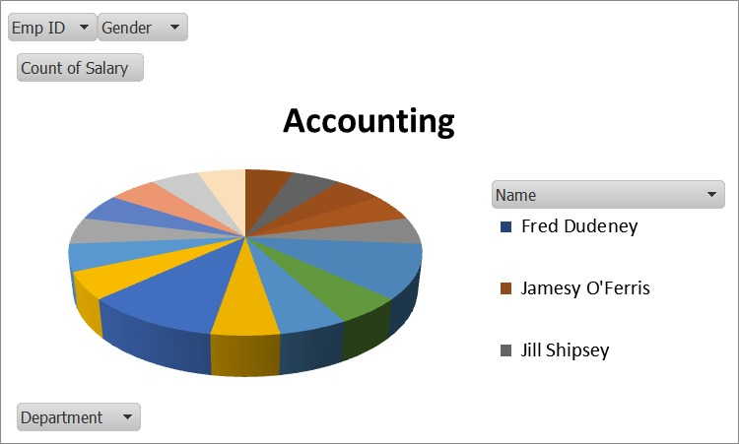
RESULTS
11

Slide 12
conclusion
In a nutshell, when it comes to salary and compensation analysis through Excel data modeling, the bottom line is that Excel helps end users, like managers and HR professionals, organize and analyze salary data effectively. By using Excel as a tool, they can make sense of the information, leading to better decision-making regarding salaries and benefits. It simplifies the process and allows for a structured approach to understanding and working with salary and compensation details.

