Slide 1

Technical Code Presentation
SimpleCalculator

Slide 2
Architectural Pattern
To calculate an arithmetic expression, chose a binary expression tree
First goal is to write code to get “atomic” units of expression ( for example, “1 + 2.3 / 4 * 5 – 6”, '2.3' is a unit, and '+' is a unit.
Once we can break expression into “atomic” units, then we can create an expression tree (binary tree), creating the nodes in such a way that operator precedence is preserved (unary operators, followed by multiply / divide, followed by add / subtract)
Once tree is constructed, we can use the 'Visitor' design patter to perform 'operations' on each node of the tree, such as printing useful info
Finally, we can evaluate the result of the expression from the tree

Slide 3
Class Structure
Class 'Node' is the base class of each tree element. This implements the 'IElement' interface so that each node of the tree can be 'visited'.
Derived tree node classes are 'NumberNode', 'UnaryNode' and 'BinaryNode'.
The expression is first broken down into “atomic” units using the class 'AtomicElementGenerator'
Class 'ExpressionTreeGenerator' is used to build the binary expression tree.
Static class 'ExpressionTreeUtilities' has a routine 'PerformOperation' to act on each node of the tree

Slide 4
Code Readability
Function headers added to describe purpose of each routine
Comments added in code to aid in understanding where intention may not be “obvious”
Variable and class names chosen to represent desired use and function
Extraneous 'using' statements and white space removed in order to decrease code 'noise'
Limited the size of functions

Slide 5
Code Testing
Performed 'System' testing with both valid and invalid expressions
Created 'Unit' tests for 'AtomicElementGenerator', unary elements, addition and subtraction, multiplication and division, and precedence phrases both with and without parentheses

Slide 6
Code Re-usablity
Base class 'Node' implements 'IElement' interface, which include the 'Accept' method. This is reused for each call of 'PerformOperation', in which case every node is 'visited' by the 'visitor' specified. An unlimited number of 'operations' can be performed on each tree node without having to modify the code that applies these operations.
Member 'NodeId' in base class 'Node' is used in three derived classes ('UnaryNode', 'NumberNode', and 'BinaryNode')

Slide 7
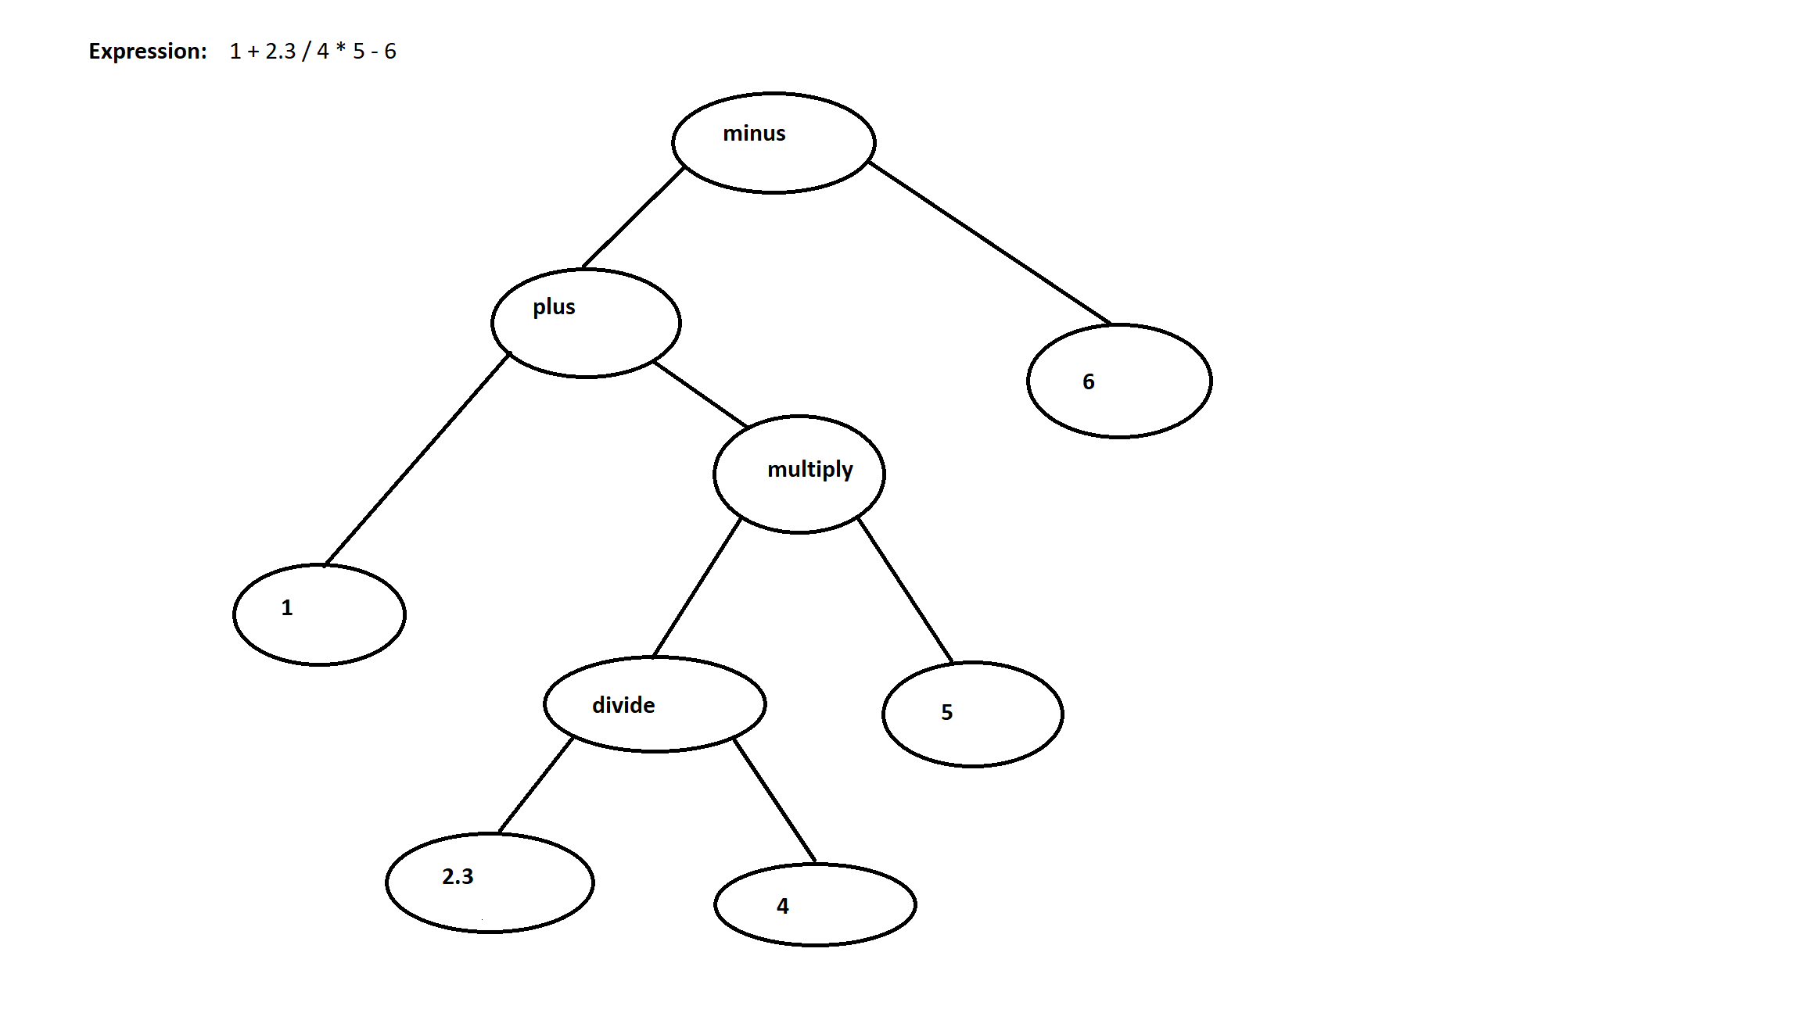
Sample Expression Tree

