Slide 1
Start Your Project
AWS DB instance
Environment setup and template project
Notes on Web DB Programming

Slide 2
Outline
Set up a free AWS account
Creating a MySQL DB Instance
Connecting to your MySQL DB Instance
Set up Environment and introduction of the template project
Notes on Web DB Programming

Slide 3
Connecting to your MySQL DB Instance
If an endpoint value is myinstance.123456789012.us-east-1.rds.amazonaws.com:3306, then you would specify the following values in a MySQL connection string:
For host or host name, specify myinstance.123456789012.us-east-1.rds.amazonaws.com
For port, specify 3306
For Username and Password: use what you have already specified when you created the MySQL instance (master username and password).

Slide 4
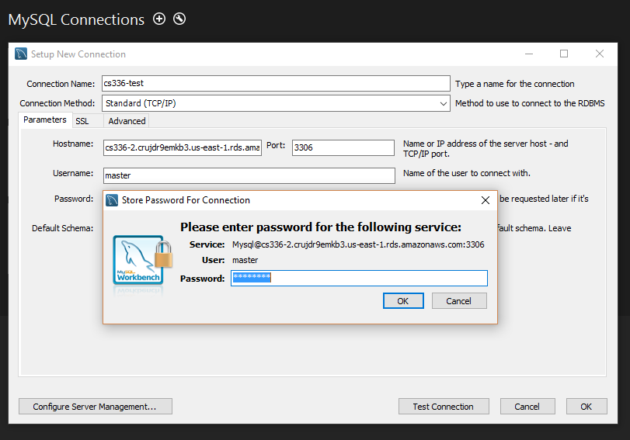
Connecting to your MySQL DB Instance
Open MySQLWorkbench and connect to your DB

Slide 5
Outline
Set up a free AWS account
Creating a MySQL DB Instance
Connecting to your MySQL DB Instance
Set up Environment and introduction of the template project
JSP tutorial

Slide 6
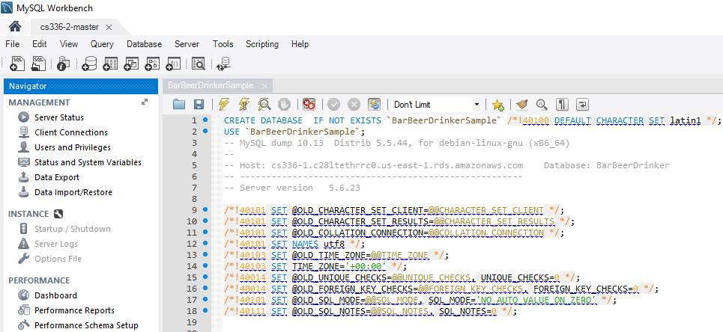
The Template Project
0. import schema BarBeerDrinkerSample in your created db instance using the provided script "BarBeerDrinkerSample.sql”. Open the script and run it. (File->Open SQL script)

Slide 7
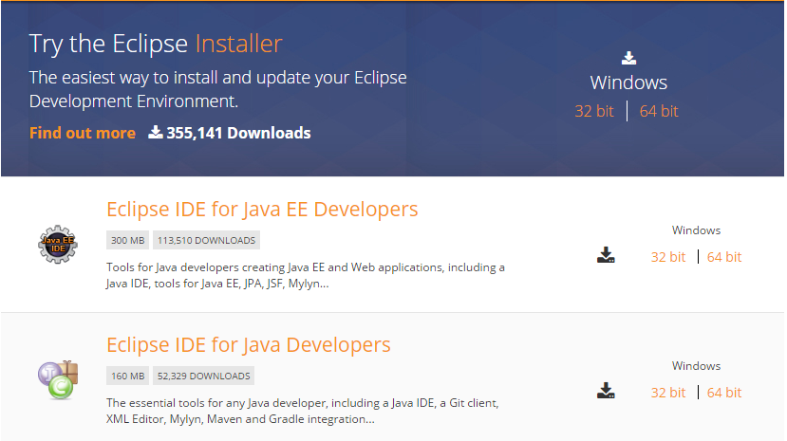
The Template Project
1. Download Eclipse IDE for Java EE Developers
https://eclipse.org/downloads/eclipse-packages/

Slide 8
The Template Project
2. Open eclipse and import the template project (TemplateProject.zip)
File – Import - General – Archive File
Or extract the .zip file and copy it under your eclipse workspace folder. Then:
File – Import - General - Existing Project into Workspace

Slide 9
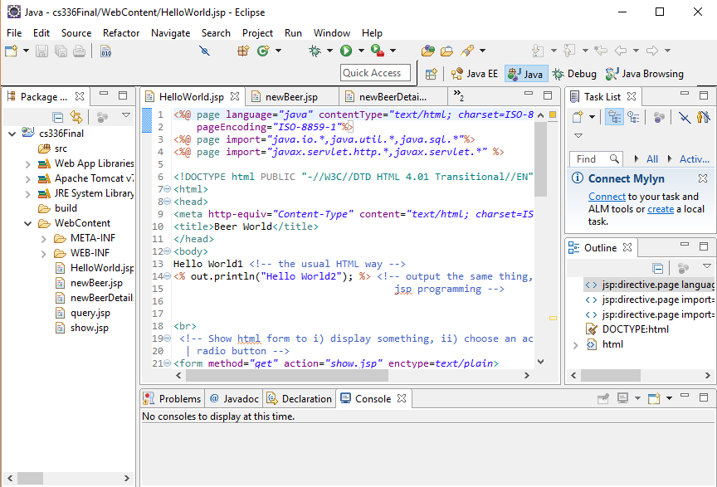

Slide 10
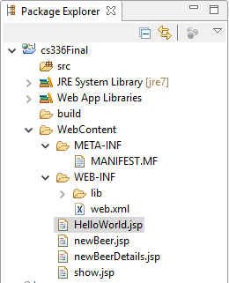
The Template Project
3. Structure of the template
Java code
Meta data of your website
HTML, JSP, JS, CSS code

Slide 11
The Template Project
4. Set your Tomcat server in eclipse
If you don’t have tomcat yet go to: https://tomcat.apache.org/download-70.cgi
and download the binary distribution for your OS.
After go back to eclipse:
Windows - Preference - Server - Runtime Environment - Add - Apache Tomcat v7.0 or
Eclipse- Preferences - Server - Runtime Environments - Add - Apache Tomcat v7.0

Slide 12
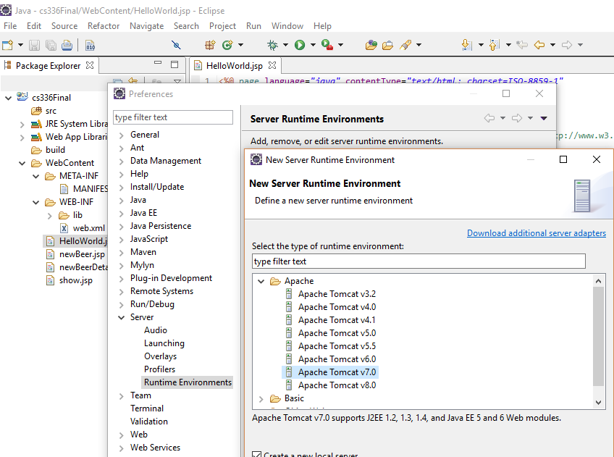

Slide 13
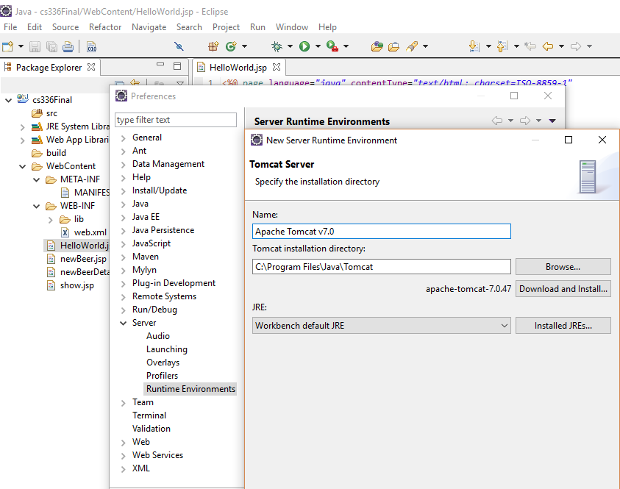

Slide 14
The Template Project
5. Run the project based on Tomcat 7
Right click on the project - Run as - Run on Server - Apache - Tomcat7

Slide 15
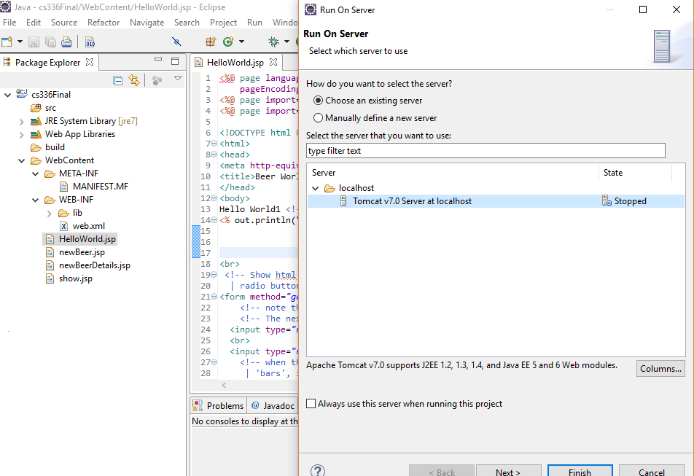

Slide 16
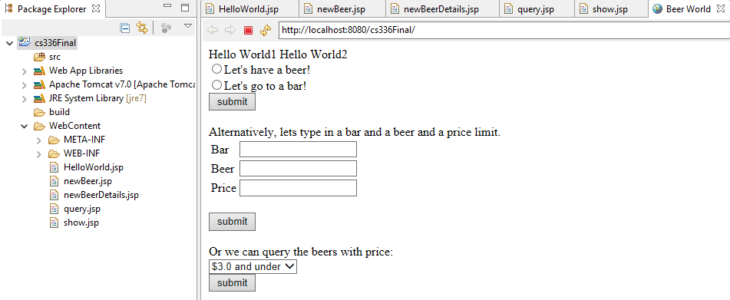
The Template Project
Now you can see your project home page, index.html page.

Slide 17
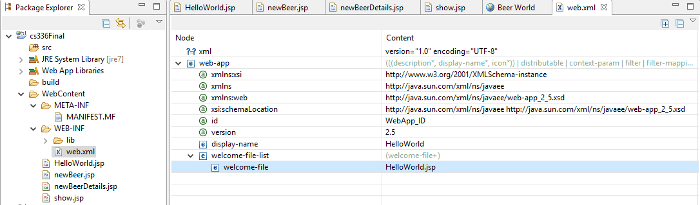
The Template Project
6. The home page is set in web.xml, you can set your own page if you want.

Slide 18
The Template Project
7. Connect to your own db instance in Project
In order to interact with db instance (add, delete, update, select), you need to set your own database address in the project.
At the same time, the database username and password are both essential.
Replace the database information with your own database information as follows.

Slide 19
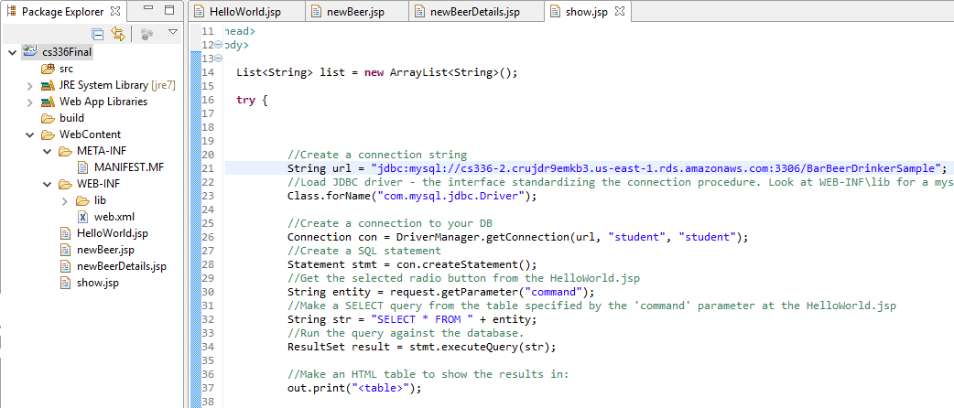
The Template Project
Hostname: Port/Schema
Username and Password

Slide 20
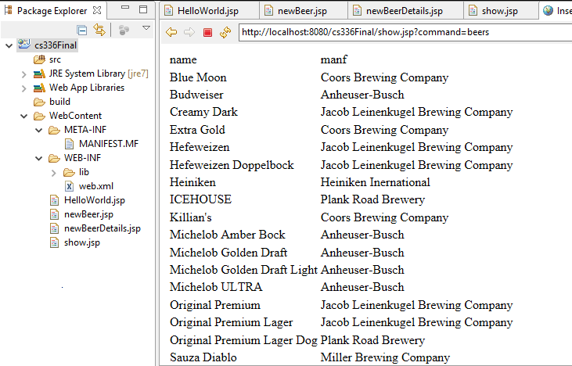
The Template Project
8. Let’s have a beer
Select the radio button and then click submit below it

Slide 21
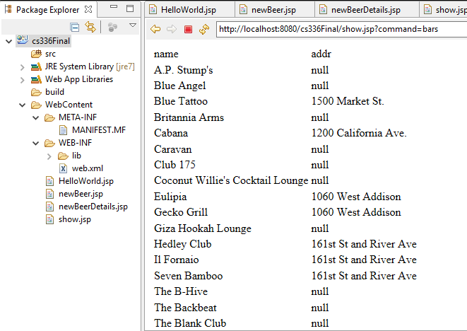
The Template Project
9. Let’s go to a bar
Select the radio button and then click submit below it

Slide 22
The Template Project
10. Insert a tuple into sells table
Input bar name, beer name and price, then click submit.
You can find a new record inserted into your database after submitting this form.

Slide 23

The Template Project
11. Query the beers with price
Choose one option from the dropdown menu, then click submit.

Slide 24
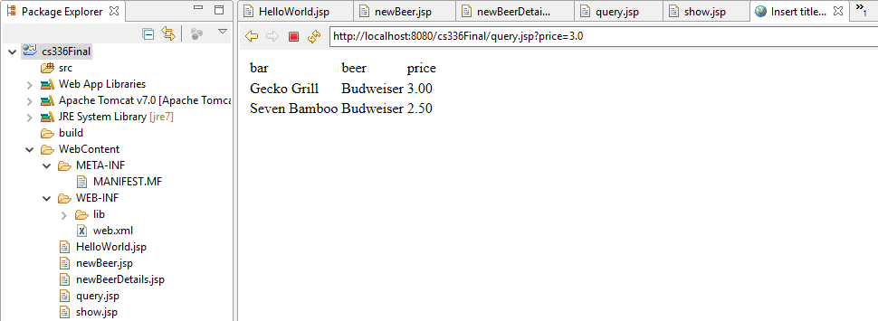
The Template Project
Query the beers with price <= 3

Slide 25
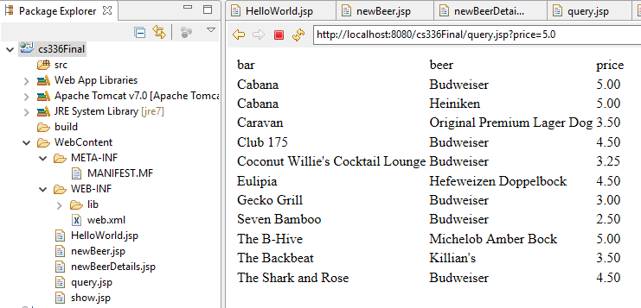
The Template Project
Query the beers with price <= 5

Slide 26
Outline
Set up a free AWS account
Creating a MySQL DB Instance
Connecting to your MySQL DB Instance
Set up Environment and introduction of the template project
Notes on Web DB Programming

Slide 27
Notes on Web DB Programming
Based on M.Muscari and UCSD (anon)

Slide 28
Outline
Needed Tools and Installation
JRE, IDE
MySQL
Apache Tomcat (or any web server)
JDBC
How to use and Examples
MySQL + JDBC + JSP

Slide 29
Three-Tier Application
Presentation Tier : user interface to make requests, provide input and see results
Middle Tier: application logic
Data Management Tier: database management

Slide 30
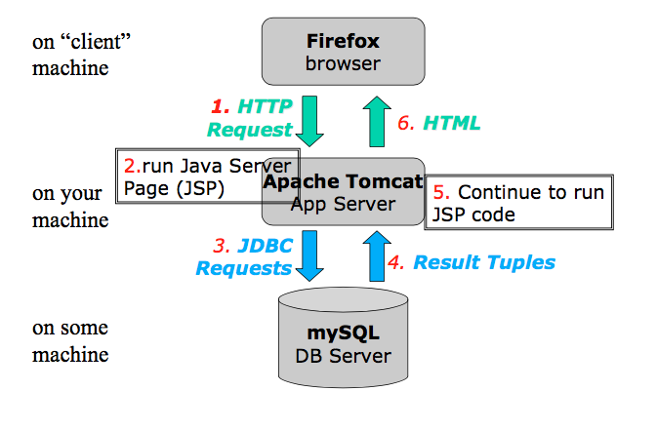
Three-Tier architecture

Slide 31
HTTP protocol
Protocol that allows web servers and browsers to exchange data over the web.
It is a request response protocol.
Client sends request
GET : ask for a resource
POST : send some data (e.g. HTML form)
Server sends response
Status code (200 OK, 404 Not Found!)
HTTP is a "stateless" protocol; each time a client retrieves a Webpage, the client opens a separate connection to the Web server and the server automatically does not keep any record of previous client request.

Slide 32
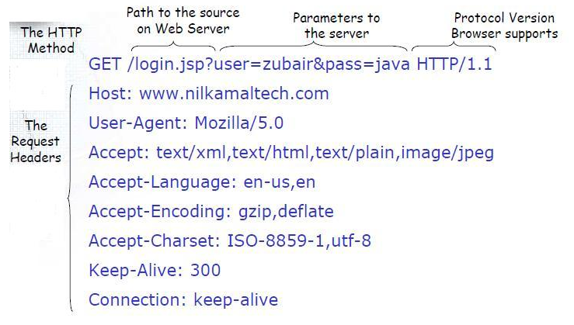
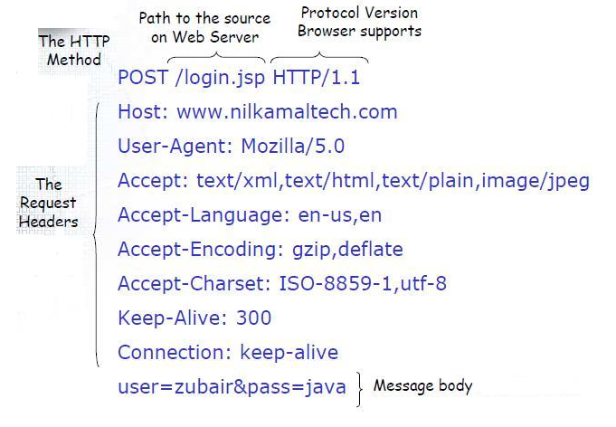
Difference between GET/POST requests
Anatomy of GET request
Anatomy of POST request

Slide 33
HTML (Hyper Text Markup Language)
Standard markup language for creating web pages
Language for creating structured documents
It consists of elements which can be nested
The HTML standard specifies a number of universally supported elements (“tags”)
Web browsers receive HTML documents from a webserver and render them into multimedia web pages.
HTML is commonly delivered as part of an HTTP response

Slide 34
HTML Tags
Common HTML tags include:
<div></div> - a logical division (section)
<p> </p> - a paragraph
<table> </table> -a table of values
<tr> </tr> - table row
<td> </td> -table column
<form></form> - a form enclosing input fields
<input></input> - an input field

Slide 35
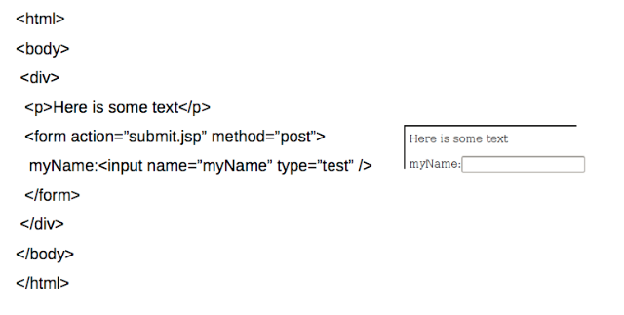
HTML Example

Slide 36
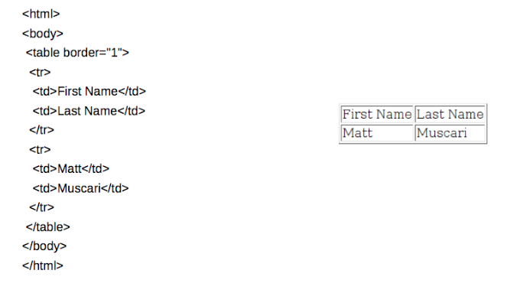
HTML Table Example

Slide 37
JSP (Java Server Pages)
A technology for building web applications that serve dynamic content
A JSP page is a text document that contains two types of text:
static data, which can be expressed in any text-based format (e.g. HTML)
JSP elements, which construct dynamic content.
The dynamic content in a JSP page is in specially marked Java code fragments (enclosed between <% and %>).
To deploy and run JSPs, a compatible web server with a servlet container, such as Apache Tomcat or Jetty is required.
When executed, the Java code fragments usually generate additional HTML into the page (in our case either accessing the database or processing parameters passed to HTTP requests)
At the end, the resulting HTML page is sent to the browser to be displayed.

Slide 38
JSP Syntax
Comment
<%-- Comment--%>
Expression
<%= Java expression %>
Expression tag evaluates the expression placed in it, converts the result into String and send the result back to the client through response object.
e.g. <p>Today is <%= new Date().toString(); %> </p>
Scriplet
<% java code fragment%>
e.g. <% person.getFirstName();%>
Include
<jsp:include page="relativeURL"/>

Slide 39
JSP Implicit Objects
Object | Class
request | HttpServletRequest
response | HttpServletResponse
session | HttpSession
out | Writer

Slide 40
request
<%@ page errorPage="errorpage.jsp" %> <html> <head> <title>UseRequest</title>
</head>
<body>
<% // Get the User's Name from the request out.println("<b>Hello: " + request.getParameter(”username") + "</b>");
%>
</body>
</html>

Slide 41
session
<%@ page errorPage="errorpage.jsp" %> <html> <head> <title>UseSession</title> </head> <body>
<% // Try and get the current count from the session Integer count = (Integer)session.getAttribute("COUNT");
// If COUNT is not found, create it and add it to the session
if ( count == null ) {
count = new Integer(1);
session.setAttribute("COUNT", count);
} else { count = new Integer(count.intValue() + 1);
session.setAttribute("COUNT", count);
} // Get the User's Name from the request out.println("<b>Hello you have visited this site: " + count + " times. </b>");
%>
</body> </html>

Slide 42
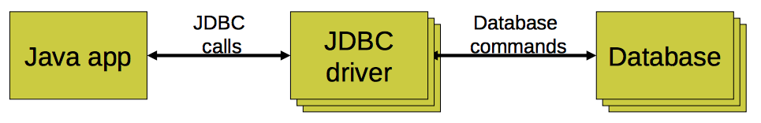
Java Database Connectivity (JDBC)
An interface to communicate with a relational database
Allows database agnostic Java code
Treat database tables/rows/columns as Java objects
JDBC driver
An implementation of the JDBC interface
Communicates with a particular database

Slide 43
JDBC steps
Connect to database
Query database (or insert/update/delete)
Process results
Close connection to database

Slide 44
1. Connect to database
Load JDBC driver
Class.forName("com.mysql.jdbc.Driver").newInstance();
Make connection
Connection conn = DriverManager.getConnection(url); 
URL
Format: “jdbc:mysql//<hostname>/<databaseName>”
jdbc:mysql://classvm50.cs.rutgers.edu/BarBeerDrinkerSample

Slide 45
2. Query database
Create statement
Statement stmt = conn.createStatement();
stmt object sends SQL commands to database
Methods
executeQuery() for SELECT statements
executeUpdate() for INSERT, UPDATE, DELETE, statements
Send SQL statements
stmt.executeQuery(“SELECT ...”);
stmt.executeUpdate(“INSERT ...”);

Slide 46
2. Query database
Prepared Statements
If you want to execute dynamic or parameterized SQL queries, use a “PreparedStatement” object instead of a statement.
PreparedStatement updateStud=conn.prepareStatement("UPDATE Student SET
fname=? WHERE lastname LIKE?");
updateStud.setString(1,"John");
updateStud.setString(2,"Doe");
updateStud.executeUpdate();

Slide 47
3. Process results
Result of a SELECT statement (rows/columns) returned as a ResultSet object
ResultSet rs = stmt.executeQuery("SELECT drinker,beer from LIKES");
Step through each row in the result
rs.next()
Get column values in a row
String userid = rs.getString(“drinker”);
int type = rs.getInt(“type”);

Slide 48
3. Process results
Add a row to the users table
String str = "INSERT INTO LIKES VALUES('Bob', ‘Corona')”;
Returns number of rows in table
int rows = stmt.executeUpdate(str);

Slide 49
4. Close connection to database
Close the ResultSet object
rs.close(); 
Close the Statement object
stmt.close();
Close the connection
conn.close();

