Slide 1
Object detection using cv-sdk
Priyanka Bagade
IoT Developer Relations, Intel

Slide 2
Object Detection: Security Camera Example

Slide 3
Describe Network Topology
The prototxt file is a text file describing the network topology..
name: "SSD_300x300"
input: "data"
input_shape {
dim: 1
dim: 3
dim: 300
dim: 300
}
layer {
bottom: "data"
top: "conv1/7x7_s2"
name: "conv1/7x7_s2"
type: "Convolution"
convolution_param { num_output: 64 pad: 3 }
}
layer {
bottom: "conv1/7x7_s2"
name: "conv1/7x7_s2/bn"
top: "conv1/7x7_s2/bn"
type: "BatchNorm"
}
SSD_GoogleNetV2_caffe/SSD_GoogleNetV2_Deploy.prototxt

Slide 4
Describe Network Topology
name: "SSD_300x300"
input: "data"
input_shape {
dim: 1
dim: 3
dim: 300
dim: 300
}
layer {
bottom: "data"
top: "conv1/7x7_s2"
name: "conv1/7x7_s2"
type: "Convolution"
convolution_param { num_output: 64 pad: 3 }
}
layer {
bottom: "conv1/7x7_s2"
name: "conv1/7x7_s2/bn"
top: "conv1/7x7_s2/bn"
type: "BatchNorm"
}
SSD_GoogleNetV2_caffe/SSD_GoogleNetV2_Deploy.prototxt
300
Define input “data” dimensions
300x300, RGB
300
3
“Data”

Slide 5
SSD_GoogleNetV2_caffe/SSD_GoogleNetV2_Deploy.prototxt
name: "SSD_300x300"
input: "data"
input_shape {
dim: 1
dim: 3
dim: 300
dim: 300
}
layer {
bottom: "data"
top: "conv1/7x7_s2"
name: "conv1/7x7_s2"
type: "Convolution"
convolution_param { num_output: 64 pad: 3 }
}
layer {
bottom: "conv1/7x7_s2"
name: "conv1/7x7_s2/bn"
top: "conv1/7x7_s2/bn"
type: "BatchNorm"
}
Define input “data” dimensions
300x300, RGB
300
300
3
“Data”

Slide 6
SSD_GoogleNetV2_caffe/SSD_GoogleNetV2_Deploy.prototxt
name: "SSD_300x300"
input: "data"
input_shape {
dim: 1
dim: 3
dim: 300
dim: 300
}
layer {
bottom: "data"
top: "conv1/7x7_s2"
name: "conv1/7x7_s2"
type: "Convolution"
convolution_param { num_output: 64 pad: 3 }
}
layer {
bottom: "conv1/7x7_s2"
name: "conv1/7x7_s2/bn"
top: "conv1/7x7_s2/bn"
type: "BatchNorm"
}
First Layer.. A convolution
“conv1/7x7_s2”
“Data”

Slide 7
SSD_GoogleNetV2_caffe/SSD_GoogleNetV2_Deploy.prototxt
name: "SSD_300x300"
input: "data"
input_shape {
dim: 1
dim: 3
dim: 300
dim: 300
}
layer {
bottom: "data"
top: "conv1/7x7_s2"
name: "conv1/7x7_s2"
type: "Convolution"
convolution_param { num_output: 64 pad: 3 }
}
layer {
bottom: "conv1/7x7_s2"
name: "conv1/7x7_s2/bn"
top: "conv1/7x7_s2/bn"
type: "BatchNorm"
}
Second Layer..
Another convolution
“conv1/7x7_s2/bn”
“conv1/7x7_s2”
“Data”
./SSD_GoogleNetV2_caffe/SSD_GoogleNetV2.caffemodel
Is a binary file, holding all the weights and biases.
Notes:
./SSD_GoogleNetV2_caffe/SSD_GoogleNetV2.caffemodel
Read/visualize it here: https://dgschwend.github.io/netscope)

Slide 8
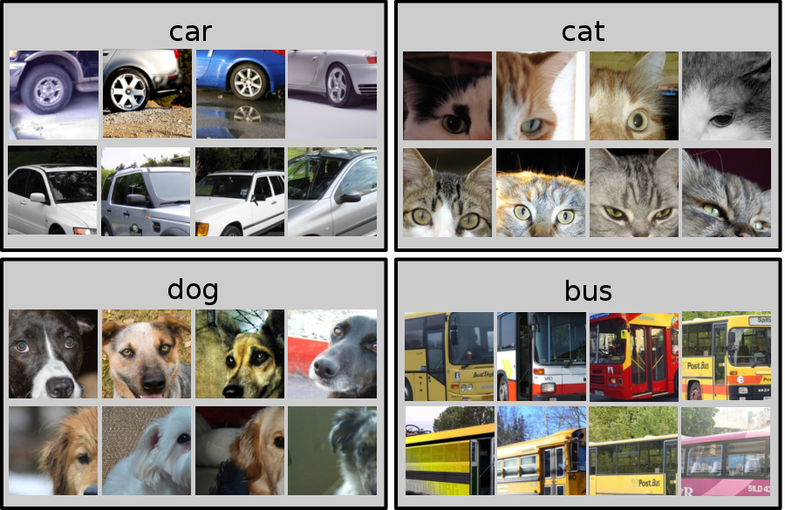
pascal_voc_classes.txt
plane bicycle bird boat bottle bus car cat chair cow table dog horse motorcycle person plant sheep

