Slide 1
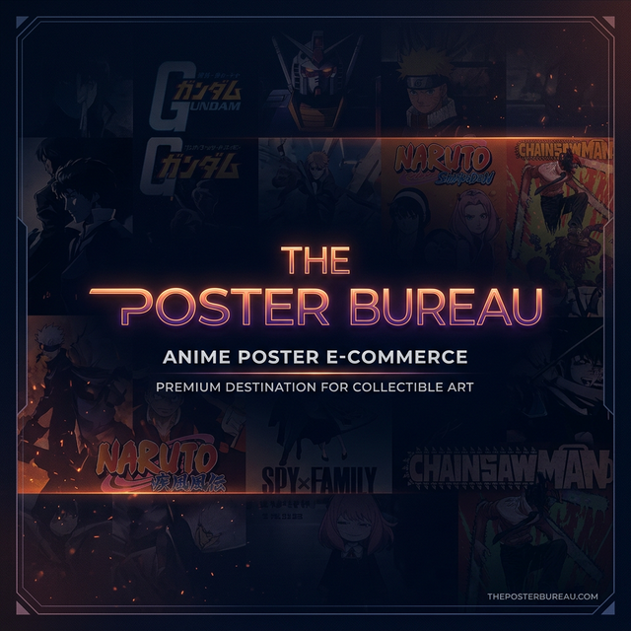
THE POSTER BUREAU
A Premium Anime Poster E-Commerce Platform
Full-Stack Web Development Project

Slide 2
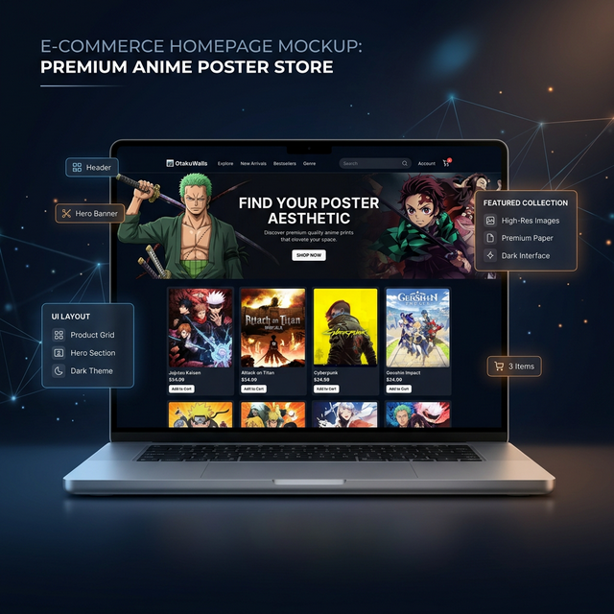
WHAT IS THE POSTER BUREAU?
→ A story-driven anime poster storefront with poster vault, store, discover & help center

Slide 3
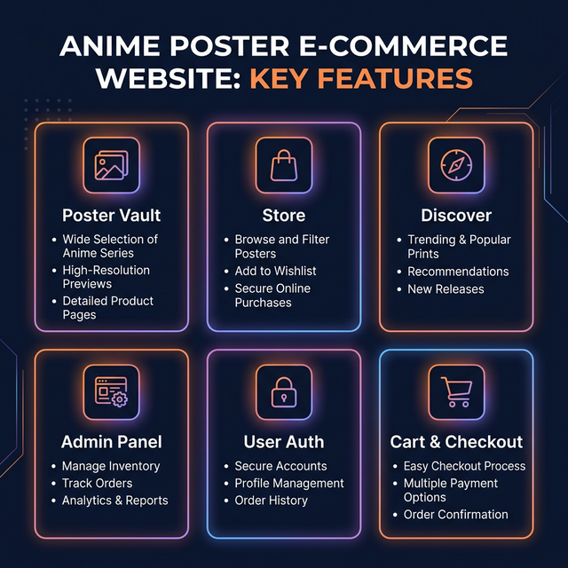
KEY FEATURES
✦ Poster Vault • ✦ Store & Merch • ✦ Discover Page • ✦ Admin Panel • ✦ User Auth • ✦ Cart & Checkout

Slide 4
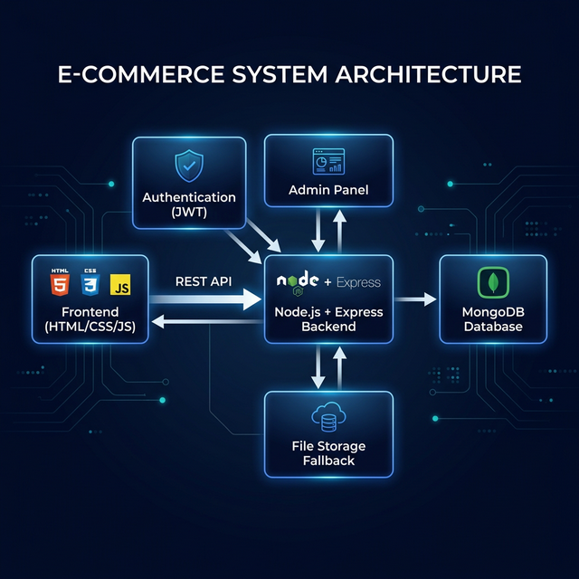
SYSTEM ARCHITECTURE
Client (HTML/CSS/JS) → REST API → Node.js/Express Server → MongoDB

Slide 5
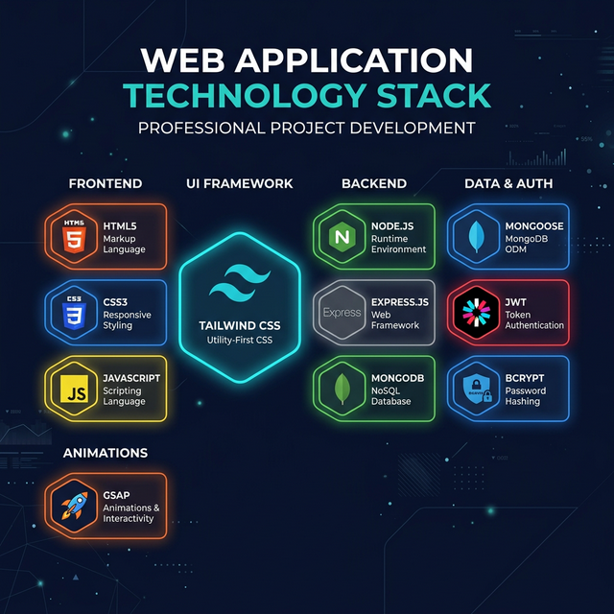
TECHNOLOGY STACK
HTML5 • CSS3 • JavaScript • TailwindCSS • Node.js • Express.js • MongoDB • JWT • GSAP

Slide 6
HOW IT WORKS
1
Browse
2
Select
3
Cart
Explore poster vault & store with categories
Click any product → detailed product page
Add items, adjust quantity, view subtotal
4
Auth
5
Checkout
6
Admin
Register/Login with JWT-secured accounts
Complete order with shipping details
Manage catalog, users & orders via admin panel

Slide 7
PROJECT PAGES
🏠 Homepage — Hero section, poster vault preview, store preview, discover jumps
🎨 Poster Vault — All posters with search, filter by series, sort options
🛍️ Store — Merch-only: manga, bottles, bags, keychains, tees
🧭 Discover — Browse by anime series with big visual cards
📦 Product Page — Full product detail, add to cart, related items
🛒 Cart & Checkout — Slide-out cart panel, checkout with order summary
👤 Account — Login, register, view orders, manage profile
⚙️ Admin Panel — CRUD for products, user management, order tracking
📞 Contact — Contact form and support info
❓ Help Center — FAQ, shipping info, terms of service

Slide 8
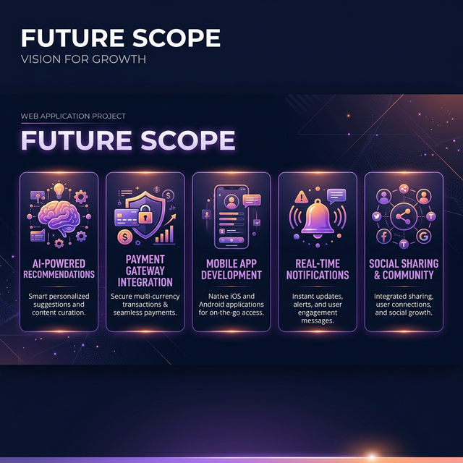
FUTURE SCOPE
🤖 AI Recommendations • 💳 Payment Gateway • 📱 Mobile App • 🔔 Real-time Notifications • 🌐 Social Sharing

Slide 9

THANK YOU!
Any Questions?

