Slide 1
Something about a Diary...
Nate Jones, Kelley Kelley, Anton Machkasov
Ryan McGarvey, Aryan Regmi, Alex Southard

Slide 2
Project Management Method
Overall development followed the Waterfall process
Defined all desired functionality in the first several weeks with a basic skeleton of what everything would do
Created a logical order for development of all features
Each individual component of the project would then implement one feature of that component at a time, be tested, then continue following an agile methodology

Slide 3





Tools
Project Tracker: Asana with Instagantt Repository: GitHub Database: PostgreSQL through a QT API (to work with c++) Testing Methods and Tools:
QT Debugger (5 out of 5)--to ensure all values set correctly in the software and to go line by line when something went wrong
Testing:
Regression and Integration testing
Program comprised of many different classes and interactions
System Testing
Ensuring that the QT, c++, and PostgreSQL components work well together
Since the program doesn’t work with significant amounts of data, most testing could be performed by hand.
Deployment: LocalHost
IDE: QT Creator

Slide 4
Asana with Instagantt
Github
Rating: 2
Wasn’t very useful
Unintuitive
Rating: 5
Made sharing work extremely easy
ö

Slide 5
PostgreSQL
QT Creator
Rating: 2
Hard to use and not particularly useful
Rating: 5
Had really easy to use implementation of useful tools

Slide 6

How did we test? Deployment Environment
Rating: 5/5 (for entertainment)
Play-testing, trying to break the program
QT Debugger
Traces functions to see where errors happen
Make sure values are appropriately set
Rating: 4/5 --Convenient, but hard to work with
Using Localhost to deploy
Postgres database on Heroku
127.0.0.1

Slide 7
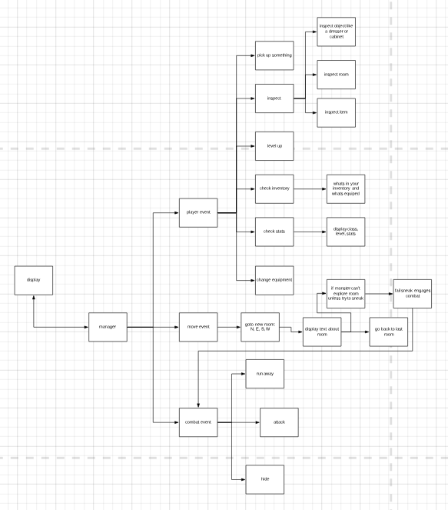
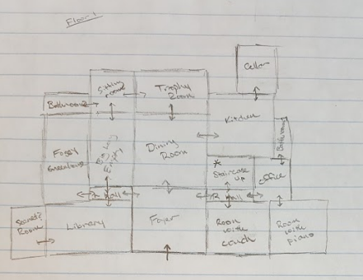
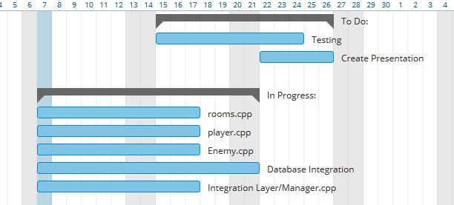
Some Planning Images

Slide 8
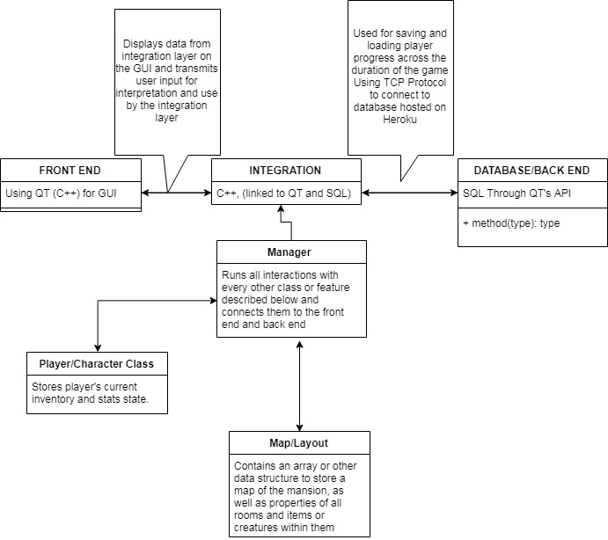
The Stack Overview

Slide 9
What Went Wrong?
Trying to merge branches in GitHub to add SQL functionality, causing a “catastrophic failure”
Conflicting coding styles and conventions
Expecting methods to be written differently or have a certain return type
Complex dependencies across many c++ classes and files
Communicating and organizing work across all of these
Very large code base
(3200+ lines of code)

Slide 10
How We Fixed Wrongs
Someone who has an older version uploaded their version
Most work was completed at our weekly meetings
Allowed Collaboration and more efficient project design
Eased difficulties caused by complex class hierarchy
Whenever conflicting functionality or someone needed a function could just ask for it from the other team member present
Overall end result wasn’t affected by challenges

