Slide 1
Database Concepts for Data Science
Course Code: TEE7423
Course Credit: 2
Prepared By,
Dr. Wasim Khan and Dr. Anjali Dalvi
Disclosure: The content included in this presentation has been sourced from the internet and is intended solely for educational purposes. We acknowledge and respect the original creators of the material.
1

Slide 2
Course Outcomes
On completion of the course, students will be able to
CO1: Gain a comprehensive understanding of the principles and concepts underlying Database Management Systems, along with relational databases, data models and schema design.
CO2: Master fundamental SQL concepts, showcasing proficiency in data definition, manipulation, and control languages.
CO3: Knowledge of database normalisation techniques to minimise redundancy and optimise database performance
CO4: Understanding of NoSQL databases, with a focus on MongoDB basic operations.
2

Slide 3
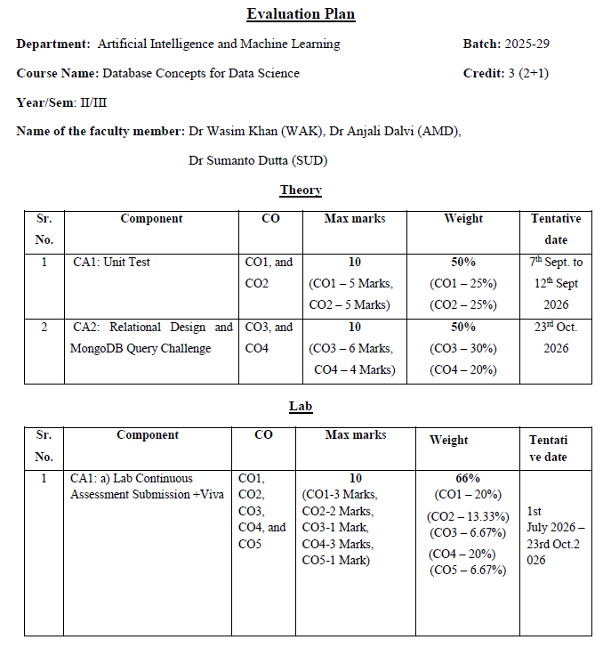
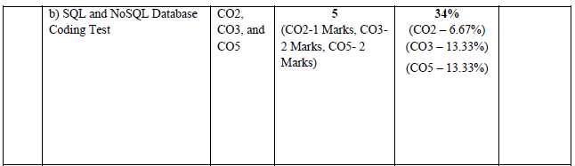
Evaluation Plan

Slide 4
Unit-I Introduction to DBMS: - DBMS basic concepts, advantages of a DBMS over file-processing systems, data abstraction, database languages, data models and data independence, components of a DBMS and overall structure of a DBMS, multi-user DBMS architecture, data modelling: basic concepts, entity, attributes, relationships, constraints, keys, E-R diagrams: components of E-R model, conventions, converting E-R diagram into tables, relational model: basic concepts, attributes and domains, Codds rules, relational integrity: nulls, entity, referential integrities, enterprise constraints, views, schema diagram.
Course Outline
Unit-II
Relational Query Languages: - Introduction to Relational algebra, basic relational algebra operation, query formation, advance operations of difference and joins. Conversion of relational algebra queries to SQL queries. Introduction to SQL: characteristics and advantages, SQL data types, SQL languages: DDL, DML, DQL, DCL, SQL DDL queries.
Unit-III
Database Analysis and Design Techniques: - Information Systems Lifecycle, Application Lifecycle, Planning, System Definition, Requirement Analysis, Design, DBMS Selection and Application Design: Transaction and User-Interface Design, Prototyping, Implementation, Data Conversion and Loading, Testing, Data and Database Administration, Relational Database Design: Purpose of Normalization, Data Redundancy and Update Anomalies, Functional Dependencies, The Process of Normalization: INF, 2NF, 3NF, BCNF, 4NF.Nosql fundamental, Mongodb architecture and commands .
4

Slide 5
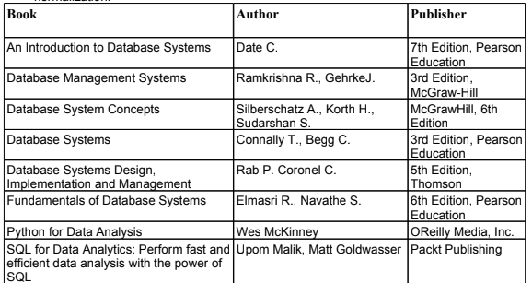
Recommended Books
5

Slide 6
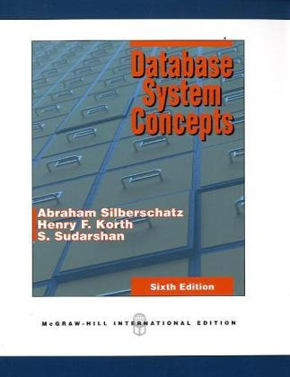
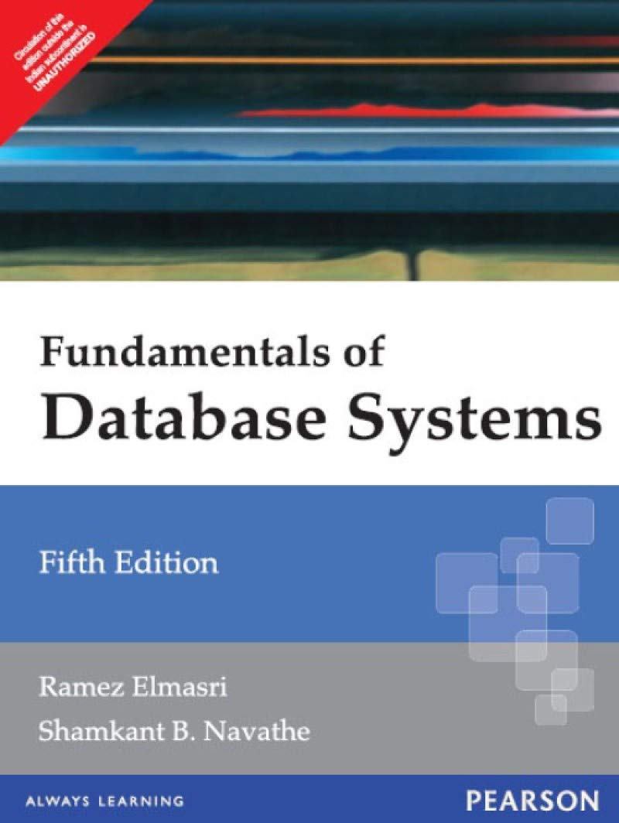

Slide 7
What is Data?
Data refers to raw, unprocessed facts and figures that lack context. This information, in its raw form, can be difficult to understand or apply without extra processing.
It can be in the form of numbers, text, images, audio, video or any other type of input.
By itself, data has no meaning or context.
Just a Number
98 — Marks? Temperature? Battery? Cricket Score? Oxygen Level? Nobody knows.
Now Add Context
“Alok scored 98 marks in DBMS." Now everyone understands. That is Information.

Slide 8
What is Information?
When raw data is processed, organised & given context, it becomes Information.
Data + Meaning or Context = Information.
Data
(Raw facts and figures)
Processing
Information
Raw Data | Information
75, 82, 60, 91, 45 | "Class average is 70.6; highest mark is 91 by Roll No. 4"
36.7, 98, 120/80, B+ | "Patient's temperature is normal, pulse is 98, BP is slightly high, blood group is B+"
34, 67, NE | "Today in Pune: Temp 34°C, Humidity 67%, Wind: North-East"

Slide 9
What is Knowledge?
Knowledge means understanding something well based on experience, learning, or information.
When information is combined with experience, understanding & judgment, it becomes Knowledge.
In simple terms, Knowledge is when you understand what the information means and how to use it.
A doctor doesn't just read the report, but they also use their experience with thousands of patients to decide your treatment. That combination of information + experience = Knowledge.
Information | Knowledge
"Class average is 70.6; 3 students below 50" | "These 3 students need remedial coaching; change teaching method for weak topics"
"Patient's BP is slightly high" | "Patient is at early hypertension risk; prescribe lifestyle changes before medication"
"Today: 34°C, Humidity 67%, NE wind" | "There may be rain in 2 days — farmers should harvest crops now"

Slide 10
DBMS Perspective: Now we connect it to Database Management Systems.
A Database stores Data.
For example: Student Table
Roll | Name | Marks
101 | Rahul | 92
102 | Aman | 78
These are Data.
When the SQL Query is executed
SELECT * FROM Student WHERE Marks > 90;
The output becomes useful. This is Information.
Now the College observes:
Students with marks above 90 should receive scholarships.
This becomes Knowledge.

Slide 11
Database
A Database is an organized collection of related data stored electronically so that it can be easily accessed, managed, and updated.
For example, College database, Bank Database, Hospital Database etc.
A database can be of any size and complexity.
🎓 College Database | 🏦 Bank Database | 🏥 Hospital Database
Stores: | Stores: | Stores:
• Student Details | • Customer Information | • Patient Information
• Faculty Details | • Account Details | • Doctor Details
• Attendance Records | • Transaction History | • Medicine Records
• Examination Results | • Loan Information | • Billing Information
• Fee Records | • ATM/Card Details | • Laboratory Reports

Slide 12
Database Management System (DBMS)
A database management system (DBMS) enables users to create and maintain a database.
The DBMS is a software system that facilitates the processes of defining, constructing, manipulating, and sharing databases among various users and applications.
The DBMS provides users and programmers with a systematic way to create, retrieve, update and manage data.
It essentially serves as an interface between the database and end users or application programs, ensuring that data is consistently organized and remains easily accessible.

Slide 13
DBMS
The DBMS acts as an intermediary/interface between the Database and the Users.
Queries
Database
Users
DBMS
OS
Programs
(COBOL/PL1/C/
Java…)

Slide 14
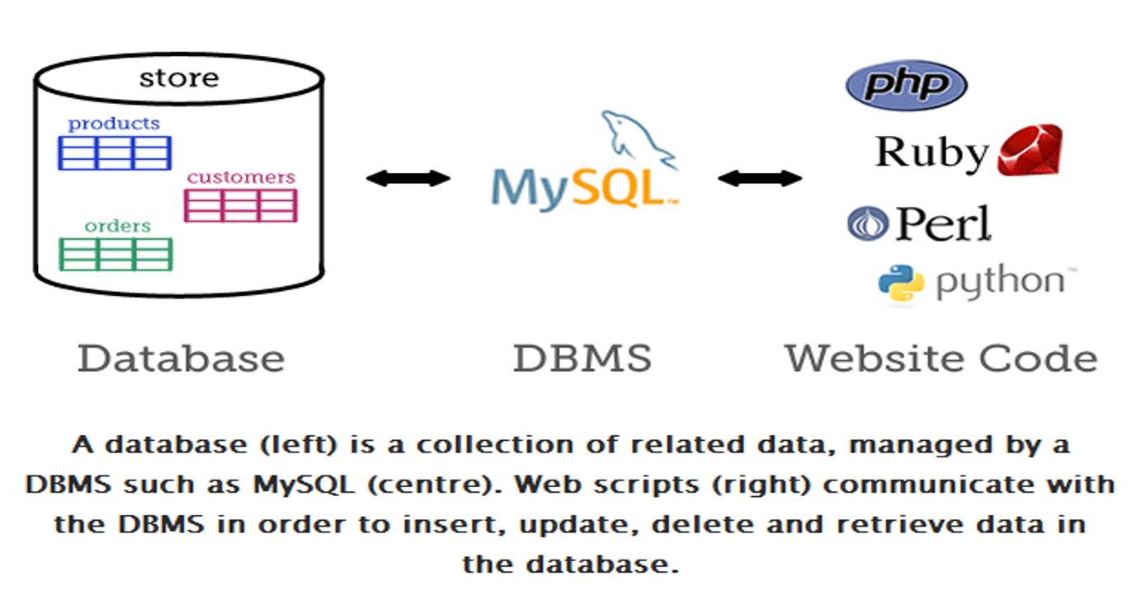

Slide 15
Examples of DBMS
The top commercial DBMS:
Oracle
Microsoft SQL Server
IBM DB2
Microsoft Access, etc.
The top open source DBMS:
MySQL
PostgreSQL
MongoDB
Cassandra
Redis
SQL Lite, etc.

Slide 16
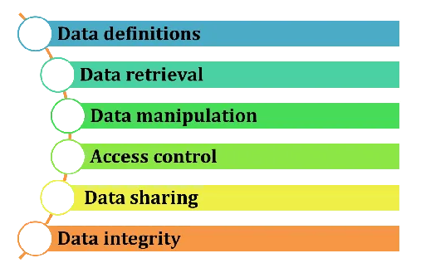
Functions of DBMS
Data definition refers to the process of creating and defining the structure of a database, including tables, columns, data types, relationships, and constraints.
Data Retrieval is the ability to fetch and query data stored in the database efficiently.
Data manipulation refers to adding, modifying, and deleting data stored in the database.
Access control ensures that only authorized users can access or modify database information. Not every user should have the same permissions.
Data sharing allows multiple users or applications to access the same database simultaneously.
Data integrity ensures that the data stored in the database remains accurate, consistent, complete, and reliable throughout its lifecycle.
16

Slide 17
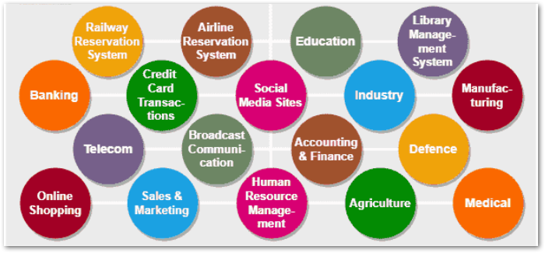
Application Areas of DBMS

Slide 18
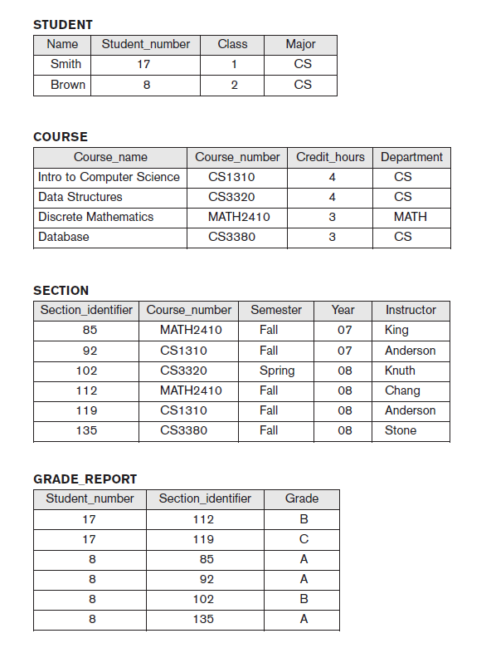
DBMS Example

Slide 19
Database Terminologies
Database: A collection of data that is organized in a specific way, allowing for efficient storage and retrieval.
Database management system ( DBMS): A software program that is used to create, manage, and interact with a database.
Data model: The structure or organization of data in a database, which defines how data is stored and accessed.
Table: A collection of data that is organized into rows and columns, similar to a spreadsheet. Tables are a common way to represent data in a relational database.
Field: A single piece of data within a table, such as a customer’s name or email address.
Record: A collection of fields that represent a single entity, such as a customer or a product.
Query: A request to retrieve specific data from a database.
Index: A data structure that allows for efficient search and retrieval of data within a database.
Primary key: A field or set of fields that uniquely identifies each record in a table.

Slide 20
Database Terminologies
Foreign key: A field or set of fields that refers to the primary key of another table, allowing for the creation of relationships between tables.
Normalization: The process of organizing data in a database in a way that minimizes redundancy and dependency and maximizes data integrity.
SQL: Structured Query Language, a standard language for interacting with databases.
NoSQL: A class of databases that do not use the traditional relational model and are designed to handle large amounts of data more efficiently.
20

Slide 21
