Slide 1

Irancell Chat Bot
designed to provide relevant answers to user questions
Irancell Chatbot

Slide 2

Model description
We used:
- ‘pandas’ for data manipulation
- ‘torch’ for PyTorch functionality
‘sentence_transformers’ library for working with pre-trained sentence embeddings.
Libraries
Irancell Chatbot

Slide 3

Model description
The system relies on an external dataset stored in a CSV file.
It contains more than 150 questions about the Irancell Term&Conditions.
Dataset
Irancell Chatbot

Slide 4

Model description
the pre-trained MiniLM model is used for generating sentence embeddings.
Embeddings for the dataset are stored in another CSV file.
Embeddings
Irancell Chatbot

Slide 5

Model description
takes a user's question as input and returns a relevant answer based on semantic search and pre-trained embeddings.
Q&A Function
Irancell Chatbot

Slide 6

Model description
The user's question is encoded using the MiniLM model, and semantic search is performed to find the most relevant answers from the dataset.
Semantic Search
Irancell Chatbot

Slide 7

Model description
The system filters the retrieved answers based on certain criteria to show gentle responses.
Answer Filtering
Irancell Chatbot

Slide 8

Model description
If no suitable answers are found, the system suggests a similar question from the dataset as a fallback.
Unclear Questions
Irancell Chatbot

Slide 9
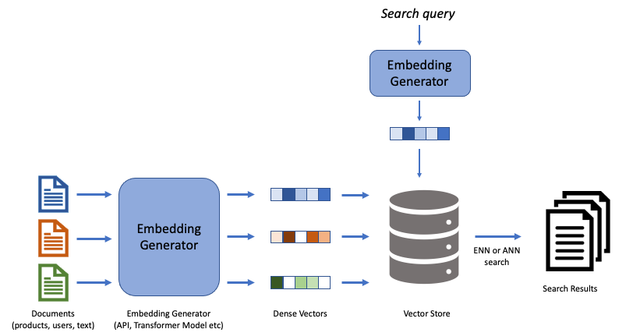
Behind The Algorithm
How Semantic Search Works?
Irancell Chatbot

Slide 10
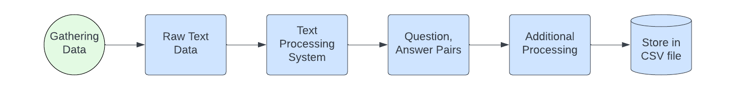
Gathering Dataset
The text chunks are input into a text processing system that generates questions and answers. The resulting Q&A pairs are then stored in a CSV file for further use.
Irancell Chatbot

Slide 11
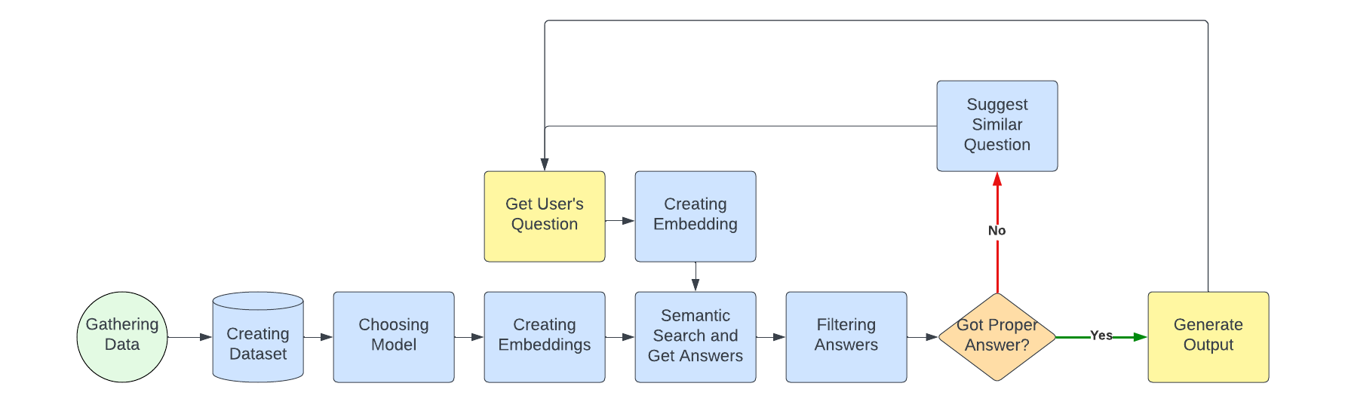
Workflow of the Model
Irancell Chatbot

Slide 12

Metrics
the similarity metric is implicitly used during the process of semantic.
The key component responsible for this similarity calculation is the semantic_search function from the sentence_transformers library.
Metric
Irancell Chatbot

Slide 13

Scalability
The model demonstrates excellent scalability, effortlessly accommodating larger datasets.
Collecting additional data would further enhance the model's capabilities.
The scalability of the model is influenced by factors such as dataset size, computational resources, and semantic search response time.
Notably, fine-tuning the model is a straightforward process.
Scalability
Irancell Chatbot

