Slide 1
Chapter 3: Syntax Analysis
Yanhui Guo
yhguo@bupt.edu.cn

Slide 2
Outline
Introduction
Context-Free Grammars
Overview of Parsing Techniques
Top-Down Parsing
Bottom-Up Parsing
Parser Generators (to be discussed in lab sessions)
Notes:
本章专门讨论编译器中通常使用的解析方法。我们首先介绍基本概念，然后介绍适合手动实现的技术，最后介绍自动化工具中使用的算法。由于程序可能包含语法错误，因此我们讨论用于从常见错误中恢复的解析方法的扩展。
根据设计，每种编程语言都有精确的规则来规定格式良好的程序的语法结构。例如，在 C 语言中，程序由函数组成，函数由声明和语句组成，语句由表达式组成，等等。

Slide 3
Describing Syntax
The syntax of programming language constructs can be specified by context-free grammars or BNF (Backus-Naur Form) notation
A grammar gives a precise, yet easy-to-understand, syntactic specification of a programming language
For certain grammars, we can automatically construct an efficient parser
A properly designed grammar defines the structure of a language and helps translate source programs into correct object code and detect errors
A grammar allows a language to be evolved or developed iteratively, by adding new constructs to perform new tasks
Notes:
编程语言结构的语法可以通过上下文无关文法或 BNF（巴科斯范式）表示法来指定，在 2.2 节中介绍。文法为语言设计者和编译器编写者提供了巨大的好处。
文法给出了一个程序设计语言的精确且易于理解的语法规范。
对于某些类型的文法，我们可以自动构造一个有效的语法分析器，它能够确定一个源程序的语法结构。语法分析器的构造过程可以揭示语法的二义性，同时还可能发现一些容易在语言的初始设计阶段被忽略的问题。
一个正确设计的文法给出了一个语言的结构。该结构有助于把源程序翻译成正确的目标代码，也有助于检测错误。
一个文法支持逐步加入可以完成新任务的新语言构造从而迭代地演化和开发语言。如果对语言的实现遵循语言的文法结构，那么在实现中加入这些新购造的工作就变得更加容易。

Slide 4
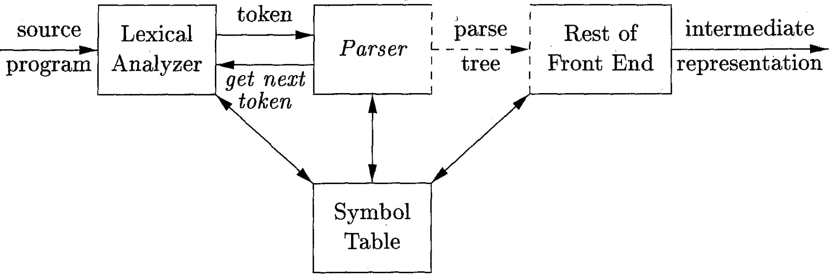
The Role of the Parser
The parser obtains a string of tokens from the lexical analyzer and verifies that the string of token names can be generated by the grammar for the source language
Report syntax errors in an intelligent fashion
For well-formed programs, the parser constructs a parse tree
The parse tree need not be constructed explicitly
Notes:
语法分析器的角色
语法分析器从词法分析器获得token串，并验证token名称是否可以由源语言的语法生成
以智能的方式报告语法错误
对于格式良好的程序，语法分析器构建一个语法分析树
语法分析树无需显式构建

Slide 5
Classification of Parsers
Universal parsers (通用语法分析器)
Some methods (e.g., Earley’s algorithm¹) can parse any grammar
However, they are too inefficient to be used in practice
Top-down parsers (自顶向下语法分析器)
Construct parse trees from the top (root) to the bottom (leaves)
Bottom-up parsers (自底向上语法分析器)
Construct parse trees from the bottom (leaves) to the top (root)
Note: Top-down and bottom-up parsing both scan the input from left to right, one symbol at a time. They work only for certain grammars, which are expressive enough.
¹ http://loup-vaillant.fr/tutorials/earley-parsing/
Notes:
语法分析器的分类
· 通用语法分析器
· 一些方法（例如，Earley算法1）可以解析任何语法
· 然而，它们效率太低，无法在实践中使用
· 自顶向下语法分析器
· 构建从顶部（根）到底部（叶）的语法分析树
· 自底向上语法分析器
·从底部（叶子）到顶部（根）构建语法分析树
注意：自上而下和自下而上的解析都从左到右扫描输入，一次扫描一个符号。它们只适用于某些语法，这些语法具有足够的表达能力。

Slide 6
Formal definition of CFG
Derivation and parse tree
Ambiguity
CFG vs. regexp
Grammar design
Outline
Introduction
Context-Free Grammars
Overview of Parsing Techniques
Top-Down Parsing
Bottom-Up Parsing
Parser Generators (to be discussed in lab sessions)
Notes:
CFG的形式化定义
推导和语法分析树
二义性
CFG与正则表达式
语法设计

Slide 7
Context-Free Grammar (上下文无关文法)
A context-free grammar (CFG) consists of four parts:
Terminals (终结符号): Basic symbols from which strings are formed (token names)
Nonterminals (非终结符号): Syntactic variables that denote sets of strings
Usually correspond to a language construct, such as stmt (statements)
One nonterminal is distinguished as the start symbol (开始符号)
The set of strings denoted by the start symbol is the language generated by the CFG
Productions (产生式): Specify the manner in which the terminals and nonterminals can be combined to form strings
Format: head (left side) → body (right side)
The head is a nonterminal; the body consists of zero or more terminals/nonterminals
Example: expression → expression + term
Notes:
上下文无关语法（CFG）由四个部分组成：
· 终结符号: 形成字符串的基本符号（token名称）
· 非终结符号: 表示字符串集的语法变量 通常对应于一个语言结构，如stmt（statements）
· 我们指定一个非终结符作为开始符号 由开始符号表示的字符串集是CFG生成的语言
· 产生式: 指定终结符号和非终结符号组合形成字符串的方式
· 格式：head（左侧）-> body（右侧）
· head是非终结符号；body由零个或多个终结符号或非终结符号组成
例如：expression -> expression + term

Slide 8
CFG Example
The grammar below defines simple arithmetic expressions
Terminal symbols: id, +, -, *, /, (, )
Nonterminals: expression, term, factor
Start symbol: expression
Productions:
expression → expression + term
expression → expression – term
expression → term
term → term * factor
term → term / factor
term → factor
factor → ( expression )
factor → id
Notes:
CFG示例
下面的语法定义了简单的算术表达式
终结符：id, +, -, *, /, (, )
非终结符：expression, term, factor
开始符：expression

Slide 9
Notational Simplification
expression → expression + term
expression → expression – term expression → term
term → term * factor term → term / factor term → factor
factor → ( expression )
factor → id
E → E + T | E – T | T
T → T * F | T / F | F F → ( E ) | id
| is a meta symbol to specify alternatives
( and ) are not meta symbols, they are terminal symbols
Notes:
符号简化
“|”是指定备选方案的元符号
“(”和”)”不是元符号，而是终结符号

Slide 10
Formal definition of CFG
Derivation and parse tree
Ambiguity
CFG vs. regexp
Grammar design
Outline
Introduction
Context-Free Grammars
Overview of Parsing Techniques
Top-Down Parsing
Bottom-Up Parsing
Parser Generators (to be discussed in lab sessions)
Notes:
CFG的形式化定义
推导和语法分析树
二义性
CFG与正则表达式
语法设计

Slide 11
Derivations
Derivation (推导): Starting with the start symbol, nonterminals are rewritten using productions until only terminals remain
Example:
CFG: E → – E | E + E | E * E | ( E ) | id
A derivation (a sequence of rewrites) of –(id) from E
o E ⇒ –E ⇒ -(E) ⇒ -(id)
Notes:
推导: 从开始符号开始，使用产生式重写非终结符，直到只剩下终结符为止
示例：
从E导出–(id)（一系列重写）

Slide 12
Notations
⇒ means “derives in one step”
∗
⇒ means “derives in zero or more steps”
𝛼 ⇒ 𝛼 holds for any string 𝛼
If 𝛼 ⇒ 𝛽 and 𝛽 ⇒ 𝛾, then 𝛼 ⇒ 𝛾
∗
∗ ∗
∗
Example: 𝐸 ⇒ −𝐸 ⇒ − 𝐸 ⇒ − 𝐢𝐝 can be written as 𝐸 ⇒ −(𝐢𝐝)
+
⇒ means “derives in one or more steps”
Notes:
符号
⇒ 意思是单步推导
⇒ ∗ 意思是“以零个或多个步骤推导” 𝛼 ⇒∗ 𝛼 适用于任何字符串𝛼
⇒ “ 意思是“以一个或多个步骤推导”

Slide 13
Terminologies
∗
If 𝑆 ⇒ 𝛼, where S is the start symbol of a grammar G, we say that 𝛼
is sentential form of G (文法的句型)
May contain both terminals and nonterminals, and may be empty
Example: 𝐸 ⇒ −𝐸 ⇒ − 𝐸 ⇒ − 𝐸 + 𝐸 ⇒ − 𝐢𝐝 + 𝐸 ⇒ −(𝐢𝐝 + 𝐢𝐝), here all strings of grammar symbols are sentential forms
A sentence (句子) of G is a sentential form with no nonterminals
In the above example, only the last string −(𝐢𝐝 + 𝐢𝐝) is a sentence
The language generated by a grammar is its set of sentences
Notes:
术语
• 如果S⇒ ∗ α, 其中S是语法G的开始符号，我们说α是G文法的句型
· 文法的句型可以同时包含终结符号和非终结符号，并且可以为空
· 示例𝐸 ⇒ −𝐸 ⇒ −(𝐸)⇒ −(𝐸+𝐸) ⇒ −(𝐢𝐝+𝐸) ⇒ −(𝐢𝐝 + 𝐢𝐝) 这里所有的语法符号串都是文法的句型
• 一个G的句子是一个没有非终结符的文法句型
· 在上面的例子中，只有最后一个字符串−(𝐢𝐝 + 𝐢𝐝)是一个句子
•语法产生的语言是它产生句子的集合

Slide 14
Leftmost/Rightmost Derivations
At each step of a derivation, we need to choose which nonterminal to replace
In leftmost derivations (最左推导), the leftmost nonterminal in each sentential form is always chosen to be replaced
𝐸 − 𝐸 − 𝐸
𝑙𝑚 𝑙𝑚
− 𝐸 + 𝐸
𝑙𝑚
− 𝐢𝐝 + 𝐸 − (𝐢𝐝 + 𝐢𝐝)
𝑙𝑚 𝑙𝑚
In rightmost derivations (最右推导), the rightmost nonterminal is always chosen to be replaced
𝐸 − 𝐸 − 𝐸
𝑟𝑚 𝑟𝑚
− 𝐸 + 𝐸
𝑟𝑚
− 𝐸 + 𝐢𝐝 − (𝐢𝐝 + 𝐢𝐝)
𝑟𝑚 𝑟𝑚
Notes:
最左/最右推导
在推导的每一步，我们都需要选择要替换的非终结符
在最左推导中,总是选择每个句型中最左边的非终结符来替换
在最右推导中, 总是选择最右边的非终结符来替换

Slide 15
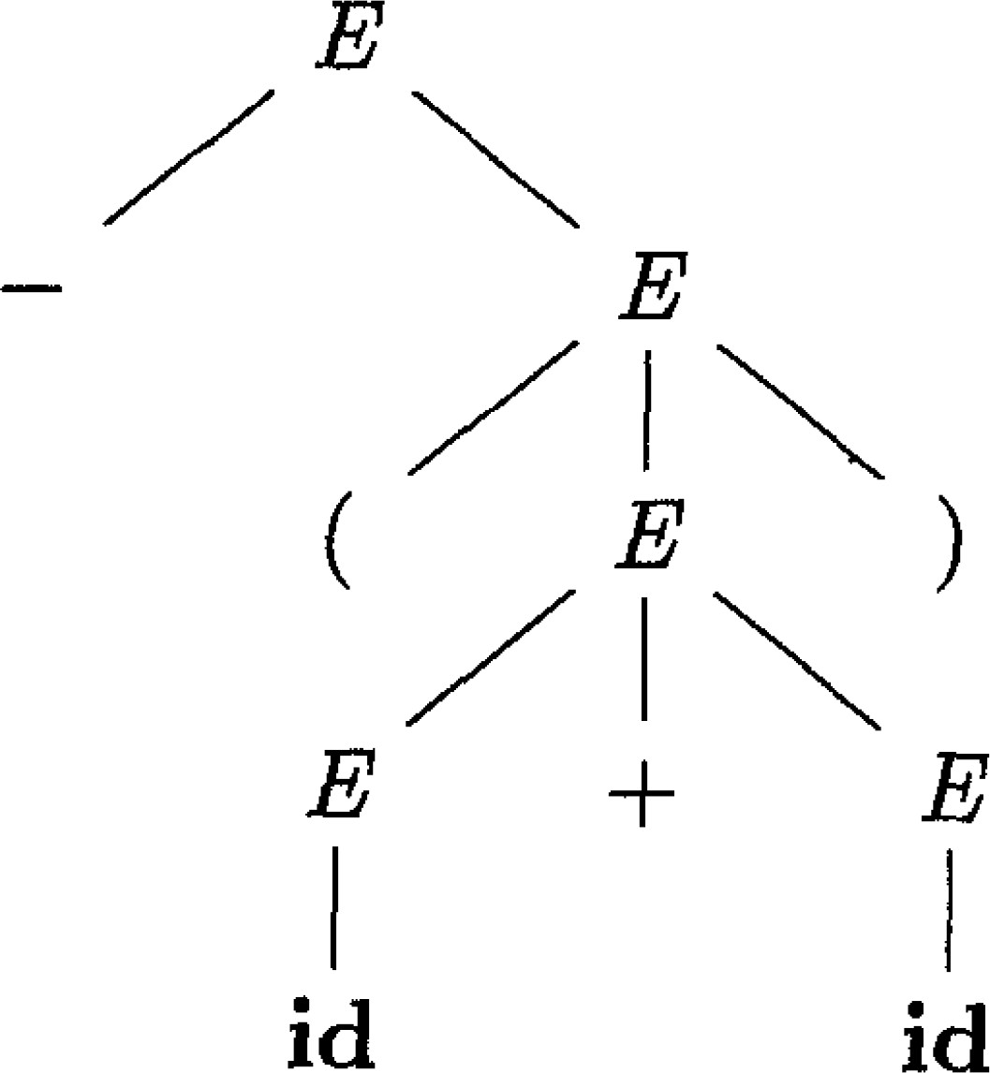


Parse Trees (语法分析树)
A parse tree is a graphical representation of a derivation
The root node (根结点) is the start symbol of the grammar
Each leaf node (叶子结点) is labeled by a terminal symbol or 𝜖
Each interior node (内部结点) is labeled by a nonterminal symbol
Each interior node represents the application of a production
o The interior node is labeled with the nonterminal in the head of the production; the children nodes are labeled, from left to right, by the symbols in the body of the production
CFG: E → – E | E + E | E * E | ( E ) | id
Which one is replaced first?
𝐸 − 𝐸 − 𝐸 − 𝐸 + 𝐸 − 𝐢𝐝 + 𝐸 − (𝐢𝐝 + 𝐢𝐝)
𝑙𝑚 𝑙𝑚 𝑙𝑚 𝑙𝑚 𝑙𝑚
𝐸 − 𝐸 − 𝐸 − 𝐸 + 𝐸 − 𝐸 + 𝐢𝐝 − (𝐢𝐝 + 𝐢𝐝)
𝑟𝑚 𝑟𝑚 𝑟𝑚 𝑟𝑚 𝑟𝑚
Notes:
语法分析树是一种推导的图形表示
· 根结点是文法的开始符号
· 每个叶子结点由终结符或𝜖标记
· 每个内部结点由非终结符标记
· 每个内部结点代表产生式的应用
· 内部节点用产生式的头部中的非终结符进行标记；
· 子节点由产生式主体中的符号从左到右进行标记
问题：语法分析树中红色虚线圈起来的E哪一个会先被替换？
答案：在最左推导中，左孩子先被替换；在最右推导中，右孩子先被替换。

Slide 16
Parse Trees (语法分析树) Cont.
The leaves, from left to right, constitute a sentential form of the grammar, which is called the yield or frontier of the tree
There is a many-to-one relationship between derivations and parse trees
There is a one-to-one relationship between leftmost/rightmost derivations and parse trees
CFG: E → – E | E + E | E * E | ( E ) | id
Which one is replaced first?
𝐸 − 𝐸 − 𝐸 − 𝐸 + 𝐸 − 𝐢𝐝 + 𝐸 − (𝐢𝐝 + 𝐢𝐝)
𝑙𝑚 𝑙𝑚 𝑙𝑚 𝑙𝑚 𝑙𝑚
𝐸 − 𝐸 − 𝐸 − 𝐸 + 𝐸 − 𝐸 + 𝐢𝐝 − (𝐢𝐝 + 𝐢𝐝)
𝑟𝑚 𝑟𝑚 𝑟𝑚 𝑟𝑚 𝑟𝑚
Notes:
从左到右，叶子结点构成了语法的一种句型，称为树的产出或边缘
推导和语法分析树之间存在多对一关系
最左/最右推导和语法分析树之间存在一对一关系

Slide 17
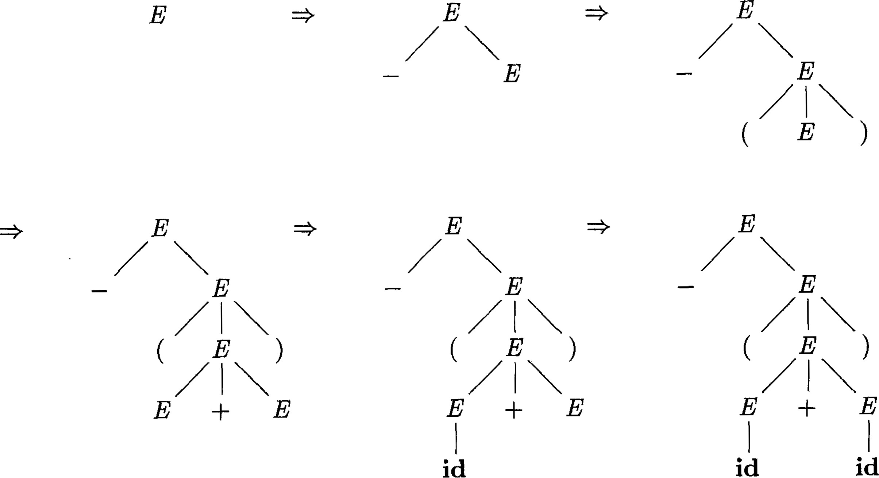
Constructing Parse Trees (Example)
Derivation: 𝐸 ⟹ −𝐸 ⟹ − 𝐸
⟹ − 𝐸 + 𝐸
⟹ − 𝐢𝐝 + 𝐸
⟹ −(𝐢𝐝 + 𝐢𝐝)
Notes:
构造语法分析树示例

Slide 18
Formal definition of CFG
Derivation and parse tree
Ambiguity
CFG vs. regexp
Grammar design
Outline
Introduction
Context-Free Grammars
Overview of Parsing Techniques
Top-Down Parsing
Bottom-Up Parsing
Parser Generators (to be discussed in lab sessions)
Notes:
CFG的形式化定义
推导和语法分析树
二义性
CFG与正则表达式
语法设计

Slide 19
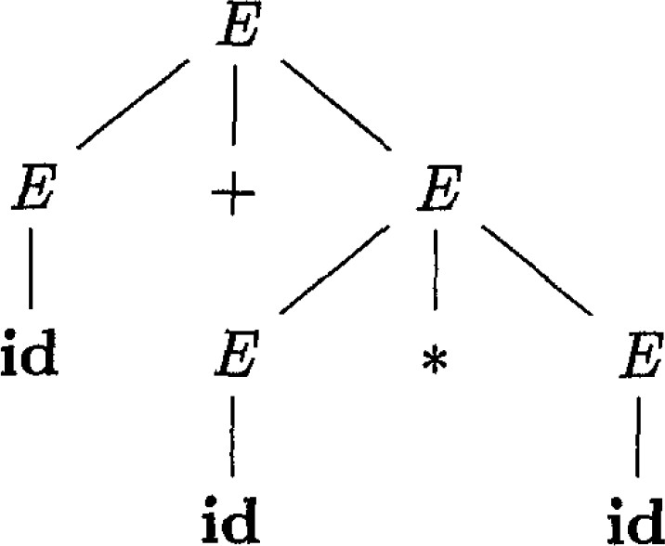
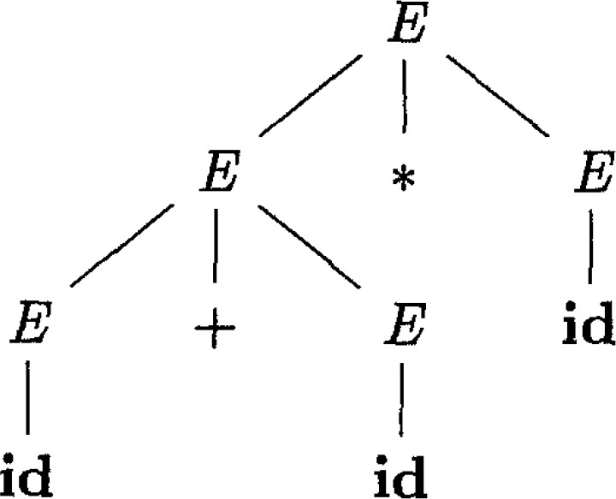
Ambiguity (二义性)
If a grammar produces more than one parse tree for some sentence, it is ambiguous
Example CFG: 𝐸 → 𝐸 + 𝐸 𝐸 ∗ 𝐸 𝐸 | 𝐢𝐝
𝐸 ⇒ 𝐸 + 𝐸
⇒ 𝐢𝐝 + 𝐸
⇒ 𝐢𝐝 + 𝐸 ∗ 𝐸
⇒ 𝐢𝐝 + 𝐢𝐝 ∗ 𝐸
⇒ 𝐢𝐝 + 𝐢𝐝 ∗ 𝐢𝐝
𝐸 ⇒ 𝐸 ∗ 𝐸
⇒ 𝐸 + 𝐸 ∗ 𝐸
⇒ 𝐢𝐝 + 𝐸 ∗ 𝐸
⇒ 𝐢𝐝 + 𝐢𝐝 ∗ 𝐸
⇒ 𝐢𝐝 + 𝐢𝐝 ∗ 𝐢𝐝
Both are leftmost derivations
Notes:
如果一个语法为某个句子生成了多个语法分析树，则它具有二义性
示例：该文法为id+id*id生成了两种语法分析树。

Slide 20
Ambiguity (二义性) Cont.
The grammar of a programming language typically needs to be unambiguous
Otherwise, there will be multiple ways to interpret a program
Given 𝐸 → 𝐸 + 𝐸 𝐸 ∗ 𝐸 𝐸 | 𝐢𝐝, how to interpret 𝑎 + 𝑏 ∗ 𝑐?
In some cases, it is convenient to use carefully chosen ambiguous grammars, together with disambiguating rules to discard undesirable parse trees
For example: multiplication before addition
Notes:
程序设计语言的语法通常需要明确
· 否则，将有多种方法来解释程序
· 问题：给定𝐸 → 𝐸 + 𝐸 | 𝐸 ∗ 𝐸 | (𝐸) | 𝐢𝐝, 如何解读 𝑎 + 𝑏 ∗ 𝑐?
· 答案：该文法是上一张PPT的示例，根据两种语法分析树，第一种解释：应先处理b*c，然后与a相加；第二种解释：应先处理a+b，然后与c相乘
在某些情况下，使用精心选择的歧义语法以及消歧规则来丢弃不需要的语法分析树是很方便的

Slide 21
Formal definition of CFG
Derivation and parse tree
Ambiguity
CFG vs. regexp
Grammar design
Outline
Introduction
Context-Free Grammars
Overview of Parsing Techniques
Top-Down Parsing
Bottom-Up Parsing
Parser Generators (to be discussed in lab sessions)
Notes:
CFG的形式化定义
推导和语法分析树
二义性
CFG与正则表达式
语法设计

Slide 22
CFG vs. Regular Expressions
CFGs are more expressive than regular expressions
Every construct that can be described by a regular expression can be described by a grammar, but not vice-versa
Every regular language is a context-free language, but not vice-versa
Example: 𝐿 ={𝑎^{𝑛}𝑏^{𝑛} | 𝑛> 0}
The language L can be described by CFG 𝑆 → 𝑎𝑆𝑏 | 𝑎𝑏
L cannot be described by regular expressions. In other words, we cannot construct a DFA to accept L
Notes:
CFG与正则表达式比较
CFG比正则表达式更具表达能力
· 可以用正则表达式描述的每个构造都可以用语法描述，但反之不成立
· 每个正则语言都是上下文无关的语言，但反之不成立
示例：𝐿 ={𝑎^{𝑛}𝑏^{𝑛} | 𝑛> 0}
语言L可以用CFG：𝑆 → 𝑎𝑆𝑏 | 𝑎𝑏 来描述
L不能用正则表达式来描述。换句话说，我们不能构造一个DFA来接受L

Slide 23
Proof by Contradiction
Suppose there is a DFA 𝐷 that accepts 𝐿 and 𝐷 has 𝑘 states
When processing 𝑎^{𝑘+1} …, 𝐷 must enter a state 𝑠 more than once (𝐷 enters one state after processing a symbol)¹
Assume that 𝐷 enters the state 𝑠 after reading the 𝑖th and 𝑗th 𝑎 (𝑖 ≠
𝑗, 𝑖 ≤ 𝑘 + 1, 𝑗 ≤ 𝑘 + 1)
Since 𝐷 accepts 𝐿, 𝑎 ^{j} 𝑏 ^{j} must reach an accepting state. There must exist a path labeled 𝑏⁺ from 𝑠 to an accepting state
Since 𝑎^{i} reaches the state 𝑠 and there is a path labeled 𝑏⁺ from 𝑠 to an accepting state, 𝐷 will accept 𝑎^{𝑖}𝑏^{j}. Contradiction!!!
¹ a^{k+1}b^{k+1} is a string in L so D must accept it
Notes:
反证法（了解即可）
假设存在DFA D 接受L，D有k个状态
处理𝑎^{𝑘+1}…时，D 必须进入状态s，且不止一次（D每处理一个符号都会进入一种状态）
假设D 进入状态s在读入第i个a和第j个a后 (i≠ j, i ≤ k + 1, j ≤ k + 1）
按照上一张PPT的示例，因为D接受文法L, 所以𝑎 ^{j} 𝑏 ^{j} 必须达到接受状态。必须存在一个标记为𝑏 ^{j} 从s到接受状态的路径
因为𝑎^{i}到达了状态s，所以必有一条标记为𝑏 ^{j} 从s到接受状态的；路径，D将接受𝑎 ^{i} 𝑏 ^{j} 。矛盾！！！

Slide 24
Any Regular Language Can Be Described by a CFG
(Proof by Construction) Each regular language can be accepted by an NFA. We can construct a CFG to describe the language:
For each state 𝑖 of the NFA, create a nonterminal symbol 𝐴_{𝑖}
If state 𝑖 has a transition to state 𝑗 on input 𝑎, add the production
𝐴_{𝑖}→ 𝑎𝐴_{j}
If state 𝑖 goes to state 𝑗 on input 𝜖, add the production 𝐴_{𝑖}→ 𝐴_{j}
If 𝑖 is an accepting state, add 𝐴_{𝑖}→ 𝜖
If 𝑖 is the start state, make 𝐴_{𝑖}be the start symbol of the grammar
Notes:
任何正则语言都可以用CFG描述
（结构证明）NFA可以接受每种常规语言。我们可以构造一个CFG来描述语言：
· 对于每个在NFA中的状态 𝑖 ，创建一个非终结符𝐴_{𝑖}
· 如果状态𝑖 在碰到输入a转为状态j 时, 添加产生式𝐴_{𝑖}→ 𝐴_{j}
· 如果状态𝑖 是一个接受状态，添加产生式𝐴_{𝑖}→𝜖
· 如果状态𝑖 是开始状态，将𝐴_{𝑖}作为文法的开始符号

Slide 25
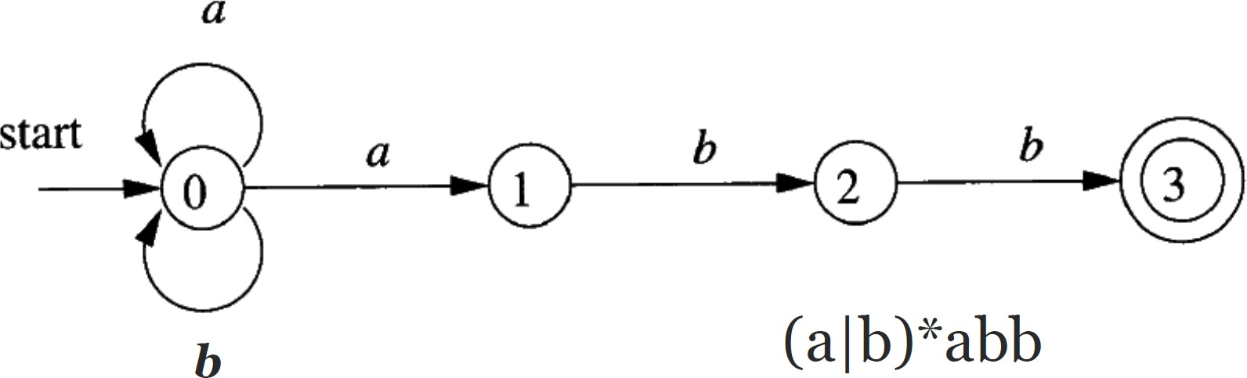
Example: NFA to CFG
𝐴₀ → 𝑎𝐴₀
𝐴₁ → 𝑏𝐴₂
𝐴₂→ 𝑏𝐴₃
𝐴₃ → 𝜖
𝑏𝐴₀
𝑎𝐴₁
Consider the string 𝒃𝒂𝒂𝒃𝒃: The process of the NFA accepting the sentence corresponds exactly to the derivation of the sentence from the grammar
Notes:
示例：NFA到CFG
考虑字符串baabb: NFA接受句子的过程与从语法中推导出句子的过程完全一致

Slide 26
Formal definition of CFG
Derivation and parse tree
Ambiguity
CFG vs. regexp
Grammar design
Outline
Introduction
Context-Free Grammars
Overview of Parsing Techniques
Top-Down Parsing
Bottom-Up Parsing
Parser Generators (to be discussed in lab sessions)
Notes:
CFG的形式化定义
推导和语法分析树
二义性
CFG与正则表达式
语法设计

Slide 27
Grammar Design
CFGs are capable of describing most, but not all, of the syntax of programming languages
“Identifiers should be declared before use” cannot be described by a CFG
Subsequent phases must analyze the output of the parser to ensure compliance with such rules
Before parsing, we typically apply several transformations to a grammar to make it more suitable for parsing
Eliminating ambiguity (消除二义性)
Eliminating left recursion (消除左递归)
Left factoring (提取左公因子)
Notes:
CFG能够描述编程语言的大部分（但不是全部）语法
· CFG不能描述“使用前应声明标识符”
· 后续阶段必须分析解析器的输出，以确保符合此类规则
在解析之前，我们通常对语法进行几种转换，使其更适合解析
· 消除二义性
· 消除左递归
· 提取左公因子

Slide 28
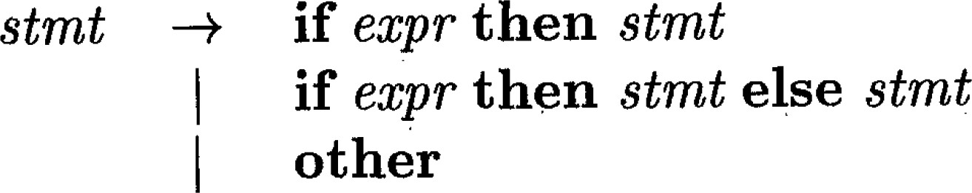
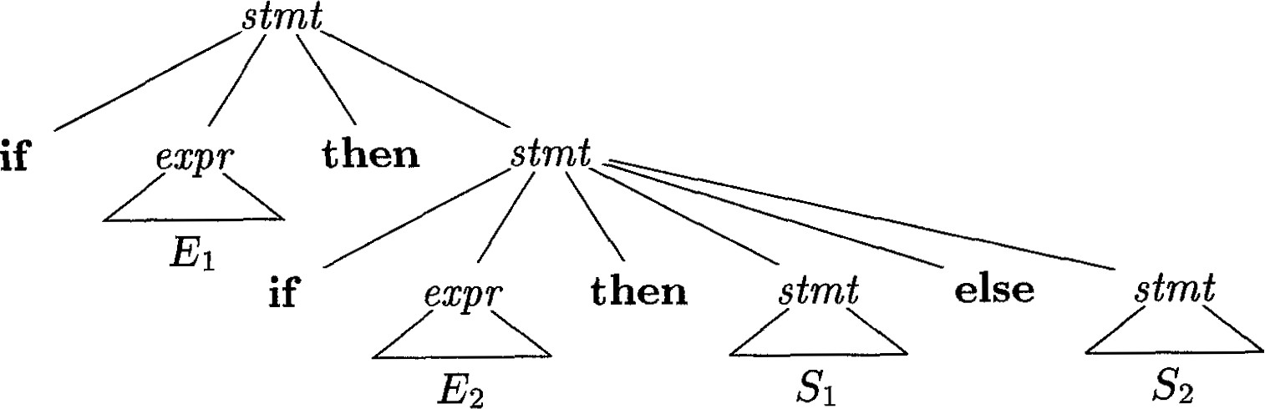
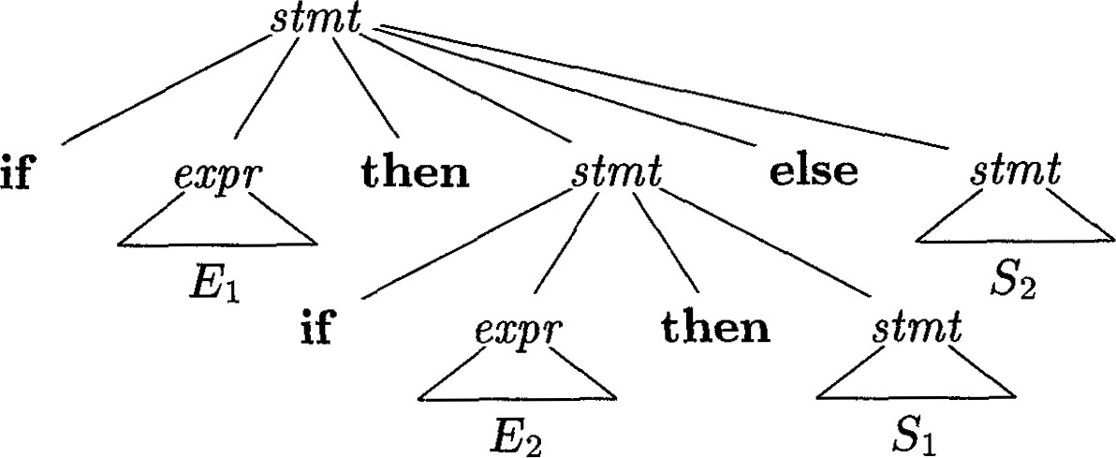

Eliminating Ambiguity (1)
Two parse trees for if E₁ then if E₂ then S₁ else S₂
Which parse tree is preferred in programming? (i.e., else matches which then?)
Notes:
消除二义性
问题：在编程中，哪个语法分析树是首选的？（即，else匹配哪个then？）
答案：第一种语法分析树

Slide 29
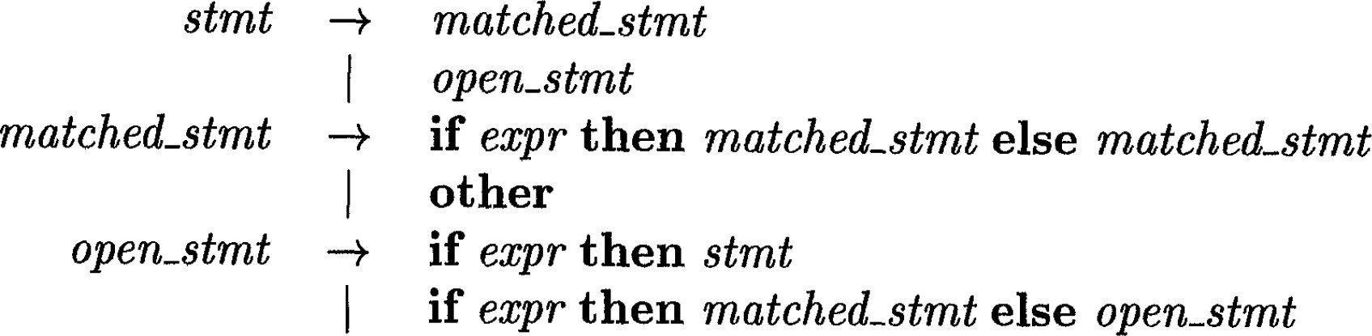

Eliminating Ambiguity (2)
Principle of proximity: match each else with the closest unmatched then
Idea of rewriting: A statement appearing between a then and an
else must be matched (must not end with an unmatched then)
Rewriting grammars to eliminate ambiguity is difficult. There are no general rules to guide the process.
Notes:
消除二义性
接近原则：用最接近的未匹配的then匹配else
· 重写的想法：出现在then和else之间的语句必须匹配（不能以不匹配的then结束）
重写语法以消除歧义是困难的。没有指导这一过程的一般规则。

Slide 30
Eliminating Left Recursion
A grammar is left recursive if it has a nonterminal 𝐴 such that there is a derivation 𝐴 ⇒ 𝐴𝛼 for some string 𝛼
𝑆 → 𝐴𝑎 | 𝑏
+
𝐴 → 𝐴𝑐 𝑆𝑑 𝜖
Because 𝑆 ⟹ 𝐴𝑎 ⟹ 𝑆𝑑𝑎
Immediate left recursion (立即左递归): the grammar has a production of the form 𝐴 → 𝐴𝛼
Top-down parsing methods cannot handle left-recursive grammars (bottom-up parsing methods can handle…)
Notes:
消除左递归
如果语法中存在一个非终结符A，使得某个字符𝛼有相关的产生式𝐴 ⇒+ 𝐴𝛼 ，则该语法为左递归语法
立即左递归: 语法有产生式𝐴 -> 𝐴𝛼
自顶向下分析方法无法处理左递归语法（自底向上的分析方法可以处理…）

Slide 31
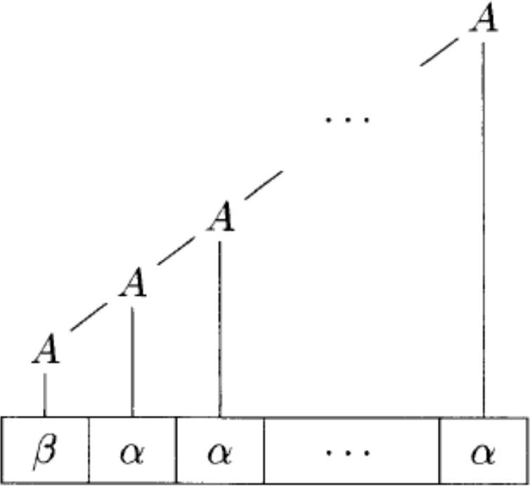


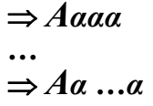

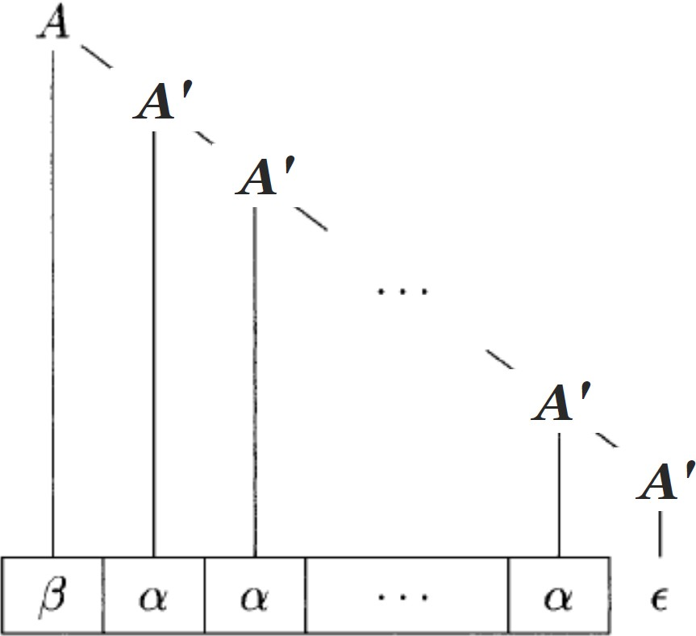


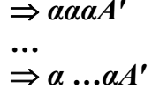

Eliminating Immediate Left Recursion
Simple grammar: 𝐴 → 𝐴𝛼 | 𝛽
It generates sentences starting with the symbol 𝛽 followed by zero or more 𝛼’s
Replace the grammar by:
𝐴 → 𝛽A'
A' → 𝛼A' | 𝜖
It is right recursive now
Notes:
消除立即左递归
简单语法：𝐴 → 𝐴𝛼 | 𝛽 它生成以符号𝛽开头的句子，后面跟零个或更多的𝛼’s
将语法替换为：
𝐴 → 𝛽A’
A' → 𝛼A' | 𝜖
它现在是右递归了

Slide 32
Eliminating Immediate Left Recursion
The general case: 𝐴 → 𝐴𝛼₁ … 𝐴𝛼_{𝑚} 𝛽₁ … | 𝛽_{𝑛}
Replace the grammar by:
𝐴 → 𝛽₁𝐴′ …
𝐴′ → 𝛼₁𝐴′ …
𝛽_{𝑛}𝐴′
𝛼_{𝑚}𝐴′ | 𝜖
Notes:
消除立即左递归
𝐴 → 𝐴𝛼₁|…|𝐴𝛼_{𝑚}|𝛽₁|… | 𝛽_{𝑛}
将语法替换为：
𝐴 →𝛽₁A’ | … |𝛽_{n}A’
A' → 𝛼₁A’ | … | 𝛼_{m}A’ |𝜖

Slide 33








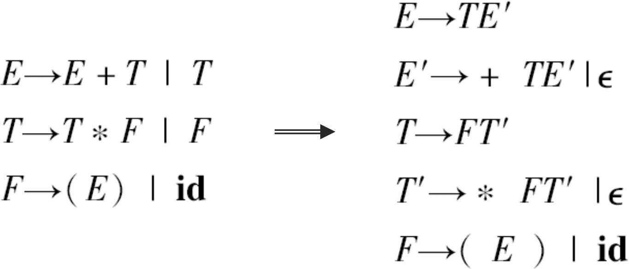
Example

Slide 34
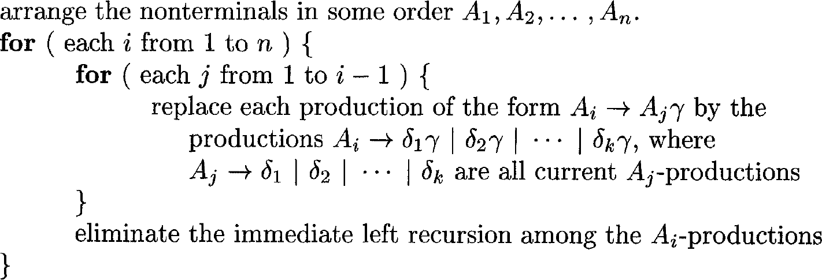
Eliminating Left Recursion
The technique for eliminating immediate left recursion does not work for the non-immediate left recursions
The general left recursion eliminating algorithm (iterative)
Input: Grammar G with no cycles or 𝜖-productions
Output: An equivalent grammar with no left recursion
Notes:
消除左递归
消除立即左递归的技术不适用于非立即左递归
虽然形式上产生式没有直接左递归，但由于形成了环，导致进行推导后后出现左递归。
通用左递归消除算法（迭代）
· 输入：没有循环或𝜖-产生式的语法G
· 输出：没有左递归的等价语法
以下是算法
对于每个非终结符Ai，检查是否有形如Ai->Ajv的产生式（Aj是其他的非终结符）
将Ai->Ajv修改为Ai->delta1 v | delta2 v | … | delta_k v
如果Aj->delta1|delta2|…
接着消除Ai的所有直接左递归

Slide 35
Example
𝑆 → 𝐴𝑎 | 𝑏 𝐴 → 𝐴𝑐 𝑆𝑑 𝜖
Order the nonterminals: 𝑆, 𝐴
𝑖 = 1:
The inner loop does not run; there is no immediate left recursion among 𝑆-productions
𝑖 = 2:
𝑗 = 1, replace the production 𝐴 → 𝑆𝑑 by 𝐴 → 𝐴𝑎𝑑 | 𝑏𝑑
o 𝐴 → 𝐴𝑎𝑑 𝑏𝑑 𝐴𝑐 | 𝜖
Eliminate immediate left recursion
𝑆 → 𝐴𝑎 | 𝑏
𝐴 → 𝑏𝑑A' | A'
𝐴' → 𝑐𝐴' |𝑎𝑑𝐴' |𝜖
The example grammar contains an 𝜖-production, but it is harmless

Slide 36
Left Factoring (提取左公因子)
If we have the following two productions
𝑠𝑡𝑚𝑡 → 𝐢𝐟 𝑒𝑥𝑝𝑟 𝐭𝐡𝐞𝐧 𝑠𝑡𝑚𝑡 𝐞𝐥𝐬𝐞 𝑠𝑡𝑚𝑡
| 𝐢𝐟 𝑒𝑥𝑝𝑟 𝐭𝐡𝐞𝐧 𝑠𝑡𝑚𝑡
On seeing input 𝐢𝐟, we cannot immediately decide which production to choose
In general, if 𝐴 → 𝛼𝛽₁ | 𝛼𝛽₂ are two productions, and the input begins with a nonempty string derived from 𝛼. We may defer choosing productions by expanding 𝐴 to 𝛼𝐴' first
𝐴 → 𝛼𝐴'
𝐴' → 𝛽₁ | 𝛽&
Notes:
如果我们有以下两个产生式
看到输入时𝐢𝐟, 我们无法立即决定选择哪个产生式
一般来说，如果𝐴 → 𝛼𝛽₁ | 𝛼𝛽₂是两个产生式，并且输入以从𝛼派生的非空字符串开始. 我们可以通过扩大𝐴 到𝛼𝐴‘来推迟选择产生式
通过改写产生式来推迟决策，直到输入足够多的信息后再做出。

Slide 37
Algorithm: Left Factoring a Grammar
Input: Grammar G
Output: An equivalent left-factored grammar
For each nonterminal 𝐴, find the longest prefix 𝛼 common to two or more of its alternatives.
If 𝛼 ≠ 𝜖, replace all 𝐴-productions 𝐴 → 𝛼𝛽₁ 𝛼𝛽& … 𝛼𝛽_{𝑛} 𝛾, where 𝛾 represents all alternatives that do not begin with 𝛼, by
𝐴 → 𝛼𝐴' | 𝛾
𝐴' → 𝛽₁ 𝛽₂ … | 𝛽_{𝑛}
Repeatedly apply the above transformation until no two alternatives for a nonterminal have a common prefix
Notes:
算法：语法的左公因子提取
输入：语法G
输出：等效的左公因子提取语法
•对于每个非终结符A, 查找最长的前缀𝛼，它是两个或多个替换项的公共前缀。
•重复转换，直到非终结符的两个替代项都没有公共前缀为止

Slide 38
Outline
Introduction
Context-Free Grammars
Overview of Parsing Techniques
Top-Down Parsing
Bottom-Up Parsing
Parser Generators (to be discussed in lab sessions)
Notes:
引言
上下文无关语法
语法分析技术概述
自顶向下解析
自底向上解析
解析器生成器

Slide 39
Top-Down Parsing
Problem definition: Constructing a parse tree for the input string, starting from the root and creating the nodes of the parse tree in preorder (depth-first)
Equivalent to finding a leftmost derivation for an input string
Basic idea (two actions):
Predict: At each step of parsing, determine the production to be applied for the leftmost nonterminal
Match: Match the terminals in the chosen production’s body with the input string
Notes:
自顶向下语法分析
问题定义：为输入字符串构建一个语法分析树，从根开始，按预序创建语法分析树的节点（深度优先）
· 相当于为输入字符串找到最左推导
基本思想（两个步骤）：
· 预测：在解析的每一步，确定最左边非终结符所用的产生式
· 匹配：将所选产生式主体中的终结符与输入字符串相匹配

Slide 40

Top-Down Parsing Example
Grammar
𝐸 → 𝑇𝐸'
𝐸' → +𝑇E' | 𝜖
𝑇 → 𝐹𝑇'
𝑇' →∗ 𝐹𝑇' | 𝜖
𝐹 → (𝐸)| 𝑖𝑑
Input string
𝐢𝐝 + 𝐢𝐝 ∗ 𝐢𝐝
Is the input string a sentence of the grammar?
Notes:
问题：输入串是该文法的句子吗？
答案：是，语法分析树见下一页PPT

Slide 41
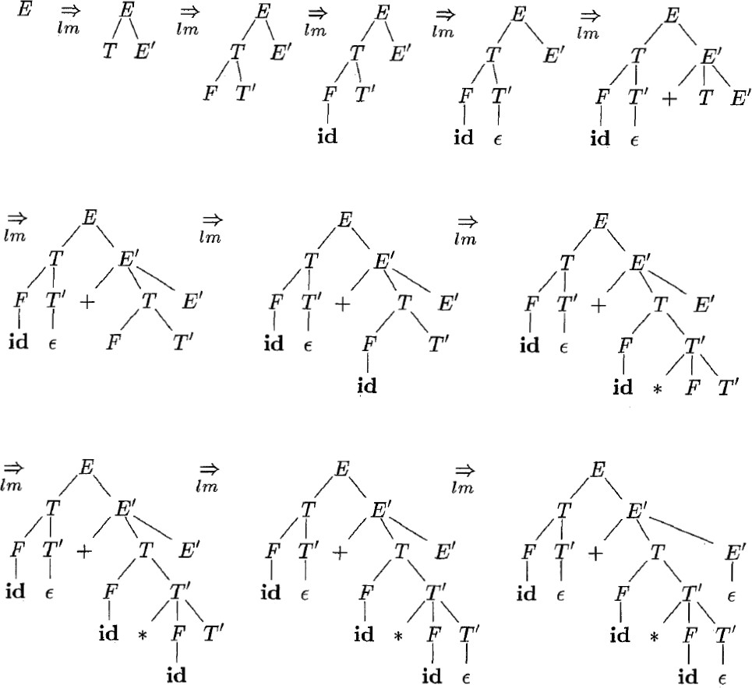
Grammar: 𝐸 → 𝑇𝐸' 𝐸' → +𝑇𝐸' Input string: 𝐢𝐝 + 𝐢𝐝 ∗ 𝐢𝐝
𝜖 𝑇 → 𝐹𝑇'
𝑇' →∗ 𝐹𝑇'
𝜖 𝐹 → 𝐸 | 𝑖𝑑

Slide 42
Key decision in top-down parsing: Which production to apply at each step?
Notes:
自顶向下解析中的关键决策：在每一步应用哪个产生式？

Slide 43
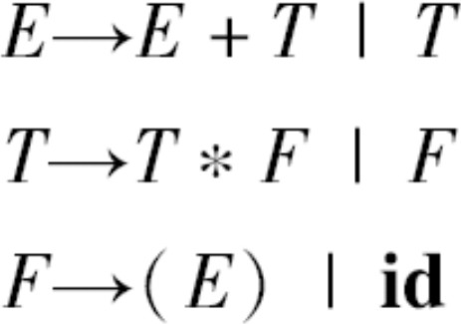
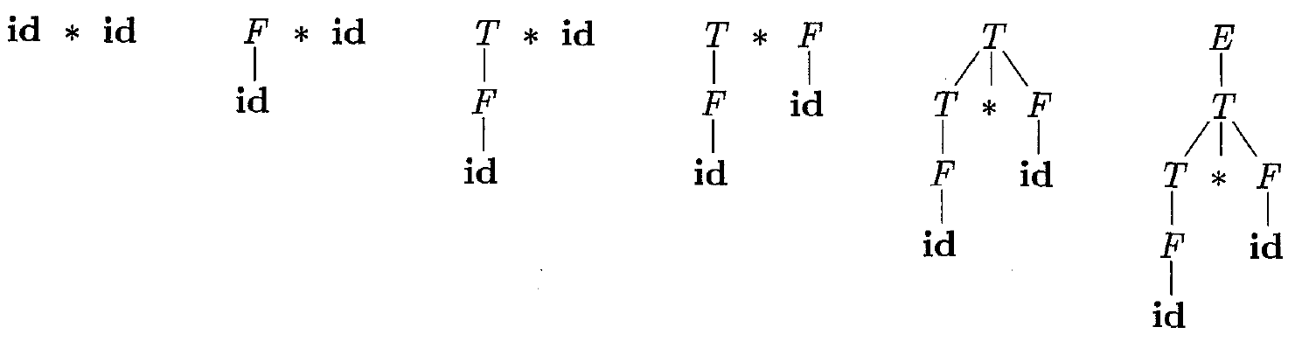
Bottom-Up Parsing
Problem definition: Constructing a parse tree for an input string beginning at the leaves (terminals) and working up towards the root (start symbol of the grammar)
Equivalent to finding a rightmost derivation (in reverse) for an input string
Shift-reduce parsing (移入-归约分析技术) is a general style of bottom-up parsing (using a stack to hold grammar symbols)
Notes:
自底向上语法分析
问题定义：为输入字符串构建一个从叶子（终结符）开始并向上延伸到根（语法的开始符号）的语法分析树
· 相当于为输入字符串找到最右推导（相反）
移入-归约分析技术是自底向上语法分析的通用方式（使用栈来保存语法符号）

Slide 44
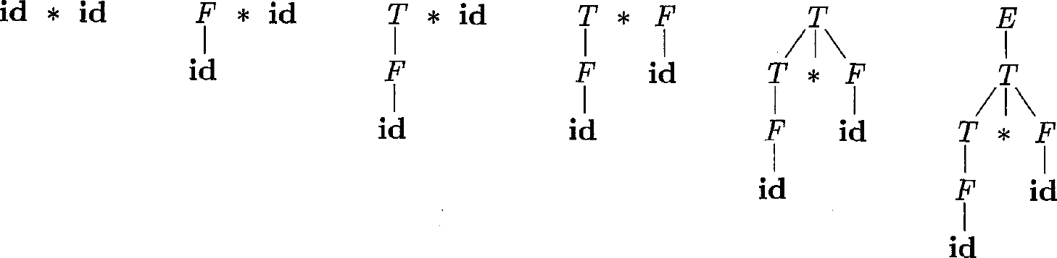
Reductions (归约)
Bottom-up parsing can be seen as a process of “reducing” a string 𝜔 to the start symbol of the grammar
At each reduction step, a specific substring (at the top of the stack) matching the body of a production is replaced by the head of the production (the reverse of a step in derivation)
Notes:
自底向上语法分析可以看作是一个将字符串𝜔“归约”到开始符号的过程
在每一个归约步骤中，与产生式主体匹配的特定子串（位于堆栈顶部）都会被产生式的头部替换（与推导步骤相反）

Slide 45
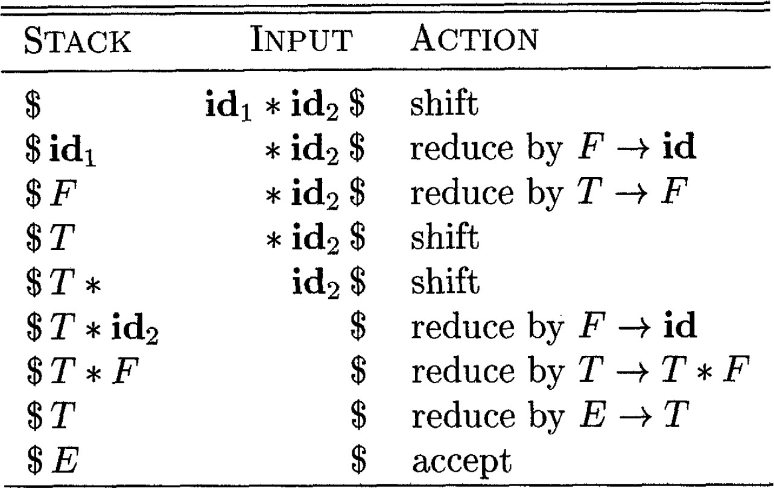
Shift-Reduce Parsing Example
Parsing steps on input 𝐢𝐝₁ ∗ 𝐢𝐝₂
Key decisions:
When to reduce?
Which production to apply?
Notes:
移入-归约分析技术示例
关键决策：
1.什么时候归约？
2.应用哪个产生式？

Slide 46
Outline
Introduction
Context-Free Grammars
Overview of Parsing Techniques
Top-Down Parsing
Bottom-Up Parsing
Parser Generators (to be discussed in lab sessions)
Recursive-descent parsing
Non-recursive predictive parsing
Notes:
递归下降的语法分析
非递归预测的语法分析

Slide 47
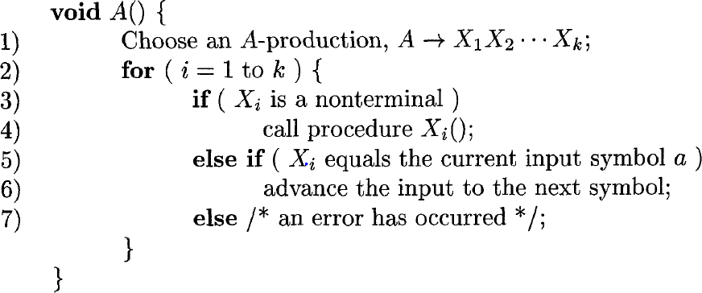
Recursive-Descent Parsing (递归下降的语法分析)
A recursive-descent parsing program has a set of procedures, one for each nonterminal
The procedure for a nonterminal scans the structure (a substring of the input) corresponding to the nonterminal
Execution begins with the procedure for the start symbol
Announce success if the procedure scans the entire input string
// a typical procedure for a nonterminal
Notes:
递归下降的语法分析程序对于每个非终结符都有一套程序
· 该程序会扫描与非终结符对应的结构（输入的子字符串）
从开始符号的程序开始执行
· 如果程序扫描整个输入字符串，则宣布成功

Slide 48
Backtracking (回溯)
If there is a failure at line 7, does this mean that there must be syntax errors?
Notes:
问题：如果第7行出现故障，这是否意味着一定存在语法错误？
答案：不一定。见下一页PPT

Slide 49

Backtracking (回溯)
The failure might be caused by a wrong choice of 𝐴-production at line 1 !!!
Notes:
故障可能是由于在底=第1行选错了𝐴-产生式

Slide 50
Backtracking (回溯)
General recursive-descent parsing may require repeated scans over the input (backtracking)
To allow backtracking, we need to modify the algorithm
Instead of exploring one 𝐴-production, we must try each possible production in some order.
Notes:
一般的递归下降语法分析可能需要对输入进行重复扫描，以尝试不同的产生式（回溯）
为了允许回溯，我们需要修改算法
与考察A-产生式不同，我们必须按照一定的顺序尝试每一种可能的产生式。

Slide 51
Backtracking (回溯)
General recursive-descent parsing may require repeated scans over the input (backtracking)
To allow backtracking, we need to modify the algorithm
When there is a failure at line 7, return to line 1 and try another 𝐴- production.
Notes:
当第7行出现故障时，返回第1行并尝试另一个A产生式

Slide 52
Backtracking (回溯)
General recursive-descent parsing may require repeated scans over the input (backtracking)
To allow backtracking, we need to modify the algorithm
In order to try another 𝐴-production, we must reset the input pointer that points to the next symbol to scan (failed trials consume symbols)
Notes:
为了尝试另一个A-产生式时，我们必须重置指向下一个要扫描的符号的输入指针（失败尝试的消耗符号）

Slide 53
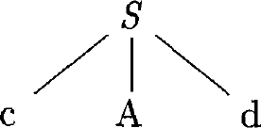
Backtracking Example
Grammar: 𝑆 → 𝑐𝐴𝑑 𝐴 → 𝑎𝑏 | 𝑎
Input string: 𝑐𝑎𝑑
The leftmost leaf matches 𝑐 in input
Advance input pointer
𝑐
𝑎
𝑑
input pointer
Notes:
S结点最左边的叶子匹配输入中的𝑐
移进输入指针

Slide 54
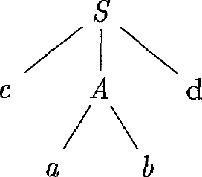
Backtracking Example
Grammar: 𝑆 → 𝑐𝐴𝑑 𝐴 → 𝑎𝑏 | 𝑎
Input string: 𝑐𝑎𝑑
Expand 𝐴 using the first production
Leftmost leaf matches 𝑎 in input
Advance input pointer
𝑐
𝑎
𝑑
input pointer
Notes:
使用第1个产生式扩展A
A结点最左边的叶子匹配输入中的a
移进输入指针

Slide 55
Backtracking Example
Grammar: 𝑆 → 𝑐𝐴𝑑 𝐴 → 𝑎𝑏 | 𝑎
Input string: 𝑐𝑎𝑑
Symbol mismatch
Go back to try another 𝐴-production
𝑐
𝑎
𝑑
input pointer
Notes:
指针指向的d与符号b不匹配
返回尝试另一个A-产生式

Slide 56
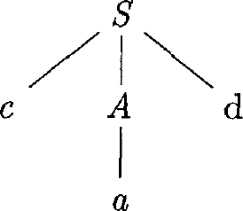
Backtracking Example
Grammar: 𝑆 → 𝑐𝐴𝑑 𝐴 → 𝑎𝑏 | 𝑎
Input string: 𝑐𝑎𝑑
Reset input pointer
Expand 𝐴 using its second production
𝑐 | 𝑎 | 𝑑
input pointer
Notes:
重置输入指针的位置
使用A的第二个产生式扩展A

Slide 57
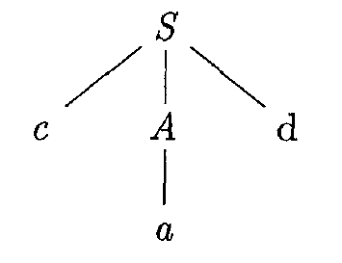
Backtracking Example
Grammar: 𝑆 → 𝑐𝐴𝑑 𝐴 → 𝑎𝑏 | 𝑎
Input string: 𝑐𝑎𝑑
Leftmost leaf matches 𝑎 in input
Advance input pointer
𝑐
𝑎
𝑑
input pointer
Notes:
A结点最左边的叶子匹配输入中的a
移进输入指针

Slide 58
Backtracking Example
Grammar: 𝑆 → 𝑐𝐴𝑑 𝐴 → 𝑎𝑏 | 𝑎
Input string: 𝑐𝑎𝑑
The last leaf node matches 𝑑 in input
Announce success!
𝑐
𝑎
𝑑
Scanned entire input
Notes:
最后的叶子匹配输入中的d
成功

Slide 59
The Problem of Left Recursion
Suppose there is 𝐴 → 𝑨𝛼 …
If there is left recursion in a CFG, a recursive-descent parser may go into an infinite loop! Revise the CFG before parsing!!!
Notes:
左递归带来的问题
如果CFG中有左递归，递归下降的语法分析器可能会进入无限循环，所以需要解析前修改CFG

Slide 60
Can We Avoid Backtracking?
Key problem: At line 1, we make random choices (brute force search)
Notes:
我们能避免回溯吗？
关键问题：在第1行，我们进行随机选择（暴力搜索）

Slide 61
Can We Avoid Backtracking?
Grammar: 𝑆 → 𝑐𝐴𝑑 𝐴 → 𝑐 | 𝑎
Input string: 𝑐𝑎𝑑
𝑐 | 𝑎 | 𝑑
input pointer
When rewriting 𝐴, is it a good idea to choose 𝐴 → 𝑐? No! If we look ahead, the next char in the input is 𝑎.
𝐴 → 𝑐 is obviously a bad choice!!!
Notes:
重写时𝐴, 选择产生式𝐴 → 𝑐好吗?
不，如果我们向前看，输入中的下一个字符是𝑎
𝐴 → 𝑐 显然是个糟糕的选择

Slide 62
Looking Ahead Helps!
Suppose the input string is 𝒙𝒂
Suppose the current sentential form is 𝒙𝑨β
𝑨 is a non-terminal; β may contain both terminals and non-terminals
If we know the following fact for the productions 𝑨 → 𝛼| 𝜸:
𝑎 ∈ 𝐹𝐼𝑅𝑆𝑇(𝛼) : 𝛼 derives strings that begin with 𝑎
𝑎 ∉ 𝐹𝐼𝑅𝑆𝑇(𝛾) : 𝛾 derives strings that do not begin with 𝑎
*𝐹𝐼𝑅𝑆𝑇(𝛼) denotes the set of terminals that begin strings derived from 𝛼
After matching 𝑥, we should choose 𝑨 →𝛼 to rewrite 𝐴
Notes:
向前看有用
假设输入字符串为𝒙𝒂
假设当前的句型是𝒙𝑨β
· 𝑨 是非终结符；β可以同时包含终结符和非终结符
如果我们知道产生式𝑨 → 𝑎 | 𝜸的以下事实:
·𝑎 ∈ 𝐹𝐼𝑅𝑆𝑇(𝛼) ：𝛼 可以推导以a开头的字符串
·𝑎 ∉ 𝐹𝐼𝑅𝑆𝑇(𝛾)：𝛾 不可以推导出以a开头的字符串
*𝐹𝐼𝑅𝑆𝑇(𝛼) 表示可从α推导得到的串的首符号的集合

Slide 63
FIRST
c ∈ FIRST(A)
FIRST(𝛼), where 𝛼 is any string of grammar symbols
The set of terminals that begin strings derived from 𝛼
If 𝛼⇒* 𝜖, then 𝜖 is also in FIRST(𝛼)
FIRST function is useful in parsing
𝑨 →𝛼| β; suppose FIRST(𝛼) and FIRST(β) are disjoint
Choose𝑨 →𝛼 if the next input symbol 𝑎 FIRST(𝛼)
Choose𝑨 → β if the next input symbol 𝑎 FIRST(β)
Notes:
FIRST（alpha) ，alpha是语法符号串
如果alpha是终结符，FIRST集为字符串首字母
如果alpha可以推导为空，则空在FIRST集中
FIRSt集在语法分析是有用的
𝑨 →𝛼| β， 假设FIRST(𝛼) and FIRST(β) 并集为空
如果下一个𝑎在FIRST(𝛼)中，选择产生式𝑨 →𝛼
如果下一个𝑎在FIRST(β)中，选择产生式𝑨 →β

Slide 64
Computing FIRST
FIRST(𝑿), where 𝑋 is a grammar symbol
If 𝑋 is a terminal, then FIRST(𝑋) = {𝑋}
If 𝑋 is a nonterminal and 𝑋 → 𝑌₁𝑌₂ … 𝑌_{𝑘} (𝑘 ≥ 1) is a production
If for some 𝑖, 𝑎 is in FIRST(𝑌_{i}) and 𝜖 is in all of FIRST(𝑌₁), …, FIRST(𝑌_{i-1}), then add 𝑎 to FIRST(𝑋)
If 𝜖 is in all of FIRST(𝑌₁), …, FIRST(𝑌_{𝑘}), then add 𝜖 to FIRST(𝑋)
If 𝑋 is a nonterminal and 𝑋 → 𝜖, then add 𝜖 to FIRST(𝑋)
Notes:
计算FIRST集
计算FIRST(𝑿) 𝑋 是语法符号
· 如果𝑋 是一个终结符，那么FIRST(𝑋) = {𝑋}
· 如果X是一个非终结符，且𝑋 → 𝑌₁𝑌₂ … 𝑌_{𝑘} (𝑘 ≥ 1) 是一个产生式
· 如果对于某个𝑖，𝑎在FIRST(𝑌_{i})中且𝜖在所有的FIRST(𝑌₁), …, FIRST(𝑌_{i-1})中，就把𝑎加入到FIRST(𝑋)中
· 如果对于所有的FIRST(𝑌₁), …, FIRST(𝑌_{𝑘})，𝜖在其中，那么将𝜖加入到FIRST(𝑋)中
· 如果X是一个非终结符，并且存在产生式𝑋 → 𝜖，那么将𝜖加入到FIRST(𝑋)中

Slide 65
Computing FIRST Cont.
FIRST(𝑿_{𝟏}𝑿_{𝟐} … 𝑿_{𝒏}), where 𝑿_{𝟏}𝑿_{𝟐} … 𝑿_{𝒏} is a string of grammar symbols
Add all non-𝜖 symbols of FIRST(𝑋₁) to FIRST(𝑋₁𝑋₂ … 𝑋_{𝑛})
If 𝜖 is in FIRST(𝑋₁), add non-𝜖 symbols of FIRST(𝑋₂) to FIRST(𝑋₁𝑋₂ … 𝑋_{𝑛}); If 𝜖 is in FIRST(𝑋₁) and FIRST(𝑋₂), add non-
𝜖 symbols of FIRST(𝑋₃) to FIRST(𝑋₁𝑋₂ … 𝑋_{𝑛}); …
If 𝜖 is in FIRST(𝑋_{i}) for all 𝑖, add 𝜖 to FIRST(𝑋₁𝑋₂ … 𝑋_{𝑛})
Notes:
计算FIRST集
计算FIRST(𝑿_{𝟏}𝑿_{𝟐} … 𝑿_{𝒏}) 𝑿_{𝟏}𝑿_{𝟐} … 𝑿_{𝒏}是语法符号的串
· 向FIRST(𝑋₁𝑋₂ … 𝑋_{𝑛})加入FIRST(𝑋₁)中所有的非𝜖符号
· 如果𝜖在FIRST(𝑋₁)中，再加入FIRST(𝑋₂)中所有的非𝜖符号；如果𝜖在FIRST(𝑋₁)和FIRST(𝑋₂)中，加入FIRST(𝑋₃)中的所有非𝜖符号，以此类推。
· 最后，如果对于所有的i，𝜖都在FIRST(𝑋_{i})中，那么将加入到FIRST(𝑋₁𝑋₂ … 𝑋_{𝑛})中。

Slide 66
FIRST Example
Grammar
𝐸 → 𝑇𝐸′
𝑇 → 𝐹𝑇′
𝐸' → +𝑇𝐸' | 𝜖
𝑇' →∗ 𝐹𝑇' | 𝜖
𝐹 → 𝐸 | 𝐢𝐝
FIRST sets
FIRST 𝐹
FIRST 𝑇
FIRST 𝐸
FIRST 𝐸'
= {(, 𝐢𝐝}
= FIRST 𝐹
= FIRST 𝑇
= {+, 𝜖}
= {(, 𝐢𝐝}
= {(, 𝐢𝐝}
FIRST 𝑇'
= {∗, 𝜖}
FIRST 𝑇𝐸'
…
= FIRST 𝑇
= { , 𝐢𝐝

Slide 67
Looking Ahead Helps Cont.
Suppose the input string is 𝒙𝒂
Suppose the current sentential form is 𝒙𝑨β
𝑨 is a non-terminal; β may contain both terminals and non-terminals
If we know that for the production 𝑨 →𝛼, 𝜖 ∈ 𝐹𝐼𝑅𝑆𝑇(𝛼), can we choose the production to rewrite 𝐴?
Yes, only if 𝛽 can derive strings beginning with 𝑎, that is, 𝐴 can be followed by 𝑎 in some sentential forms (i.e., 𝒂 ∈ 𝑭𝑶𝑳𝑳𝑶𝑾(𝑨))
Notes:
向前看有用
假设输入字符串为𝒙𝒂
假设当前的句型是𝒙𝑨β
· 𝑨 是非终结符；β可以同时包含终结符和非终结符
如果我们知道生产𝑨 →𝛼, 𝜖 ∈ 𝐹𝐼𝑅𝑆𝑇(𝛼), 我们能选择重写A的产生式吗?
可以，只有在𝛽 可以推导以𝑎开头的字符串, 即，在一些句型中𝐴 后面可以跟着𝑎 （即，𝒂 ∈ 𝑭𝑶𝑳𝑳𝑶𝑾(𝑨))

Slide 68
FOLLOW
FOLLOW(A), where A is a nonterminal
The set of terminals 𝑎 that can appear immediately to the right of A in some sentential form
FOLLOW function is also useful in parsing
Consider a production 𝑨 →𝛼; when 𝛼⇒𝜖 , FOLLOW(A) can help choose the right production
Example: if the next input symbol is b , and b ∈ FOLLOW(A), then we can choose 𝑨 →𝛼
𝑎 ∈FOLLOW(A)
*
Fall 2023
BUPT Compilers
68
Notes:
FOLLOW(A), A是非终结符
𝑎 ∈FOLLOW(A)表示终结符在某些句型中可以出现在A的右边
对产生式𝑨 →𝛼，当𝛼⇒*𝜖 , FOLLOW(A)可以帮助我们选择正确的产生式

Slide 69
Computing FOLLOW
Computing FOLLOW(A) for all nonterminals A
Add $ in FOLLOW(S), where S is the start symbol and $ is the input right endmarker
Apply the rules below, until all FOLLOW sets do not change
If there is a production 𝐴 → 𝛼𝐵𝛽, then everything in FIRST(𝛽) except 𝜖 is in FOLLOW(𝐵)
If there is a production 𝐴 → 𝛼𝐵 (or 𝐴 → 𝛼𝐵𝛽 and FIRST(𝛽) contains 𝜖) then everything in FOLLOW(𝐴) is in FOLLOW(𝐵)
𝜖 will not appear in any FOLLOW set
Notes:
计算FOLLOW集
计算所有非终结符A的FOLLOW(A)集合
· 将$添加到FOLLOW（S）中，其中S是开始符号，$是输入右端的结束标记
· 不断应用下面的规则，直到所有FOLLOW集不再改变
· 如果存在一个产生式𝐴 → 𝛼𝐵𝛽，那么FIRST(𝛽)中除𝜖之外的所有符号都在FOLLOW(𝐵)
中
· 如果存在一个产生式𝐴 → 𝛼𝐵 ，或存在产生式𝐴 → 𝛼𝐵𝛽且FIRST(𝛽)包含𝜖，那么FOLLOW(𝐴)中的所有符号都在FOLLOW(𝐵)
中
𝜖不会在任何FOLLOW集中

Slide 70
FOLLOW Example
Grammar
𝐸 → 𝑇𝐸′
𝑇 → 𝐹𝑇′
𝐸' → +𝑇𝐸' | 𝜖
𝑇' →∗ 𝐹𝑇' | 𝜖 𝐹 → 𝐸 | 𝐢𝐝
FOLLOW sets
$ is always in FOLLOW(𝐸)
Everything in FIRST()) except 𝜖 is in
FOLLOW(𝐸)
▪
FOLLOW 𝐸 = {$, )}
FOLLOW 𝐸′ = {$, )}
▪
FOLLOW 𝑇 = {+, $, )}
Everything in FIRST(𝐸′) except 𝜖 is in
FOLLOW(𝑇)
Since 𝐸’ → 𝜖, everything in
FOLLOW(𝐸) is in FOLLOW(𝑇)
FOLLOW 𝑇′ = {+, $, )}
FOLLOW 𝐹 = {∗, +, $, )}
Notes:
FOLLOW集示例

Slide 71
LL(1) Grammars
Recursive-descent parsers needing no backtracking can be constructed for a class of grammars called LL(1)
1st L: scanning the input from left to right
2nd L: producing a leftmost derivation
1: using one input symbol of lookahead at each step to make parsing decision
Notes:
我们可以为一类称为LL(1)的语法构造不需要回溯的递归下降语法分析器
从左到右扫描输入
产生最左推导
在每一步使用一个前瞻输入符号来作出分析决策

Slide 72
LL(1) Grammars Cont.
A grammar 𝑮 is LL(1) if and only if for any two distinct productions
𝐴 → 𝛼 | 𝛽, the following conditions hold:
There is no terminal 𝑎 such that 𝛼 and 𝛽 derive strings beginning with 𝑎
At most one of 𝛼 and 𝛽 can derive the empty string
If 𝛽 ⇒ 𝜖, then 𝛼 does not derive any string beginning with a terminal in
FOLLOW(𝐴) and vice versa
∗
* The three conditions basically rule out the possibility of applying both productions
More formally:
FIRST 𝛼 ∩ FIRST 𝛽 = ∅ (conditions 1-2 above)
If 𝜖 ∈ FIRST 𝛽 , then FIRST 𝛼 ∩ FOLLOW 𝐴 = ∅ and vice versa
Notes:
语法𝑮 是LL(1)当且仅当对于任意两个不同的产生式𝐴 → 𝛼 | 𝛽, 以下条件成立：
不存在终结符𝑎 使得𝛼 和𝛽 都可以推导以𝑎开头的字符串
𝛼 和𝛽 中最多只有一个可以推导空字符串
如果𝛽 ⇒* 𝜖, 那么𝛼 不能推导出任何以FOLLOW(𝐴)中某个终结符开头的字符串，反之亦然
*这三个条件基本上排除了应用两个产生式的可能性
更正式地说：
1. FIRST(𝛼)∩ FIRST(𝛽)= ∅ （上述条件1-2）
如果𝜖 ∈ FIRST(𝛽)，那么 FIRST(𝛼)∩ FOLLOW(𝐴)= ∅ ，反之亦然

Slide 73
LL(1) Grammars Cont.
For LL(1) grammars, during recursive-descent parsing, the proper production to apply for a nonterminal can be selected by looking only at the current input symbol
Grammar: 𝑠𝑡𝑚𝑡 → 𝐢𝐟 𝐞𝐱𝐩𝐫 𝑠𝑡𝑚𝑡 𝐞𝐥𝐬𝐞 𝑠𝑡𝑚𝑡 | 𝐰𝐡𝐢𝐥𝐞 𝐞𝐱𝐩𝐫 𝑠𝑡𝑚𝑡 | 𝐚
1 2 3
Parsing steps for input: 𝐢𝐟 𝐞𝐱𝐩𝐫 𝐰𝐡𝐢𝐥𝐞 𝐞𝐱𝐩𝐫 𝐚 𝐞𝐥𝐬𝐞 𝐚
1. Rewrite the start symbol stmt with ①: 𝐢𝐟 𝐞𝐱𝐩𝐫 𝑠𝑡𝑚𝑡 𝐞𝐥𝐬𝐞 𝑠𝑡𝑚𝑡
2. Rewrite the leftmost stmt with ②: 𝐢𝐟 𝐞𝐱𝐩𝐫 | 𝐰𝐡𝐢𝐥𝐞 𝐞𝐱𝐩𝐫 | 𝑠𝑡𝑚𝑡 𝐞𝐥𝐬𝐞 𝑠𝑡𝑚𝑡
3. Rewrite the leftmost stmt with ③: 𝐢𝐟 𝐞𝐱𝐩𝐫 | 𝐰𝐡𝐢𝐥𝐞 𝐞𝐱𝐩𝐫 | 𝐚 𝐞𝐥𝐬𝐞 𝑠𝑡𝑚𝑡
4. Rewrite the leftmost stmt with ③: 𝐢𝐟 𝐞𝐱𝐩𝐫 | 𝐰𝐡𝐢𝐥𝐞 𝐞𝐱𝐩𝐫 | 𝐚 𝐞𝐥𝐬𝐞 𝐚
Notes:
对于LL(1)语法，在递归下降语法分析过程中，只需查看当前输入符号，就可以选择应用于非终结符的正确产生式：
给定文法
给出输入的分析步骤：
1.用产生式①重写开始符号stmt： 𝐢𝐟(𝐞𝐱𝐩𝐫)𝑠𝑡𝑚𝑡 𝐞𝐥𝐬𝐞 𝑠𝑡𝑚𝑡
2.用产生式②重写最左边的stmt：𝐢𝐟(𝐞𝐱𝐩𝐫)𝐰𝐡𝐢𝐥𝐞(𝐞𝐱𝐩𝐫) 𝑠𝑡𝑚𝑡 𝐞𝐥𝐬𝐞 𝑠𝑡𝑚𝑡
3.用产生式③重写最左边的stmt：𝐢𝐟(𝐞𝐱𝐩𝐫)𝐰𝐡𝐢𝐥𝐞(𝐞𝐱𝐩𝐫) 𝐚 𝐞𝐥𝐬𝐞 𝑠𝑡𝑚𝑡
4.用产生式③重写最左边的stmt：𝐢𝐟(𝐞𝐱𝐩𝐫)𝐰𝐡𝐢𝐥𝐞(𝐞𝐱𝐩𝐫) 𝐚 𝐞𝐥𝐬𝐞 a

Slide 74
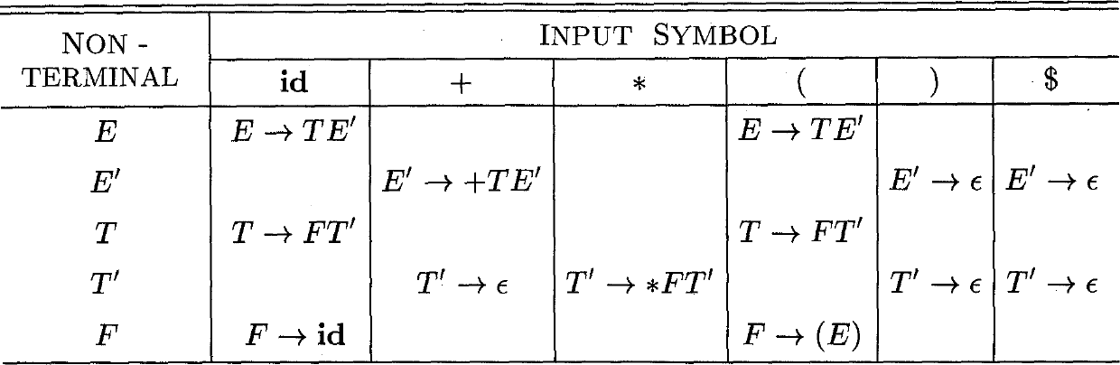
Parsing Table (预测分析表)
Recursive-descent parsers (or LL parsers) are table-based parsers
A predictive parsing table is a two-dimensional array that determines which production the parser should choose when it sees a nonterminal A and a symbol 𝑎 on its input stream
The parsing table of an LL(1) parser has no entries with multiple productions
Notes:
递归下降语法分析器（或LL分析器）是基于表的解析器
预测分析表是一个二维数组，用于确定解析器在看到非终结符A和符号a时应该选择哪个产生式
LL(1)解析器的预测分析表没有包含多个产生式的条目

Slide 75
Parsing Table Construction
The following algorithm can be applied to any CFG
Input: Grammar 𝐺 Output: Parsing table 𝑀
Method:
For each production 𝐴 → 𝛼 of 𝐺, do the following:
For each terminal 𝑎 in FIRST(𝛼), add 𝐴 → 𝛼 to 𝑀[𝐴, 𝑎]
If 𝜖 is in FIRST(𝛼), then for each terminal 𝑏 (including the right endmarker $) in FOLLOW(𝐴), add 𝐴 → 𝛼 to 𝑀[𝐴, 𝑏]
Set all empty entries in the table to error
Notes:
构造预测分析表
以下算法可以应用于任何CFG
输入：文法G
输出：预测分析表M
方法：对于每个产生式𝐴 → 𝛼 ，进行以下处理：
执行以下操作：
·对于FIRST(𝛼)中每个终结符𝑎，将𝐴 → 𝛼加入到𝑀[𝐴, 𝑎]
· 如果𝜖在FIRST(𝛼)中，对于FOLLOW(𝐴)中每个终结符b，包括$，将𝐴 → 𝛼加入到𝑀[𝐴, b]
将表中的所有空条目设置为错误

Slide 76
Parsing Table Construction Example
Grammar
𝐸 → 𝑇𝐸′
𝑇 → 𝐹𝑇′
𝐸′→ +𝑇𝐸′ | 𝜖
𝑇′ →∗ 𝐹𝑇′ | 𝜖
𝐹 → 𝐸 | 𝐢𝐝
𝐸′ : {+, 𝜖}
𝑇, 𝑇′: {+, $, )}
FIRST sets: 𝐸, 𝑇, 𝐹: {(, 𝐢𝐝}
FOLLOW sets: 𝐸, 𝐸′: {$, )}
𝑇′ : {∗, 𝜖}
𝐹: {∗, +, $, )}
For 𝐸 → 𝑇𝐸′:
FIRST 𝑇𝐸′
= FIRST(𝑇)
= {(, 𝐢𝐝}
Notes:
预测分析表构造示例

Slide 77
Parsing Table Construction Example
Grammar
𝐸 → 𝑇𝐸′
𝑇 → 𝐹𝑇′
𝐸′→ +𝑇𝐸′ | 𝜖
𝑇′ →∗ 𝐹𝑇′ | 𝜖
𝐹 → 𝐸 | 𝐢𝐝
𝐸′ : {+, 𝜖}
𝑇, 𝑇′: {+, $, )}
FIRST sets: 𝐸, 𝑇, 𝐹: {(, 𝐢𝐝}
FOLLOW sets: 𝐸, 𝐸′: {$, )}
𝑇′ : {∗, 𝜖}
𝐹: {∗, +, $, )}
For 𝐸′ → 𝜖:
𝜖 in FIRST(𝜖) FOLLOW 𝐸′
= {$, )}

Slide 78
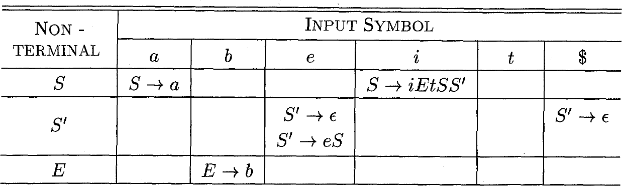
Conflicts in Parsing Tables
Grammar: 𝑆 → 𝐢𝐸𝐭𝑆𝑆′ | 𝐚 𝑆′ → 𝐞𝑆 | 𝜖 𝐸 → 𝐛
FIRST(𝐞𝑆) = {𝐞}, so we add 𝑆′ → 𝐞𝑆 to 𝑀[𝑆′, 𝐞]
FOLLOW(𝑆′) = {$, 𝐞}, so we add 𝑆′ → 𝜖 to 𝑀[𝑆′, 𝐞]
LL(1) grammar is never ambiguous.
This grammar is not LL(1). The language has no LL(1) grammar !!!
Notes:
预测分析表中的冲突
LL(1)文法不存在二义性

Slide 79
Conflicts in Parsing Tables
Grammar: 𝑆 → 𝐢𝐸𝐭𝑆𝑆′ | 𝐚 𝑆′ → 𝐞𝑆 | 𝜖 𝐸 → 𝐛
FIRST(𝐞𝑆) = {𝐞}, so we add 𝑆′ → 𝐞𝑆 to 𝑀[𝑆’, 𝐞]
FOLLOW(𝑆′) = {$, 𝐞}, so we add 𝑆′ → 𝜖 to 𝑀[𝑆’, 𝐞]
Solution: Choose 𝑆’ → 𝑒𝑠 to resolve ambiguity (associating an else
with the closest previous then)
Notes:
解决方案：选择𝑆’ → 𝑒𝑠 解决歧义（将else与最接近的前一个then关联）

Slide 80
Recursive-Descent Parsing for LL(1) Grammars
Replace line 1 with: Choose A-production according to the parse table
Assume input symbol is 𝑎, then the choice is the production in 𝑀[𝐴, 𝑎]
Notes:
LL(1)文法的递归下降语法分析
将第1行替换为：根据预测分析表选择A-产生式
假设输入符号为𝑎, 那么选择𝑀[𝐴, 𝑎]中的产生式

Slide 81
Outline
Introduction
Context-Free Grammars
Overview of Parsing Techniques
Top-Down Parsing
Bottom-Up Parsing
Parser Generators (to be discussed in lab sessions)
Recursive-descent parsing
Non-recursive predictive parsing
Notes:
递归下降的语法分析
非递归的预测分析

Slide 82
Non-Recursive Predictive Parsing
Recursive-descent parsing has recursive calls. Can we design a non-recursive parser?
Notes:
递归下降的语法分析具有递归调用。
我们能设计一个非递归解析器吗？

Slide 83
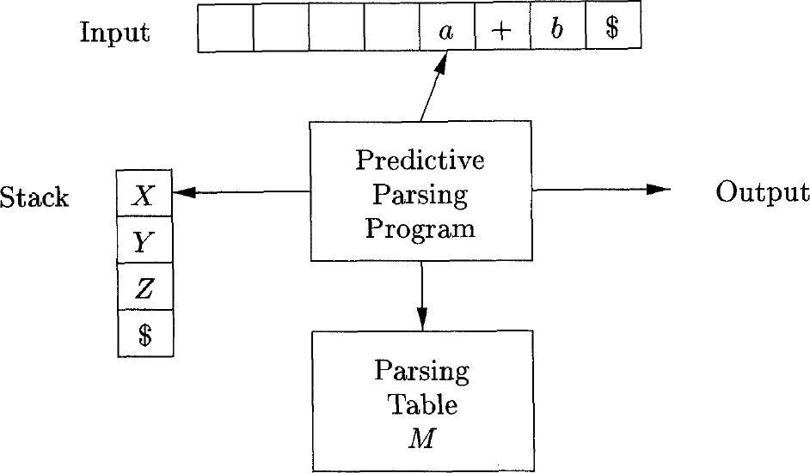
Non-Recursive Predictive Parsing
A non-recursive predictive parser can be built by explicitly maintaining a stack (not implicitly via recursive calls)
Input buffer contains the string to be parsed, ending with $
Stack holds a sequence of grammar symbols with $ at the bottom. Initially, the stack contains only $ and the start symbol 𝑆 on top of $
Notes:
非递归的预测分析器可以通过显式维护堆栈（而不是通过递归调用隐式维护）来构建
· 输入缓冲区包含要解析的字符串，以$结尾
· 堆栈包含底部为$的语法符号序列。
最初，堆栈只包含$和在$顶部的开始符号𝑆

Slide 84
Table-Driven Predictive Parsing
Input: A string 𝜔 and a parsing table 𝑀 for grammar 𝐺
Output: If 𝜔 is in 𝐿(𝐺), a leftmost derivation of 𝜔; otherwise, an error indication
Initially, the input buffer contains 𝜔$.
The start symbol 𝑆 of 𝐺 is on top of the stack, above $.
Notes:
表驱动的预测语法分析
输入：字符串𝜔 和文法G的预测分析表M
输出：如果𝜔 在𝐿(𝐺)中, 输出𝜔的一个最左边推导; 否则，给出一个错误指示
最初，输入缓冲区包含𝜔$
开始符号𝑆 位于堆栈顶部，在$上方。

Slide 85
Parsing Algorithm
let 𝑎 be the first symbol of 𝜔;
let 𝑋 be the top stack symbol;
while ( 𝑋 ≠ $ ) { /* stack is not empty */
if ( 𝑋 = 𝑎 ) pop the stack and let 𝑎 be the next symbol of 𝜔;
else if ( 𝑋 is a terminal) error(); /* 𝑋 can only match 𝑎 */
else if ( 𝑀[𝑋, 𝑎] is an error entry ) error();
7. else if ( 𝑀 𝑋, 𝑎 = 𝑋 → 𝑌₁𝑌₂ … 𝑌_{𝑘} ) {
output the production 𝑋 → 𝑌₁𝑌₂ … 𝑌_{𝑘} ;
pop the stack;
push 𝑌_{𝑘} , 𝑌_{𝑘-1}, …, 𝑌₁ onto the stack, with 𝑌₁ on top; /* order is critical */
11. }
12. let 𝑋 be the top stack symbol;
13. }
Notes:
分析算法

Slide 86
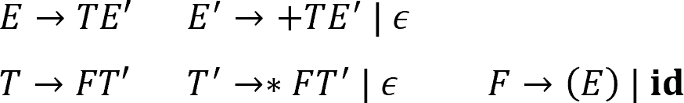
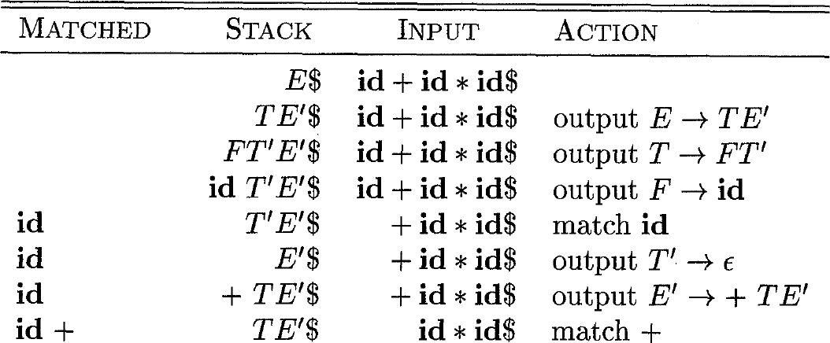
Example
Input:
𝐢𝐝 + 𝐢𝐝 ∗ 𝐢𝐝
Matched part
+
Stack content (from top to bottom)
=
A left-sentential form
总是最左句型
Notes:
匹配部分+栈内容（从顶部到底部）=总是最左句型

Slide 87
Outline
Introduction
Context-Free Grammars
Overview of Parsing Techniques
Top-Down Parsing
Bottom-Up Parsing (Recall & A Detailed Look)
Parser Generators (to be discussed in lab sessions)
Notes:
自底向上分析

Slide 88
Bottom-Up Parsing
Problem definition: Constructing a parse tree for an input string beginning at the leaves (terminals) and working up towards the root (start symbol of the grammar)
Equivalent to finding a rightmost derivation (in reverse) for an input string
Shift-reduce parsing (移入-归约分析技术) is a general style of bottom-up parsing (using a stack to hold grammar symbols)
Notes:
自底向上的语法分析
问题定义：为输入字符串构建一个从叶子（终结符）开始并向上延伸到根（语法的开始符号）的语法分析树
· 相当于为输入字符串找到最右边的推导（相反）
移入-归约分析技术是一种自底向上语法分析的通用方式（使用栈来保存语法符号）

Slide 89
Reductions (归约)
Bottom-up parsing can be seen as a process of “reducing” a string 𝜔 to the start symbol of the grammar
At each reduction step, a specific substring (at the top of the stack) matching the body of a production is replaced by the head of the production (the reverse of a step in derivation)
Key decisions in bottom-up parsing:
When to reduce? What production to apply?
Notes:
自底向上语法分析可以看作是一个将字符串𝜔“归约”到开始符号的过程
在每一个归约步骤中，与产生式体匹配的特定子串（位于栈顶部）会被产生式的头部替换（与推导步骤相反）

Slide 90
Illustration of Challenges
For sentential form 𝑇 ∗ 𝐢𝐝, there are two applicable productions:
𝑇 is the body of 𝐸 → 𝑇
𝐢𝐝 is the body of 𝐹 → 𝐢𝐝
Why reducing 𝐢𝐝 to 𝐹, instead of reducing 𝑇 to 𝐸?
Reason: If reducing 𝑇 to 𝐸, 𝐸 ∗ 𝐢𝐝 is no longer a sentential form
Challenge: how do we know this before making choices?
Notes:
对于句型𝑇 ∗ 𝐢𝐝, 有两个适用的产生式：
T是𝐸 → 𝑇的体
𝐢𝐝是𝐹 → 𝐢𝐝的体
为什么把id归约为𝐹，而不是将𝑇归约为𝐸
· 原因：如果将𝑇归约为𝐸，𝐸 ∗ 𝐢𝐝不再是句型
· 在这之前我们如何作决定？

Slide 91
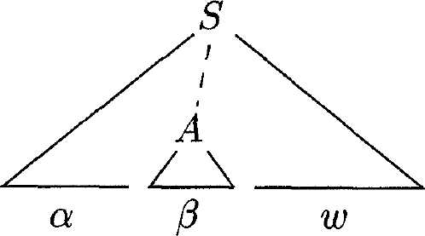

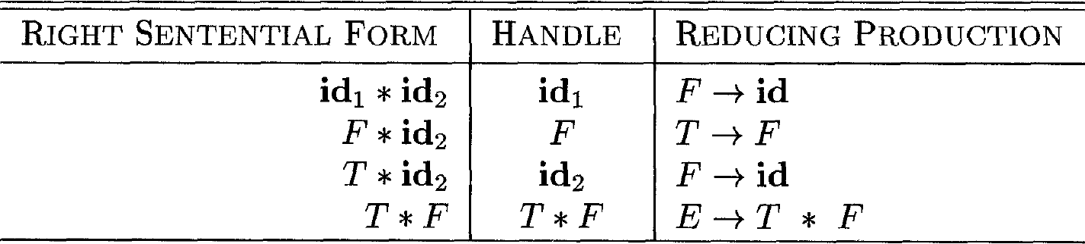
Handles (句柄)
Informally, a substring that matches the body of a production, and whose reduction represents one step along the reverse of a rightmost derivation
Formally, if , then production 𝐴 → 𝛽 (or simply 𝛽) in the position following 𝛼 is a handle of the sentential form 𝛼𝛽𝜔
Notes:
非正式地讲，句柄是和某个产生式体匹配的子串，对它的归约代表了相应的最右推导中的一个反向步骤
正式地讲，如果S->*rm 𝛼A𝜔 ->rm 𝛼𝛽𝜔，那么紧跟𝛼的产生式𝐴 → 𝛽 （或者简单地𝛽) 是句型𝛼𝛽𝜔的一个句柄

Slide 92
Handle Pruning (句柄剪枝)
In a right-sentential form (最右句型), the string to the right of the handle must contain only terminal symbols
If a grammar is unambiguous, every right-sentential form of the grammar has exactly one handle*
A rightmost derivation in reverse (bottom-up parsing) can be obtained by “handle pruning”
In every step:
Locate the handle
Replace it by production head
* Given an unambiguous grammar, a right-sentential form can only be derived in one way
Notes:
在最右句型中， 句柄右侧的字符串必须仅包含终结符号
如果一个文法是无二义性的，那么该文法的每个右句型都有且只有一个句柄（如果文法二义，句柄可能不唯一）
通过句柄剪枝可以得到一个反向的最右推导

Slide 93
Shift-Reduce Parsing
Shift-reduce parsing is a general style of bottom-up parsing in which:
A stack holds grammar symbols
An input buffer holds the rest of the string to be parsed
The stack content (from bottom to top) and the input buffer content form a right-sentential form (assuming no errors)
Notes:
移入-归约语法分析技术是自底向上语法分析的一种通用方式，其中：
· 使用栈保存文法符号
· 使用输入缓冲区保存要进行语法分析的字符串的其余部分
· 栈内容（从底部到顶部）和输入缓冲区内容形成最右句型（假设没有错误）

Slide 94

Shift-Reduce Parsing
Actions:
Shift
Reduce
Accept
Error
STACK | INPUT
$ | 𝜔$
Initial status:
Shift-reduce process:
The parser shifts zero or more input symbols onto the stack, until it is ready to reduce a string 𝛽 (a handle) on top of the stack*
Reduce 𝛽 to the head of the appropriate production
The parser repeats the above cycle until it has detected an error or the stack contains the start symbol and input is empty
* During shift-reduce parsing, the handle will always eventually appear on top of the stack
Notes:
初始状态：
移入-归约过程：
· 语法分析器将零个或多个输入符号转移到栈顶上，直到它可以对栈顶的一个文法符号串𝛽进行归约为止
· 将𝛽归约为某个产生式的头
语法分析器重复上述循环，直到检测到错误或栈包含开始符号且输入为空
*在移入-归约解析过程中，句柄最终总是出现在栈的顶部

Slide 95
Example
Parsing steps on input 𝐢𝐝₁ ∗ 𝐢𝐝₂
Notes:
示例

Slide 96
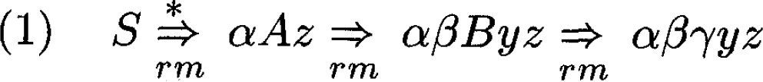
Why Handles Always Appear at Stack Top?
(Analysis by enumeration) Consider the possible forms of two successive steps in any rightmost derivation*
Step 1: the rightmost nonterminal 𝐴 is replaced by a string with nonterminals. Suppose 𝐵 is the rightmost nonterminal in the string.
Step 2: 𝐵 is replaced by a string 𝛾
Step 1: the rightmost nonterminal 𝐴 is replaced by a string 𝑦 with terminals only.
Step 2: the next rightmost nonterminal 𝐵 (somewhere to the left of 𝑦) is replaced by a string 𝛾
* The analysis is trivial when there is only one step of derivation
Notes:
为什么句柄总是出现在栈顶？
（枚举分析）考虑在任何最右推导中两个连续步骤的可能具有的形式
情况1：
步骤1：最右边的非终结符𝐴 被一个带有非终结符的字符串替换。假设𝐵 是字符串中最右边的非终结符。
步骤2：𝐵 被替换为𝛾
情况2：
步骤1：最右边的非终结符𝐴 被替换为𝑦，𝑦中仅包含终结符。
步骤2：下一个最右边的非终结符𝐵 将位于𝛾左侧的某个地方

Slide 97
Why Handles Always Appear at Stack Top?
STACK | INPUT | ACTION
… | … | …
$𝛼𝛽𝛾 | 𝑦𝑧$ | Reduce
$𝛼𝛽𝐵 | 𝑦𝑧$ | Shift
$𝛼𝛽𝐵𝑦 | 𝑧$ | Reduce
$𝛼𝐴 | 𝑧$ | Shift
… | … | …
STACK | INPUT | ACTION
… | … | …
$𝛼𝛾 | 𝑥𝑦𝑧$ | Reduce
$𝛼𝐵 | 𝑥𝑦𝑧$ | Shift
$𝛼𝐵𝑥 | 𝑦𝑧$ | Shift
$𝛼𝐵𝑥𝑦 | 𝑧$ | Reduce
$𝛼𝐵𝑥𝐴 | 𝑧$ | Shift
… | … | …
𝑥, 𝑦, 𝑧 are strings of terminals
Notes:
在这两种情况下，语法分析器在进行一次归约后，都必须接着移入零个或多个符号才能在栈顶找到下一个句柄。因此它不需要到栈中间去寻找句柄。

Slide 98
Conflicts During Shift-Reduce Parsing
There are context-free grammars for which shift-reduce parsing cannot be used
Every shift-reduce parser for such a grammar can reach a configuration in which the parser, knowing the entire stack and also the next 𝑘 input symbols, cannot decide
Whether to shift or to reduce (shift/reduce conflicts, 移入/归约冲突)
Which of several possible reductions to make (reduce/reduce conflicts, 归约/归约冲突)
Notes:
移入-归约语法分析中的冲突
有些上下文无关文法不能使用移入-归约语法分析技术
这种文法的每一个移入-归约语法分析器都会达到这样一种格局：即使移入-归约语法分析器知道整个栈的内容以及下一个输入符号k，仍然无法决定是进行移入还是归约（移入/归约冲突）或者无法在多个可能的归约方法中选择正确的归约动作（归约/归约冲突）

Slide 99
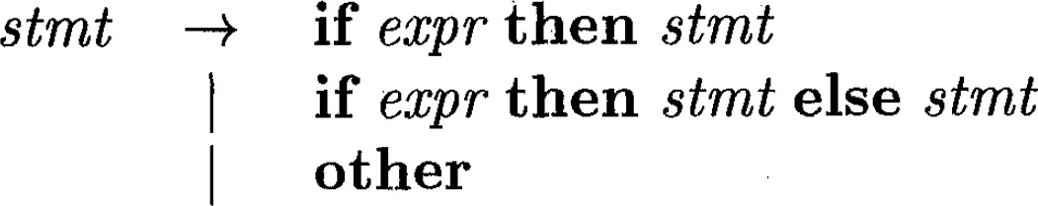
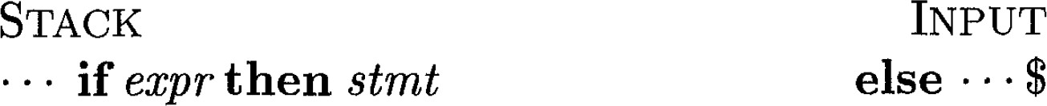
Shift/Reduce Conflict Example
Reduce or shift? What if there is a 𝑠𝑡𝑚𝑡 after 𝐞𝐥𝐬𝐞?
Notes:
移入/归约冲突示例，是应该把栈内的进行规约还是继续移入？

Slide 100
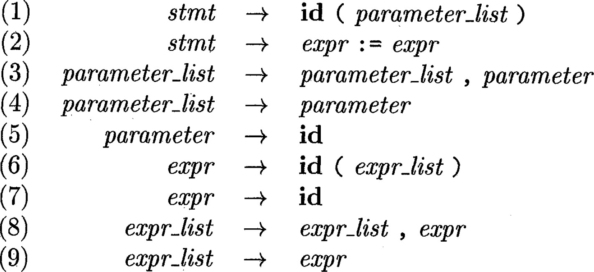
Reduce/Reduce Conflict Example
Parsing input 𝐢𝐝(𝐢𝐝, 𝐢𝐝)
STACK | INPUT
$𝐢𝐝(𝐢𝐝 | , 𝐢𝐝$
Reduce by which production?
Notes:
归约/归约冲突示例，不知用哪个产生式进行规约

Slide 101
Outline
Introduction
Context-Free Grammars
Overview of Parsing Techniques
Top-Down Parsing
Bottom-Up Parsing
Parser Generators (to be discussed in lab sessions)
Simple LR (SLR)
Canonical LR (CLR)
Error Recovery
Notes:
简单LR
规范LR
错误恢复

Slide 102
LR Parsing (LR语法分析技术)
LR(k) parsers: the most prevalent type of bottom-up parsers
L: left-to-right scan of the input
R: construct a rightmost derivation in reverse
k: use k input symbols of lookahead in making parsing decisions
LR(0) and LR(1) parsers are of practical interest
When 𝑘 ≥ 2, the parser becomes too complex to construct (parsing table will be too huge to manage)
Notes:
LR(k)语法分析器：最流行的自底向上的语法分析器类型
· L： 从左到右扫描输入
· R： 反向构造最右推导
· k： 在做出解析决策时使用k个前瞻性输入符号
LR(0)和LR(1)语法分析器具有实际意义
当𝑘 ≥ 2时，语法分析器变得太复杂，无法构建（解析表太大，无法管理）

Slide 103
Advantages of LR Parsers
Table-driven (like non-recursive LL parsers) and powerful
Although it is too much work to construct an LR parser by hand, there are parser generators to construct parsing tables automatically
Comparatively, LL parsers tend to be easier to write by hand, but less powerful (handle fewer grammars)
LR-parsing is the most general nonbacktracking shift-reduce parsing method known
LR parsers can be constructed to recognize virtually all programming language constructs for which CFGs can be written
LR grammars can describe more languages than LL grammars
Recall the stringent conditions for a grammar to be LL(1)
Notes:
LR语法分析器的优势
· 表驱动（类似于非递归LL语法分析器）、强大
· 尽管手工构建LR语法分析器工作量太大，但也有一些语法分析器生成器可以自动构建语法分析表
· 相比之下，LL语法分析器往往更容易手工编写，但功能较弱（处理的语法较少）
· LR语法分析技术是已知的最通用的非回溯移入-归约语法分析方法
· LR语法分析器可以被构造为识别几乎所有可以为其编写CFG的编程语言结构
· LR语法比LL语法可以描述更多的语言
· 回想文法成为LL(1)的严格条件

Slide 104
When to Shift/Reduce?
Parsing input 𝐢𝐝₁ ∗ 𝐢𝐝₂
How does a shift/reduce parser know that 𝑇 on stack top is not a handle (so the right action is to shift, not reducing 𝑇 to 𝐸)?
Notes:
移入-归约语法分析器如何知道𝑇 栈顶上没有句柄（所以正确的操作是移入，而不是归约𝑇 到𝐸)?

Slide 105
LR(0) Items (LR(0)项)
An LR parser makes shift-reduce decisions by maintaining states
to keep track of what have been seen in a parse
An LR(0) item (item for short) is a production with a dot at some position of the body, indicating how much we have seen at a given point in the parsing process
𝐴 → ∙ 𝑋𝑌𝑍 𝐴 → 𝑋 ∙ 𝑌𝑍 𝐴 → 𝑋𝑌 ∙𝑍 𝐴 → 𝑋𝑌𝑍 ∙
𝐴 → 𝑋 ∙ 𝑌𝑍: we have just seen on the input a string derivable from 𝑋
and we hope to see a string derivable from 𝑌𝑍 next
States: sets of LR(0) items (LR(0)项集)
The production 𝐴 → 𝜖 generates only one item 𝐴 → ·
Notes:
一个LR语法分析器通过维护一些状态来跟踪在语法分析中所处的位置，从而来做出移入-归约的决策。
LR(0)项（简称item）是产生式再加上一个位于它的体中某处的点，表示在语法分析过程中的给定点上，我们已经看到了一个产生式的哪些部分。
𝐴 →} 𝑋𝑌𝑍𝐴 → 𝑋 } 𝑌𝑍𝐴 → 𝑋𝑌 } 𝑍𝐴 → 𝑋𝑌𝑍 }
𝐴 → 𝑋 } 𝑌𝑍: 我们刚刚在输入中看到了一个可以由X推导得到的字符串，我们希望接下来看到一个能从YZ推导得到的字符串
状态：LR(0)项集
产生式𝐴 → 𝜖 仅生成一个item 𝐴 → ·

Slide 106
Canonical LR(0) Collection
One collection of sets of LR(0) items, called the canonical LR(0) collection (规范LR(0)项集族), provides the basis for constructing a DFA that is used to make parsing decisions
To construct canonical LR(0) collection for a grammar, we need to define:
An augmented grammar (增广文法)
Two functions:
(1) CLOSURE of item sets (项集闭包)
(2) GOTO
Notes:
规范LR(0)项集族
LR(0)项集合的一个集合，称为规范LR(0)项集族, 为构建用于做出语法分析决定的DFA提供了基础
为了构造文法的LR(0)项集规范族，我们需要定义：
· 增广文法
· 两个函数：（1）项集闭包的CLOSURE 和（2）GOTO

Slide 107
Augmented Grammar
Augmenting a grammar 𝐺 with start symbol 𝑆
Introduce a new start symbol 𝑆’ to replace 𝑆
Add a new production 𝑆’ → 𝑆
Obviously, 𝐿(𝐺) = 𝐿(𝐺’)
Benefit: With the augmentation, acceptance occurs when and only when the parser is about to reduce by 𝑆’ → 𝑆
Otherwise, acceptance could occur at many points since there may be multiple 𝑆-productions
Notes:
增广文法
增广一个以S为开始符号的文法G：
· 引入一个新开始符号S‘代替S
· 增加产生式S‘ -> S
明显地𝐿(𝐺)=𝐿(𝐺’)
优点：通过增广，只有当语法分析器使用𝑆’ → 𝑆进行归约时输入符号串被接受。否则，输入符号串可能在多处被接受，因为可能存在多个𝑆-产生式

Slide 108
Closure of Item Sets
If 𝐼 is a set of items for a grammar 𝐺, then CLOSURE(𝐼) is the set of items constructed from 𝐼 by the two rules
Initially, add every item in 𝐼 to CLOSURE(𝐼)
If 𝐴 → 𝛼 · 𝐵𝛽 is in CLOSURE(𝐼) and 𝐵 → 𝛾 is a production, then add the item
𝐵 → · 𝛾 to CLOSURE(𝐼), if it is not already there. Apply this rule until no more new items can be added to CLOSURE(𝐼)
Intuition: 𝐴 → 𝛼 · 𝐵𝛽 indicates that we hope to see a substring derivable from 𝐵𝛽. This substring will have a prefix derivable from 𝐵. Therefore, we add items for all 𝐵-productions.
Notes:
项集闭包
如果𝐼 是文法𝐺的一组项集, 那么CLOSURE(𝐼)就是按照下面两条规则构造的项集：
1. 一开始，将𝐼中的各个项加入到CLOSURE(𝐼)
2. 如果𝐴 → 𝛼 · 𝐵𝛽在CLOSURE(𝐼)中，𝐵 → 𝛾是一个产生式，并且𝐵 → ·𝛾不在CLOSURE(𝐼)中，那么将𝐵 → ·𝛾加入CLOSURE(𝐼)中。不断应用这条规则，直到没有新项可以加入到
直观地讲：𝐴 → 𝛼 · 𝐵𝛽 表示我们希望看到从一个能够从𝐵𝛽推导得到的子串。这个子串的某个前缀可以从B推导得到。因此，我们将所有𝐵-产生式加入到项集。

Slide 109
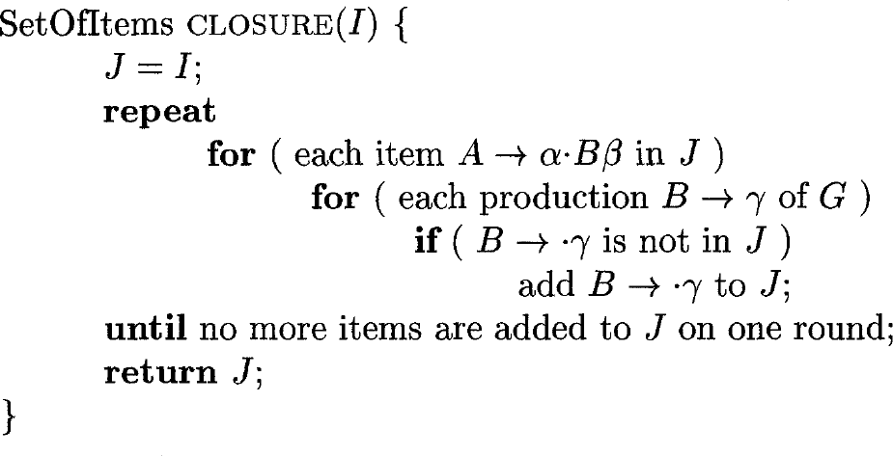
Algorithm for CLOSURE(𝐼)
// the earlier natural language description is already clear enough

Slide 110
Example
Augmented grammar
𝐸’ → 𝐸 𝐸 → 𝐸 + 𝑇 | 𝑇
𝑇 → 𝑇 ∗ 𝐹 | 𝐹
𝐹 → 𝐸 | 𝐢𝐝
Computing the closure of the item set {[𝐸’ →· 𝐸]}
Initially, [𝐸’ →· 𝐸] is in the closure
Add [𝐸 →· 𝐸 + 𝑇] and [𝐸 → · 𝑇] to the closure
Add [𝑇 → · 𝑇 ∗ 𝐹] and [𝑇 → · 𝐹] to the closure
Add [𝐹 → · (𝐸)] and [𝐹 → · 𝐢𝐝] to the closure (reached fixed point)

Slide 111
The Function GOTO
𝐆𝐎𝐓𝐎(𝑰, 𝑿), where 𝐼 is a set of items and 𝑋 is a grammar symbol, is defined to be the closure of the set of all items 𝐴 → 𝛼𝑋 · 𝛽 such that [𝐴 → 𝛼 · 𝑋𝛽] is in 𝐼
𝐶𝐿𝑂𝑆𝑈𝑅𝐸( 𝐴 → 𝛼𝑋 · ········𝛽 𝐴 → 𝛼 · 𝑋𝛽 ∈ 𝐼})
Example: Computing GOTO(𝐼, +) for 𝐼 = { 𝐸' → 𝐸 · , [𝐸 → 𝐸 · +𝑇]}
There is only one item 𝐸 → 𝐸 ·+𝑇 , in which + follows ·
Then compute the CLOSURE({ 𝐸 → 𝐸 +· 𝑇 }), which contains
o 𝐸 → 𝐸 +· 𝑇
o 𝑇 → · 𝑇 ∗ 𝐹 , 𝑇 → · 𝐹
o 𝐹 → · (𝐸) , 𝐹 →· 𝐢𝐝
Notes:
GOTO函数
返回项目集I对应于文法符号X的后继项目集闭包

Slide 112
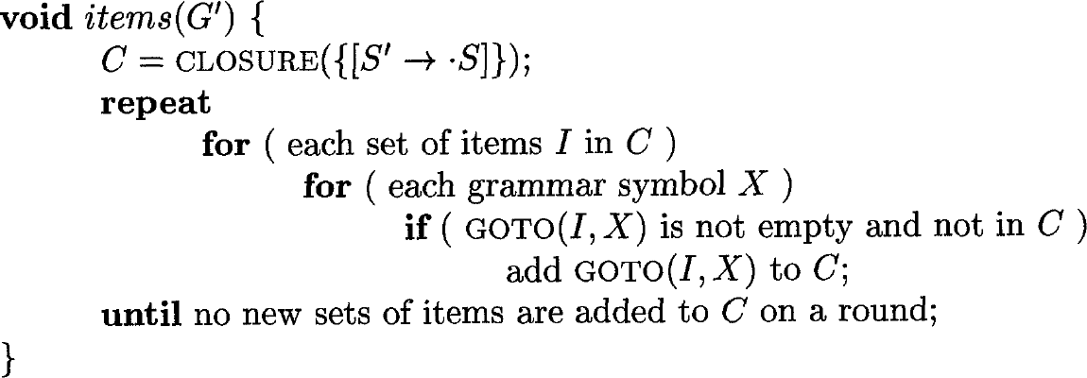
Constructing Canonical LR(0) Collection
{
};
Initial item set
Iteratively find all possible GOTO targets (corresponding to states in the automaton for parsing)
Notes:
构造规范LR(0)项集族
迭代查找所有可能的GOTO目标（对应于用于语法分析的自动机中的状态）

Slide 113
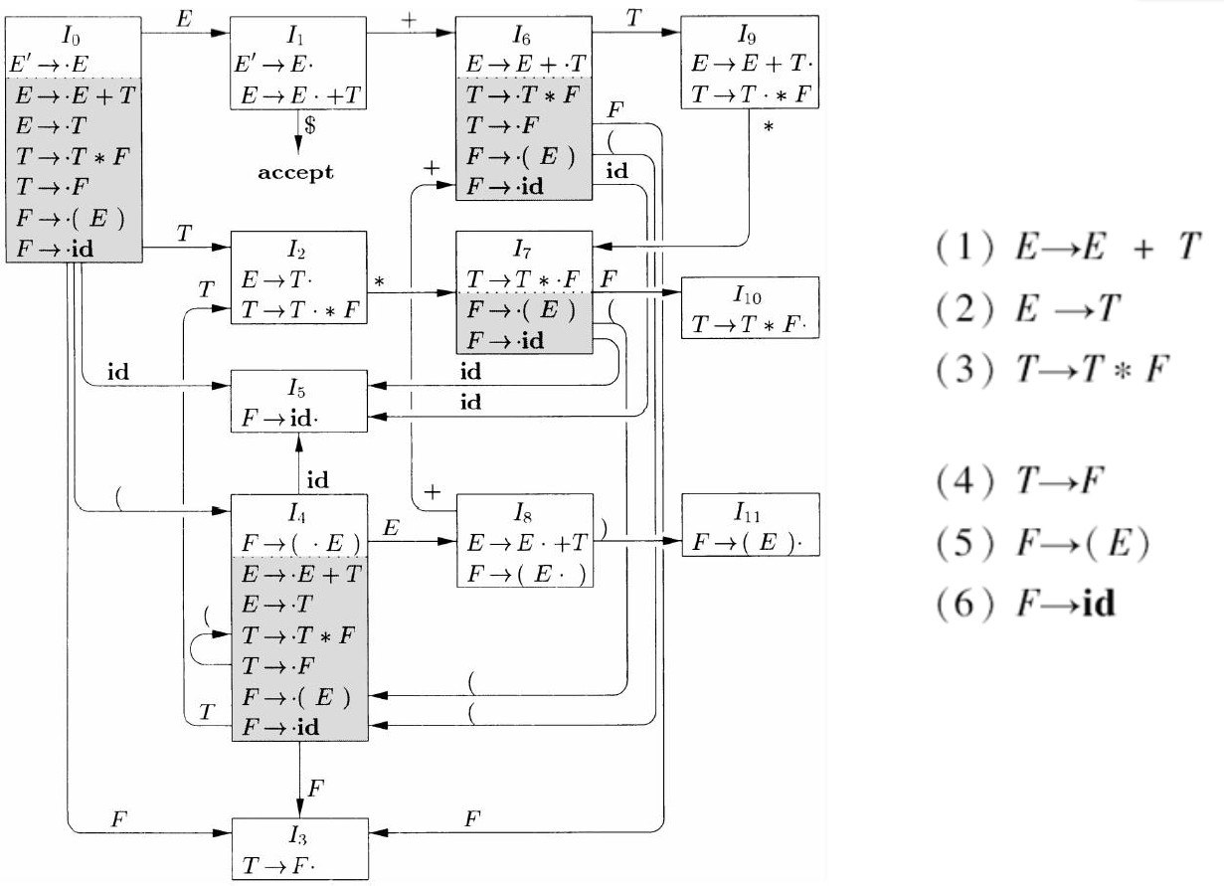
The canonical LR(0) collection for the grammar below is {𝐼₀, 𝐼₁, … , 𝐼₁₁}
Example

Slide 114
LR(0) Automaton
The central idea behind “Simple LR”, or SLR, is constructing the LR(0) automaton from the grammar
The states are the item sets in the canonical LR(0) collection
The transitions are given by the GOTO function
The start state is CLOSURE({𝑆’ →· 𝑆})
Notes:
LR(0)自动机
“简单LR语法分析技术”（即SLR分析技术）的中心思想是根据文法构造出LR(0)自动机。
· 这个自动机的状态是规范LR(0)项集族
· 它的转换由GOTO函数给出
· 开始状态是CLOSURE({𝑆’ →· 𝑆})

Slide 115
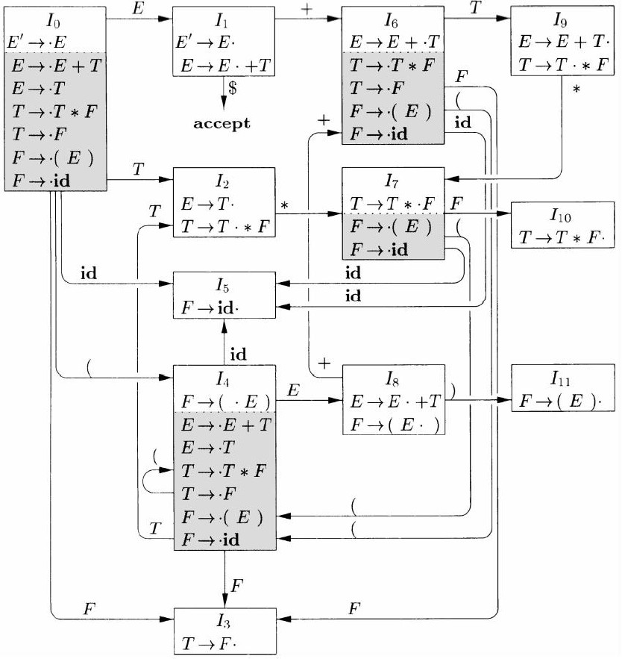
The Use of LR(0) Automaton
Helps make shift-reduce decisions:
Suppose that the string 𝛾 of grammar symbols takes the automaton from the start state 0 to some state 𝑗
Shift on next input symbol 𝑎 if state 𝑗
has a transition on 𝑎
Otherwise, reduce; the items in state 𝑗
will tell us which production to use
Notes:
LR(0)自动机的使用
帮助做出移入-归约决定：
· 假设文法符号𝛾 使自动机从开始状态0运行到某个状态𝑗
· 如果下一个输入符号为𝑎且状态𝑗有一个在𝑎上的转换，那就移入𝑎
· 否则，归约；状态𝑗的项将会告诉我们使用哪个产生式进行归约

Slide 116
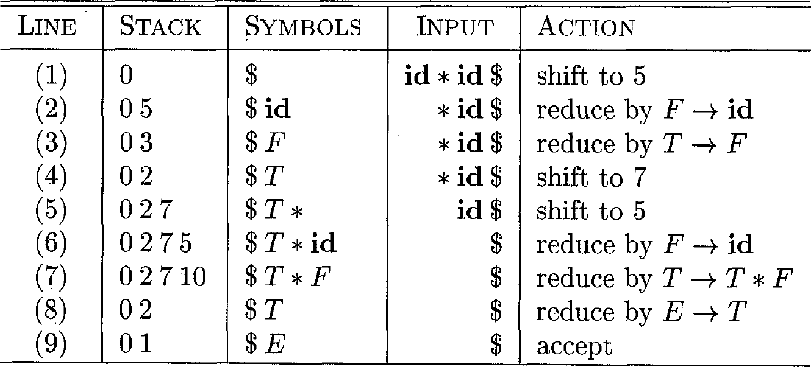
Example: Parsing 𝐢𝐝 ∗ 𝐢𝐝 (1)
We only keep states in the stack; grammar symbols can be recovered from the states
Notes:
栈只保存状态，文法符号可以从相应状态中获取
从状态0开始，移入id，进入状态5，id出栈规约为F，F进栈，状态5出栈，状态3进栈；

Slide 117
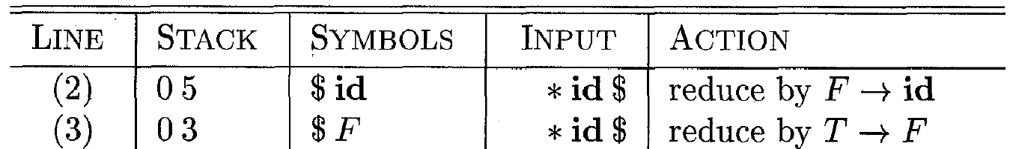
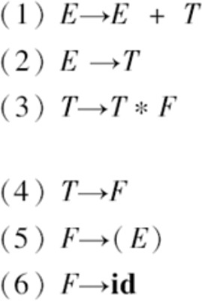
Example: Parsing 𝐢𝐝 ∗ 𝐢𝐝 (2)
Line 2: State 5 has no transition on input symbol ∗, so reduce
Pop state 5
Since id will be replaced by 𝐹, state 5 should be replaced by state 3; pop state 5 and push state 3 to stack*
*State 0 transits to 3 on F
Notes:
在第2行，状态5已压入栈中，从状态5出发没有输入*上的转换，因此选择归约。
因为id将会被F代替，状态5将会被状态3代替，所以弹出状态5，压入状态3。

Slide 118
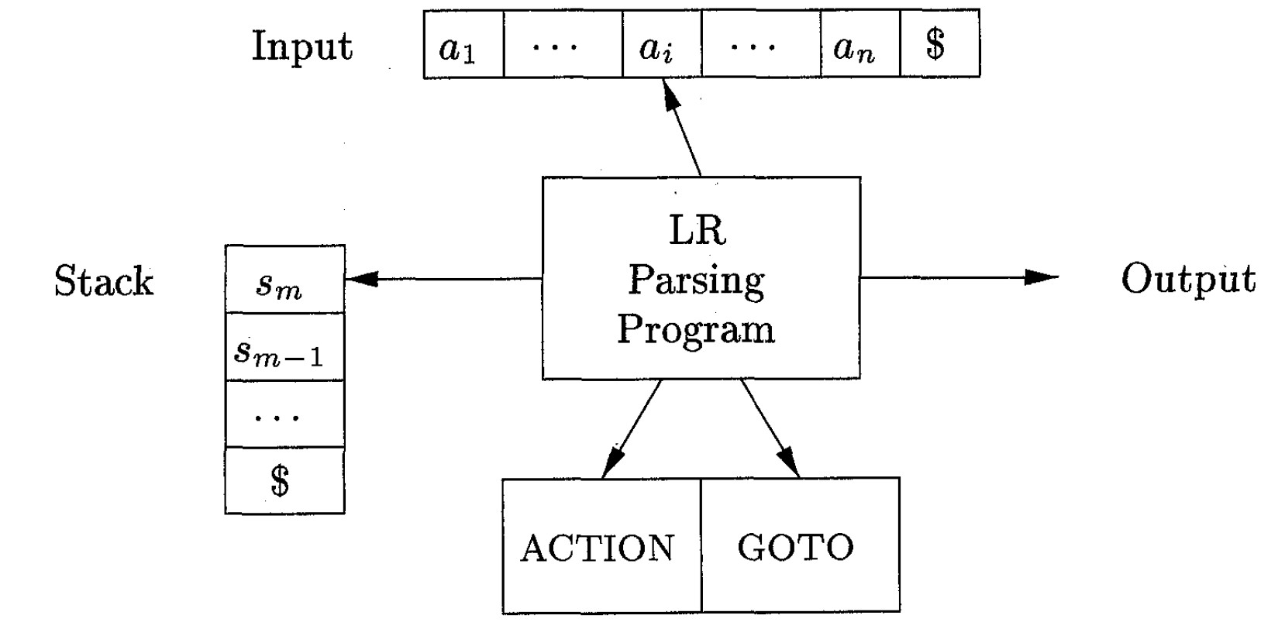
LR Parser Structure
An LR parser consists of an input, an output, a stack, a driver program, and a parsing table (ACTION + GOTO)
The driver program is the same for all LR parsers; only the parsing table changes from one parser to another
The stack holds a sequence of states
In SLR, the stack holds states from the LR(0) automaton
The parser decides the next action based on (1) the state at the top of the stack and (2) the terminal read from the input buffer
Notes:
LR语法分析器结构
LR语法分析器由一个输入、一个输出、一个栈、一个驱动程序和一个语法分析表（ACTION+GOTO）组成
所有LR语法分析器的驱动程序都是相同的；只有语法分析表随语法分析器的不同而变化
栈保存一个状态序列
在SLR中，栈保存来自LR(0)自动机的状态
语法分析器根据（1）栈顶部的状态和（2）从输入缓冲区读取的终结符来决定下一个动作

Slide 119
Parsing Table: ACTION + GOTO
The ACTION function takes two arguments: (1) a state 𝑖 and (2) a terminal 𝑎 (or $)
ACTION[𝒊, 𝒂] can have one of the four forms of values:
Shift 𝒋: shift input 𝑎 to the stack, but uses state 𝑗 to represent 𝑎
Reduce 𝑨 →𝛽: reduce 𝛽 on the top of the stack to head 𝐴
Accept: The parser accepts the input and finishes parsing
Error: syntax errors exist
The GOTO function is extended from the one defined on sets of items to states: if GOTO(𝐼_{𝑖}, 𝐴) = 𝐼_{𝑗}, then GOTO(𝑖, 𝐴) = 𝑗
Notes:
LR语法分析表：ACTION + GOTO
ACTION函数接受两个参数：（1）状态𝑖 和（2）终结符𝑎 （或$）
ACTION[𝒊, 𝒂] 可以具有以下四种形式的值之一：
· 移入𝒋: 其中𝑗是一个状态，把输入符号𝑎移入栈中，但使用状态𝑗 代表𝑎
· 归约𝑨 →𝛽: 将栈顶的𝛽归约为产生式头A
· 接受：语法分析器接受输入并完成语法分析过程
· 报错：存在语法错误
将定义在项集上的GOTO函数扩展为定义在状态集上的函数：如果GOTO(𝐼_{𝑖}, 𝐴) = 𝐼_{𝑗}，那么GOTO也把状态𝑖和一个非终结符A映射到状态𝑗

Slide 120
LR Parser Configurations (态势)
“Configuration” is notation for representing the complete state of the parser. A configuration is a pair:
Stack contents (top on the right)
(𝑠₀𝑠₁ … 𝑠_{𝑚}, 𝑎_{i}𝑎_{i+1} … 𝑎_{𝑛}$)
Remaining input
By construction, each state (except 𝑠₀) in an LR parser corresponds to a set of items and a grammar symbol (the symbol that leads to the state transition, i.e., the symbol on the incoming edges)
Suppose 𝑋_{i} is the grammar symbol for state 𝑠_{i}
Then 𝑋₀𝑋₁ … 𝑋_{𝑚}𝑎_{i}𝑎_{i+1} … 𝑎_{𝑛} is a right-sentential form (assume no errors)
Notes:
LR语法分析器的态势
“态势”是表示语法分析器完整状态的符号。态势是一个形如：(𝑠₀𝑠₁ … 𝑠_{𝑚}, 𝑎_{i}𝑎_{i+1} … 𝑎_{𝑛}$)的对
第一个分量是栈中的内容，第二个分量是余下的输入。
根据结构，每个状态（除𝑠0）对应于一组项和文法符号（导致状态转换的符号，即传入边上的符号）
· 假设𝑋_{i}是状态𝑠_{i}的文法符号
· 那么𝑋₀𝑋₁ … 𝑋_{𝑚}𝑎_{i}𝑎_{i+1} … 𝑎_{𝑛}是最右句型（假设没有错误）

Slide 121
Behavior of the LR Parser
For the configuration (𝑠₀𝑠₁ … 𝑠_{𝑚}, 𝑎_{i} 𝑎_{i+1} … 𝑎_{𝑛}$), the LR parser checks ACTION[𝑠_{𝑚}, 𝑎_{i}] in the parsing table to decide the parsing action
shift 𝑠: shift the next state 𝑠 onto the stack, entering the configuration
(𝑠₀𝑠₁ … 𝑠_{𝑚}𝑠, 𝑎_{i+1} … 𝑎_{𝑛}$)
reduce 𝐴 → 𝛽: execute a reduce move, entering the configuration (𝑠₀𝑠₁ … 𝑠_{𝑚-𝑟}𝑠, 𝑎_{i}𝑎_{i+1} … 𝑎_{𝑛}$), where 𝑟 = the length of 𝛽, and 𝑠 = GOTO(𝑠_{𝑚-𝑟}, 𝐴)
accept: parsing is completed
error: the parser has found an error and calls an error recovery routine
Notes:
LR语法分析器的行为

Slide 122
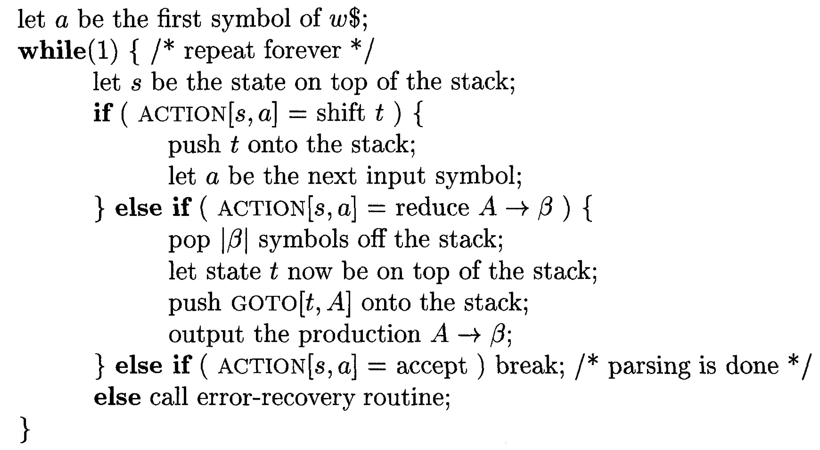
LR-Parsing Algorithm
Input: The parsing table for a grammar 𝐺 and an input string 𝜔
Output: If 𝜔 is in 𝐿(𝐺), the reduction steps of a bottom-up parse for 𝜔; otherwise, an error indication
Initial configuration: (𝑠₀, 𝜔$)
Notes:
LR语法分析算法

Slide 123
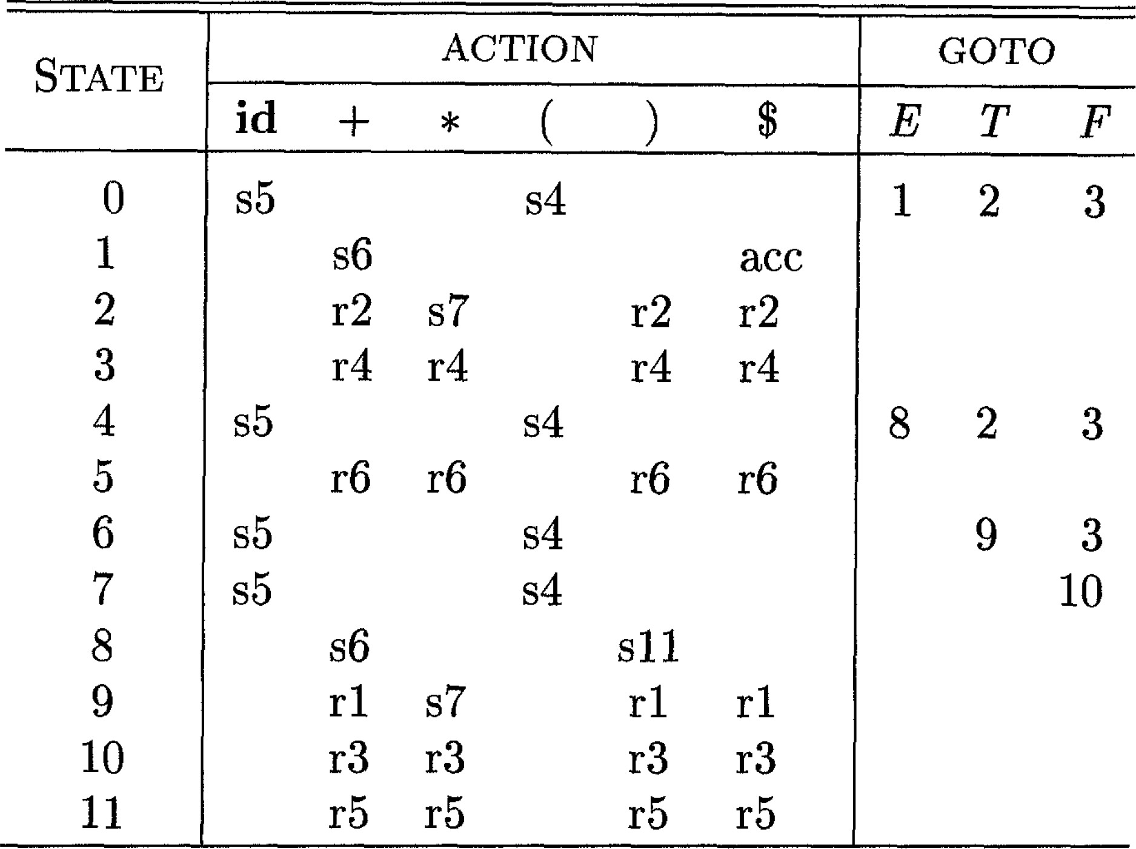
Parsing Table Example
𝑠5: shift by pushing state 5 𝑟3: reduce using production No. 3
GOTO entries for terminals are not listed, can be checked in ACTION part

Slide 124
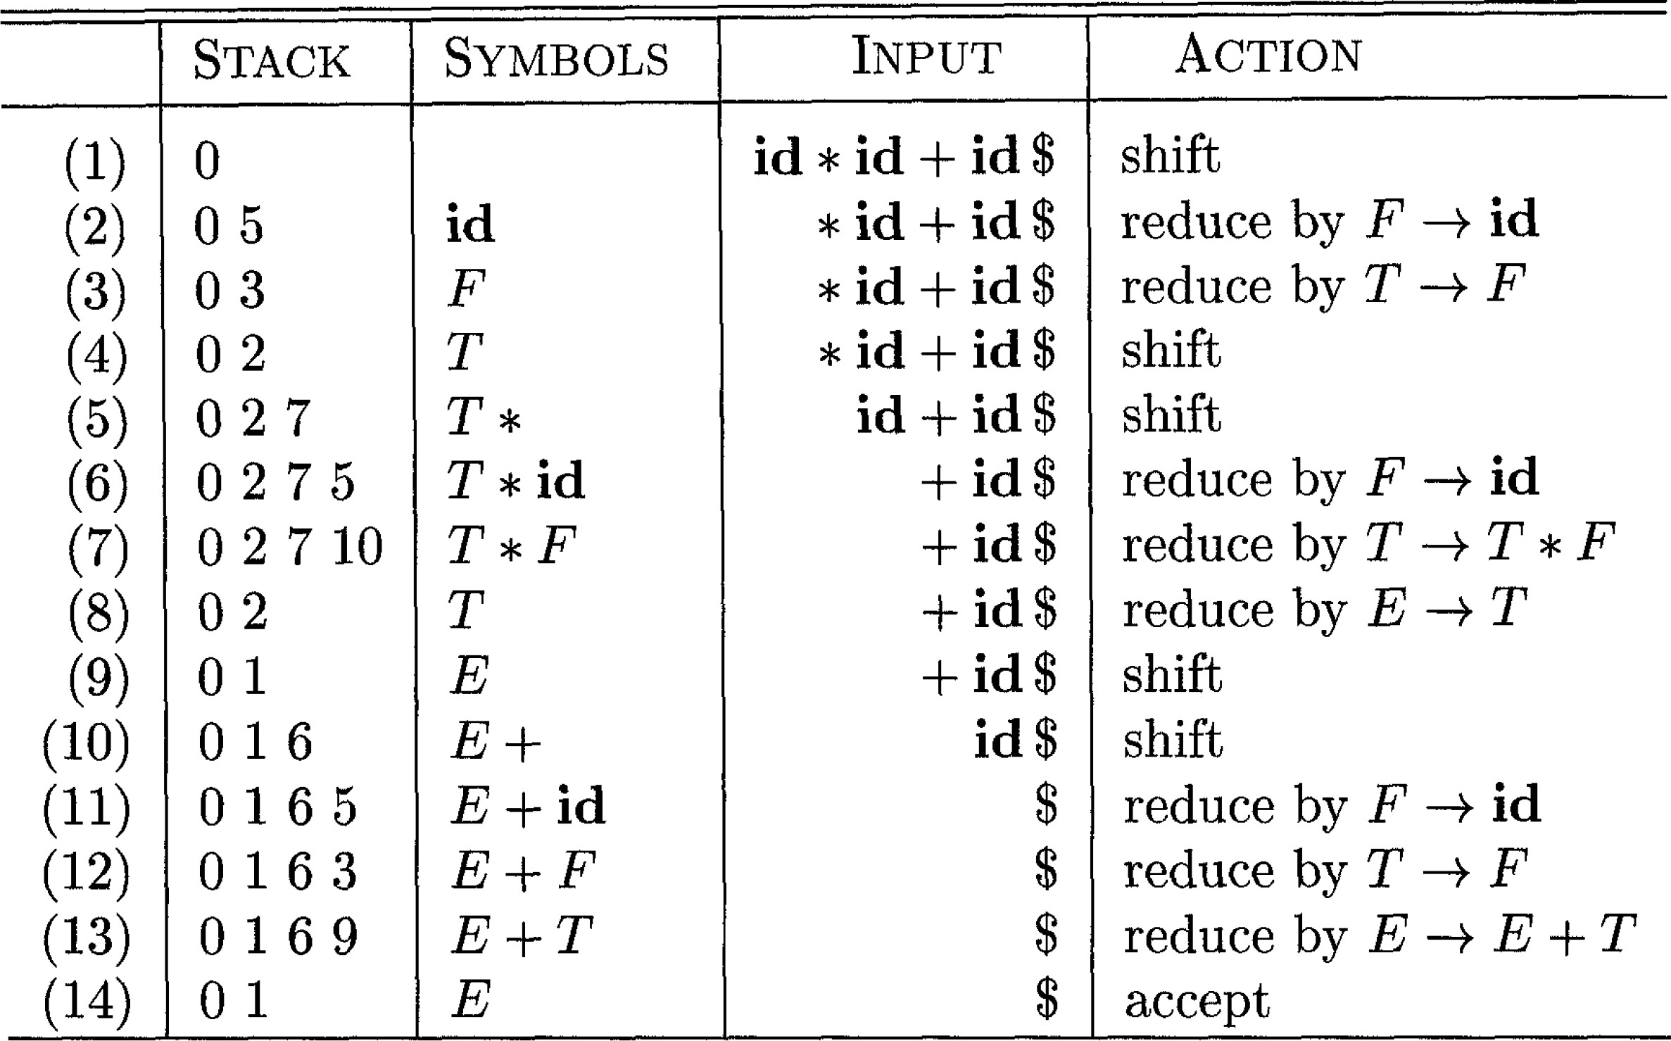
LR Parsing Example
Input string: 𝐢𝐝 ∗ 𝐢𝐝 + 𝐢𝐝
Push state 5
Remove id
Pop three states 2, 7, 10
Push state 2 (GOTO[0, 𝑇] = 2)

Slide 125
Constructing SLR-Parsing Tables (1)
The SLR-parsing table for a grammar 𝐺 can be constructed based on the LR(0) item sets and LR(0) automaton
Construct the canonical LR(0) collection {𝐼₀, 𝐼₁, … , 𝐼_{𝑛}} for the augmented grammar 𝐺’
State i is constructed from 𝐼_{i}. ACTION can be determined as follows:
If [𝐴 → 𝛼 · 𝑎𝛽] is in 𝐼_{𝑖} and GOTO 𝐼_{𝑖}, 𝑎 = 𝐼_{j}, then set ACTION 𝑖, 𝑎 to “shift j” (here 𝑎
must be a terminal)
o If [𝐴 → 𝛼·] is in 𝐼_{𝑖} , then set ACTION 𝑖, 𝑎 to “reduce 𝐴 → 𝛼” for all 𝒂 in 𝐅𝐎𝐋𝐋𝐎𝐖(𝑨); here 𝐴 may not be 𝑆’
If [𝑆’ → 𝑆·] is in 𝐼_{𝑖} , then set ACTION 𝑖, $ to “accept”
The goto transitions for state i are constructed for all nonterminals A using the rule: If GOTO 𝐼_{i}, 𝐴 = 𝐼_{𝑗}, then GOTO 𝑖, 𝐴 = 𝑗
Notes:
构造SLR语法分析表
SLR语法分析表𝐺以LR(0)项和LR(0)自动机为基础。
1. 构造增广文法G‘的规范LR(0)项集族{𝐼₀, 𝐼₁, … , 𝐼_{𝑛}}
2. 根据𝐼_{i}构造得到状态i，状态i的语法分析动作按照下面的方法决定：
· 如果[𝐴 → 𝛼 · 𝑎𝛽]在𝐼_{𝑖}中并且GOTO [𝐼_{𝑖}, 𝑎 ]= 𝐼_{j}，那么将ACTION[ 𝑖, 𝑎]设置为“移入j”
· 如果[𝐴 → 𝛼·]在𝐼_{𝑖}中，那么对于𝐅𝐎𝐋𝐋𝐎𝐖(𝑨)中的所有𝑎，将设置ACTION[ 𝑖, 𝑎]为“归约𝐴 → 𝛼”。这里𝐴不等于S’
· 如果[𝑆’ → 𝑆·]在𝐼_{𝑖}中，那么将设置ACTION[𝑖, $]为“接受”
3. 状态i对于各个非终结符号A的转换使用下面的规则构造得到：如果GOTO [𝐼_{i}, 𝐴]= 𝐼_{𝑗}，那么GOTO[𝑖, 𝐴]= 𝑗

Slide 126
Constructing SLR-Parsing Tables (2)
All entries not defined in steps 2 and 3 are set to “error”
Initial state is the one constructed from the item set containing [𝑆′ → · 𝑆]
If there is no conflict during the parsing table construction (i.e., multiple actions for a table entry), the grammar is SLR(1)
Notes:
4. 规则2、3没有定义的所有条目都设置为“报错”
5. 语法分析器的初始状态就是根据[𝑆′ → · 𝑆]所在项集构造得到的状态
如果在语法分析构造过程中没有冲突（即，一个表项的多个条目），则语法为SLR（1）

Slide 127
Example (1)
ACTION(0, () = s4 (shift 4)
ACTION(0, 𝐢𝐝) = s5
GOTO[0, 𝐸] = 1
GOTO[0, 𝑇] = 2
GOTO[0, 𝐹] = 3

Slide 128
Example (2)
ACTION(1, +) = s6
ACTION 1, $
= accept

Slide 129
Example (3)
ACTION(2,∗) = s7
ACTION 2, $ = reduce 𝐸 → 𝑇
ACTION 2, + = reduce 𝐸 → 𝑇
ACTION 2, ) = reduce 𝐸 → 𝑇
FOLLOW E
= {$, +, )}

Slide 130
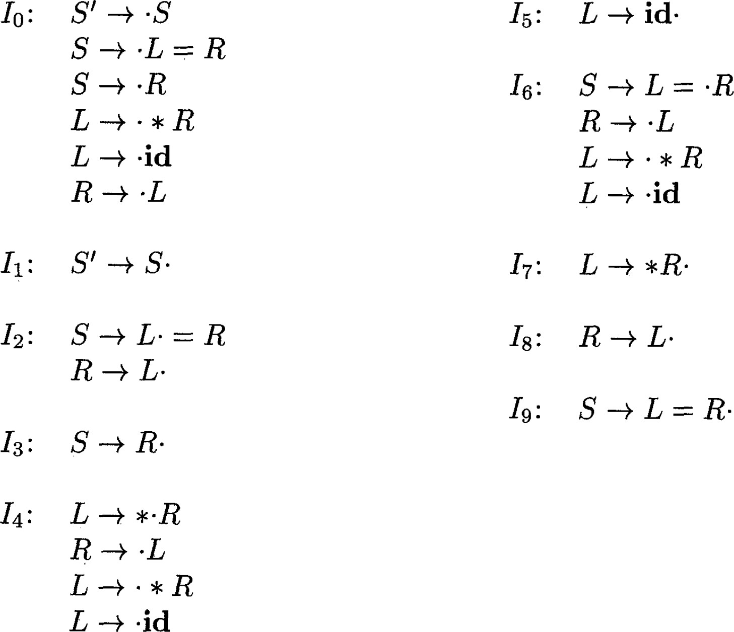
Non-SLR Grammar
Grammar
𝑆 → 𝐿 = 𝑅 | 𝑅
𝐿 →∗ 𝑅 | 𝐢𝐝
𝑅 → 𝐿
This grammar is not ambiguous
For item set 𝐼₂:
According to item #1:
ACTION 2, = is "s6"
According to item #2:
ACTION 2, = is "reduce 𝑅 → 𝐿"
(FOLLOW(𝑅) contains =)
CLR and LALR will succeed on a larger collection of grammars, including the above one. However, there exist unambiguous grammars for which every LR parser construction method will encounter conflicts.
Notes:
CLR和LALR将在更大的文法集合上取得成功，包括上面的文法集合。然而，存在着明确的文法，对于这些文法，每个LR语法分析器构造方法都会遇到冲突。

Slide 131
Weakness of the SLR Method
In SLR, the state 𝑖 calls for reduction by 𝐴 → 𝛼 if the item set 𝐼 _{𝑖}
contains item [𝐴 → 𝛼 · ] and input symbol 𝑎 is in FOLLOW 𝐴
In some situations, after reduction, the content 𝛽𝛼 on stack top would become 𝛽𝐴 that cannot be followed by 𝑎 in any right- sentential form
Notes:
在SLR中，状态𝑖 要求归约𝐴 → 𝛼，如果项集𝐼𝑖包含项[𝐴 → 𝛼 · ] ，同时输入符号𝑎 在FOLLOW(𝐴)中
在某些情况下，归约后𝛽𝛼 在栈顶上会变成𝛽𝐴， 后面跟着的不是𝑎的任何最右句型

Slide 132
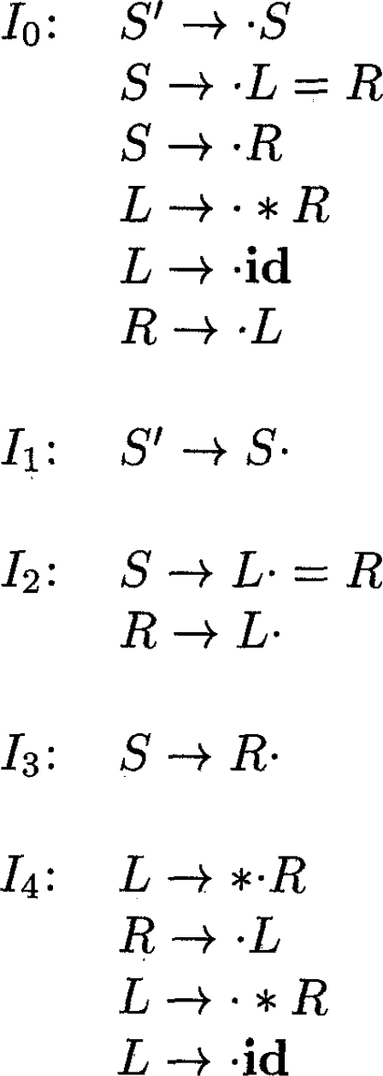

𝑆 → 𝐿 = 𝑅 | 𝑅
𝐿 →∗ 𝑅 | 𝐢𝐝
𝑅 → 𝐿
Example: Parsing id = id
Stack | Symbols | Input | Action
$0 |  | id = id | Shift 5
$05 | id | = id | Reduce L→id
$02 | L | = id | Suppose reduce R→L
$03 | R | = id | Error!*
* Cannot shift, cannot reduce since FOLLOW(S) = {$}
Problem: SLR reduces too casually
How to know if a reduction is a good move? Utilize the next input symbol to precisely determine whether to call for a reduction.
Notes:
如何知道归约是否是一个好的决定？利用下一个输入符号精确地确定是否要求归约。

Slide 133
Outline
Introduction
Context-Free Grammars
Overview of Parsing Techniques
Top-Down Parsing
Bottom-Up Parsing
Parser Generators (to be discussed in lab sessions)
Simple LR (SLR)
Canonical LR (CLR)
Error Recovery
Notes:
简单LR
规范LR
错误恢复

Slide 134
LR(1) Item
Idea: Carry more information in the state to rule out some invalid reductions (splitting LR(0) states)
General form of an LR(1) item: 𝐴 → 𝛼 · 𝛽, 𝑎
𝐴 → 𝛼𝛽 is a production and 𝑎 is a terminal or $
“1” refers to the length of the 2nd component: the lookahead (向前看字符)*
The lookahead symbol has no effect if 𝛽 is not 𝜖 since it only helps determine whether to reduce (𝑎 will be inherited during state transitions)
An item of the form 𝐴 → 𝛼· , 𝑎 calls for a reduction by 𝐴 → 𝛼 only if the next input symbol is 𝑎 (the set of such 𝑎’s is a subset of FOLLOW(𝐴))
*: LR(0) items do not have lookahead symbols, and hence they are called LR(0)
Notes:
规范LR(1)项
在状态中携带更多信息以排除一些无效的归约（通过分裂LR（0）状态）
LR(1)项的一般形式：[𝐴 → 𝛼 · 𝛽, 𝑎]
· 𝐴 → 𝛼𝛽是一个产生式，𝑎是一个终结符或右端结束标记
· 1指的是第二个分量𝑎的长度，第二个分量𝑎叫做向前看字符
· 当𝛽不为空时，向前看字符没有任何作用因为它决定是否归约
· 一个形如[𝐴 → 𝛼· , 𝑎]的项只有在下一个输入符号等于𝑎时，才会按照𝐴 → 𝛼进行归约。这样的𝑎的集合总是的FOLLOW(𝐴)子集
𝐴 → 𝛼𝛽 是一个生产和𝑎 是终端还是$“1”是指第二个组成部分的长度：展望(向前看字符)*如果𝛽 不是𝜖 因为它只帮助确定是否减少(𝑎 将在状态转换期间继承）表单中的一项𝐴 → 𝛼· , 𝑎要求减少𝐴 → 𝛼 仅当下一个输入符号𝑎 （𝑎’s是FOLLOW的子集(𝐴))*：LR（0）项没有先行符号，因此它们被称为LR（0

Slide 135


Constructing LR(1) Item Sets (1)
Constructing the collection of LR(1) item sets is essentially the same as constructing the canonical collection of LR(0) item sets. The only differences lie in the CLOSURE and GOTO functions.
It only generates the new item [𝐵→·𝛾, 𝑏] from [𝐴 →𝛼·𝐵𝛽, 𝑎 ] if 𝑏 is in FIRST(𝛽𝑎)
Notes:
构造LR（1）项集族本质上与构造规范LR（0）项集族相同。唯一的区别在于CLOSURE和GOTO函数。

Slide 136
Why 𝒃 should be in 𝐅𝐈𝐑𝐒𝐓 𝛽𝒂 ?
An informal analysis:
The lookahead 𝑏 decides when to reduce 𝛾 to 𝐵
Suppose the algorithm also generates an item for 𝑏 that is NOT in FIRST(𝛽𝑎)
At a certain point, when we see 𝛾 on stack top and 𝑏 as next input, we would reduce 𝛾 to 𝐵 ([𝐵 → 𝛾 ·, 𝑏] must come from [𝐵 → · 𝛾, 𝑏] )
Since we generate [𝐵 → · 𝛾, 𝑏] from [𝐴→𝛼·𝐵𝛽, 𝑎] during closure computation, we hope to see α𝐵𝛽 at stack top sometime after reducing 𝛾 to 𝐵 and reduce using 𝐴 → 𝛼𝐵𝛽 when 𝑎 is the next input symbol
Unfortunately, this is impossible when 𝑏 is not in FIRST(𝛽𝑎)
Then why generate [𝐵 → · 𝛾, 𝑏]from [𝐴→𝛼·𝐵𝛽, 𝑎] ???

Slide 137

Constructing LR(1) Item Sets (2)
Constructing the collection of LR(1) item sets is essentially the same as constructing the canonical collection of LR(0) item sets. The only differences lie in the CLOSURE and GOTO functions.
𝐆𝐎𝐓𝐎(𝑰, 𝑿) in LR(0) item sets:
The closure of the set of all items
𝐴 → 𝛼𝑋·𝛽 such that [𝐴 → 𝛼 · 𝑋𝛽]
is in 𝐼.
The lookahead symbols are passed to new items from existing items
Notes:
构造LR（1）项集族本质上与构造规范LR（0）项集族相同。唯一的区别在于CLOSURE和GOTO函数。
向前看符号从现有项传递到新项

Slide 138

Constructing LR(1) Item Sets (3)
{
Constructing the collection of LR(0) item sets
{
};
Constructing the collection of LR(1) item sets

Slide 139
LR(1) Item Sets Example
Augmented grammar:
𝑆’ → 𝑆 𝑆 → 𝐶𝐶 𝐶 → 𝑐𝐶 | 𝑑
Constructing 𝐼₁ item set and GOTO function:
𝐼₀ = CLOSURE 𝑆 ′ → · 𝑆, $ =
o {[𝑆′ → · 𝑆, $], [𝑆 → · 𝐶𝐶, $], [𝐶 → · 𝑐𝐶, 𝑐/𝑑], [𝐶 → · 𝑑, 𝑐/𝑑]}
FIRST($) = {$}
FIRST(C$) = {c, d}
GOTO 𝐼₀, 𝑆 = CLOSURE 𝑆′ → 𝑆 ·, $ = 𝑆′ → 𝑆·, $
GOTO 𝐼₀, 𝐶 = CLOSURE 𝑆 → 𝐶 · 𝐶, $ =
o { 𝑆 → 𝐶 · 𝐶, $ , 𝐶 →·c𝐶, $ , [𝐶 → ·𝑑, $]}
GOTO 𝐼₀, 𝑐 = CLOSURE 𝐶 → c ·𝐶, 𝑐/𝑑 =
o {[𝐶 → c ·𝐶, 𝑐/𝑑 ], [𝐶 →·c𝐶, 𝑐/𝑑], [𝐶 → ·𝑑, 𝑐/𝑑]}
FIRST($) = {$}
GOTO 𝐼₀, 𝑑 = CLOSURE 𝐶 → 𝑑· , c /𝑑 =
𝐶 → 𝑑·, 𝑐/𝑑

Slide 140

The GOTO Graph Example
10 states in total
These states are equivalent if we ignore the lookahead symbols (SLR makes no such distinctions of states):
𝐼₃ and 𝐼₆
𝐼₄ and 𝐼₇
𝐼₈ and 𝐼₉

Slide 141
Constructing Canonical LR(1) Parsing Tables (1)
Construct 𝐶' = 𝐼₀, 𝐼₁, … , 𝐼_{𝑛} , the collection of LR(1) item sets for the augmented grammar 𝐺’
State 𝑖 of the parser is constructed from 𝐼_{𝑖} .Its parsing action is determined as follows:
If 𝐴 → 𝛼· 𝑎𝛽, 𝑏 is in 𝐼_{i} and GOTO 𝐼_{i}, 𝑎 = 𝐼_{j}, then set ACTION[𝑖, 𝑎] to “shift j.” Here, 𝑎 must be a terminal.
If 𝐴 → 𝛼·, 𝑎 is in 𝐼_{i}, 𝐴 ≠ 𝑆′, then set ACTION[𝑖, 𝑎] to “reduce 𝐴 → 𝛼”
If 𝑆′ → 𝑆·, $ is in 𝐼_{i}, then set ACTION[𝑖, $] to “accept”
If any conflicting actions result from the above rules, we say the grammar is not LR(1)
Notes:
构造规范LR(1)语法分析表
1. 构造增广文法G‘的规范LR(1)项集族{𝐼₀, 𝐼₁, … , 𝐼_{𝑛}}
2. 根据𝐼_{i}构造得到状态i，状态i的语法分析动作按照下面的方法决定：
· 如果[𝐴 → 𝛼 · 𝑎𝛽, 𝑏 ]在𝐼_{𝑖}中并且GOTO [𝐼_{𝑖}, 𝑎 ]= 𝐼_{j}，那么将ACTION[ 𝑖, 𝑎]设置为“移入j”
· 如果[𝐴 → 𝛼·, 𝑎 ]在𝐼_{𝑖}中，设置ACTION[ 𝑖, 𝑎]为“归约𝐴 → 𝛼”。这里𝐴不等于S’
· 如果[𝑆’ → 𝑆·, $ ]在𝐼_{𝑖}中，那么将设置ACTION[𝑖, $]为“接受”
如果以上规则导致任何冲突的动作，我们就说这个文法不是LR(1)的。

Slide 142
Constructing Canonical LR(1) Parsing Tables (2)
The goto transitions for state i are constructed from all nonterminals 𝐴 using the rule: If GOTO 𝐼_{i}, 𝐴 = 𝐼_{𝑗}, then GOTO 𝑖, 𝐴 = 𝑗
All entries not defined in steps (2) and (3) are made “error”
The initial state of the parser is the one constructed from the set of items containing [𝑆' →· 𝑆, $]
Notes:
3. 状态i对于各个非终结符号A的转换使用下面的规则构造得到：如果GOTO [𝐼_{i}, 𝐴]= 𝐼_{𝑗}，那么GOTO[𝑖, 𝐴]= 𝑗
4. 规则2、3没有定义的所有条目都设置为“报错”
5. 语法分析器的初始状态就是根据[𝑆′ → · 𝑆, $]所在项集构造得到的状态

Slide 143

LR(1) Parsing Table Example
Grammar:
𝑆’ → 𝑆
𝑆 → 𝐶𝐶
𝐶 → 𝑐𝐶 | 𝑑
These pairs of states can be seen as being split from the corresponding LR(0) states:
(3, 6)
(4, 7)
(8, 9)

Slide 144
Outline
Introduction
Context-Free Grammars
Overview of Parsing Techniques
Top-Down Parsing
Bottom-Up Parsing
Parser Generators (to be discussed in lab sessions)
Simple LR (SLR)
Canonical LR (CLR)
Error Recovery
Notes:
错误恢复

Slide 145
Error Recovery in LR Parsing
An LR parser should be able to handle errors:
Report the precise location of an error
Recover from an error and continue with the parsing
Two typical error recovery strategies
Panic-mode recovery (恐慌模式)
Phrase-level recovery (短语层次的恢复)
Notes:
LR语法分析中的错误恢复
LR语法分析器应该能够处理错误：
· 报告错误的精确位置
· 从错误中恢复并继续分析
两种典型的错误
· 恐慌模式
· 短语层次的恢复

Slide 146
Panic-Mode Recovery
Basic idea: Discard zero or more input symbols until a synchronization token (同步词法单元) is found
Rationale:
The parser always looks for a prefix of the input that can be derivable from a non-terminal 𝐴
When there is an error, it means it is impossible to find such a prefix
If errors only occur in the part related to 𝐴, we can skip the part by looking for a symbol that can legitimately follow 𝐴
o Example: If 𝐴 is 𝑠𝑡𝑚𝑡, then the synchronization symbol can be a semicolon
Notes:
恐慌模式
基本思想：丢弃零个或多个输入符号，直到同步词法单元已找到
原理：
· 语法分析器总是查找可以从非终结符𝐴推导的输入的前缀
· 当出现错误时，意味着无法找到这样的前缀
· 如果错误仅发生在与𝐴相关的部分, 我们可以通过寻找一个可以合法跟随的符号来跳过这一部分
· 示例：如果𝐴 是𝑠𝑡𝑚𝑡, 则同步词法单元可以是分号

Slide 147

Phrase-Level Recovery
Basic idea:
Examine each error entry in the parsing table and decide the most likely programmer error that would give rise to the error
Modify the top of the stack or first input symbols and issue messages to programmers
Example phrase-level recovery:
Remove the right ) from the input;
Issue diagnostic “unbalanced right parenthesis”.
Notes:
短语层次的恢复
基本思路：
· 检查语法分析表中的每个错误条目，并确定最有可能导致错误的程序员错误
· 修改栈顶部或第一个输入符号，并向程序员发出消息
短语层次的恢复示例：
· 删除右侧的）
· 提示“不匹配的右括号”。

Slide 148
Outline
Introduction
Context-Free Grammars
Overview of Parsing Techniques
Top-Down Parsing
Bottom-Up Parsing
Parser Generators (to be discussed in lab sessions)
Notes:
语法分析器生成工具

Slide 149

The Parser Generator YACC/BISON
Yacc：yet another compiler-compiler
Bison：an extension and improvement of Yacc
Notes:
本节将介绍如何使用语法分析器生成工具来帮助构造一个编译器的前端，我们将使用LALR语法分析生成工具Yacc作为讨论的基础。Yacc，又一个编译器的编译器
Yacc在UNIX系统中是以命令的方式出现的，它已经用于实现多个编译器产品。Bison 是GNU项目的一部分，是对Yacc的扩展和改进。

Slide 150
Structure of YACC Source Programs
Declarations (声明)
Ordinary C declarations
Grammar tokens
Translation rules (翻译规则)
declarations
%%
translation rules
%%
supporting C routines
Rule = a grammar production + the associated semantic action
Supporting C routines (辅助性C语言例程)
Directly copied to y.tab.c
Can be invoked in the semantic actions
yylex() must be provided, which returns tokens
Other procedures such as error recovery routines may be provided
Notes:
声明
· 通常的C声明
· 对词法单元的声明
翻译规则
· 翻译规则 = 产生式 + 语义动作
辅助性C语言例程
· 将会被直接拷贝至y.tab.c
· 可以在语义动作中调用
· 必须提供yylex()这一词法分析器，它将返回一个由词法单元和相关属性组成的词法单元
· 可以添加错误恢复例程等其他过程

Slide 151

Translation Rules
The first head is taken to be the start symbol
A semantic action is a sequence of C statements
$$ refers to the attribute value associated with the nonterminal of the head
$i refers to the value associated with ith grammar symbol of the body
A semantic action is performed when we reduce by the associated production
We can compute a value for $$ in terms of the $i’s
Notes:
翻译规则
第一个产生式头符号被视为开始符号
一个语义动作是一个C语句的序列
· $$表示和相应产生时头部的非终结符关联的属性值
· $i表示和相应产生式体中第i个文法符号关联的属性值
当我们按照一个产生式归约时就会执行盒盖产生式相关联的语义动作
· 我们通常根据$i的值来计算$$的值

Slide 152

YACC
Source Program Example

Slide 153
Conflicts Resolution in YACC
Default strategy:
Shift/reduce conflicts: always shift
Reduce/reduce conflicts: reduce with the production listed first
Specifying the precedence and associativity of terminals
Associativity: %left, %right, %nonassoc
Shift 𝒂/reduce 𝑨 → 𝑎 conflict: compare the precedence of 𝑎 and 𝐴 →
𝛼 (use associativity when precedence is not enough)
The declaration order of terminals determine their precedence
The precedence of a production is equal to the precedence its rightmost terminal. It can also be specified using %prec<terminal>, which defines the precedence of the production to be the same as the terminal
Notes:
Yacc的冲突解决
默认策略：
· 移入/归约冲突：始终移入
· 归约/归约冲突：归约第一个列出的产生式
指定终结符的优先级和结合性：
· 结核性：%left、%right、%nonassoc
· 移入𝒂/归约𝑨 → 𝑎 冲突：比较的优先级𝑎 和𝐴 →𝛼 （优先级不够时使用结合性）
· 终结符的声明顺序决定了它们的优先级
· 一个产生式的优先级等于它最右边终结符的优先级。也可以使用%prec<terminal>指定，它将产生式的优先级定义为与终结符相同

Slide 154
Error Recovery in YACC
In YACC, error recovery uses a form of error productions
General form: 𝐴 → 𝐞𝐫𝐫𝐨𝐫 𝛼
The users can decide which nonterminals (e.g., those generating expressions, statements, blocks, etc.) will have error productions
Example: 𝒔𝒕𝒎𝒕 → 𝐞𝐫𝐫𝐨𝐫 ;
When the parser encounters an error, it would skip just beyond the next semicolon and assumes that a statement had been found
The semantic action of the error production will be invoked: it would not need manipulate the input, but could simply generate a diagnostic message
Notes:
Yacc的错误恢复
在Yacc中，错误恢复使用一种错误产生式的形式：
· 一般形式：𝐴 → 𝐞𝐫𝐫𝐨𝐫 𝛼
· 用户可以决定哪些非终结符（例如，生成表达式、语句、块等的非终结符）将具有错误产生式
错误示例：𝒔𝒕𝒎𝒕 → 𝐞𝐫𝐫𝐨𝐫 ;
· 该错误产生式规定当语法分析器遇到错误时，它要跳到下一个分号之后，并假设已经找到一条语句
· 将调用错误产生式的语义动作不需要处理输入，只需生成诊断消息

