Slide 1

Presentation
We are Group 6 (Masroor Khan, Istiak Mohammad, Stanley Ejike-Ume, Keon Goulbourne, Mahamed Mahamed, Bellal Abdelaziz Mezghrani
Our goal is to pitch our own solution for the pressing IT issues at Waitrose.
We have analyzed this topic extensively and have a presentation to submit our research as well as our solution.

Slide 2

Key Issues
The focus for our solution are issues in the supply chain caused by lack of required software.
This includes:
Outdated software
Corrupted data
Old/Worn hardware systems
Unoptimised network design

Slide 3

Our Solution
Provide IT service including hardware and software.
Reduce the technical barrier.
Eliminate technical limitations.
Increase customer satisfaction.
Reduce technical failures.
Comprehensive hardware and software integration.
Scalable technology solutions.

Slide 4

Value proposition
Benefits for Waitrose:
Enhanced decision-making efficiency.
Reduced operational costs.
Stronger relationships with suppliers.
Benefits for Suppliers:
Simplified data submission processes.
Greater visibility into Waitrose's data requirements.
Reduced compliance burden.
Enhanced Customer Experience
Operational Efficiency
Sales optimisation

Slide 5

First Customer
Waitrose will be the first customer
We aim to expand to other retail chains in the future.
Strategic partnership with well-known and established companies.

Slide 6

Costs
Hardware Costs
Software Costs
Operational costs
Staffing costs
Marketing and sales costs.
Support & maintenance costs.
Miscellaneous costs ( Legal fees, travel expenses)

Slide 7

Competition analysis
Competitor​ | OUR IDEA | Tesco | Sainsbury’s | Asda
Benefits To Customer​ | Real time data synchronisation. Tailor data fields. Automated data validation. Ethical and sustainable practice into data handling. | Use Roambee to enhance supply chain visibility. Clubcard to personalised customer engagement. | Use AWS to enhance supply chain visibility. Loyalty programs to personalised customer engagement. | Use MS Azure to enhance supply chain visibility. Asda reward to personalised customer engagement.
There are private companies all around that provide software and hardware maintenance services.
Some examples are:
IBM
Full Metal
Gartner
However, these are private companies who work on commission. We can provide customized and long-term maintenance which allows us to stand out as a more reliable alternative.

Slide 8
Competition analysis
There are private companies all around that provide software and hardware maintenance services.
Some examples are:
IBM
Full Metal
Gartner
However, these are private companies who work on commission. We can provide customized and long-term maintenance which allows us to stand out as a more reliable alternative.

Slide 9

Revenue
Revenue from software sales.
Subscription fees.
Consulting services.
Hardware and software sales.

Slide 10
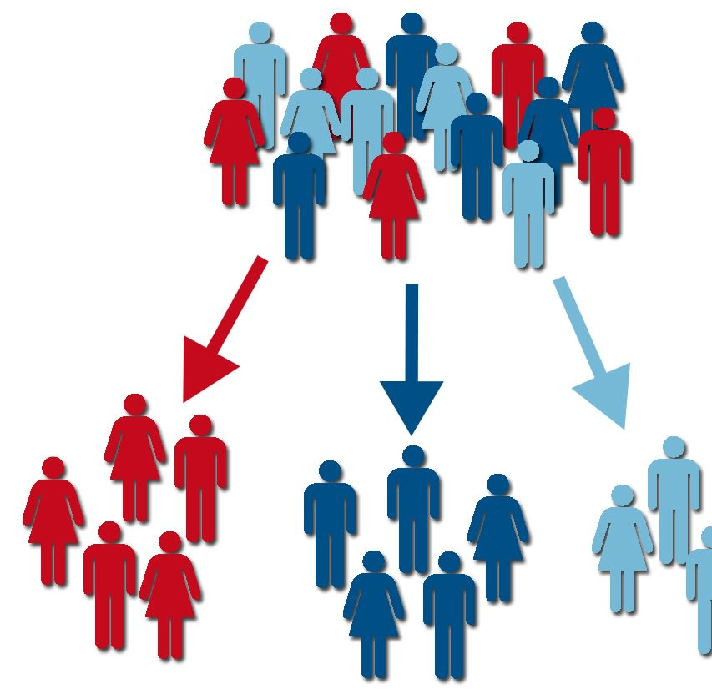
Customer segments
Small to large retail chains
Grocery distributor
Retail startups
Our first customer will be Waitrose

Slide 11

Legal and ethical implications
Data Protection and Privacy Laws
- Compliance with data protection as an IT solutions provider is critical
Handling sensitive data from customer or employees requires robust measures to ensure confidentiality
Failure to adhere to these laws can lead to significant legal action as well as fines
Responsible Data Usage
Data usage as an IT solutions provider should be transparent and responsible
Data collected and viewed through our systems must be utilised for the purpose agreed upon with Waitrose.
Ensuring data is used ethically protects the client as well as the relationship and integrity between the client and our company

Slide 12

Elevator pitch
Innovative software and hardware solutions.
Streamline retail operations.
Enhance customer experiences.
Scalable and reliable systems
Tailored solutions for retail businesses.
Simplified inventory and sales management.

Slide 13

Any Questions?

