Slide 1
SURF
By: Jennifer Chiang

Slide 2
SURF
Speeded
Up
Robust
Features
Scale and rotation invariant interest point detection

Slide 3
Key Features
Speed
Can be computed much faster than other algorithms
Fast-Hessian Detector
Determinant of hessian matrix used for selecting location and scale of the image
Evaluated independent of matrix size
Box filters and integral images
Does not need to iteratively apply filters
Filters can be applied directly and even run in parallel
Low computational cost
Robustness
Weighed with gaussian

Slide 4
SURF Detector

Slide 5
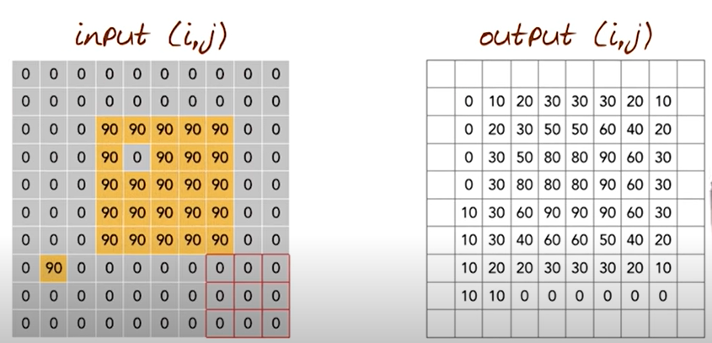
Box filters
Notes:
Different types of kernels can be applied to the box filter to do different things
One in this example is simply using an average to smooth over things
Sums up neighboring pixels and divide by number of pixels in box (9)

Slide 6
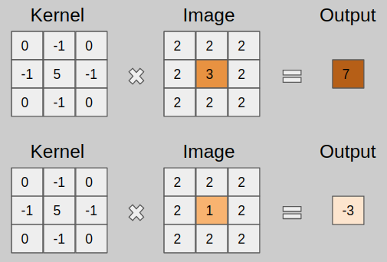

Slide 7
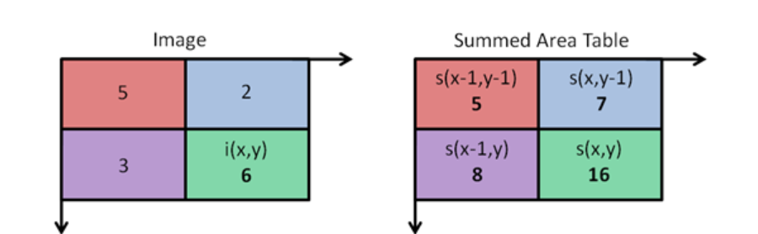


Integral images/summed area table
Notes:
Box filter + integral image makes SURF faster than SIFT which uses the difference of gaussian

Slide 8
SURF Descriptor
Orientation assignment
Haar-wavelet response is calculated in x and y direction
Radius 6s around the interest point is taken into consideration
Sum of vertical & horizontal wavelet response calculated
Change scanning orientation (pi/3) and recalculate
Main Orientation is orientation with largest sum value
Descriptor components
Construct square region aligned with orientation
Region split into subregions
Simple features calculated at regularly spaced points
Haar wavelet responses in horizontal and vertical weighed with gaussian
Increases robustness
Decreases localization error
Notes:
s the scale at which the interest point was detected

Slide 9
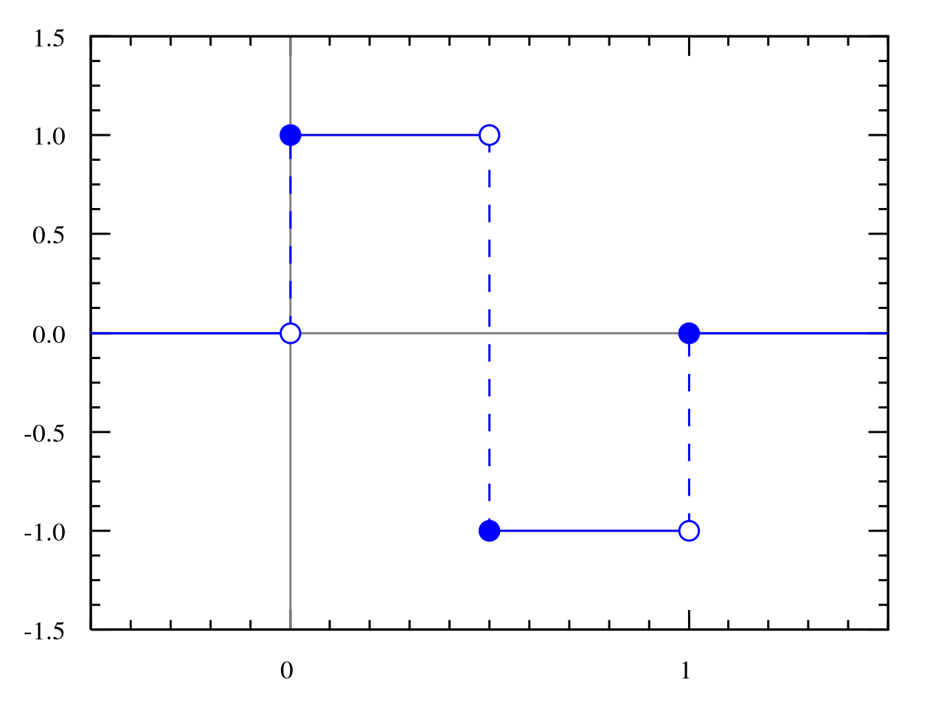
Haar Wavelet
Wavelet
General way to represent images & sound & signals
Accounts for both frequency and scale of image
Haar wavelet
0/1/-1
Often used in black and white image processing
Simplest form of wavelet
Notes:
0 = white
1 = black

Slide 10
SURF Descriptor
Orientation assignment
Haar-wavelet response is calculated in x and y direction
Radius 6s around the interest point is taken into consideration
Sum of vertical & horizontal wavelet response calculated
Change scanning orientation (pi/3) and recalculate
Main Orientation is orientation with largest sum value
Descriptor components
Construct square region aligned with orientation
Region split into subregions
Simple features calculated at regularly spaced points
Haar wavelet responses in horizontal and vertical weighed with gaussian
Increases robustness
Decreases localization error
Notes:
s the scale at which the interest point was detected

