Slide 1




AGRICULTURE DOCS CHAIN
TEAM ID:NM2023TMID00980 ZONE:08

Slide 2
ABSTRACT:
Agriculture is a big part of the economy of any country because it helps feed the entire population.
It connects and communicates with all of the related industries.
If the agriculture base is strong, it is generally regarded as a socially and politically stable society.
Many modern farms make use of cutting-edge technology and scienti„c and technological ideas.

Slide 3
INTRODUCTION:
The following are some of the reasons for food supply chain problems and processing environment challenges.
The maximization of the prot„s relies on some farmers’ vegetables and fruits with chemicals.
Chemical fertilizers, insecticides, and other compounds are used in several plants and fruits. As a result, pesticide residues in vegetables and fruits become excessive. It is a signic„ant health risk.

Slide 4
EXISTING SYSTEM:
The key reason we chose to work with blockchain and incorporate its features into our architecture was the absence of need for third parties.
Additionally, the control over a decentralized ledger stays with the user rather than a centralized authority.
Another benefit of blockchain is that there are no data breaches and hacks. However, the scalability of a centralized system with a single server is limited.

Slide 5
Most blockchain systems implement smart contracts provided by the Ethereum platform and its extension platform, Quorum: they compile using Solidity or Serpent into Ethereum virtual machine (EVM) bytecodes.
Hyperledger Fabric and Sawtooth, the most active platforms in the Hyperledger family, use Golong, Java, Python, and JavaScript as the major programming languages for smart contract development.

Slide 6
CHALLENGES IN EXISTING SYSTEM:
Contract Owner: The contract owner has more control over the system than anyone else. The owner enters the contract into the system and checks to see if the rule gets correctly implemented.
Seed Storage: Seed and other agricultural products are stored in the seed storage.
Producers: The farmers are considered the most basic rung in production. They are in charge of all tasks relating to agricultural planting and harvesting.

Slide 7
Distributors: Distributors are in charge of safely transporting crops from one location to another.
Wholesalers: Wholesalers buy a decent quantity of crops and agriproducts and resell them to retailers.
Retailers: Retailers buy commodities and products from wholesalers and sell them to consumers on a small scale in open markets.
Consumers: They are a large group of individuals that rely on agricultural products. They play a big part in the system by constantly creating demand.

Slide 8
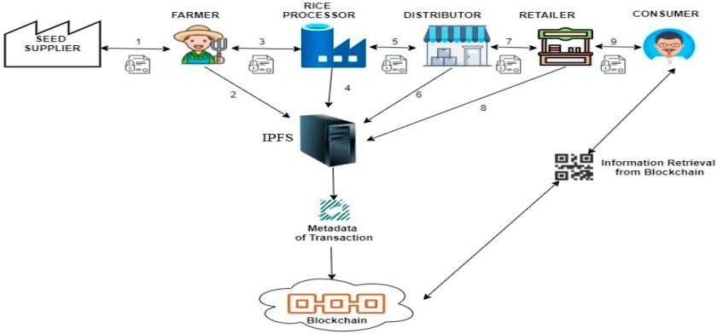
BLOCK DIAGRAM OF EXISTING SYSTEM:

Slide 9
PROPOSED SYSTEM:
The smart contracts interact with the blockchain participants:
Seed company maintains local records and produces seeds. These seeds get labeled by the EANUCC global standard.
Farmer purchases recognized seeds from seed companies, harvests the crop, and sets up the smart contract. Data are also saved on the decentralized file system IPFS by the farmer.

Slide 10
Grain processor purchases grain from the elevator, refines it, removes foreign matter, and produces the finished product.
Retailer purchases traceable items from manufacturers and sells them in small quantities to consumers.
Distributor is in charge of the product distribution procedure.
Customer is the person who uses the product and consumes it.

Slide 11
The following are some of the most significant smart agriculture notions:
Sensors and surveillance cameras.
The network participants like farmers, suppliers, customers, and so on.
Computing equipment like microcontroller systems and cloud computing.
Applications and libraries include mobile device apps, machine-to-machine communication, API, and a blockchain web app.

Slide 12
The steps for the interactions between some agricultural supply chain entities are as follows:
The farmer lodges an insurance claim to AgriOnBlock.
AgriOnBlock delivers the information to the insurance carrier when it gets verified.
The insurance company sends the claim to a surveyor for physical inspection.
The surveyor physically visits the site to do the survey.

Slide 13
The surveyor submits a report to the insurance company, accompanied by the amount of the insurance claim for payment.
The insurance company notifies the bank to reimburse the farmer after obtaining the report from surveyor.
The bank pays the farmer.
The insurance company informs AgriOnBlock of the transaction.

Slide 14
ADVANTAGES:
Reduction of product losses in transportation and storage.
Increasing of sales.
Dissemination of technology, advanced techniques, capital and knowledge among the chain partners.
Better information about the flow of products, markets and technologies.

Slide 15
Transparency of the supply chain.
Tracking & tracing to the source.
Better control of product safety and quality.
Large investments and risks are shared among partners in the chain.

Slide 16
PROGRAM:
1.Solidity Smart Contract:
Solidity
// SPDX-License-Identifier: MIT
pragma solidity ^0.8.0;
contract AgricultureDocumentChain {
address public owner;
uint public documentCount = 0;
struct Document { uint id;
string title; string content;
address owner;
}

Slide 17
mapping(uint => Document) public documents; event DocumentCreated(uint id, string title,
address owner);
constructor() {
owner = msg.sender;
}
modifier onlyOwner() {
require(msg.sender == owner, "Only the owner
can perform this action");
_;
}

Slide 18
function createDocument(string memory title,
string memory content) public { documentCount++;
documents[documentCount] = Document(documentCount, title,
content, msg.sender);
emit DocumentCreated(documentCount, title, msg.sender);
}
}

Slide 19
2. JavaScript Front-End (using web3.js):
Avascript
const Web3 = require('web3');
const web3 = new Web3('YOUR_ETHEREUM_PROVIDER'); //
Replace with your Ethereum provider URL
const contractAddress = 'YOUR_CONTRACT_ADDRESS'; //
Replace with your contract's address
const contractAbi = [YOUR_CONTRACT_ABI]; // Replace
with your contract's ABI

Slide 20
const contract = new web3.eth.Contract(contractAbi, contractAddress);
const account = 'YOUR_ACCOUNT_ADDRESS'; // Replace with your Ethereum account address
// Create a new document
function createDocument(title, content) {
contract.methods.createDocument(title, content)
.send({ from: account })
.on('transactionHash', (hash) => {
console.log('Transaction hash:', hash);
})

Slide 21
.on('receipt', (receipt) => { console.log('Document created:',
receipt.events.DocumentCreated.returnValues);
});
}
// Example usage
createDocument("Sample Document", "This is the content of the document.");

Slide 22
RESULT:
Throughput is probably the most misunderstood performance testing principle that beginner testers occasionally have trouble mastering.
In general, “throughput” refers to the volume of transactions generated throughout the test.
It may also be described as the minimum amount of capacity that an application or website can handle.

Slide 23
CONCLUSION:
In conclusion, blockchain and IoT technologies can aid in developing a secure, transparent, open, and innovative ecological agriculture system that involves all participants.
The is work aims to provide a possible technique to build practical blockchain-based applications and change the agriculture industry, even though the evolution of blockchain and agriculture research studies is still in its infancy.
The is model is considered a prototype for reducing financial loss and agricultural pollution.

Slide 24
