Slide 1
Engaging Employees
A critical step to improving the customer experience
Airis McCottry Gill, US Dept of Veterans Affairs
Morgan Montes & Janet Shimabukuro, Washington State Dept of Revenue

Slide 2

Employee Experience UX Summit with Washington State June 22, 2021

Slide 3
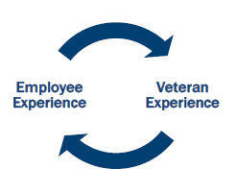
Program Overview
The Veterans Experience Office (VEO) and the Office of Human Resources Administration/Operations, Security and Preparedness (HRA/OSP) have partnered to lead VA’s effort to establish a world-class employee experience (EX).
Ultimately, VA efforts to improve EX will directly impact the customer experience (CX) for Veterans, their families, caregivers, and survivors, consistent with VA’s ICARE Core Values and Customer Experience Principles.
Project Goal: Provide easy, effective, and emotionally resonant experiences for employees across their workforce life-cycle as members of the VA family. Leverage proven CX data, tools, technology, and engagement efforts that will support the culture of employee customer experience so they Choose VA.

Slide 4

What Does EX Encompass
Employee experience is holistic and cross-functional in nature. Six core relational attributes impact the way employees experience VA at every moment along the employee journey.
Diversity, Equity & Inclusion
WORK
WELL-BEING
The relationship I have with the work I do, the norms, methods and tools I use to get work done, and how my work strengthens me
The relationship I have with my personal life, identities, goals, and worldview and my ability to bring my whole, authentic self to work
PEOPLE
ORGANIZATION
The relationship I have with the customers I serve, the people I manage, report to, collaborate with, partner with, and engage with in my work community
The relationship I have with the mission, purpose, culture, and leadership behaviors of the organization, and its policies, programs, and rewards
VA Employee
PLACES
TECHNOLOGY
The relationship I have with where I do work and the physical space in which work gets done
The relationship I have with the technologies that connect me to my work, workforce, and workplace
This framework, in the context of an employee's journey through the organization, can help VA understand and strategically redesign the most impactful parts of experience.
4

Slide 5
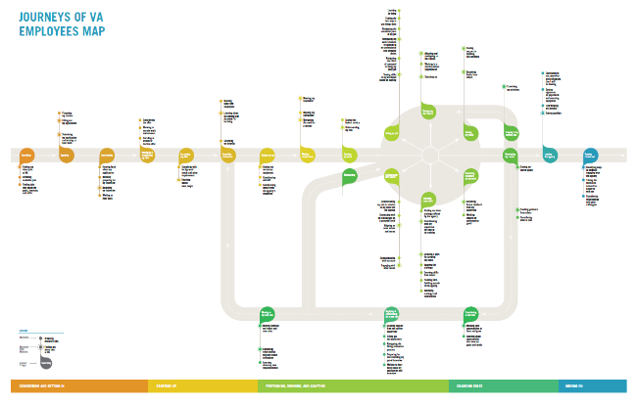
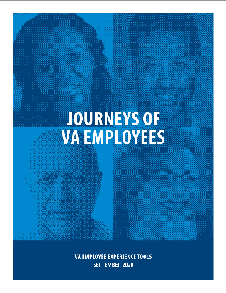
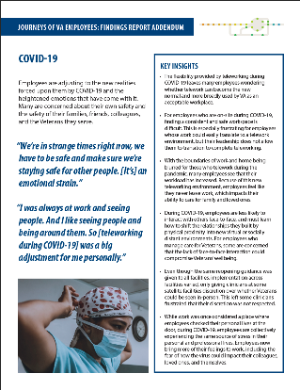
EX Journey Map & Insights
Our Recent Efforts Have Provided Insight into the VA Employee Journey
Modeled after the Journey of Veterans Map to create the federal government’s first-ever EX Journey Map
Collected 11,000+ insights from a diverse set of VA employees (WG-SES, clinical, frontline, clerical, technical, etc.) across 33 geographic areas
Identified 5 “phases” and 30 key “Moments that Matter” (bright spots and pain points) for VA employees along their employment journey

Slide 6
Current EX Efforts
Worked with the VA Employee Engagement Council (EEC) to identify the top 4 department-wide EX priorities
1) Starting Up/Onboarding; 2) Developing My Career; 3) Learning New Skills; and 4) Receiving Feedback On My Work
EX Environmental Scan
Understand values & requirements around an enterprise-wide EX capability
Research industry best practices and understand optimal organizational capabilities for long-term sustainability
Meeting with sibling agencies
General Services Administration, Consumer Financial Protection Bureau, US Department of Agriculture,
National Association of Retired Federal Employees, Executive Office of the President, Secret Service, Department of Justice, Environmental Protection Agency, Department of State and Washington Headquarters Service (Department of Defense)
EX Deep Dives
Starting Up/Onboarding (New Employee Welcome Kit, Buddy Program) and Developing My Career (Program Analysts)
Employee Signals (ESignals)
Evaluate an employee listening capability that provides real-time feedback from VA employees. ESignals modeled from Veteran listening via Veterans Signals (VSignals)

Slide 7
Engaging Employees A critical step to improving customer experience
Presented by
Morgan Montes & Janet Shimabukuro
Notes:
Janet

Slide 8
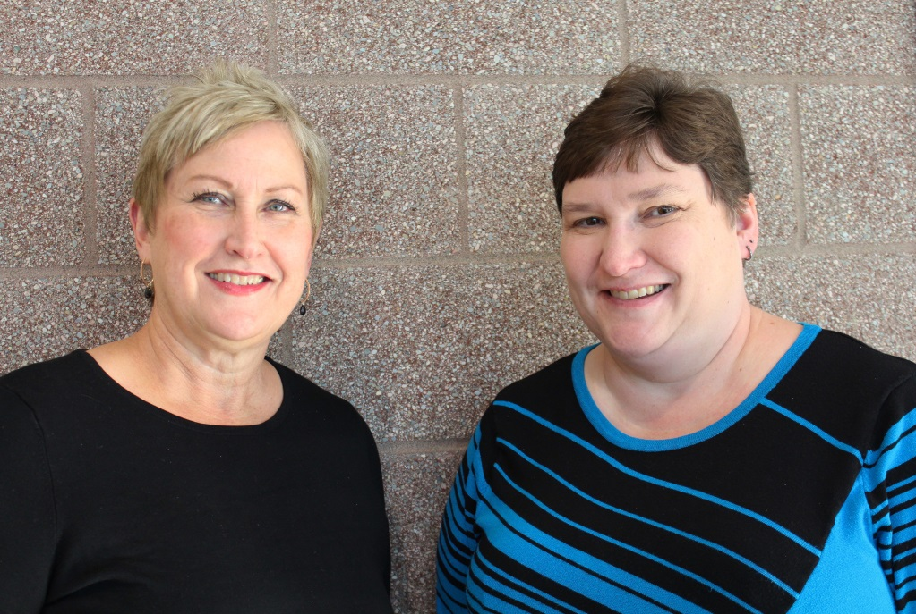
Employee engagement is linked to organizational performance
“You can’t have happy customers if you don’t have happy employees.”
- Vikki Smith, Director
Notes:
Janet
Revenue’s Director, Vikki Smith is known for championing the idea that you can’t have happy customer if you don’t have happy employees.
Research shows there is a link between employee engagement and organizational performance.
An engaged employee is more likely to feel ownership over their work. They are connected to the organizational objectives. An engaged employee is more likely to feel passionate about their work and put in extra effort to serve their customers. This means that if you have an engaged workforce you are more likely to have satisfied customers.
Engaged employees show up to work with intent, they are empowered to fix problems, they create more value for their customers, and ultimately build trust in government.
We are going launch a poll to get a sense of where you think your teams are today with engagement levels.
1. On a scale of 1 – 3, how engaged is your team today?
3 – Engaged
2 – Neutral
1 - Disengaged
If you don’t see the poll pop up, please chat in your response. If you are joining us by phone only today, unfortunately we don’t have a way for you to participate.
(Make comment about what you are seeing in poll to fill space. “Looks like the majority of us are at….”
Do we really know? It’s not a finish line. . . We will hopefully give you some nuggets to help you with this today.
Thank you. We have a follow up question, so we will open a second poll.
2. How do you think the engagement of your team has changed since the pandemic?
Engagement has increased
Engagement is about the same
Engagement has decreased
If you don’t see the pop up, please chat in your response.

Slide 9
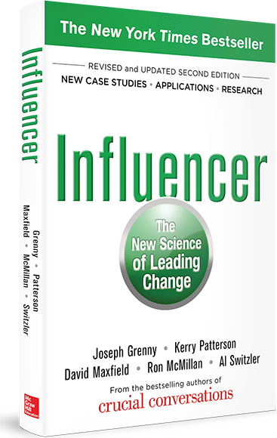
Using the power of influence
How do I leverage positive deviants to increase employee engagement?
Notes:
Janet
I took the Influencer training class a few years ago and one of my take-always was the importance of seeking out the positive deviants – those doing the vital behaviors that influence others. It made me reflect on how we could leverage positive deviants at Revenue to increase employee engagement.
I wanted to:
Identify engagement behaviors in a clear and simple way for leaders throughout our organizational.
Make all leaders aware of these behaviors and regularly reflect on how they could use these to increase engagement on a daily basis.
Make these behaviors visible so that we could build habits and make them part of our culture.
I went back to the office from the training and checked with Morgan and others from our Lean Transformation Office how we could accomplish these things.
Our Lean Administrator suggested pulling the 2017 Leadership Award nominations. So I asked our Human Resources office and they gave me the list. As I was reading through, there were several things that stood out to me. Here are a few things I read:
“She cares about her staff and their success and meets with them regularly.”
“ When people make mistakes, he coaches them in the right direction without ever making them feel “less than”
“He is quick to thank people for their help and encourages everyone to participate”
“He manages with integrity, decisiveness, and a killer sense of humor.”

Slide 10
Focus group question 1
What about your leader’s style makes you want to come to work?
Notes:
4 minutes – Morgan
We decided to hold two series of focus groups – one with leaders nominated for a Leadership Award and a second with employees of those leaders. In total, 43 employee participated.
By engaging with employees, we were able to identify the vital behaviors that lead to engaged employees at Revenue (not just any organization, we wanted to know what behaviors mattered here).
I want to give you an abbreviated version of that focus group and because there are so many of us here today, we are going to use chat. I am going to read the question out loud, I am going to place a question in the chat and then give you just a minute to respond. Grammar doesn’t count. Just give me a sentence or two:
Chat: “What about your leader’s style makes you want to come to work?
Chat: “What does your leader do to create an engaging experience for you?
Chat: “How does your leader show that they value and care about you?
Thank you, we thought it would be fun to put your responses into a word cloud and send that to you so you could see what stood out in terms of response for this group of people here today.
We collected and categorized all of the responses and comments we heard from our employees. We spent time reviewing them, theming them, and placed them into a pivot table within Excel so we could see common themes. Here is what the data told us.

Slide 11
Focus group question 2
What does your leader do to create an engaging experience for you?
Notes:
4 minutes – Morgan
We decided to hold two series of focus groups – one with leaders nominated for a Leadership Award and a second with employees of those leaders. In total, 43 employee participated.
By engaging with employees, we were able to identify the vital behaviors that lead to engaged employees at Revenue (not just any organization, we wanted to know what behaviors mattered here).
I want to give you an abbreviated version of that focus group and because there are so many of us here today, we are going to use chat. I am going to read the question out loud, I am going to place a question in the chat and then give you just a minute to respond. Grammar doesn’t count. Just give me a sentence or two:
Chat: “What about your leader’s style makes you want to come to work?
Chat: “What does your leader do to create an engaging experience for you?
Chat: “How does your leader show that they value and care about you?
Thank you, we thought it would be fun to put your responses into a word cloud and send that to you so you could see what stood out in terms of response for this group of people here today.
We collected and categorized all of the responses and comments we heard from our employees. We spent time reviewing them, theming them, and placed them into a pivot table within Excel so we could see common themes. Here is what the data told us.

Slide 12
Focus group question 3
How does your leader show that they value and care about you?
Notes:
4 minutes – Morgan
We decided to hold two series of focus groups – one with leaders nominated for a Leadership Award and a second with employees of those leaders. In total, 43 employee participated.
By engaging with employees, we were able to identify the vital behaviors that lead to engaged employees at Revenue (not just any organization, we wanted to know what behaviors mattered here).
I want to give you an abbreviated version of that focus group and because there are so many of us here today, we are going to use chat. I am going to read the question out loud, I am going to place a question in the chat and then give you just a minute to respond. Grammar doesn’t count. Just give me a sentence or two:
Chat: “What about your leader’s style makes you want to come to work?
Chat: “What does your leader do to create an engaging experience for you?
Chat: “How does your leader show that they value and care about you?
Thank you, we thought it would be fun to put your responses into a word cloud and send that to you so you could see what stood out in terms of response for this group of people here today.
We collected and categorized all of the responses and comments we heard from our employees. We spent time reviewing them, theming them, and placed them into a pivot table within Excel so we could see common themes. Here is what the data told us.

Slide 13
Vital behavior 1
Get to know me as an individual and build a trusting relationship.
Notes:
1 Minute -Morgan
There was one behavior that stood out – head and shoulders above the rest. And it’s this. . .
Get to know your employees as individuals and build trusting relationships
This theme was brought up 50% more than the next common theme.
Our employees want us to get to know them as individuals – to know their strengths, their goals, where they want to grow, and understand them as whole people (not just employees of DOR).
Give them individual time, like one on one meetings
Focus on employee when talking with them
Take time to get to know their strengths and goals
Delegate responsibilities
Create a safe environment, be approachable, be humble

Slide 14
Vital behavior 2
Give me honest feedback to help me achieve my goals.
Notes:
1 Minute - Morgan
#2 - Give honest feedback to help them achieve their goals.
This was the second most common theme.
Our employees want to hear our feedback that helps them improve – both positive and negative.
Giving another person constructive criticism is the highest form of respect for that individual. It’s easy to recognize an opportunity for constructive feedback and simply ignore it.
It takes courage for leaders to share honest feedback.
You’ll notice that this behavior is secondary to the first one . . . You can’t give honest feedback (or it won’t be taken the right way) if you don’t first have a trusting relationship.

Slide 15
Vital behavior 3
Listen and welcome my perspectives.
Notes:
1 Minute - Morgan
#3 - Listen and welcome their perspectives…
We heard that staff want us to listen like they are they only one in the room. We need to turn away from the computer, ignore our cell phones and give them our full attention.
Welcoming their perspectives also means putting aside my own biases and perspectives and truly listening to understand the other person.
Welcome diverse perspectives, listen to concerns, make it ok to ask questions. Value your employee’s input.

Slide 16
Vital behavior 4
Recognize me often.
Notes:
1 Minute - Morgan
#4 - Recognize them often
Employees are craving day-to-day recognition from their supervisors. Help them see the small victories in their work.
Frequent recognition for a job well done – or for employees living out our agency’s values.

Slide 17
Vital behavior 5
Collaborate with me to solve problems.
Notes:
1 Minute - Morgan
#5 - Collaborate with them to solve problems
Involve your employees in decision making. Ask them for their input and perspectives.
Our staff know the work better than we do. Let’s collaborate with them.
This is a lean culture – one that empowers staff to fix what bugs them.

Slide 18
What’s in it for you to actively engage your employees?
Excited to come to work.
Offer suggestions and problem solve.
Do quality work.
Volunteer and take the initiative.
Stay with your organization.
Notes:
5 Minutes - Janet
What’s in it for you to have engaged employees?
Chat: What are the benefits of working with engaged employees?
We asked our leaders this questions and this are some of the things they identified (call out any that are unique)

Slide 19
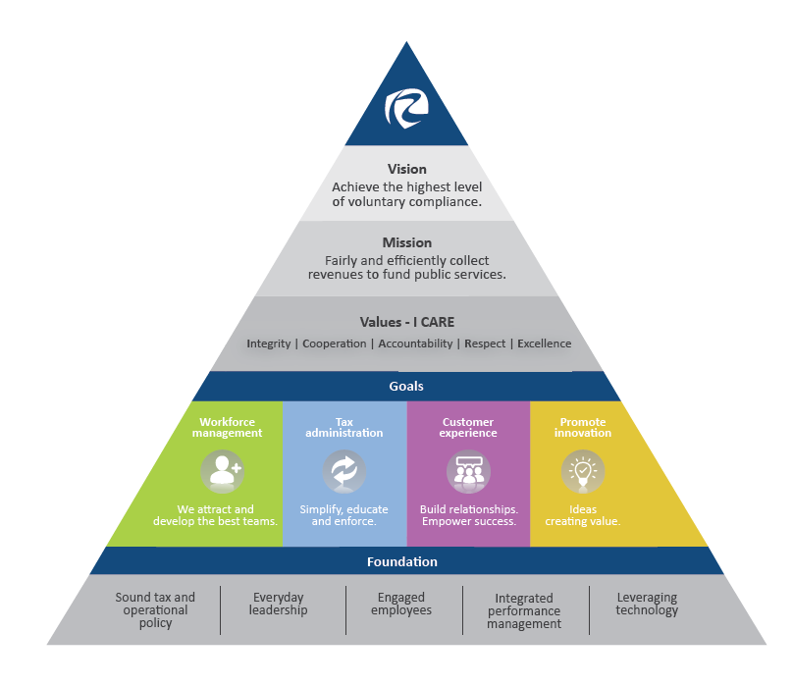
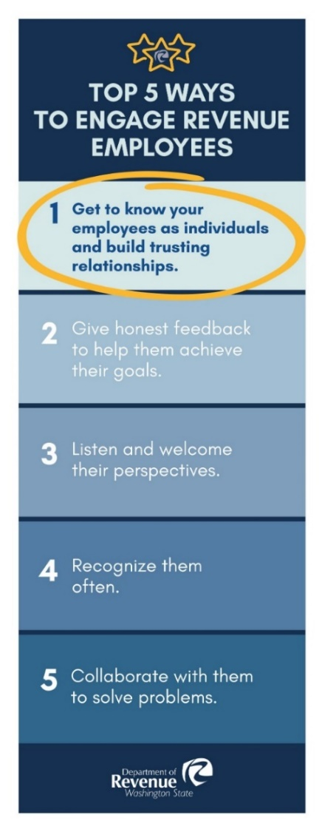
Building these behaviors into our culture
Notes:
Janet
It is important that we share these vital behaviors, and continue to remind leaders of the importance of investing time in employee engagement. It’s not (in addition to the work); it is part of our work!
Documented and shared the results of our research with Revenue managers and supervisors at the 2019 Leadership Summit. This rack card was given to everyone as a visual reminder.
Included “Engaged Employees” in the foundational elements of our strategic pyramid. This visual is part of agency culture, on our internet site and visible in our offices.
Engaging behaviors are shared and part of our Lean Leadership and new supervisor performance management training. They are all elements of providing effective engagement with our employees during the building of our expectation for performance throughout the year. Providing regular feedback and engaging with the employee to help them reach the goals of the agency is vitally important to engagement, which includes recognizing good performance often.

Slide 20
Tracking progress with data
I have the opportunity to give input on decisions affecting my work.
Analysis
Revenue is a leader and exceeds the statewide average by 10%.
Notes:
Janet
Let’s look at this measurement which reflects how well we are “Listening and Welcoming Perspectives.” This is pulled from our annual Employee Engagement Survey.
Because there are many factors that impact employee engagement, we can’t directly pinpoint that our work helped this trend upward, I’m confident that it influenced the results.
The grey bar on this graph shows the statewide average and the black bar is specific to Revenue. This represents the % of employees that reported “this always” or “usually happens.” The dotted line is our trend line and the solid green line is our goal of 80%.

Slide 21
Outcome Measures
These both increased from 2018 to 2020.
73%
of employees in 2018
81%
of employees in 2020
In general, I’m satisfied with my job.
I would recommend my agency as a great place to work.
74%
of employees in 2018
80%
of employees in 2020

Slide 22
Tracking progress with data
We use customer feedback to improve our work processes.
Analysis
No longer measured at the statewide level, but important to our agency.
Increased by 13% over last year.
Notes:
Janet
Let’s look at this measurement which reflects how well we are “Listening and Welcoming Perspectives.” This is pulled from our annual Employee Engagement Survey.
Because there are many factors that impact employee engagement, we can’t directly pinpoint that our work helped this trend upward, I’m confident that it influenced the results.
The grey bar on this graph shows the statewide average and the black bar is specific to Revenue. This represents the % of employees that reported “this always” or “usually happens.” The dotted line is our trend line and the solid green line is our goal of 80%.

Slide 23
Pulse Surveys: Ongoing feedback question 1
How are you doing with teleworking? (Most of the responses were “Great” or “Okay”)
Great
Okay
Depends on the day
Getting by, but barely
Not great at all
Notes:
Janet
Rapid change – impact greater than any other time in our lives. An annual survey wasn’t enough, so we started doing pulse surveys – roughly every 6 months since the start of the pandemic. The last one included 13 questions.
The survey included questions around teleworking, agency pandemic communications, general health and wellbeing, equipment and tools, and workplace productivity.
Some highlights of the survey:
87.5% of employees said they are doing “Great” or “Okay” with telework.

Slide 24
Pulse Surveys: Ongoing feedback question 2
Once it is approved to return to the office, what is your vision for telework? (The most popular response was for “3-4 days a week of telework”)
No telework
2 or less days a week of telework
3-4 days a week of telework
A few days per month in the office
Full-time telework
Notes:
Janet
74% said they wanted to telework 3-4 days a week.

Slide 25
Pulse Surveys: Ongoing feedback question 3
What aspects of telework appeal to you most? (Check all that apply) (The most popular response was “No commute”)
Work/life balance
No commute
No distractions
More productive
Easier to connect to co-workers
Easier to connect to customers
More comfortable
Other: _________________
Notes:
Janet
92% responded that the biggest benefit of telework has been not having to commute to the office.
80% responded that the improved work/life balance was the biggest benefit.
About 37% of employees noted the lack of informal collaboration as their biggest concern around teleworking in the future, while relationships with co-workers and ergonomics both came as close seconds in the list of concerns.
This information reminds us that employee engagement is never done. There is no finish line. This is something that needs to be continually managed as engagement is constantly evolving.

Slide 26
Self-reflection and take-aways
What is something you want to do as a result of what you’ve heard today?
What are your first actions toward making that happen?
Notes:
Janet
Take a few moments to think about:
We want to give you some time to reflect on what you’ve heard today and identify
What is something you want to do as a result of the content we shared with you today? What are your first actions toward making that happen?
If you want to share, chat your response.

Slide 27
“Never let a problem to be solved, become more important than a person to be loved.” Barbara Johnson Questions?
Notes:
Janet
Thank you for joining us today. We hope that you come out of today’s session knowing:
Everyone is on their own journey, we all have to start somewhere.
When you invest in employee engagement (EX) you are advancing customer satisfaction (CX/UX).
If our employees feel valued and engaged, they will want to provide outstanding service and create positive customer experiences. And we are more likely to keep them on our teams.
Getting input and feedback from your team members is so valuable. It’s the first step in understanding what engages them. No assumptions – go directly to staff and find ways to create continuous listening channels.
The supervisor and team member relationship is so important. When you know the whole person, you are better able to support and engage that person. This is especially important today!

