Slide 1
Equity-centered design:
challenges in government
2021 Government UX Summit
Ben Peterson & Julie Strothman
Notes:
Thank you for joining us today!
We’re here to talk about equity-centered design--what that means and what some of the challenges are in government.
We’re here from 18F in the federal General Services Administration. I’m Ben Peterson, my pronouns are he/him. I’m a UX designer for 18F and co-lead of the Technology Transformation Services Research Guild. I’ve worked on projects related to the criminal justice system, community reentry, addiction, and equity-centered design.
I’m Julie Strothman, my pronouns are she/her, and I manage the UX team at 18F. I’ve been doing user research for 20 years--including projects related to neurodiversity, homelessness and affordable housing, social determinants of health, and equity-centered design.

Slide 2
Equity requires more than just centering humans in our design work
Notes:
Equity requires more than just centering humans in our design work.
Centering people’s needs, and even making sure we’re hearing from a diverse group of people isn’t sufficient because our research and design practices have inequity built in. Today we’ll talk about ways to not only center people but also center equity in our work.

Slide 3
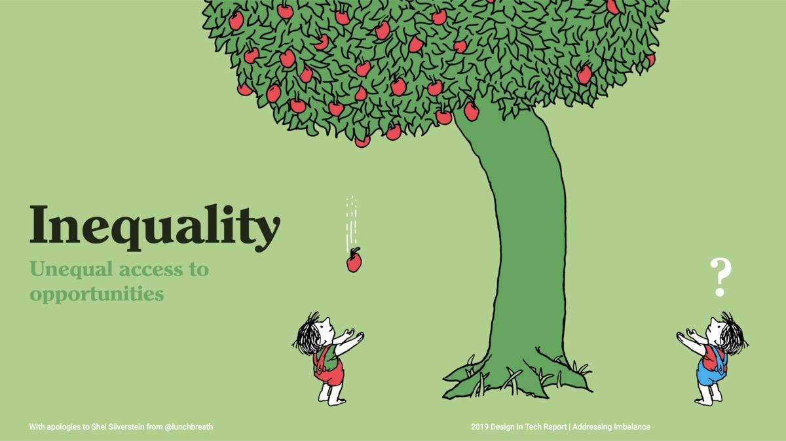
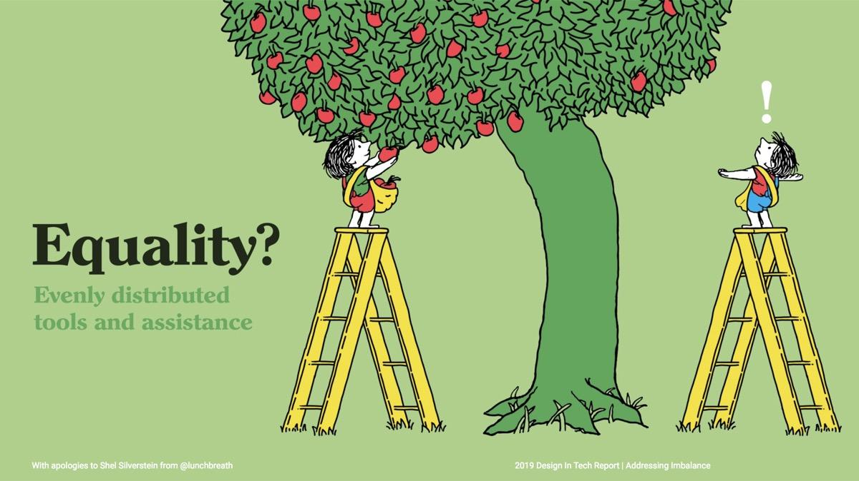
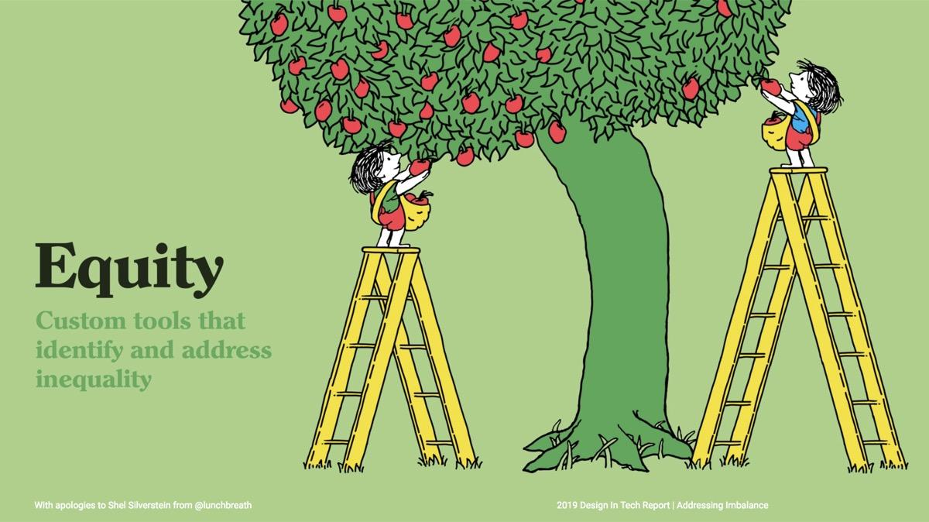
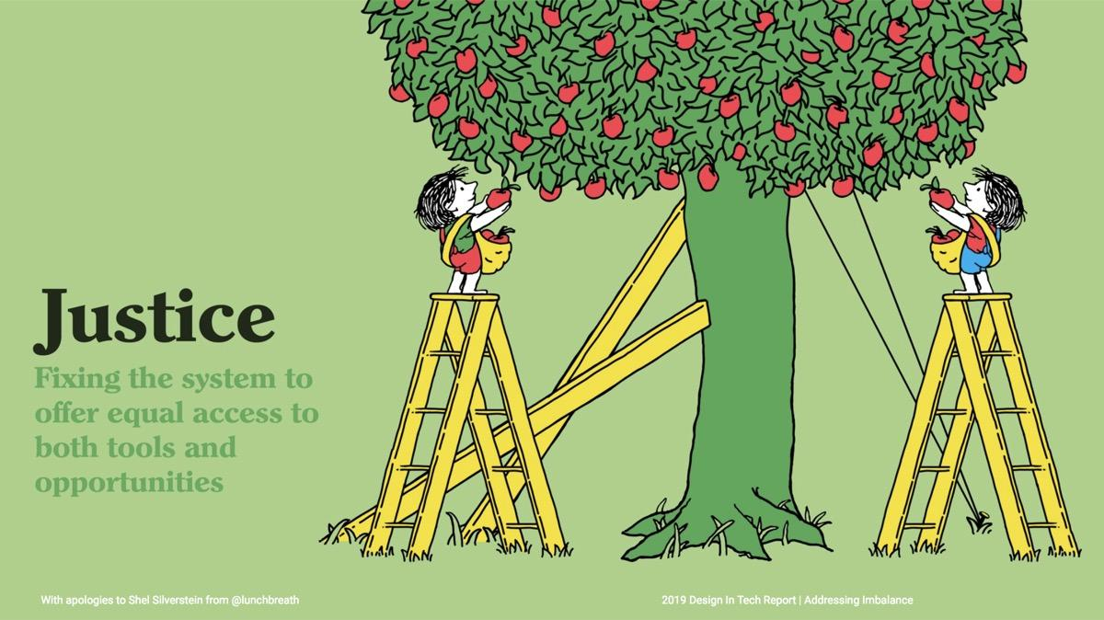
What do we mean by equity?
Notes:
What do we mean by equity? These illustrations were created by Tony Ruth for the 2019 Design in Tech Report to show the differences among: inequality, equality, equity, and justice. In each image, there are two children under opposite sides of an apple tree:
With inequality, people have unequal access to opportunities: The tree bends toward one of the kids, with an apple falling from the plentiful side of the tree, right into the hands of the waiting child. The other child looks up at the tree, hands out but there are no apples falling.
With equality, tools and assistance are evenly distributed : Here both kids have the same size ladder. The child on the plentiful side of the tree is easily reaching and filling a sack of apples. The other child looks up at the tree, hands out to their sides, in exclamation, still unable to get apples.
With equity, there are custom tools that identify and address inequality: The child who couldn’t reach now has a larger ladder. They now can also pick apples, but their side of the tree still has far fewer apples
With justice, the system is fixed to offer equal access to both tools and opportunities: Here the tree has wooden supports and cables to pull it up straight and the tree is plentiful, with apples all around. The children have same-size ladders again and can reach many apples with ease.

Slide 4
The assumptions, perspectives, & biases that go into design decisions determine who benefits & who is left out or harmed from what we create
Notes:
The assumptions, perspectives, & biases that go into design decisions determine who benefits & who is left out or harmed from what we create

Slide 5
Covid vaccine sign-up websites were impossible for some of the most vulnerable
Sign-up sites weren’t designed for
People who only have internet access on mobile phones
People who weren’t technically savvy
Blind people and others who use screen readers
The sites required
Time to research tips on how & when to get an appointment
Volunteer efforts to hack sign-up aggregator sites so people could find appointments
Notes:
Remember all the news around Covid vaccine sign-up website failures? Many covid vaccine sign-up websites were impossible to use for some of the most vulnerable.
Sign-up sites weren’t designed for:
People who only have internet access on mobile phones
People who aren’t technically savvy, or
Blind people and others who use screen readers
The sites required:
Time to research tips on how & when to get an appointment, and
Volunteer efforts to hack sign-up aggregator sites so people could find appointments
We don’t know how many people contracted Covid as a result of equity and access not being considered in many of these sites.
Common human-centered design approaches would have accounted for things like basic accessibility and responsiveness. This is where government digital services often stop. However, just making the digital experience smoother would have furthered inequity by not considering people without internet access, or people who needed to schedule over a phone call because they’re not familiar with using websites--some waited days to sign up over the phone for the same pool of appointments that were snapped up in minutes on websites.
Equity issues would have surfaced had the websites been considered as one touchpoint in the overall experience of getting a vaccine. A service design approach would have found other barriers to actually getting a vaccine, even after the hurdles of sign-up. Some sites were only accessible by car, or required waiting in long lines, which made it impossible to get a vaccine for someone who doesn’t have a car, couldn’t drive safely, or who couldn’t leave their responsibilities during the open hours of a clinic.
An equity-centered approach would have taken into account broader systemic issues that caused people from different groups to be infected at different rates. It would have taken into account mistrust of government, based on historic abuses, especially in the area of medicine--which might have meant earlier partnership with trusted community organizations for messaging.
It’s critical to consider who’s informing your design.

Slide 6
When we center equity in our design, we:
Recognize power imbalances between researcher & participant; designer & users
Provide value back to participants
Identify potential hazards and harms in the services we build
Notes:
When we center equity in our design:
We recognize power imbalances between researcher & participant; designer & users
We provide value back to participants, and
We identify potential hazards and harms in the services we build

Slide 7
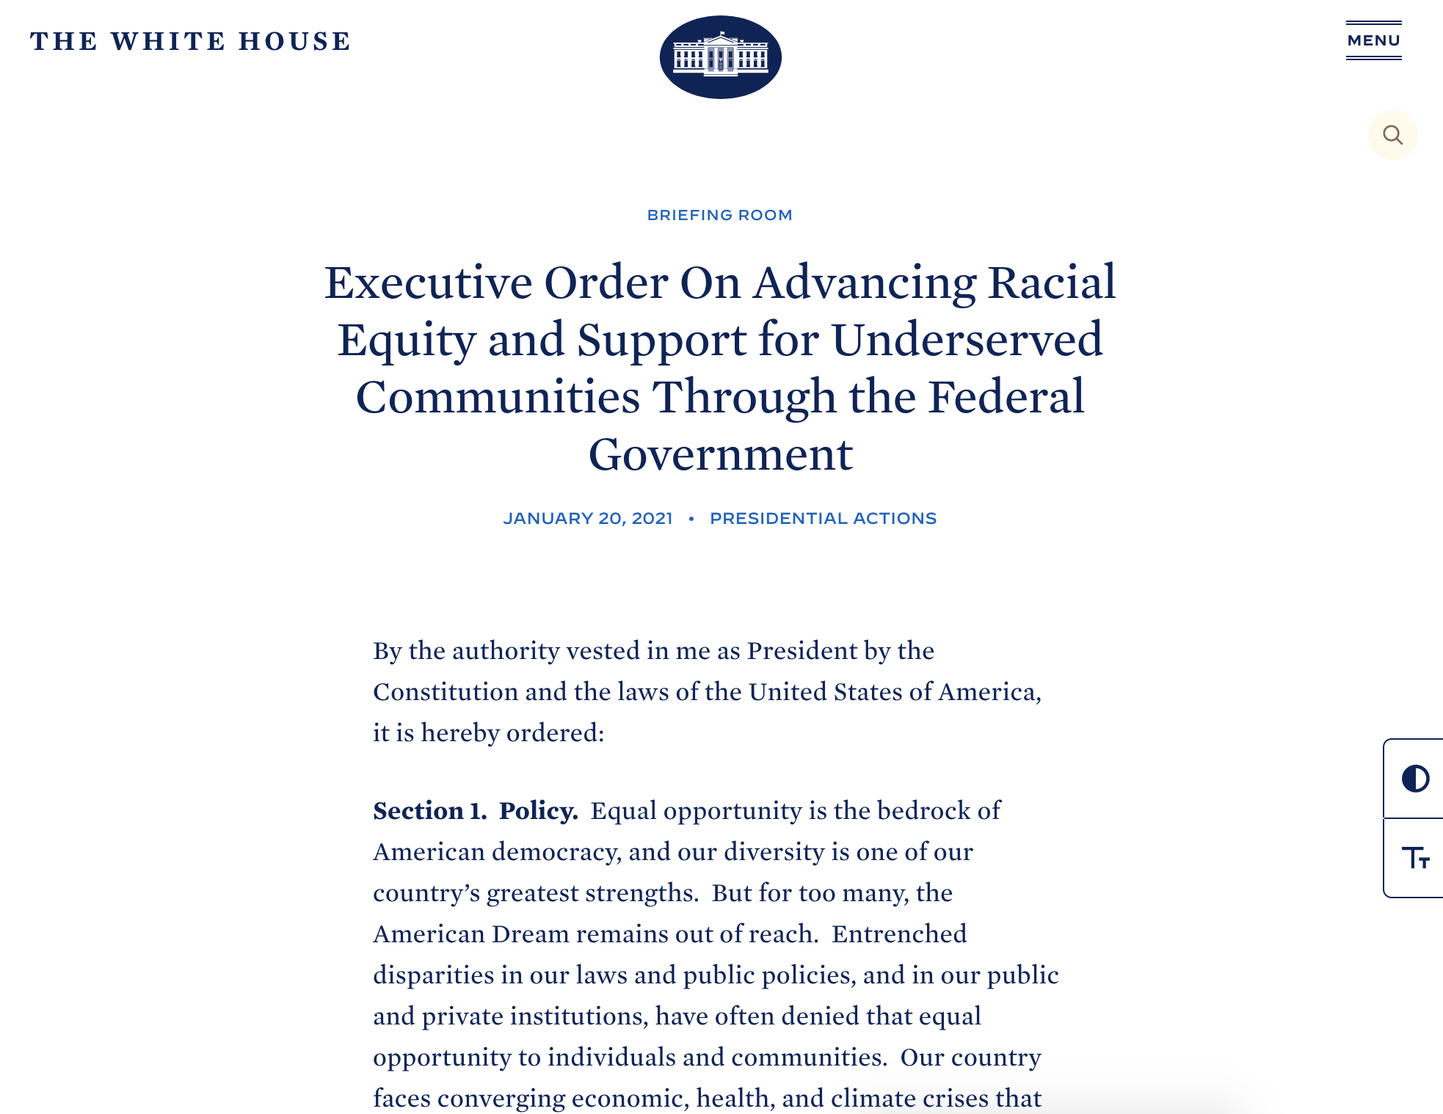
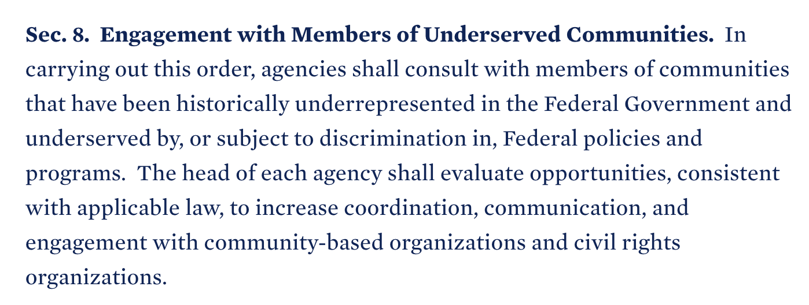
Now’s a great time to work on challenges to equity-centered design in government!
Notes:
Now is a great time to work on challenges to equity-centered design in government~
We’re showing here some excerpts from President Biden’s Executive Order on Advancing Racial Equity & Support for Underserved Communities through the Federal Government.
Section 8 is about Engagement with Members of Underserved Communities. It says: “In carrying out this order, agencies shall consult with members of communities that have been historically underrepresented in the Federal Government and underserved by, or subject to discrimination in, Federal policies and programs. The head of each agency shall evaluate opportunities, consistent with applicable law, to increase coordination, communication, and engagement with community-based organizations and civil rights organizations.”
For federal agencies, we have to show progress toward equity within the first 200 days of Biden/Harris administration. (We’re at 154 days, by the way.) This made it much easier for us at 18F to make the case, for instance, that we need more ways to be able to compensate participants. More on that in a bit.

Slide 8
Planning research
Notes:
Planning research

Slide 9
To start, recognize the power you hold to shape the UX design process
Who controls and influences:
Identifying research goals
Determining the process to follow
Defining priorities and success metrics
Deciding whose perspectives are included
Who else should be involved?
Notes:
Power is not good or bad, it's how it’s used that determines its value. How can you shift your power to benefit your participants’ community?
To start, recognize the power you have to shape the UX design process. Small steps can be impactful to reduce harm on the way to building better practices within your agency.
Think about:
Who controls and influences:
Identifying research goals
Determining the process to follow
Defining priorities and success metrics
Deciding whose perspectives are included
Who else should be involved?

Slide 10
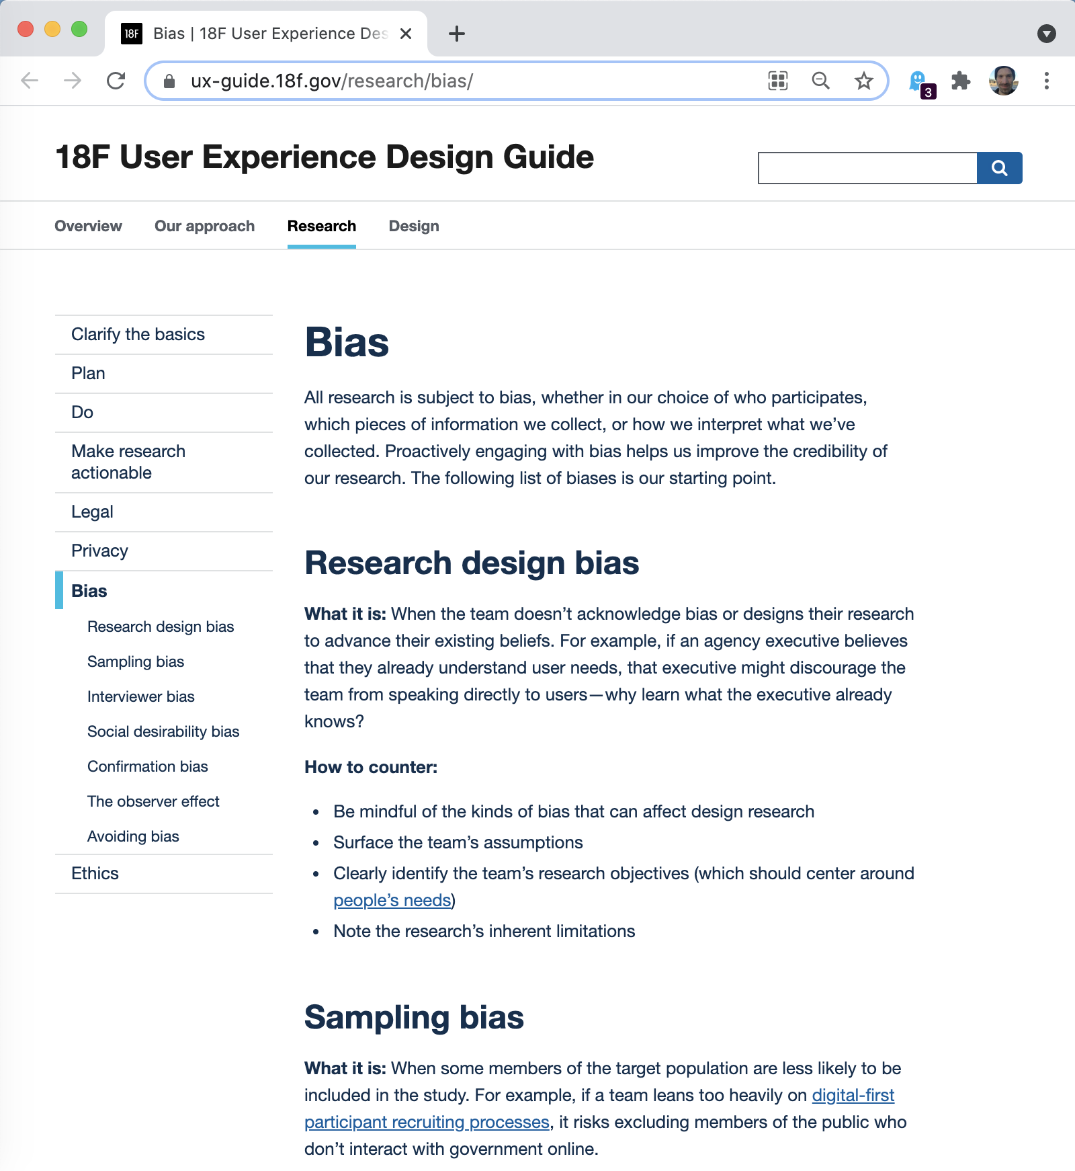
Next look inward
Mitigating bias
We carry our biases into our designs
We need to explicitly identify the relevant* background we bring to the research at hand
* or seemingly irrelevant, but potentially meaningful
Notes:
We have tactics to avoid bias, but there’s more we can do: self-awareness requires work.
We must look inward because we carry our biases into our designs.
We need to explicitly identify the relevant background we bring to the research at hand.
In 18F’s UX guide--a screenshot of the bias page is shown in this slide--we describe some common biases we need to mitigate in our research: sampling bias where the people we interview or test with don’t fully represent the public. Social desirability bias where people tend to respond in ways that paint themselves in the best possible light, regardless of whether or not that bears any resemblance to reality.
Let’s dig in a bit to interviewer bias and confirmation bias where our own beliefs & assumptions influence how we lead sessions & what we hear in those conversations.
As they say, what’s normal to each of us becomes as invisible as air. For example, if you’ve never had physical mobility problems or traveled with someone who does, it’s easy to leave that frame of reference out of your thinking, like when planning how much time it takes to go somewhere or get something done.

Slide 11
As researchers & stakeholders, we identify our frames of reference so we can improve the credibility of our evidence
Notes:
As researchers & stakeholders, we identify our frames of reference so we can improve the credibility of our evidence
We’ve been experimenting with a workshop activity to identify the frames of reference among the team.
We describe this as “frames of reference,” to reinforce that it is the nature of being human: we all have bias because we can’t know every type of experience. We need self-awareness and group understanding.

Slide 12
What are some frames of reference you bring to this project?
On a piece of paper
Consider…
Types of locations where you’ve lived (e.g. urban, rural)
Typical internet speed
Race & ethnicity
Gender identity
Financial situations you’ve experienced
Familiarity with physical & mental disabilities
Your values
Your agency’s values
Anything else you think is relevant
Notes:
First, we do a silent solo exercise to take a first pass at identifying our own frames of reference. At 18F, we’re a consulting group, so the team is often new to working with each other. We note out loud that we’ve only just started working with each other, and we want this to be comfortable for everyone.
We give an example, then prompts, and everyone privately notes their frames of reference on paper or computer.
The prompts as noted in this slide are:
Types of locations where you’ve lived (e.g. urban, rural)
Typical internet speed
Race & ethnicity
Gender identity
Financial situations you’ve experienced
Familiarity with physical & mental disabilities
Your values
Your agency’s values
Anything else you think is relevant
Then, if there are enough people to keep things deidentified, we respond to more specific questions in a google form. We don’t collect names, and we remind people that we’re a small group, so it can’t be truly anonymous--and people should only share what they’re comfortable sharing.

Slide 13
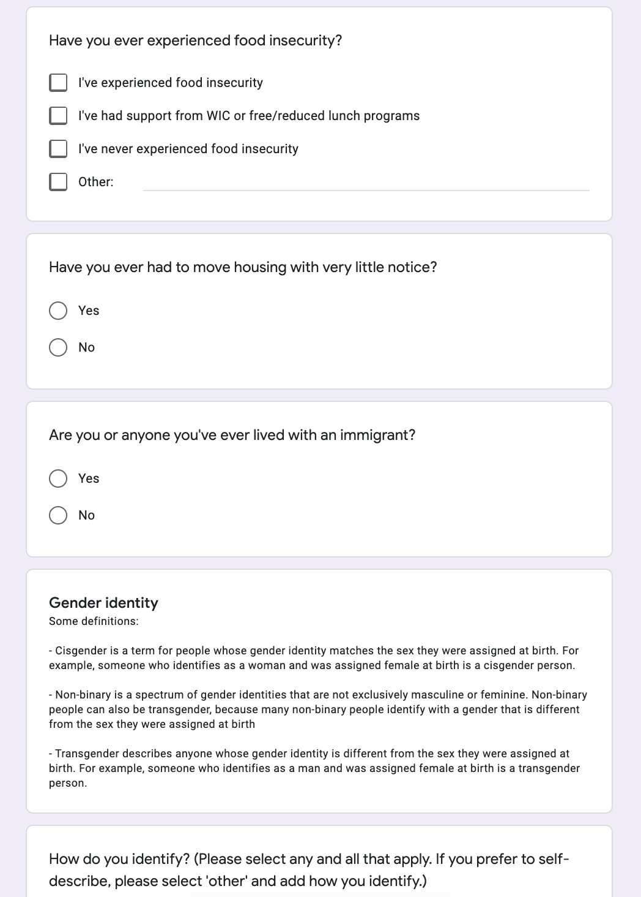
What are some frames of reference you bring to this project? (2)
Google form
Notes:
The Google form: What are some frames of reference you bring to this project? has more specific questions, like “Have you ever had to move housing with very little notice?” and “Are you or anyone you’ve ever lived with an immigrant?” -- there’s an example form linked in the slide notes -- we adjust the form to choose questions that are relevant to the service or product, and to edit or add others as needed.
After everyone’s done, we paste the responses and charts into a digital whiteboard app and discuss.

Slide 14
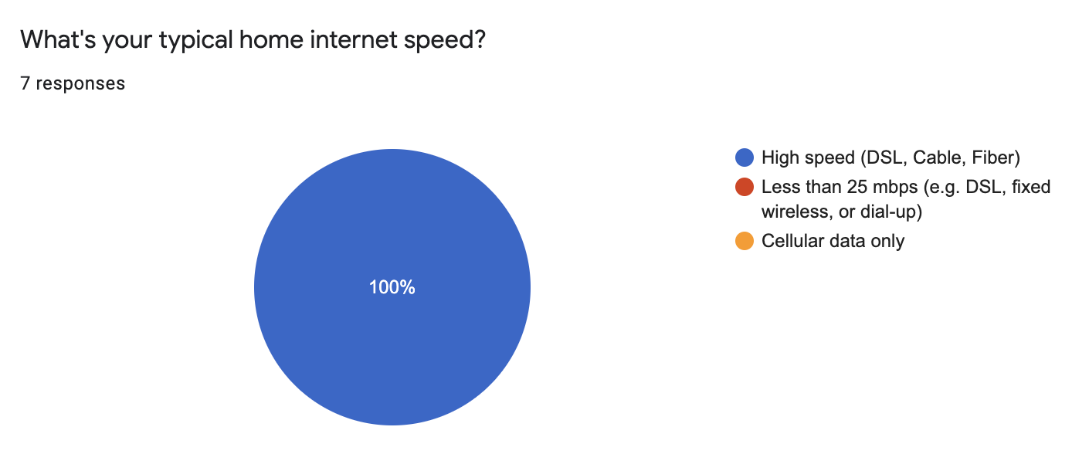
What did you notice?
What did you notice while filling out the form?
Did you notice any perspectives that are clearly missing?
Did anything surprise you?
In one session, we could easily see that all stakeholders have high speed internet
Notes:
While in the whiteboard app, after pasting in the responses & charts, we ask everyone to group the yellow stickies into related frames of reference and label them.
We discuss:
What did you notice while filling out the form?
Did you notice any perspectives that are clearly missing?
Did anything surprise you?
In this slide there’s a screenshot of the results of the question “What’s your typical home internet speed?” where we could easily see that all stakeholders present have high-speed internet. Something we might not have thought about without the exercise, but helped us realize we should include participants with limited internet access.
In a research alignment workshop, this is a good place to move on to a discussion of assumptions we have about what we’re designing, as well as target audiences, and recruiting. The whole group is now primed to bring awareness of our limitations to those conversations.

Slide 15
“Having a team with varied life experience helps us create more accessible, usable products and services.”
18F UX guide
Notes:
The 18F UX Guide notes that:
“Having a team with varied life experience helps us create more accessible, usable products and services.”
Doing the work to recognize missing perspectives on our teams is critical. It helps us recognize who we need to include in our research. However, we still also need to work on the long game of ensuring we hire for diversity in our teams.

Slide 16
It takes more time to recruit participants when we optimize for equity
Recruiting
Develop relationships and trust
Strive for durable relationships with community organizations of marginalize people
Slow down Take the time needed to build relationships and collaborate
Compensate fairly
Pay research participants and community collaborators for the value they contribute
Notes:
It takes more time to recruit participants when we optimize for equity
First, we need to Develop relationships and trust.
When we use a 3rd party platform that supplies participants based on our screeners, we’re optimizing for an impersonal transaction. We have very limited ability to ensure we’re really reaching the most vulnerable members of the public, and we’re not able to reach back out to those participants to provide some value back to them beyond their payment. Those 3rd party platforms also generally rely on people having bank accounts or a payment application in order to be paid, and this leaves out many of the people we need to serve. In 2020, 5.4% of US households were unbanked.
When we recruit from our own networks, say on social media, we tend to get participants who have similar backgrounds to us.
At GSA, a year ago we finally had guidance allowing us to recruit and compensate through 3rd parties. The guidance, however, was to trial this with professional recruiting agencies. While this was a step forward, it didn’t help us reach people who don’t trust government, nor those who don’t have bank accounts.
Ideally, we’re creating durable relationships with community organizations that support marginalized people. Community organizations have developed trust and can facilitate outreach. Sometimes they are also subject matter experts and can provide valuable input as well. Just as with recruiting agencies, the amount we pay includes a fee for their time. In this way, we’re also supporting the valuable work of those community organizations.
Earlier this month, we got approval to pay an advocacy organization for recruiting--they do job placement with people with disabilities, and recently have also started user research recruiting. In getting permission to work with them, we also got permission to recruit through community organizations--a giant step forward for us. (If you’re at a federal agency and would like to chat about the details of how we did this, please reach out.)
Second, we need to slow down and take the time needed to build relationships and collaborate.
Now we need to establish some relationships with more organizations, so we can go to them as projects come up.
Third, we need to compensate fairly
We often hear the rationalization that it’s okay that we’re not compensating people--”the people we speak with are happy to contribute to making things better.” This may be a sign that the participants are privileged to be able to take the time to participate and for whom it’s not a painful experience.
So how do you make the case that compensation is necessary to ensure equitable representation?

Slide 17
We compensate for more than just people’s time
Compensation
Additional financial costs to participation:
Transportation
Time off from work
Child care
Emotional costs to participation:
Anger
Shame
Anxiety
Notes:
We need to compensate for more than just people’s time
Additional potential costs & barriers to participation include:
Transportation
Time off from work, and
Child care
There are also emotional costs to participation. Sometimes we ask participants to imagine or recall a painful personal experience, including previous difficulties that resulted from interactions with government services. Participants may leave an interview carrying anger or shame from those experiences. Other times, particularly with users of work tools that are being modernized, interviews can leave participants with anxiety about possible changes to their job.
But we’re not just compensating for costs.

Slide 18
We should compensate people for the value they provide when they share their lived experience
Notes:
We should compensate people for the value they provide when they share their lived experience
In a recent talk, Sarah Fathallah, a Moroccan social designer & researcher, encouraged participants to reflect on a design project interaction and note: How much were the designers paid? How much was the design participant paid? How much did each party have to give up to be able to show up for the interaction?
Chances are payment, and the things they had to give up, weren’t equal between the designer and the participant.

Slide 19

When we center equity in our design:
Recognize power imbalances between researcher & participant; designer & users
Provide value back to participants
Identify potential hazards and harms in the services we build
Notes:
Compensation is also an opportunity to think about how we provide value back to our participants--one of the things we mentioned as a way to center equity in design.

Slide 20
We can compensate with more than just money
Compensation
Opportunity to provide feedback on design over time
Offer to find out answers to questions they may have
Resources for additional information on the topic
Whenever possible, share the outcomes of the research
Notes:
We should compensate with more than just money.:
We can give an opportunity to provide feedback on design over time
Resources for additional information on the topic
We can offer to find out answers to questions they may have
Whenever possible, we can share the outcomes of the research

Slide 21
Conducting research
Notes:
Conducting research

Slide 22
Your impact matters more than your intentions
Notes:
Your impact matters more than your intentions
It’s not enough to approach your design activities with the confidence that you’re an empathetic person; that you’re skilled at assessing someone else’s feelings about an experience.

Slide 23
(Theme 1) When we center equity in our design, we:
Recognize power imbalances between researcher & participant; designer & users
Provide value back to participants
Identify potential hazards and harms in the services we build
Notes:
Earlier we said that one of the ways we can center equity in our design is to recognize power imbalances between researchers & participants, and between designers & users

Slide 24
UX design has inherent power imbalance
The researcher:
Decides what topics to cover, potentially ignoring what the participants see as relevant or important
Asks the questions and the participant answers, creating a one-direction data extraction interaction
Shapes the insights and observation narratives from the research, without confirmation from the community that the insights are drawn from
Notes:
UX design has inherent power imbalance
The researcher decides what topics to cover, potentially ignoring what the participants see as relevant or important
The researcher asks the questions and the participant answers, creating a one-direction data extraction interaction
The researcher shapes the insights and observation narratives from the research, without confirmation from the community the insights are drawn from

Slide 25
Shared power results in better design & outcomes
Give over time in your design & research activities for people to tell their story, in their own words, in addition to meeting your objectives
Return value to the participant community as quickly as you benefit from their lived experiences
Notes:
Shared power results in better design & outcomes
An equity-centered process creates the conditions for the participant to have more control over what’s discussed and makes sure critical data informs the design.
Honor the fact that your participants have information that’s of value to you. Give over time in your design & research activities for them to tell their story in their own words, if they want to, in addition to meeting your objectives.
Return value to the participant community as quickly as you benefit from their lived experiences.

Slide 26
You represent the government
History
You bring with you the history of government interaction with your participant community
Acknowledge past failings and prove to the community why they should trust you and work with you
Notes:
You represent the government
You bring with you the history of government interaction with your participant community.
Acknowledge past failings and prove to the community why they should trust you and work with you.

Slide 27
You represent the government (2)
Current relationships
Learn who else is working with the community so you can avoid overtaxing the community: Collaborate so you don’t create multiple communication and design research channels.
Notes:
You represent the government
Learn who else is working with the community so you can avoid overtaxing the community:
Collaborate so you don’t create multiple communication and design research channels.

Slide 28
Prepare participants for what to expect ahead of your research session
Share the research topic(s) that will be covered
This is especially important when you need to ask participants about negative or stressful experiences.
Explain why you’d like their input Tell them why you’d like to learn from them, in particular
Plain language consent forms
Note they can change their mind during the conversation or afterward with no penalty.
Notes:
Before your research session, prepare participants for what to expect--give an outline of how the session will run.
Share the research topic(s) that will be covered
This is especially important when you need to ask participants about negative or stressful experiences, such as applying and being denied services.
Explain why you’d like their input
Tell them why you’d like to learn from them, in particular. This way participants can decide if they agree with the value of giving you their time.
Provide plain language consent forms, and note they can change their mind during the conversation or afterward with no penalty.

Slide 29
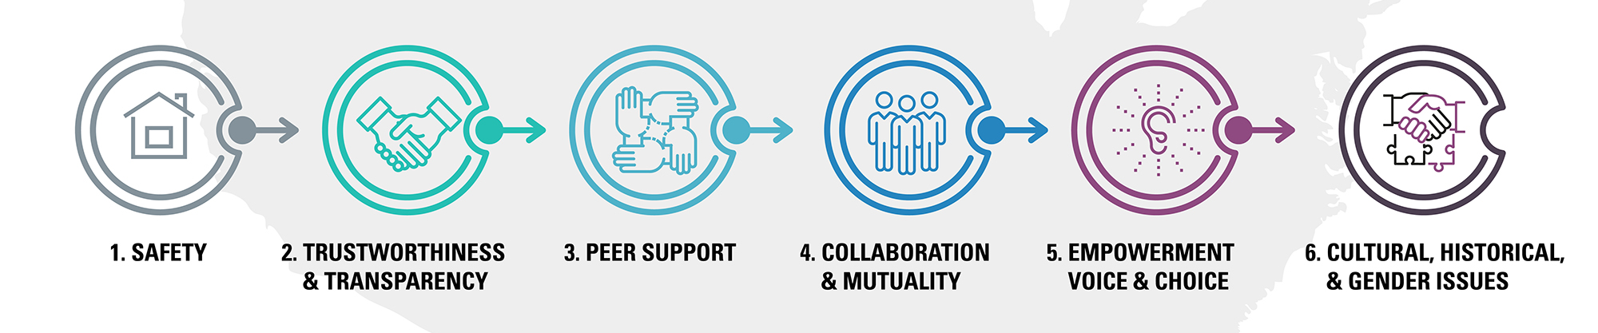
Take a trauma-informed approach to research
CDC’s Office of Public Health Preparedness and Response (OPHPR) and SAMHSA’s National Center for Trauma-Informed Care: 6 Principles to a Trauma-Informed Approach
Notes:
If you saw Rachael Dietkus’ opening keynote, you heard wisdom about what it means to bring a trauma-informed approach to our UX design work. I’m not a trained social worker, but I’d like to share what I learned from my professional frame of reference for trauma-informed conversations--from 10 years of supporting survivors of domestic violence and sexual assault. I want to talk about how to hold space and support someone else’s autonomy--their power.
People often access government services in their most vulnerable moments--after a violent incidence, loss of financial independence, when they’re facing health risks--the list goes on.
We don’t always know when our conversations may bring up very difficult experiences that have had lasting effects. The way we behave as UX researchers can affect how re-traumatizing or empowering those conversations are.
Re-experiencing trauma can also be an issue for the people conducting research, so I’ll talk a bit about self-care as well.
The six principles shown on this slide are from the CDC’s Office of Public Health Preparedness and Response (OPHPR) and SAMSHA’s National Center for Trauma-Informed Care – they developed these for a training about the role of trauma-informed care during public health emergencies. I’ll run through briefly how they each apply to user research, and then dig in a little deeper:
Safety - Notice & prevent interactions that put people’s emotional or physical safety at risk. This is much easier to do if you can establish rapport early in an interaction, while still respecting boundaries.
Trustworthiness & transparency - Be clear, consistent, and transparent. When you tell someone in advance what to expect in an interview or usability session, follow through on that plan. Don’t make false promises about what the project’s going to achieve.
Peer Support – If your research plan has you feeling like participants may need a peer present to participate, you probably should review your plan with a trained social worker. If you’re recruiting, and someone says they’d like to participate but asks if they can bring a friend, that’s great--ask them about whether they’d prefer the person be there as support or an equal contributor in the conversation. This communicates two things--your value for their input and that they have control over how the conversation will go. Also, consider peer support for yourself as a researcher. It’s often wise to pair up for research, and prepare ahead of time for how you’ll recognize and handle the situation if it gets triggering or unacceptable for one of you
Collaboration & mutuality - Share power in your interactions & share back your learnings--ask participants if they would be willing to talk through the findings so you can know where you missed the mark
Empowerment & choice - Ensure that participants have choice and control. Ask what you can offer in return--we mentioned earlier--that can look like: resources for more information, answering questions, sharing outcomes of the research.
Cultural, historical, & gender issues - When you’re representing a government program, seek out the history of interactions between that program and the community you’re interviewing. Sometimes it may be appropriate to acknowledge that history in the conversation. If you’re from a privileged group that usually holds power and rarely experiences hate or disregard, are you the only option for interviewing people from marginalized groups? It’s especially important that you develop your awareness of ways you can cede power in decision-making with people experiencing re-traumatization--whether that’s a participant or your fellow researcher.

Slide 30
Notice when emotional safety is at risk
Look for:
Anger
Crying
Nervousness
Visible or audible shakiness, sadness
Quick answers & agreeing
Big change in attitude
Offer options:
“I realize this is hard. Would you like to take a break or stop?”
“Would you like me to stop recording?”
“Do you want to just here quietly for a few minutes?”
Notes:
How do you notice when emotional safety is at risk and what do you do? This could happen to the person you’re interviewing or to you.
Signs of distress include anger, crying, nervousness, visible or audible shakiness or sadness, quick answers & agreeing, or a big change in attitude.
If the person you’re interviewing seems to be in distress or the conversation gets hard, offer options to pause or stop. And remember to genuinely give them the power to make that decision. Hold more space than usual for silence.
You might say things like: “I realize this is hard. Would you like to take a break or stop?”
“Would you like me to stop recording?”
“Do you want to just sit here quietly for a few minutes?”
These are questions. Asking is very different from stating something like “This is really hard. Let’s stop. We can try again another time.” That’s you as the researcher making the decision--centering your discomfort rather than leaving the power to stop the conversation with the person who’s upset.
It’s not okay to give advice or specific help--we’re not trained. It is good, however, to offer some closure if they do decide to stop an interview: “Thank you for taking the time today--I’ll reach back out to you, but please only reply if you want to.”
There are some related resources in the slide notes: A video of panel from Women Talk Design with Sarah Fathallah & Rachael Dietkus on Trauma-informed design, and My Grandmother's Hands: Racialized Trauma and the Pathway to Mending Our Hearts and Bodies, a book by Resmaa Menakem

Slide 31

Traditional academic approaches can increase power distance
Optimize for:
Free-flowing conversation instead of formal scripts
Stories instead of answers
Notes:
The fields of human-computer interaction and usability research have a traditional academic background that values academic rigor, often for appropriate reasons.
But applying rigor to our qualitative research -- to our semi-structured interviews, can unnecessarily increase the power distance between the researcher and the participant.
From the moment someone receives a consent form they can feel like a research subject. Can you make it more conversational? Emphasize the value they will bring?
We still recommend having clear overarching research goals and research questions. However instead of a script you’ll follow from top to bottom, consider having a list of guiding questions & prompts to help you address your overall questions. Take a look at a recent script you’ve used. How would you change it to cede more control over the conversation to the person you’re interviewing?
Related resource: For an example of this approach, check out the work Cyd Harrell & Dana Chisnell did with the National Conference on Citizenship: Researching the safety net during the COVID crisis: Approaches for urgent and respectful interviews

Slide 32
Ask for consent during interviews, not just at the beginning
“I’d like to ask about a time you _________ — are you up for talking about that?”
Notes:
Ask for consent on a granular basis, not just at the beginning of an interview. Just because someone agreed to talk with us doesn’t mean they knew what they were getting into or how it would feel in the moment. You don’t have to ask for consent for every question, but the first time you hit a topic that might bring up a stressful time, tell the person what you’d like to talk about, and ask if that’s ok.
This sets up the dynamic that they can help steer the conversation.
Also give space for people to pause. This is a user research basic, I know, but it always bears repeating. Next time you’re facilitating anything and there’s silence, try counting to five in your head--1, one thousand, 2 one thousand, 3 one thousand, 4 one thousand, 5 one thousand. It’s a long time--establish that there’s not a rush and you’re there to hear what the person has to say.

Slide 33
Protect employee safety during internal research
When stakeholders observe usability tests and interviews, they can cause:
Anxiety
Diminished honesty
Repercussions for things said
“Usability research gets the best results when participants are most at ease, so management is generally not in the room”
Notes:
Protect employee safety during internal research
We want stakeholders to be engaged, but having them observe usability tests and interviews can cause:
Anxiety
Repercussions for things said, and
Diminished honesty
It’s helpful to establish a response ahead of time for when stakeholders ask to observe, like, “Usability testing gets the best results when participants are most at ease, so management is generally not in the room.” After you tell them this, describe how you will share results and ask them if they have concerns you can address.

Slide 34
Don’t do synthesis alone
Basic human-centered design: include teammates, partners, and stakeholders in the sensemaking to reduce bias
With equity-centered design: include the participant community to shape insights and narratives. Bring the people who you’re quoting in to help clarify what was heard and to validate findings.
Notes:
Don’t do synthesis alone It’s basic human-centered design to include teammates, partners, and stakeholders in sensemaking to reduce bias.
For equity-centered design, include the participant community to shape insights and narratives. Bring in the people who you’re quoting to help clarify what was heard and to validate findings. Are you elevating people’s voices or speaking for them?

Slide 35
(Theme 3) When we center equity in our design, we:
Recognize power imbalances between researcher & participant; designer & users
Provide value back to participants
Identify potential hazards and harms in the services we build
Notes:
The third approach we’d like to discuss for centering equity in our design is to identify potential hazards and harms in the services we build

Slide 36
Identify potential hazards so our services don’t cause people harm

Slide 37
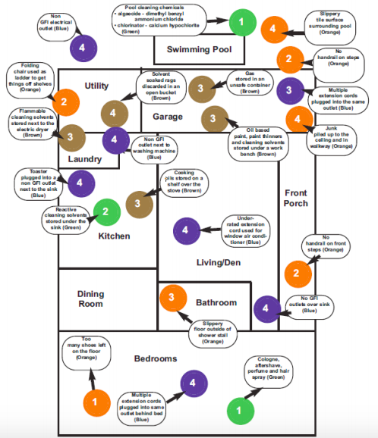
Map hazards in design artifacts
Diagram of household hazards from an OSHA hazard-mapping manual
Notes:
In a 2019 piece: Hazard Mapping -- The information architecture of ethics, a draft proposal, Erika Hall suggested we consider including hazards in our wireframes, similar to how a building floor plan calls out chemical & electrical hazards. The diagram in the slide is from Erika’s piece: It shows a residential apartment floor plan with color-coded annotations indicating a variety of household hazards. There's no legend and the annotations aren't legible. In the context of a wireframe, you might annotate hazards like privacy breach or discrimination, and describe how you’ll mitigate those hazards.

Slide 38
Add an interview question: How might people be harmed by this system?
Example: New statewide homelessness data warehouse
Hazards:
Data misuse
Targeted abuse
Potential Harms: Anxiety
Fear Diminished confidence
Physical danger Loss of housing
Notes:
You can add a simple interview question as one way to identify hazards:
How might people be harmed by this system?
I was working on a new statewide homelessness data warehouse. The intent of these data warehouses is to facilitate coordination of care. Permissions are based on data use agreements between agencies, and somewhat restricted according to need for access.
Nevertheless, there was legitimate access in the state I was working in, for 1000s of people to have access to search the warehouse, including people’s names--between state employees, housing advocates, law enforcement, and medical practitioners.
Now, generally, data from domestic violence shelters is not included in these data warehouses. However, sometimes there aren’t enough beds for survivors to stay in a domestic violence shelter. So with a statewide system, you could suddenly make it easier for an abuser who has access to find their victim. In this case, someone did raise concerns in our interviews, and we were able to build in scans for queries that didn’t make sense, like program staff searching for the same person in multiple geographic locations. We were able to identify the hazards of data misuse and targeted abuse so we could work to prevent the system from causing harms like: anxiety,
fear, diminished confidence, physical danger, and loss of housing.

Slide 39
Hazards (an incomplete list)
Data theft
Data misuse
Opaque algorithms
Privacy breach
Widespread misinformation
Techno-chauvenism
System outage
Enshrined status quo
Enshrined power structures
Discrimination
Dehumanization
Oppression
Racial profiling
Co-optation
Exploitation
Systemic bias
Deception
Harassment
Targeted abuse
Attention hijacking
Intimidation
Entrapment
Abandonment
Judgement
Disregard
Individual bias
Deadnaming
Power imbalance
Assumptions
Displacement
Triggering topics
Exclusion
Inaccessibility
Digital redlining
Notes:
There are many potential hazards in digital products and services. This list of 34 hazards isn’t specific to government, and it’s certainly not complete.
You can use it like a checklist of what we need to be on the lookout for:
Data theft
Data misuse
Opaque algorithms
Privacy breach
Widespread misinformation
Techno-chauvenism (assuming technology is the solution)
System outages
Enshrined status quo
Enshrined power structures
Discrimination
Dehumanization
Oppression
Racial profiling
Co-optation
Exploitation
Systemic bias
Deception
Harassment
Targeted abuse
Attention hijacking
Intimidation
Entrapment
Abandonment
Judgement
Disregard
Individual bias
Deadnaming (when a trans person’s birth name is used for someone who’s changed their name)
Power imbalance
Assumptions
Displacement
Triggering topics
Exclusion
Inaccessibility
Digital redlining

Slide 40
Harms (an incomplete list)
Anxiety
Depression
Fear
Anger
Shame
Diminished confidence
Incorrect understanding of reality
Damaged reputation
Lack of consent
Being misinformed
Physical danger
Underserved, unmet needs
Diminished freedom
Legal penalties
Financial penalties
Injury or death
Environmental damage
Discomfort
Diminished autonomy
Diminished access
Invisibility
Reduced influence
Misrepresentation
Retraumatization
Isolation
Loss of progress
Loss of employment
Loss of housing
Loss of education
Exhaustion
False hope
Notes:
Those are hazards because they can cause a variety of harm. This list of 31 harms is also not complete:
Anxiety
Depression
Fear
Anger
Shame
Diminished confidence
Incorrect understanding of reality
Damaged reputation
Lack of consent
Being misinformed
Physical danger
Underserved, unmet needs
Diminished freedom
Legal penalties
Financial penalties
Injury or death
Environmental damage
Discomfort
Diminished autonomy
Diminished access
Invisibility
Reduced influence
Misrepresentation
Retraumatization
Isolation
Loss of progress
Loss of employment
Loss of housing
Loss of education
Exhaustion
False hope

Slide 41
Include hazards & harms identification in your design activities
Interviews: Ask “How might people be harmed by this system?” or “How might someone use this system to cause harm?”
Journey maps: Add a row for potential harms associated with the moments or decisions in the map
Personas: Who’s missing? Who decides? Include potential risks in the relevant personas, if they’re present in the research.
Heuristic evaluations: Consider what hazards the service or product might hold for its users
Notes:
Include hazards & harms identification in your design activities
Interviews: Ask “How might people be harmed by this system?” or “How might someone use this system to cause harm?”
Journey maps: Add a row for potential harms associated with the moments or decisions in the map
Personas: Ask who’s missing? Who decides?
Also, include potential risks in the relevant personas, if they’re present in the research.
Heuristic evaluations: Consider what hazards the service or product might hold for its users

Slide 42
Recap: When we center equity in our design, we:
Recognize power imbalances between researcher & participant; designer & users
Provide value back to participants
Identify potential hazards and harms in the services we build
Notes:
To recap, when we center equity in our design:
We recognize power imbalances between researcher & participant; designer & users
We provide value back to participants, and
We identify potential hazards and harms in the services we build.
Questions to take back to your work:
Can you recognize the power you have to influence your research practice, and advocate for changes?
Can you work with your participants’ communities to scope your research so the data collected could be used for other interests or concerns of that community?
What small steps can you take to reduce harm on the way to building better practices in your agency?

Slide 43
Some resources to dig deeper
Design Justice Principles, The Design Justice Network
The Ethical Researcher’s Checklist, Alba Villamil
Ethics & Power: Understanding the Role of Shame in UX Research, Vivianne Castillo
Equity-Centered Community Design Field guide, by Creative Reaction Lab
My Grandmother's Hands: Racialized Trauma and the Pathway to Mending Our Hearts and Bodies, Resmaa Menakem
Researching the safety net during the COVID crisis: Approaches for urgent and respectful interviews, Cyd Harrell & Dana Chisnell
Trauma-informed design, Sarah Fathallah & Rachael Dietkus -- video of panel with Women Talk Design
AU.gov on Preparing for challenging research topics
Gov.uk on Researching emotionally sensitive subjects
Notes:
Some resources to dig deeper
Design Justice Principles, The Design Justice Network
The Ethical Researcher’s Checklist, Alba Villamil
Ethics & Power: Understanding the Role of Shame in UX Research, Vivianne Castillo
Equity-Centered Community Design Field guide, by Creative Reaction Lab
My Grandmother's Hands: Racialized Trauma and the Pathway to Mending Our Hearts and Bodies, Resmaa Menakem
Researching the safety net during the COVID crisis: Approaches for urgent and respectful interviews, Cyd Harrell & Dana Chisnell
Trauma-informed design, Sarah Fathallah & Rachael Dietkus -- video of panel with Women Talk Design
AU.gov on Preparing for challenging research topics
Gov.uk on Researching emotionally sensitive subjects

Slide 44
Thank you!
Contact benjamin.peterson@gsa.gov julie.strothman@gsa.gov
Follow @18F
ux-guide.18f.gov
Notes:
Thank you!
Contact
benjamin.peterson@gsa.gov
julie.strothman@gsa.gov
Follow @18F
ux-guide.18f.gov

