Slide 1
Discovery Research For APIs: Why And How
Andrew Fichter
Product Owner
VA Lighthouse APIs
Maria Vidart-Delgado
Sr. UX Researcher
Ad Hoc LLC - VA Lighthouse APIs
2021 User Experience Summit
June 23, 2021

Slide 2
Agenda
What are VA Lighthouse APIs?
Impact
Why discovery for APIs?
How to? (an example)
Methods
Questions
Learnings
Key Takeaways
FOR INTERNAL USE ONLY Office of Information and Technology

Slide 3
What are VA Lighthouse APIs?

Slide 4
APIs are digital “pipes” that connect UIs to backend systems.
FOR INTERNAL USE ONLY Office of Information and Technology
Notes:
API is short for Application Programming Interface. APIs are like digital pipes that connect the websites you use to backend systems, and they “transport” information, requests and return data to answer those requests.
In the context of government, APIs mediate the communication between people using a website and agencies’ databases. An API, for example, will enable people to submit documents or request information from an agency’s database in a secure way.
We work with a set of APIs at VA Lighthouse that enable Veterans to apply, manage and appeal benefits digitally.

Slide 5
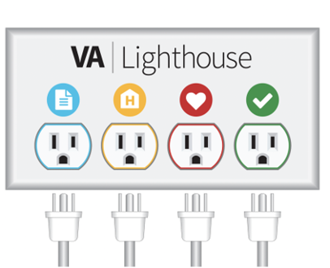
APIs can solve many problems at VA
The VA Lighthouse API platform offers a portfolio of public-facing services, allowing third parties to seamlessly and securely “plug in” to VA data – much like plugging an appliance into a wall socket.

Slide 6
APIs help solve problems at VA
The Department of Veterans Affairs offers many critical benefits and services to an enormous population of Veterans.
But the process to discover, apply for, and obtain access to those benefits and services is often time-consuming, difficult, and slow.
VA Lighthouse APIs help to address this.
Veterans applying for VA benefits wait weeks (often months) for an award decision, while relying on paper mail correspondence to navigate the application process. Until recently, Veteran benefit claims applications could not be submitted digitally to VA.

Slide 7
Who integrates with VA Lighthouse Benefits and Appeals APIs?
VA.gov
Third party vendors that offer specialized software for Veteran Service Organizations (VSOs)
Veteran Law Offices
County VSOs
VSOs assist Veterans with their claims.
FOR INTERNAL USE ONLY Office of Information and Technology
Notes:
These APIs are used by other teams at VA, third-party vendors that offer specialized software for Veteran Service Organizations, known as VSOs, Veteran Law Offices and County VSOs. And they enable Veterans and their representatives to digitally submit VA forms and supporting documentation in a secure way.

Slide 8
Impact

Slide 9
Impact indicators
25%
In 2021, a self-service form was launched on VA.gov (and powered by a new API), enabling Veterans to digitally submit a specific Appeals form for the first time.
Almost 25% of all submissions of this form now come through the API.
FOR INTERNAL USE ONLY Office of Information and Technology

Slide 10
Impact indicators continued
55,000
In April 2021, VSOs digitally submitted more than 55,000 claims packets to VA, and this number has been climbing steadily since the API that enables this was launched.
FOR INTERNAL USE ONLY Office of Information and Technology

Slide 11
Why discovery for APIs?
Notes:
We have conducted extensive discovery research projects for the Benefits and Appeals APIs. Why?

Slide 12
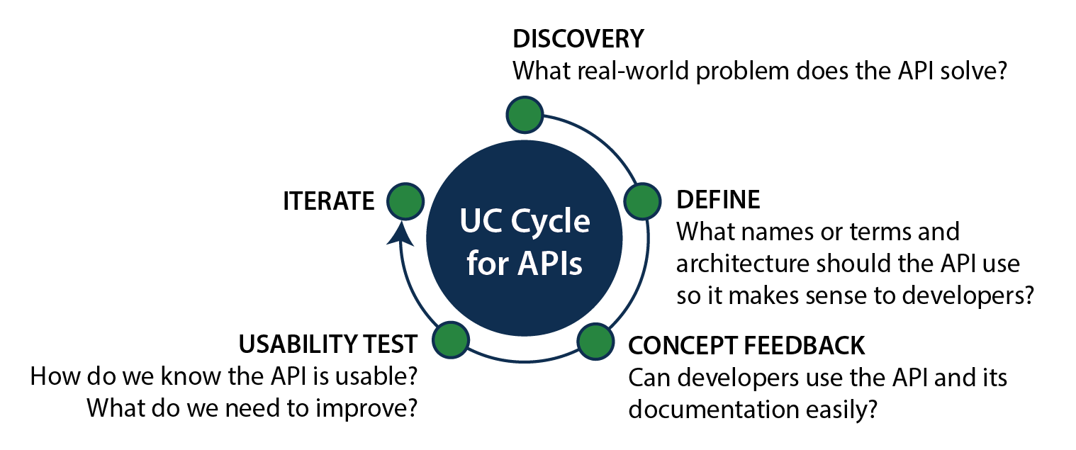
UX for APIs
UC Cycle for APIs
Discover
What real-world problem does the API solve?
Define
What names or terms and architecture should the API use so it. Makes sense to developers?
Concept Feedback
Can developers use the API and its documentation easily?
Usability Test
How do we know that API is usable? What do we need to improve?
Iterate.
FOR INTERNAL USE ONLY Office of Information and Technology
Notes:
Before we dig into the why of discovery, let me give some context. There are different phases and different types of UX work for APIs.
Discovery aims to understand the real-world problems that APIs will solve, and also to deeply understanding the complexities of VA processes, policy frameworks, legal constraints and the requirements of internal systems.
Once we understand what the API will do, there’s a phase of architecting the API, defining naming conventions, naming resources, mapping out functions, writing documentation on how to use it in a way that makes sense to developers who will not be familiar with the API or in some cases with VA’s internal processes and terminology.
After, UX focuses resources on ensuring that developers can easily use the API and its documentation, and uncovering potential (big) problems.
This initial feedback gets incorporated into prototypes and designs than then get tested more widely to establish benchmarks and validate designs.
With changes to the API, like new versions or tweaks in the documentation, and depending on how big these changes are, then this will trigger new cycles of research.

Slide 13
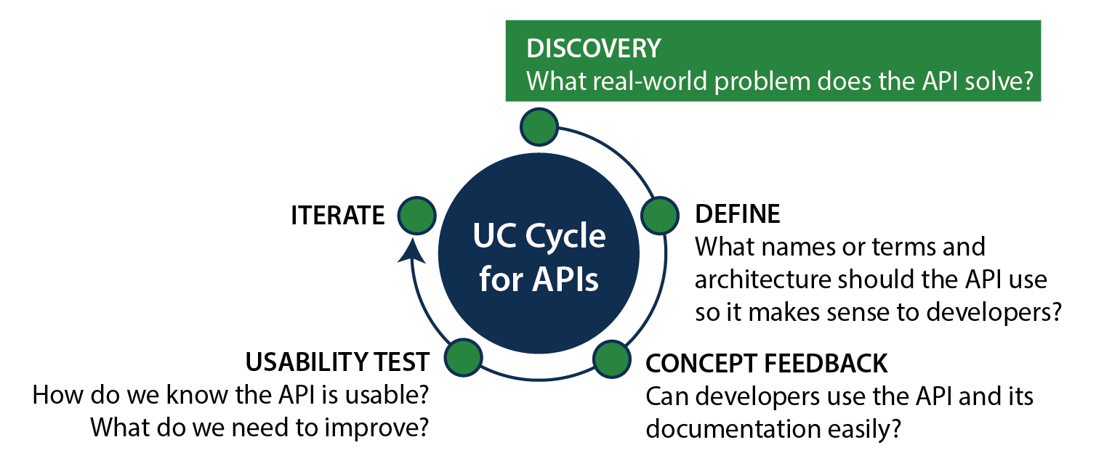
UX for APIs Continued
UC Cycle for APIs
Discover
What real-world problem does the API solve?
Define
What names or terms and architecture should the API use so it. Makes sense to developers?
Concept Feedback
Can developers use the API and its documentation easily?
Usability Test
How do we know that API is usable? What do we need to improve?
Iterate.
FOR INTERNAL USE ONLY Office of Information and Technology
Notes:
I’m focusing now the phase of discovery. This initial phase of discovery ensures that the team is solving the right problem with the API, and doing it in a way that makes sense within existing regulations and policy frameworks.

Slide 14
Differences between UX Phases
Discovery
Other UX Phases
Geared to end-users
Understand processes and contexts of government services
Define problems (policy versus technical)
Geared to API users
Understand users’ workflows and information needs
Assess whether APIs are usable
FOR INTERNAL USE ONLY Office of Information and Technology
Notes:
Differently from other phases, discovery for APIs
Is centered around end-users, who can be both external to VA, like Veterans, or internal to VA, like review officers.
Is geared towards understanding processes and services end-to-end, the people involved in those processes and services, the pain points they experience and what they are trying to accomplish
And it strives to define and delineate problems, what can be solved with technical solutions, what is a policy problem?

Slide 15
Why Discovery research for APIs? (1)
Ensure the API solves the right problem.
FOR INTERNAL USE ONLY Office of Information and Technology
Notes:
So what this means is that we do discovery research for APIs”
To ensure the API solves the right problem

Slide 16
Why Discovery research for APIs? (2)
Ensure the API solves the right problem.
If it doesn’t, developers won’t know what to build with it.
FOR INTERNAL USE ONLY Office of Information and Technology
Notes:
If it doesn’t solve the right problem, developers who integrate with it won’t know what to build with it.

Slide 17
Why Discovery research for APIs? (3)
Ensure the API solves the right problem.
If it doesn’t, developers won’t know what to build with it.
If developers don’t know what to build with it, you can’t UX your way to adoption.
FOR INTERNAL USE ONLY Office of Information and Technology
Notes:
If developers don’t know what they can build on top of your API, you can invest all resources making beautiful APIs with the most complete documentation that no one will be able to use.

Slide 18
How to? An Example Methods, Questions, Learnings
Notes:
We will talk now about how we conduct discovery research, the methods we use, the questions we ask and what we’ve learned, and I will use a specific example.

Slide 19
An Ethnographic Approach
An ethnographic approach to understand the benefits and appeals application and adjudication process at VA.
FOR INTERNAL USE ONLY Office of Information and Technology
Notes:
We use an ethnographic approach to understand the benefits and appeals application and adjudication processes at VA.

Slide 20
An Ethnographic Approach Continued
An ethnographic approach to understand the benefits and appeals application and adjudication process at VA.
Ethnographic approach equals Systems thinking:
How systems are set up?
To what end?
What’s their organizing principle?
FOR INTERNAL USE ONLY Office of Information and Technology
Notes:
An ethnographic approach is akin to systems thinking. Consider that ethnography, the main method that anthropologists use, was developed to study cultures, which anthropologists commonly approach as systems of shared meaning.
So an ethnographic approach asks how large systems are set up, to what end, and their organizing principles.

Slide 21
Ethnographic Methods (1)
Over 65 interviews with VSOs, Attorneys, Claims Agents, VA staff and SMEs located all over the country.
FOR INTERNAL USE ONLY Office of Information and Technology
Notes:
We use ethnographic methods.
We have conducted many interviews with Veteran representatives and VA staff to understand how different individuals interact with these services.

Slide 22
Ethnographic Methods (2)
Over 65 interviews with VSOs, Attorneys, Claims Agents, VA staff and SMEs located all over the country.
Remote qualitative interviews, remote contextual inquiries, and collaborative process mapping exercises.
FOR INTERNAL USE ONLY Office of Information and Technology
Notes:
We regularly conduct qualitative interviews that focus on people’s experience of these services, contextual inquiries to observe how they do their work in their own work environments, and collaborative process mapping exercises where we ask participants to work with us on mapping out their understanding of a process.

Slide 23
Ethnographic Methods (3)
Over 65 interviews with VSOs, Attorneys, Claims Agents, VA staff and SMEs located all over the country.
Remote qualitative interviews, remote contextual inquiries, and collaborative process mapping exercises.
Focused on understanding information needs, pain points and points of confusion.
FOR INTERNAL USE ONLY Office of Information and Technology
Notes:
We focus these methods on understanding information needs, pain points and points of confusion.

Slide 24
Example of Ethnographic Questions (1)
Are there gaps between codified processes and practices on the ground?
FOR INTERNAL USE ONLY Office of Information and Technology
Notes:
Here’s an example of the types questions we regularly ask in these discovery initiatives:
Are there gaps between codified processes and practices on the ground?

Slide 25
Example of Ethnographic Questions (2)
Are there gaps between codified processes and practices on the ground?
Are there differences in how individuals involved interpret the process?
FOR INTERNAL USE ONLY Office of Information and Technology
Notes:
Are there differences in how individuals involved interpret the process?

Slide 26
Example of Ethnographic Questions (3)
Are there gaps between codified processes and practices on the ground?
Are there differences in how individuals involved interpret the process?
What are the different goals that individuals are trying to achieve?
FOR INTERNAL USE ONLY Office of Information and Technology
Notes:
What are the different goals that individuals are trying to achieve?

Slide 27
Example of Ethnographic Questions (4)
Are there gaps between codified processes and practices on the ground?
Are there differences in how individuals involved interpret the process?
What are the different goals that individuals are trying to achieve?
What is a benefit claim or appeal and according to whom?
FOR INTERNAL USE ONLY Office of Information and Technology
Notes:
What is a benefit claim/appeal and according to whom?

Slide 28
Learnings (1)
For benefits and appeals, we learned that:
Veterans, VSOs, Lawyers and Claims Assistants are looking for confirmation of receipt when they submit.
FOR INTERNAL USE ONLY Office of Information and Technology
Notes:
Through this discovery research process, we have learned that:
Representatives are primarily looking for a confirmation of receipt when they submit an application. This because effective dates and deadlines are central to how Veteran benefits work.

Slide 29
Learnings (2)
For benefits and appeals, we learned that:
Veterans, VSOs, Lawyers and Claims Assistants are looking for confirmation of receipt when they submit.
BUT...They don’t always get the information they need. So they end up submitting duplicates.
FOR INTERNAL USE ONLY Office of Information and Technology
Notes:
But, they don’t always get the information they need, so they end up submitting duplicates to make sure the application has been received

Slide 30
Learnings (3)
For benefits and appeals, we learned that:
Veterans, VSOs, Lawyers and Claims Assistants are looking for confirmation of receipt when they submit.
BUT...They don’t always get the information they need. So they end up submitting duplicates.
WHICH backlog processing systems and delay the review process, causing stress and anxiety for claimants.
FOR INTERNAL USE ONLY Office of Information and Technology
Notes:
And in turn, these duplicates end up backlogging VA’s processing systems and delaying the review process, which causes stress and anxiety to claimants.

Slide 31
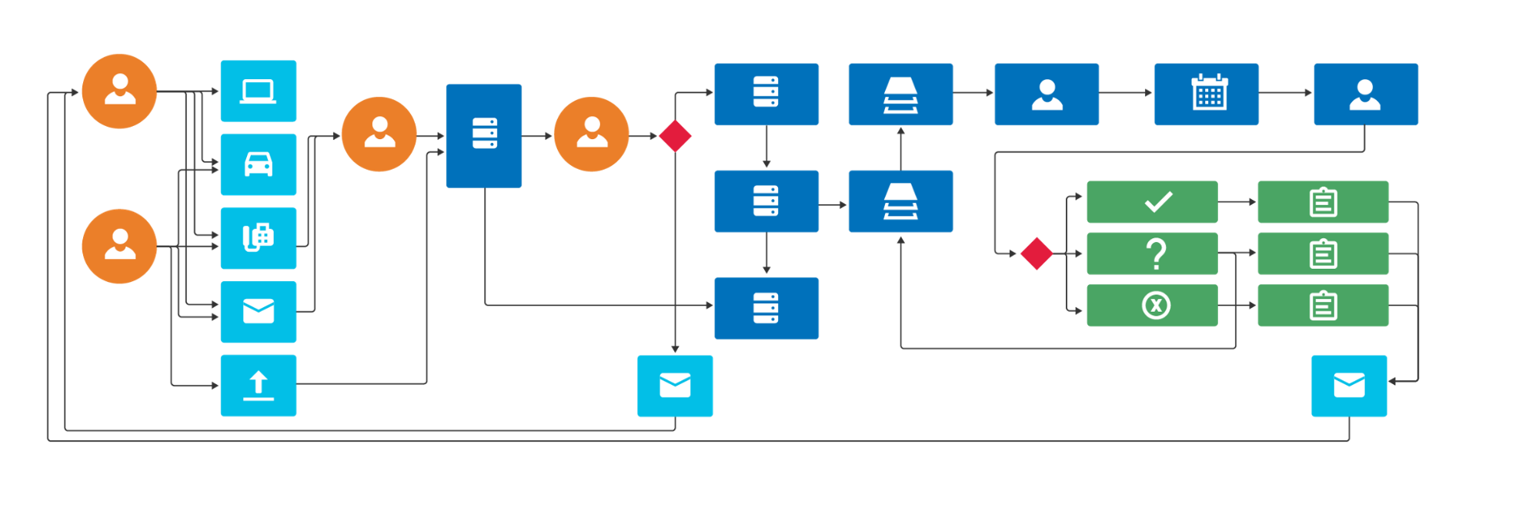
Data Abstraction Maps
FOR INTERNAL USE ONLY Office of Information and Technology
Notes:
We use what we call Data Abstraction Maps to map our findings.
Here I’m showing a representation of one of those maps, in which we plot out how the APIs work in conjunction with internal systems of record, processing systems, actions and people.

Slide 32
Solutions
We mapped actions taken and by whom, systems of record used, data reviewed and mistakes encountered.
We have used these maps to architect the APIs and the validation logic.
We’re working on informative status endpoints for representatives, that are also legally compliant.
FOR INTERNAL USE ONLY Office of Information and Technology
Notes:
We use these maps to map out the actions individuals take to process and intake data, the systems of record they use, the data they review and the mistakes they encounter, and compare these processes to the needs of end-users.
We use these maps to architect the APIs and build the necessary validation logic.
And we’re currently working on informative status endpoints for representatives, that are also legally compliant.

Slide 33
Key Takeaways
Notes:
So to wrap up, why do discovery research for APIs and how to do it?

Slide 34
Takeaways
API usability entails having the right API functionality
Ethnographic approaches are powerful to understand complex service systems and how digital solutions interact with them.
Ethnographic questions, and their emphasis on understanding practices on the ground, lend to understanding how individuals interact with a system, and the information they need from an API.
FOR INTERNAL USE ONLY Office of Information and Technology
Notes:
API usability entails having the right API functionality
Ethnographic approaches are powerful to understand complex service systems and how digital solutions interact with them.
Ethnographic questions emphasize understanding gaps between norms and on the ground practice. These types of question lend to understanding how individuals interact with a system, and the information they need from an API.

Slide 35
“We don't have the time to help all the Veterans. And, you know, like I said, 10 people helping 50,000 Veterans is almost untenable. You can't do it. (...) Meanwhile, we're fighting budgets at the county. Some of the things that I see that can help us is being able to process claims more efficiently. That's why I'm very interested in all these API type solutions” – County VSO
FOR INTERNAL USE ONLY Office of Information and Technology
Notes:
To restate, the goal of our APIs is to serve Veterans by serving the data needed to make better services for them. In the words of a County VSO:
“We don't have the time to help all the Veterans. And, you know, like I said, 10 people helping 50,000 Veterans is almost untenable. You can't do it. (...) Meanwhile, we're fighting budgets at the county. Some of the things that I see that can help us is being able to process claims more efficiently. That's why I'm very interested in all these API type solutions”

Slide 36
QUESTIONS?
Notes:
Thanks for your time!

