Slide 1
Pivot on a deadline
How to Use More Testing, Not Less, to Drive Delivery
June 23, 2021

Slide 2

Intro
Good

Fast

Cheap

Slide 3
Agenda
01 Good(er) on a Deadline
02 Fast(er) on a Deadline
03 Cheap(er) on a Deadline
04 Okay, but How? (Quick!)
01 Good
02 Fast
03 Cheap
04 Okay, but How?

Slide 4
Good(er) on a deadline

Slide 5
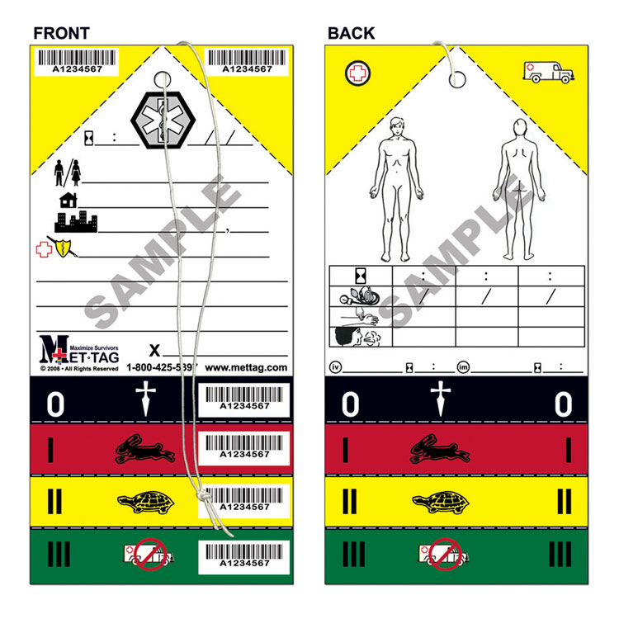
(sample)

Slide 6
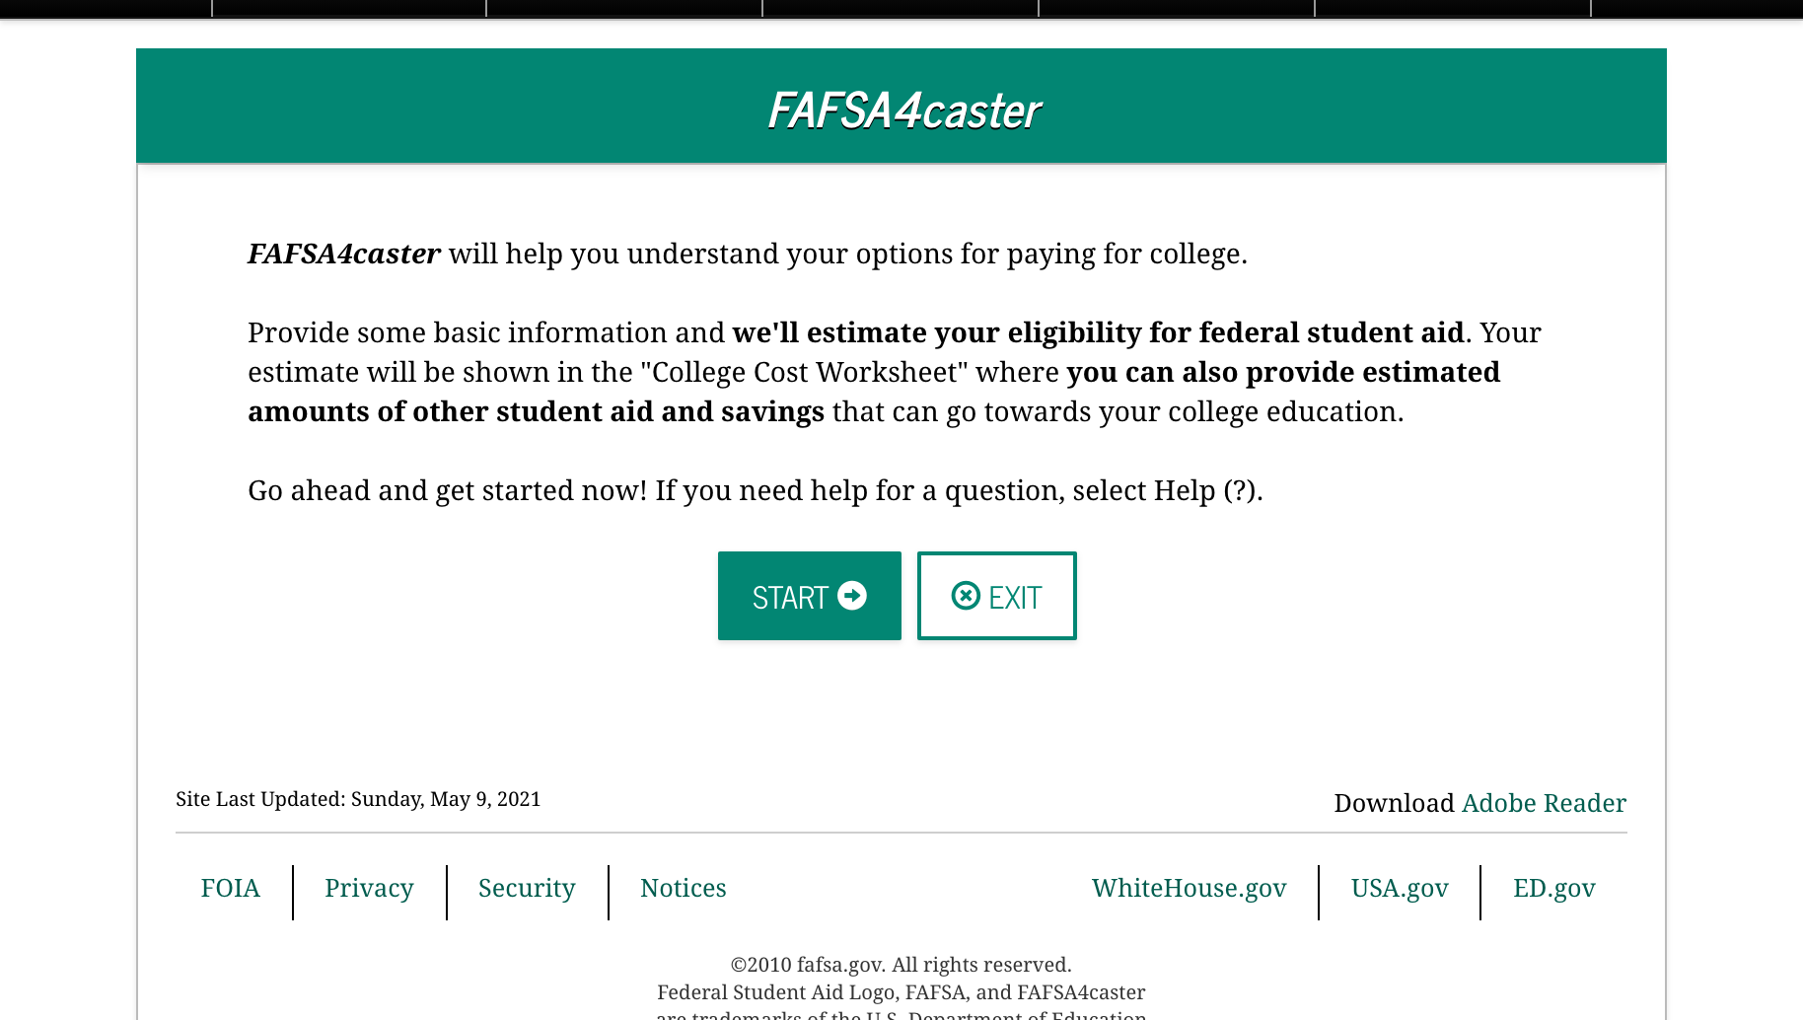
EXAMPLE: FAFSA4caster

Slide 7
LESSONS LEARNED
If you don’t ask your users, you’re doing triage blind.
Don’t forget your internal users.

Slide 8
FAST(er) on a deadline

Slide 9

(example)

Slide 10
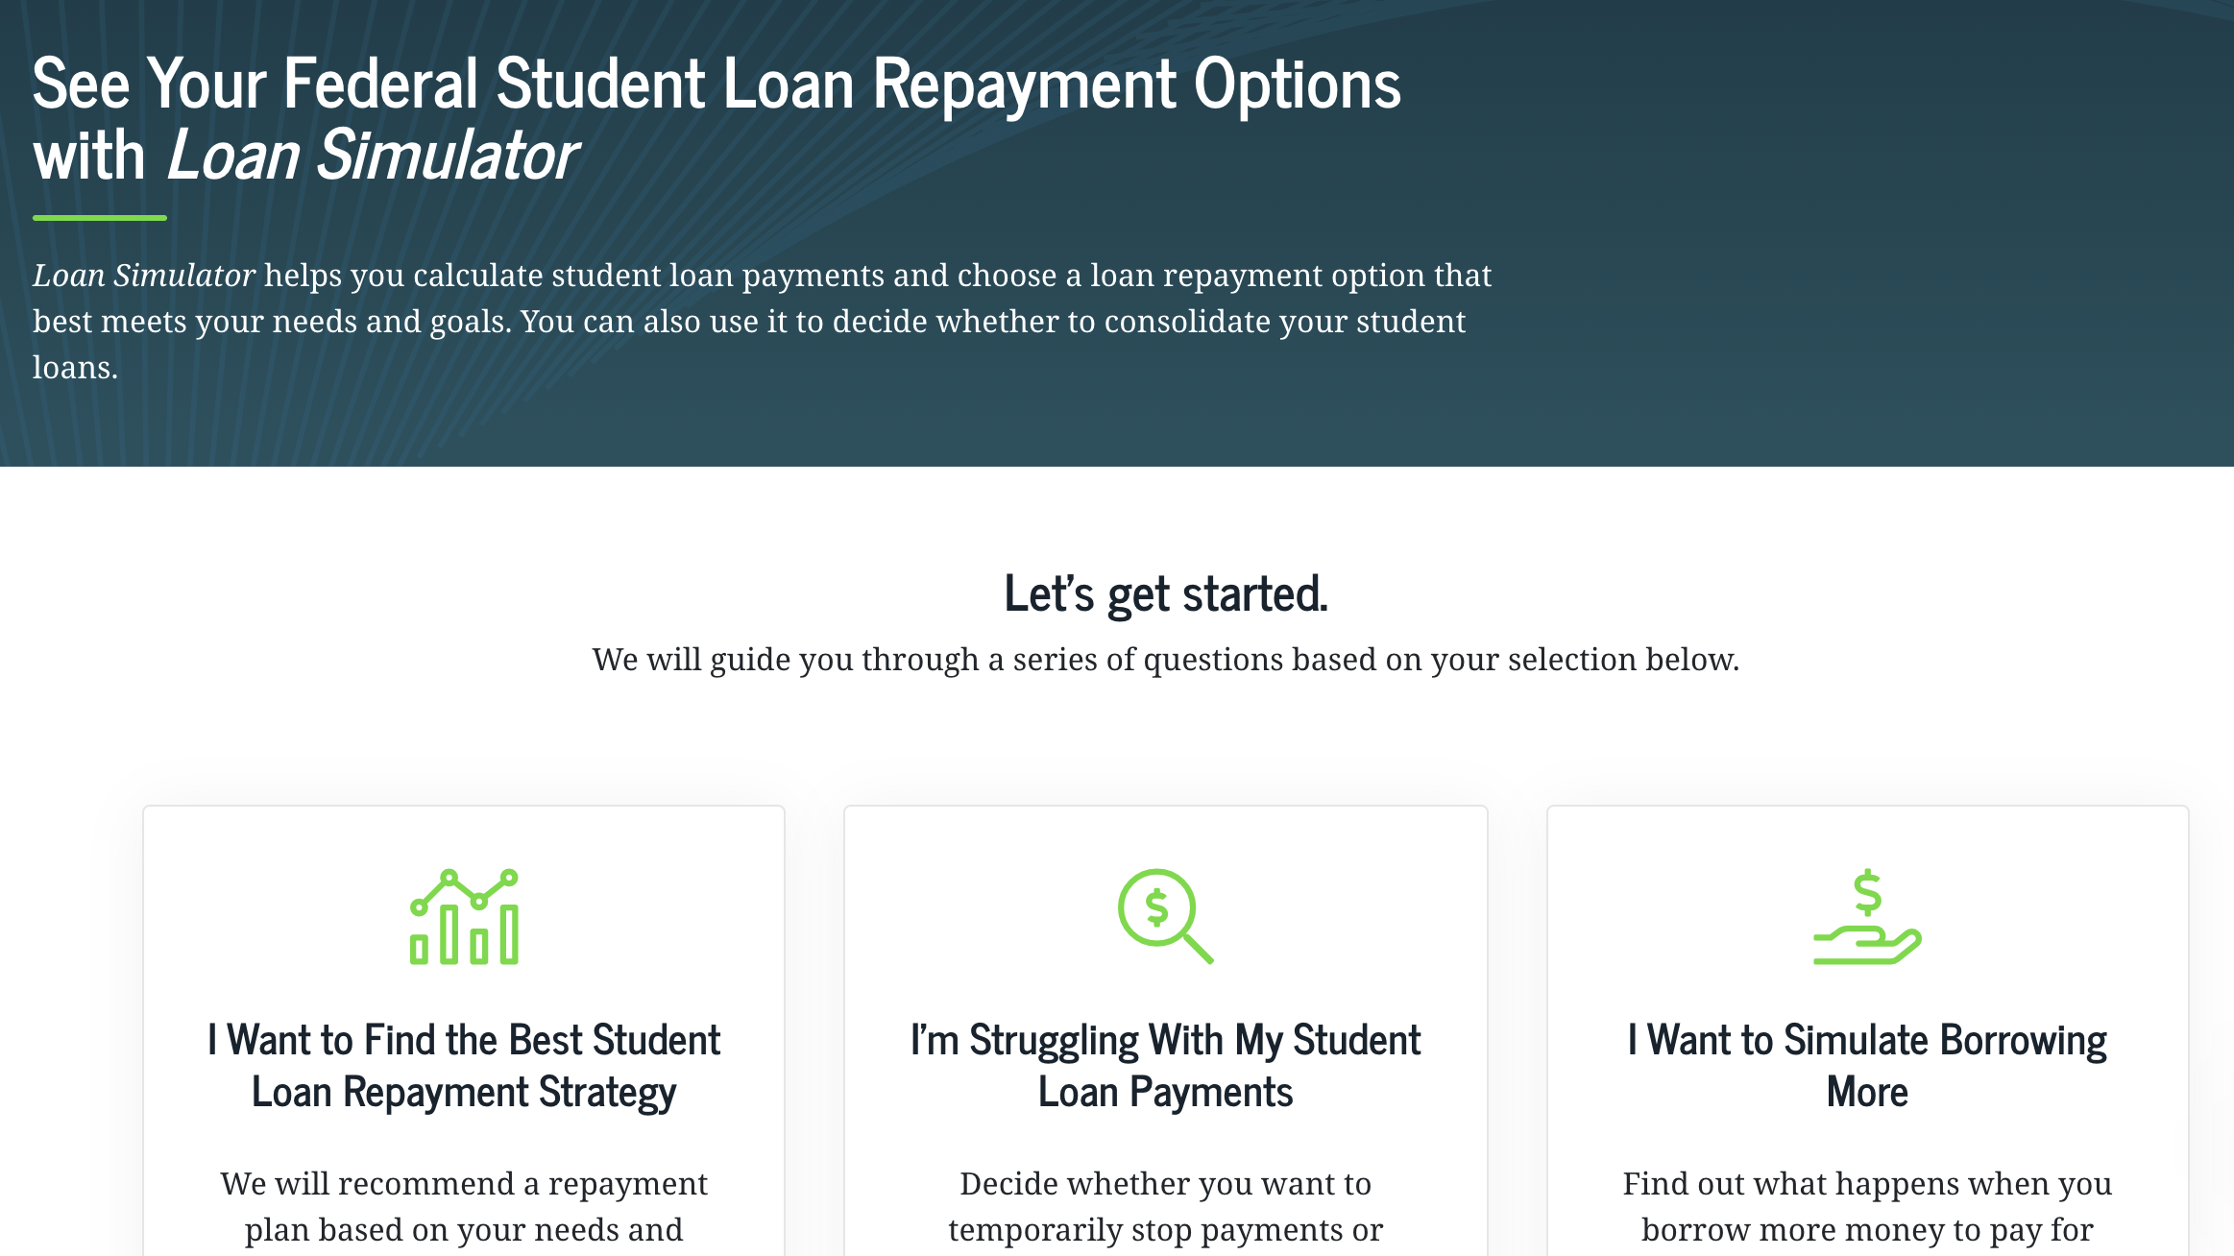
EXAMPLE: Loan simulator

Slide 11
LESSON LEARNED
Don’t dominate, divert.

Slide 12
CHEAP(er) on a deadline

Slide 13
Pick one
Now
Later

Slide 14
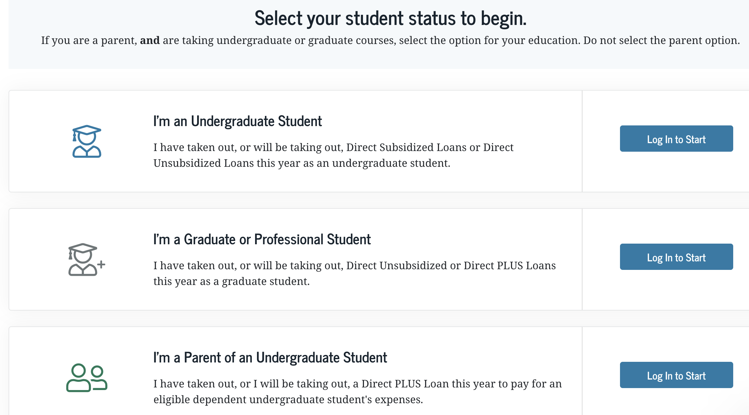
EXAMPLE: Annual Student Loan Acknowledgement

Slide 15
LESSON LEARNED
It’s cheaper to pay now.

Slide 16
Okay, but how? (fast)

Slide 17
LESSONS LEARNED
Guerilla Usability
Get to 85%
Paperwork Reduction Act
User Testing Pools
Virtual Testing
Make It a Habit

Slide 18
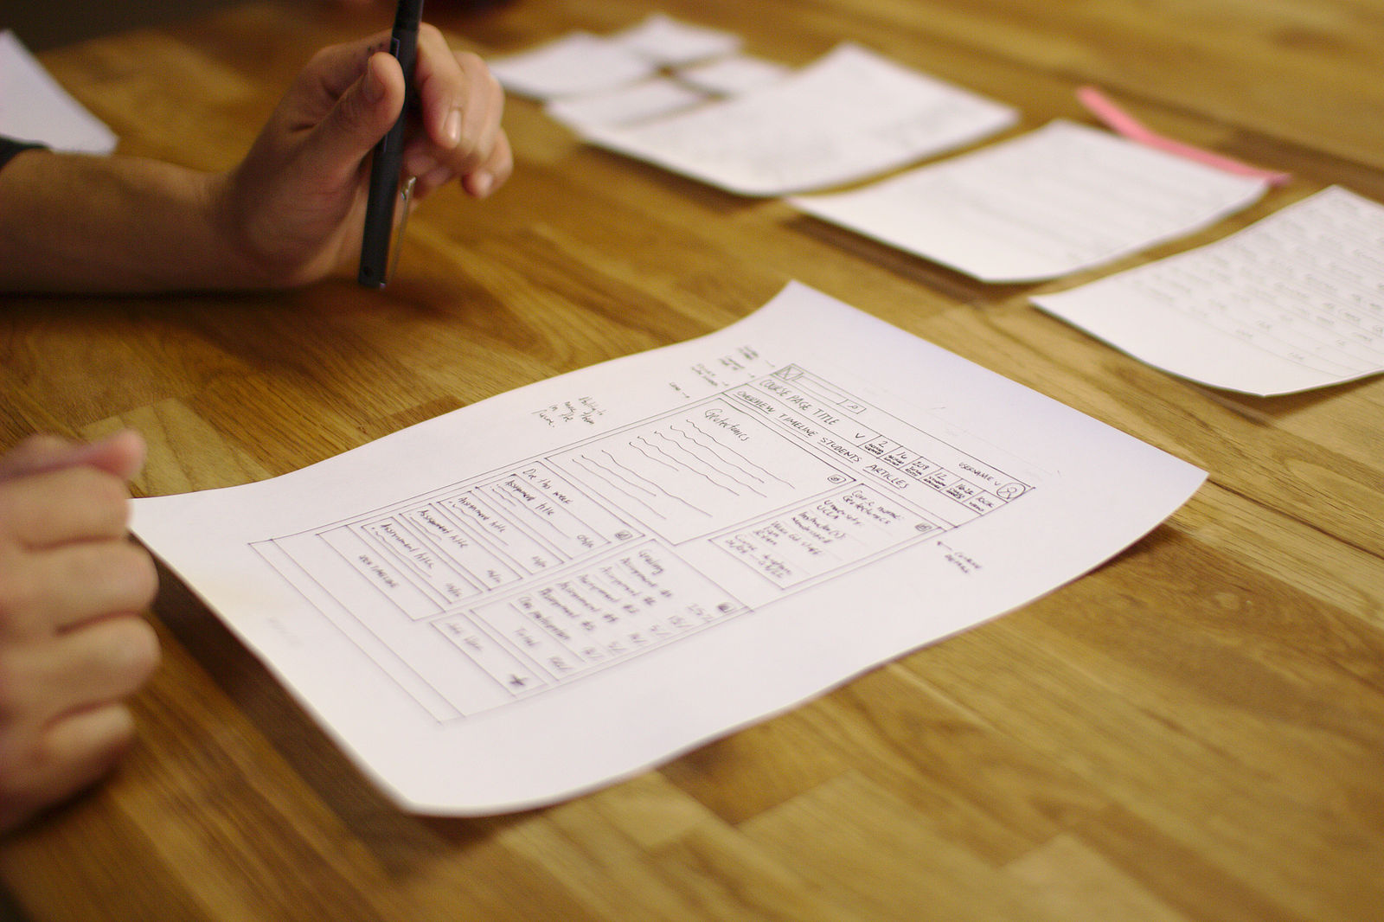
(do) Guerilla Usability
What is it?
Quick, formative user sessions to gauge feedback on designs and early insights in a design process. Sometimes called “concept testing.” Uses in-person intercepts, fewer users, low-fi designs.
Time needed: 3–10 days
Number of users: 3–6 (street, web intercept, question pool, etc.)​

Slide 19
(just) Get to 85%
Rule of 5
100
75
50
25
0
According to NN/G, testing with 5 participants will uncover up to 85% of the issues that affect the majority (31% or more) of a feature’s users. By testing with 8 participants, we uncover up to 95% of a feature’s usability issues.
% of Usability Problems Found
0 3 6 9 12 15
# of Usability Testing Participants
Source : nngroup.com/articles/why-you-only-need-to-test-with-5-users

Slide 20
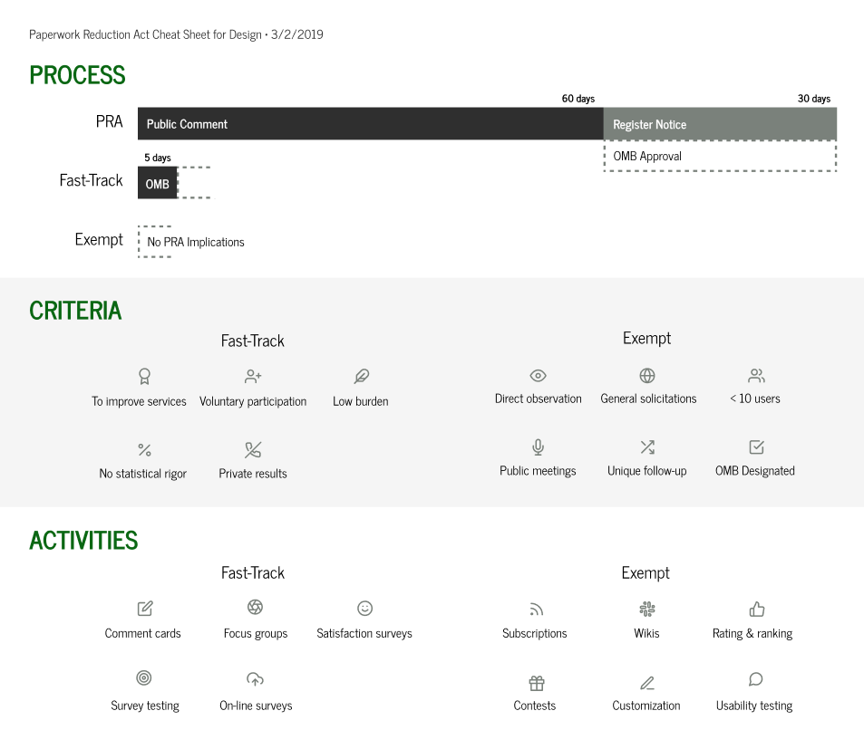
(Avoid the) Paperwork reduction act

Slide 21
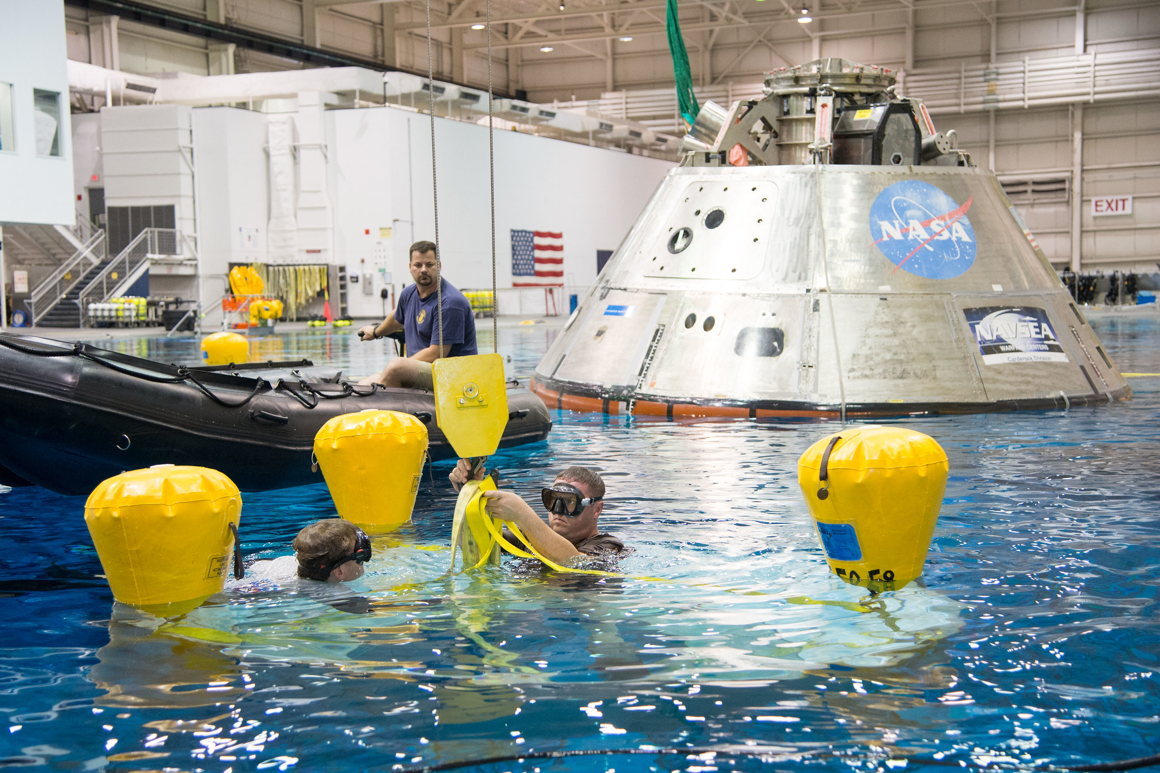
(build) user testing pools

Slide 22

(Do) virtual testing

Slide 23

Make it a habit (every time)

Slide 24
Questions?

