Slide 1
Overturning Precedent, Applying Human-Centered Design to Legal Matters
1
Alexis Schilf | User Experience Summit 2021
This presentation is being made by a Consumer Financial Protection Bureau representative on behalf of the Bureau. It does not constitute legal interpretation, guidance, or advice of the Consumer Financial Protection Bureau. Any opinions or views stated by the presenter are the presenter’s own and may not represent the Bureau’s views.

Slide 2
As designers, researchers, and innovators we often must build bridges between analytical and design mindsets.
2

Slide 3
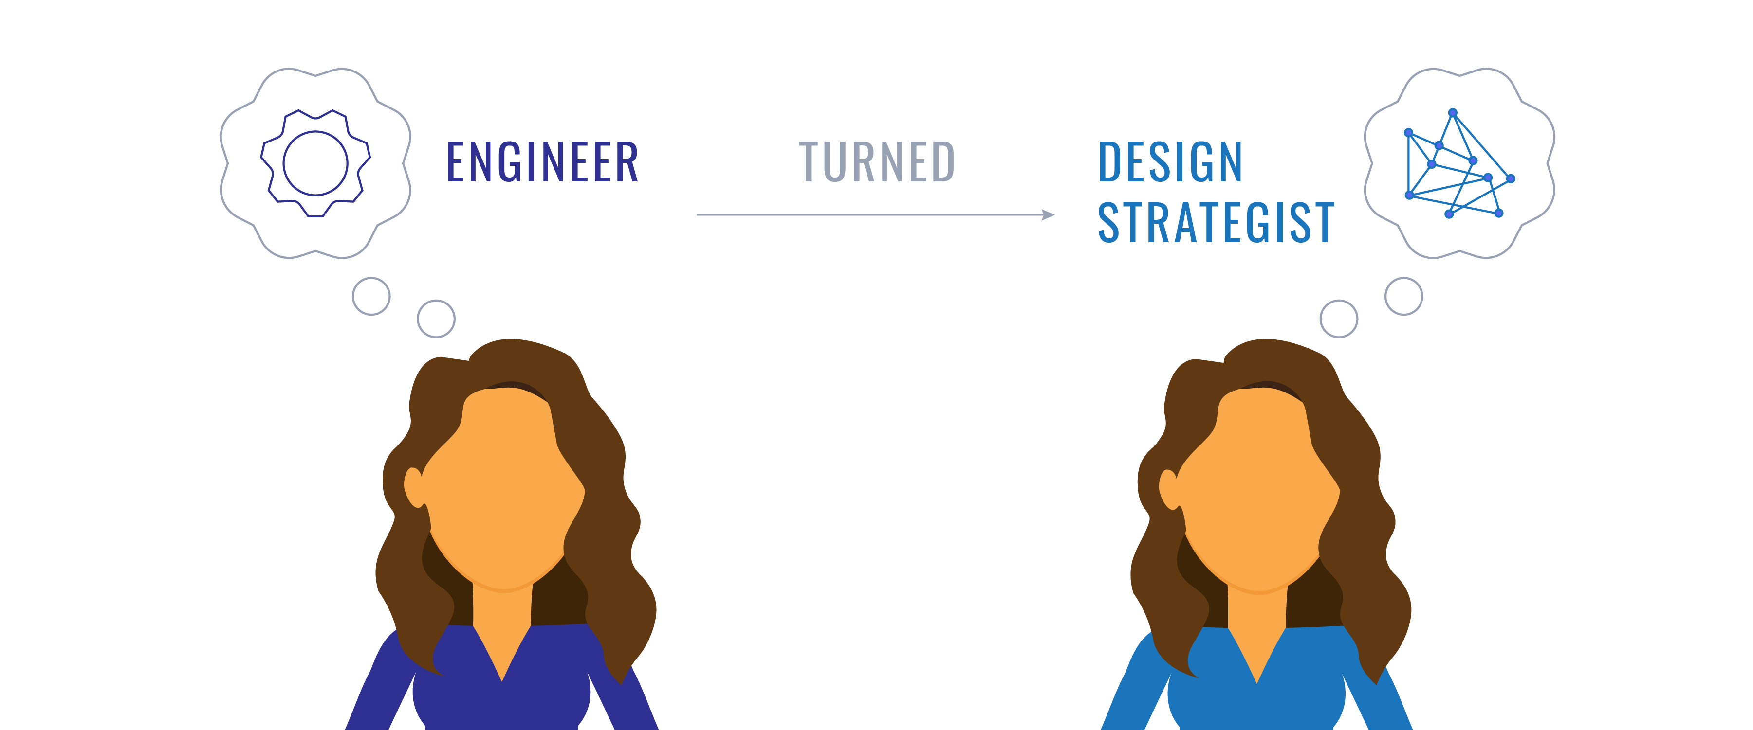
Who am I?
3

Slide 4
What is the Equal Employment Opportunity (EEO) Complaint Process?
4
“If you are a federal employee or job applicant, the law protects you from discrimination because of your race, color, religion, sex (including gender identity, sexual orientation, and pregnancy), national origin, age (40 or older), disability or genetic information. The law also protects you from retaliation if you oppose employment discrimination, file a complaint of discrimination, or participate in the EEO complaint process (even if the complaint is not yours.)” – U.S. Equal Employment Opportunity Commission
https://www.eeoc.gov/federal-sector/overview-federal-sector-eeo-complaint-process

Slide 5
Improving the customer experience of participants in the EEO process
5
To best support affected staff and managers, CFPB sought to identify ways to improve transparency, coordination, support and proactively address issues early in the EEO process.

Slide 6
1. Build a deep understanding of the subject matter to become a translator between the technical and the creative mindsets.
6

Slide 7
2. Develop frameworks to guide subject matter experts through the human-centered design process.
7

Slide 8
3. Center the project on the people and emotions to build empathy and find opportunities for growth.
8

Slide 9
How do we build bridges across disciplines?
9
Build a deep understanding of subject matter to become a translator between the technical and the creative mindsets.
Develop frameworks to guide subject matter experts through the human-centered design process.
Center the project on the people and emotions to build empathy and find opportunities for growth.

Slide 10
In regulated environments, applying a human-centered design lens helps subject matter experts identify opportunities to grow.
10

