Slide 1


Iterating on a State Digital Service Team
The Colorado Digital Service Team’s One-Year Retrospective

Slide 2
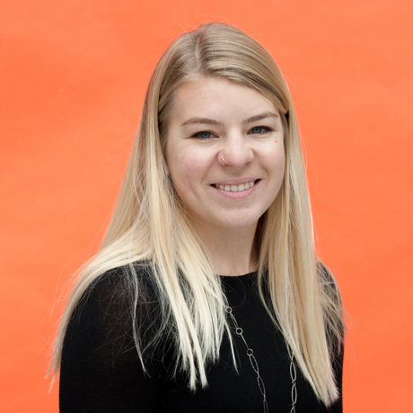
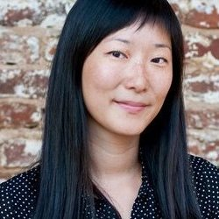
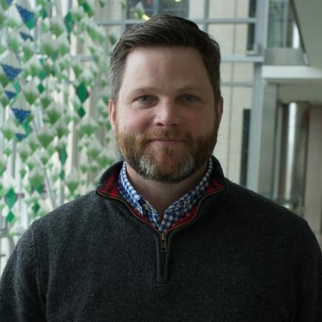
Hello and welcome.
Stephanie Cain
Karyn Lu
Randy Hart
Colorado Digital Service
UX Researcher and Designer
She / Her / Hers
stephanie.cain@state.co.us
Colorado Digital Service
Product Manager
She / Her / Hers
karyn.lu@state.co.us
18F
Federal IT Procurement Reform
He / Him / His
Notes:
All

Slide 3
Colorado Digital Service (CDS) Values
Be curious
Start with the problem, move to action
Be humble
Government was here before us and will be here after us
Challenge the status quo
Social justice
Find the truth, tell the truth (credit: USDS)
Strength in diversity (inspired by: Protect Democracy)
Government is us, just us (credit: Megan Smith)
Notes:
The Colorado Digital Service is a diverse cross-functional team of senior engineers, designers, product managers, and procurement specialists serving limited "tours of civic service" (six months to two years) in government.
We work alongside dedicated civil servants in the Governor’s Office of Information Technology (OIT) and across state agencies to develop and improve human-centered solutions to Colorado's most pressing technical challenges.

Slide 4
At our one-year anniversary, our team wanted to learn:
How did our agency partners view the value that our team provided?
What happened after we rolled off a project?
What opportunities exist to improve the way we engage with our partners?

Slide 5
Our method (how we did it)
Self-reflection
Collected value statements from each Colorado Digital Service team member
Guided by past team strategy and goal-setting conversations
Pulled themes from past Colorado Digital Service retrospectives
External feedback
Interviewed more than 40 state and vendor partners
Notes:
We wanted to capture qualitative statements and themes across a large group of people. We wanted to have the opportunity to ask questions and let our participants guide the conversation.

Slide 6
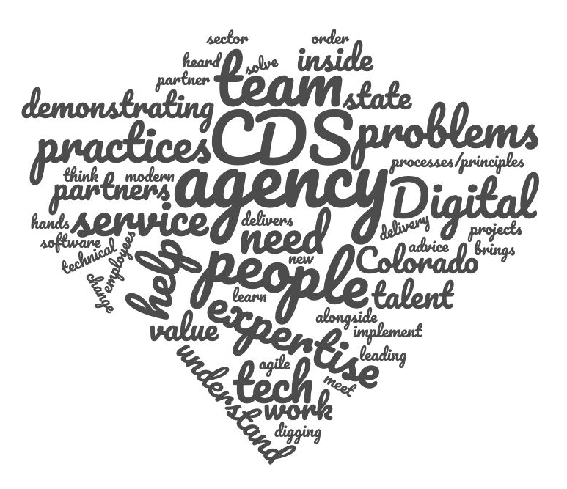
Teach by demonstrating
“CDS delivers value by rolling up our sleeves in order to do the work alongside experts at agencies and by coaching and mentoring people to implement the same practices in their own work.”
Meet people where they are
“We meet agency partners where they are at. We assess their values, their style, their needs, and their emotions, and connect with them in an authentic way that allows them to feel heard.”
Strong culture
“Diverse brains & kind, smart, collaborative people in your corner.”

Slide 7
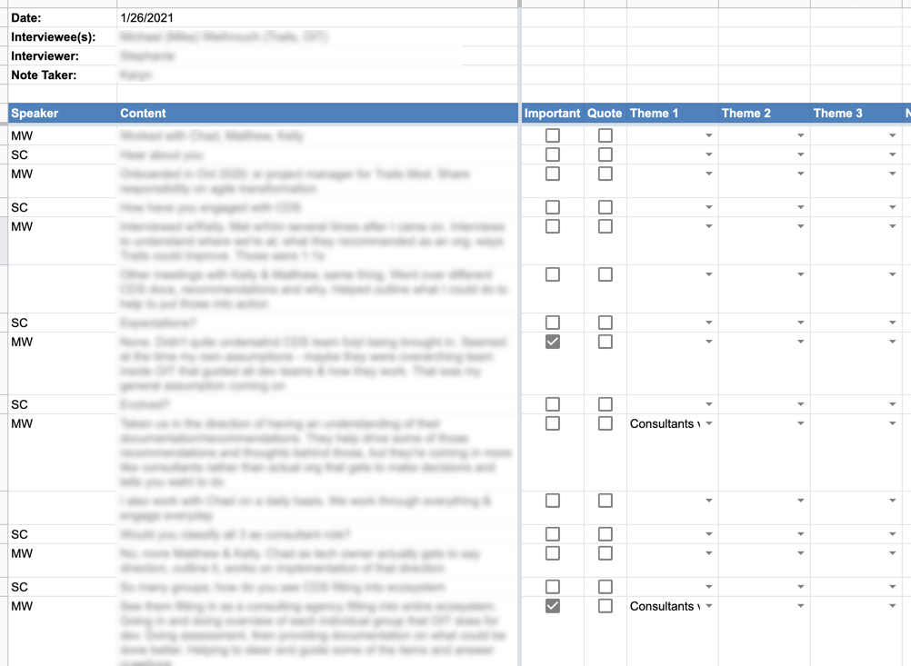
30 min external interview
Questions
Before the engagement began, what did you expect from working with the CDS team?
Did that evolve over the course of the project?
Walk us through what happened with the project after the engagement with CDS ended.
What advice would you give someone who was about to engage with the CDS team?
What advice would you give to our team for future engagements?

Slide 8
What we learned:
How our partners saw us

Slide 9
Partners valued our expertise, drive and neutrality.
“Not being tied to the way things have always been done, that's really valuable.”
“Political neutrality is super valuable. You model functions that live in the middle space (IT and business) that help clarify the conversation and set the stage for those practices to evolve.”

Slide 10
We offer kinship, healthy culture, and a collaborative partnership.
“It was helpful to watch the way you work together.. It’s a great model for how teams should collaborate and work together.”
“You constantly asked what isn't working? What do we need to change?”

Slide 11
Many people saw us as consultants. That came with mixed connotations and emotions.
“I hate to use the word consultant, but you come in with no dog in the fight and present what you think is the right thing to do based on past experience.”
“I was like, is this a subversive way of assessing what we're doing well and badly?"

Slide 12
Sometimes, the language or processes we used felt unfamiliar and inaccessible. Not everyone felt comfortable asking us to clarify.
“Even a retro...I get the word but in public health world I'd call it a debrief. It doesn't prohibit you from participating but the fast pace of the work, it can feel intimidating and inaccessible if you don't feel comfortable asking.”

Slide 13
Even after months of an engagement, some of our partners struggled to describe the Colorado Digital Service. Sometimes they saw us only as individuals, and not as a team.
“I don’t know what the Colorado Digital Service is or how to engage them.”

Slide 14
Deeper self-reflection

Slide 15
Where to focus and to prioritize
Not every project is a good fit even if we’re passionate about the subject. Ask the right questions during project intake and prioritize.
Some things are outside of our control; not everyone will be on board with our work.

Slide 16
Change management and team culture
“We are change management experts disguised as technologists.” Aaron Snow
Team culture is CRITICAL to a successful technology project.

Slide 17
Sustainability
Our partners are so busy that they often see us an extra pair of hands, rather than a coach. They don’t always absorb new practices just by watching us work.
Discovery sprints are only as valuable as their implementation.
After we exit, our partners can face systematic barriers that prevent them from implementing processes that we advocate for during our engagements.

Slide 18
Attracting and supporting talent
A person hired into an agency is less supported than a person who is a part of a digital service team. They are uniquely challenged in being the first hire in an organization that is unfamiliar with that particular skill set.
The drive to work in a mission-driven organization is an important factor when hiring. Just because someone is a leader in the private sector, does not make them a good fit for this type of work.

Slide 19
Improving the way we work

Slide 20
Improving the way we work
Better define CDS and our value from the beginning
More inclusion to bring people along in the process
Do a better job transitioning off projects
Remember we are not long-term owners
Break expectations, not rules
“Advance team model” to better scope projects before getting one-pagers approved by CIO and Gov’s COO.

Slide 21
Discussion topic:
What lessons have you learned the hard way?
Notes:
Randy can talk about
“just writing a different kind of RFP isn’t the magic bullet….internal design and product thinking are important pre-requisites to healthy vendor management (in better words).
“Modular (smaller) contract scope is a good idea, but don’t make it so small/short that you are constantly working with new teams. IOW - $100M is too big….but $25K is too small and you’d lose continuity if constantly in the procurement cycle.”

Slide 22
Questions?

