Slide 1



Journey Mapping: Access to Justice
Journey Mapping:
Access to Justice
Kansas City, Kansas Municipal Court
with
OpenCities

Slide 2

Introductions & Welcome
Crystal Sprague

Slide 3



Slide 3
Unified Government of WYCO/KCK
Municipal Court
Founded in 1872
3rd Largest City in Kansas
Consolidated City / County
165,000 residents
21.4% poverty rate
Files traffic & misdemeanor cases from 10 agencies
40,000 charges / year
55% Traffic Offense to 14% Misdemeanor Crimes
Provides the website & forms functionality modern governments need to transform their digital customer journey.
Helps governments of all sizes deliver superior website & online services

Slide 4


Unified Government’s Path Taken
Unified Government’s Path Taken:
DIGITAL SERVICE PILOT - 2019
GOAL :
Improve citizen accesss to digital services for the Unified Government of Wyandotte County / Kansas City, Kansas.
Municipal Court was a pilot department.
UG is introduced to Journey Mapping

Slide 5
Typical Response – Policy First
Typical Response – POLICY FIRST
Policy Makers enact the policy we, public servants, quickly write instructions on what needs to be done by the citizen.
Something will happen BUT we will return or decline the form if it is not filled out correctly, you have not provided payment or you missed a step in our process.
You must pick up the application from the city office between 8am and 5pm Monday - Friday
Apply
Cost
The Application fee is $X.00
It might be more if you have a special circumstance
ACTION
Bring with you the required forms, I.D., proof of residency, etc.
Your form will be processed by staff, and we will be in contact with you soon
Required
Process

Slide 6
Flipped Response – Citizen Driven
Flipped Response – Citizen Driven
What does the citizen go through to access the service?
What do they feel during the process?
Do they accomplish what they set out to do?
Can I do this online?
3
Do I have to do this annually?
5
What do I need to do?
Wait? I have to come back next week?
1
4
What makes me eligible for this service?
What do I need to have before I start?
6
7
Did I accomplish my goal?
2
Notes:
A journey map is a visualization of the process that a person goes through in order to accomplish a goal. In its most basic form, journey mapping starts by compiling a series of user actions into a timeline. Next, the timeline is fleshed out with user thoughts and emotions in order to create a narrative.

Slide 7
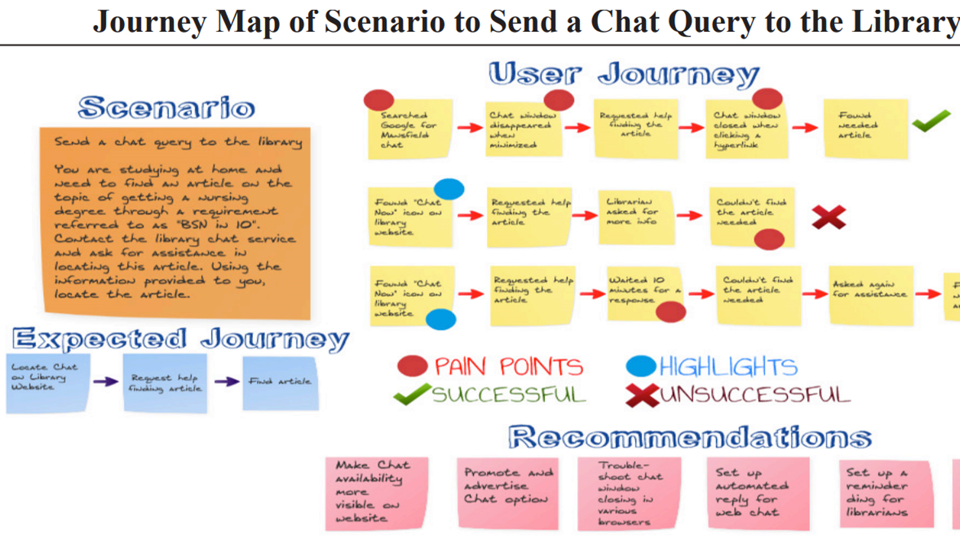
Sample
Sample

Slide 8
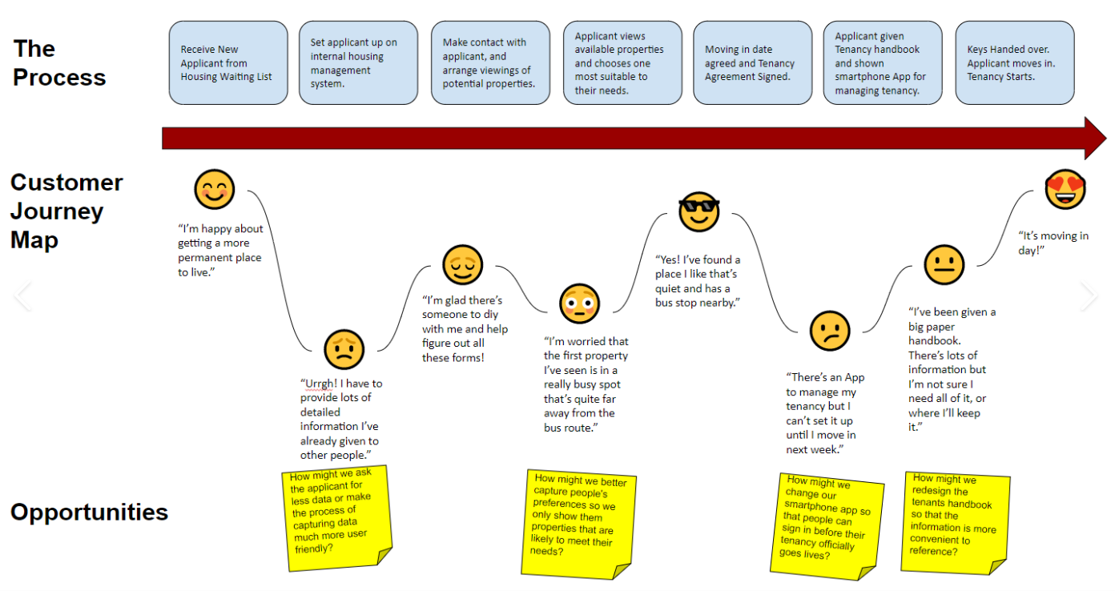
Slide 8

Slide 9
ENGAGE Unusual Voices Early and Often
ENGAGE Unusual Voices Early & Often
Frontline staff understand the citizen journey better than most.
Fresh eyes are valuable
Students
Employees
Technologist
Citizens
Logic and Learning can make the impossible happen
Listen & Ask
Complaints are often Requests

Slide 10


Slide 10
Solve for: Defense Attorneys Clogging the Court Room for First Continuance
Process
Current Defendant Journey
Opportunities
Entry of Appearance – In Person
Request a Continuance – In Person
Always Granted
Defendant Posts Appearance Bond for New Court Date
Attorney Appears
Defendant Appears
Attorneys should be able to request 1 continuance digitally
Why do defendants with counsel get treated differently?
Everyone should have the same access to the justice system!
POLICY CHANGE

Slide 11

Let’s Engage

Slide 12




Let’s Map Your Services
Let’s Map Your Services

Slide 13
Crystal Sprague clsprague@wycokck.org Home (opencities.com) More Information KCK reimagines access to justice in times of crisis (opencities.com)

