Slide 1
Resource Allocation for Task-Oriented Semantic Communications in Integrated Sensing and Communication Networks
Ruikang Wang
Chair of Information Theory and Data Analytics
07. October 2024

Slide 2
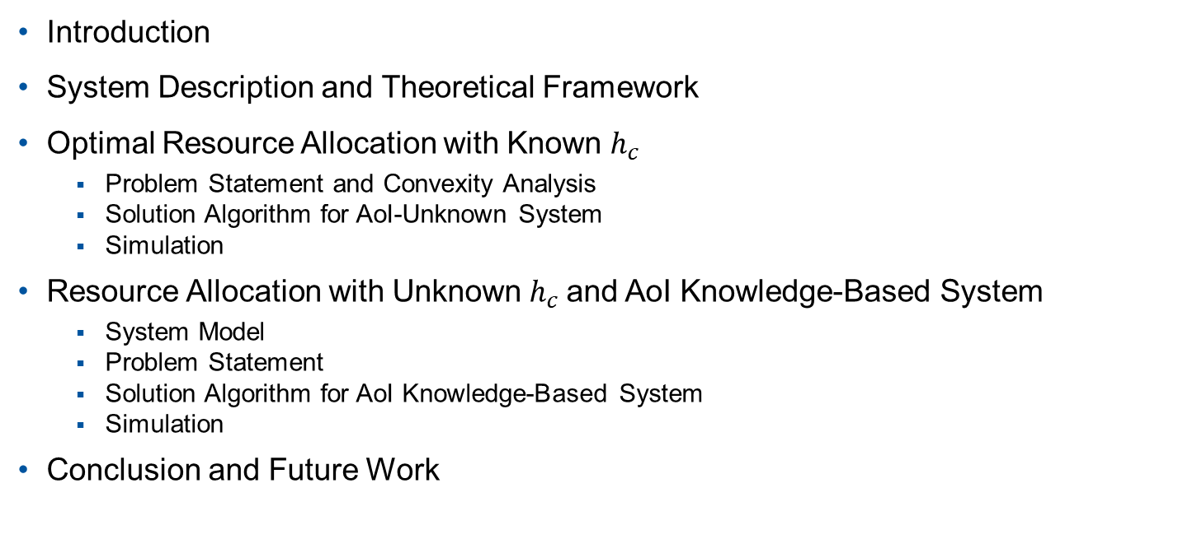
Outline
Introduction
System Description and Theoretical Framework
Optimal Resource Allocation with Known $h_{c}$
Problem Statement and Convexity Analysis
Solution Algorithm for AoI-Unknown System
Simulation
Resource Allocation with Unknown $h_{c}$and AoI Knowledge-Based System
System Model
Problem Statement
Solution Algorithm for AoI Knowledge-Based System
Simulation
Conclusion and Future Work

Slide 3
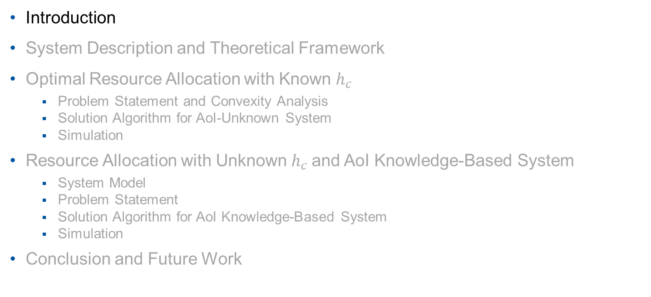
Outline
Introduction
System Description and Theoretical Framework
Optimal Resource Allocation with Known $h_{c}$
Problem Statement and Convexity Analysis
Solution Algorithm for AoI-Unknown System
Simulation
Resource Allocation with Unknown $h_{c}$and AoI Knowledge-Based System
System Model
Problem Statement
Solution Algorithm for AoI Knowledge-Based System
Simulation
Conclusion and Future Work

Slide 4
Introduction
Integrated Sensing and Communication (ISAC) networks:
Key technology for 6G networks
Sensing and communication functions realized by one set of hardware
Sharing resources between sensing and communication
Joint optimization to balance the sensing and communication performance
 | Goal | Data transmission
Task-oriented communications | Task completion | Only task-relevant data
Non-task-oriented communications | Data accuracy | All data
Less resource consumption with task-oriented communications

Slide 5
Introduction
Ultra Reliable Low Latency Communications (URLLC)
Low Latency $→$ Finite Blocklength (FBL) Regime
URLLC
Ultra Reliability $→$ Ultra Low Error Probability
The assumption of infinite Blocklength for Shannon capacity model no longer holds in FBL regime.

Slide 6
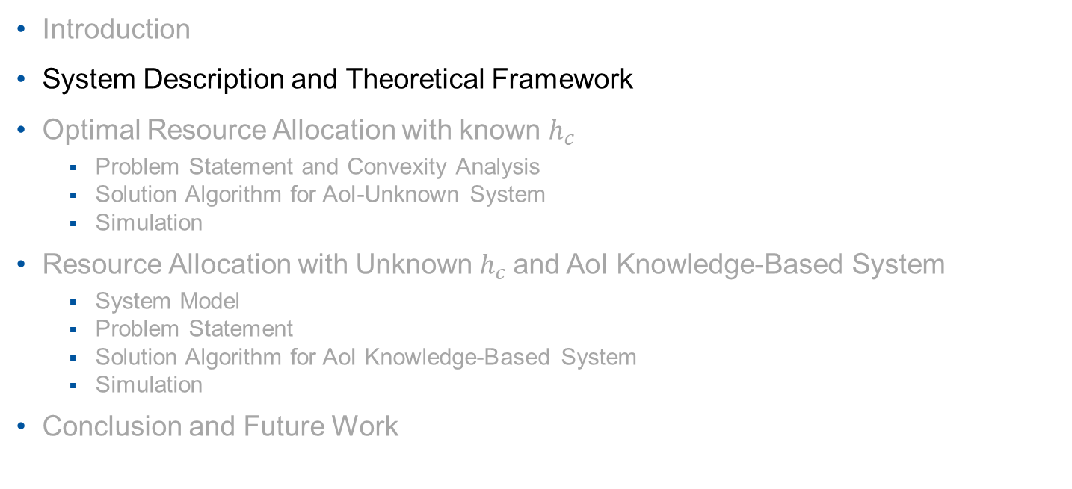
Outline
Introduction
System Description and Theoretical Framework
Optimal Resource Allocation with known $h_{c}$
Problem Statement and Convexity Analysis
Solution Algorithm for AoI-Unknown System
Simulation
Resource Allocation with Unknown $h_{c}$and AoI Knowledge-Based System
System Model
Problem Statement
Solution Algorithm for AoI Knowledge-Based System
Simulation
Conclusion and Future Work

Slide 7
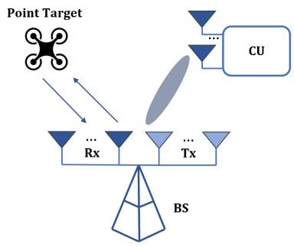




System Description and Theoretical Framework
Beamforming
Beamforming is used in MISO systems to realize low error probability
Form a directional transmission beam pattern to improve the SNR of received signals
The transmitted and received sensing signals:
$$X=[x\left(1\right),…,x(m_{s})]$$
$$Y_{s}=H_{s}X+Z_{s}$$
The transmitted and received communication signals:
$$x$$
$$y_{c}=H_{c}x+z_{s}$$

Slide 8
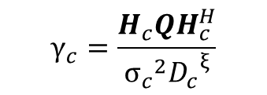
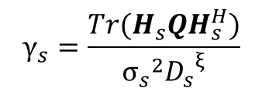

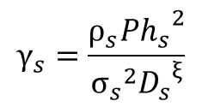
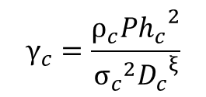
System Description and Theoretical Framework
Signal-to-noise ratio
$$Q= \{xx^{H}\}$$
MISO
SISO
$$γ_{c}=\frac{H_{c}QH_{c}^{H}}{{σ_{c}}^{2}{D_{c}}^{ξ}}$$
$$γ_{c}=\frac{ρ_{c}P{h_{c}}^{2}}{{σ_{c}}^{2}{D_{c}}^{ξ}}$$
$$γ_{s}=\frac{Tr(H_{s}QH_{s}^{H})}{{σ_{s}}^{2}{D_{s}}^{ξ}}$$
$$γ_{s}=\frac{ρ_{s}P{h_{s}}^{2}}{{σ_{s}}^{2}{D_{s}}^{ξ}}$$

Slide 9

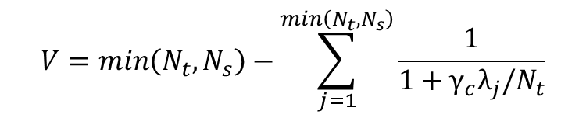
System Description and Theoretical Framework
Finite Blocklength
Finite blocklength (FBL) regime
Shannon‘s capacity model not applicable
Error probability for communication in FBL regime [1]:
$$ε_{c}=Q(\sqrt{\frac{m_{c}}{V}}\left(C\left(γ_{c}\right)−r\right)ln2)$$
With Shannon‘s capacity and channel dispersion:
$$C\left(γ_{c}\right)=\log_{2}{(1+γ_{c})}$$
$$V=\min\left(N_{t},N_{s}\right)−\sum_{j=1}^{\min\left(N_{t},N_{s}\right)}{\frac{1}{1+γ_{c}λ_{j}/N_{t}}}$$
[1] Y. Polyanskiy, H. Poor, and S. Verdu, “Channel coding rate in the ﬁnite blocklength regime,” IEEE Trans. Inf. Theory, vol. 56, no. 5, pp. 2307–2359, May 2010.

Slide 10
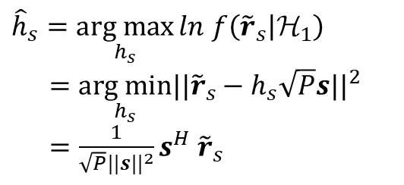
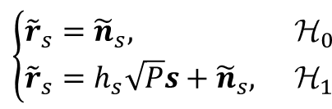


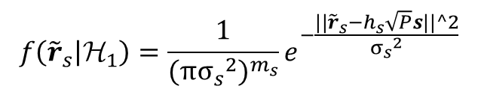
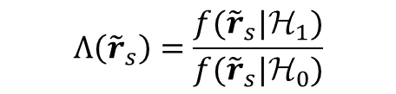
System Description and Theoretical Framework
Sensing Model
Received signal:
$$\left\{\begin{aligned}&{\tilde{r}}_{s}={\tilde{n}}_{s}, &&Η_{0} \\ &{\tilde{r}}_{s}=h_{s}\sqrt{P}s+{\tilde{n}}_{s}, & &Η_{1}\end{aligned}\right.$$
Unknown $h_{s}$:
(by MLE)
${\hat{h}}_{s}=\underset{h_{s}}{arg max}{ln}$ $f\left({\tilde{r}}_{s} | _{1}\right)$ $=$ $\underset{h_{s}}{arg min}{||{\tilde{r}}_{s}−h_{s}\sqrt{P}s||}^{2}$ $=\frac{1}{\sqrt{P}{||s||}^{2}}s^{H}$ ${\tilde{r}}_{s}$
$$Λ\left({\tilde{r}}_{s}\right)=\frac{f({\tilde{r}}_{s}|Η_{1})}{f({\tilde{r}}_{s}|Η_{0})}$$
Likelihood ratio test (LRT) function:
$$f\left({\tilde{r}}_{s} | _{1}\right)=\frac{1}{{(π{σ_{s}}^{2})}^{m_{s}}}e^{−\frac{||{\tilde{r}}_{s}−h_{s}\sqrt{P}s||^2}{{σ_{s}}^{2}}}$$
$$f\left({\tilde{r}}_{s} | _{0}\right)=\frac{1}{{(π{σ_{s}}^{2})}^{m_{s}}}e^{−\frac{||{\tilde{r}}_{s}||^2}{{σ_{s}}^{2}}}$$

Slide 11

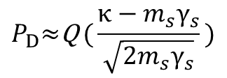



System Description and Theoretical Framework
$$P_{D}=Pr⁡\{lnΛ\left({\tilde{r}}_{s}\right)≥κ|Η_{1}\}$$
$$P_{FA}=Pr⁡\{lnΛ\left({\tilde{r}}_{s}\right)≥κ|Η_{0}\}$$
Probability of detection for known and unknown${ h}_{s}$
$$P_{D}\text{≈}\text{Q} \text{(}\frac{κ−m_{s}γ_{s}}{\sqrt{2m_{s}γ_{s}}}\text{)}$$
$$P_{D}\text{≈}Q_{1} \text{(}\sqrt{2m_{s}γ_{s}},\sqrt{2κ}\text{)}$$
Sensing error probability
$$ε_{s}=1−P_{D}$$

Slide 12
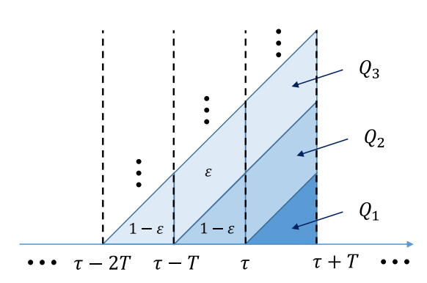
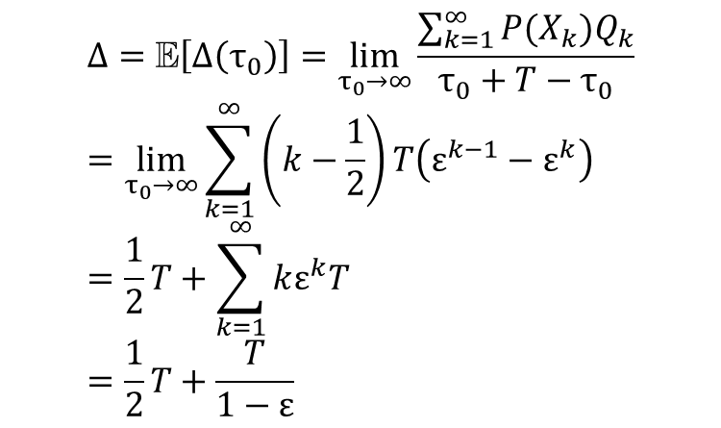

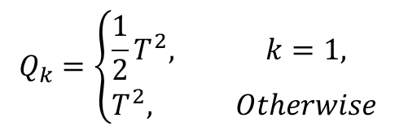
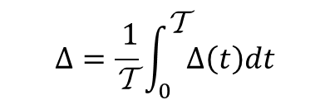

System Description and Theoretical Framework
Age of Information
$$Δ\left(t\right)=t−U(t)$$
Time-average AoI:
(for periodic updating rounds)
$$Δ=\frac{ 1}{Τ}\int_{0}^{Τ}{Δ\left(t\right)dt}$$
$$Q_{k}=\left\{\begin{aligned}&\frac{1}{2}T^{2}, &k=1, \\ &T^{2},&Otherwise\end{aligned}\right.$$
$$Δ=Ε\left[Δ\left(τ_{0}\right)\right]=\lim_{τ_{0}→∞}{\frac{\sum_{k=1}^{∞}{P(X_{k})Q_{k}}}{τ_{0}+T−τ_{0}}} \\ =\lim_{τ_{0}→∞}\sum_{k=1}^{∞}{\left(k−\frac{1}{2}\right)T\left(ε^{k−1}−ε^{k}\right)} \\ =\frac{1}{2}T+\sum_{k=1}^{∞}{kε^{k}T} \\ =\frac{1}{2}T+\frac{T}{1−ε}$$
$$P\left(X_{k}\right)=(1−ε)ε^{k}$$

Slide 13
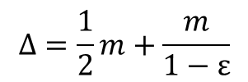




System Description and Theoretical Framework
Trade-Off
Objective: Minimize time-average AoI (Δ) for updating process
$$Δ=\frac{1}{2}m+\frac{m}{1−ε}$$
$ε=ε_{s}+$ $ε_{c}−ε_{s}$ $ε_{c}$
Monotonicity of $ε$ w.r.t. $m$
Trade-off between $ε$ and $m$
Nonmonotonicity of $Δ$ w.r.t. $m$

Slide 14
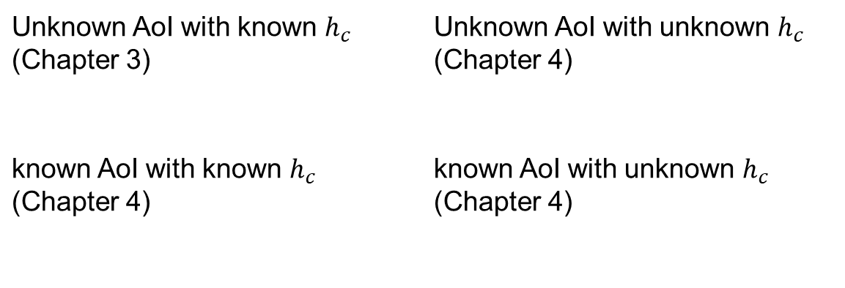
System Description and Theoretical Framework
Comm. CSI and AoI Knowledge Statement
To analyze the performance of the ISAC system under different levels of information uncertainty.
Unknown AoI with known $h_{c}$ (Chapter 3) | Unknown AoI with unknown $h_{c}$ (Chapter 4)
known AoI with known $h_{c}$ (Chapter 4) | known AoI with unknown $h_{c}$ (Chapter 4)

Slide 15
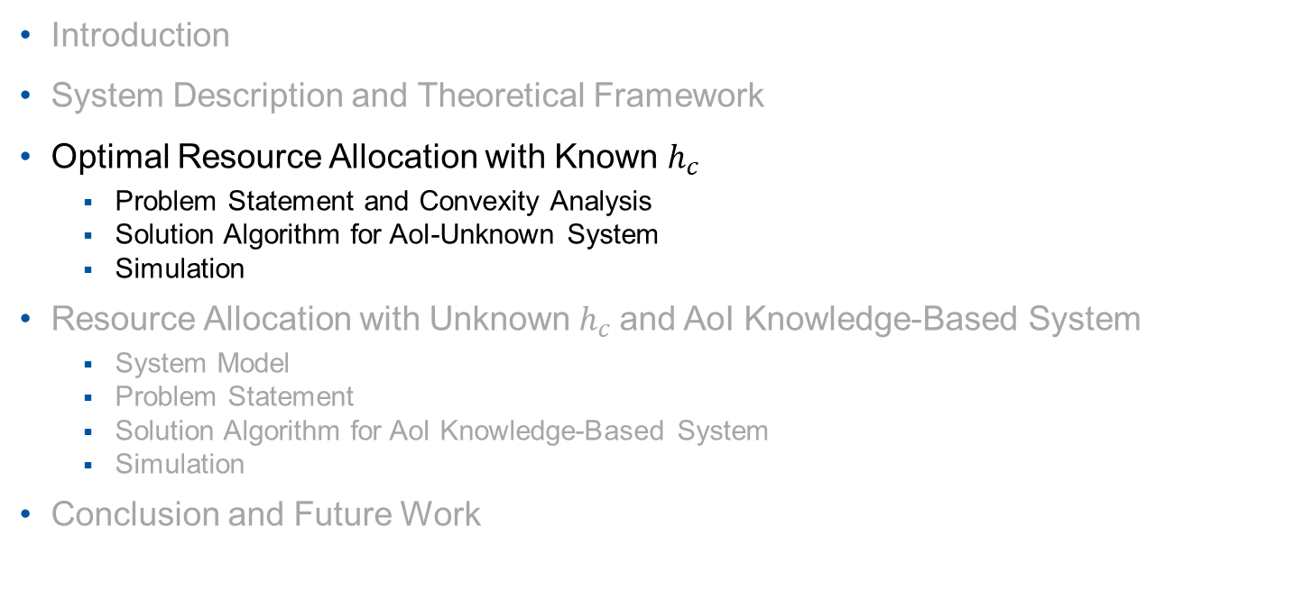
Outline
Introduction
System Description and Theoretical Framework
Optimal Resource Allocation with Known $h_{c}$
Problem Statement and Convexity Analysis
Solution Algorithm for AoI-Unknown System
Simulation
Resource Allocation with Unknown $h_{c}$and AoI Knowledge-Based System
System Model
Problem Statement
Solution Algorithm for AoI Knowledge-Based System
Simulation
Conclusion and Future Work

Slide 16
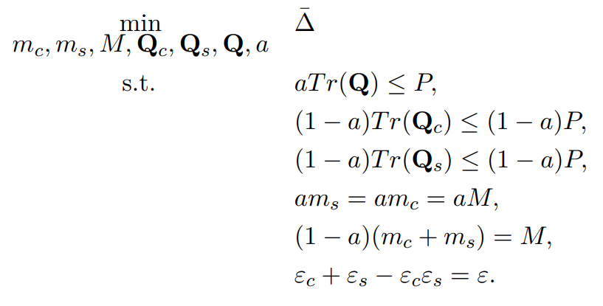
Optimal Resource Allocation with Known $h_{c}$
Problem Statement and Convexity Analysis
Scenario selection & resource allocation to optimize AoI performance
Lemma: The time-average AoI $\overline{\text{Δ}}$ is conditionally convex w.r.t. $Q$ and $m$

Slide 17
Optimal Resource Allocation with Known $h_{c}$
Problem Statement and Convexity Analysis
Lemma: ε_{s} , ε_{c} are conditionally convex w.r.t. $Q$and $m$

Slide 18
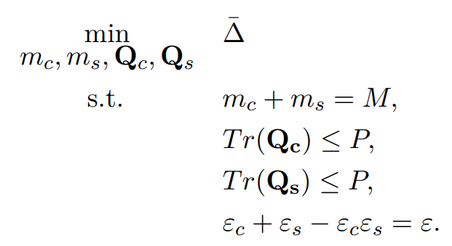

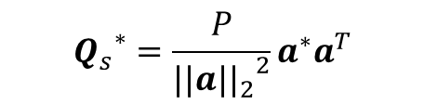

Optimal Resource Allocation with Known $h_{c}$
Solution Algorithm for AoI-Unknown System
M
Co-exist
$$a=0$$
Sensing
Comm.
P
m_{s}
m_{c}
$${Q_{s}}^{∗}=\frac{P}{{{||a||}_{2}}^{2}}a^{∗}a^{T}$$
$${Q_{c}}^{∗}=V_{c}Λ_{c}{V_{c}}^{H}$$

Slide 19
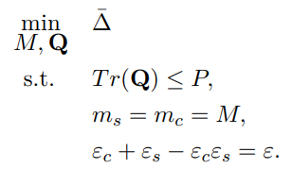

Optimal Resource Allocation with Known $h_{c}$
Solution Algorithm for AoI-Unknown System
M
Superposition
$$a=1$$
P_{c}
Comm.
P_{s}
Sensing

Slide 20



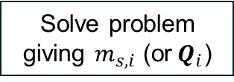
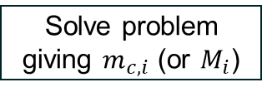
Optimal Resource Allocation with Known $h_{c}$
Solution Algorithm
Start
Initialize
$$i=1$$
Iteratively solve Problems separately to obtain the optimal solution for the origin problem
Solve problem giving $m_{c,i}$ (or $M_{i}$)
Solve problem giving $m_{s,i}$ (or$Q_{i}$)
$$i=i+1$$
$$\left|Δ_{i+1}−Δ_{i}\right|<TH$$
No
Yes
Stop

Slide 21
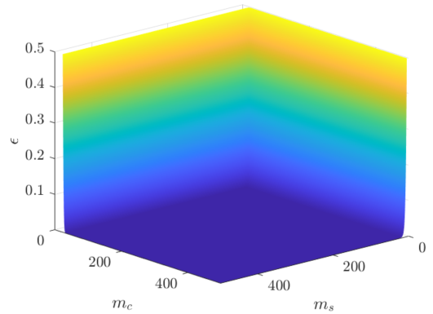
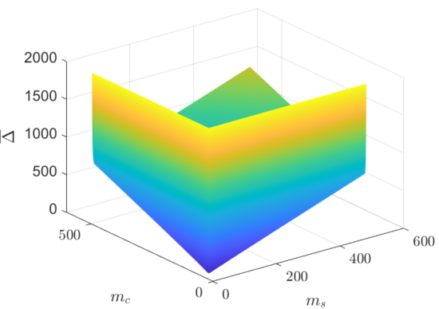
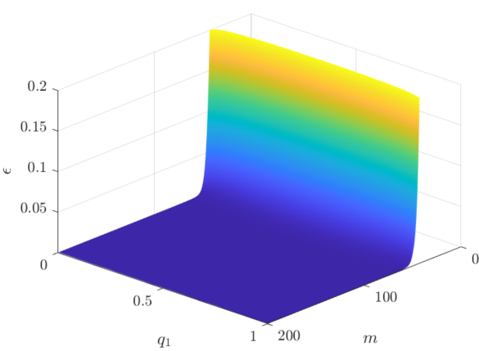
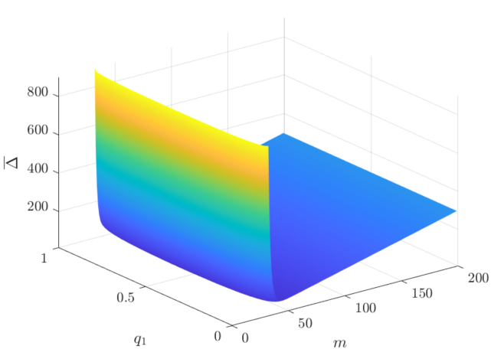

Optimal Resource Allocation with Known $h_{c}$
Simulation
With known $h_{s}$
Co-exist
Convex optimization method can be applied (e.g. iterative search)
Superposition

Slide 22
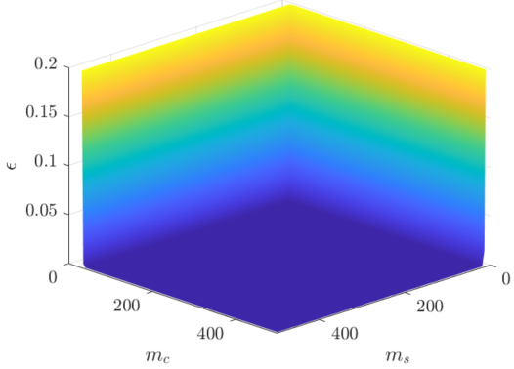
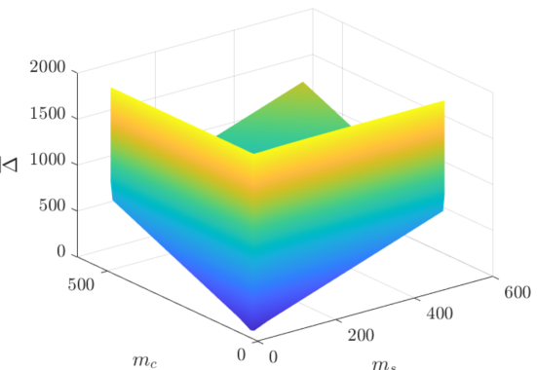
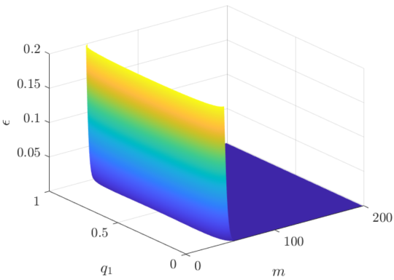
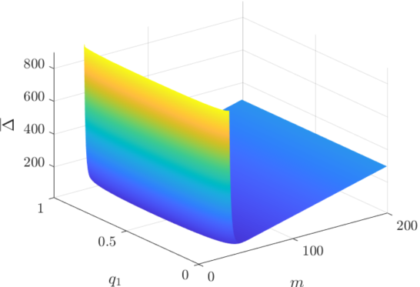

Optimal Resource Allocation with Known $h_{c}$
Simulation
With unknown $h_{s}$
Co-exist
Convex optimization method can be applied (e.g. iterative search)
Superposition

Slide 23
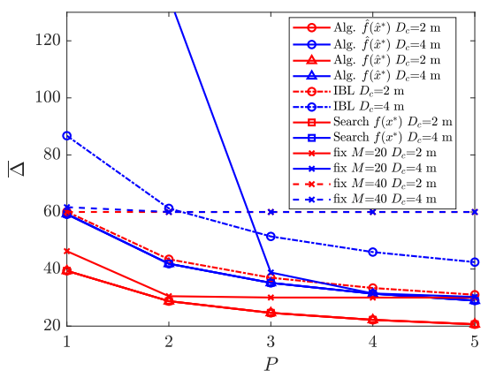
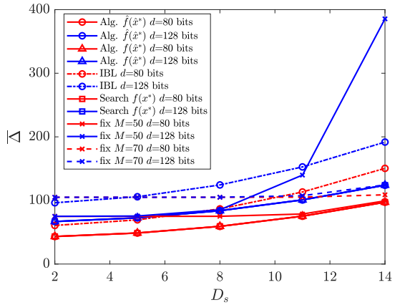
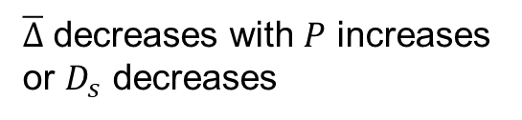
Optimal Resource Allocation with Known $h_{c}$
Simulation
$\overline{Δ}$ decreases with $P$ increases or $D_{s}$ decreases
Proposed Alg. achieve global optimality

Slide 24
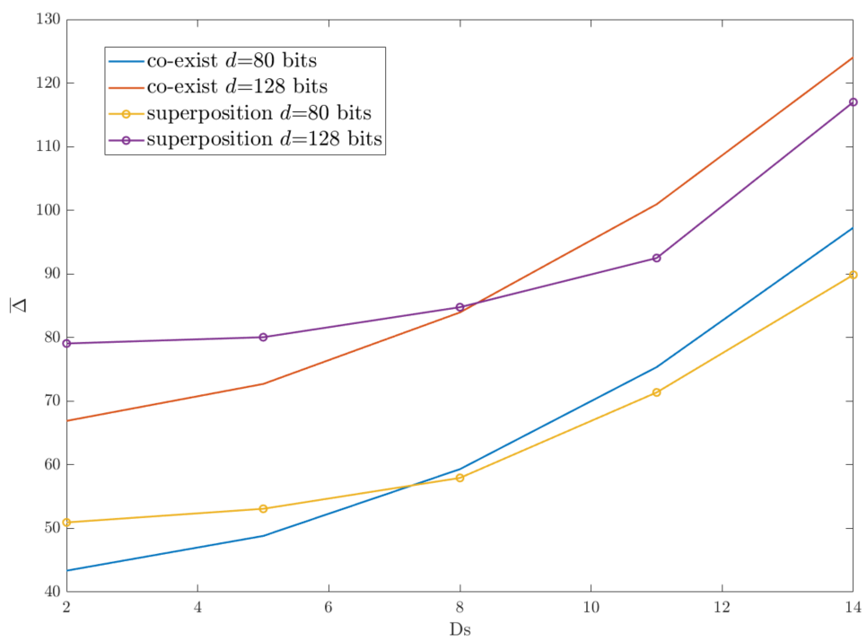
Optimal Resource Allocation with Known $h_{c}$
Simulation
Comparison to obtain optimal solution for origin problem

Slide 25
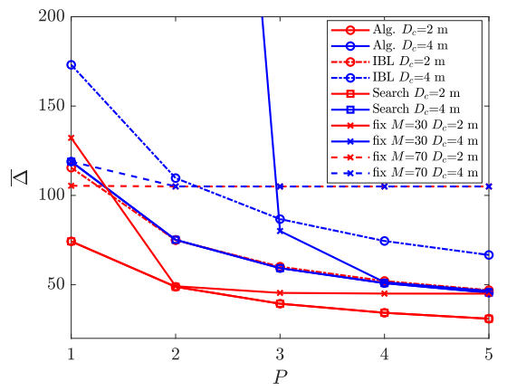
Optimal Resource Allocation with Known $h_{c}$
Simulation
SISO vs MISO

Slide 26
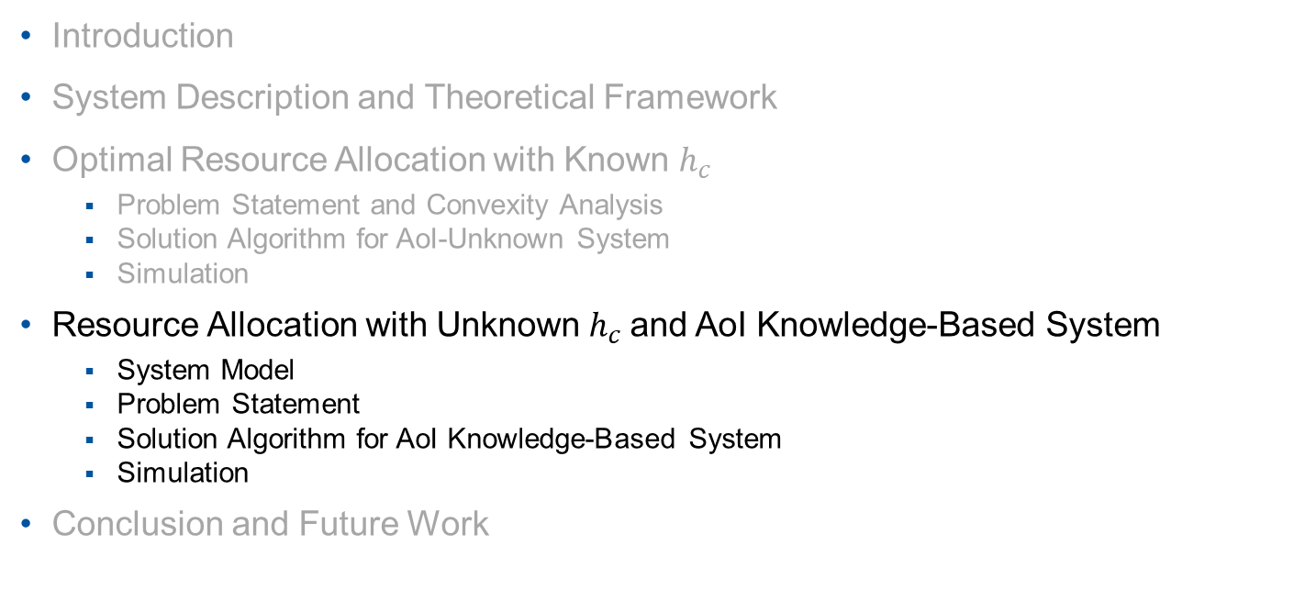
Outline
Introduction
System Description and Theoretical Framework
Optimal Resource Allocation with Known $h_{c}$
Problem Statement and Convexity Analysis
Solution Algorithm for AoI-Unknown System
Simulation
Resource Allocation with Unknown $h_{c}$and AoI Knowledge-Based System
System Model
Problem Statement
Solution Algorithm for AoI Knowledge-Based System
Simulation
Conclusion and Future Work

Slide 27

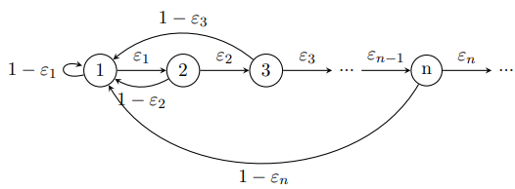
Resource Allocation with Unknown $h_{c}$and AoI Knowledge-Based System
System Model
Communication error probability with unknown $h_{c}$:
System states of AoI knowledge-based ISAC system:

Slide 28
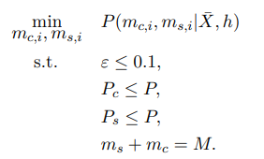

Resource Allocation with Unknown $h_{c}$and AoI Knowledge-Based System
Problem Statement
To obtain optimal solution at each state
AoI knowledge-based system:
With penalty function:

Slide 29
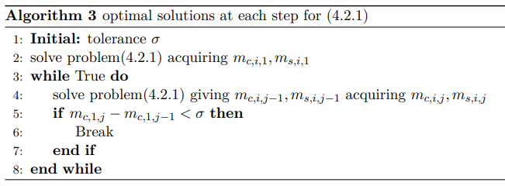
Resource Allocation with Unknown $h_{c}$and AoI Knowledge-Based System
Solution Algorithm for AoI Knowledge-Based System
Optimal solutions at each step are obtained by solving the problem using DP

Slide 30
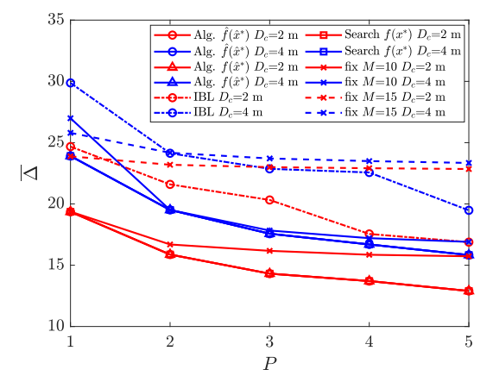
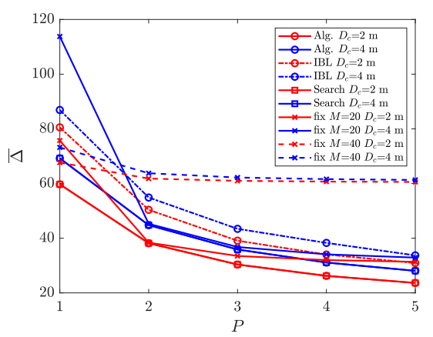

Resource Allocation with Unknown $h_{c}$and AoI Knowledge-Based System
Simulation
Unknown AoI with unknown $h_{c}$
MISO
SISO

Slide 31
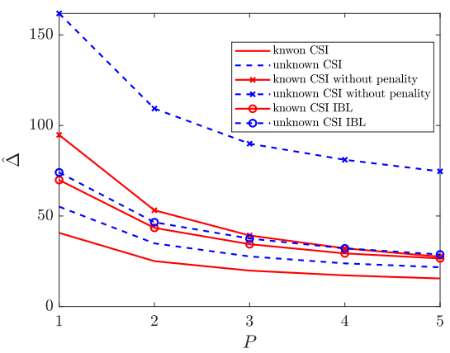
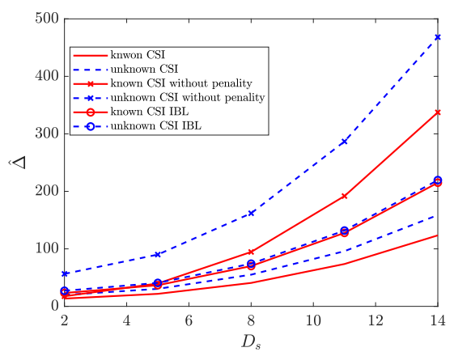
Resource Allocation with Unknown $h_{c}$and AoI Knowledge-Based System
Simulation
AoI knowledge-based system:

Slide 32
Conclusion and Future Work
In this thesis, we optimized the AoI performance of the ISAC system in FBL regime
Study AoI and error probability
Characterize trade-off between error probability and blocklength
Show superiority of our proposed algorithm
Future Work
Multi-user ISAC networks
Multi-target ISAC networks
ISAC networks in 3D space

Slide 34

Proof: Concavity of $P_{D}$ with Known $h_{s}$

Slide 35
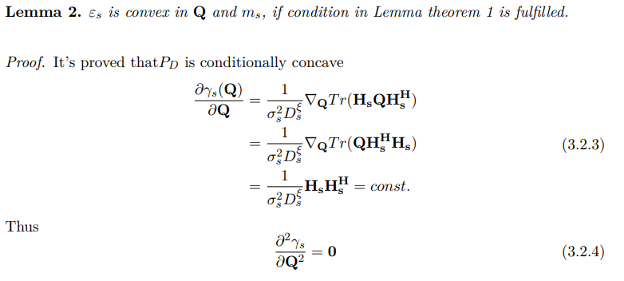
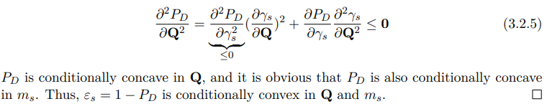
Proof: Convexity of $ε_{s}$ with Known $h_{s}$

Slide 36

Proof: Concavity of $P_{D}$ with Unknown $h_{s}$

Slide 37


Proof: Concavity of $P_{D}$ with Unknown $h_{s}$

Slide 38

Proof: Concavity of $P_{D}$ with Unknown $h_{s}$

Slide 39


Proof: Convexity of $ε_{s}$ with Unknown $h_{s}$

Slide 40

Proof: Convexity of $ε_{c}$ with Known $h_{c}$

Slide 41

Proof: Convexity of $ε_{c}$ with Known $h_{c}$

Slide 42


Proof: Convexity of Optimization Problem

Slide 43

Proof: Convexity of Optimization Problem

Slide 44

Iteration Algorithm

Slide 45

Iteration Algorithm

Slide 46

Iteration Algorithm

