Slide 1
Project Presentation of CO-OP Project at Industry (Module-2) (22CS421)
On
AI in Customer Service: Efficiency and Satisfaction
Priya Singla (2210992097)
Priyank Mahajan (2210992099)
Priyanshi (2210992101)
Rudra Narayan Biswal (2210992191)
Supervised By
Dr. Shikha Tuteja, Associate Professor,
Computer Science & Engineering, Chitkara University, Rajpura
Department of Computer Science and Engineering,
Chitkara University, Punjab

Slide 2
Abstract and Overview
Today’s AI-powered customer service systems are reshaping how businesses interact with their customers. Handles high volumes cost-effectively with faster response and greater personalization.
The system features cross-lingual capability to automatically translate user messages and reduces operational costs and error rates.
Hybrid approach: AI automation combined with deliberate human intervention.
Sentiment analysis routes complex queries to humans with seamless context transfer.
Measured by response time, First Contact Resolution (FCR), and CSAT scores.
AI alone is insufficient — the combination of efficiency and human judgment creates sustainable customer relationships.

Slide 3
Introduction
AI technologies have evolved from experimental tools to core business operations in customer service.
Powered by advanced algorithms and natural language processing, these systems handle everything from routine enquiries to real-time multilingual support fundamentally changing what modern customer service looks like.
Study examines efficiency gains: automation, cost reduction, and faster resolution.
Also evaluates user-experience impact: personalization and customer satisfaction.
Critically assesses strengths and weaknesses to build effective hybrid systems.
Understanding where AI excels and where it falls short is the foundation for building systems that genuinely work.
Key question: Where does AI excel, and where must humans intervene?

Slide 4
Literature Review
AI Boosts Efficiency: Chatbots process large inquiry volumes without human intervention — faster and cheaper.
Voice technology provides 24/7 assistance, eliminating queue wait times entirely.
Satisfaction Is Complex: AI excels at immediate responses and recommendations.
However, customers prefer humans for emotionally complex or ambiguous situations.
Hybrid Systems Win: Blending AI automation with human assistance outperforms either approach alone.
The research is clear that these systems outperform purely automated or purely human approaches on both efficiency and satisfaction metrics.
Lack of transparency in AI decision-making is a significant ongoing concern.

Slide 5
Methodology & System Architecture
Three-tier architecture:
User Interface Level (Chat & Voice).
AI Processing Level (Intent recognition, query classification).
Human Support Level.
Step 1: User submits request via chat or voice interface.
Step 2: AI applies Natural Language Processing (NLP) to understand user intent.
Step 3: Query is classified as simple or complex by intent/sentiment analysis.
Step 4: Simple queries receive AI auto-response immediately.
Step 5: Complex queries are escalated to human agents with full conversation context.
Step 6: Human agent provides personalized, empathetic answer to the customer.

Slide 6
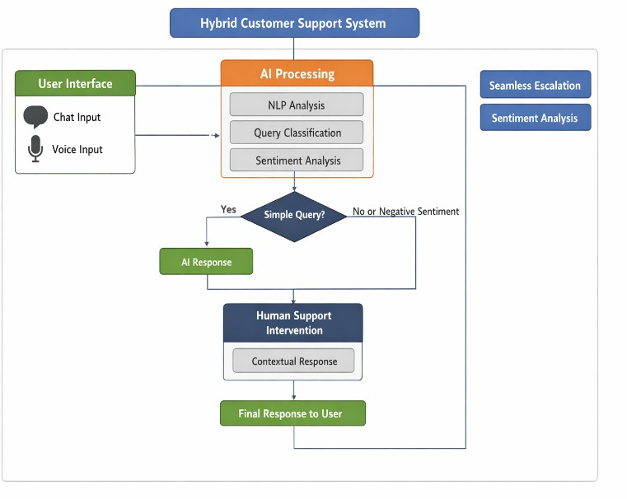
Fig. 1. Hybrid AI-Based Customer Support System Architecture and Workflow

Slide 7
Results: Impact on Operational Efficiency
Handle times decrease significantly with AI automation across all query types.
Voice bots eliminate queue time for routine inquiries, improving customer wait experience.
Substantial financial savings achieved by automating repetitive and mundane tasks.
AI handles unexpected volume spikes without requiring crisis management protocols.
AI enhances human staff capabilities — it does not replace them; service quality improves.
Organizations report measurable ROI within months of hybrid system deployment.

Slide 8
Results: Influence on User Satisfaction
AI Excels At: Order tracking, password resets, and simple product queries with instant answers.
AI Struggles With: Emotionally complex issues, ambiguous statements, empathy, and regional accents.
Critical Drop Point: Satisfaction plummets when customers hit an AI dead-end with no escalation path.
Hybrid Systems Win: Combines the speed of AI with the empathy and judgment of human agents.
Context transfer ensures users do not have to repeat themselves during escalation.
Overall satisfaction scores highest in hybrid deployments versus pure AI or pure human models.

Slide 9
Comparative Analysis: AI vs Human vs Hybrid
Response Time: AI is very fast; Human is moderate; Hybrid delivers fast resolution
Availability: AI and Hybrid offer 24/7 coverage; Human agents are limited by working hours
Cost Efficiency: AI is high; Human is low; Hybrid achieves moderate-to-high efficiency
Complex Queries: AI is limited; Human and Hybrid both handle complex issues strongly
Personalization: AI uses data-driven models; Humans use experience; Hybrid is highly effective
Empathy: AI is low; Human is high; Hybrid delivers a balanced empathetic experience

Slide 10
Research Gaps & Future Scope
Limited Multimodal Support: Current tools focus on text/speech; video and AR channels unexplored
Static Personalization: Most systems rely on static rules; deep learning user models are underutilized
Nuanced Emotion Detection: Existing sentiment analysis misses subtle cues like polite frustration
Real-time Adaptive Learning: Most systems cannot learn from user input during an ongoing session
AI Explainability: Customers need to understand why AI makes decisions transparency builds trust
SME Scalability: Affordable hybrid AI solutions for small/medium enterprises remain scarce

Slide 11
Thank You

