Slide 1

Artificial Intelligence
Game trees
CS-632
Dr. Ghulam Mustafa
University Institute of Information Technology
PMAS-Arid Agriculture University Rawalpindi

Slide 2
Games
Competitive environments, in which the agents’ goals are in conﬂict, giving rise to adversarial search problems—often known as games.
Mathematical game theory, a branch of economics, views any multiagent environment as a game, provided that the impact of each agent on the others is “signiﬁcant,” regardless of whether the agents are cooperative or competitive.
Notes:
a move always has the same result
zero-sum – one player wins and the other must loose (or tie)
perfect information – all information available to players (unlike cards)
games are interesting because they are too hard to solve
chess: branching factor 35 and there will be about 50 moves (need to make some decisions)
inefficiency is plenalized

Slide 3
Kinds of Games
Deterministic
Turn-taking
2-player
Zero-sum
Perfect information
This means deterministic, fully observable environments in which two agents act alternately and in which the utility values at the end of the game are always equal and opposite.
Notes:
a move always has the same result
zero-sum – one player wins and the other must loose (or tie)
perfect information – all information available to players (unlike cards)
games are interesting because they are too hard to solve
chess: branching factor 35 and there will be about 50 moves (need to make some decisions)
inefficiency is plenalized

Slide 4
Game as Search Problem
Initial State: board position and player to move
Successor Function: returns a list of legal (move, state) pairs
Terminal Test: determines when the game is over
Utility function: Gives a numeric value for the terminal state
Notes:
chess utility = +1, 0, -1
backgammon utility = -192 to +192

Slide 5
Game Trees
Game trees are used to represent two-player games.
Alternate moves in the game are represented by alternate levels in the tree.
Nodes in the tree represent positions.
Edges between nodes represent moves.
Leaf nodes represent won, lost or drawn positions.

Slide 6
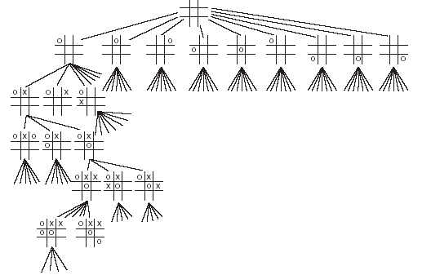
Game Trees
This is an example of a partial game tree for the game tic-tac-toe.
Even for this simple game, the game tree is very large.

Slide 7
Assumptions
In talking about game playing systems, we make a number of assumptions:
The opponent is rational – will play to win.
The game is zero-sum – if one player wins, the other loses.
Usually, the two players have complete knowledge of the game. For games such as poker, this is clearly not true.
Notes:
deterministic, turn-taking, two-player, zero-sum games or perfect information

Slide 8
Minimax
Minimax is a method used to evaluate game trees.
A static evaluator is applied to leaf nodes, and values are passed back up the tree to determine the best score the computer can obtain against a rational opponent.

Slide 9
Minimax – Animated Example
Max
3
6
The computer can obtain 6 by choosing the right hand edge from the first node.
6
Min
5
3
Max
1
3
6
0
7
5
5
2
1
3
6
2
0
7

Slide 10
Minimax Function
MINIMAX-VALUE(n) =
UTILITY(n)
if n is a terminal state
max_{s} _{∈ Successors(n)} MINIMAX-VALUE(s)
if n is a MAX node
min_{s} _{∈ Successors(n)} MINIMAX-VALUE(s)
if n is a MIN node
Notes:
minimax performs complete depth-first search of tree O(b^m) where max depth of tree = m and b legal moves at each point
for real games this time cost is totally impractical

Slide 11
Searching Game Trees
Exhaustively searching a game tree is not usually a good idea.
Even for a game as simple as tic-tac-toe there are over 350,000 nodes in the complete game tree.
An additional problem is that the computer only gets to choose every other path through the tree – the opponent chooses the others.

Slide 12
Alpha-beta Pruning
A method that can often cut off a half the game tree.
Based on the idea that if a move is clearly bad, there is no need to follow the consequences of it.
alpha – highest value we have found so far
beta – lowest value we have found so far

Slide 13
Alpha-beta pruning (cont.)
In Minimax search algorithm, the number of game states are exponential in depth of the tree.
We cannot eliminate the exponent, but we can cut it to half.
Hence pruning is a technique by which without checking each node of the game tree we can compute the correct minimax decision.
This involves two threshold parameter, Alpha and Beta for future expansion.
So, it is called alpha-beta pruning or Alpha-Beta Algorithm.

Slide 14
Alpha-beta pruning (cont.)
Alpha: The best (highest-value) choice we have found so far at any point along the path of Maximizer. The initial value of alpha is -∞.
Beta: The best (lowest-value) choice we have found so far at any point along the path of Minimizer. The initial value of beta is +∞.
The Alpha-beta pruning to a standard minimax algorithm returns the same move as the standard algorithm does, but it removes all the nodes which are not really affecting the final decision but making algorithm slow. Hence by pruning these nodes, it makes the algorithm fast.

Slide 15
Alpha-beta pruning (cont.)
The main condition which required for alpha-beta pruning is: α>=β
The Max player will only update the value of alpha.
The Min player will only update the value of beta.
While backtracking the tree, the node values will be passed to upper nodes instead of values of alpha and beta.
We will only pass the alpha, beta values to the child nodes.

Slide 16
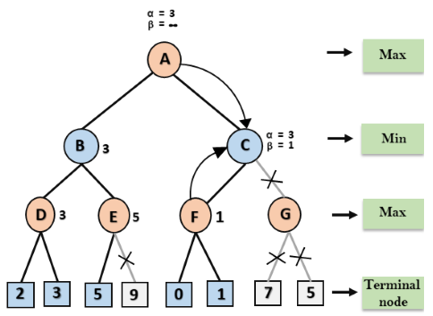
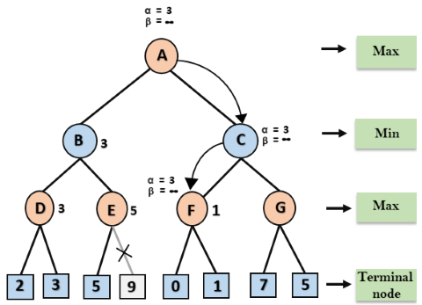
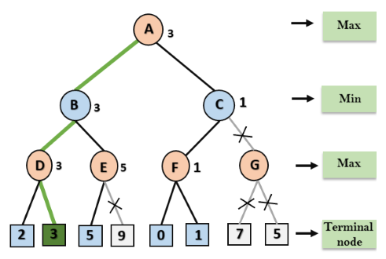
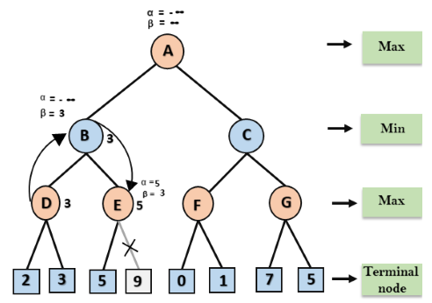
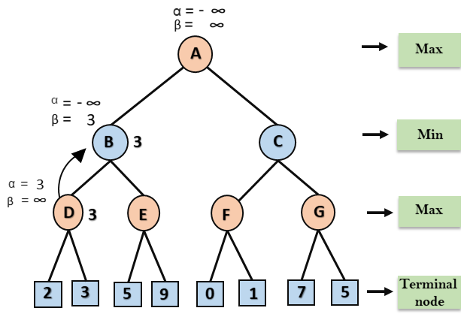
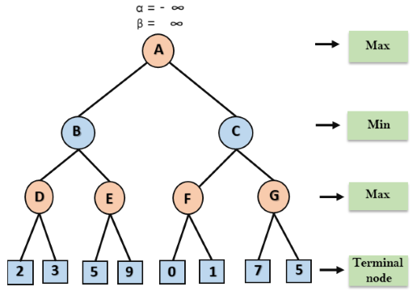
Alpha-beta pruning (cont.)
https://www.javatpoint.com/ai-alpha-beta-pruning

Slide 17
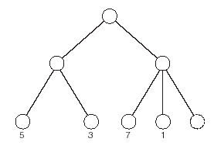
Alpha-beta Pruning – Example.
max
3
In this tree, having examined the nodes with values 7 and 1 there is no need to examine the final node.
min
Notes:
optimal time – O(b^(m/2)) instead of O(b^m)
branching factor goes from b to sqrt(b)
order of nodes matters
random order: O(b^(3m/4))
chess: order (capture first, then threats, then forward moves, then backward moves) gets within factor of 2 of best case
adding dynamic ordering – try moves that were best last time brings close to theoretical limit

Slide 18
Checkers
In 1959, Arthur Samuel creates a computer program that could play checkers to a high level using minimax and alpha-beta pruning.
Chinook, developed in Canada defeated the world champion:
Uses alpha-beta pruning.
Has a database of millions of end games.
Also has a database of openings.
Uses heuristics and knowledge about the game.

Slide 19
Chess
In 1997, Deep Blue defeated world champion, Garry Kasparov.
This has not yet been repeated.
Current systems use parallel search, alpha-beta pruning, databases of openings and heuristics.
The deeper in a search tree the computer can search, the better it plays.

Slide 20
Go
Go is a complex game played on a 19x19 board.
Average branching factor in search tree around 360 (compared to 38 for chess).
The best computer programs cannot compete yet with the best human players.
Methods use pattern matching or selective search to explore the most appropriate parts of the search tree.

Slide 21
Games of Chance
The methods described so far do not work well with games of chance such as poker or backgammon.
Expectiminimax is a variant of minimax designed to deal with chance.
Nodes have expected values based on probabilities.

Slide 22
Thank You

