Slide 1

Artificial Intelligence
Artificial Neural Networks
CS-632
Dr. Ghulam Mustafa
University Institute of Information Technology
PMAS-Arid Agriculture University Rawalpindi

Slide 2
Artificial Neural Networks
Artificial neural network (ANN) is a machine learning approach that models human brain and consists of a number of artificial neurons.
Neuron in ANNs tend to have fewer connections than biological neurons.

Slide 3
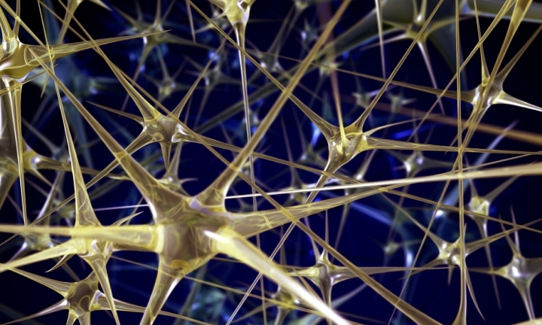
Neural Networks
A large number of very simple neuron like processing elements
A large number of weighted connections between the elements
Highly parallel, distributed control
An emphasis on learning internal representations automatically

Slide 4
Why Neural Nets?
Solving problems under the constraints similar to those of the brain may lead to solutions to AI problems that might otherwise be overlooked.
Individual neurons operate relatively slowly, but make up for that with massive parallelism.

Slide 5
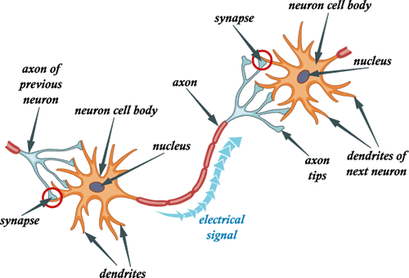
The Parts of a Neuron

Slide 6
How it Works
Each neuron has branching from it a number of small fibers called dendrites and a single long fiber, the axon.

Slide 7
How it Works
The axon eventually splits and ends in a number of synapses which connect the axon to the dendrites of other neurons.

Slide 8
How it Works
Communication between neurons occurs along these paths. When the electric potential in a neuron rises above a threshold, the neuron activates.

Slide 9
How it Works
The neuron sends the electrical impulse down the axon to the synapses.

Slide 10
How it Works
A synapse can either add to the electrical potential or subtract from the electrical potential.

Slide 11
How it Works
The pulse then enters the connected neuron’s dendrites, and the process begins again.

Slide 12
Portion of a network: two interconnected cells.
Signals can be transmitted unchanged or they can be altered by synapses.
A synapse is able to increase or decrease the strength of the connection from the neuron to neuron. This is where information is stored.
The information processing abilities of biological neural systems must follow from highly parallel processes operating on representations that are distributed over many neurons.
One motivation for ANN is to capture this kind of highly parallel computation based on distributed representations.

Slide 13
Warren and Walter, 1943
Modern era of neural networks starts in the 1940’s, when Warren and Walter (a mathematician) explored the computational capabilities of networks made of very simple neurons
A Warren and Walter network fires if the sum of its excited inputs exceeds its threshold, as long as it does not receive an out of scope Input
Using a network of such neurons, they showed that it was possible to construct any logical function

Slide 14
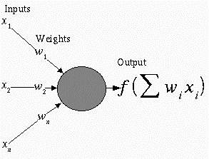
Neural network representation
An ANN is composed of processing elements called perceptrons, organized in different ways to form the network’s structure.
Processing Elements
An ANN consists of perceptrons. Each of the perceptrons receives inputs, processes inputs and delivers a single output.
The input can be raw input data or the output of other perceptrons. The output can be the final result (e.g. 1 means yes, 0 means no) or it can be inputs to other perceptrons.

Slide 15
Perceptrons
A perceptron takes a vector of real-valued inputs, calculates a linear combination of these inputs, then outputs
a 1 if the result is greater than some threshold
–1 otherwise.
Given real-valued inputs x₁ through x_{n}, the output o(x₁, …, x_{n}) computed by the perceptron is
o(x₁, …, x_{n}) = 1 if w₀ + w₁x₁ + … + w_{n}x_{n} > 0
-1 otherwise
where w_{i} is a real-valued constant, or weight.
Here w₀ is a threshold that the weighted combination of inputs w₁x₁ + … + w_{n}x_{n} must surpass in order for perceptron to output a 1.

Slide 16
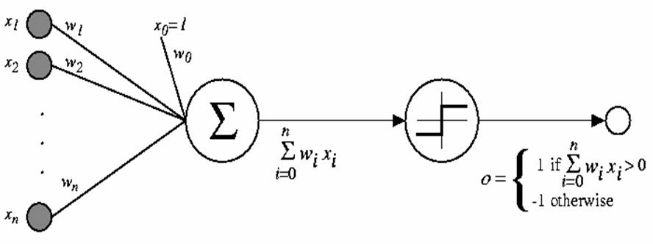
Perceptrons
To simplify notation, we imagine an additional constant input called Bias value x₀ = 1, allowing us to write the above inequality as
n
∑_{i=0} w_{i}x_{i} >0
Learning a perceptron involves choosing values for the weights w₀, w₁,…, w_{n}.
b (bias)

Slide 17
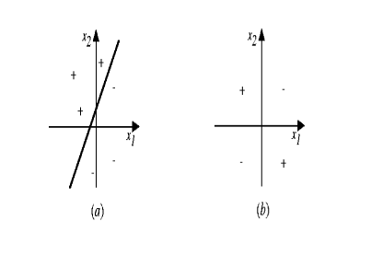
Representation Power of Perceptrons
We can view the perceptron as representing a hyperplane decision surface in the n-dimensional space of instances (i.e. points). The perceptron outputs a 1 for instances lying on one side of the hyperplane and outputs a –1 for instances lying on the other side, as in ,
Some sets of positive and negative examples cannot be separated by any hyperplane.
Those that can be separated are called linearly separated set of examples.

Slide 18
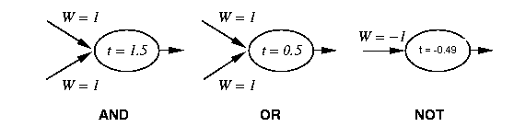
Perceptron Training
1 if Σ w_{i} x_{i} >t
Output=
-1 otherwise
{
_{i=0}
Linear threshold is used.
W - weight value
t - threshold value

Slide 19
Simple network
1 if Σ w_{i} x_{i} >t
output=
-1 otherwise
{
_{i=0}
W = 1.5
X
t = 0.0
W = 1
Y

Slide 20
Training Perceptrons
For AND
A B Output
0 0 0
0 1 0
1 0 0
1 1 1
W = ?
x
T
W = ?
W = ?
y
What are the weight values?
Initialize with random weight values

Slide 21
Training Perceptrons
For AND
X Y Output
0 0 0
0 1 0
1 0 0
1 1 1
W = -0.8
x
t = 0
W = 0.5
W = 0.5
y
Decision hyperplane :
w₀ + w₁ x₁ + w₂ x₂ = 0
-0.8 + 0.5 x₁ + 0.5 x₂ = 0

Slide 22
Training Perceptrons
For OR
X Y Output
0 0 0
0 1 1
1 0 1
1 1 1
W = -0.3
x
t = 0.0
W = 0.5
W = 0.5
y
1
1
1
Decision hyperplane :
w₀ + w₁ x₁ + w₂ x₂ = 0
-0.3 + 0.5 x₁ + 0.5 x₂ = 0

Slide 23
Thank You

