Slide 1

Artificial Intelligence
Artificial Neural Networks-II
CS-632
Dr. Ghulam Mustafa
University Institute of Information Technology
PMAS-Arid Agriculture University Rawalpindi

Slide 2
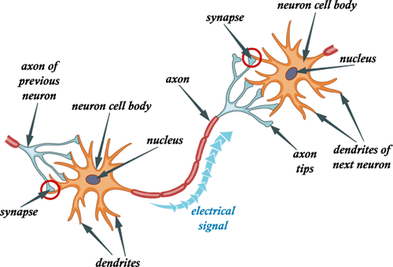
The Parts of a Neuron

Slide 3
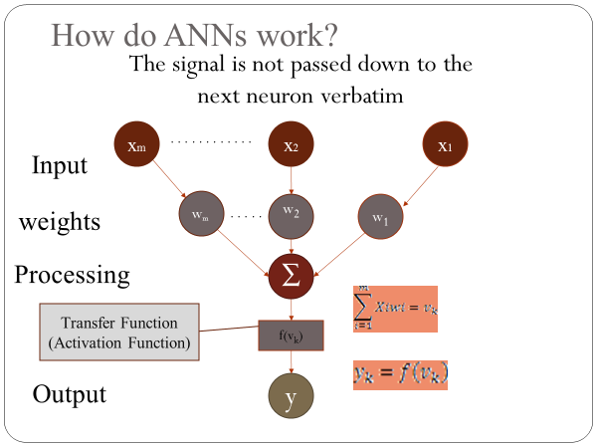
Perceptrons

Slide 4
Activation Functions
Step(x) = 1 if x >= t, else 0
Sign(x) = +1 if x >= 0, else –1
Sigmoid(x) = 1/(1+e-x)
Identity Function A(x) = X

Slide 5
Representational Power of Perceptrons
Perceptrons can represent the logical AND, OR, and NOT functions as above.
we consider 1 to represent True and –1 to represent False.

Slide 6
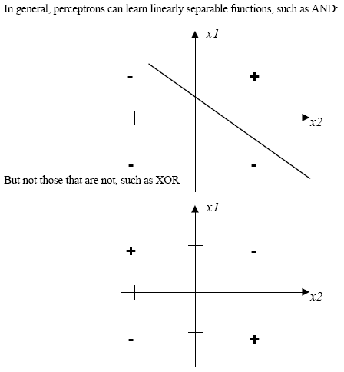
Here there is no way to draw a single line that separates the "+" (true) values from the "-"
(false) values.

Slide 7
Train a perceptron
At start of the experiment there are W random values
Than the training begins with objective of teaching it to differentiate two classes of inputs I and II
The goal is to have the nodes output o = 1 if the input is of class I , and to have
o= -1 if the input is of class II
You can free to choose any inputs (Xi) and to designate them as being of class I or II

Slide 8
Train a perceptron
If the node happened to output 1 signal when given a class II input or output -1 signal when given a class I input the weight Wi has no change.
Then the training is complete.

Slide 9
Single Layer Perceptron
For a problem which calls for more then 2 classes, several perceptrons can be combined into a network.
Can distinguish only linear separable functions.

Slide 10
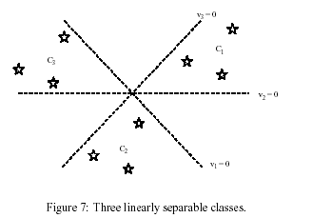
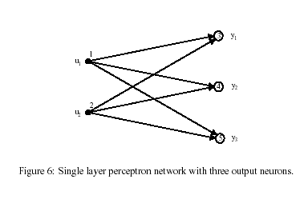
Single Layer Perceptron
Single layer, five nodes. 2 inputs and 3 outputs
Recognizes 3 linear separate classes, by means of 2 features

Slide 11
Multi-Layer Networks

Slide 12
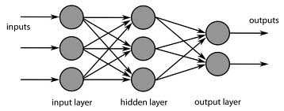
Multi-Layer Networks
A Multi layer perceptron can classify non linear separable problems.
A Multilayer network has one or more hidden layers.

Slide 13
Multi-layer networks
x₁
x₂
Input
(visual input)
Output
(Motor output)
x_{n}
Hidden layers

Slide 14
EXAMPLE
1,0
1,1
Logical XOR
Function
X Y output
0 0 0
0 1 1
0 1
1 1 0
X
0,0
0,1
Y

Slide 15
XOR
XOR
0
0
Activation Function:
if (input >= threshold), fire
else, don’t fire
1
w₁₃
w₂₁
1
0
0
0
0
1
2
1
0
0
0
All weights are 1, unless otherwise labeled.
-2
1
0

Slide 16
XOR
XOR
1
0
Activation Function:
if (input >= threshold), fire
else, don’t fire
1
w₁₃
w₂₁
1
0
0
1
0
1
2
1
1
0
0
All weights are 1, unless otherwise labeled.
-2
1
1

Slide 17
XOR
XOR
0
1
Activation Function:
if (input >= threshold), fire
else, don’t fire
1
w₁₃
w₂₁
1
0
0
0
1
1
2
1
0
0
1
All weights are 1, unless otherwise labeled.
-2
1
1

Slide 18
XOR
XOR
1
1
Activation Function:
if (input >= threshold), fire
else, don’t fire
1
w₁₃
w₂₁
1
0
0
1
1
1
2
1
1
1
1
All weights are 1, unless otherwise labeled.
-2
1
0

Slide 19
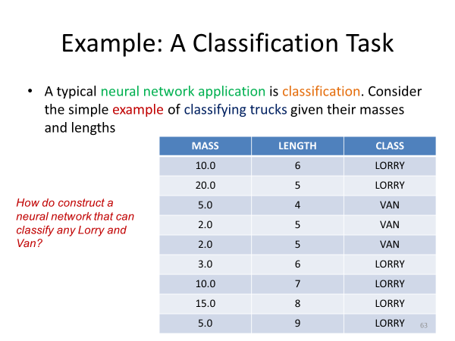

Slide 20
Training Multilayer Perceptron
The training of multilayer networks raises some important issues:
How many layers ?, how many neurons per layer ?
Too few neurons makes the network unable to learn the desired behavior.
Too many neurons increases the complexity of the learning algorithm.

Slide 21
Training Multilayer Perceptron
A desired property of a neural network is its ability to generalize from the training set.
If there are too many neurons, there is the danger of over fitting.

Slide 22
Training Perceptrons
Learning involves choosing values for the weights
The perceptron is trained as follows:
First, inputs are given random weights (usually between –0.5 and 0.5).
An item of training data is presented. If the perceptron mis-classifies it, the weights are modified according to the following:
where t is the target output for the training example, o is the output generated by the preceptron and a is the learning rate, between 0 and 1 (usually small such as 0.1)
Cycle through training examples until successfully classify all examples
Each cycle known as an epoch

Slide 23
Backpropagation
Multilayer neural networks learn in the same way as perceptrons.
However, there are many more weights, and it is important to assign credit (or blame) correctly when changing weights.
E sums the errors over all of the network output units

Slide 24
Backpropagation Algorithm
Create a feed-forward network with n_{in} inputs, n_{hidden} hidden units, and n_{out} output units.
Initialize all network weights to small random numbers
Until termination condition is met, Do
For each <x,t> in training examples, Do
Propagate the input forward through the network:
Input the instance x to the network and compute the output o_{u} of every unit u in the network
Propagate the errors backward through the network:
For each network output unit k, calculate its error term δ_{k}
For each hidden unit h, calculate its error term δ_{h}
Update each network weight w_{ji}
where

Slide 25
Problems with training:
Nets get stuck
Not enough degrees of freedom
Hidden layer is too small
Training becomes unstable
too many degrees of freedom
Hidden layer is too big / too many hidden layers
Over-fitting
Can find every pattern, not all are significant. If neural net is “over-fit” it will not generalize well to the testing dataset

Slide 26
Thank You

