Slide 1

Artificial Intelligence
Machine Learning
CS-632
Dr. Ghulam Mustafa
University Institute of Information Technology
PMAS-Arid Agriculture University Rawalpindi

Slide 2
Machine learning
A branch of artificial intelligence, concerns the construction and study of systems that can learn from data.
A machine learning system could be trained on email messages to learn to distinguish between spam and non-spam messages.
After learning, it can then be used to classify new email messages into spam and non-spam folders.
Notes:
The core of machine learning deals with representation and generalization.
Representation of data instances and functions evaluated on these instances are part of all machine learning systems. Generalization is the property that the system will perform well on unseen data instances; the conditions under which this can be guaranteed are a key object of study in the subfield of computational learning theory.

Slide 3
Machine learning
Machine learning deals with representation and generalization.
Representation of data instances and functions evaluated on these instances are part of all machine learning systems.
Generalization is the property that the system will perform well on unseen data instances; the conditions under which this can be guaranteed are a key object of study in the subfield of Computational Learning Theory.

Slide 4
Machine learning / Data mining
These two terms are commonly confused, as they often employ the same methods and overlap significantly.
They can be roughly defined as follows:
Machine learning focuses on prediction, based on known properties learned from the training data.
Data mining (which is the analysis step of Knowledge Discovery in Databases) focuses on the discovery of (previously) unknown properties on the data.

Slide 5
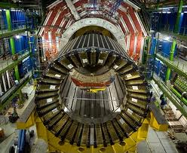
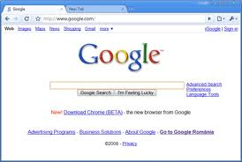
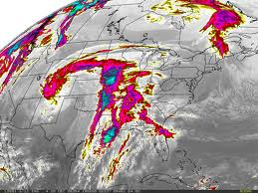
Learning from Data
The world is driven by data.
Germany’s climate research centre generates 10 petabytes per year
Google processes 24 petabytes per day
The Large Hadron Collider produces 60 gigabytes per minute (~12 DVDs)
There are over 50m credit card transactions a day in the US alone.

Slide 6
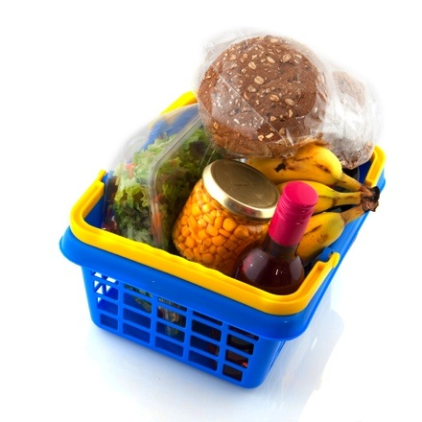

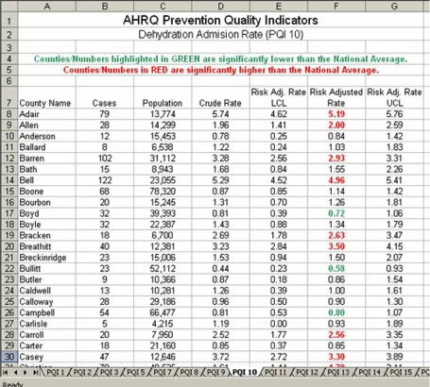
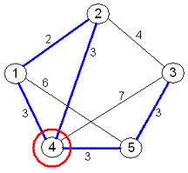
Learning from Data
Data is recorded from some real-world phenomenon.
What might we want to do with that data?
Prediction
What can we predict about this phenomenon?
Description
How can we describe/understand this phenomenon in a new way?

Slide 7


Learning from Data
How can we extract knowledge from data to help humans take decisions?
How can we automate decisions from data?
How can we adapt systems dynamically to enable better user experiences?
Write code to explicitly
do the above tasks
Write code to make the computer
learn how to do the tasks

Slide 8
Machine Learning
Where does it fit? What is it not?
Artificial Intelligence
Statistics / Mathematics
Data Mining
Machine Learning
Computer Vision
Robotics

Slide 9
Coding Skills
Maths/Statistics
Knowledge
Machine Learning
Data Science
£££
Software Engineer
Statistician
Specialist Domain Knowledge

Slide 10
Human interaction
Some machine learning systems attempt to eliminate the need for human intuition in data analysis, while others adopt a collaborative approach between human and machine.
Human intuition cannot, however, be entirely eliminated, since the system's designer must specify how the data is to be represented and what mechanisms will be used to search for a characterization of the data

Slide 11
What is Learning?
Many different answers, depending on the field you’re considering and whom you ask
AI vs. psychology vs. education vs. neurobiology vs. …

Slide 12
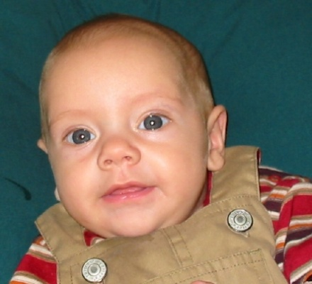


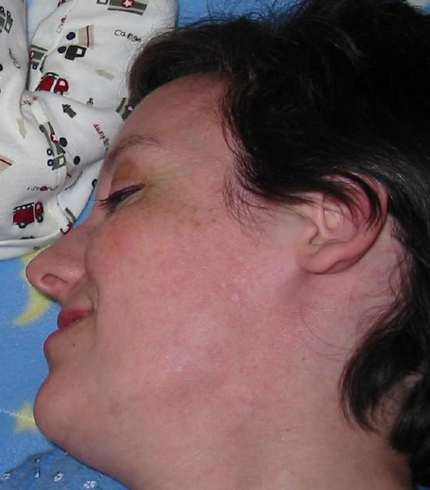


Does Memorization = Learning?
Test #1: Thomas learns his mother’s face
Memorizes:
But will he recognize:

Slide 13

Thus he can generalize beyond what he’s seen!

Slide 14
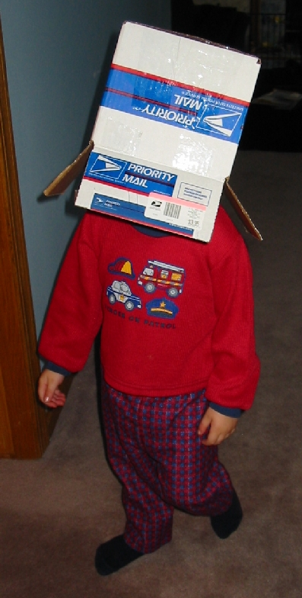
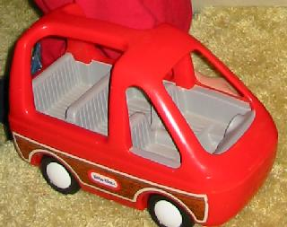
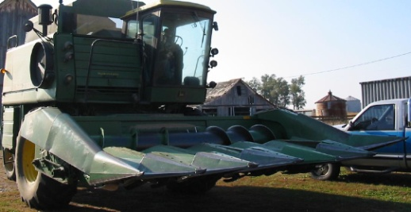
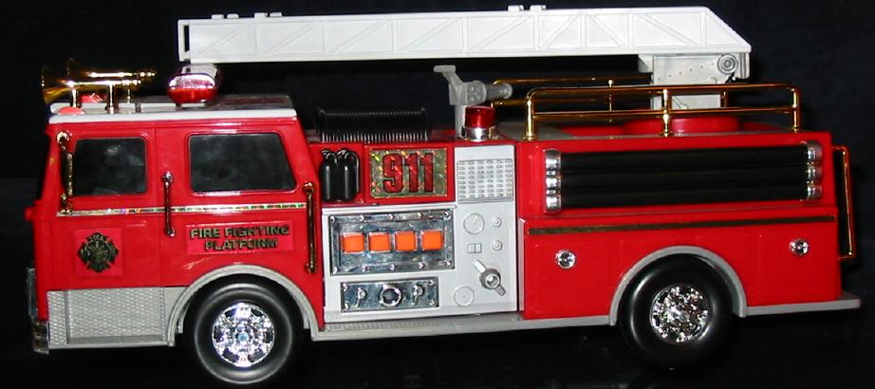
Does Memorization = Learning? (cont’d)
Test #2: Nicholas learns about trucks
Memorizes:
But will he recognize others?

Slide 15
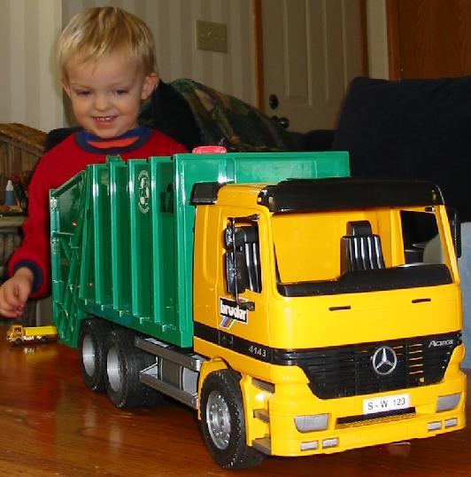
So learning involves ability to generalize from labeled examples
(in contrast, memorization is trivial, especially for a computer)

Slide 16
Again, what is Machine Learning?
Given several labeled examples of a concept
E.g. trucks vs. non-trucks
Examples are described by features
E.g. number-of-wheels (integer), relative-height (height divided by width), hauls-cargo (yes/no)
A machine learning algorithm uses these examples to create a hypothesis that will predict the label of new (previously unseen) examples
Similar to a very simplified form of human learning

Slide 17
Why Machine Learning?
(Relatively) new kind of capability for computers
Data mining: extracting new information from medical records, maintenance records, etc.
Self-customizing programs: Web browser that learns what you like and seeks it out
Applications we can’t program by hand: E.g. speech recognition, autonomous driving

Slide 18
Why Machine Learning? (cont’d)
Many old real-world applications of AI were expert systems
Essentially a set of if-then rules to emulate a human expert
E.g. “If medical test A is positive and test B is negative and if patient is chronically thirsty, then diagnosis = diabetes with confidence 0.85”
Rules were extracted via interviews of human experts

Slide 19
Other Applications of ML
The Google search engine uses numerous machine learning techniques
Spelling corrector: “spehl korector”, “phonitick spewling”, “Brytney Spears”, “Brithney Spears”, …
Grouping together top news stories from numerous sources (news.google.com)
Analyzing data from over 3 billion web pages to improve search results
Analyzing which search results are most often followed, i.e. which results are most relevant.

Slide 20
Algorithm types
Machine learning algorithms can be organized into a taxonomy based on the desired outcome of the algorithm or the type of input available during training the machine.

Slide 21
Supervised learning
Algorithms are trained on labeled examples, i.e., input where the desired output is known.
The supervised learning algorithm attempts to generalize a function or mapping from inputs to outputs which can then be used to speculatively generate an output for previously unseen inputs.

Slide 22
Unsupervised learning
Algorithms operate on unlabelled examples, i.e., input where the desired output is unknown.
Here the objective is to discover structure in the data (e.g. through a cluster analysis), not to generalize a mapping from inputs to outputs.

Slide 23
Semi-supervised learning
Combines both labeled and unlabelled examples to generate an appropriate function or classifier.

Slide 24
Reinforcement learning
Concerned with how intelligent agents have to to act in an environment to maximize some notion of reward.
The agent executes actions which cause the observable state of the environment to change. Through a sequence of actions, the agent attempts to gather knowledge about how the environment responds to its actions, and attempts to synthesizes a sequence of actions that maximizes a cumulative reward.

Slide 25
Working Examples

Slide 26
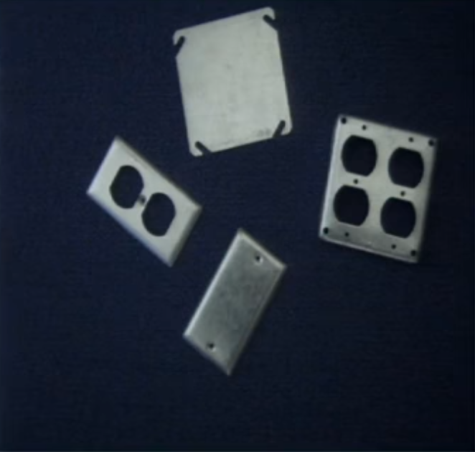
Robot to Sort Objects
How do a robot will sort
these objects?

Slide 27
Decision Boundaries
2-D plane representation of the Features
Hole
Area
Area
Notes:
Consult MIT Artificial Intelligence OCW (Open Course ware )
https://www.youtube.com/watch?v=09mb78oiPkA&t=570s

Slide 28
K- Nearest Neighbor (K-NN)
Non-Parametric method using for classification
Prediction for test data is done on the basis of its neighbor
K is an integer (small), if K=1, K is assigned to the class of single nearest neighbor

Slide 29
K-NN (Example)
Name | Acid-Durability | Strength | Class
Type-1 | 7 | 7 | Bad
Type-2 | 7 | 4 | Bad
Type-3 | 3 | 4 | Good
Type-4 | 1 | 4 | Good
New Product -> Acid Durability (3), Strength (7)
Which Class this new product fits in?
https://people.revoledu.com/kardi/tutorial/KNN/KNN_Numerical-example.html

Slide 30
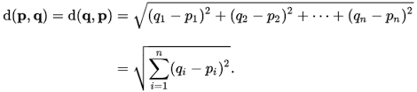
Step 1: Calculate Similarity
Use Distance formula (e.g. Euclidean distance)
Name | Acid-Durability | Strength | Class | Distance
Type-1 | 7 | 7 | Bad | Sqrt((7-3)²+(7-7) ²) = 4
Type-2 | 7 | 4 | Bad | 5
Type-3 | 3 | 4 | Good | 3
Type-4 | 1 | 4 | Good | 3.6

Slide 31
Step 2: Rank These Attributes
Name | Acid-Durability | Strength | Class | Distance | Rank
Type-1 | 7 | 7 | Bad | 4 | 3
Type-2 | 7 | 4 | Bad | 5 | 4
Type-3 | 3 | 4 | Good | 3 | 1
Type-4 | 1 | 4 | Good | 3.6 | 2

Slide 32
Step 3: K=1
Name | Acid-Durability | Strength | Class | Distance | Rank
Type-1 | 7 | 7 | Bad | 4 | 3
Type-2 | 7 | 4 | Bad | 5 | 4
Type-3 | 3 | 4 | Good | 3 | 1
Type-4 | 1 | 4 | Good | 3.6 | 2

Slide 33
Step 3: K=2
Name | Acid-Durability | Strength | Class | Distance | Rank
Type-1 | 7 | 7 | Bad | 4 | 3
Type-2 | 7 | 4 | Bad | 5 | 4
Type-3 | 3 | 4 | Good | 3 | 1
Type-4 | 1 | 4 | Good | 3.6 | 2
New Product -> Acid Durability (3), Strength (7)
GOOD

Slide 34
Thank You

