Slide 1
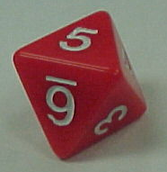
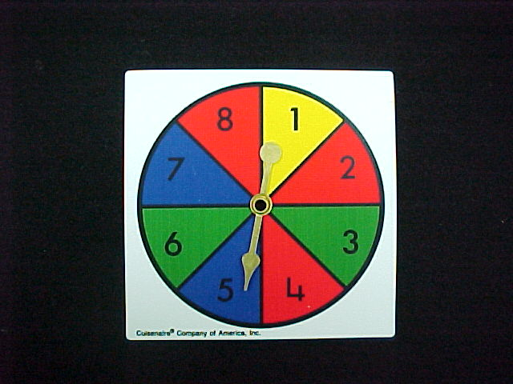
Artificial Intelligence
Probability
A probability is a number that reflects the chance or likelihood that a particular event will occur.

Slide 2
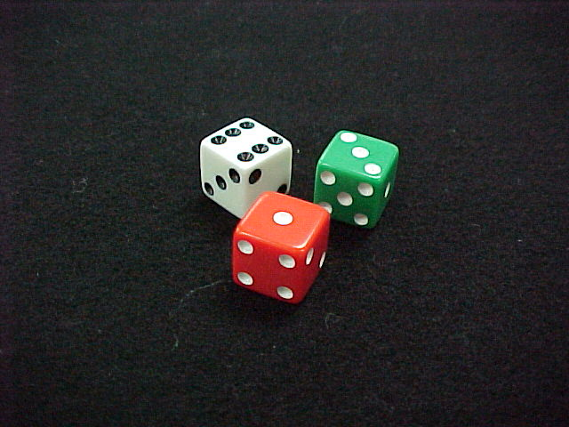

What are the Chances?
A probability experiment is something that can happen in more than one way.

Slide 3
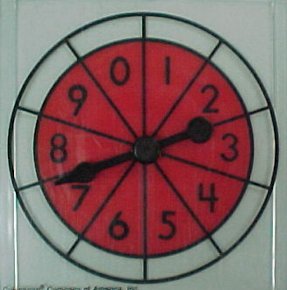
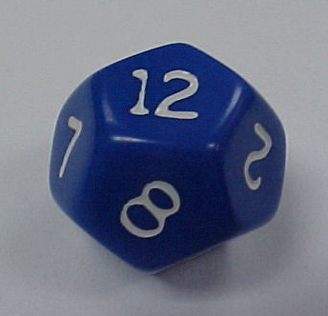

The outcomes of an experiment are the ways it can happen.
6
10
12
52
The event is the particular outcome you are looking for.

Slide 4

The Probability of an Event =
P(Event) = the number of ways it can happen
the number of possible outcomes
P(H+T) = 2 = 1
__ __
4 2
H H
T T
H T
T H

Slide 5
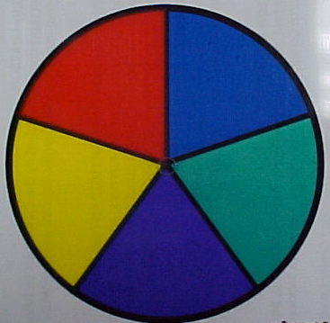
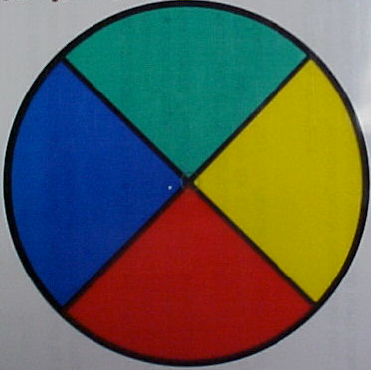
Try these…
a)
b)
P(red)
P(blue)
P(yellow or blue)
1
5
2
5
3
5
A
A
A
B
B
B
1
4
1
4
1
2

Slide 6
Prior probability:
Probability in the absence of any other information
Concepts:
P(Dice = 2) = 1/6
Random variable: Dice
Domain = <1, 2, 3, 4, 5, 6>
Probability distribution:
P(Dice) = <1/6, 1/6, 1/6, 1/6, 1/6, 1/6>

Slide 7
Conditional Probability
Conditional Probability contains a condition that may limit the sample space for an event.
You can write a conditional probability using the notation
- This reads “the probability of event B, given event A”

Slide 8
Conditional Probability
The table shows the results of a class survey.
Find P(own a pet | female)
Do you own a pet?
yes no
female 8 6
male 5 7
14 females;
13 males
The condition female limits the sample space to 14 possible outcomes.
Of the 14 females, 8 own a pet.
Therefore, P(own a pet | female) equals
8
14

Slide 9
Conditional Probability
The table shows the results of a class survey.
Find P(wash the dishes | male)
Did you wash the dishes last night?
yes no
Female 7 6
male 7 8
13 females;
15 males
The condition male limits the sample space to 15 possible outcomes.
Of the 15 males, 7 did the dishes.
Therefore, P(wash the dishes | male)
7
15

Slide 10
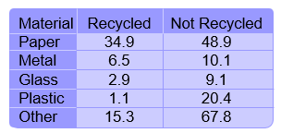
Let’s Try One
Using the data in the table, find the probability that a sample of not recycled waste was plastic. P(plastic | non-recycled)
The given condition limits the
sample space to non-recycled
waste.
A favorable outcome is
non-recycled plastic.
P(plastic | non-recycled) =
20.4
48.9 + 10.1 + 9.1 + 20.4 + 67.8
=
20.4
156.3
0.13
The probability that the non-recycled waste was plastic is about 13%.

Slide 11
Conditional Probability Formula
For any two events A and B from a sample space with P(A) does not equal zero

Slide 12



Conditional Probability
Researchers asked people who exercise regularly whether they jog or walk. Fifty-eight percent of the respondents were male. Twenty percent of all respondents were males who said they jog. Find the probability that a male respondent jogs.
0.2
0.58
= Substitute 0.2 for P(A and B) and 0.58 for P(A).
0.344 Simplify.
The probability that a male respondent jogs is about 34%.

Slide 13
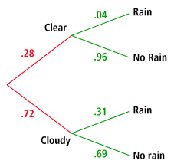
Using Tree Diagrams
Amir created the tree diagram after examining years of weather observations in his hometown. The diagram shows the probability of whether a day will begin clear or cloudy, and then the probability of rain on days that begin clear and cloudy.
Find the probability that a day will start out
clear, and then will rain.
The path containing clear and rain represents days that start out clear
and then will rain.
P(clear and rain) = P(rain | clear) • P(clear)
= 0.04 • 0.28
= 0.011
The probability that a day will start out clear and then rain is about 1%.

Slide 14
(continued)
Find the probability that it will not rain
on any given day.
The paths containing clear and no rain and cloudy and no rain both represent a day when it will not rain. Find the probability for both paths and add them.
P(clear and no rain) + P(cloudy and no rain) =
P(clear) • P(no rain | clear) + P(cloudy) • P(no rain | cloudy)
= 0.28(.96) + .72(.69)
= 0.7656
The probability that it will not rain on any given day is about 77%.

Slide 15
Important Formulas :
i)
ii)
iii)

Slide 16
Joint Distribution
A joint probability distribution shows a probability distribution for two (or more) random variables. Instead of events being labeled A and B, the norm is to use X and Y. The formal definition is:
f(x, y) = P(X = x, Y = y)

Slide 17

Joint Distribution
The joint probability distribution for a set of random variables, X₁,…,X_{n} gives the probability of every combination of values (an n-dimensional array with v^{n} values if all variables are discrete with v values, all v^{n} values must sum to 1): P(X₁,…,X_{n})

Slide 18
Joint Distribution
?

Slide 19
Joint Distribution
EXAMPLE
The probability that a card is a five and black = p(five and black) = 2/52 = 1/26. (There are two black fives in a deck of 52 cards, the five of spades and the five of clubs).
A joint probability distribution shows a probability distribution for two (or more) random variables. Instead of events being labeled A and B, the norm is to use X and Y. The formal definition is:
f(x, y) = P(X = x, Y = y)
The whole point of the joint distribution is to look for a relationship between two variables. For example, the following table shows some probabilities for X and Y happening at the same time:

Slide 20
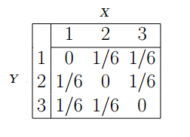
Joint Distribution
You can use the table to find probabilities. For example: Question: What is the probability for Y = 2 and X = 3?

Slide 21
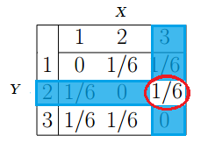
Joint Distribution
Answer: Look at the table for the intersection of Y = 2 and X = 3. The answer (1/6) is circled:

Slide 22
Joint Distribution
The probability of all possible conjunctions (assignments of values to some subset of variables) can be calculated by summing the appropriate subset of values from the joint distribution
?

Slide 23
Joint Distribution
?

Slide 24
Joint Distribution
APPLICATION IN MACHINE LEARNING
The design of learning algorithms is such that key often depend on probabilistic assumptions if the data. Uncertainty is a key concept pattern recognition, which is in turn essential in machine learning. Being able to make optimal predictions from an incomplete data set by using the data a machine does have is essential in the framework of “smarter” and faster AI.

Slide 25
Independent Event
If the probability of occurrence of an event A is not affected by the occurrence of another event B, then A and B are said to be independent events.
The literal meaning of Independent Events is the events which occur freely of each other. The events are independent of each other. In other words, the occurrence of one event does not affect the occurrence of the other.
P(A | B) = P(A)
Example: You flip a coin and get a head and you flip a second coin and get a tail .The two coins don’t influence each other.

Slide 26
Conditional Independence
Conditional independence describes situations wherein an observation is irrelevant or redundant when evaluating the certainty of a hypothesis.
If A is the hypothesis, and B and C are observations, conditional independence can be stated as
P(A|B,C) = P(A|C)
where P(A|B,C) is the probability of A given both B and C . Since the probability of A given C is the same as the probability of A given both B and C , this equality expresses that B contributes nothing to the certainty of A. In this case, A and B are said to be conditionally independent given C

Slide 27
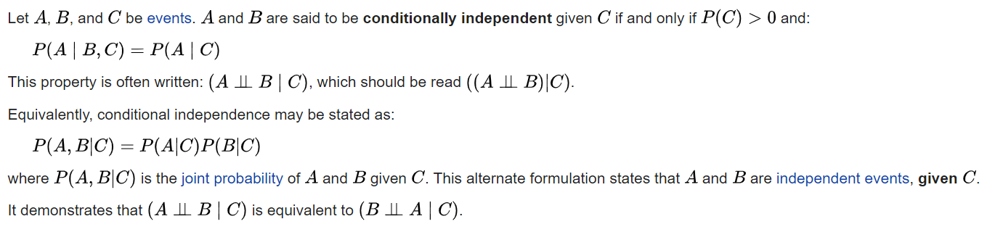
Conditional Independence

Slide 28
Conditional Independence
Conditional independence depends on the nature of the third event. If you roll two dice, one may assume that the two dice behave independently of each other. Looking at the results of one dice will not tell you about the result of the second dice. (That is, the two dice are independent.) If, however, the 1st dice's result is a 3, and someone tells you about a third event - that the sum of the two results is even - then this extra unit of information restricts the options for the 2nd result to an odd number. In other words, two events can be independent, but NOT conditionally independent

Slide 29
Conditional Independence
Does independence imply conditional independence?
Consider two events A and B to be independent. Now given a event C has occurred, the event A and B has become mutually exclusive event (both can’t happen at the same time), therefore not independent. So independence doesn’t implies conditional independence.

Slide 30
Conditional Independence
Q. You want to diagnose whether there is a fire in a building
• You receive a noisy report about whether everyone is leaving the building
• If everyone is leaving, this may have been caused by a fire alarm
• If there is a fire alarm, it may have been caused by a fire or by tampering
• If there is a fire, there may be smoke
Alarm depends on both Fire and Tampering: it could be caused by either or both
Leaving is caused by Alarm, and thus is independent of the other variables given Alarm
Report is caused by Leaving, and thus is independent of the other variables given Leaving

