Slide 1
Artificial Intelligence

Slide 2
Today’s Lecture
What is intelligence? What is artificial intelligence?
-The ability to learn and solve a problems.
-The study and design of intelligent agents . The science of developing methods to solve a problems usually associated with humans intelligent. Making computer think behave like a humans.

Slide 3
What is Intelligence?
Intelligence:
“The capacity to learn and solve problems”
(Webster's dictionary)
in particular,
the ability to solve novel problems
the ability to act rationally (logically)
the ability to act like humans

Slide 4
What is Artificial Intelligence?
What is artificial intelligence?
It is the science and engineering of making intelligent machines, especially intelligent computer programs. It is related to the similar task of using computers to understand human intelligence, but AI does not have to confine itself to methods that are biologically observable.
Yes, but what is intelligence?
Intelligence is the computational part of the ability to achieve goals in the world. Varying kinds and degrees of intelligence occur in people, many animals and some machines.

Slide 5
AI is one of the…..
AI is one of the newest sciences. Work started in earnest soon after World War II, and the name itself was coined in 1956. Along with molecular biology, AI is regularly cited as the "field I would most like to be in" by scientists in other disciplines.
A student in physics might reasonably feel that all the good ideas have already been taken by Galileo, Newton, Einstein, and the rest. AI, on the other hand, still has openings for several full-time Einstein.

Slide 6
AI is one of the…..
AI currently encompasses a huge variety of subfields, ranging from general-purpose areas, such as learning and perception to such specific tasks as playing chess, proving mathematical theorems, writing poetry, and diagnosing diseases.
AI systematizes and automates intellectual tasks and is therefore potentially relevant to any sphere of human intellectual activity. In this sense, it is truly a universal field.

Slide 7
What is artificial Intelligence?
We have claimed that A1 is exciting, but we have not said what it is?
Definitions of artificial intelligence according to eight textbooks are

Slide 8
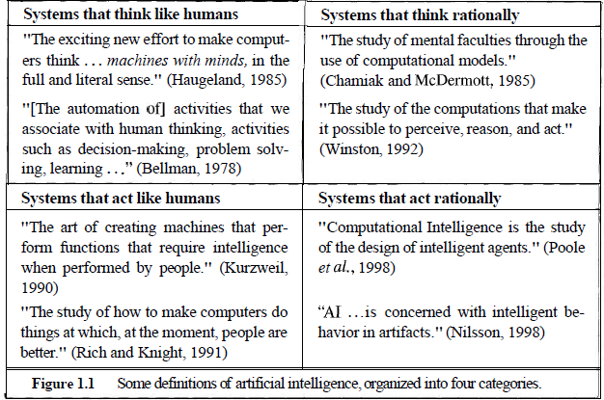
What is artificial Intelligence?

Slide 9
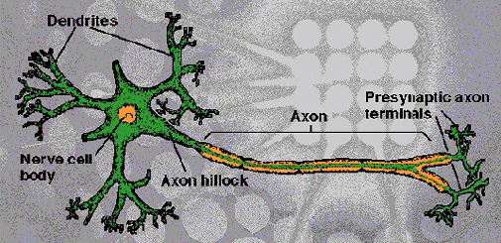

Structure of a Biological Neuron
Dendrites: Accepts Inputs
Soma: Processes the Inputs
Axon: Turns the processed inputs into outputs
Synapses: The electrochemical contact between neurons
Sec 2: ANN
9

Slide 10
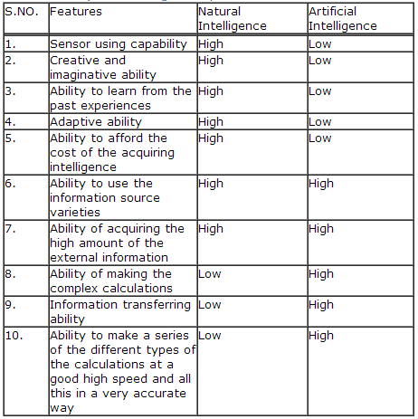
Comparison b/w AI and NI

Slide 11
Intelligent Systems in Your Everyday Life
Post Office
automatic address recognition and sorting of mail
Banks
automatic check readers, signature verification systems
automated loan application classification
Customer Service
automatic voice recognition
The Web
Identifying your age, gender, location, from your Web surfing
Automated fraud detection
Digital Cameras
Automated face detection and focusing
Computer Games
Intelligent characters/agents

Slide 12
Major AI Areas
NASA’s Remote agent program
It monitored the operation of the spacecraft as the plans were executed-detecting, diagnosing, and recovering from problems as they occurred.
2. Expert Systems
An ES is a computer program designed to act as an expert in a particular domain (area of expertise). It typically includes a sizeable knowledge base, consisting of facts about the domain and rules for application to those facts. Medical, chemical, geological

Slide 13
Major AI Areas
3. Natural Language Processing
Goal is to enable people and computers to communicate in ordinary or natural English.
4. Robotics and Computer Vision
Electromechanical devices programmed to perform manual tasks. Not all robots are intelligent. Some are pre-programmed by conventional techniques and are dumb. An intelligent robot usually includes some kind of sensory apparatus that allows it to respond to changes in its environment.

Slide 14
Major AI Areas
5. Game Playing
IBM’s Deep Blue became the first computer program to defeat the world champion in a chess match when it bested Garry Kaspawov by a score of 3.5 to 2.5 in an exhibition match.
6. Languages understanding
PROVERB is a computer program that solves crossword puzzles better than human.

Slide 15
Major AI Areas
6. Planning and Decision Support
Intelligent programs designed to provide active assistance in the planning process. They are helpful to managers with decision making responsibilities
Automatic Programming
The aim is a computer system that could develop programs by itself, in response to and in accordance with the specifications of a program developer
Intelligent Computer Aided Instruction
Computerised tutors that shape their teaching techniques to fit the learning patterns of individual students

Slide 16
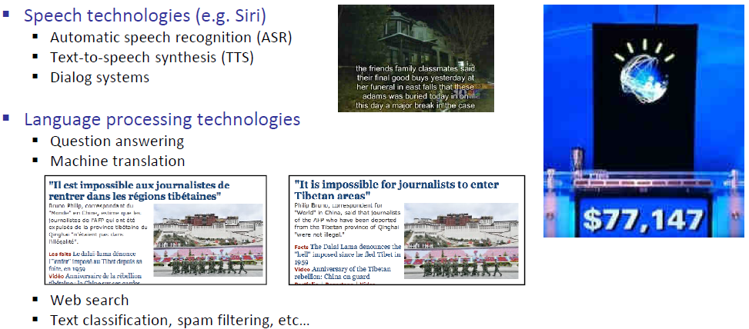
Application of AI

Slide 17
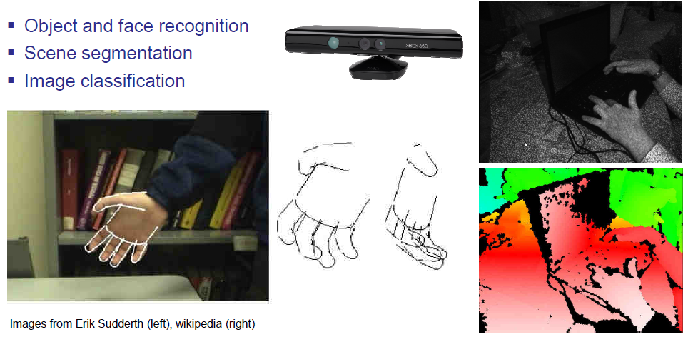
Application of AI

Slide 18
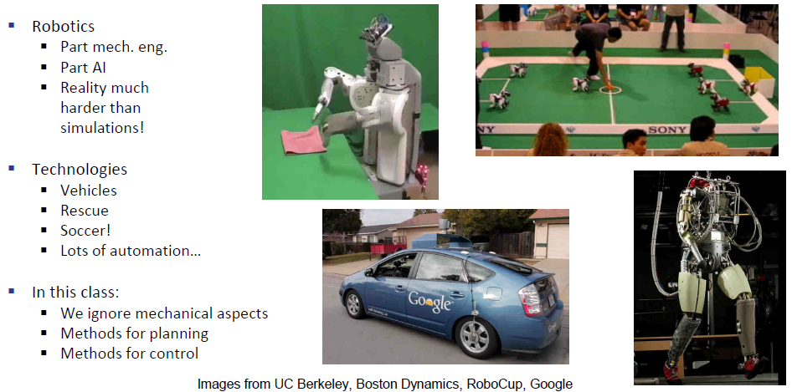
Application of AI

Slide 19
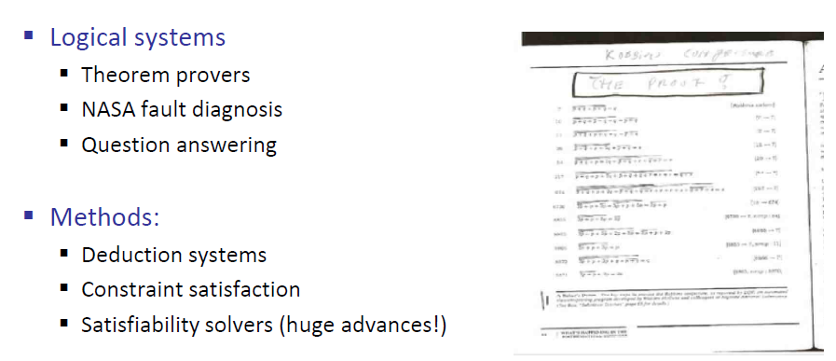
Application of AI

Slide 20
Different Types of Artificial Intelligence
Modeling exactly how humans actually think
Modeling exactly how humans actually act
Modeling how ideal agents “should think”
Modeling how ideal agents “should act”
Modern AI focuses on the last definition
we will also focus on this “engineering” approach
success is judged by how well the agent performs

