Slide 1
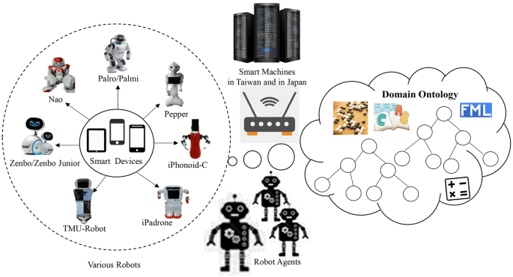
Introduction to Artificial Intelligence
Agents and Intelligent Agents
Part-II
Dr. Saif Ur Rehman

Slide 2
Contents
Properties/Types of Task Environment
Fully observable / Partially observable
Deterministic / Stochastic
Episodic / Sequential - Static / Dynamic
Discrete / Continuous - Single agent / Multi-agent
Environment Examples
Agent Types
Lookup Table Driven Agents
Simple reflex agents
Reflex agents with state/model
Goal-based agents
Utility-based agents
Learning Agent
Notes:
Kriegspiel chess variant in which each player can see their own pieces, but not those of their opponent. )

Slide 3
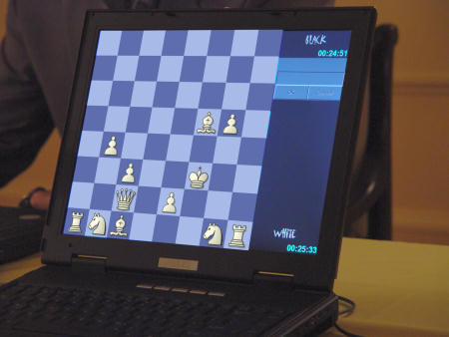
Properties/Types of Task Environment
Fully observable / Partially observable
If an agent’s sensors give it access to the complete state of the environment needed to choose an action, the environment is fully observable.
A fully observable environment is convenient because the agent need not maintain any internal state to keep track of the world.
Example
Chess – the board is fully observable, and so are the opponent’s moves.
Notes:
Kriegspiel chess variant in which each player can see their own pieces, but not those of their opponent. )

Slide 4
Properties/Types of Task Environment
Fully observable / Partially observable
An environment might be Partially observable because of noisy and inaccurate sensors or because parts of the state are simply missing from the sensor data.
Example
Driving – the environment is partially observable because what’s around the corner is not known.
A local dirt sensor of the cleaner cannot tell Whether other squares are clean or not
Notes:
Kriegspiel chess variant in which each player can see their own pieces, but not those of their opponent. )

Slide 5
Properties/Types of Task Environment
Deterministic / Stochastic
An environment is deterministic if the next state of the environment is completely determined by the current state of the environment and the action of the agent;
In a stochastic environment, there are multiple, unpredictable outcomes. (If the environment is deterministic except for the actions of other agents, then the environment is strategic).
In a fully observable, deterministic environment, the agent need not deal with uncertainty.
Notes:
Kriegspiel chess variant in which each player can see their own pieces, but not those of their opponent. )

Slide 6
Properties/Types of Task Environment
Deterministic / Stochastic
In a fully observable, deterministic environment, the agent need not deal with uncertainty.
Examples:
Chess – there would be only a few possible moves for a coin at the current state and these moves can be determined (Deterministic)
Self-Driving Cars- the actions of a self-driving car are not unique, it varies time to time. (Stochastic)
Notes:
Kriegspiel chess variant in which each player can see their own pieces, but not those of their opponent. )

Slide 7
Properties/Types of Task Environment
Episodic / Sequential
In an episodic environment, the agent’s experience is divided into atomic episodes. Each episode consists of the agent perceiving and then performing a single action.
Subsequent episodes do not depend on what actions occurred in previous episodes. The choice of action in each episode depends only on the episode itself. (E.g., classifying images.)
In a sequential environment, the agent engages in a series of connected episodes. The current decision can affect future decisions. (E.g., chess and driving)
Notes:
Kriegspiel chess variant in which each player can see their own pieces, but not those of their opponent. )

Slide 8
Properties/Types of Task Environment
Static / Dynamic
A static environment does not change while the agent is thinking.
The passage of time as an agent deliberates is irrelevant.
The environment is semi-dynamic if the environment itself does not change with the passage of time but the agent's performance score does.
Examples
Taxi driving is an example of a dynamic environment whereas Crossword puzzles are an example of a static environment.
Notes:
Kriegspiel chess variant in which each player can see their own pieces, but not those of their opponent. )

Slide 9
Properties/Types of Task Environment
Discrete / Continuous
If the number of distinct percepts and actions is limited, the environment is discrete, otherwise, it is continuous.
Examples
Discrete: A chess game comes under discrete environment as there is a finite number of moves that can be performed.
Continuous: A self-driving car is an example of a continuous environment.
Notes:
Kriegspiel chess variant in which each player can see their own pieces, but not those of their opponent. )

Slide 10
Properties/Types of Task Environment
Single agent / Multi-agent
If the environment contains other intelligent agents, the agent needs to be concerned about strategic, game-theoretic aspects of the environment (for either cooperative or competitive agents).
Most engineering environments don’t have multi-agent properties, whereas most social and economic systems get their complexity from the interactions of (more or less) rational agents.
The agent design problems in the multi-agent environment are different from single agent environment.
Notes:
Kriegspiel chess variant in which each player can see their own pieces, but not those of their opponent. )

Slide 11
Properties/Types of Task Environment
Single agent / Multi-agent
Playing a crossword puzzle – single agent
Chess playing – two agents
Competitive multiagent environment
Chess playing
Cooperative multiagent environment
Automated taxi driver
Avoiding collision
Notes:
Kriegspiel chess variant in which each player can see their own pieces, but not those of their opponent. )

Slide 12
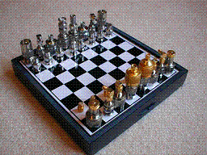
Environment Examples
Environment | Observable | Deterministic | Episodic | Static | Discrete | Agents
Chess
Fully observable vs. partially observable
Deterministic vs. stochastic / strategic
Episodic vs. sequential
Static vs. dynamic
Discrete vs. continuous
Single agent vs. multiagent
Notes:
Kriegspiel chess variant in which each player can see their own pieces, but not those of their opponent. )

Slide 13
Environment Examples
Environment | Observable | Deterministic | Episodic | Static | Discrete | Agents
Chess | Fully | Strategic | Sequential | Static | Discrete | Multi
Fully observable vs. partially observable
Deterministic vs. stochastic / strategic
Episodic vs. sequential
Static vs. dynamic
Discrete vs. continuous
Single agent vs. multiagent
Notes:
Kriegspiel chess variant in which each player can see their own pieces, but not those of their opponent. )

Slide 14
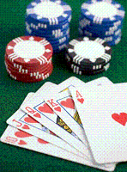
Environment Examples
Environment | Observable | Deterministic | Episodic | Static | Discrete | Agents
Poker
Fully observable vs. partially observable
Deterministic vs. stochastic / strategic
Episodic vs. sequential
Static vs. dynamic
Discrete vs. continuous
Single agent vs. multiagent
Notes:
Kriegspiel chess variant in which each player can see their own pieces, but not those of their opponent. )

Slide 15
Environment Examples
Environment | Observable | Deterministic | Episodic | Static | Discrete | Agents
Poker | Partial | Strategic | Sequential | Static | Discrete | Multi
Fully observable vs. partially observable
Deterministic vs. stochastic / strategic
Episodic vs. sequential
Static vs. dynamic
Discrete vs. continuous
Single agent vs. multiagent
Notes:
Kriegspiel chess variant in which each player can see their own pieces, but not those of their opponent. )

Slide 16
Environment Examples
Environment | Observable | Deterministic | Episodic | Static | Discrete | Agents
Chess with a clock
Chess without a clock
Poker
Backgammon
Taxi driving
Medical diagnosis
Image analysis
Robot part picking
Interactive English tutor
Notes:
Kriegspiel chess variant in which each player can see their own pieces, but not those of their opponent. )

Slide 17
Environment Examples
Environment | Observable | Deterministic | Episodic | Static | Discrete | Agents
Chess with a clock | Fully | Strategic | Sequential | Semi | Discrete | Multi
Chess without a clock | Fully | Strategic | Sequential | Static | Discrete | Multi
Poker | Partial | Strategic | Sequential | Static | Discrete | Multi
Backgammon | Fully | Stochastic | Sequential | Static | Discrete | Multi
Taxi driving | Partial | Stochastic | Sequential | Dynamic | Continuous | Multi
Medical diagnosis | Partial | Stochastic | Episodic | Static | Continuous | Single
Image analysis | Fully | Deterministic | Episodic | Semi | Discrete | Single
Robot part picking | Fully | Deterministic | Episodic | Semi | Discrete | Single
Interactive English tutor | Partial | Stochastic | Sequential | Dynamic | Discrete | Multi
Notes:
Kriegspiel chess variant in which each player can see their own pieces, but not those of their opponent. )

Slide 18
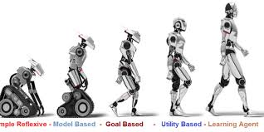
Structure of Agent
Agent = architecture + program
Architecture = some sort of computing device (sensors + actuators)
(Agent) Program = some function that implements the agent mapping = “?”
Agent Program = Job of AI
Notes:
Kriegspiel chess variant in which each player can see their own pieces, but not those of their opponent. )

Slide 19
Agent Program
Input for Agent Program
Only the current percept
Input for Agent Function
The entire percept sequence
The agent must remember all of them
Implement the agent program as
A look up table (Agent function)
Notes:
Kriegspiel chess variant in which each player can see their own pieces, but not those of their opponent. )

Slide 20
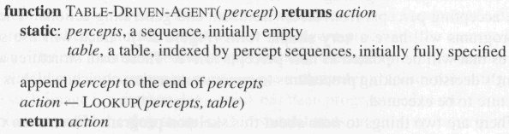
Agent Program
Skeleton design of an agent program
Notes:
Kriegspiel chess variant in which each player can see their own pieces, but not those of their opponent. )

Slide 21
Agent Program
P = the set of possible percepts
T= lifetime of the agent
The total number of percepts it receives
Size of the lookup table
Consider playing chess
P =10, T=150
Will require a table of at least 10150 entries
Notes:
Kriegspiel chess variant in which each player can see their own pieces, but not those of their opponent. )

Slide 22
Agent Program
Despite of huge size, look-up table does what we want.
The key challenge of AI
Find out how to write programs that, to the extent possible, produce rational behavior
From a small amount of code
Rather than a large number of table entries
E.g., a five-line program of Newton’s Method V.s. huge tables of square roots, sine, cosine, …
Notes:
Kriegspiel chess variant in which each player can see their own pieces, but not those of their opponent. )

Slide 23
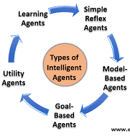
Agent Types
Lookup Table Driven Agents
Simple reflex Agents
Reflex Agents with state/model
Goal-based Agents
Utility-based Agents
Learning Agents
Notes:
Kriegspiel chess variant in which each player can see their own pieces, but not those of their opponent. )

Slide 24
Table-lookup driven agents
In a simple Table-driven Agent, a lookup table is used to match every possible percept sequence to the corresponding action
Implemented as a (large) lookup table.
It is the most effective form of implementing the desired agent function, but it comes with a penalty of occupying humongous amounts of space.
Even for a small game of chess requires 150th Power of 10 entries in the lookup table, forget about the lookup table for the taxi driving agent(for comparison, the number of atoms in the observable universe is less than 80th power of 10)

Slide 25
Table-lookup driven agents
This huge requirement for space means that:
There is not much space in the entire universe to store this huge amount of data.
The designer will not have time to fill up the table.
Even if you make a learning agent to fill the lookup table on itself, it’ll take ages for it.

Slide 26
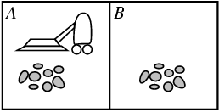
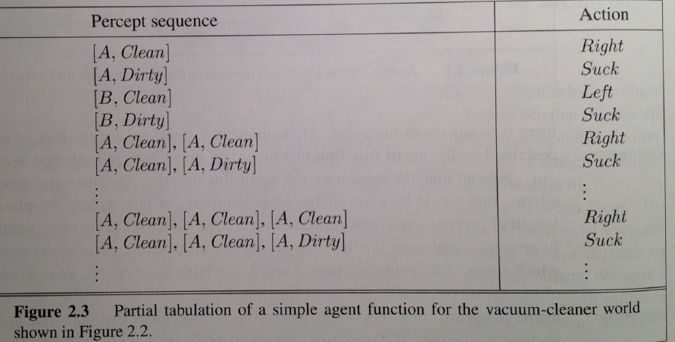
Toy example: Vacuum world
Percepts: robot senses it’s location and “cleanliness.”
So, location and contents, e.g., [A, Dirty], [B, Clean].
With 2 locations, we get 4 different possible sensor inputs. Actions: Left, Right, Suck, NoOp

Slide 27
Table-lookup driven agents
Action sequence of length K, gives 4^K different possible sequences.
At least many entries are needed in the table. So, even in this very toy World, with K = 20, you need a table with over 4^20 > 10^12 entries.
In more real-world scenarios, one would have many more different percepts (eg many more locations), e.g., >=100.
There will therefore be 100^K different possible sequences of length K. For K = 20, this would require a table with over 100^20 = 10^40 entries. Infeasible to even store.

Slide 28
Table-lookup driven agents
So, table lookup formulation is mainly of theoretical interest.
For practical agent systems, we need to find much more compact representations.
For example, logic-based representations, Bayesian net representations, or neural net style representations, or use a different agent architecture, e.g., “ignore the past” --- Reflex agents.

Slide 29
Agent Types - Simple reflex agents
Agents do not have memory of past world states or percepts. So, actions depend solely on current percept.
Action becomes a “Reflex.”
Uses condition-action rules
The rules are like the form “if … then …”
Efficient but have a narrow range of applicability
Because knowledge sometimes cannot be stated explicitly
Work only: if the environment is fully observable
Notes:
Kriegspiel chess variant in which each player can see their own pieces, but not those of their opponent. )

Slide 30
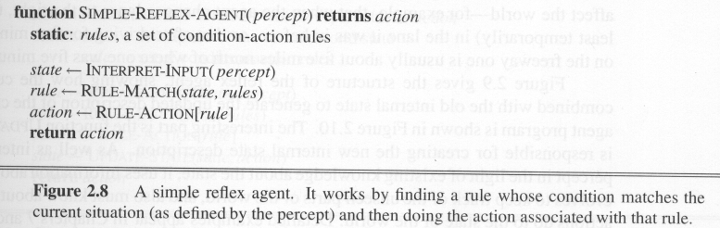
Agent Types - Simple reflex agents
Works by finding a rule whose condition matches the current situation and then doing the action associated with that rule
Notes:
Kriegspiel chess variant in which each player can see their own pieces, but not those of their opponent. )

Slide 31
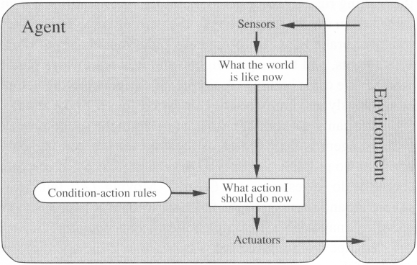
Agent Types - Simple reflex agents
Notes:
Kriegspiel chess variant in which each player can see their own pieces, but not those of their opponent. )

Slide 32
A Simple Reflex Agent in Nature
percepts
(size, motion)
RULES:
(1) If small moving object,
then activate SNAP
(2) If large moving object,
then activate AVOID and inhibit SNAP
ELSE (not moving) then NOOP
needed for
completeness
Action: SNAP or AVOID or NOOP
Notes:
Kriegspiel chess variant in which each player can see their own pieces, but not those of their opponent. )

Slide 33
Agent Types – Model-based reflex agents
Key difference (w.r.t simple reflex agents):
Agents have internal state, which is used to keep track of past states of the world.
Agents have the ability to represent change in the World.
Example: Rodney Brooks’ Subsumption Architecture
behavior based robots.
Notes:
Kriegspiel chess variant in which each player can see their own pieces, but not those of their opponent. )

Slide 34
An example: Brooks’ Subsumption Architecture
Main idea: build complex, intelligent robots by decomposing behaviors into a hierarchy of skills, each defining a percept-action cycle for one very specific task.
Examples: collision avoidance, wandering, exploring, recognizing doorways, etc.
Each behavior is modeled by a finite-state machine with a few states (though each state may correspond to a complex function or module; provides an internal state to the agent).
Behaviors are loosely coupled via asynchronous interactions.
Note: minimal internal state representation.
Notes:
Kriegspiel chess variant in which each player can see their own pieces, but not those of their opponent. )

Slide 35
Subsumption Architecture
In subsumption architecture, increasingly complex behaviors arise from the combination of simple behaviors.
The most basic simple behaviors are on the level of reflexes:
Avoid an object;
Go toward food if hungry,
Move randomly.
A more complex behavior that sits on top of simple behaviors may be “go across the room.”
The more complex behaviors subsume the less complex ones to accomplish their goal.
Notes:
Kriegspiel chess variant in which each player can see their own pieces, but not those of their opponent. )

Slide 36
Agent Types – Model-based reflex agents
For the world that is partially observable
the agent has to keep track of an internal state
That depends on the percept history
Reflecting some of the unobserved aspects
E.g., driving a car and changing lane
Requiring two types of knowledge
How the world evolves independently of the agent
How the agent’s actions affect the world
Notes:
Kriegspiel chess variant in which each player can see their own pieces, but not those of their opponent. )

Slide 37
Agent Types – Model-based reflex agents
Example Table Agent With Internal State
IF
THEN
Saw an object ahead, and turned right, and it’s now clear ahead | Go straight
Saw an object Ahead, turned right, and object ahead again | Halt
See no objects ahead | Go straight
See an object ahead | Turn randomly
Notes:
Kriegspiel chess variant in which each player can see their own pieces, but not those of their opponent. )

Slide 38
Agent Types – Model-based reflex agents
Example Reflex Agent With Internal State: Wall-Following
start
Actions: left, right, straight, open-door
Rules:
If open(left) & open(right) and open(straight) then
choose randomly between right and left
If wall(left) and open(right) and open(straight) then straight
If wall(right) and open(left) and open(straight) then straight
If wall(right) and open(left) and wall(straight) then left
If wall(left) and open(right) and wall(straight) then right
If wall(left) and door(right) and wall(straight) then open-door
If wall(right) and wall(left) and open(straight) then straight.
(Default) Move randomly
Notes:
Kriegspiel chess variant in which each player can see their own pieces, but not those of their opponent. )

Slide 39
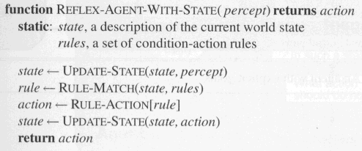
Agent Types - Model-based reflex agents
The agent is with memory
Notes:
Kriegspiel chess variant in which each player can see their own pieces, but not those of their opponent. )

Slide 40
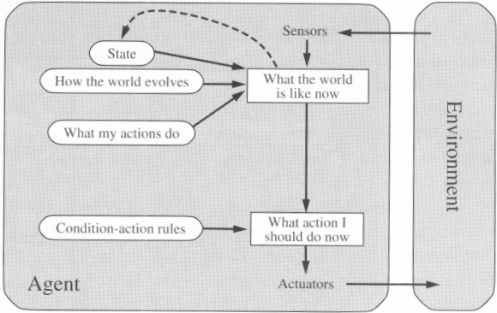
Agent Types - Model-based reflex agents
Notes:
Kriegspiel chess variant in which each player can see their own pieces, but not those of their opponent. )

Slide 41

Goal-based agents
A goal-based agent has an agenda,
It operates based on a goal in front of it and makes decisions based on how best to reach that goal
The current state of the environment is always not enough
The goal is another issue to achieve
- Judgment of Rationality/Correctness
Actions are chosen ➔ goals, based on
The current state
The current percept

Slide 42
Goal-based agents
Unlike a simple reflex agent that makes decisions based solely on the current environment, a goal-based agent is capable of thinking beyond the present moment to decide the best actions to take in order to achieve its goal.
Therefore, a goal-based agent operates as a search and planning function, meaning it targets the goal ahead and finds the right action in order to reach it. This helps a goal-based agent to be proactive rather than simply reactive in its decision-making.

Slide 43
Goal-based agents
Conclusion
Goal-based agents are less efficient
but more flexible
Agent ⬅ Different goals ⬅ different tasks
Search and Planning
Two other sub-fields in AI
To find out the action sequences to achieve its goal

Slide 44
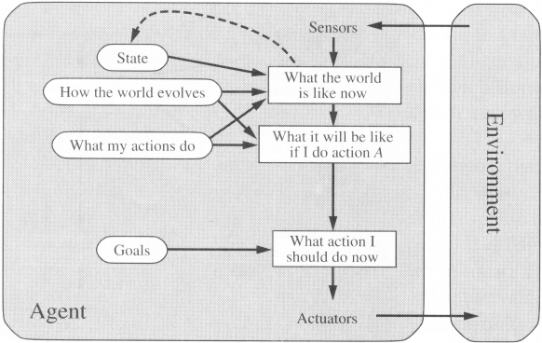
Goal-based agents

Slide 45
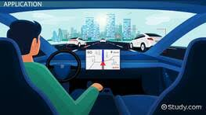
Utility-based agents
These agents are similar to the goal-based agent but provide an extra component of utility measurement which makes them different by providing a measure of success at a given state.
An agent acts based not only on what the goal is but the best way to reach that goal.
In short, it's the usefulness (or utility) of the agent that makes itself distinct from its counterparts.
It is useful when there are multiple possible alternatives, and an agent has to choose
in order to perform the best action

Slide 46
Utility-based agents
Goals alone are not enough
to generate high-quality behavior
E.g. meals in Canteen, good or not?
Many actions sequence ➔ the goals
some are better and some worse
If the goal means success,
then utility means the degree of success (how successful it is)

Slide 47
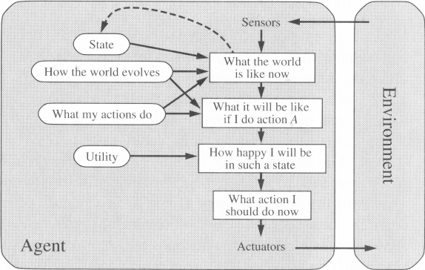
Utility-based agents

Slide 48
Utility-based agents
It is said state A has higher utility
If state A is more preferred than others
Utility is therefore a function
that maps a state onto a real number
the degree of success

Slide 49
Utility-based agents
Utility has several advantages:
When there are conflicting goals,
Only some of the goals but not all can be achieved
utility describes the appropriate trade-off
When there are several goals
None of them are achieved certainly
utility provides a way for the decision-making

Slide 50
Utility-based agents
After an agent is programmed, can it work immediately?
No, it still needs teaching
In AI,
Once an agent is done
We teach it by giving it a set of examples
Test it by using another set of examples
We then say the agent learns
A learning agent

Slide 51
Learning Agent
A learning agent in AI is the type of agent that can learn from its past experiences, or it has learning capabilities.
It starts to act with basic knowledge and then is able to act and adapt automatically through learning.

Slide 52
Learning Agent
A learning agent has mainly four conceptual components, which are:
Learning element: It is responsible for making improvements by learning from the m environment
Critic: The learning element takes feedback from the critic which describes that how well the agent is doing with respect to a fixed performance standard.
Performance element: It is responsible for selecting external action
Problem Generator: This component is responsible for suggesting actions that will lead to new and informative experiences

Slide 53
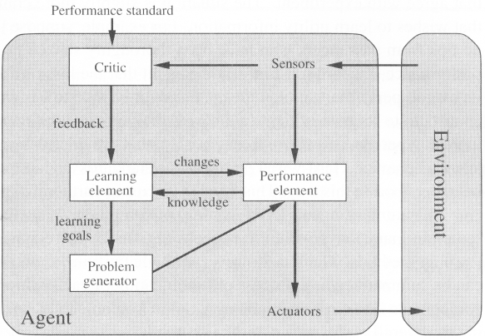
Learning Agent

Slide 54
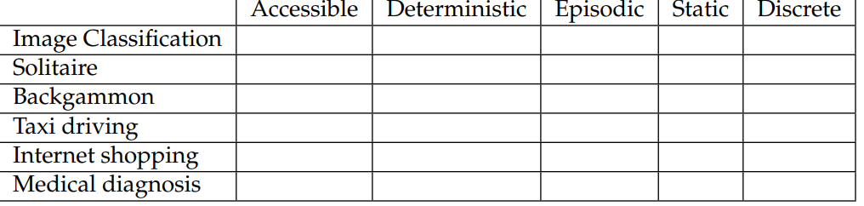
Assignment
Mark Tick or Cross in each Colum in the following Properties of Environment
Notes:
Kriegspiel chess variant in which each player can see their own pieces, but not those of their opponent. )

Slide 55
Summary of Today’s Lecture
An autonomous agent uses its own experience rather than built-in knowledge of the environment by the designer.
An agent program maps from percept to action and updates its internal state.
Reflex agent responds immediately to percepts.
Goal-based agent acts in order to achieve their goal(s).
Utility-based agent maximizes their own utility function.
Representing knowledge is important for successful agent design.
Most challenging environments are inaccessible, nondeterministic, nonepisodic, dynamic, and continuous, and contain intelligent adversaries.

