Slide 1

AI Searching Techniques
Introduction to Artificial Intelligence
Dr. Saif Ur Rehman

Slide 2
Today’s Lecture
Heuristically Informed Methods
Best First Search
A* Procedure
Hill Climbing
Beam Search
Adversarial Search
Min-Max Procedure
Static Evaluation Function
Alpha Beta Pruning

Slide 3
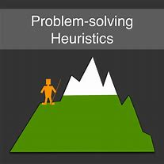
Hill Climbing Searching
We often are ready to wait in order to obtain the best solution to our problem. But what if, you just don’t have the time.
Hill Climbing is one such Algorithm, that will find you the best possible solution to the problem in the most reasonable period of time!

Slide 4

Hill Climbing Searching
Hill climbing search is also called a local search problem.
The purpose of the hill climbing search is to climb a hill and reach the topmost peak/ point of that hill
One of the widely discussed examples of Hill climbing algorithm is Traveling-salesman Problem in which we need to minimize the distance traveled by the salesman.

Slide 5
Hill Climbing Searching
Hill Climbing is a heuristic search used for mathematical optimisation problems in the field of Artificial Intelligence.
Hill Climbing is mostly used when a good heuristic is available.
In this approach, a person who is climbing up on the hill estimates the direction which will lead him to the highest peak.
It terminates when it reaches a peak value where no neighbor has a higher value.

Slide 6
Hill Climbing Searching
It is also called greedy local search as it only looks to its good immediate neighbor state and not beyond that.
A node of hill climbing algorithm has two components which are state and value.
In this algorithm, we don't need to maintain and handle the search tree or graph as it only keeps a single current state.

Slide 7
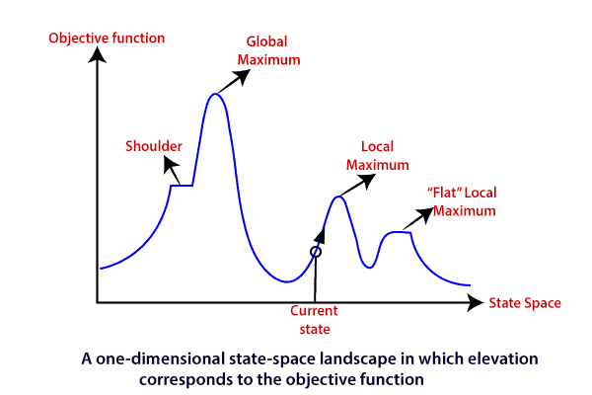
Hill Climbing Searching

Slide 8
Regions in the State Space Diagram
Global Maximum: It is the highest point on the hill, which is the goal state.
Local Maximum: It is the peak higher than all other peaks but lower than the global maximum.
Flat local maximum: It is the flat area over the hill where it has no uphill or downhill. It is a saturated point of the hill.
Shoulder: It is also a flat area where the summit is possible.
Current state: It is the current position of the person.

Slide 9
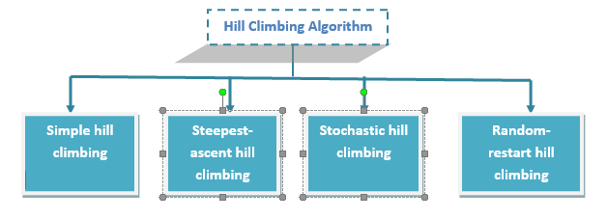
Types of Hill Climbing Searching

Slide 10
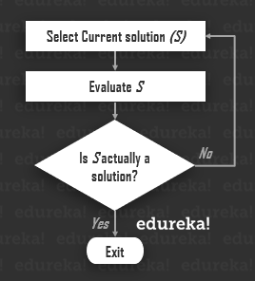
Hill Climbing Searching Algorithm
Step1: Generate possible solutions.
Step2: Evaluate to see if this is the expected solution.
Step3: If the solution has been found quit else go back to step 1.

Slide 11
Simple Hill Climbing Searching
It is the simplest technique to climb a hill.
The task is to reach the highest peak of the mountain.
Movement of the climber depends on his move/steps.
If he finds his next step better than the previous one, he continues to move else remain in the same state.
This search focus only on his previous and next step.

Slide 12
Simple Hill Climbing Searching
Simple hill climbing Algorithm
Create a CURRENT node, NEIGHBOUR node, and a GOAL node.
If the CURRENT node=GOAL node,
return GOAL and terminate the search.
else CURRENT node<= NEIGHBOUR node, move ahead.
Loop until the goal is not reached or a point is not found.

Slide 13
Steepest-ascent Hill Climbing
Unlike simple hill climbing search, It considers all the successive nodes, compares them, and choose the node which is closest to the solution.
Steepest hill climbing search is similar to best-first search because it focuses on each node instead of one.
Note: Both simple, as well as steepest-ascent hill climbing search, fails when there is no closer node.

Slide 14
Steepest-ascent Hill Climbing
Steepest-ascent hill climbing Algorithm
Create a CURRENT node and a GOAL node.
If the CURRENT node=GOAL node,
return GOAL and terminate the search.
Loop until a better node is not found to reach the solution.
If there is any better successor node present, expand it.
When the GOAL is attained, return GOAL and terminate.

Slide 15
Stochastic Hill Climbing
Stochastic Hill climbing is an optimization algorithm.
It does not focus on all the nodes.
It selects one node at random and decides whether it should be expanded or search for a better one.

Slide 16
Random-restart Hill Climbing
Random-restart algorithm is based on try and try strategy.
It iteratively searches the node and selects the best one at each step until the goal is not found.
Success depends most commonly on the shape of the hill.
If there are few plateaus, local maxima, and ridges, it becomes easy to reach the destination.

Slide 17
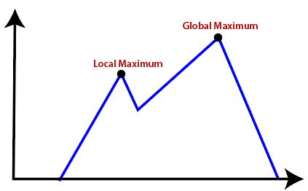
Limitations of Hill climbing algorithm
Local Maxima
It is that peak of the mountain which is highest than all its neighboring states but lower than the global maxima.
It is not the goal peak because there is another peak higher than it.

Slide 18
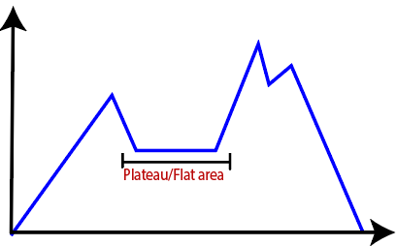
Limitations of Hill climbing algorithm
Plateau
It is a flat surface area where no uphill exists.
It becomes difficult for the climber to decide that in which direction he should move to reach the goal point. Sometimes, the person gets lost in the flat area.

Slide 19
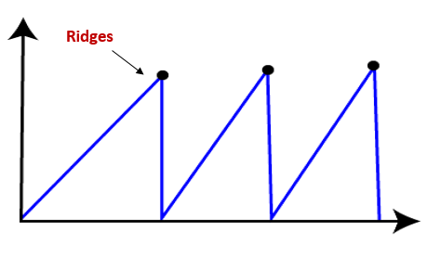
Limitations of Hill climbing algorithm
Ridges
It is a challenging problem where the person finds two or more local maxima of the same height commonly.
It becomes difficult for the person to navigate the right point and stuck to that point itself.

Slide 20
Limitations of Hill climbing algorithm
Other limitations offered by the hill-climbing algorithm are:
It is not an efficient searching method.
Not suitable for problems where the value of heuristic function drops suddenly.
It is a local method, where the focus is on getting the immediate solution after considering the current state, rather than exploring all possible outcomes.

Slide 21
Beam Searching Algorithm
Beam search is a heuristic search algorithm that explores a graph by expanding the most optimistic node in a limited set.
Beam search is an optimization of best-first search that reduces its memory requirements.
Best-first search is a graph search that orders all partial solutions according to some heuristic. But in beam search, only a predetermined number of best partial solutions are kept as candidates.
Therefore, it is a greedy algorithm

Slide 22
Beam Searching Algorithm
Beam search uses breadth-first search to build its search tree.
At each level of the tree, it generates all successors of the states at the current level, sorting them in increasing order of heuristic cost.
However, it only stores a predetermined number (β), of best states at each level called the beamwidth. Only those states are expanded next.

Slide 23
Beam Searching Algorithm
The greater the beam width, the fewer states are pruned. No states are pruned with infinite beam width, and beam search is identical to breadth-first search.
The beamwidth bounds the memory required to perform the search. Since a goal state could potentially be pruned, beam search sacrifices completeness (the guarantee that an algorithm will terminate with a solution if one exists).
Beam search is not optimal, which means there is no guarantee that it will find the best solution

Slide 24
Beam Searching Algorithm
In general, beam search returns the first solution found.
Once reaching the configured maximum search depth (i.e., translation length), the algorithm will evaluate the solutions found during a search at various depths and return the best one that has the highest probability.
The beam width can either be fixed or variable.
One approach that uses a variable beam width starts with the width at a minimum. If no solution is found, the beam is widened, and the procedure is repeated.

Slide 25
Components of Beam Search
A beam search takes three components as its input:
A problem to be solved,
A set of heuristic rules for pruning,
And a memory with a limited available capacity

Slide 26
Beam Searching Algorithm
The problem is the problem to be solved, usually represented as a graph, and contains a set of nodes in which one or more of the nodes represents a goal.
The set of heuristic rules are rules specific to the problem domain and prune unfavorable nodes from memory regarding the problem domain.
The memory is where the "beam" is stored, memory is full, and a node is to be added to the beam, the most costly node will be deleted, such that the memory limit is not exceeded.

Slide 27
Uses of Beam Searching Algorithm
Most often used to maintain tractability in large systems with insufficient memory to store the entire search tree. For example,
It has been used in many machine translation systems.
Each part is processed to select the best translation, and many different ways of translating the words appear.
According to their sentence structures, the top best translations are kept, and the rest are discarded. The translator then evaluates the translations according to a given criterion, choosing the translation which best keeps the goals.
The first use of a beam search was in the Harpy Speech Recognition System, CMU 1976.

Slide 28
Drawbacks Beam Searching
In general, the Beam Search Algorithm is not complete. Despite these disadvantages, beam search has found success in the practical areas of speech recognition, vision, planning, and machine learning.
Beam search may not result in an optimal goal and may not even reach a goal at all after given unlimited time and memory when there is a path from the start node to the goal node.
It terminates for two cases: a required goal node is reached, or a goal node is not reached, and there are no nodes left to be explored.
A more accurate heuristic function and a larger beam width can improve Beam Search's chances of finding the goal.

Slide 29
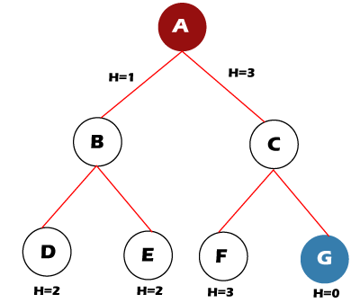
Beam Searching Algorithm
For example, let's take the value of ß = 2 for the tree shown below. So, follow the following steps to find the goal node.

Slide 30
Beam Searching Algorithm
Step 1: OPEN= {A}
Step 2: OPEN= {B, C}
Step 3: OPEN= {D, E}
Step 4: OPEN= {E}
Step 5: OPEN= { }
The open set becomes empty without finding the goal node.

Slide 31
Beam Search Optimality
The Beam Search algorithm is not complete in some cases. Therefore it is also not guaranteed to be optimal. It can happen because of these reasons:
The beam width and an inaccurate heuristic function may cause the algorithm to miss expanding the shortest path.
A more precise heuristic function and a larger beam width can make Beam Search more likely to find the optimal path to the goal.

Slide 32
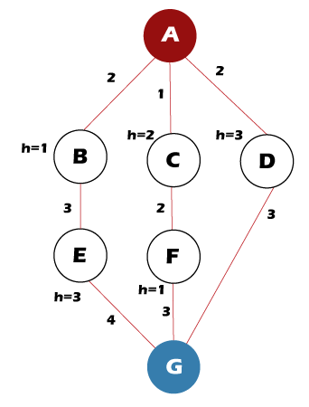
Beam Searching Algorithm

Slide 33
Beam Searching Algorithm
Follow the following steps to find the path for the goal node.
Step 1: OPEN= {A}
Step 2: OPEN= {B, C}
Step 3: OPEN= {C, E}
Step 4: OPEN= {F, E}
Step 5: OPEN= {G, E}
Step 6: Found the goal node {G}, now stop.
Path: A-> C-> F-> G
But the Optimal Path is A-> D-> G

Slide 34
Beam Searching Algorithm
Time Complexity of Beam Search
The time complexity of the Beam Search algorithm depends on the following things, such as:
The accuracy of the heuristic function.
In the worst case, the heuristic function leads Beam Search to the deepest level in the search tree.
The worst-case time = O(B*m)
B is the beam width, and m is the maximum depth of any path in the search tree.

Slide 35
Beam Searching Algorithm
Space Complexity of Beam Search
The space complexity of the Beam Search algorithm depends on the following things, such as:
Memory consumption is its most desirable trait.
Since the algorithm only stores B nodes at each level in the search tree.
The worst-case space complexity = O(B*m)
B is the beam width, and m is the maximum depth of any path in the search tree.
This linear memory consumption allows Beam Search to probe very deeply into large search spaces and potentially find solutions that other algorithms cannot reach.

