Slide 1

Neural Networks Videos
Brief Review
The Next Generation Neural Networks - Geoff Hinton

Slide 2
Neural Networks – Brief Review

Slide 3
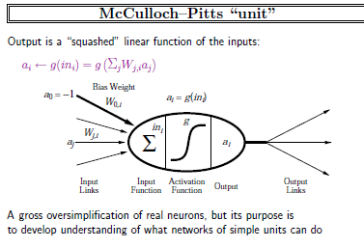
Neural Networks – Brief Review

Slide 4
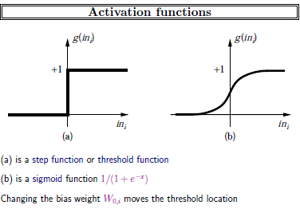
Neural Networks – Brief Review

Slide 5
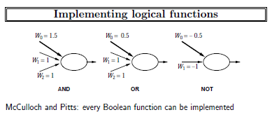
Neural Networks – Brief Review

Slide 6
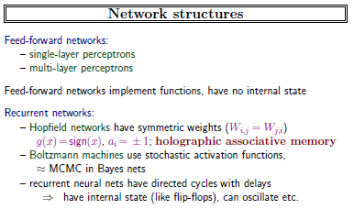
Neural Networks – Brief Review

Slide 7
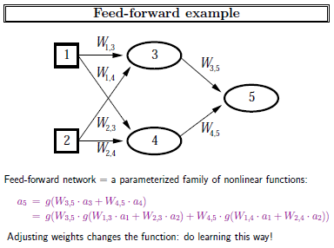
Neural Networks – Brief Review

Slide 8
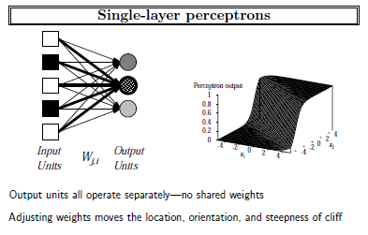
Neural Networks – Brief Review

Slide 9
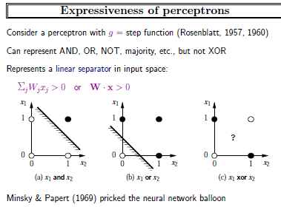
Neural Networks – Brief Review

Slide 10
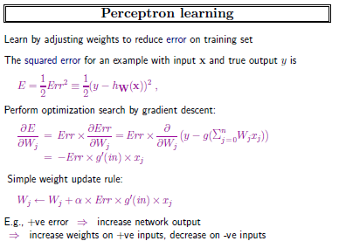
Neural Networks – Brief Review

Slide 11
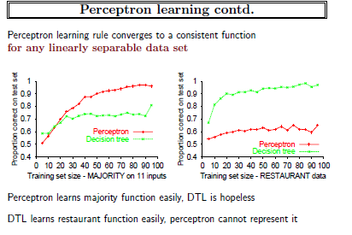
Neural Networks – Brief Review

Slide 12
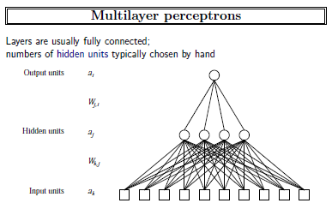
Neural Networks – Brief Review

Slide 13
Neural Networks – Back Propagation Algorithm
Most people would consider the Back Propagation network to be the quintessential Neural Net. Actually, Back Propagation is the training or learning algorithm rather than the network itself. Let’s consider what Back Propagation is and how to use it.
A Back Propagation network learns by example. You give the algorithm examples of what you want the network to do and it changes the network’s weights so that, when training is finished, it will give you the required output for a particular input. Back Propagation networks are ideal for simple Pattern Recognition and Mapping Tasks. To train the network you need to give it examples of what you want - the output you want (called the Target) for a particular input.

Slide 14
Neural Networks – Back Propagation Algorithm
Once the network is trained, it will provide the desired output for any of the input patterns. Let’s now look at how the training works.
The network is first initialised by setting up all its weights to be small random numbers - say between -1 and +1. Next, the input pattern is applied and the output calculated (this is called the forward pass). The calculation gives an output which is completely different to what you want (the Target), since all the weights are random. We then calculate the Error of each neuron, which is essentially: Target - Actual Output (i.e., What you want - What you actually get). This error is then used mathematically to change the weights in such a way that the error will get smaller. In other words, the Output of each neuron will get closer to its Target (this part is called the reverse pass). The process is repeated again and again until the error is minimal.

Slide 15
Neural Networks – Back Propagation Algorithm
Let's do an example with an actual network to see how the process works. We’ll just look at one connection initially, between a neuron in the output layer and one in the hidden layer.
Single connection learning in
a Back Propagation network.
The connection we’re interested in is between neuron A (a hidden layer neuron) and neuron B (an output neuron) and has the weight W_{AB}. The diagram also shows another connection, between neuron A and C, but we’ll return to that later. The algorithm works like this:

Slide 16
Neural Networks – Back Propagation Algorithm
1. First apply the inputs to the network and work out the output - remember this initial output could be anything, as the initial weights were random numbers.
2. Next work out the error for neuron B. The error is What you want - What you actually get, in other words:
Error_{B} = Output_{B} (1-Output_{B})(Target_{B} - Output_{B})
The “Output(1-Output)” term is necessary in the equation because of the Sigmoid Function - if we were only using a threshold neuron it would just be (Target - Output).
3. Change the weight. Let W+_{AB} be the new (trained) weight and W_{AB} be the initial weight.
W+_{AB} = W_{AB} + (Error_{B} x Output_{A})
Notice that it is the output of the connecting neuron (neuron A) we use (not B). We update all the weights in the output layer in this way.

Slide 17
Neural Networks – Back Propagation Algorithm
4. Calculate the Errors for the hidden layer neurons. Unlike the output layer we can’t calculate these directly (because we don’t have a Target), so we Back Propagate them from the output layer (hence the name of the algorithm). This is done by taking the Errors from the output neurons and running them back through the weights to get the hidden layer errors. For example if neuron A is connected as shown to B and C then we take the errors from B and C to generate an error for A.
Error_{A} = Output _{A} (1 - Output _{A})(Error_{B} W_{AB} + ErrorC W_{AC})
Again, the factor “Output (1 - Output )” is present because of the sigmoid squashing function.
5. Having obtained the Error for the hidden layer neurons now proceed as in stage 3 to change the hidden layer weights. By repeating this method we can train a network of any number of layers.

Slide 18
Neural Networks – Back Propagation Algorithm
This may well have left some doubt in your mind about the operation, so let’s clear that up by explicitly showing all the calculations for a full sized network with 2 inputs, 3 hidden layer neurons and 2 output neurons as shown below. W+ represents the new, recalculated, weight, whereas W represents the old weight.

Slide 19
Neural Networks – Back Propagation Algorithm

Slide 20
Neural Networks – Back Propagation Algorithm - worked example

Slide 21
Neural Networks – Back Propagation Algorithm - worked example

Slide 22
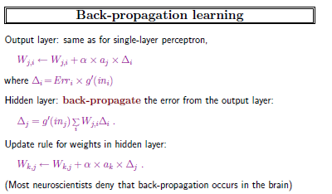
Neural Networks – Back Propagation Algorithm

Slide 23
Neural Networks – Geoff Hinton’s Lecture
Please view the 59 minute video at
http://www.youtube.com/watch?v=AyzOUbkUf3M

Slide 24
Concluding Remarks
T. T. T.
Put up in a place
where it's easy to see
the cryptic admonishment
T. T. T.
When you feel how
Depressingly slowly you climb,
it's well to remember that
Things Take Time.

