Slide 1

Chapter 22
Network Layer:
Delivery, Forwarding,
and Routing
22.<number>
Copyright © The McGraw-Hill Companies, Inc. Permission required for reproduction or display.

Slide 2
22-1 DELIVERY
The network layer supervises the handling of the packets by the underlying physical networks. We define this handling as the delivery of a packet.
Topics discussed in this section:
Direct Versus Indirect Delivery
22.<number>

Slide 3

Figure 22.1 Direct and indirect delivery
22.<number>

Slide 4
22-2 FORWARDING
Forwarding means to place the packet in its route to its destination. Forwarding requires a host or a router to have a routing table. When a host has a packet to send or when a router has received a packet to be forwarded, it looks at this table to find the route to the final destination.
Topics discussed in this section:
Forwarding Techniques
Forwarding Process
Routing Table
22.<number>

Slide 5

Figure 22.2 Route method versus next-hop method
22.<number>

Slide 6

Figure 22.3 Host-specific versus network-specific method
22.<number>

Slide 7

Figure 22.4 Default method
22.<number>

Slide 8

Figure 22.5 Simplified forwarding module in classless address
22.<number>

Slide 9

Note
In classless addressing, we need at least four columns in a routing table.
22.<number>

Slide 10
Example 22.1
Make a routing table for router R1, using the configuration in Figure 22.6.
Solution
Table 22.1 shows the corresponding table.
22.<number>

Slide 11

Figure 22.6 Configuration for Example 22.1
22.<number>

Slide 12

Table 22.1 Routing table for router R1 in Figure 22.6
22.<number>

Slide 13
Example 22.2
Show the forwarding process if a packet arrives at R1 in Figure 22.6 with the destination address 180.70.65.140.
Solution
The router performs the following steps:
1. The first mask (/26) is applied to the destination address.
The result is 180.70.65.128, which does not match the
corresponding network address.
2. The second mask (/25) is applied to the destination
address. The result is 180.70.65.128, which matches the
corresponding network address. The next-hop address
and the interface number m0 are passed to ARP for
further processing.
22.<number>

Slide 14
Example 22.3
Show the forwarding process if a packet arrives at R1 in Figure 22.6 with the destination address 201.4.22.35.
Solution
The router performs the following steps:
1. The first mask (/26) is applied to the destination
address. The result is 201.4.22.0, which does not
match the corresponding network address.
2. The second mask (/25) is applied to the destination address. The result is 201.4.22.0, which does not match the corresponding network address (row 2).
22.<number>

Slide 15
Example 22.3 (continued)
3. The third mask (/24) is applied to the destination
address. The result is 201.4.22.0, which matches the
corresponding network address. The destination
address of the packet and the interface number m3 are
passed to ARP.
22.<number>

Slide 16
Example 22.4
Show the forwarding process if a packet arrives at R1 in Figure 22.6 with the destination address 18.24.32.78.
Solution
This time all masks are applied, one by one, to the destination address, but no matching network address is found. When it reaches the end of the table, the module gives the next-hop address 180.70.65.200 and interface number m2 to ARP. This is probably an outgoing package that needs to be sent, via the default router, to someplace else in the Internet.
22.<number>

Slide 17
22-3 UNICAST ROUTING PROTOCOLS
A routing table can be either static or dynamic. A static table is one with manual entries. A dynamic table is one that is updated automatically when there is a change somewhere in the Internet. A routing protocol is a combination of rules and procedures that lets routers in the Internet inform each other of changes.
Topics discussed in this section:
Optimization
Intra- and Interdomain Routing
Distance Vector Routing and RIP
Link State Routing and OSPF
Path Vector Routing and BGP
22.<number>

Slide 18

Figure 22.12 Autonomous systems
22.<number>

Slide 19

Figure 22.13 Popular routing protocols
22.<number>
Notes:
OSPF open shortest path first

Slide 20

Figure 22.14 Distance vector routing tables
22.<number>

Slide 21

Figure 22.15 Initialization of tables in distance vector routing
■
■
■
22.<number>

Slide 22
Note
In distance vector routing, each node shares its routing table with its
immediate neighbors periodically and when there is a change.
22.<number>

Slide 23

Figure 22.16 Updating in distance vector routing
22.<number>
Notes:
In A’s modified table, Add 2 in each cost bcz C is 2 distance away from A

Slide 24

Figure 22.19 Example of a domain using RIP
22.<number>

Slide 25

Figure 22.20 Concept of link state routing
22.<number>
Notes:
RIP is only good for 16 hops and anything pass that you get Network is unreachable. RIP takes hop count into consideration but OSPF takes Path Cost into consideration to exchange routing information between the routers. RIP serves good when small network is taken care of while OSPF is mostly used for large network

Slide 26

Figure 22.21 Link state knowledge
22.<number>

Slide 27

Figure 22.22 Dijkstra algorithm
22.<number>

Slide 28

Figure 22.23 Example of formation of shortest path tree
22.<number>

Slide 29

Table 22.2 Routing table for node A
22.<number>

Slide 30

Figure 22.24 Areas in an autonomous system
22.<number>

Slide 31
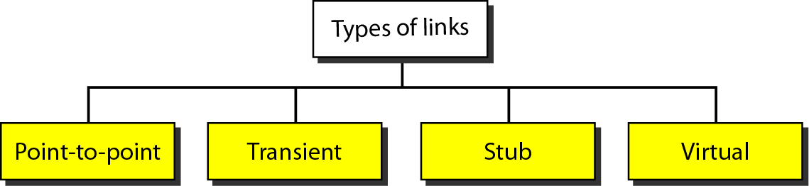
Figure 22.25 Types of links
22.<number>

Slide 32
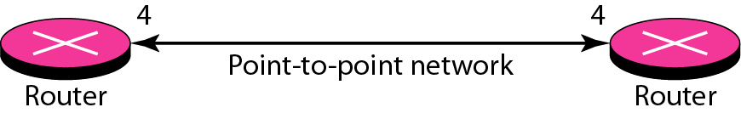
Figure 22.26 Point-to-point link
22.<number>

Slide 33
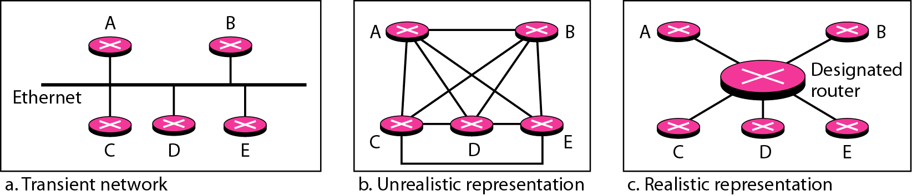
Figure 22.27 Transient link
22.<number>

Slide 34
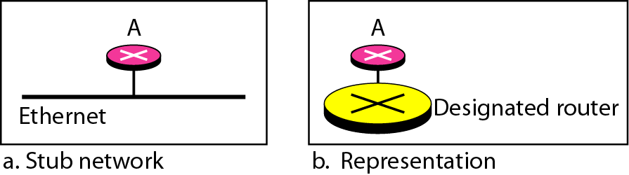
Figure 22.28 Stub link
22.<number>
Notes:
Stub Network: An individual or group that uses only one router to link to an Internet service provider (ISP) (The individual/group are considered stub networks by the ISP.)

Slide 35
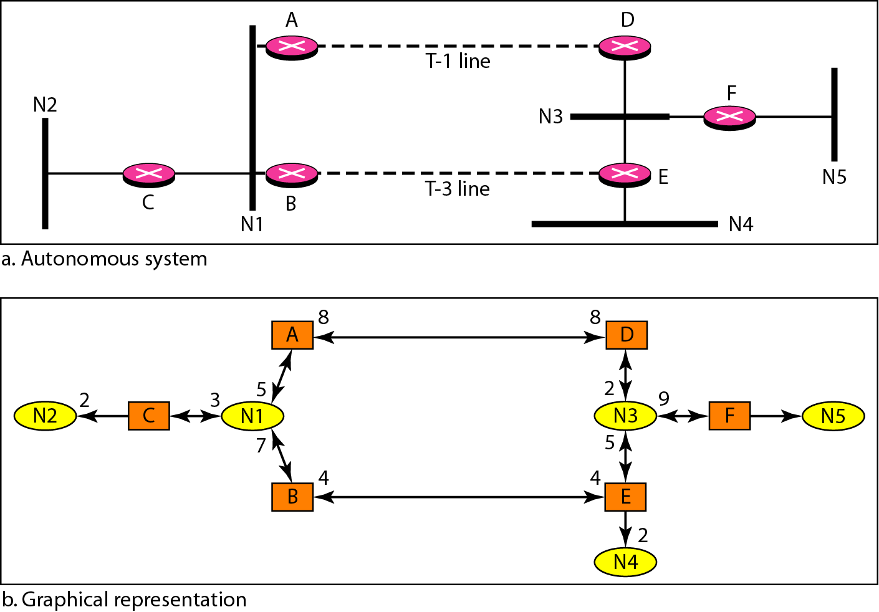
Figure 22.29 Example of an AS and its graphical representation in OSPF
22.<number>

Slide 36
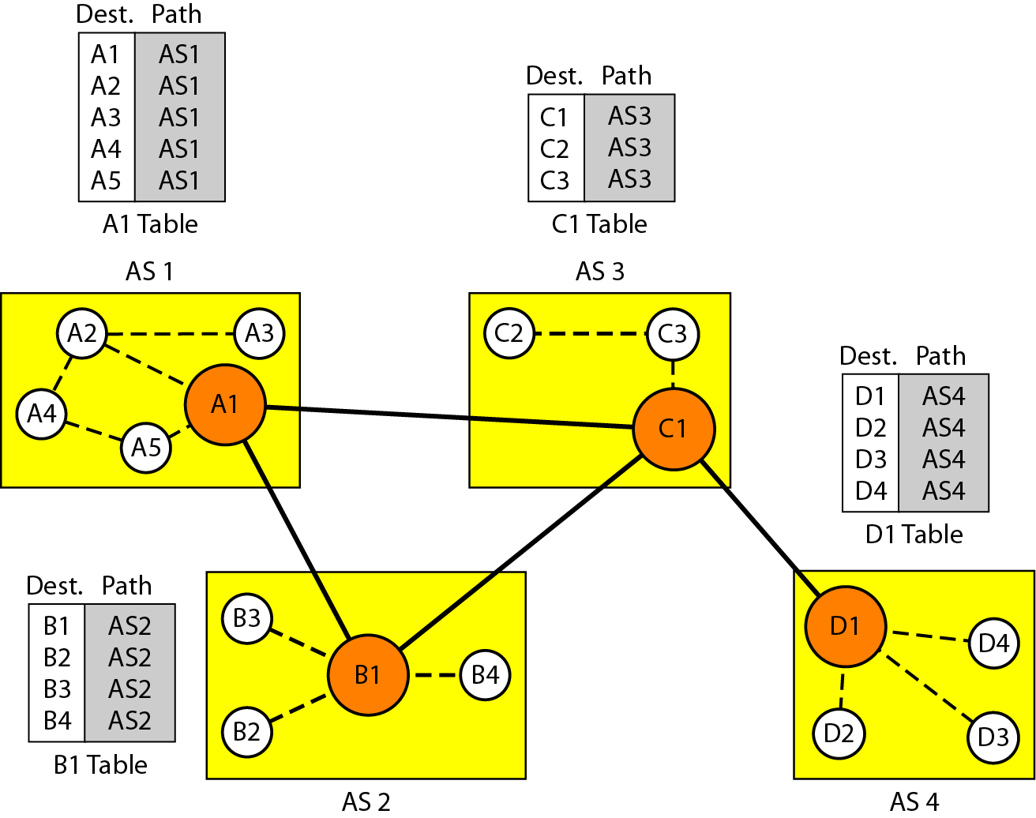
Figure 22.30 Initial routing tables in path vector routing
22.<number>

Slide 37
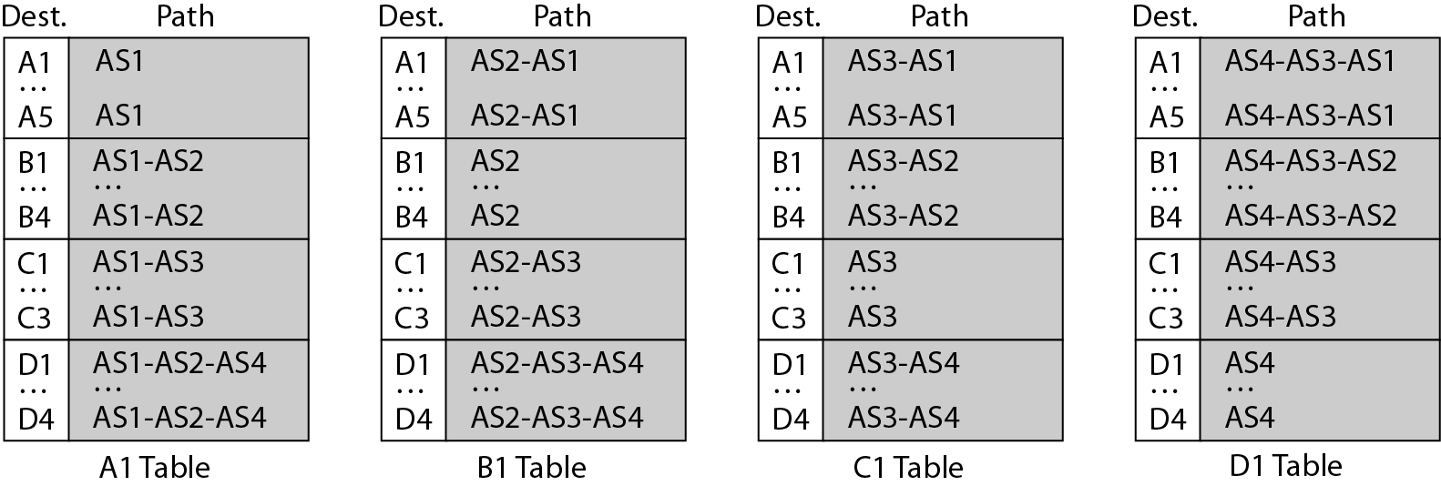
Figure 22.31 Stabilized tables for three autonomous systems
22.<number>

Slide 38
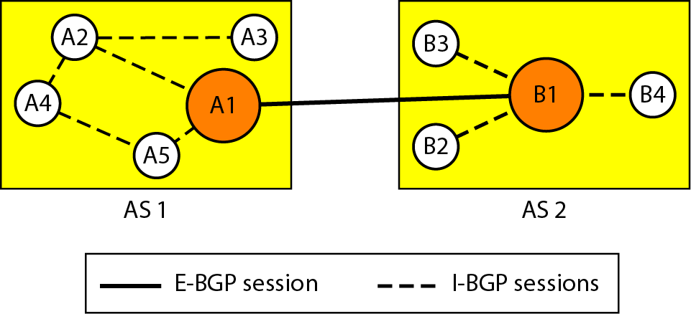
Figure 22.32 Internal and external BGP sessions
22.<number>

Slide 39
22-4 MULTICAST ROUTING PROTOCOLS
In this section, we discuss multicasting and multicast routing protocols.
Topics discussed in this section:
Unicast, Multicast, and Broadcast
Applications
Multicast Routing
Routing Protocols
22.<number>

Slide 40
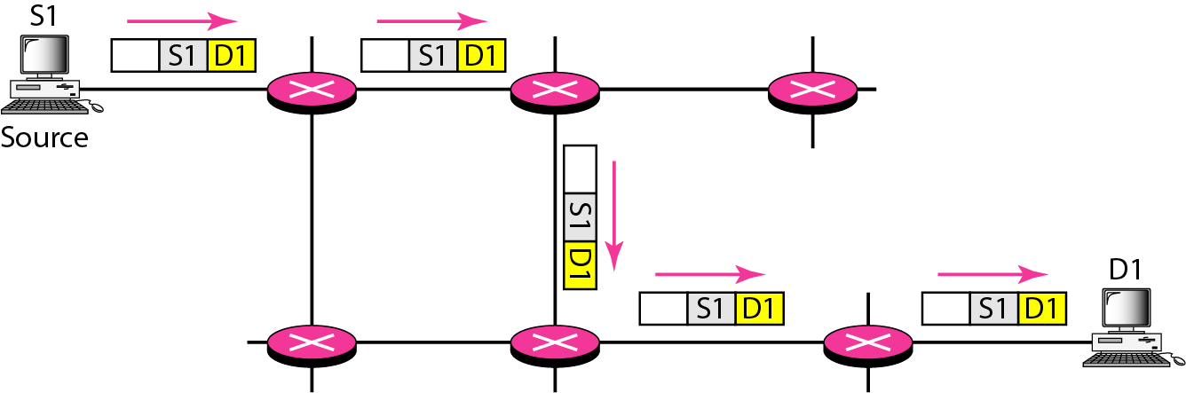
Figure 22.33 Unicasting
22.<number>

Slide 41
Note
In unicasting, the router forwards the received packet through
only one of its interfaces.
22.<number>

Slide 42
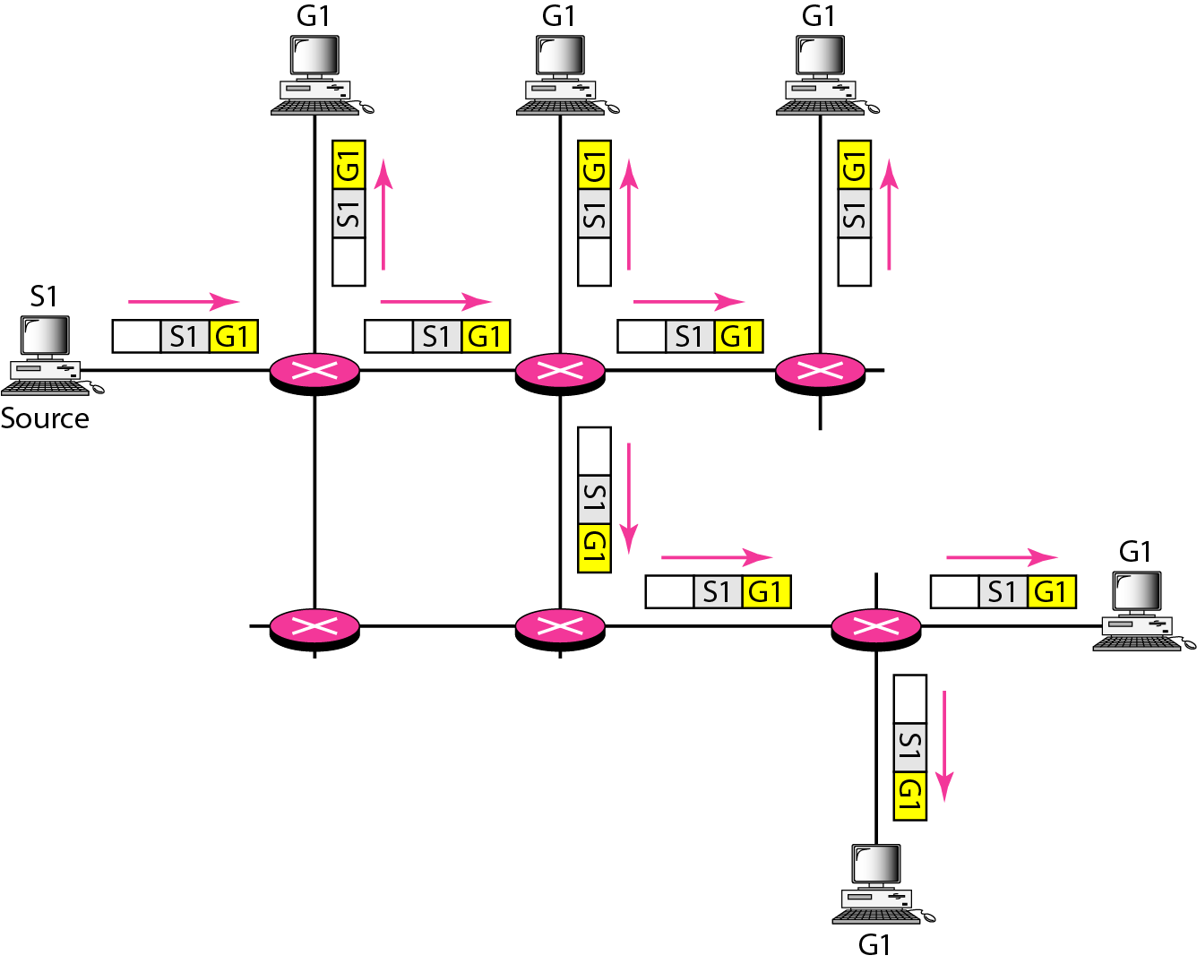
Figure 22.34 Multicasting
22.<number>

Slide 43
Note
In multicasting, the router may
forward the received packet
through several of its interfaces.
22.<number>

Slide 44
Note
In unicast routing, each router in the domain has a table that defines
a shortest path tree to possible destinations.
22.<number>

Slide 45
Routed Protocol:
A Routed Protocol is a network protocol which can be used to send the user data from one network to another network. Routed Protocol carries user traffic such as e-mails, file transfers, web traffic etc.
Examples:
  IP (IPv4, IPv6, Telnet etc)
  IPX (Internetwork Packet Exchange)
  Appletalk
Routing Protocol:
Routing Protocols are network protocols used to dynamically advertise and learn the networks connected, and to learn the routes (network paths) which are available.
Examples:
  RIP
  OSPF
  BGP
22.<number>

Slide 46
18-1 FRAME RELAY
Frame Relay is a virtual-circuit wide-area network that was designed in response to demands for a new type of WAN in the late 1980s and early 1990s.
18.<number>

Slide 47
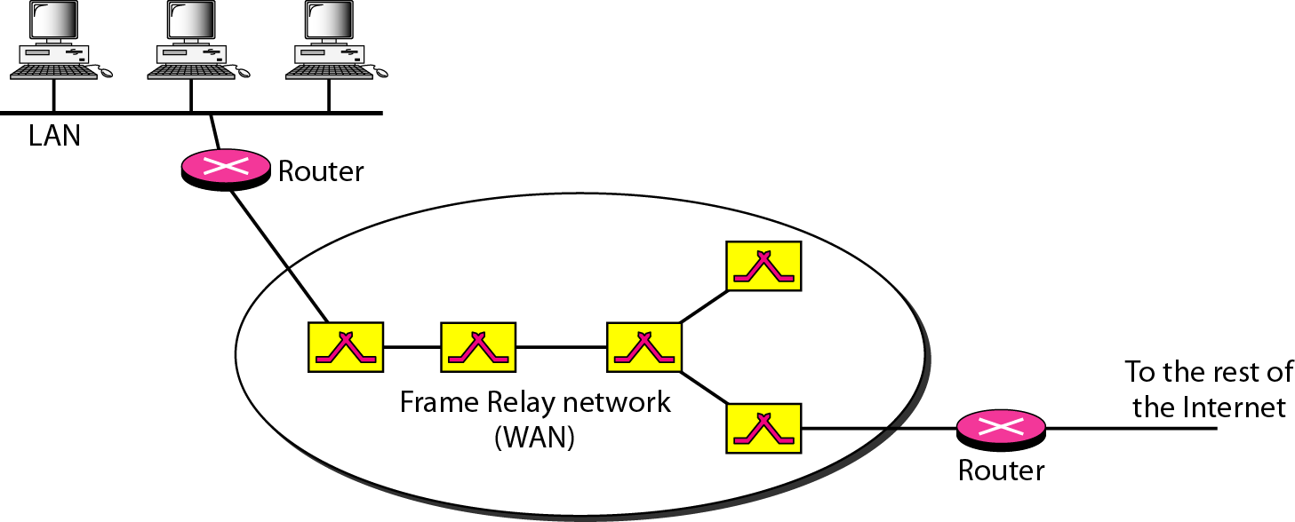
Figure 18.1 Frame Relay network
18.<number>

Slide 48
18-2 ATM
Asynchronous Transfer Mode (ATM) is the cell relay protocol designed by the ATM Forum and adopted by the ITU-T.
18.<number>
Notes:
International Telecommunications Union – Telecommunications Sector

Slide 49
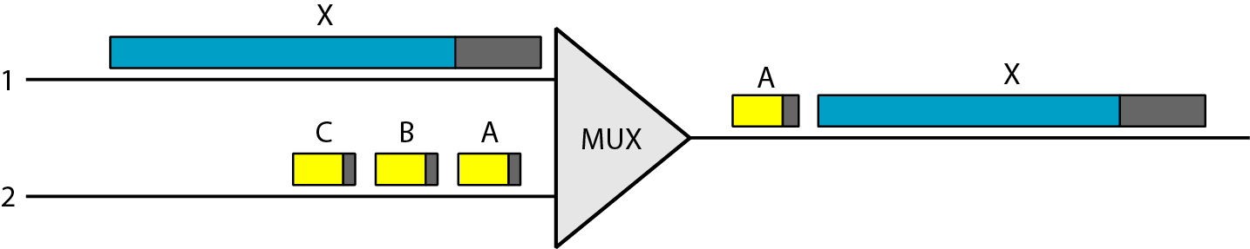
Figure 18.6 Multiplexing using different frame sizes
18.<number>

Slide 50
Note
A cell network uses the cell as the basic unit of data exchange.
A cell is defined as a small, fixed-size block of information.
18.<number>

Slide 51
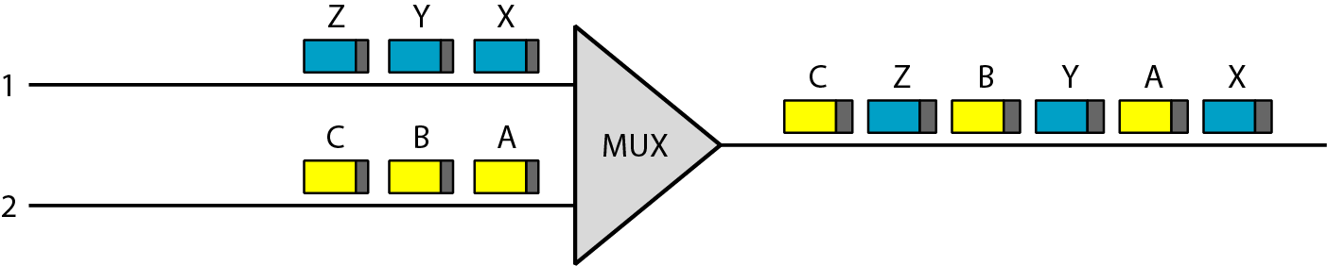
Figure 18.7 Multiplexing using cells
18.<number>

Slide 52
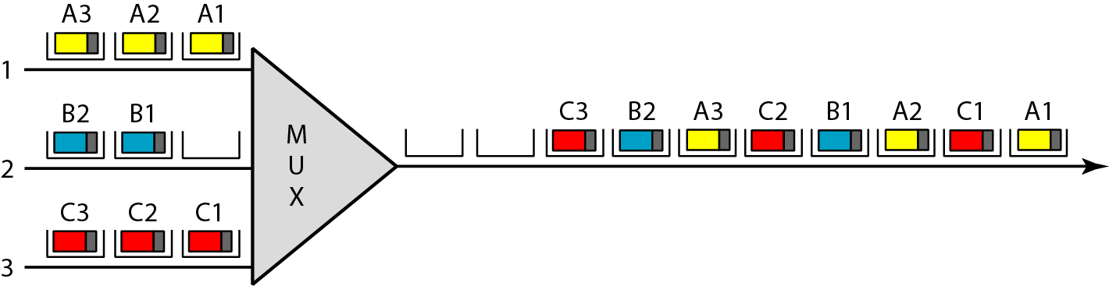
Figure 18.8 ATM multiplexing
18.<number>

Slide 53
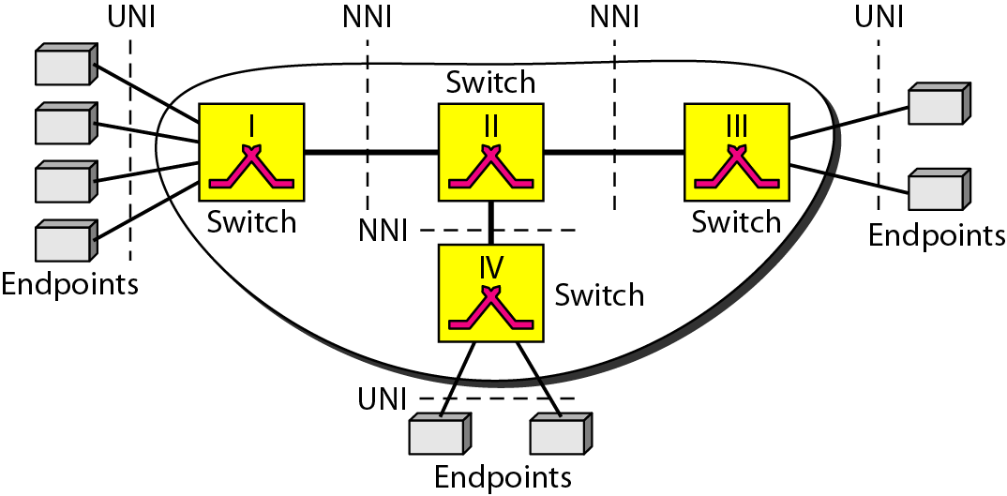
Figure 18.9 Architecture of an ATM network
18.<number>
Notes:
User Network Interface UNI
Network Node Interface NNI

Slide 54
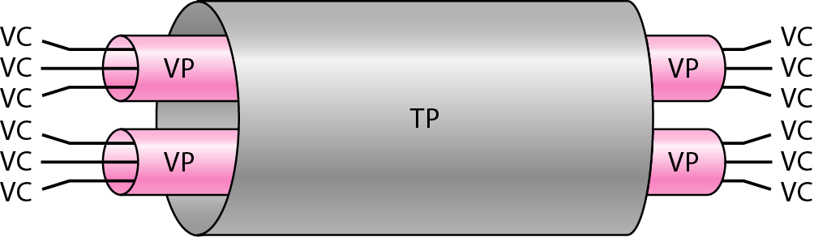
Figure 18.10 TP, VPs, and VCs
18.<number>
Notes:
Virtual Circuit, Virtual Path, Transmission Path

Slide 55
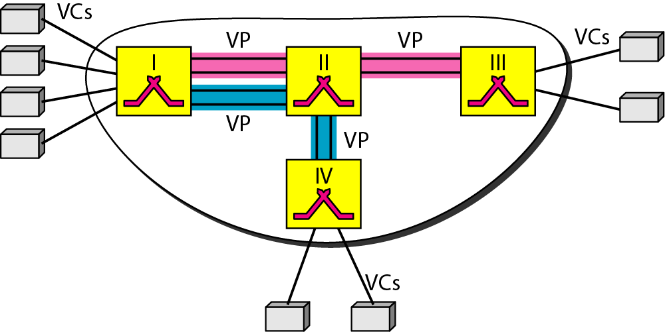
Figure 18.11 Example of VPs and VCs
18.<number>

Slide 56
Note
Note that a virtual connection is defined by a pair of numbers:
the VPI and the VCI.
18.<number>

Slide 57
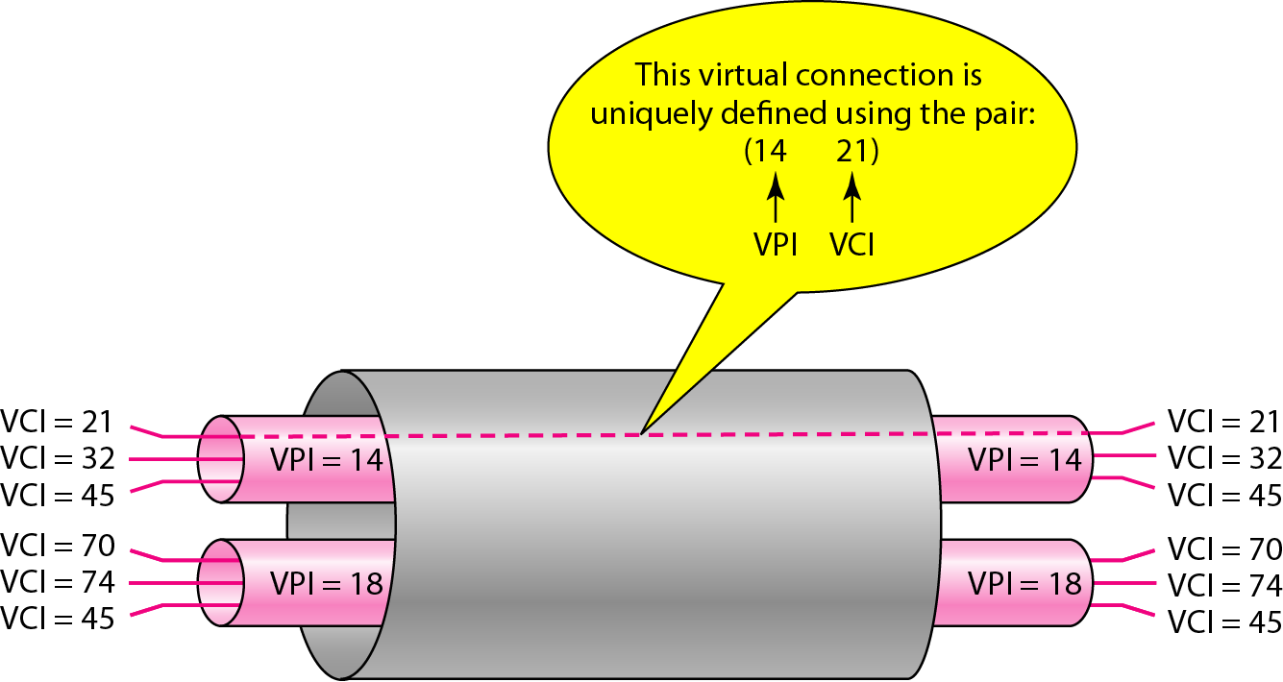
Figure 18.12 Connection identifiers
18.<number>

Slide 58
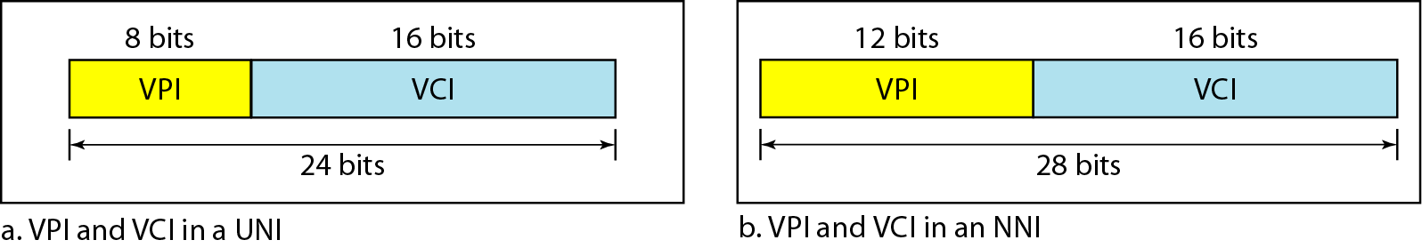
Figure 18.13 Virtual connection identifiers in UNIs and NNIs
18.<number>

Slide 59
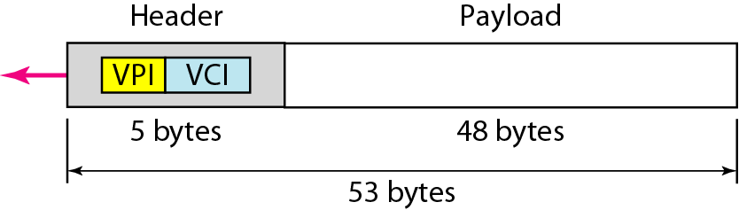
Figure 18.14 An ATM cell
18.<number>

Slide 60
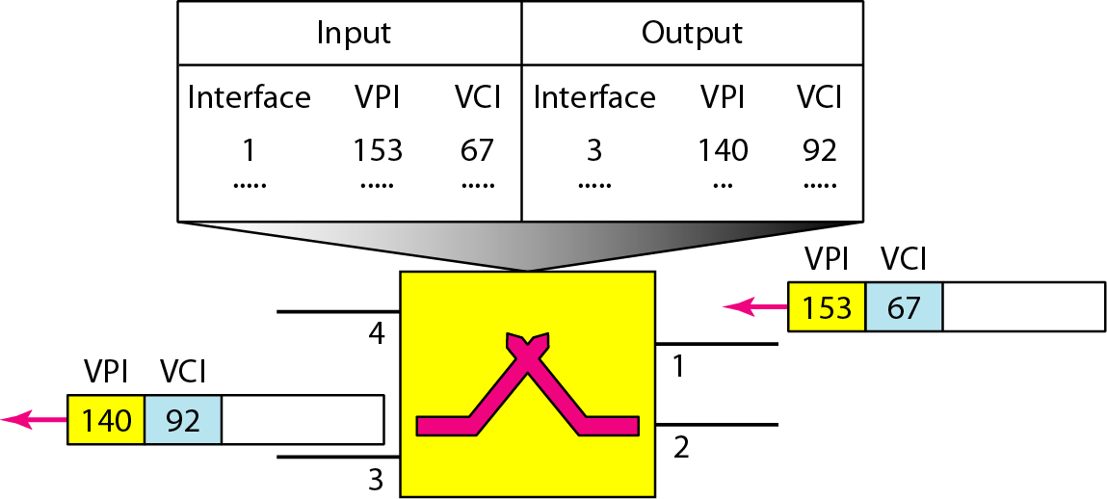
Figure 18.15 Routing with a switch
18.<number>

Slide 61
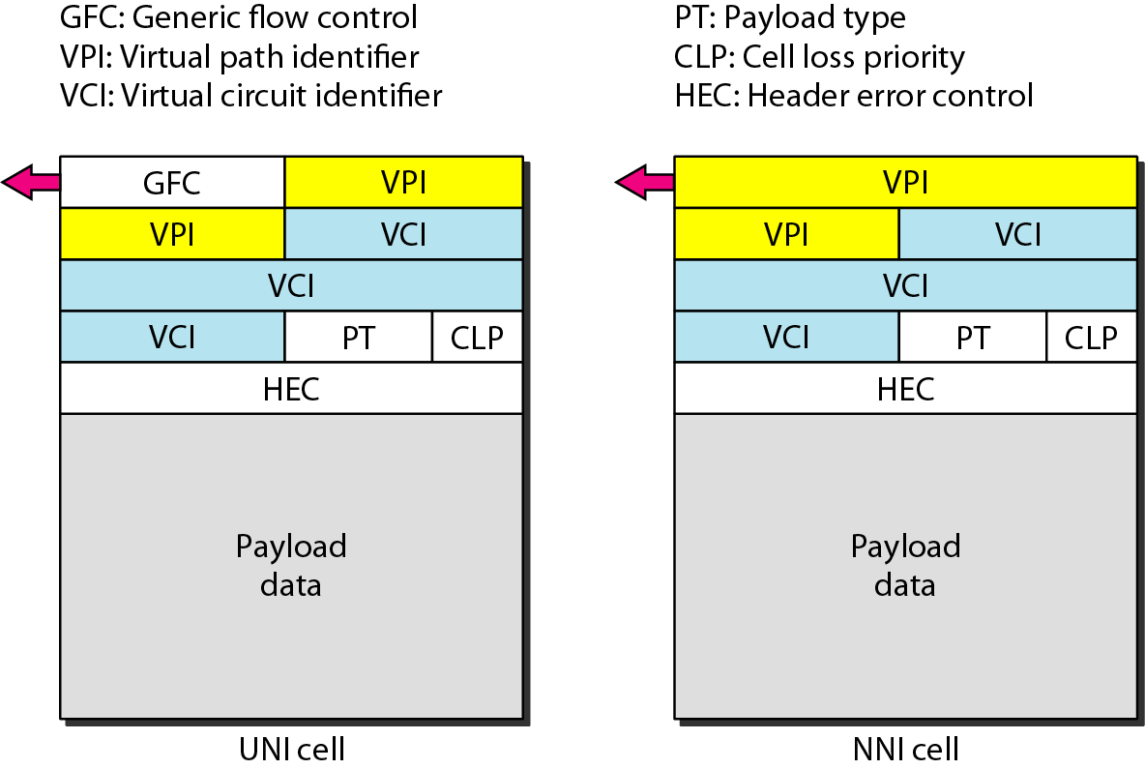
Figure 18.19 ATM headers
18.<number>

