Slide 1

Chapter 19
Network Layer:
Logical Addressing
19.<number>
Copyright © The McGraw-Hill Companies, Inc. Permission required for reproduction or display.

Slide 2
19-1 IPv4 ADDRESSES
An IPv4 address is a 32-bit address that uniquely and universally defines the connection of a device (for example, a computer or a router) to the Internet.
Topics discussed in this section:
Address Space
Notations
Classful Addressing
Classless Addressing
Network Address Translation (NAT)
19.<number>

Slide 3

Note
An IPv4 address is 32 bits long.
19.<number>

Slide 4
Note
The IPv4 addresses are unique
and universal.
19.<number>

Slide 5
Note
The address space of IPv4 is
2³² or 4,294,967,296.
19.<number>

Slide 6

Figure 19.1 Dotted-decimal notation and binary notation for an IPv4 address
19.<number>

Slide 7
Note
Numbering systems are reviewed in Appendix B.
19.<number>

Slide 8


Example 19.1
Change the following IPv4 addresses from binary notation to dotted-decimal notation.
Solution
We replace each group of 8 bits with its equivalent decimal number (see Appendix B) and add dots for separation.
19.<number>

Slide 9


Example 19.2
Change the following IPv4 addresses from dotted-decimal notation to binary notation.
Solution
We replace each decimal number with its binary equivalent (see Appendix B).
19.<number>

Slide 10

Example 19.3
Find the error, if any, in the following IPv4 addresses.
Solution
a. There must be no leading zero (045).
b. There can be no more than four numbers.
c. Each number needs to be less than or equal to 255.
d. A mixture of binary notation and dotted-decimal
notation is not allowed.
19.<number>

Slide 11
Note
In classful addressing, the address space is divided into five classes:
A, B, C, D, and E.
19.<number>

Slide 12

Figure 19.2 Finding the classes in binary and dotted-decimal notation
19.<number>

Slide 13
Example 19.4
Find the class of each address.
a. 00000001 00001011 00001011 11101111
b. 11000001 10000011 00011011 11111111
c. 14.23.120.8
d. 252.5.15.111
Solution
a. The first bit is 0. This is a class A address.
b. The first 2 bits are 1; the third bit is 0. This is a class C
address.
c. The first byte is 14; the class is A.
d. The first byte is 252; the class is E.
19.<number>

Slide 14
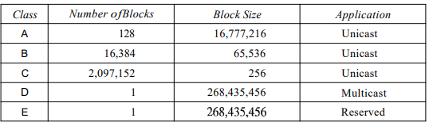
Table 19.1 Number of blocks and block size in classful IPv4 addressing
19.<number>

Slide 15
Note
In classful addressing, a large part of the available addresses were wasted.
19.<number>

Slide 16
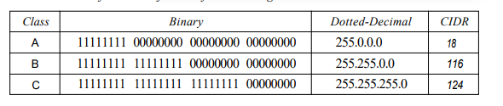
Table 19.2 Default masks for classful addressing
19.<number>

Slide 17
Note
Classful addressing, which is almost obsolete, is replaced with classless addressing.
19.<number>

Slide 18
Example 19.5
Figure 19.3 shows a block of addresses, in both binary and dotted-decimal notation, granted to a small business that needs 16 addresses.
We can see that the restrictions are applied to this block. The addresses are contiguous. The number of addresses is a power of 2 (16 = 2⁴), and the first address is divisible by 16. The first address, when converted to a decimal number, is 3,440,387,360, which when divided by 16 results in 215,024,210.
19.<number>
Notes:
IANA: Internet Assigned Numbers Authority
5 Registries in the world -- RIR (Regional Internet Registry)→ NIR(National Internet Registry)→ LIR (Local Internet Registry)→ ISP → User
3440387360= 205.16.37.32 → 205x256^3 + 16x256^2 + 37x256 + 32

Slide 19

Figure 19.3 A block of 16 addresses granted to a small organization
19.<number>

Slide 20
Note
In IPv4 addressing, a block of
addresses can be defined as
x.y.z.t /n
in which x.y.z.t defines one of the addresses and the /n defines the mask.
19.<number>

Slide 21
Note
The first address in the block can be found by setting the rightmost
32 − n bits to 0s.
19.<number>

Slide 22
Example 19.6
A block of addresses is granted to a small organization. We know that one of the addresses is 205.16.37.39/28. What is the first address in the block?
Solution
The binary representation of the given address is
11001101 00010000 00100101 00100111
If we set 32−28 rightmost bits to 0, we get
11001101 00010000 00100101 00100000
or
205.16.37.32.
This is actually the block shown in Figure 19.3.
19.<number>

Slide 23
Note
The last address in the block can be found by setting the rightmost
32 − n bits to 1s.
19.<number>

Slide 24
Example 19.7
Find the last address for the block in Example 19.6.
Solution
The binary representation of the given address is
11001101 00010000 00100101 00100111
If we set 32 − 28 rightmost bits to 1, we get
11001101 00010000 00100101 00101111
or
205.16.37.47
This is actually the block shown in Figure 19.3.
19.<number>

Slide 25
Note
The number of addresses in the block can be found by using the formula
2^{32−n}.
19.<number>

Slide 26
Example 19.8
Find the number of addresses in Example 19.6.
Solution
The value of n is 28, which means that number
of addresses is 2 ³²⁻²⁸ or 16.
19.<number>

Slide 27
Example 19.9
Another way to find the first address, the last address, and the number of addresses is to represent the mask as a 32-bit binary (or 8-digit hexadecimal) number. This is particularly useful when we are writing a program to find these pieces of information. In Example 19.5 the /28 can be represented as
11111111 11111111 11111111 11110000
(twenty-eight 1s and four 0s).
Find
a. The first address
b. The last address
c. The number of addresses.
19.<number>

Slide 28

Example 19.9 (continued)
Solution
a. The first address can be found by ANDing the given
addresses with the mask. ANDing here is done bit by
bit. The result of ANDing 2 bits is 1 if both bits are 1s;
the result is 0 otherwise.
19.<number>

Slide 29

Example 19.9 (continued)
b. The last address can be found by ORing the given
addresses with the complement of the mask. ORing
here is done bit by bit. The result of ORing 2 bits is 0 if
both bits are 0s; the result is 1 otherwise. The
complement of a number is found by changing each 1
to 0 and each 0 to 1.
19.<number>

Slide 30
Example 19.9 (continued)
c. The number of addresses can be found by
complementing the mask, interpreting it as a decimal
number, and adding 1 to it.
19.<number>

Slide 31
Figure 19.4 A network configuration for the block 205.16.37.32/28
19.<number>

Slide 32
Note
The first address in a block is
normally not assigned to any device;
it is used as the network address that represents the organization
to the rest of the world.
19.<number>

Slide 33

Figure 19.5 Two levels of hierarchy in an IPv4 address
19.<number>

Slide 34

Figure 19.6 A frame in a character-oriented protocol
19.<number>

Slide 35
Note
Each address in the block can be considered as a two-level
hierarchical structure:
the leftmost n bits (prefix) define
the network;
the rightmost 32 − n bits define
the host.
19.<number>

Slide 36

Figure 19.7 Configuration and addresses in a subnetted network
19.<number>

Slide 37

Figure 19.8 Three-level hierarchy in an IPv4 address
19.<number>

Slide 38
Example 19.10
An ISP is granted a block of addresses starting with 190.100.0.0/16 (65,536 addresses). The ISP needs to distribute these addresses to three groups of customers as follows:
a. The first group has 64 customers; each needs 256
addresses.
b. The second group has 128 customers; each needs 128
addresses.
c. The third group has 128 customers; each needs 64
addresses.
Design the subblocks and find out how many addresses are still available after these allocations.
19.<number>

Slide 39
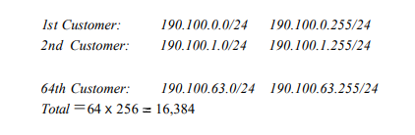
Example 19.10 (continued)
Solution
Figure 19.9 shows the situation.
Group 1
For this group, each customer needs 256 addresses. This means that 8 (log2 256) bits are needed to define each host. The prefix length is then 32 − 8 = 24. The addresses are
19.<number>

Slide 40
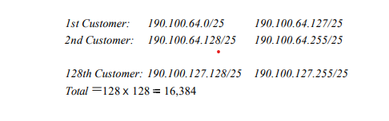
Example 19.10 (continued)
Group 2
For this group, each customer needs 128 addresses. This means that 7 (log2 128) bits are needed to define each host. The prefix length is then 32 − 7 = 25. The addresses are
19.<number>

Slide 41
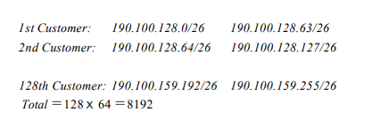
Example 19.10 (continued)
Group 3
For this group, each customer needs 64 addresses. This means that 6 (log₂64) bits are needed to each host. The prefix length is then 32 − 6 = 26. The addresses are
Number of granted addresses to the ISP: 65,536
Number of allocated addresses by the ISP: 40,960
Number of available addresses: 24,576
19.<number>

Slide 42

Figure 19.9 An example of address allocation and distribution by an ISP
19.<number>

Slide 43

Table 19.3 Addresses for private networks
19.<number>

Slide 44

Figure 19.10 A NAT implementation
19.<number>

Slide 45

Figure 19.11 Addresses in a NAT
19.<number>

Slide 46

Figure 19.12 NAT address translation
19.<number>

Slide 47
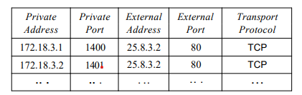
Table 19.4 Five-column translation table
19.<number>

Slide 48

Figure 19.13 An ISP and NAT
19.<number>

Slide 49
19-2 IPv6 ADDRESSES
Despite all short-term solutions, address depletion is still a long-term problem for the Internet. This and other problems in the IP protocol itself have been the motivation for IPv6.
Topics discussed in this section:
Structure
Address Space
19.<number>

Slide 50
Note
An IPv6 address is 128 bits long.
19.<number>

Slide 51

Figure 19.14 IPv6 address in binary and hexadecimal colon notation
19.<number>

Slide 52

Figure 19.15 Abbreviated IPv6 addresses
19.<number>

Slide 53
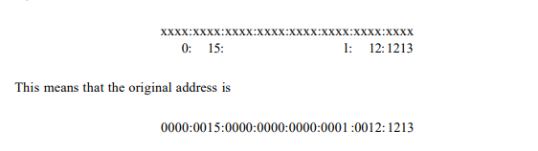
Example 19.11
Expand the address 0:15::1:12:1213 to its original.
Solution
We first need to align the left side of the double colon to the left of the original pattern and the right side of the double colon to the right of the original pattern to find how many 0s we need to replace the double colon.
19.<number>

Slide 54
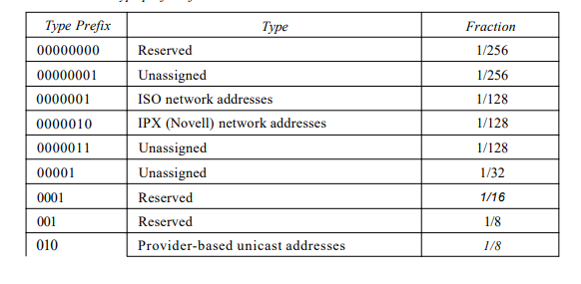
Table 19.5 Type prefixes for IPv6 addresses
19.<number>

Slide 55
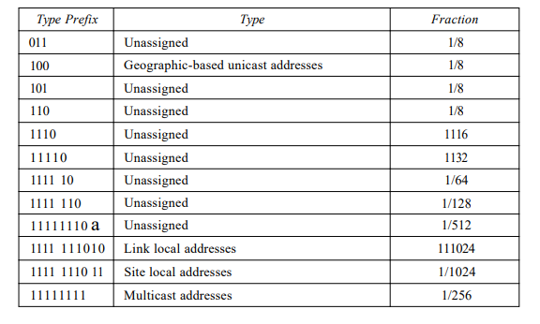
Table 19.5 Type prefixes for IPv6 addresses (continued)
19.<number>

Slide 56

Figure 19.16 Prefixes for provider-based unicast address
19.<number>
Notes:
First 3 bits: Format Prefix
Next 13 bits: Top Level Aggregation ID
First 5 bits: Registry ID
Next 8 bits: Provider ID
Next 8 bits: Reserved for future use
Next 24 bits: Next Level Aggregation ID
Next 16 bits: Site Level Aggregation ID
Last 64 bits: Node Interface ID
Type identifier. This 3-bit field defines the address as a provider-base.d address. o Registry identifier. This 5-bit field indicates the agency that has registered the address. Currently three registry centers have been defined. INTERNIC (code 11000) is the center for North America; RIPNIC (code 01000) is the center for European registration; and APNIC (code 10100) is for Asian and Pacific countries
Provider identifier. This variable-length field identifies the provider for Internet access (such as an ISP). A 16-bit length is recommended for this field. o Subscriber identifier. When an organization subscribes to the Internet through a provider, it is assigned a subscriber identification. A 24-bit length is recommended for this field. o Subnet identifier. Each subscriber can have many different subnetworks, and each subnetwork can have an identifier. The subnet identifier defines a specific subnetwork under the territory of the subscriber. A 32-bit length is recommended for this field. o Node identifier. The last field defines the identity of the node connected to a subnet. A length of 48 bits is recommended for this field to make it compatible with the 48-bit link (physical) address used by Ethernet. In the future, this link address will probably be the same as the node physical address.

Slide 57

Figure 19.17 Multicast address in IPv6
19.<number>

Slide 58

Figure 19.18 Reserved addresses in IPv6
19.<number>
Notes:
Loopback of IPv4: 127.0.0.1
Compatible is used if network device is IPv6 aware
Mapped is used if device is IPv4 aware

Slide 59

Figure 19.19 Local addresses in IPv6
19.<number>
Notes:
In a computer network, a link-local address is a network address that is valid only for communications within the network segment (link) or the broadcast domain that the host is connected to.
Link Local: limited access than site local, only route to a particular physical link.
Site Local: route Within organization not public
Node local: within the router/device for interprocess communication

