Slide 1

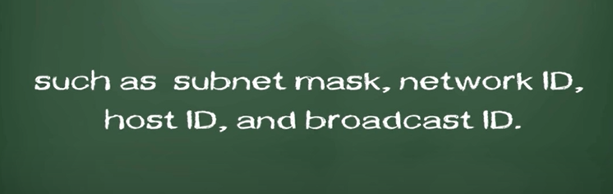

Slide 2

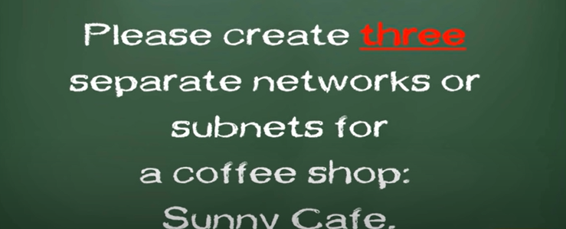

Slide 3



Slide 4


Slide 5
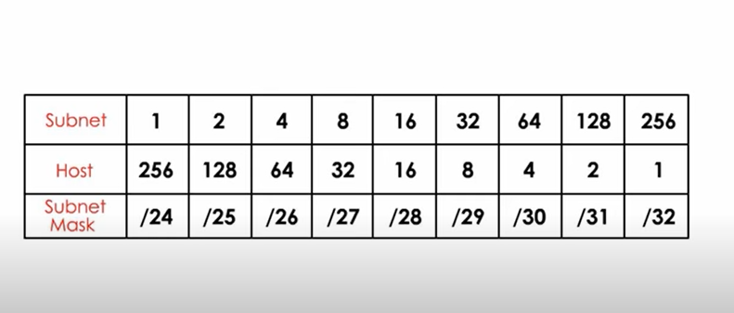
Let us first build a Table

Slide 6
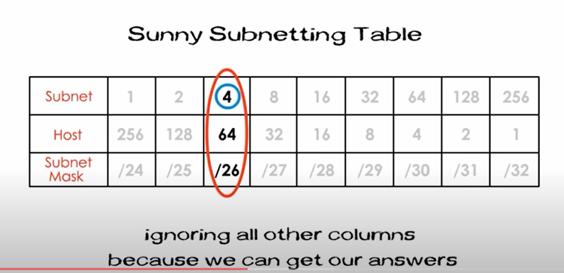
You are required to get three subnets

Slide 7
64 means each subnet will have 64 total host iDs including network ID and Broadcast ID.
/26 means new subnet mask for 4 subnets
The first network ID is is always the original network ID
Therefore the second network iD would be 0+64,which is 64.
The third one 64+64 which is 128
The fourth network ID is 128+64 which is 192.

Slide 8
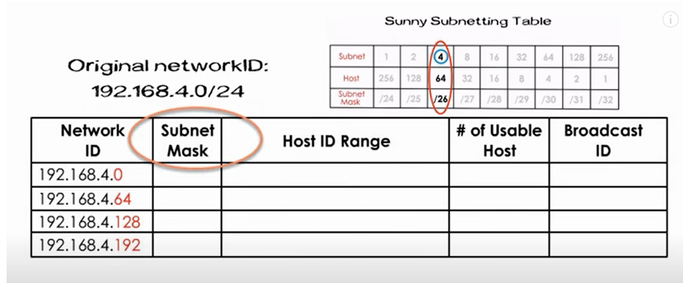

Slide 9
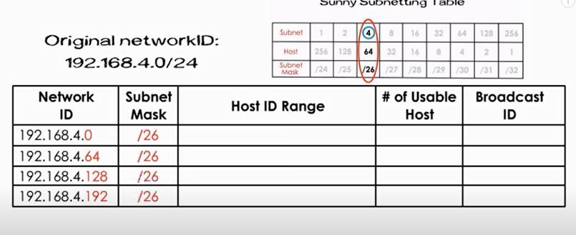

Slide 10
64 is the total number of host IDs for each network .

Slide 11
First host ID is reserved for the network ID and last Host ID is reserved for broadcast ID

Slide 12
The number od used host IDs will be 64-2= 62
Thus we wrote 62 for all four subnets

Slide 13
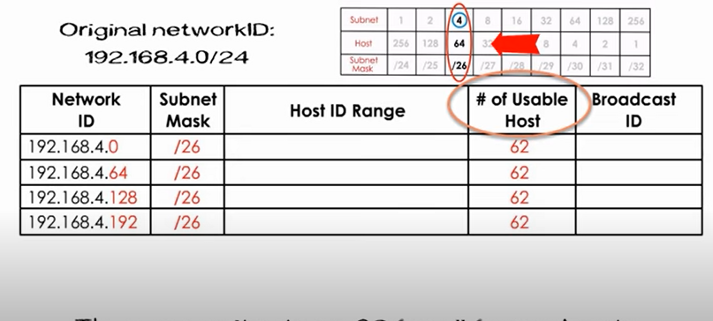

Slide 14
Keep in mind last host ID is reserved for the broadcast ID.
Thus Broadcast ID for first subnet is 63.
The broadcast ID is equal to next subnet network ID minus one.

Slide 15
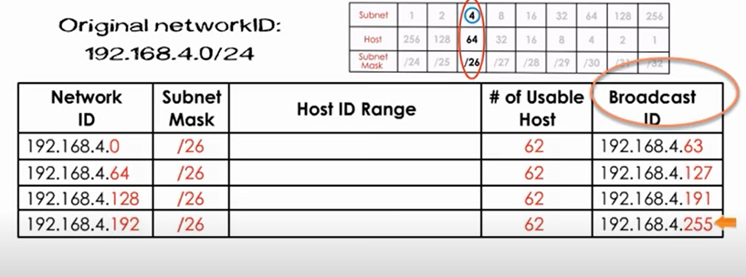

Slide 16
A subnet host range is any IDs between its network ID and broadcast ID.

Slide 17
