Slide 1

Data Mining:
Concepts and Techniques
— Chapter 2 —

Slide 2
Chapter 2: Getting to Know Your Data
Data Objects and Attribute Types
Basic Statistical Descriptions of Data
Data Visualization
Measuring Data Similarity and Dissimilarity
Summary

Slide 3


Types of Data Sets
Record
  Relational records
  Data matrix, e.g., numerical matrix, crosstabs
  Document data: text documents: term-frequency vector
  Transaction data
Graph and network
  World Wide Web
  Social or information networks
  Molecular Structures
Ordered
  Video data: sequence of images
  Temporal data: time-series
  Sequential Data: transaction sequences
  Genetic sequence data
Spatial, image and multimedia:
  Spatial data: maps
  Image data:
  Video data:

Slide 4
Important Characteristics of Structured Data
Dimensionality
  Curse of dimensionality
Sparsity
  Only presence counts
Resolution
  Patterns depend on the scale
Distribution
  Centrality and dispersion

Slide 5
Data Objects
Data sets are made up of data objects.
A data object represents an entity.
Examples:
  sales database: customers, store items, sales
  medical database: patients, treatments
  university database: students, professors, courses
Also called samples , examples, instances, data points, objects, tuples.
Data objects are described by attributes.
Database rows -> data objects; columns ->attributes.

Slide 6
Attributes
Attribute (or dimensions, features, variables): a data field, representing a characteristic or feature of a data object.
  E.g., customer _ID, name, address
Types:
  Nominal
  Binary
  Numeric: quantitative
    Interval-scaled
    Ratio-scaled

Slide 7
Attribute Types
Nominal: categories, states, or “names of things”
  Hair_color = {auburn, black, blond, brown, grey, red, white}
  marital status, occupation, ID numbers, zip codes
Binary
  Nominal attribute with only 2 states (0 and 1)
  Symmetric binary: both outcomes equally important
    e.g., gender
  Asymmetric binary: outcomes not equally important.
    e.g., medical test (positive vs. negative)
    Convention: assign 1 to most important outcome (e.g., HIV positive)
Ordinal
  Values have a meaningful order (ranking) but magnitude between successive values is not known.
  Size = {small, medium, large}, grades, army rankings

Slide 8
Numeric Attribute Types
Quantity (integer or real-valued)
Interval
    Measured on a scale of equal-sized units
    Values have order
      E.g., temperature in C˚or F˚, calendar dates
    No true zero-point
Ratio
    Inherent zero-point
    We can speak of values as being an order of magnitude larger than the unit of measurement (10 K˚ is twice as high as 5 K˚).
      e.g., temperature in Kelvin, length, counts, monetary quantities

Slide 9
Discrete vs. Continuous Attributes
Discrete Attribute
  Has only a finite or countably infinite set of values
    E.g., zip codes, profession, or the set of words in a collection of documents
  Sometimes, represented as integer variables
  Note: Binary attributes are a special case of discrete attributes
Continuous Attribute
  Has real numbers as attribute values
    E.g., temperature, height, or weight
  Practically, real values can only be measured and represented using a finite number of digits
  Continuous attributes are typically represented as floating-point variables

Slide 10
Chapter 2: Getting to Know Your Data
Data Objects and Attribute Types
Basic Statistical Descriptions of Data
Data Visualization
Measuring Data Similarity and Dissimilarity
Summary

Slide 11
Basic Statistical Descriptions of Data
Motivation
  To better understand the data: central tendency, variation and spread
Data dispersion characteristics
  median, max, min, quantiles, outliers, variance, etc.
Numerical dimensions correspond to sorted intervals
  Data dispersion: analyzed with multiple granularities of precision
  Boxplot or quantile analysis on sorted intervals
Dispersion analysis on computed measures
  Folding measures into numerical dimensions
  Boxplot or quantile analysis on the transformed cube

Slide 12
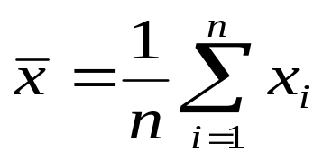


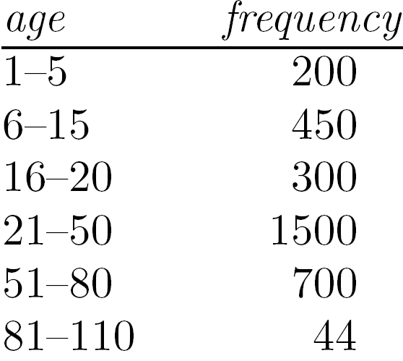
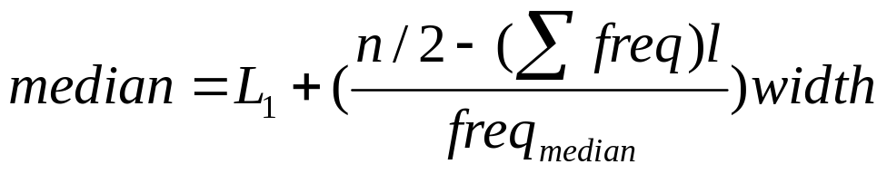
Measuring the Central Tendency
Mean (algebraic measure) (sample vs. population):
  Note: n is sample size and N is population size.
  Weighted arithmetic mean:
  Trimmed mean: chopping extreme values
Median:
  Middle value if odd number of values, or average of the middle two values otherwise
  Estimated by interpolation (for grouped data):
Mode
  Value that occurs most frequently in the data
  Unimodal, bimodal, trimodal
  Empirical formula:

Slide 13



Symmetric vs. Skewed Data
Median, mean and mode of symmetric, positively and negatively skewed data
symmetric
positively skewed
negatively skewed
Data Mining: Concepts and Techniques

Slide 14


Measuring the Dispersion of Data
Quartiles, outliers and boxplots
  Quartiles: Q₁ (25th percentile), Q₃ (75th percentile)
  Inter-quartile range: IQR = Q₃ – Q₁
  Five number summary: min, Q₁, median, Q₃, max
  Boxplot: ends of the box are the quartiles; median is marked; add whiskers, and plot outliers individually
  Outlier: usually, a value higher/lower than 1.5 x IQR
Variance and standard deviation (sample: s, population: σ)
  Variance: (algebraic, scalable computation)
  Standard deviation s (or σ) is the square root of variance s² ⁽or σ²⁾

Slide 15
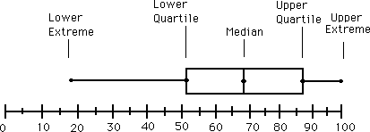
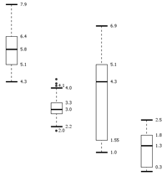
Boxplot Analysis
Five-number summary of a distribution
  Minimum, Q1, Median, Q3, Maximum
Boxplot
  Data is represented with a box
  The ends of the box are at the first and third quartiles, i.e., the height of the box is IQR
  The median is marked by a line within the box
  Whiskers: two lines outside the box extended to Minimum and Maximum
  Outliers: points beyond a specified outlier threshold, plotted individually

Slide 16

Visualization of Data Dispersion: 3-D Boxplots
Data Mining: Concepts and Techniques

Slide 17
Graphic Displays of Basic Statistical Descriptions
Boxplot: graphic display of five-number summary
Histogram: x-axis are values, y-axis repres. frequencies
Quantile plot: each value x_{i} is paired with f_{i} indicating that approximately 100 f_{i} % of data are ≤ x_{i}
Quantile-quantile (q-q) plot: graphs the quantiles of one univariant distribution against the corresponding quantiles of another
Scatter plot: each pair of values is a pair of coordinates and plotted as points in the plane

Slide 18
References
W. Cleveland, Visualizing Data, Hobart Press, 1993
T. Dasu and T. Johnson. Exploratory Data Mining and Data Cleaning. John Wiley, 2003
U. Fayyad, G. Grinstein, and A. Wierse. Information Visualization in Data Mining and Knowledge Discovery, Morgan Kaufmann, 2001
L. Kaufman and P. J. Rousseeuw. Finding Groups in Data: an Introduction to Cluster Analysis. John Wiley & Sons, 1990.
H. V. Jagadish, et al., Special Issue on Data Reduction Techniques. Bulletin of the Tech. Committee on Data Eng., 20(4), Dec. 1997
D. A. Keim. Information visualization and visual data mining, IEEE trans. on Visualization and Computer Graphics, 8(1), 2002
D. Pyle. Data Preparation for Data Mining. Morgan Kaufmann, 1999
S. Santini and R. Jain,” Similarity measures”, IEEE Trans. on Pattern Analysis and Machine Intelligence, 21(9), 1999
E. R. Tufte. The Visual Display of Quantitative Information, 2nd ed., Graphics Press, 2001
C. Yu , et al., Visual data mining of multimedia data for social and behavioral studies, Information Visualization, 8(1), 2009

