Slide 1
Data Mining:
Concepts and Techniques
(3rd ed.)
— Chapter 9 —
Classification: SVM
Jiawei Han, Micheline Kamber, and Jian Pei
University of Illinois at Urbana-Champaign &
Simon Fraser University
©2011 Han, Kamber & Pei. All rights reserved.

Slide 2
SVM—Support Vector Machines
Popular Supervised Learning Algorithm used for classification as well as Regression.
  Spam Vs Non-spam (Classification).
Goal of SVM is to create a best line or decision boundary that can segregate Dataset into classes to easily put data in correct category in future.
This best decision boundary is called hyperplane.

Slide 3
SVM—How to draw Hyperplane
There could be multiple lines/ decision boundaries for segregation.
Need to find out the best decision boundary.
This best boundary is known as the hyperplane of SVM.

Slide 4
SVM—General Philosophy
Small Margin
Large Margin
Support Vectors

Slide 5
SVM—When Data Is Linearly Separable
m
There are infinite lines (hyperplanes) separating the two classes but we want to find the best one (the one that minimizes classification error on unseen data)
SVM searches for the hyperplane with the largest margin, i.e., maximum marginal hyperplane (MMH)

Slide 6
SVM-Hyperplane
The dimensions depend on features in dataset.
If there are two features, then hyperplane will be a straight line.
If three features then hyperplane will be a 2-dimension plane
Data Mining: Concepts and Techniques

Slide 7
SVM-Support Vectors
The data points or vectors closest to hyperplane and which effect the position of hyperplane are termed as Support Vectors.
Data Mining: Concepts and Techniques

Slide 8
Types of SVM
Two types
  Linear SVM:
    Used for linearly separable data
  Non-Linear SVM:
    Used for non-linearly separable data
Data Mining: Concepts and Techniques

Slide 9
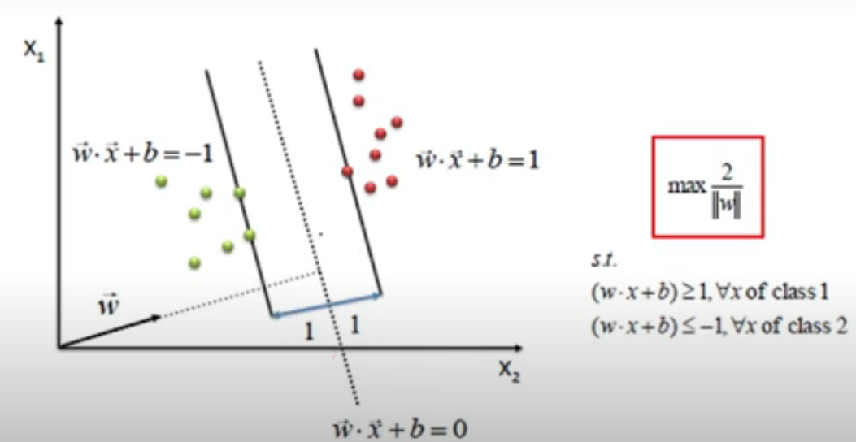
Maximizing the margin
We want a classifier with as big margin as possible.
We need to get a hyperplane where we will get the maximum value for this particular condition

Slide 10
SVM Example
Suppose we have been given a dataset of 6 points.
  Points (4,1), (4,-1) and (6,0) belongs to positive class.
  Points (1,0), (0,1) and (0,-1) belongs to negative class.
Draw an optimal hyperplane to classify the points.
Data Mining: Concepts and Techniques

Slide 11
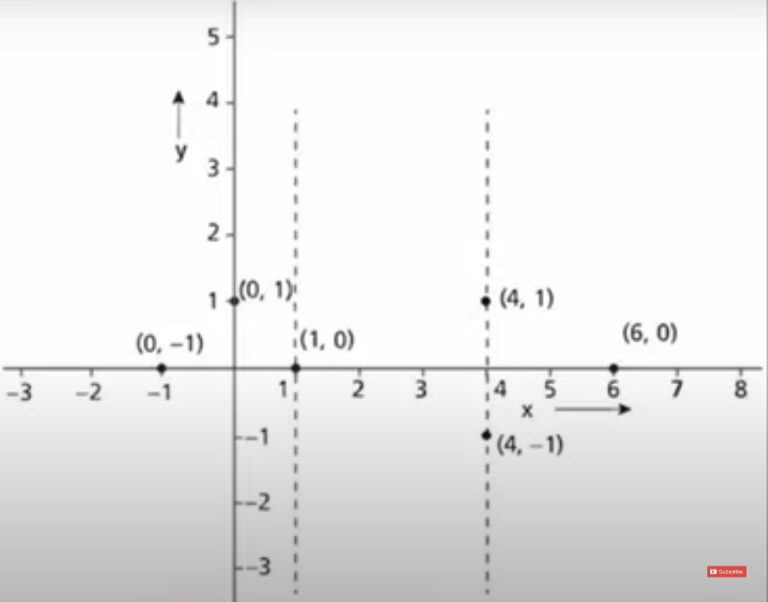
Data Mining: Concepts and Techniques

Slide 12
It can be observed that the support vectors are s1= (1,0), s2= (4,1) and s3= (4,-1).
Data Mining: Concepts and Techniques

Slide 13

It can be observed that the support vectors are s1= (1,0), s2= (4,1) and s3= (4,-1).
Now we need to add Bias to the support vectors to get the augmented vector
Data Mining: Concepts and Techniques

Slide 14

From the augmented vector, a set of three equations can be obtained as
  1st equation is equals to -1 because this vector belongs to negative class rest are +1 because of positive class
Data Mining: Concepts and Techniques

Slide 15

1st Equation
We need to take the dot product of vectors
Data Mining: Concepts and Techniques

Slide 16
1st Equation
We need to take the dot product of vectors
Data Mining: Concepts and Techniques

Slide 17
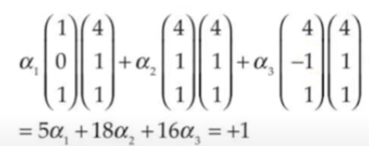
2nd Equation
We need to take the dot product of vectors
Data Mining: Concepts and Techniques

Slide 18
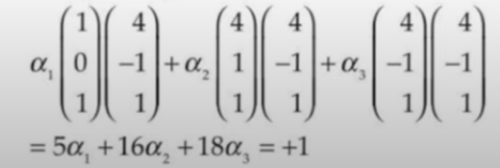
3rd equation
Data Mining: Concepts and Techniques

Slide 19
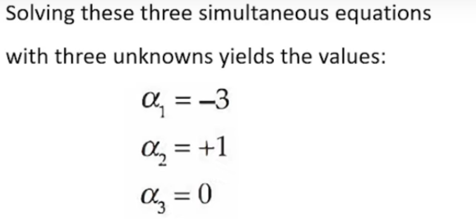
Data Mining: Concepts and Techniques

Slide 20
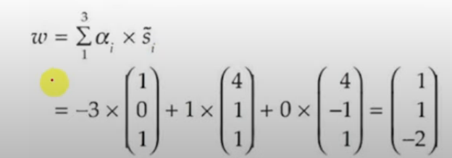
Optimal Hyperplane
Coefficient of 1st variable
Coefficient of 2nd variable
Intercept
Data Mining: Concepts and Techniques

Slide 21
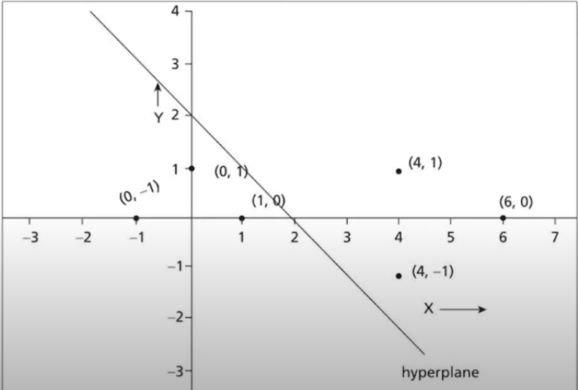
The hyperplane is (1,1) with an offset -2
Data Mining: Concepts and Techniques

