Slide 1

Artificial Intelligence
Decision Trees
CS-632
Dr. Ghulam Mustafa
University Institute of Information Technology
PMAS-Arid Agriculture University Rawalpindi

Slide 2
Decision trees
Falls in the category of supervised learning.
Can be used for both, regression and classification problems.
Uses the tree representation to solve the problem.
Each leaf node corresponds to a class label.
Attributes are represented on the internal node of the tree.
Boolean function on discrete attributes can be represented using the decision tree.

Slide 3
Decision Tree
Used for decisions
Understand by example
A loan company want to know the persons who will be interested in loans
Categories on basis of Age

Slide 4
Decision Tree
Person
20
20-50
50
2%
U
M
5%
10%
90%
UK
K
20%
80%

Slide 5
Lets suppose you have been given a problem to find whether your company will be in profit or loss?
Age | Competition | Type | Profit
Old | Yes | Software | Down
Old | No | Software | Down
Old | No | Hardware | Down
Mid | Yes | Software | Down
Mid | Yes | Hardware | Down
Mid | No | Hardware | Up
Mid | No | Software | Up
New | Yes | Software | Up
New | No | Hardware | Up
New | No | Software | Up

Slide 6
First of all, find root node
Some formulas to identify
Last attribute is class attribute and will be leaf of tree
Calculate Entropy of class attribute

Slide 7
Entropy Calculation
Lets have P and N
P is positive signs
N for Negative signs
P = 5
N = 5
Up
Down

Slide 8

Entropy (Class)
$$=\frac{−P}{P+N}\log_{2}\left(\frac{P}{P+N}\right) − \frac{N}{P+N}\log_{2}\left(\frac{N}{P+N}\right)$$
P=5 , N=5
= 1

Slide 9
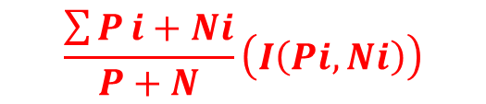
Now we calculate 3 things
First of all Information gain
When we use a node in a decision tree to partition the training instances into smaller subsets the entropy changes. Information gain is a measure of this change in entropy.
Second Calculate Entropy
Third
For each Attribute
$$I\left(Pi,Ni\right)=\left(\frac{−P}{P+N}\right)\log_{2}\left(\frac{P}{P+N}\right)\frac{−N}{P+N}\log_{2}\left(\frac{N}{P+N}\right)$$
Entropy is the measure of uncertainty of a random variable, it characterizes the impurity of an arbitrary collection of examples. The higher the entropy more the information content.
Entropy (Attributes)
$$\frac{\sum{P}i+Ni}{P+N}\left(I\left(Pi,Ni\right)\right)$$
Gain = Entrophy Class – Entropy (attributes)
Now will compare gain
Maximum gain attribute will be root

Slide 10
Age | Pi | Ni | I(Pi , Ni)
Old | 0 | 3 | 0
Mid | 2 | 2 | 1
New | 3 | 0 | 0
How many Up in Class attribute
How many Down in Class attribute
If one of the number is zero then information gain is zero
If Both are same then Information gain is 1

Slide 11
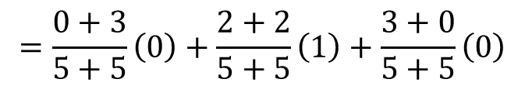
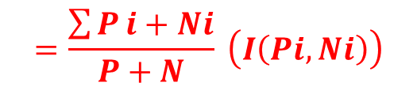
Entropy of Complete Age Attribute
Now will calculate Entropy of Age attribute
Entropy (attribute)
$$=\frac{\sum{P}i+Ni}{P+N} \left(I\left(Pi,Ni\right)\right)$$
$$=\frac{0+3}{5+5}\left(0\right)+\frac{2+2}{5+5}\left(1\right)+\frac{3+0}{5+5}\left(0\right)$$
= 0.4

Slide 12
Now Gain
Gain = Entropy of Class - Entropy (Age)
= 1 - 0.4
= 0.6
Gain = Entropy Class – Entropy (attributes)

Slide 13

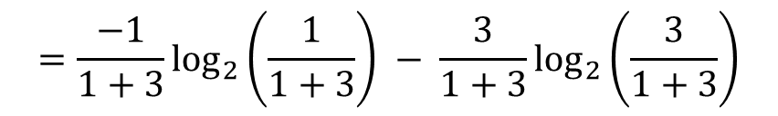
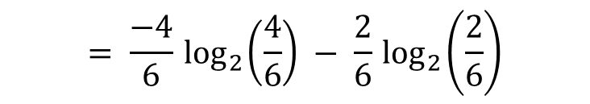
Now will calculate for rest of the attributes (Competition)
$$=\frac{−1}{1+3}\log_{2}\left(\frac{1}{1+3}\right) − \frac{3}{1+3}\log_{2}\left(\frac{3}{1+3}\right)$$
I (Pi , Ni)
Yes
$$=\frac{−1}{4}\log_{2}\left(\frac{1}{4}\right) − \frac{3}{4 }\log_{2}\left(\frac{3}{4}\right)$$
= 0.81127
$$= \frac{−4}{6}\log_{2}\left(\frac{4}{6}\right) − \frac{2}{6}\log_{2}\left(\frac{2}{6}\right)$$
I (Pi , Ni)
No
= 0.918295

Slide 14
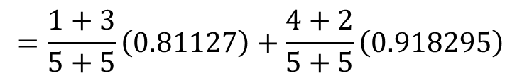

Competition
 | Pi | Ni | I (Pi , Ni)
Yes | 1 | 3
No | 4 | 2
I (Pi , Ni)
Yes
I (Pi , Ni)
Yes
= 0.81127
= $0.918295$
Entrophy (Competition)
$$=\frac{1+3}{5+5}\left(0.81127\right)+\frac{4+2}{5+5}\left(0.918295\right)$$
= 0.8754
Gain = Class entropy – Entropy (Competition)
= 1 - 0.8754
= 0.124515

Slide 15







Type
Type
 | Pi | Ni | I (Pi , Ni)
Software | 3 | 3
Hardware | 2 | 2
Entropy (Software) = 1
Entropy (Hardware) = 1
Entropy (Type)
$$= \frac{3+3}{5+5} \left(1\right)+\frac{2+2}{5+5} \left(1\right)$$
$$⇒$$
$$\frac{6}{10}+\frac{4}{10}$$
$$\frac{10}{10}$$
$$1$$
$$⇒$$
$$⇒$$
Gain = Class entropy – Entropy (Type)
= 1-1
= 0

Slide 16
Information Gain
Age | 0.6
Competition | 0.124515
Type | 0
Age
old
mid
new
Down
Up
?
It can be either Type or Competition

Slide 17
Now create table of Mid part only
Age | Competition | Type | Profit
mid | Yes | Software | Down
mid | Yes | Hardware | Down
mid | No | Hardware | Up
mid | No | Software | Up
P=2
Entropy (Profit) = 1
N=2

Slide 18
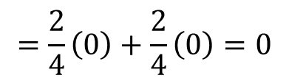
Now find information gain of Competition and type
Greater value (attribute) will be below Mid
Competition
 | Pi | Ni | I (Pi , Ni)
Yes | 0 | 2
No | 2 | 0
I (Pi , Ni) = 0
I (Pi , Ni) = 0
(Yes)
(No)
Entropy (Competition)
$$=\frac{2}{4}\left(0\right)+\frac{2}{4}\left(0\right)=0$$
Gain = Entropy Class – Entropy (Competition)
= 1-0
= 1

Slide 19
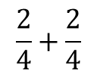
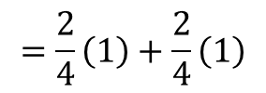



Gain of Type
Type
 | Pi | Ni | I (PI , Ni)
Software | 1 | 1
Hardware | 1 | 1
Entropy (Software) = 1
Entropy (Hardware) = 1
Entrophy (Type)
$$=\frac{2}{4}\left(1\right)+\frac{2}{4}\left(1\right)$$
$$⇒$$
$$\frac{2}{4}+\frac{2}{4}$$
$$⇒$$
$$1$$
Gain = Entropy Class – Entropy (Type)
= 1-1
= 0

Slide 20
Age
old
new
mid
Down
Up
Competition
Yes
No
Down
Up

Slide 21
Thank You

