Slide 1
Digital Logic Design
0
Lecture#1
Instructor: Nasir Ali
Slides Courtesy: Mr. Syed Usman Lecturer

Slide 2
Grading Policy
1
Assignments/ Projects (16%)
4 Assignments.
Quizzes (14%)
4 (Announced/ Unannounced) quizzes
Mid Exam (30%)
Final (40%)

Slide 3
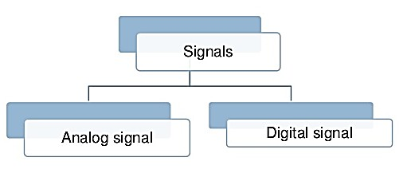
Digital Systems
2
Digital systems represent information using a binary system, where data can assume one of only two possible values:
zero or one.
Appropriate for implementation in electronic circuitry, where values are characterized by the absence/presence of an electrical current flow.

Slide 4
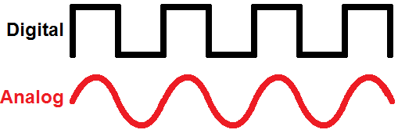
Analog signals
3
These are usually older electronic gadgets (introduced before the mid 1990’s).
A good example of an analog signal is the loud-speaker of a stereo system. When the volume is turned up the sound increases slowly and constantly.
Examples of analog systems include; Old radios, megaphones and the volume control on old telephone hand sets.

Slide 5
Digital signals
4
Modern electronic products such as computers and mobile phones depend on digital signals.
The signal is sent as a series of ‘on’ and ‘off’ pulses.
The signal is either present or it is not.

Slide 6
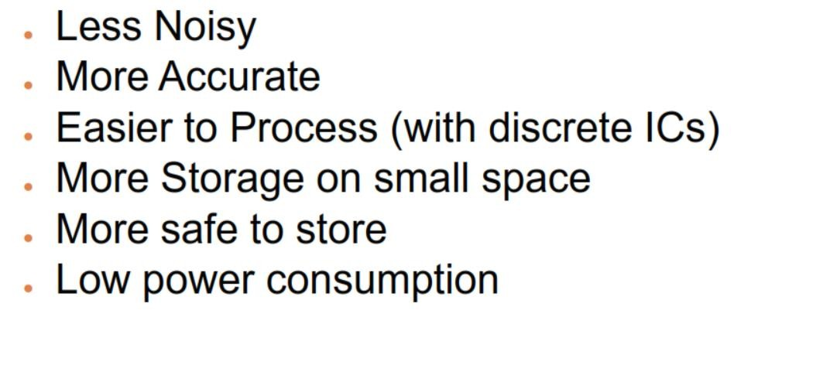
Advantages of Digital System
5

Slide 7
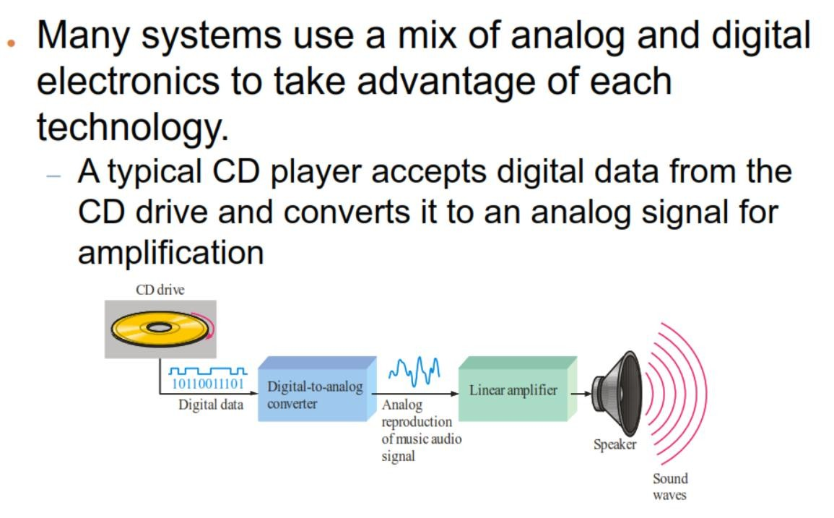
Digital to Analog Systems
6

Slide 8
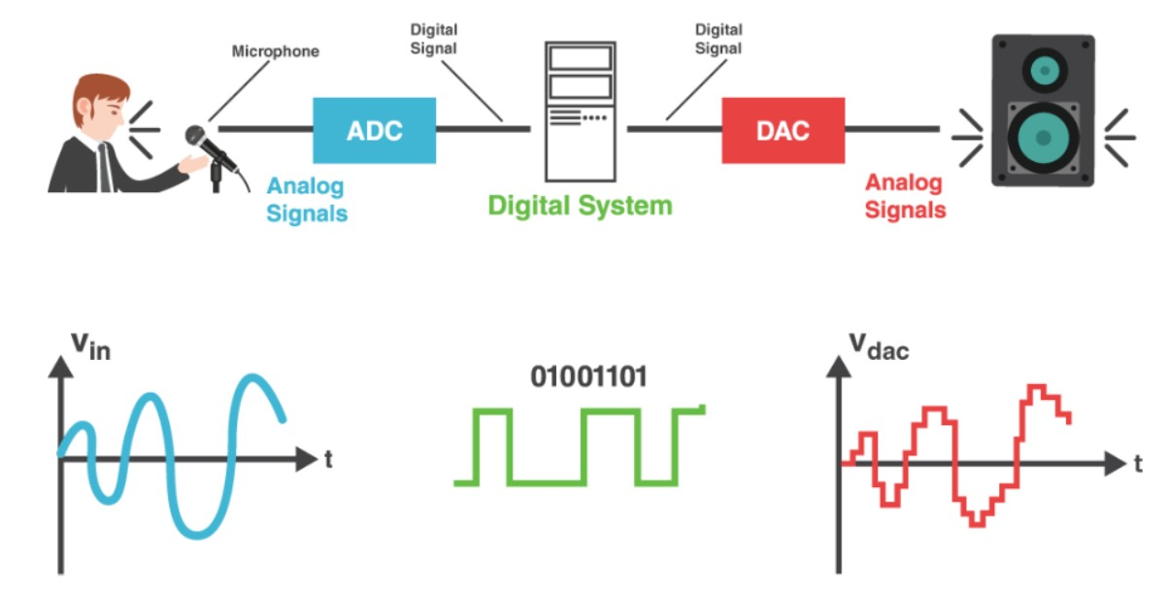
Analog to Digital Systems
7

Slide 9
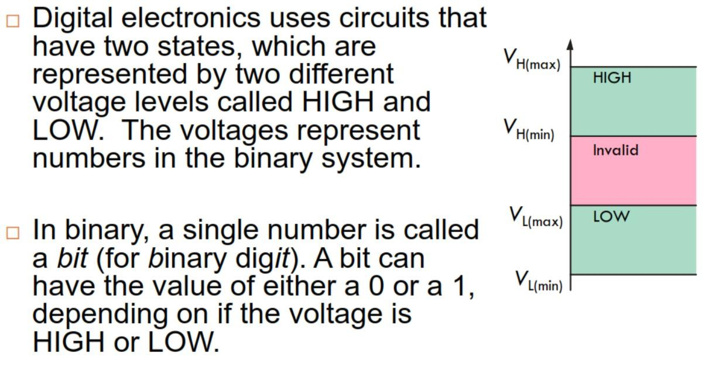
Binary Digits and Logic Levels
8

Slide 10
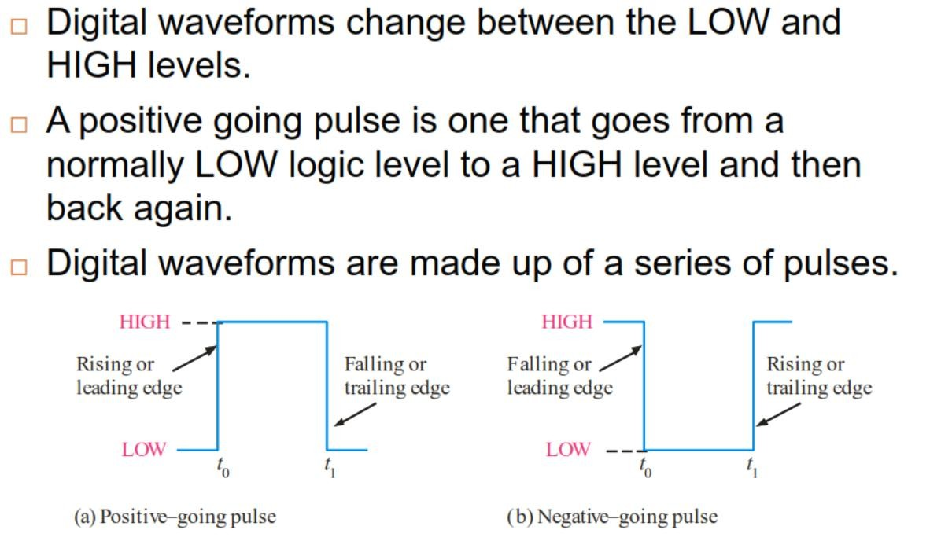
Digital Waveform
9

Slide 11
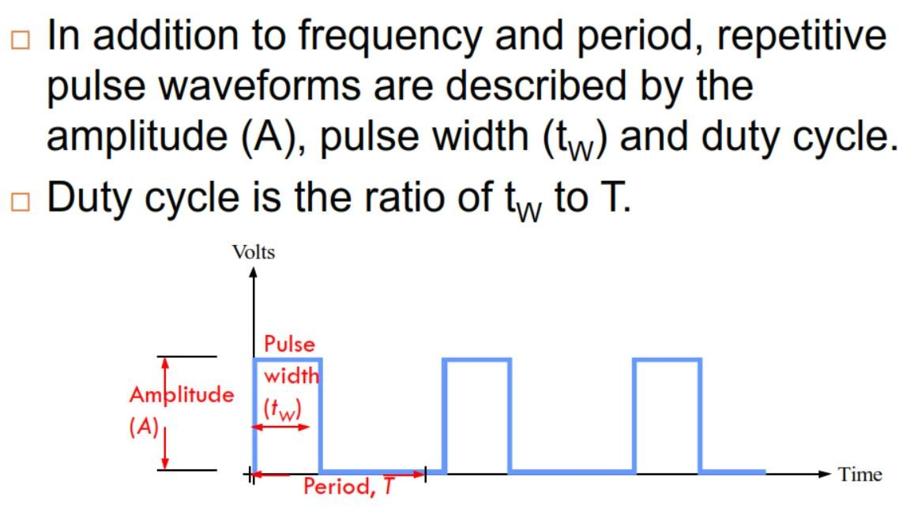
Digital Waveform (cont.)
10

Slide 12
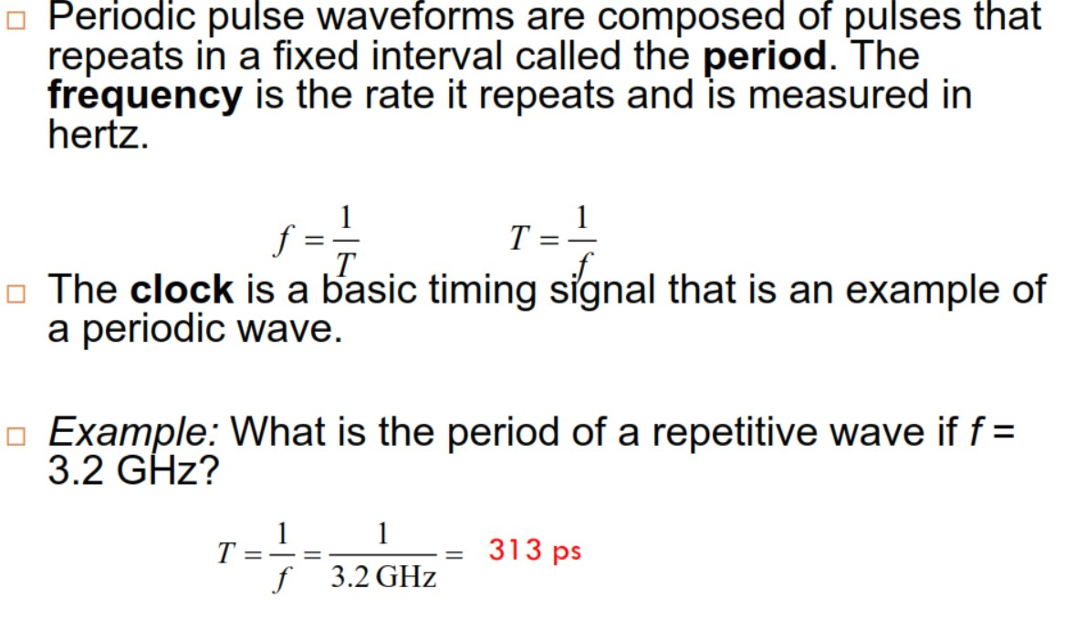
Periodic Pulse Waveforms
11

Slide 13
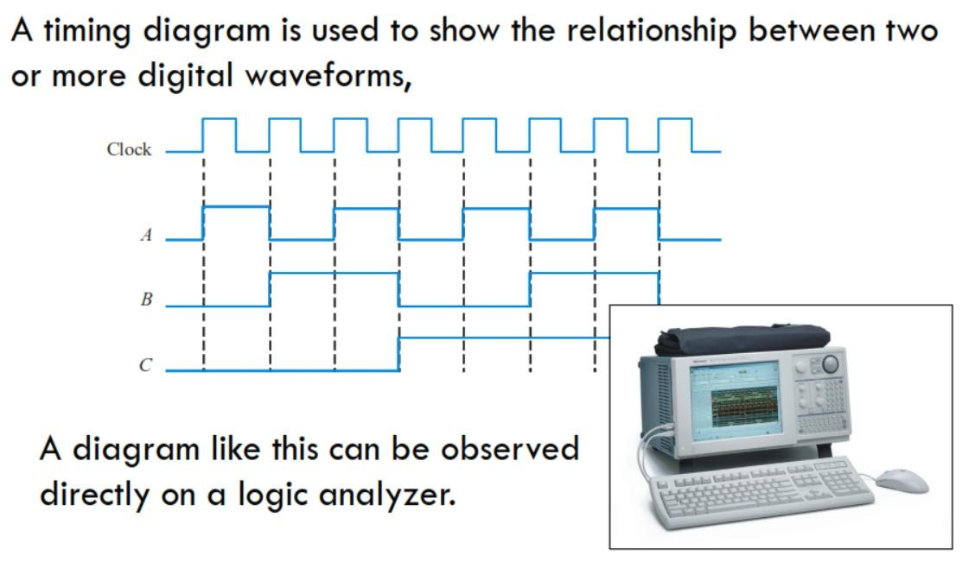
Timing Diagrams
12

Slide 14
Logic Gates
13
Digital systems are said to be constructed by using logic gates.
These gates are the AND, OR, NOT, NAND, NOR, XOR and XNOR gates.
The basic operations are described below with the aid of Truth Tables.

Slide 15
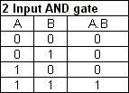

Logic Gates
14
AND gate
The AND gate is an electronic circuit that gives a high output (1) only if all its inputs are high.
A dot (.) is used to show the AND operation i.e. A.B.

Slide 16
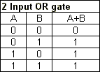

Cont.
15
OR gate
The OR gate is an electronic circuit that gives a high output
(1) if one or more of its inputs are high.
A plus (+) is used to show the OR operation.

Slide 17


Cont.
16
NOT gate
The NOT gate is an electronic circuit that produces an inverted version of the input at its output.
It is also known as an inverter.

Slide 18
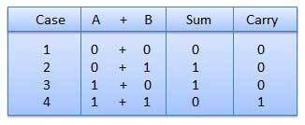
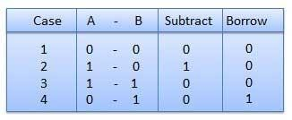
Binary Arithmetic Operations
17
Binary Addition
It is a key for binary subtraction, multiplication, division.
Binary Subtraction
Subtraction and Borrow, these two words will be used very frequently for the binary subtraction.

Slide 19
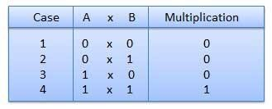
Binary Multiplication
18
Binary multiplication is similar to decimal multiplication.
It is simpler than decimal multiplication because only 0s and 1s are involved.

Slide 20
Number System
19
Binary Number System
Octal Number System
Decimal Number System
Hexa-Decimal Number System

Slide 21

20 Binary Number System
Binary numbers uses only 0 and 1 digits.
Example:

Slide 22

Octal Number System
21
Octal numbers uses digits from 0 to 7.
Example:

Slide 23

Decimal Number System
22
Decimal numbers uses digits from 0 to 9.
Example:

Slide 24

Hexadecimal Numbers
23
Hex numbers uses digits from 0 to 9 and A to F.
Example:

Slide 25
Number System Conversion Table
24
DecimalBase- 10 | BinaryBase-2 | OctalBase-8 | HexadecimalBas e-16
0 | 0 | 0 | 0
1 | 1 | 1 | 1
2 | 10 | 2 | 2
3 | 11 | 3 | 3
4 | 100 | 4 | 4
5 | 101 | 5 | 5
6 | 110 | 6 | 6
7 | 111 | 7 | 7
8 | 1000 | 10 | 8
9 | 1001 | 11 | 9
10 | 1010 | 12 | A
11 | 1011 | 13 | B
12 | 1100 | 14 | C
13 | 1101 | 15 | D
14 | 1110 | 16 | E
15 | 1111 | 17 | F

Slide 26
Decimal to Other Base System
25
Step 1 − Divide the decimal number to be converted by the value of
the new base.
Step 2 − Get the remainder from Step 1 as the rightmost digit (least significant digit) of new base number.
Step 3 − Divide the quotient of the previous divide by the new base.
Step 4 − Record the remainder from Step 3 as the next digit (to the left) of the new base number.
Repeat Steps 3 and 4, getting remainders from right to left, until the
quotient becomes zero in Step 3.
The last remainder thus obtained will be the Most Significant Digit
(MSD) of the new base number.

Slide 27
Example
26
Decimal Number: (29)₁₀
Calculating Binary Equivalent −
Step | Operation | Result | Remainder
Step 1 | 29 / 2 | 14 | 1
Step 2 | 14 / 2 | 7 | 0
Step 3 | 7 / 2 | 3 | 1
Step 4 | 3 / 2 | 1 | 1
Step 5 | 1 / 2 | 0 | 1

Slide 28
Cont.
27
As mentioned in Steps 2 and 4, the remainders have to be arranged in the reverse order so that the first remainder becomes the Least Significant Digit (LSD) and the last remainder becomes the Most Significant Digit (MSD).
Decimal Number − (29)₁₀ = Binary Number − (11101)₂.

Slide 29
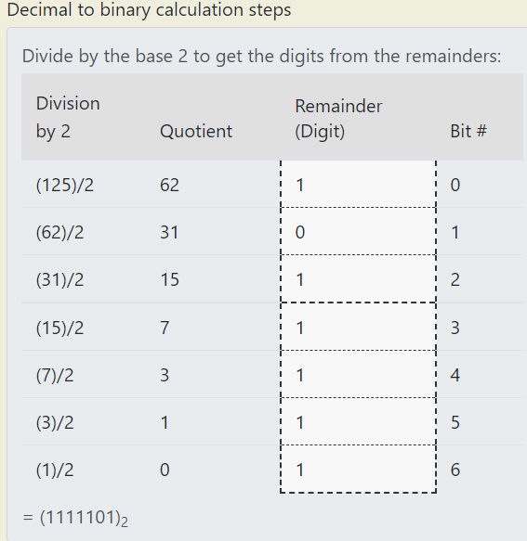
Example 2
28

Slide 30
Class Task
29
Decimal Number: (22)₁₀

Slide 31
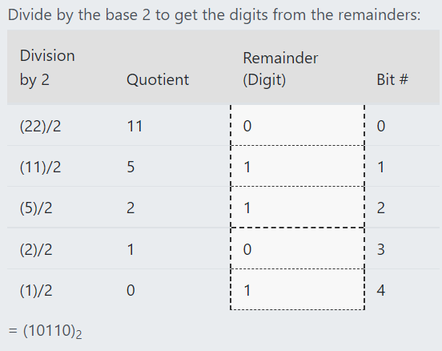
Class Task Solution
30

Slide 32
Binary to Decimal
31
Binary Number − 11101₂ Calculating Decimal Equivalent −
Step | Binary Number | Decimal Number
Step 1 | 11101 | ((1 × 2⁴) + (1 × 2³) + (1 × 2²) + (0 × 2¹) + (1 × 2⁰))
Step 2 | 11101 | (16 + 8 + 4 + 0 + 1)
Step 3 | 11101 | 29
Binary Number − (11101)₂ = Decimal Number − (29)₁₀

Slide 33
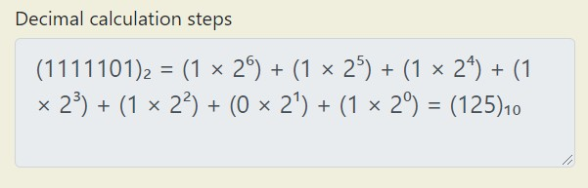
Example 2
32
Binary Number − (1111101)₂.

Slide 34
Class Task
33
Binary Number − (110101)₂.

Slide 35
Class Task Solution
34

Slide 36
Octal to Binary
35
Octal Number − (25)₈
Step 1 − Convert to Decimal
Step | Octal Number | Decimal Number
Step 1 | 25 | ((2 × 8¹) + (5 × 8⁰))
Step 2 | 25 | (16 + 5 )
Step 3 | 25 | 21
Octal Number − (25)₈ = Decimal Number − (21)₁₀

Slide 37
Octal to Binary (Cont.)
36
Step 2 − Convert Decimal to Binary
Decimal Number (21)₁₀ = Binary Number − (10101)₂
Step | Operation | Result | Remainder
Step 1 | 21 / 2 | 10 | 1
Step 2 | 10 / 2 | 5 | 0
Step 3 | 5 / 2 | 2 | 1
Step 4 | 2 / 2 | 1 | 0
Step 5 | 1 / 2 | 0 | 1
Octal Number (25)₈ = Binary Number (10101)₂

Slide 38
Direct Method: Binary to Octal
37
Step 1 − Divide the binary digits into groups of three (starting from the right).
Step 2 − Convert each group of three binary digits to one octal digit.
Example
Binary Number − (10101)₂ Calculating Octal Equivalent
Step | Binary Number | Octal Number
Step 1 | 10101 | 010 101
Step 2 | 10101 | 2 5
Step 3 | 10101 | 25
Binary Number (10101)₂ = Octal Number (25)₈

Slide 39
Direct Method: Octal to Binary
38
Step 1 − Convert each octal digit to a 3 digit binary number.
Step 2 − Combine all the resulting binary groups (of 3 digits each) into a single binary number.
Example
Octal Number − (25)₈
Calculating Binary Equivalent −
Step | Octal Number | Binary Number
Step 1 | 25 | 2 5
Step 2 | 25 | 010 101
Step 3 | 25 | 010101
Binary Number (25)₈ = Octal Number (010101)₂

Slide 40
Direct method: Binary to Hexadecimal
39
Step 1 − Divide the binary digits into groups of four (starting from the right).
Step 2 − Convert each group of four binary digits to one hexadecimal symbol.
Example
Binary Number − (10101)₂
Step | Binary Number | Hexadecimal Number
Step 1 | 10101 | 0001 0101
Step 2 | 10101 | 1 5
Step 3 | 10101 | 15
Binary Number (10101)₂ = Hexadecimal Number (15)₁₆

Slide 41
Direct Method: Hexadecimal to Binary
40
Step 1 − Convert each hexadecimal digit to a 4 digit binary number (the hexadecimal digits may be treated as decimal for this conversion).
Step 2 − Combine all the resulting binary groups (of 4 digits each) into a single binary number.
Example: Hexadecimal Number − (15)₁₆
Calculating Binary Equivalent
Step | Hexadecimal Number | Binary Number
Step 1 | 15 | 1 5
Step 2 | 15 | 0001 0101
Step 3 | 15 | 00010101
Hexadecimal Number (15)₁₆ = Binary Number (10101)₂

Slide 42
Hexadecimal to Octal
41
When converting from hexadecimal to octal, it is often easier to first convert the hexadecimal number into binary and then from binary into octal.
For example, to convert A2DE hex into octal:
Add leading zeros or remove leading zeros to group into sets of three binary digits.
Binary: 1010001011011110 = 001 010 001 011 011 110
Then, look up each group in a table:
Hexadeci mal = | A | 2 | D | E
Binary = | 1010 | 0010 | 1101 | 1110 | = 10100010 11011110 binary

Slide 43
Cont.
42
Binary: | 000 | 001 | 010 | 011 | 100 | 101 | 110 | 111
Octal: | 0 | 1 | 2 | 3 | 4 | 5 | 6 | 7
Binary = | 001 | 010 | 001 | 011 | 011 | 110
Octal = | 1 | 2 | 1 | 3 | 3 | 6 | = 121336 octal
Through a two-step conversion process, hexadecimal A2DE
equals binary 1010001011011110 equals octal 121336.

Slide 44
Octal to Hexadecimal
43
When converting from octal to hexadecimal, it is often easier to first convert the octal number into binary and then from binary into hexadecimal.
For example, to convert 345 octal into hex:
Drop any leading zeros or pad with leading zeros to get groups of four binary digits (bits):
Binary 011100101 = 1110 0101
Then, look up the groups in a table to convert to hexadecimal
digits.
Octal = | 3 | 4 | 5
Binary = | 011 | 100 | 101 | = 011100101 binary

Slide 45
Cont.
44
Therefore, through a two-step conversion process, octal 345 equals binary 011100101 equals hexadecimal E5.
Binary: | 0000 | 0001 | 0010 | 0011 | 0100 | 0101 | 0110 | 0111
Hexad ecimal: | 0 | 1 | 2 | 3 | 4 | 5 | 6 | 7
Binary: | 1000 | 1001 | 1010 | 1011 | 1100 | 1101 | 1110 | 1111
Hexad ecimal : | 8 | 9 | A | B | C | D | E | F

Slide 46
One’s Complement
45
Take one’s complement of 1010110
1111111
-1010110
Answer ???

Slide 47
Two’s complement
46
Take two’s complement of 1010110
Answer??

