Slide 1
Subsumption relationships between pairs of concept, role and attribute expressions are defined in terms of subset relationships between their interpretations.
Like the subset relation, subsumption is transitive, reflexive and antisymmetric, and is therefore a partial ordering relation.
Classification is the computation of the partial ordering based on the subsumption relation
The concept hierarchy can be used to provide rapid answers to queries regarding classified concepts and to minimize the number of subsumption tests required to classify a new concept

Slide 2
Consistency, which means that no theorem of the system contradicts another.
Soundness, which means that the system's rules of proof will never allow a false inference from a true premise. If a system is sound and its axioms are true then its theorems are also guaranteed to be true.
Completeness, which means that there are no true sentences in the system that cannot, at least in principle, be proved in the system.
Entailment is the relationship between two sentences where the truth of one (A) requires the truth of the other (B)
A formula is Satisfiability with respect to a class of interpretations if it is possible to find an interpretation that makes the formula true

Slide 3
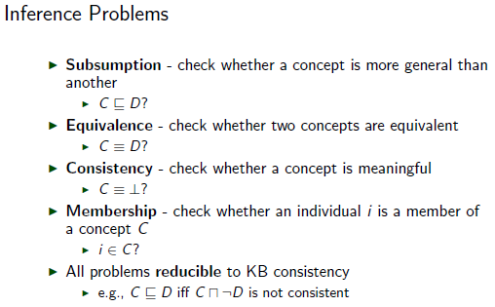

Slide 4
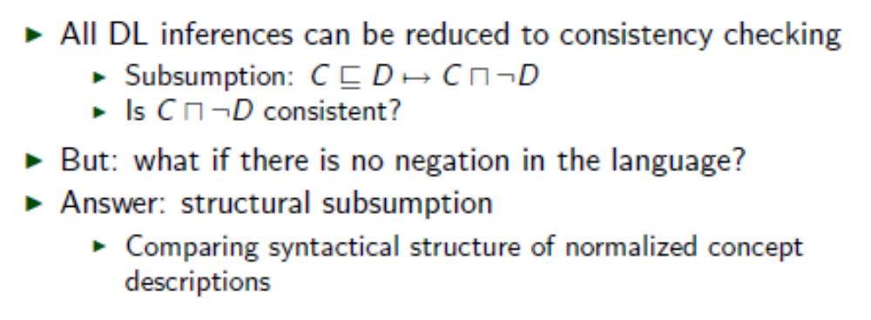
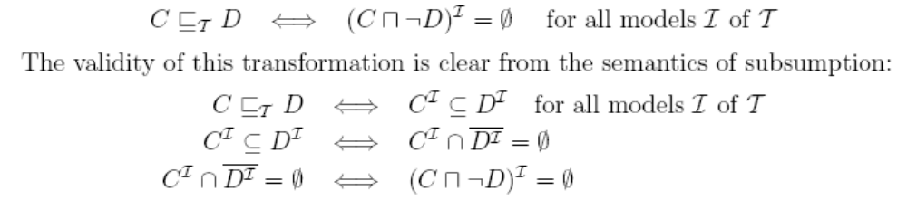
DL Inferences

Slide 5
Structural Subsumption
Normalize descriptions
Compare syntactical structure of normal forms

Slide 6
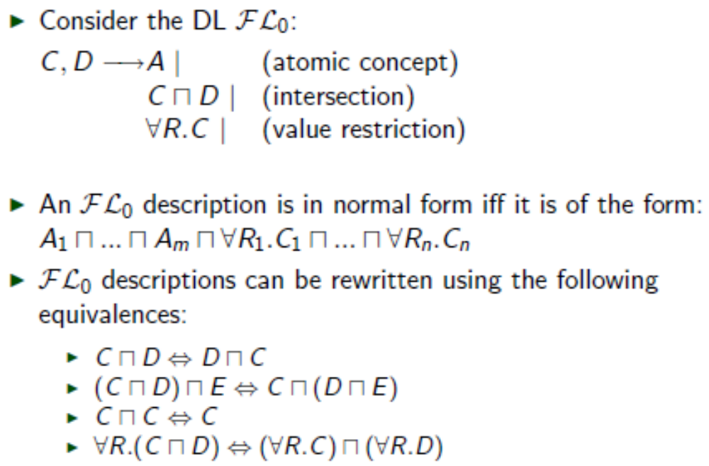
Structural Subsumption

Slide 7
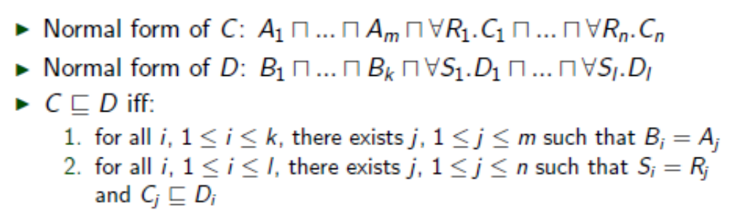
Structural Subsumption

Slide 8
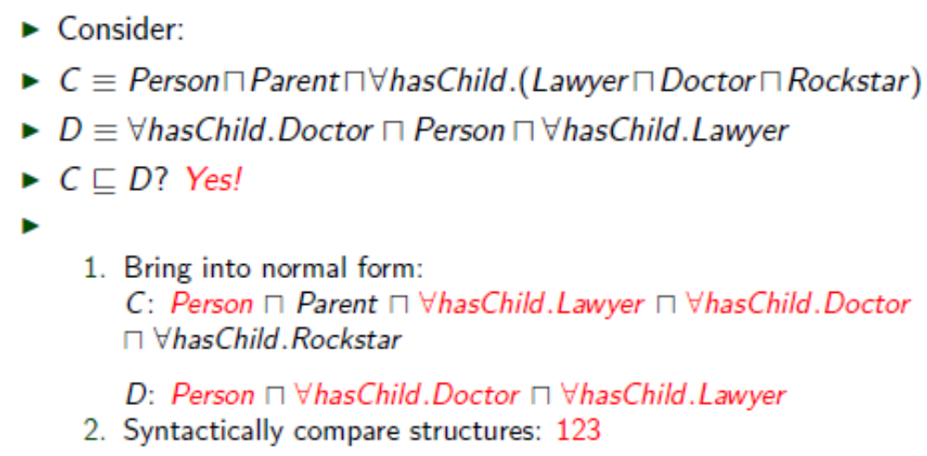
Example: Structural Subsumption

Slide 9
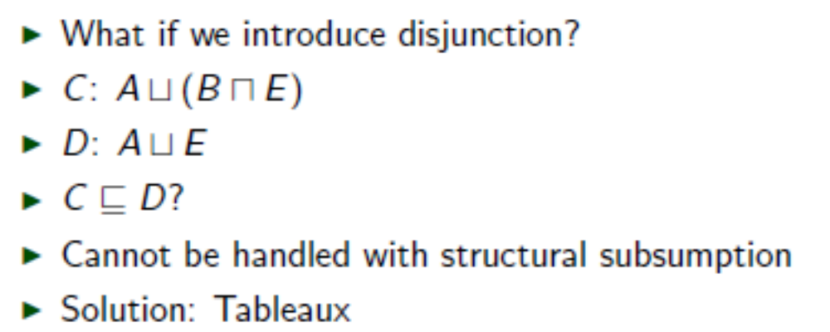
More expressive DLs

Slide 10
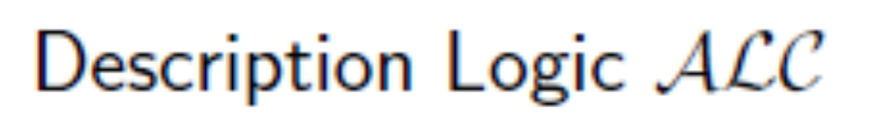
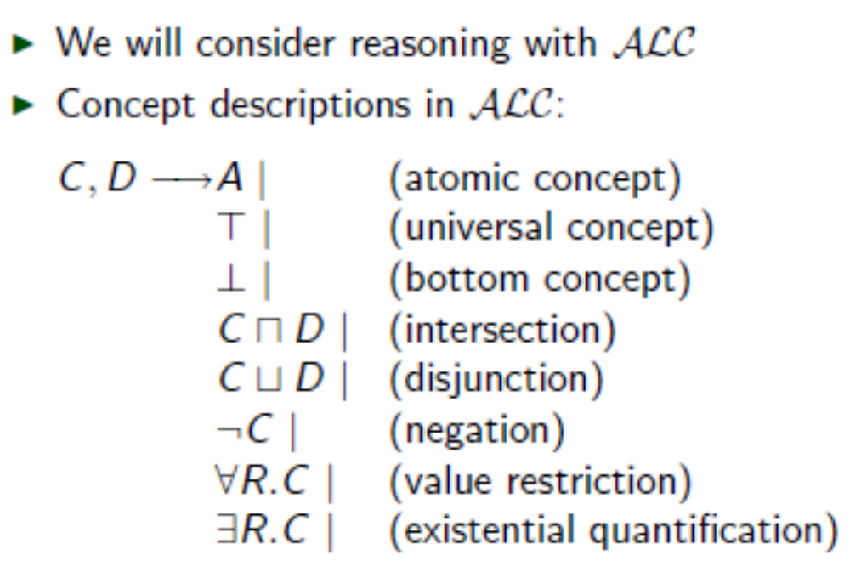

Slide 11
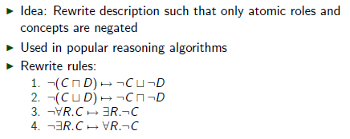
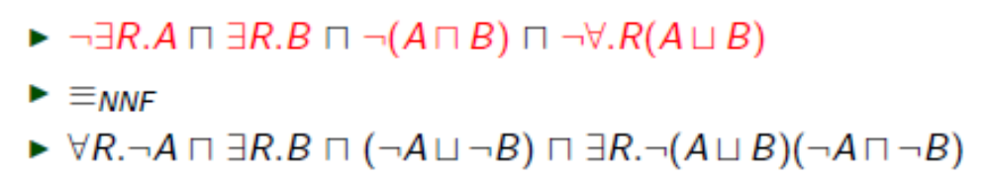
Negation Normal Form (NNF)
Example

Slide 12
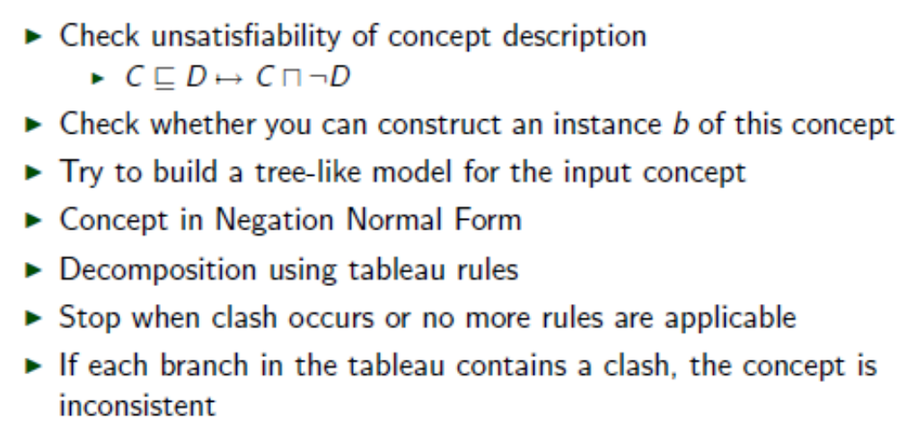
Tableau Inferencing

Slide 13
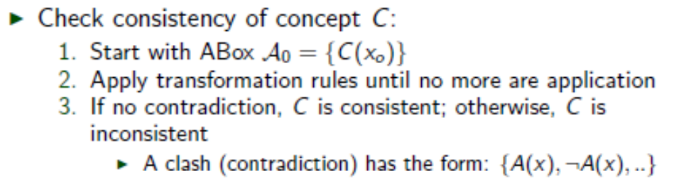
Tableau

Slide 14
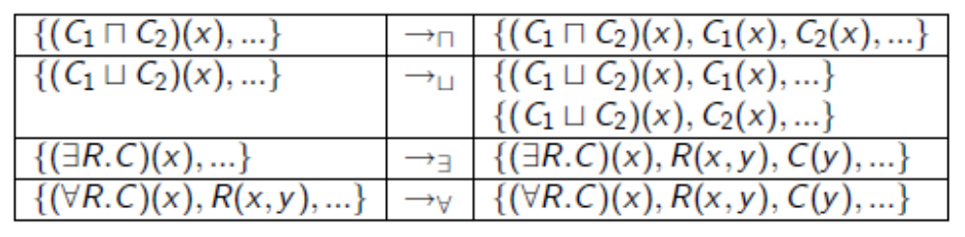
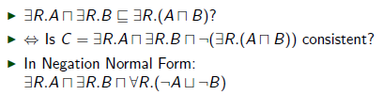
Transformation rules
Example

Slide 15
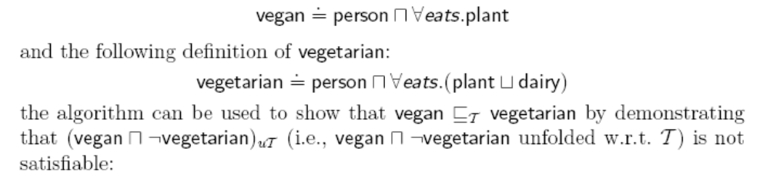

Slide 16
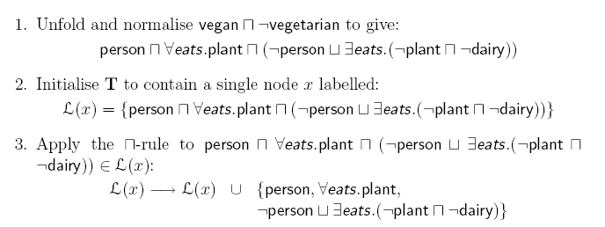

Slide 17
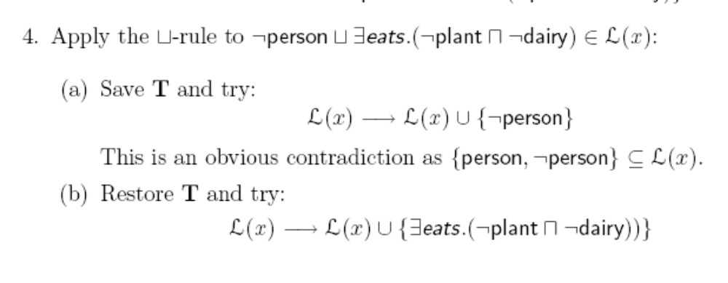

Slide 18
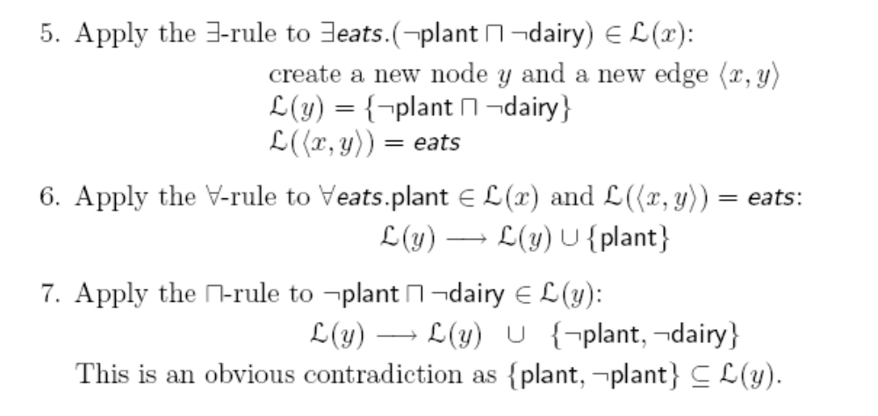


Slide 19
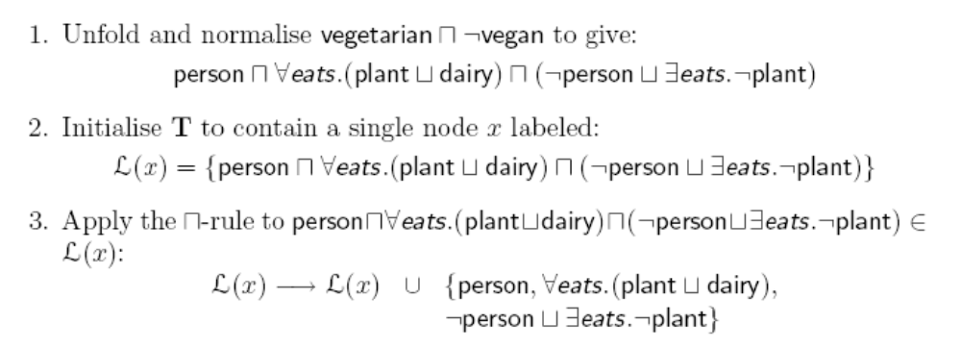

Slide 20
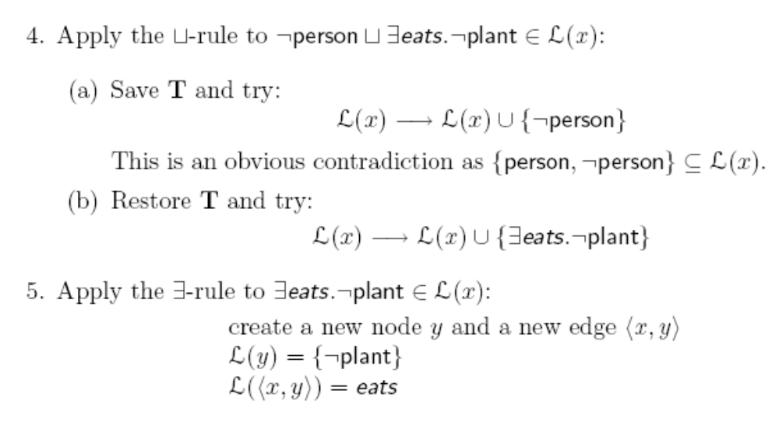

Slide 21
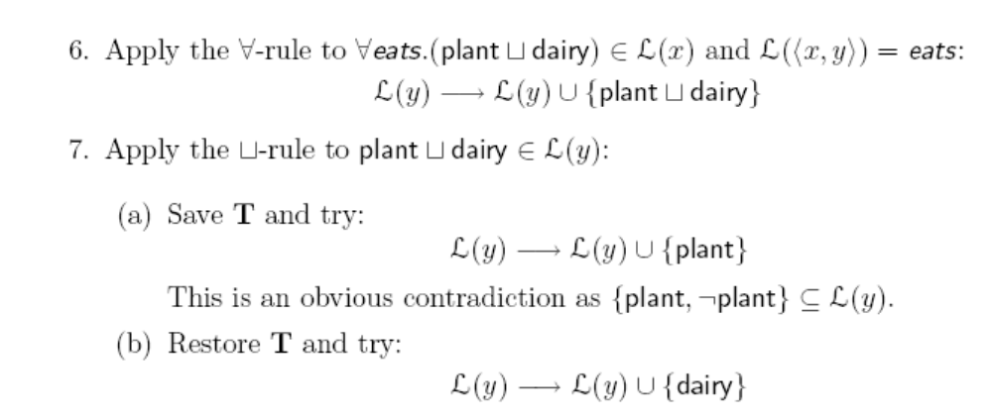

Slide 22
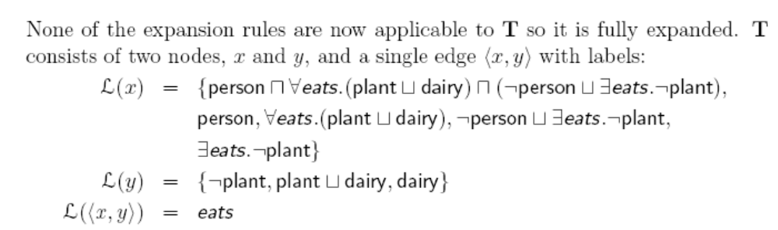
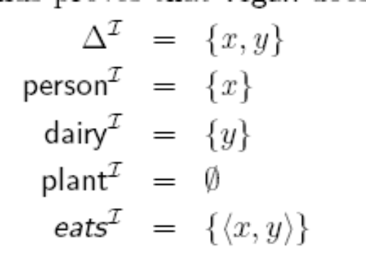

Slide 23
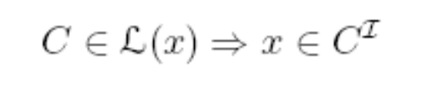
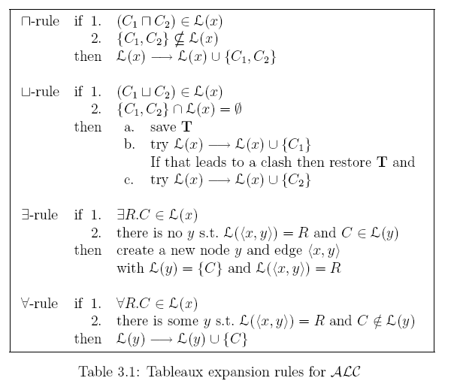

Slide 24
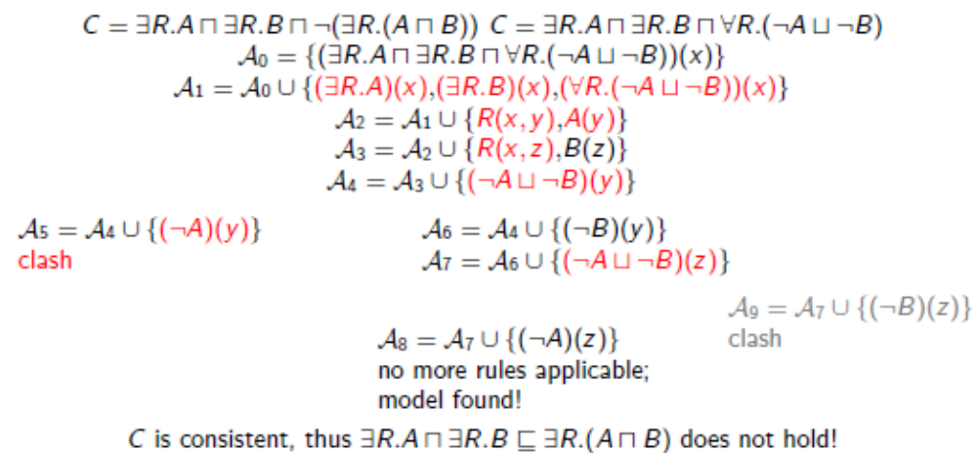
Example - Tableau Proof

Slide 25
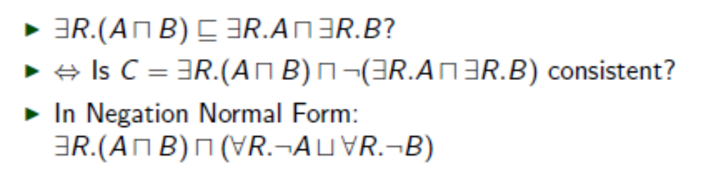
Another Example

Slide 26
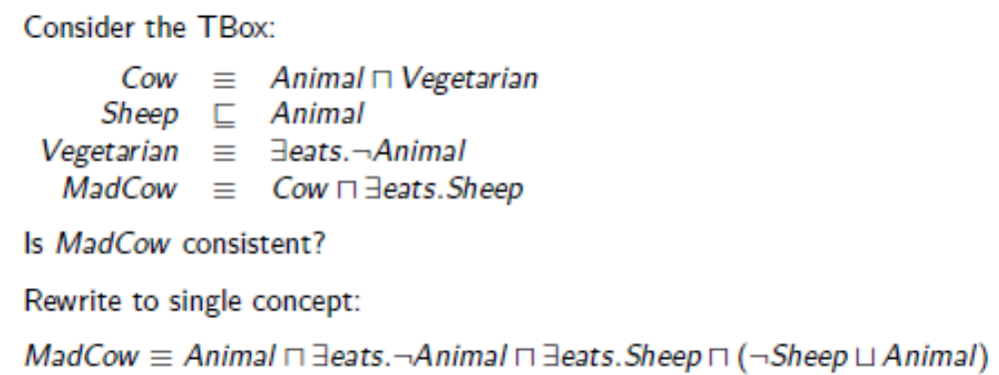
Mad Cow Example

Slide 27
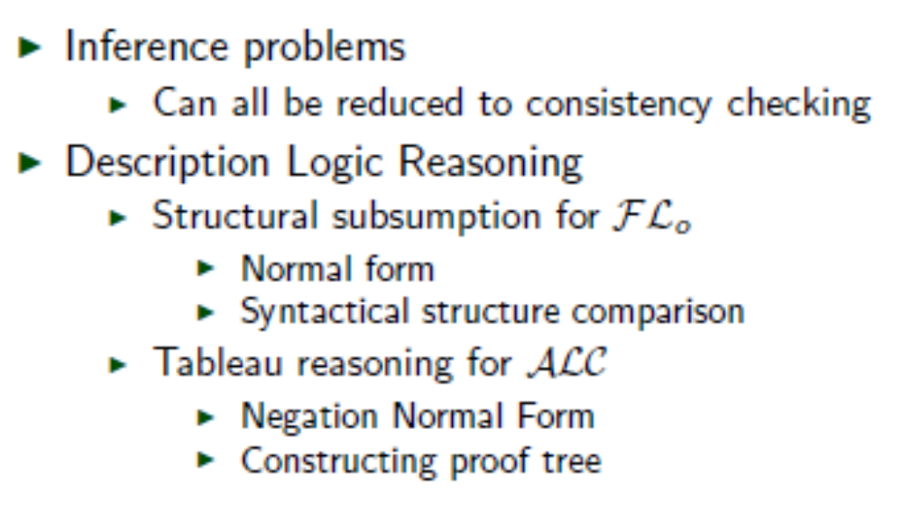
Summary

Slide 28
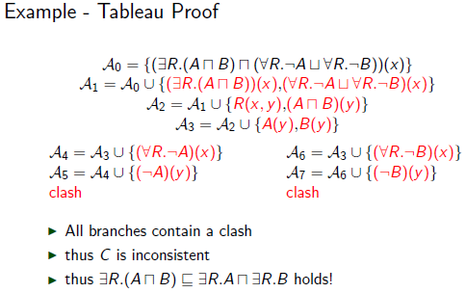

Slide 29
Reasoning 2
part4b-tableaux

Slide 30
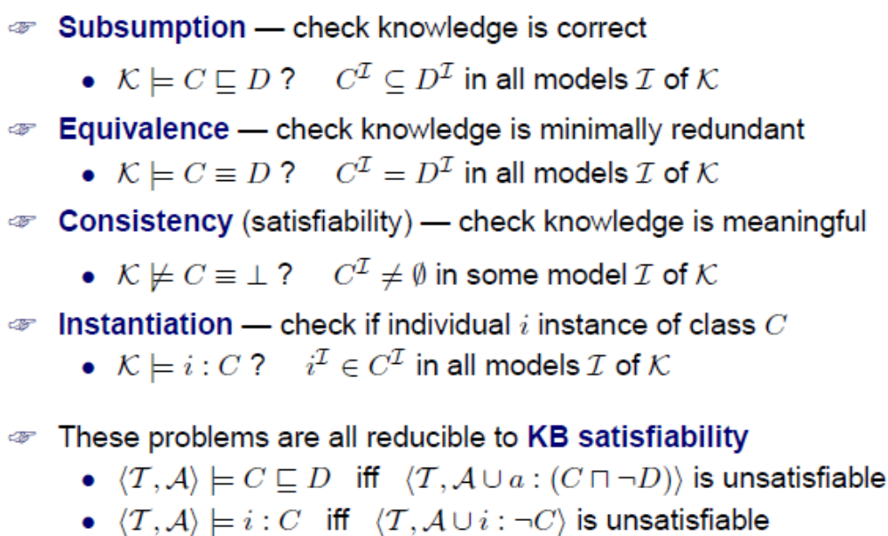
Basic Inference Problems

Slide 31
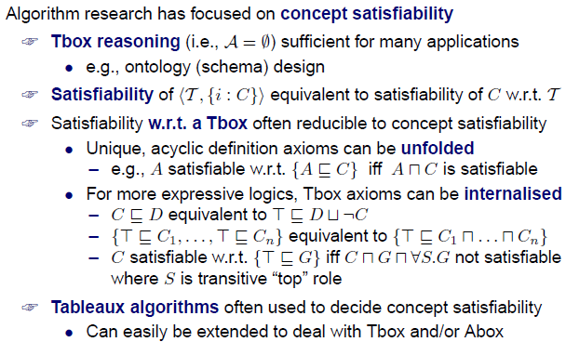
Concept Satisfiability Problem

Slide 32
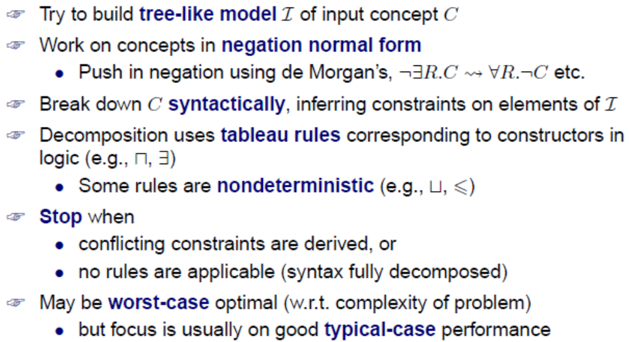
Tableaux Algorithms — Basics

Slide 33
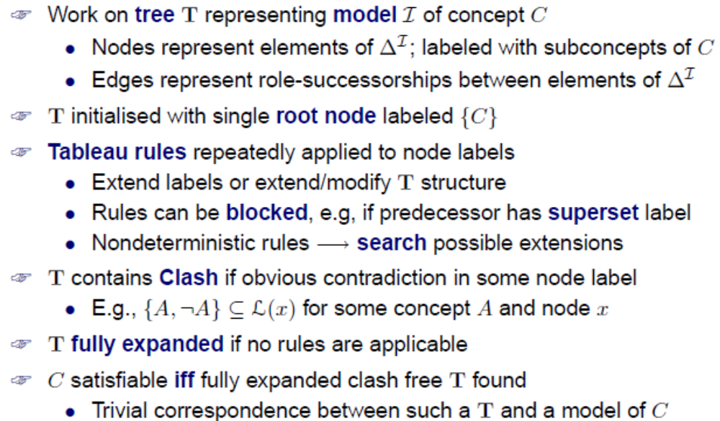
Tableaux Algorithms — Details

Slide 34
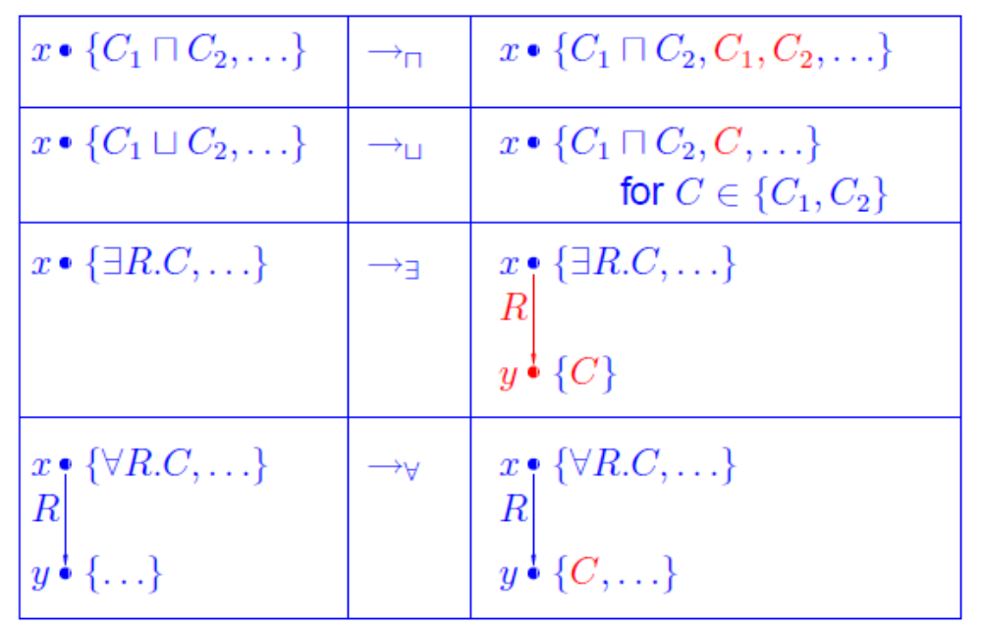
Tableaux Rules for ALC

Slide 35
