Slide 1
Description Logics: Syntax
Knowledge Based / Intelligent Systems

Slide 2
Intelligent Systems
“intelligent” refers to the ability of a system to find implicit consequences of its explicitly represented knowledge.

Slide 3
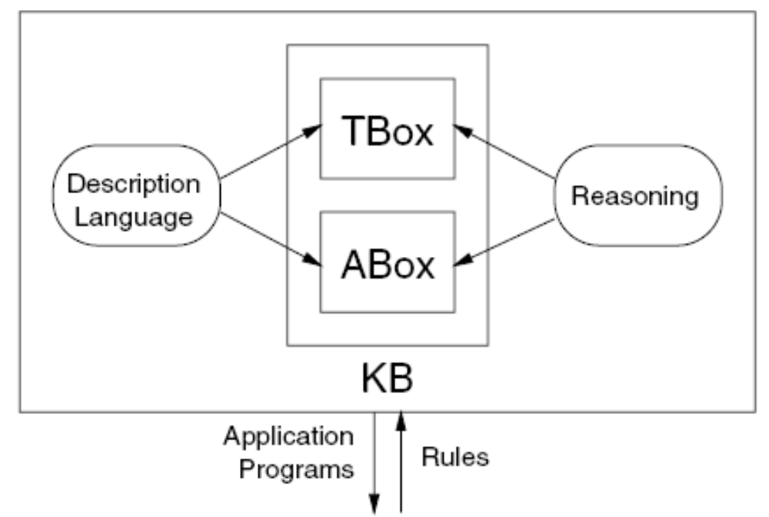
Architecture of a knowledge representation system based on Description Logics

Slide 4
The TBox introduces the terminology, i.e., the vocabulary of an application domain
The vocabulary consists of concepts, which denote sets of individuals, and
roles, which denote binary relationships between individuals.
In addition to atomic concepts and roles (concept and role names), all DL systems allow their users to build complex descriptions of concepts and roles.
The TBox can be used to assign names to complex descriptions
the ABox contains assertions about named individuals in terms of this vocabulary

Slide 5
A DL system not only stores terminologies and assertions, but also offers services that reason about them.
Typical reasoning tasks for a terminology are to determine whether a description is satisfiable (i.e., non-contradictory), or
Whether one description is more general than another one, that is, whether the first subsumes the second.

Slide 6
Important problems for an ABox are to find out whether its set of assertions is consistent, that is, whether it has a model, and whether the assertions in the ABox entail that a particular individual is an instance of a given concept description
Satisfiability checks of descriptions and consistency checks of sets of assertions are useful to determine whether a knowledge base is meaningful at all
With subsumption tests, one can organize the concepts of a terminology into a hierarchy according to their generality
A concept description can also be conceived as a query, describing a set of objects one is interested in. Thus, with instance tests, one can retrieve the individuals that satisfy the query.

Slide 7
atomic concepts and atomic roles.
concept constructors.
we use the letters A and B for atomic concepts, the letter R for atomic roles, and the letters C and D for concept descriptions.

Slide 8
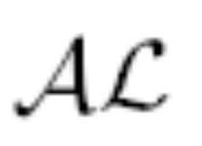
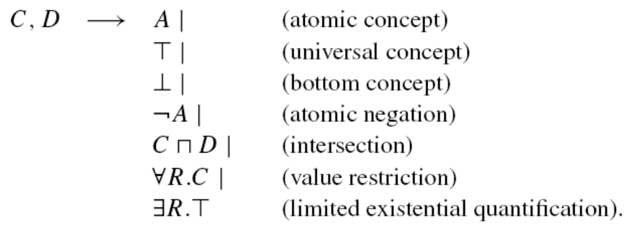
The basic description language

Slide 9

we suppose that Person and Female are atomic concepts
those persons that are female, and those that are not female
suppose that hasChild is an atomic role,
denoting those persons that have a child, and those persons all of whose children are female.
A person without a child

Slide 10
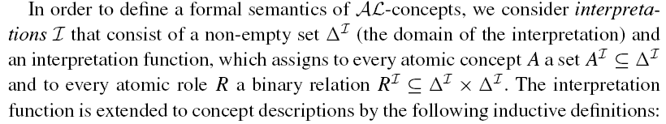
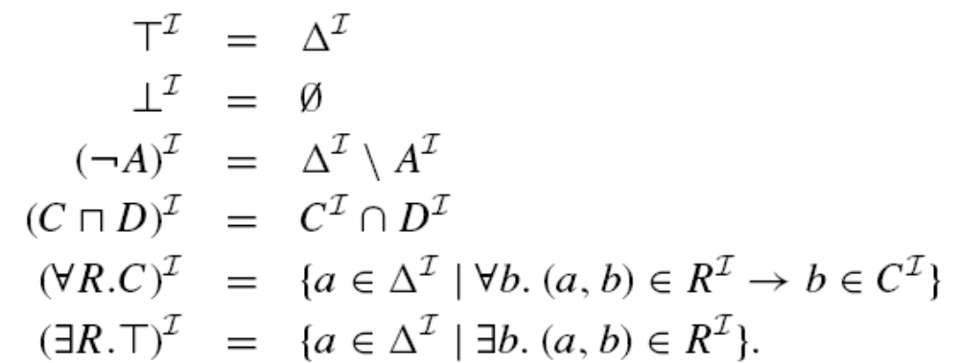

Slide 11
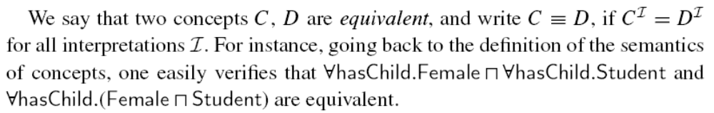
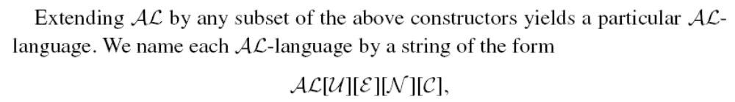
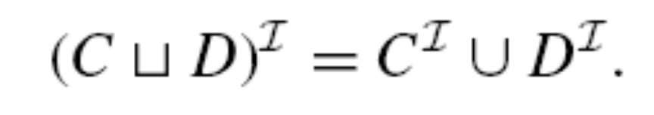
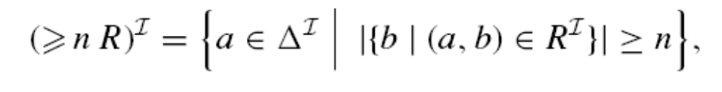
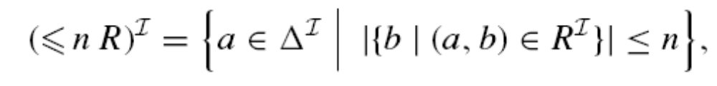
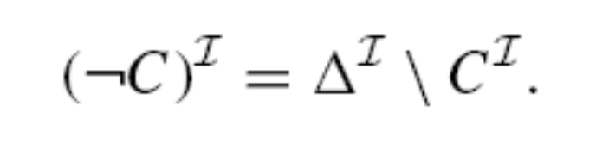

Slide 12
With the additional constructors, we can, for example, describe those persons that have either not more than one child or at least three children, one of whom is female:

Slide 13
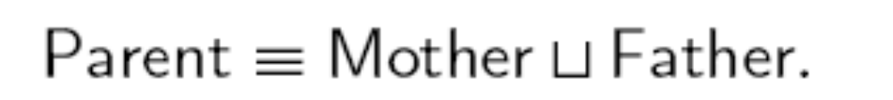
terminological axioms have the form
where C, D are concepts (and R, S are roles).
Axioms of the first kind are called inclusions,
while axioms of the second kind are called equalities.
An equality whose left-hand side is an atomic concept is a definition.

Slide 14
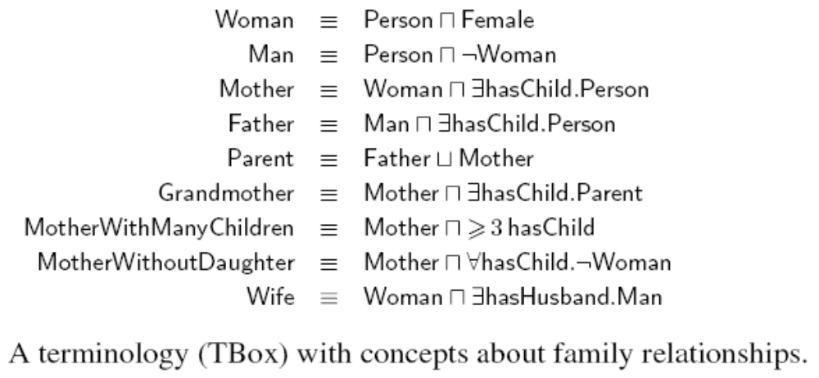

Slide 15
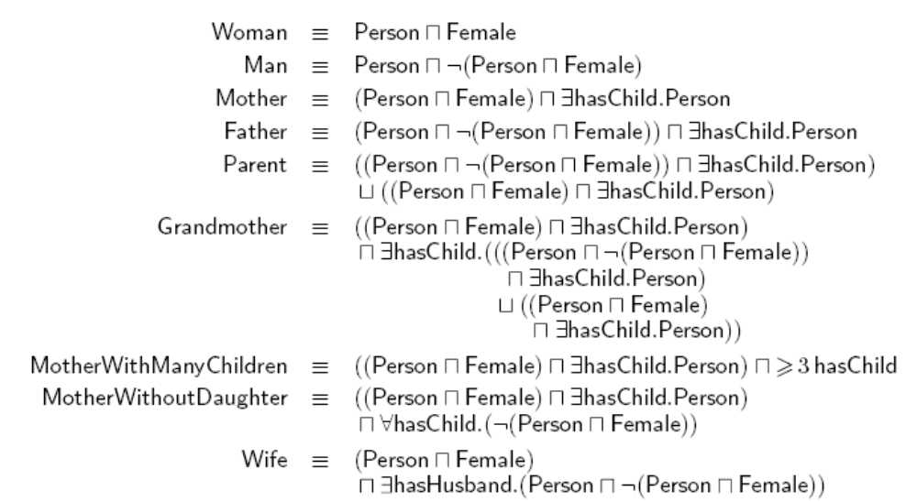
The expansion of the Family TBox in the previous slide

Slide 16
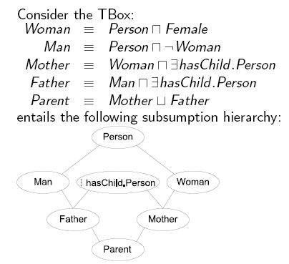

Slide 17
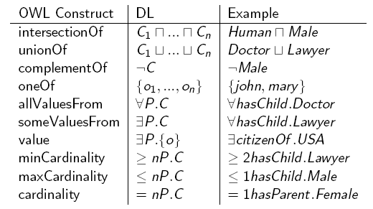

Slide 18
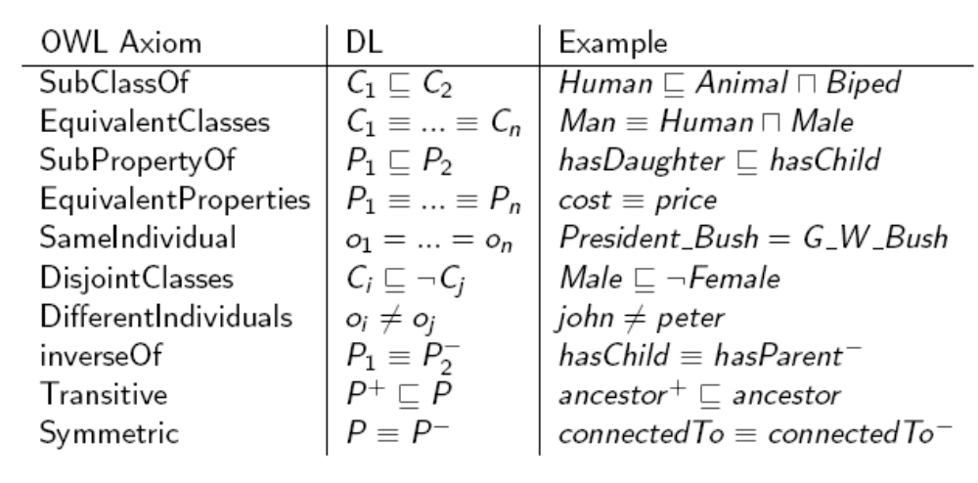

Slide 19
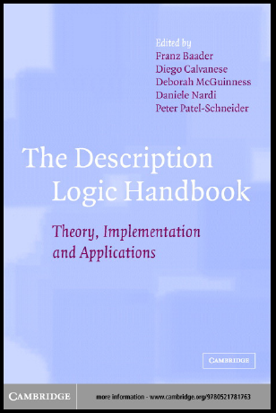

Slide 20
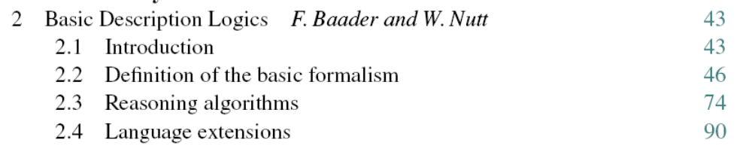
Chapter 2
Carefully Read and Understand

