Slide 1
Description Logic
From Propositional logic to FOL to DL

Slide 2
Next Lecture
Lecture 7

Slide 3

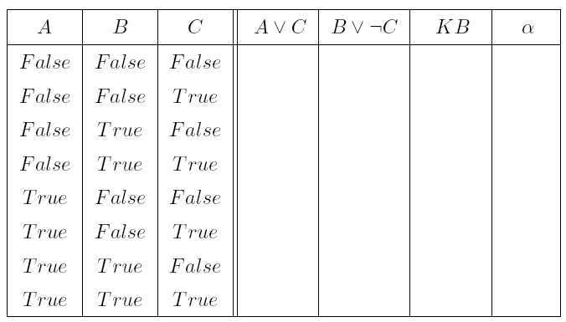
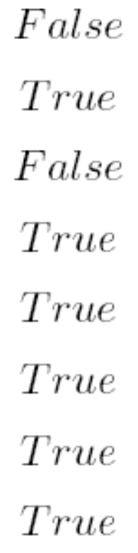
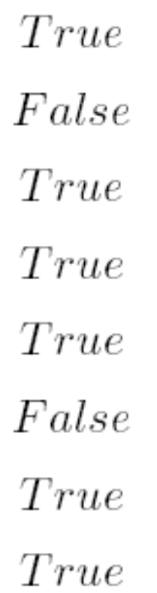
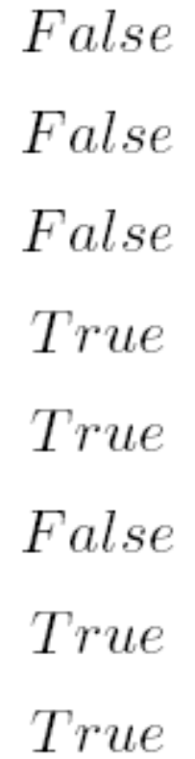
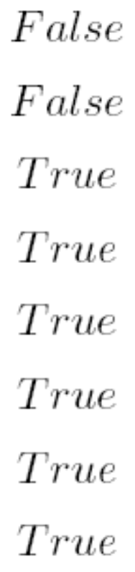

Slide 4
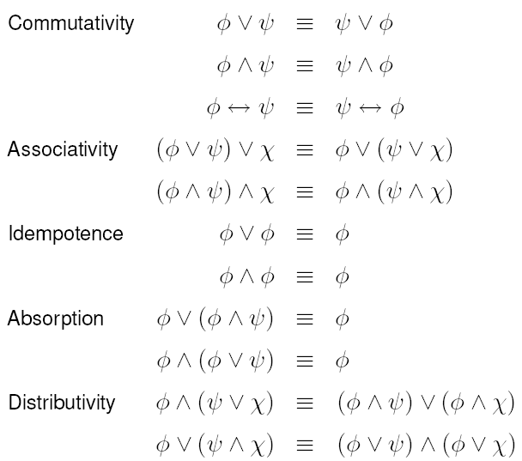
Equivalences (I)

Slide 5
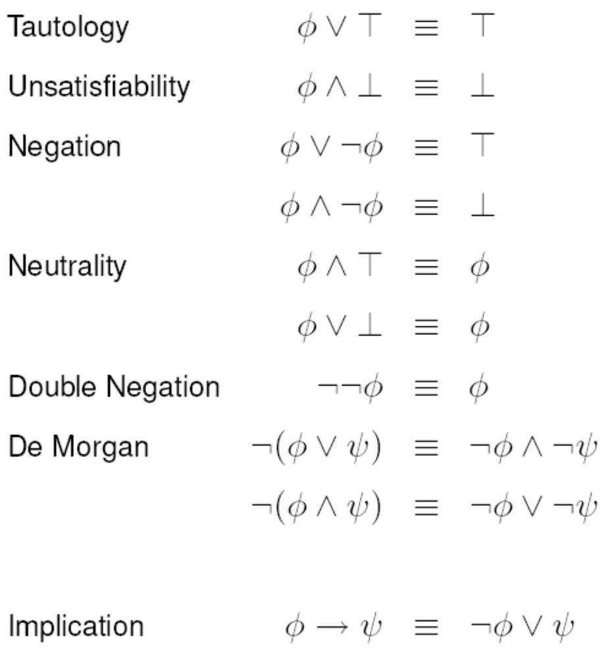
Equivalences (II)

Slide 6
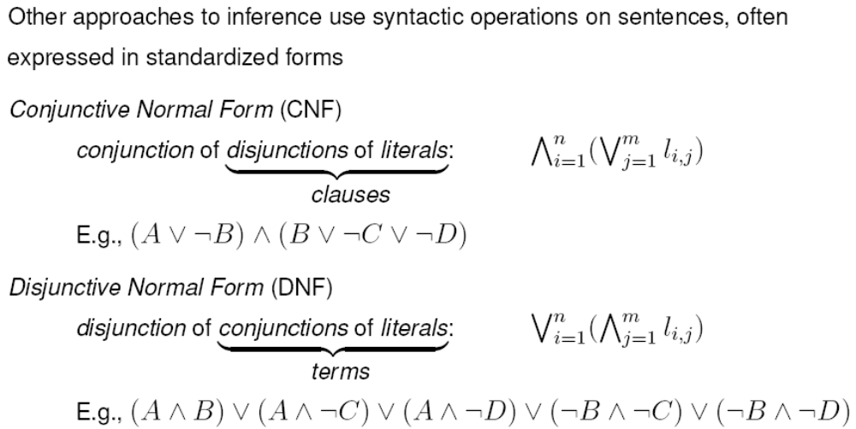
Normal Forms

Slide 7
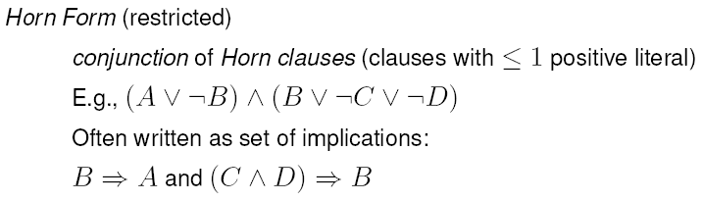
Normal Forms…
Theorem For every formula, there exists an equivalent formula in CNF and one in DNF.

Slide 8
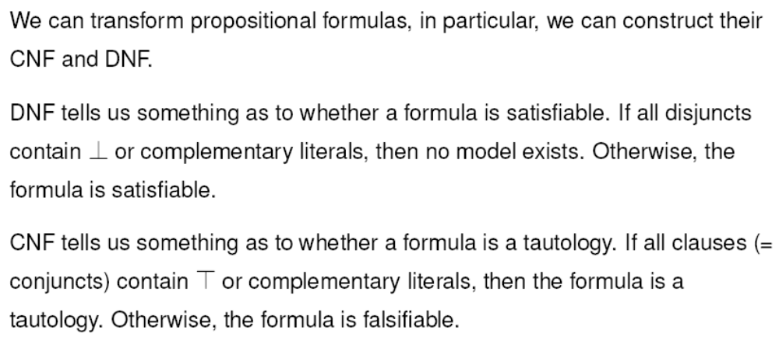
Why Normal Forms?
But,
the transformation into DNF or CNF is expensive (in time/space)
it is only possible for finite sets of formulas

Slide 9
Deduction in Propositional Logic

Slide 10
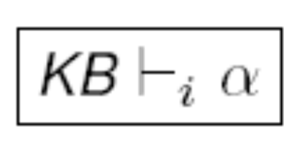


Decision Procedures in Logic
A decision procedure solves a problem with YES or NO answers
Sentence can be derived from the set of sentences KB by procedure i.
Soundness: procedure i is sound if
  whenever procedure i proves that a sentence can be derived from a set of sentences in KB, then it is also true that KB entails

Slide 11
Soundness….
no wrong inferences are drawn.
A sound procedure may fail to find the solution in some cases, when there is actually one.

Slide 12



Completeness: procedure i is complete if
whenever a set of sentences KB entails a sentence then procedure i proves that can be derived from KB
  All the correct inferences are drawn.
  A complete procedure may claim to have found a solution in some cases, when there is actually no solution.

Slide 13
Propositional Decision Procedures
Truth tables provide a sound and complete decision procedure for testing Satisfiability, validity, and entailment in propositional logic.
  The proof is based on the observation that truth tables enumerate all possible models.
Satisfiability, validity, and entailment in propositional logic are thus decidable problems.
For problems involving a large number of atomic propositions the amount of calculation required by using truth tables may be prohibitive (always 2^{n}, where n is the number of atomic proposition involved in the formulas).

Slide 14
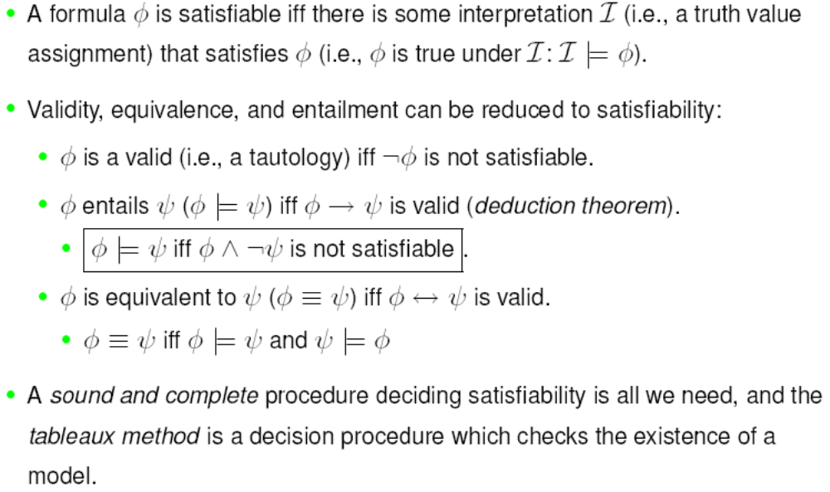
Reduction to Satisfiability

Slide 15
Tableaux Calculus
The Tableaux Calculus is a decision procedure solving the problem of Satisfiability.
If a formula is Satisfiability, the procedure will constructively exhibit a model of the formula.
The basic idea is to incrementally build the model by looking at the formula, by decomposing it in a top/down fashion.
The procedure exhaustively looks at all the possibilities, so that it can eventually prove that no model could be found for unsatisfiable formulas.

Slide 16
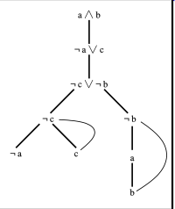
A partial tableaux

Slide 17
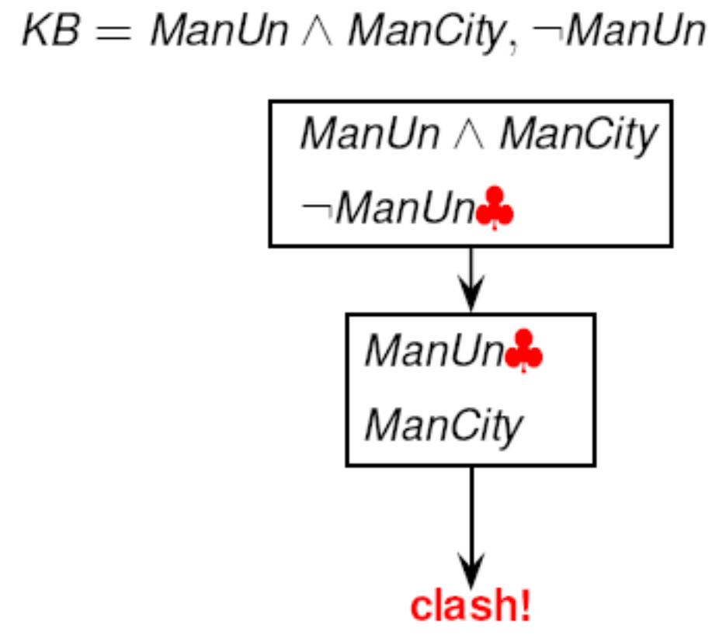
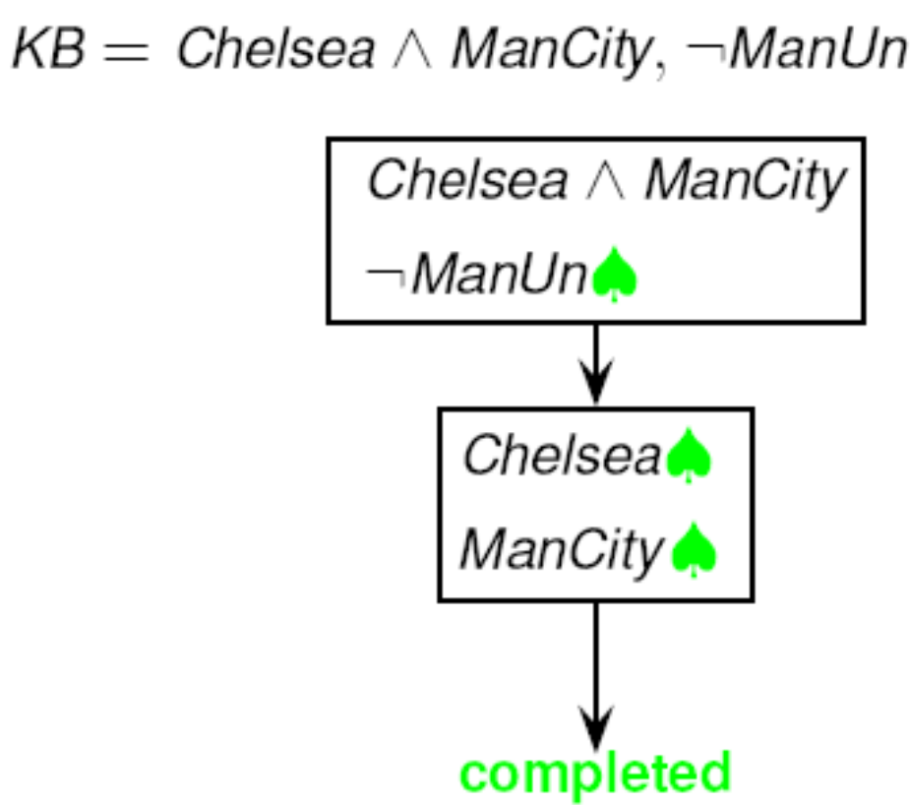
Simple examples

Slide 18

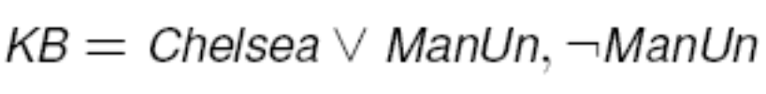
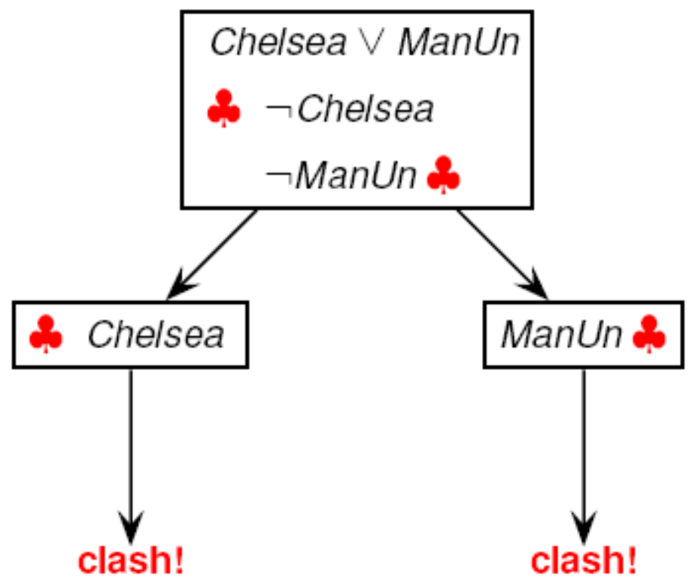
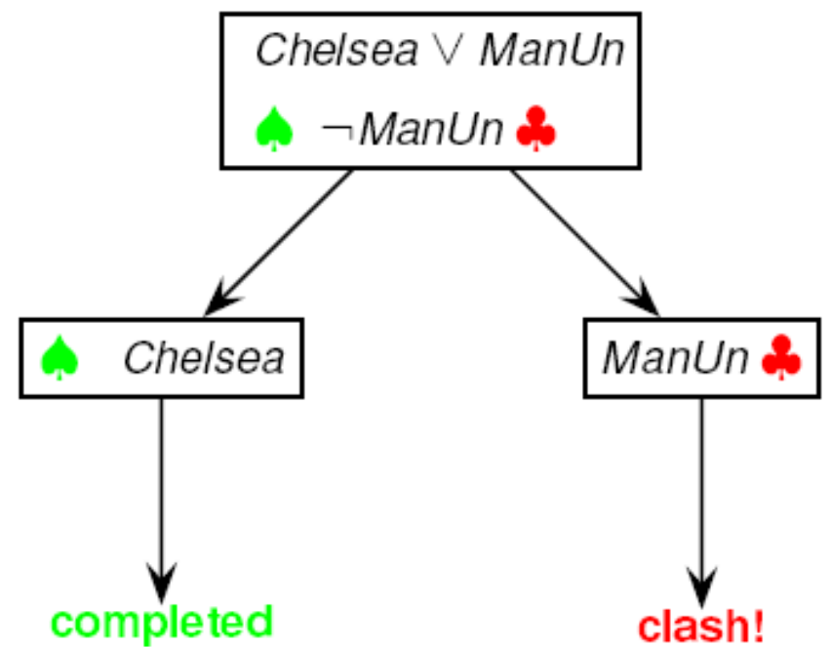
Simple Examples

Slide 19
Tableaux Calculus
Find a model for a given collection of sentences KB in negation normal form.
Consider the knowledge base KB as the root node of a refutation tree. A node in a refutation tree is called tableaux.
Starting from the root, add new formulas to the tableaux, applying the completion rules.
Completion rules are either deterministic . they yield a uniquely determined successor node . or nondeterministic . yielding several possible alternative successor nodes (branches).
Apply the completion rules until either
  an explicit contradiction due to the presence of two opposite literals in a node (a clash) is generated in each branch, or
  there is a completed branch where no more rule is applicable.

Slide 20
Models
The completed branch of the refutation tree gives a model of KB: the KB is satisfiable. Since all formulas have been reduced to literals (i.e., either positive or negative atomic propositions), it is possible to find an assignment of truth and falsity to atomic sentences which make all the sentences in the branch true.
If there is no completed branch (i.e., every branch has a clash), then it is not possible to find an assignment making the original KB true: the KB is unsatisfiable. In fact, the original formulas from which the tree is constructed can not be true simultaneously.

Slide 21

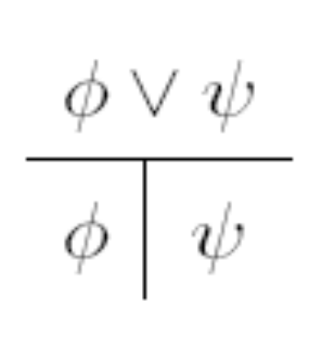
The Calculus
If a model satisfies a conjunction, then it also satisfies each of the conjuncts
If a model satisfies a disjunction, then it also satisfies one of the disjuncts. It is a non-deterministic rule, and it generates two alternative branches of the tableaux.
The given tableaux calculus works only if the formula has been translated into Negation Normal Form, i.e., all the negations have been pushed down.

Slide 22
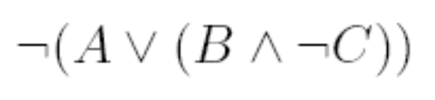
Example

Slide 23
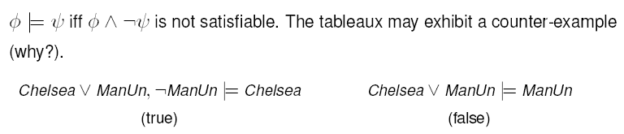
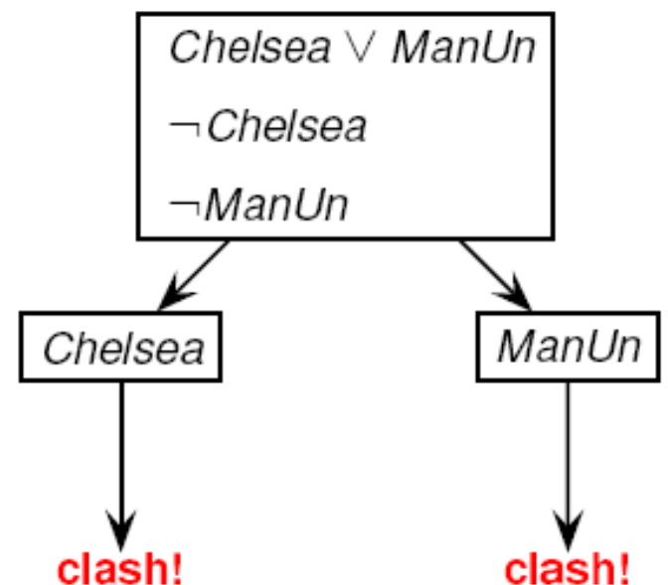
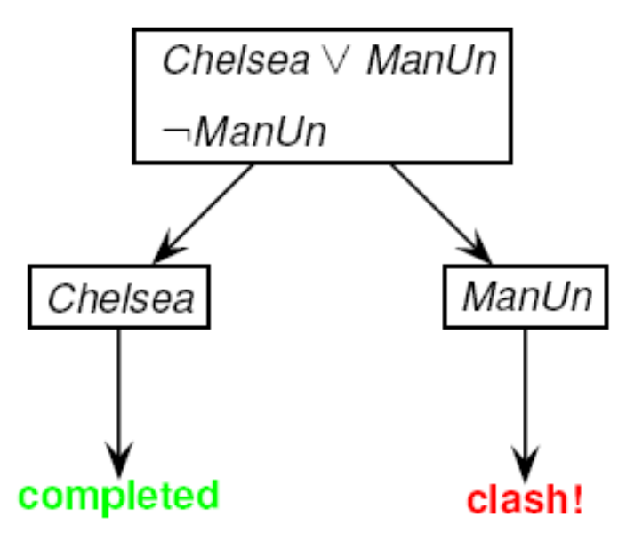
Entailment and Refutation

Slide 24
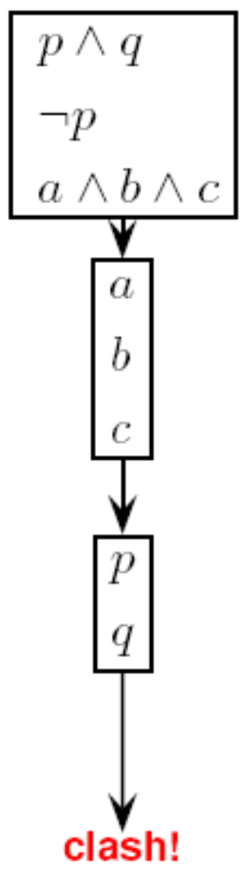

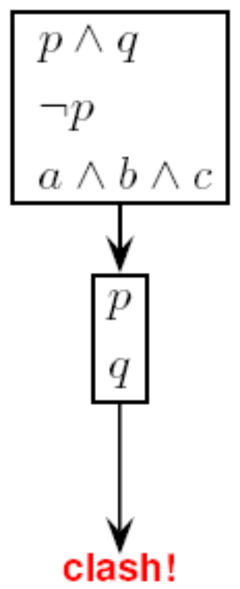
Efficiency: order of rule application

Slide 25

Efficiency: comparison with truth tables
The complexity of truth tables depends on the number of atomic formulas appearing in the KB,
the complexity of tableaux depends on the syntactic structure of the formulas in KB.

Slide 26
Exercise 1
(or (not A) (not B))
(or C D (not E))
(or A (not D))
(and B E)

Slide 27
?
Does the following fact entails by the previous facts?
(or (not C) D)
Previous facts are
(or (not A) (not B))
(or C D (not E))
(or A (not D))
(and B E)

Slide 28
Tableaux as a Decision Procedure
Tableaux is a decision procedure for computing satisfiability, validity, and entailment in propositional logics:
it is a sound algorithm
it is a complete algorithm
it is a terminating algorithm

Slide 29
FOL

Slide 30
FOL
We can already do a lot with propositional logic.
But it is unpleasant that we cannot access the structure of atomic sentences.
Atomic formulas of propositional logic are too atomic .
They are just statement which my be true or false but which have no internal structure.
In First Order Logic (FOL) the atomic formulas are interpreted as statements about relationships between objects.

Slide 31
Predicates and Constants
Let's consider the statements:
  Mary is female
  John is male
  Mary and John are siblings
In propositional logic the above statements are atomic propositions:
  Mary-is-female
  John-is-male
  Mary-and-John-are-siblings
In FOL atomic statements use predicates, with constants as argument:
  Female(mary)
  Male(john)
  Siblings(mary,john)

Slide 32
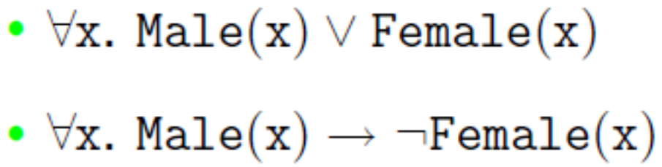
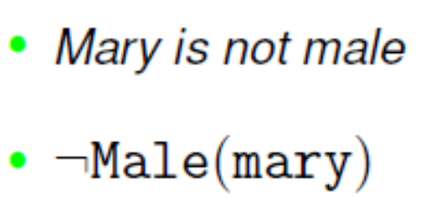
Variables and Quantiers
Let's consider the statements:
  Everybody is male or female
  A male is not a female
In FOL predicates may have variables as arguments, whose value is bounded by quantifiers:
Deduction

Slide 33

Functions
Let's consider the statement:
  The father of a person is male
  In FOL objects of the domain may be denoted by functions applied to (other) objects:

Slide 34
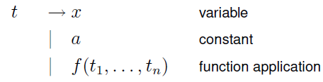
Syntax
variable symbols: x,y,z
n-ary function symbols: f,g,h
individual constants: a,b,c
n-ary predicate symbols: P,Q,R
Ground terms: terms that do not contain variables
Terms:

Slide 35
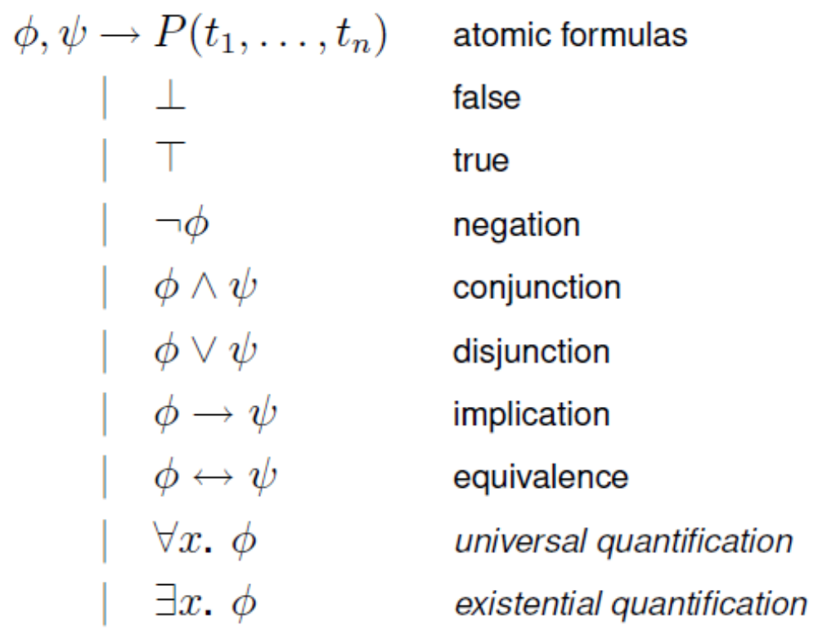
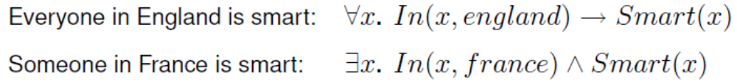
Syntax of full FOL
Formulas:

Slide 36
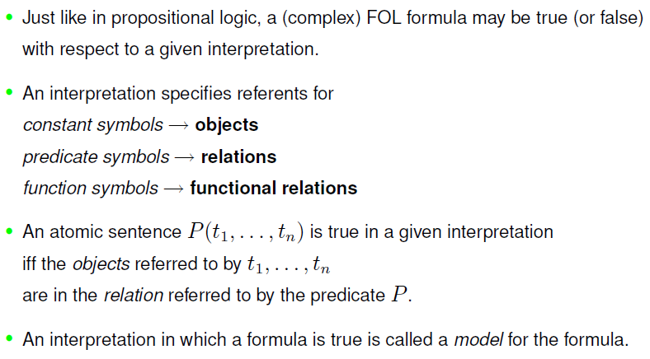
Semantics of FOL: intuition

Slide 37
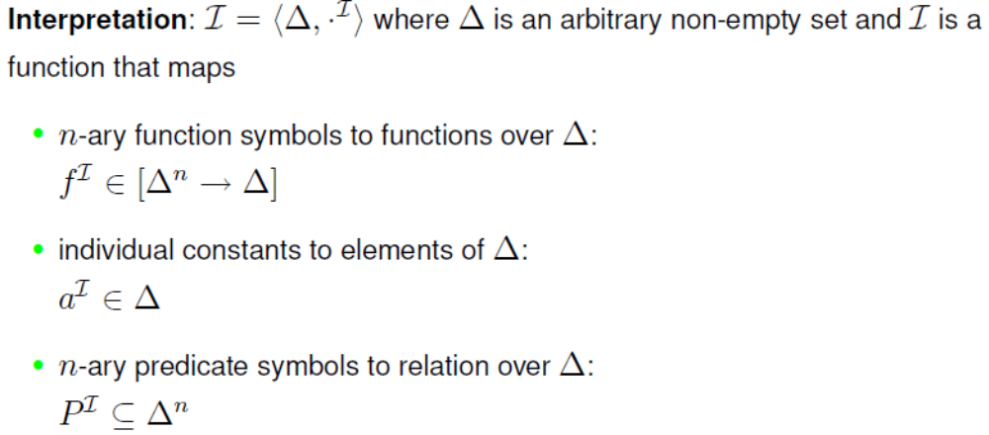
Semantic of FOL: Interpretations

Slide 38
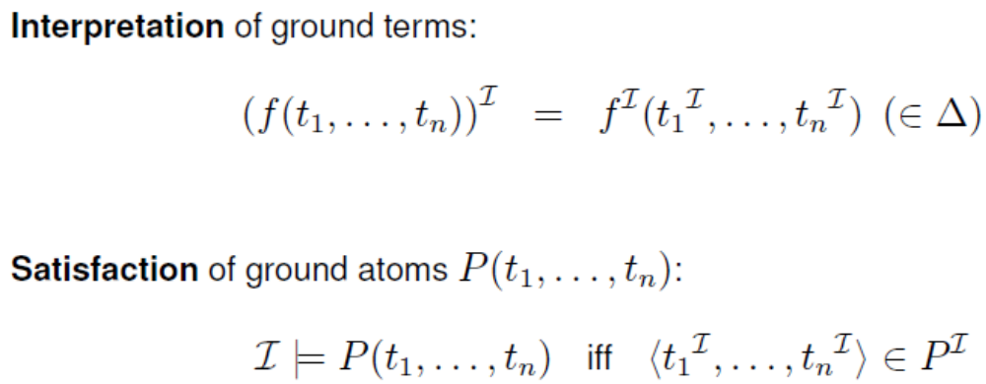
Semantic of FOL: Satisfaction

Slide 39
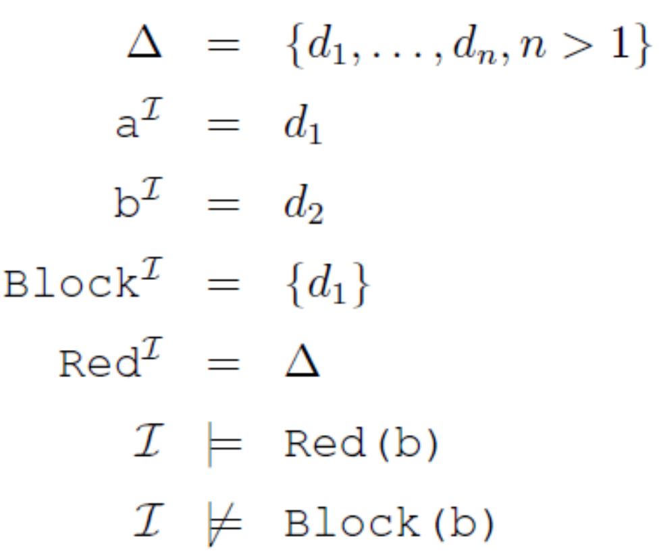
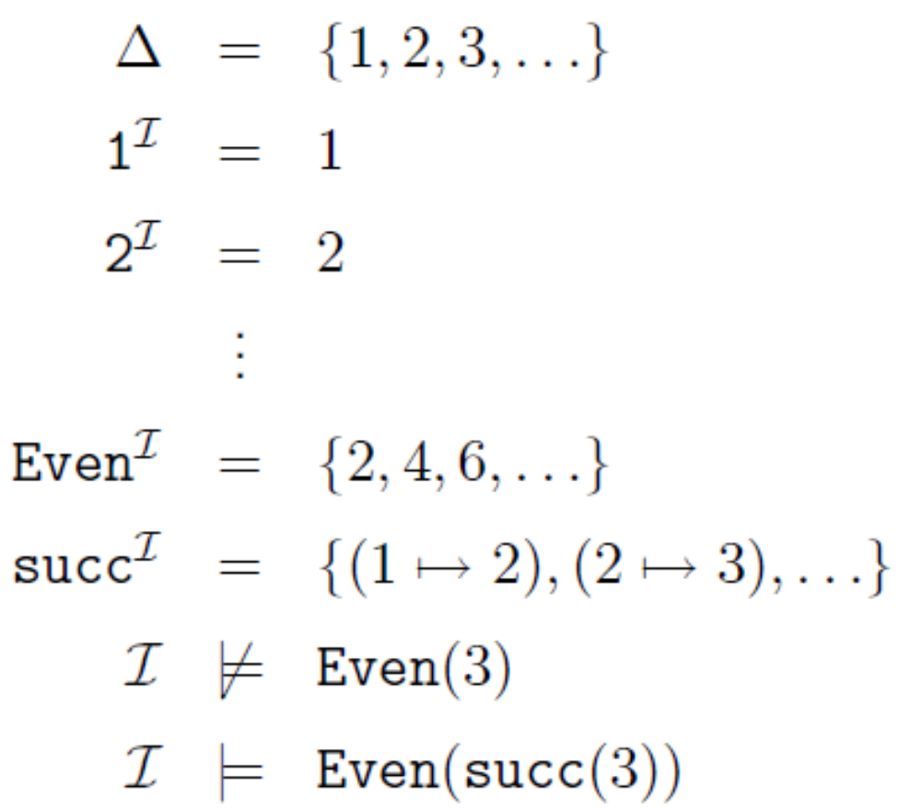
Examples

Slide 40
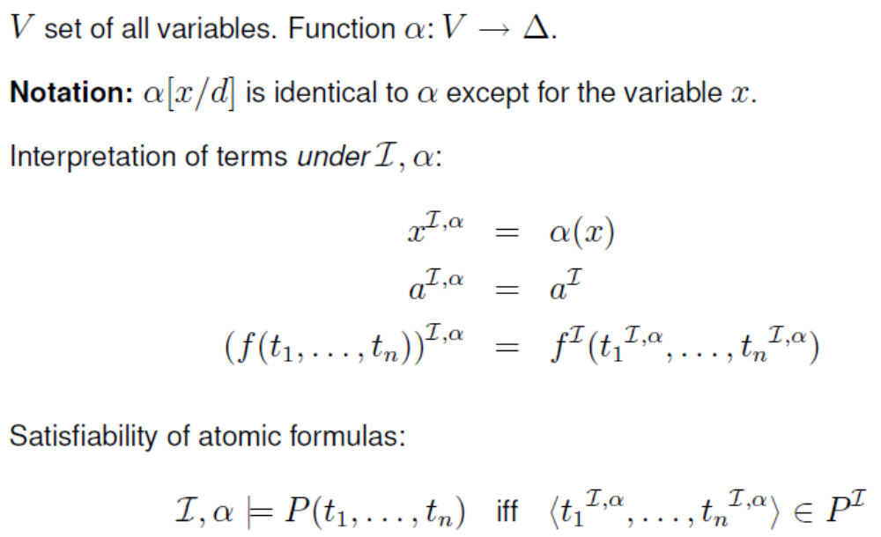
Semantics of FOL: Variable Assignments

Slide 41
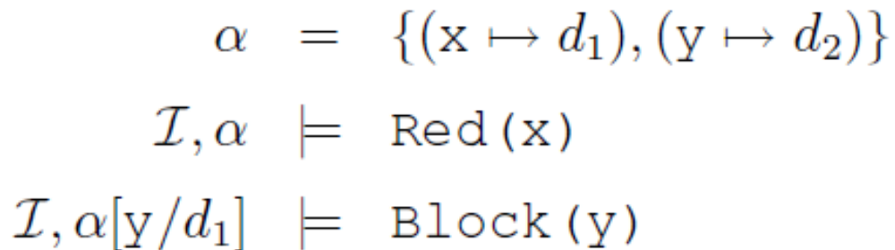
Variable Assignment example

Slide 42
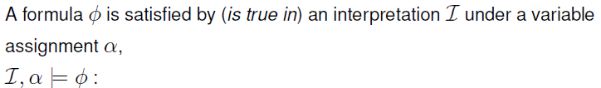
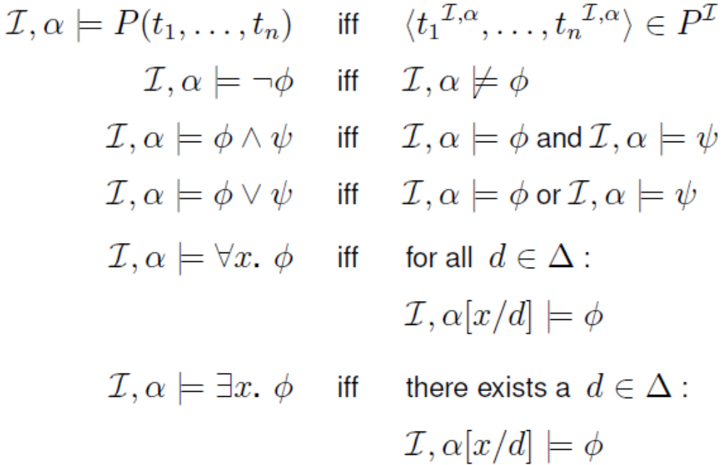
Semantics of FOL: Satisfiability of formulas

Slide 43
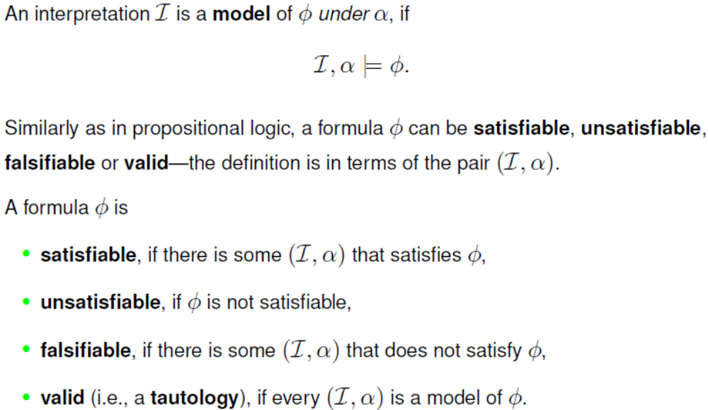
Satisfiability and Validity

Slide 44
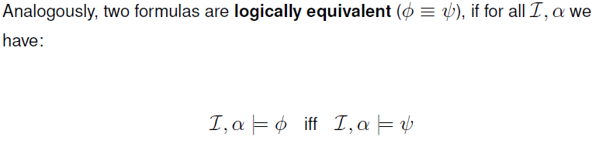
Equivalence

Slide 45
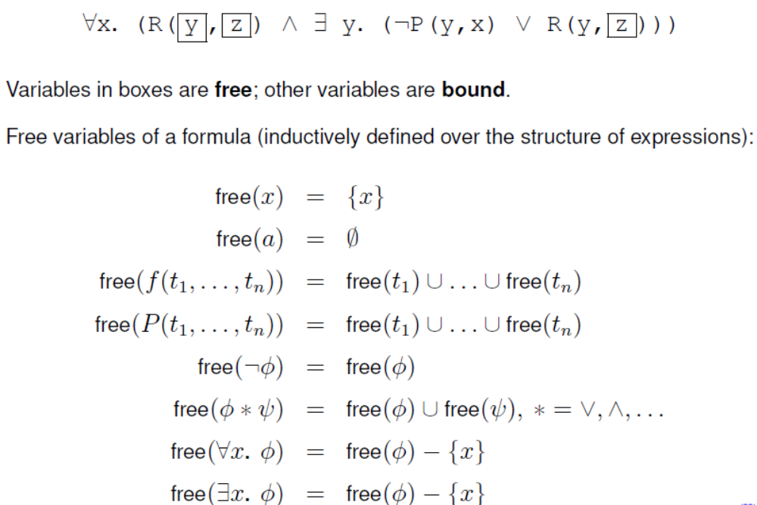

Slide 46
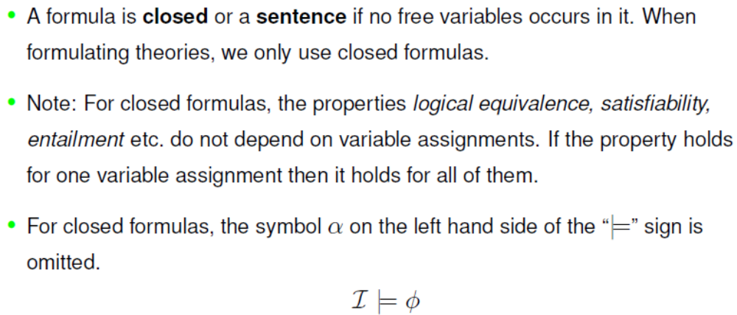
Open and Closed Formulas

Slide 47
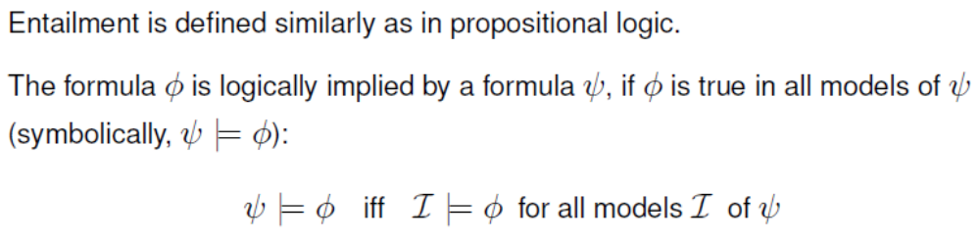
Entailment

Slide 48
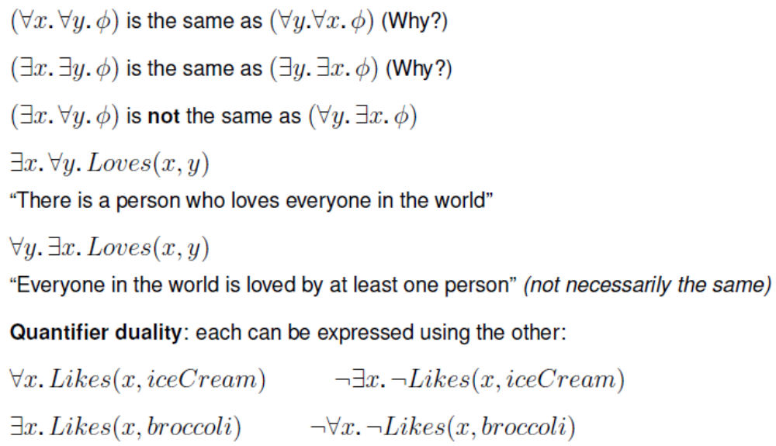
Properties of quantifiers

Slide 49
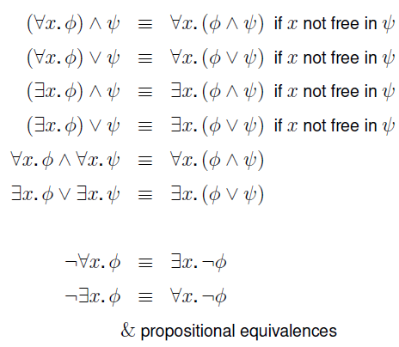
Equivalences

Slide 50
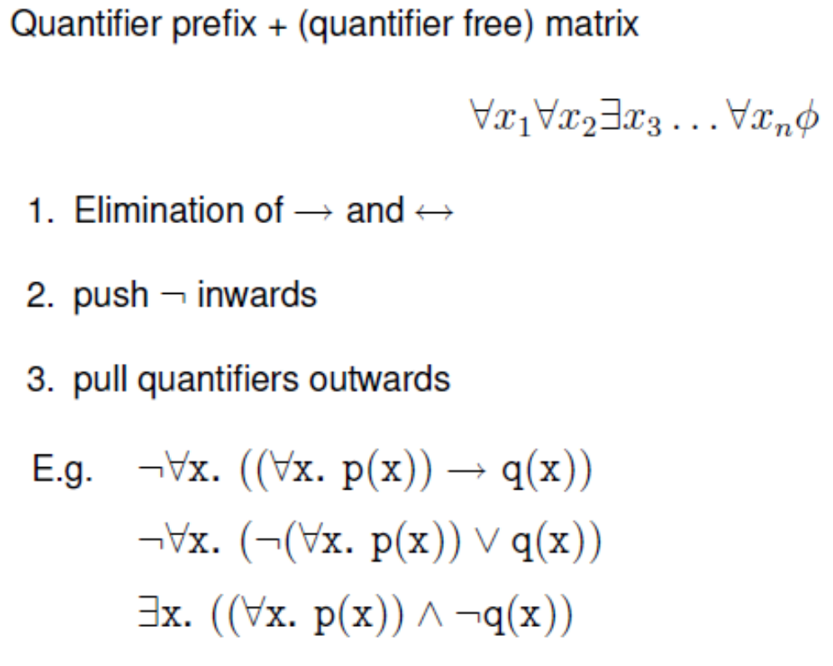
The Prenex Normal Form

Slide 51
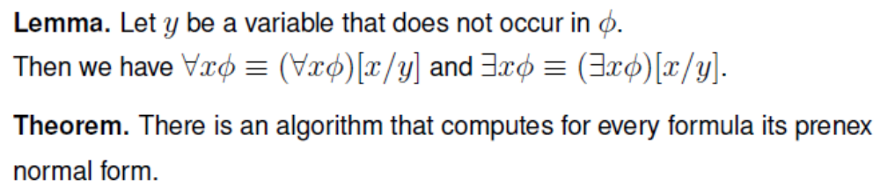
Prenex Normal Form

