Slide 1
Ontology Engineering
CS6143
Fall 2009
2nd lecture

Slide 2
Requirement….
In an information system we need to
  express information in a precise, machine-interpretable form,
  ready for software agents to process, share, and reuse it
  as well as to understand what the terms describing the data mean
That would enable the applications to interoperate on the semantic level

Slide 3
Ontology
Ontology of a certain domain is
  about terminology (domain vocabulary),
  all essential concepts in the domain,
  their classification,
  their taxonomy,
  their relations (including all important hierarchies and constraints), and
  about domain axioms

Slide 4
Ontology
of a domain D using a language L,
provides a catalog of the types of things assumed to exist in D
the types in the ontology are represented in terms of the concepts, relations, and predicates of L
Notes:
Both formally and informally, ontology is an extremely important part of knowledge of any domain.
Moreover, ontology is the fundamental part of knowledge and all other knowledge should rely on it and refer to it.
Many branches of science and technology realize this fact and have recently started their efforts in developing ontologies to represent their domains.
These efforts are largely facilitated by existing formal languages for representing ontologies and software tools that support their development

Slide 5
Definitions: Gruber
‘An ontology is an explicit and formal specification of a conceptualization of a domain of interest’ (Gruber, 1993).
Conceptualization ?
Specification ?
Notes:
Conceptualization means an abstract, simplified view of the world
If a knowledge base of an intelligent system should represent the world for some purpose, then it must be committed to some conceptualization, explicitly or implicitly.
Every conceptualization is based on the concepts, objects, and other entities that are assumed to exist in some area of interest and the relationships that hold among them.
The other part of the above definition - specification - means a formal and declarative representation.
In a data structure representing an ontology, the type of concepts used and the constraints on their use are stated declaratively, explicitly, and using a certain formal language.
Formal representation implies that ontology should be machine-readable.
However, ontology is not "active"; it cannot be run as a program

Slide 6
Definition: Hendler
"Ontology is a set of knowledge terms, including the vocabulary, the semantic interconnections, and some simple rules of inference and logic for some particular topic." (Hendler, 2001)
Semantic interconnections: ontology specifies the meaning of relations among the concepts used
Inference and logic: ontologies enable some forms of reasoning

Slide 7
Other definitions
"Ontology is the basic structure or armature around which a knowledge base can be built." (Swartout and Tate, 2001)
"An ontology is an explicit representation of a shared understanding of the important concepts in some domain of interest." (Kalfoglou, 2001)
The word shared here indicates that an ontology captures some consensual knowledge
Notes:
The word shared here indicates that an ontology captures some
consensual knowledge. It is not supposed to represent the subjective
knowledge of some individual, but the knowledge accepted by a group or a
community. All individual knowledge is subjective; ontology implements an
explicit cognitive structure that helps present objectivity as an agreement
about subjectivity. Hence ontology conveys a shared understanding of a
domain that is agreed between a number of individuals or agents. Such an
agreement facilitates accurate and effective communication of meaning.
This, in turn, opens the possibility for knowledge sharing and reuse, which
enables semantic interoperability between intelligent agents and
applications.

Slide 8
An other definition
Ontology s a 4-tuple <C, R, I, A> where C is a set of concepts, R a set of relations, I a set of instances and A a set of axioms (Staab and Studer, 2004).

Slide 9
How to develop an ontology?

Slide 10
Definition
“An ontology is a formal, explicit specification of a shared conceptualization”
Machine-readable
Concepts, properties, relations, functions, constraints, axioms, are explicitly defined
Consensual Knowledge
Abstract model and simplified view of some phenomenon in the world that we want to represent

Slide 11
I want to build my ontology
Which one are the activities involved in the ontology development process?
Which one is the goal of each activity?
When should I carry out each activity?
What is the relationship of one activity with the others?
Where can I find ontologies with the goal of reusing them?
How can I use the ontology in my application?

Slide 12
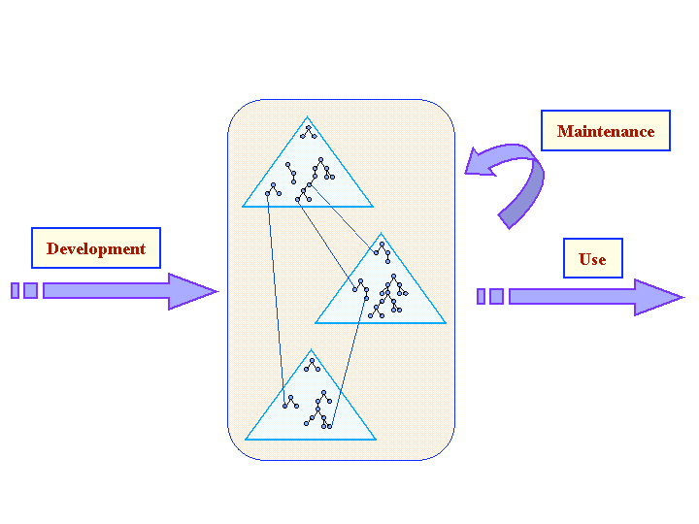
Ontology Engineering

Slide 13
Three aspects of ontology development
Development Process: Which activities
Life Cycle: Order of activities
  Intra-ontology dependencies
  Inter-ontology dependencies
Methodologies: How to carry out the activities
  Input and outputs
  Methods, tasks, techniques, tools
  Who, When, What, How, Where, Which
Notes:
The ontology development process refers to which
activities are performed when building ontologies. It is crucial to identify these
activities if agreement is to be reached on ontologies built by geographically distant
cooperative teams. It is advisable to carry out the three categories of activities
presented in Figure 3.2 and steer clear of anarchic constructions:

Slide 14
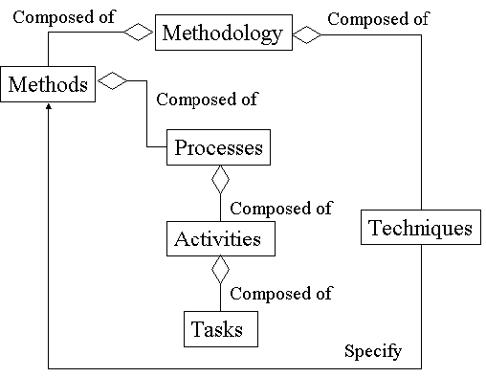
Graphical representation of terminological relationships in methodologies

Slide 15
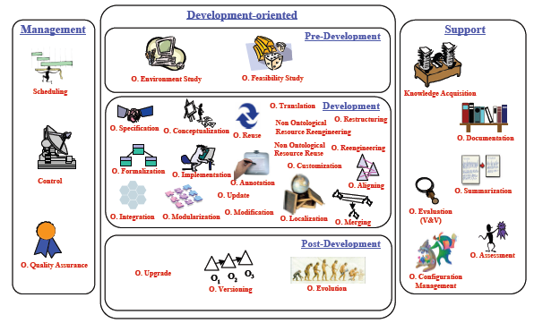

Slide 16
Management Activities
Scheduling
  identifies the tasks to be performed, their arrangement, and the time and resources needed for their completion
Control
  Guarantees that scheduled tasks are completed in the manner intended to be performed
Quality Assurance
  Assures that the quality of each and every product output (ontology, software and documentation) is satisfactory.
Notes:
Ontology management activities include scheduling, control and quality assurance.
The scheduling activity identifies the tasks to be performed, their arrangement, and
the time and resources needed for their completion. This activity is essential for
ontologies that use ontologies stored in ontology libraries or for ontologies that
require a high level of abstraction and generality. The control activity guarantees
that scheduled tasks are completed in the manner intended to be performed. Finally,
the quality assurance activity assures that the quality of each and every product
output (ontology, software and documentation) is satisfactory.

Slide 17
Pre Development
Environment Study
  is carried out to know the platforms where the ontology will be used, the applications where the ontology will be integrated, etc.
Feasibility Study
  Answers questions like:
  is it possible to build the ontology?
  is it suitable to build the ontology?, etc.

Slide 18
Development Activities
Specifications
  why the ontology is being built,
  what its intended uses are and
  who the end-users are
Conceptualization
  structures the domain knowledge as meaningful models at the knowledge level
Formalization
  Transforms the conceptual model into a formal or semi-computable model.
Implementation
  build computable models in an ontology language
Maintenance
  updates and corrects the ontology if needed
Notes:
Ontology development oriented activities are grouped, as presented in Figure 3.2,
into pre-development, development and post-development activities.
During the pre-development, an environment study is carried out to know the
platforms where the ontology will be used, the applications where the ontology will
be integrated, etc. Also during the pre-development, the feasibility study answers

Slide 19
Post Development
Upgrade
Evolution
Versioning

Slide 20
Support Activities
Knowledge Acquisition
  acquire knowledge from experts of a given domain or through some kind of (semi) automatic process, which is called ontology learning
Integration
  required when building a new ontology by reusing other ontologies already available
Evaluation
  makes a technical judgment of the ontologies, of their associated software environments, and of the documentation.
Merging
  obtaining a new ontology starting from several ontologies on the same domain. The resulting ontology is able to unify concepts, terminology, definitions, constraints, etc., from all the source ontologies
Alignment
  establishes different kinds of mappings (or links) between the involved ontologies.
Documentation
Configuration Management

Slide 21
Ontology Life Cycle
Identifies when the activities should be carried out,
it identifies the set of stages through which the ontology moves during its life time, describes what activities are to be performed in each stage and how the stages are related (relation of precedence, return, etc.)

Slide 22
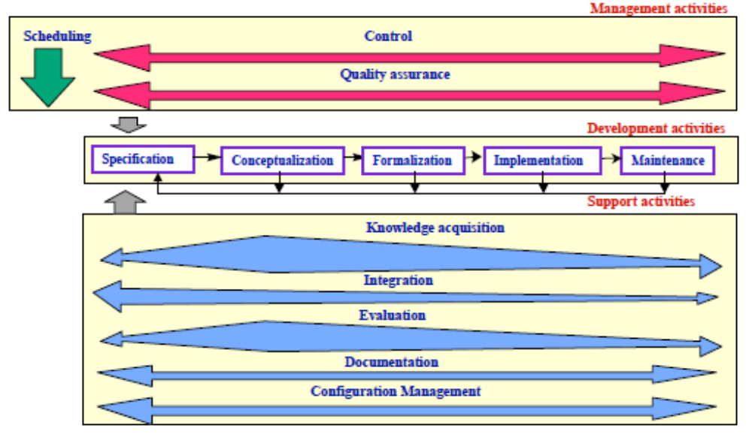
Ontology Life Cycle. Intra-dependencies

Slide 23
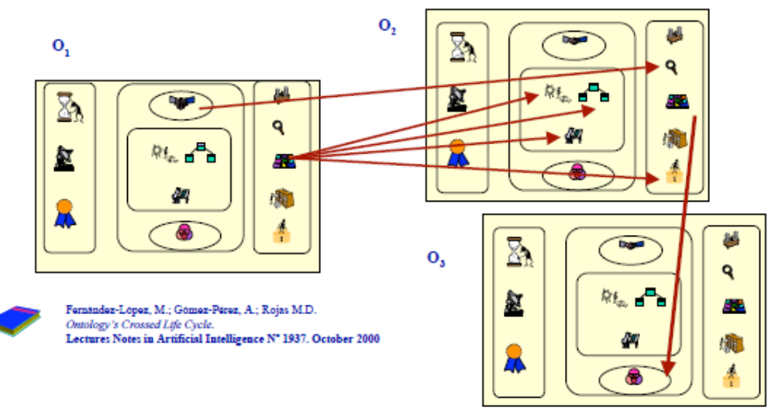
Ontology Life Cycle. Inter-dependencies

Slide 24
Methodologies
A series of methods and methodologies for developing ontologies have been reported.
  The Cyc method
  Uschold and King’s method
  Grüninger and Fox’s methodology
  The KACTUS approach
  METHONTOLOGY
  SENSUS-based method
  On-To-Knowledge

Slide 25
Study Exercise
Start reading chapter 3 of Ontological Engineering
Read Paper “chandrasekaranetal99.pdf” “What Are Ontologies, and Why Do We Need Them?”

