Slide 1
Introduction to Programming
Python Lab 8:
Loops
PythonLab8 lecture slides.ppt
Ping Brennan (p.brennan@bbk.ac.uk)
19 November 2019 or 6 March 2020

Slide 2
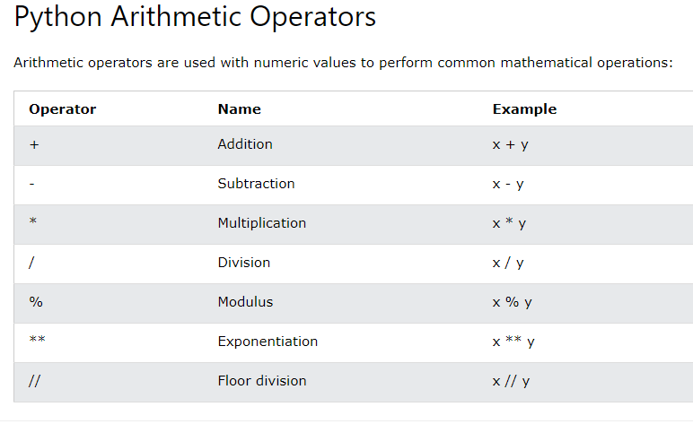

Slide 3
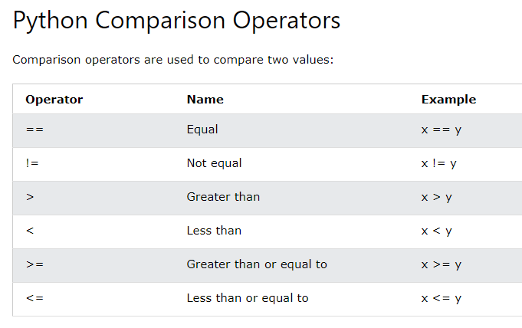

Slide 4
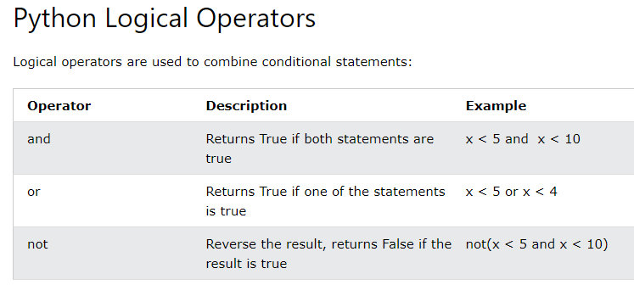

Slide 5
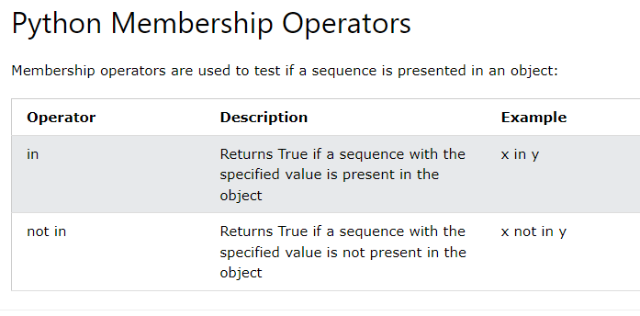

Slide 6
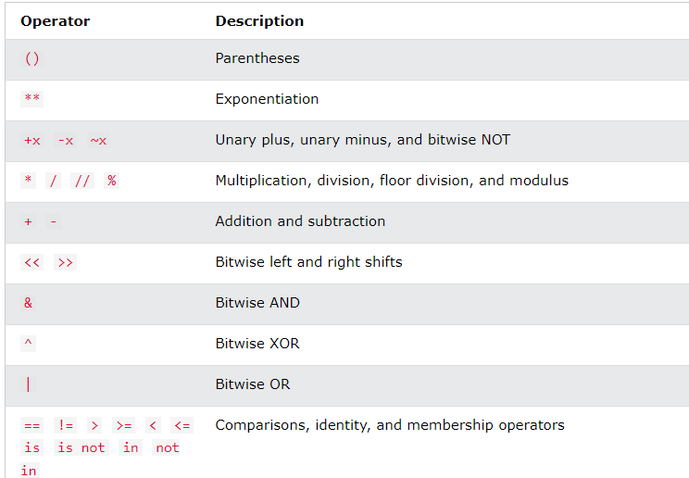
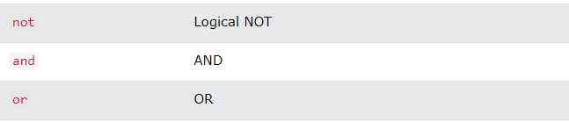

Slide 7
Getting Started
Create a new folder in your disk space with the name PythonLab8
Launch the Python Integrated Development Environment (IDLE) - begin with the Start icon in the lower left corner of the screen.
If you are in a DCSIS laboratory, search using the keyword Python and click on IDLE (Python 3.6 64-bit) .
A window with the title Python 3.6.2 Shell should appear. This window is the Shell.

Slide 8
Getting Started (2)
If you are in the ITS laboratory MAL 109, then right mouse click on the Start icon in the lower left corner of the screen.
A list of menu options should appear and click on Search. Type Python in the search text box at the bottom of the pop-up window. A list of Apps should appear and select
Python 3.4 IDLE(PythonGUI)
A window with the title Python 3.4.3 Shell should appear. This window is the Shell.
In the Shell click on File. A drop down menu will appear.
Click on New File. A window with the `title` Untitled should appear. This window is the Editor.

Slide 9
Getting Started (3)
In the Editor, click on File, and then in the drop down menu click on Save As… .
A window showing a list of folders should appear.
To search any folder on the list, double click on the folder.
Find the folder PythonLab8 and double click on it.
In the box File name at the bottom of the window
Type Vowels.py
Then click on the button Save in the lower right corner of the window.
The title of the Editor should change to show the location of the file Vowels.py.

Slide 10
Objectives of the exercises set
Objectives
Use for statements to implement count-controlled loops that iterate over a range of integer values or the contents of any container.
Syntax | Example | Explanation
for variable in container: statements #loop body | stateName = "Ohio" for letter in stateName: print(letter) # loop body | The string "Ohio" is stored in the variable stateName. The loop body is executed for each successive character of the string in stateName, starting with the first character.
All the statements in the block (loop body) have the same level of indentation.
The variable letter takes each of the values 'O', 'h', 'i', 'o' in turn for each iteration.
iteration | letter | Output
1 | O | O h i o
2 | h
3 | i
4 | o
The header ends in a colon

Slide 11
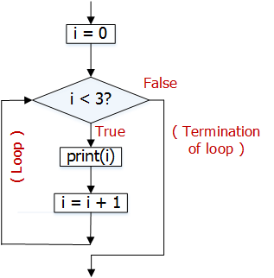

Objectives of the exercises set (2)
Objectives
Use while statements to implement event-controlled loops.
A while loop executes instructions repeatedly while a condition is true.
Syntax | Example | Flow chart
while condition : statements | i = 0 while i < 3 : print(i) i = i + 1 Output 0 1 2
1
1
condition
2
3
2
All the statements in the block (loop body) have the same indentation.
4
3
The header ends in a colon.
4
In the example, the variable i is initialised outside the while loop (statement ) and updated in the loop body (statement ).
1
4

Slide 12
Objectives of the exercises set (3)
The table below shows the working of the while loop example shown on page 6.
i | i < 3 ? | Output using print(i) | i = i + 1
0 | True | 0 | 1
1 | True | 1 | 2
2 | True | 2 | 3
3 | False – end of the while loop

Slide 13
Program Vowels.py: Vowels
Question 2: Problem statement
Consider the following for loop,
stateName = "Ohio"
for letter in stateName :
print(letter)
The variable letter takes each of the values "O", "h", "i", "o"
in turn.
The output of the code is
O
h
i
o

Slide 14
Program Vowels.py: Vowels (2)
Problem statement (continued)
Write a program that requests a string from the keyboard and then prints out the characters in the string in a vertical line, as in the above example. (see page 8)
Add to your program code to count the number of lower case vowels in the input string and then print out this number after printing out the vertical line of characters. The vowels are a, e, i, o, u.

Slide 15

Program Vowels.py: Vowels (3)
Problem solving - Convert the following pseudo code into a sequence of Python statements in your program.
Read in a string and store it in a variable named s.
Declare a variable named n and assign a value of 0 to it.
The variable n is used to keep a count of the number of lower case vowels (a, e, i, o, u) in the input string s.
Add the following for statement to print out the characters in the string s in a vertical line, as shown in the output example on page 8.
for letter in s :
print(letter) # loop body
Input
Process the input and display the output (steps 2 to 5).
Indent the print statement in the block (loop body).

Slide 16
Program Vowels.py: Vowels (4)
Problem solving (continued)
Inside the for loop, add an if statement to check if the letter is equal to an "a", "e", "i", "o", or "u" after the print statement in step 3. Align the print and if statements at the same level of indentation.
If the combined Boolean expression is true, then add 1 to the current value of n. Use the if statement below to help you get started.
if letter == "a" or letter == "e" or complete the combined Boolean expression by adding test conditions for the remaining vowels (i,o,u) :
# True branch - if the combined expression is true
Indent & write an assignment statement to add 1 to n and store the result in n. Recall n keeps a count of the number of lower case vowels.
Outside the for loop, write the code to print out the number of lower case vowels. Align the print and for statements.
Provide a comment at the beginning of the program to explain the purpose of the program together with your name and the date. Save the program to the file Vowels.py and then run it.
Note the indentation of the code.

Slide 17
Program NumberProperties.py: NumberProperties
Create a new Editor for a new file called NumberProperties.py
Question 3: Problem statement
Write a program that reads a list of strictly positive integers from the keyboard, one at a time.
Use a while loop to read these integers.
The end of the input is indicated by the integer 0. Note that this 0 is a sentinel in that it marks the end of the input but does not belong to the set of integers whose properties are sought (PFE Section 4.3).
The program then prints out the following numbers.
the average value
the smallest of the values
the largest of the values
the inclusive range, that is one more than the difference between the smallest and the largest values.
It can be assumed that the input contains at least one number other than 0. See PFE P4.5.

Slide 18
Program NumberProperties.py: NumberProperties (2)
Problem statement (continued)
Include a comment with each number that is printed out, for example:
The average value is: …
If you need to check how a while loop behaves, then test the following code.
nextNumber = 5
while not (nextNumber == 0) : # test for entry to the loop
print(nextNumber) # in the loop do something with the data
nextNumber = nextNumber-1 # get the next number
All the statements in the block (loop body) have the same indentation.

Slide 19
Program NumberProperties.py: NumberProperties (3)
Input
A set of positive integer numbers.
For example,
the numbers:
2 5 3 9
are typed in at the keyboard, one at a time.
Computations
average =
(2 + 5 + 3 + 9) / 4
2. mn = min(2, 5, 3, 9)
3. mx = max(2, 5, 3, 9)
4. range = (mx - mn) + 1
Output
The average value is 4.75
The smallest value is 2
The largest value is 9
The range is 8
Note: The Python built-in function max returns the largest value of the arguments; and the function min returns the smallest value of the arguments.

Slide 20
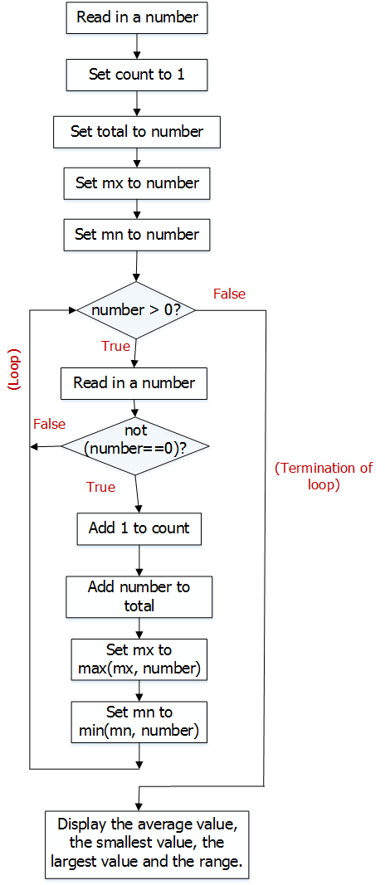
Flow chart of a while loop for the program NumberProperties.py (4)
The largest and smallest of the values are stored in the variables mx and mn respectively.

Slide 21
Program NumberProperties.py: NumberProperties (5)
Problem solving - Convert the following pseudo code into a sequence of Python statements in your program.
Read in an integer and store it in a variable named number *
Create a variable named count and initialise it with the value of 1. The variable keeps a count of the number of inputs.
Create variables, for example, total to store the total of the inputs,
mx to store the largest value and mn to store the smallest value.
Set the value of each variable to be the value of the variable number initially.
An example is shown below for the variable total.
total = number
* Assume that the first numeric value read in from the keyboard is a positive integer greater than 0.
Input
Process the input and display all required results (steps 2 to 5).

Slide 22
Program NumberProperties.py: NumberProperties (6)
Problem solving (continued)
Write a while loop statement to read in more integers as long as the condition, number > 0, remains true. Below is an outline of the algorithm needed to solve the problem set inside the loop.
while number > 0 :
# loop body
# Add code below to read in a number
number = read in an integer similar to step 1
# Add an if statement below to check if the number is not # equal to zero.
if (condition tests if the number is not equal to zero) :
# True branch of the if statement
# i) add 1 to count as shown, indented below.
count = count + 1
# Write more code inside the True branch to
# ii) add number to total and store result in total
# iii) Set mx to be the larger of the two values in
# the variables mx and number using the max function.
# iv) Set mn to be the smaller of the two values in
# the variables mn and number using the min function.
Note the indentation of the statements.

Slide 23
Program NumberProperties.py: NumberProperties (7)
Problem solving (continued)
Outside the while loop, write additional code to find the average value and the inclusive range. Then write code to print all required results separately together with suitable messages.
For example, the print statement below can be used to display the inclusive range.
print("The range is ", mx – mn + 1)
Align the while statement and the additional code for step 5, such as print statements.
Provide a comment at the beginning of the program to explain the purpose of the program together with your name and the date.
Save your program to the file NumberProperties.py and then run it.

Slide 24
Supplementary Questions for Private Study
The laboratory worksheet contains supplementary questions in section 4 for private study.
You are encouraged to complete the supplementary questions at home, or in the laboratory if you have time after completing questions 2 to 3.

