Slide 1
Lecture 01 Introduction
Software Engineering

Slide 2
What is Software?
Software: “Computer programs and associated documentation such as requirements, design models and user manuals”.
Software products may be developed for a particular customer or may be developed for a general market.

Slide 3
Software
Program: The program or code itself is definitely included in the software.
Data: The data on which the program operates is also considered as part of the software.
Documentation: Another very important thing that most of us forget is documentation. All the documents related to the software are also considered as part of the software.
So the software is not just the code written in Cobol, Java, Fortran or C++. It also includes the data and all the documentation related to the program.

Slide 4
Types of Software.
Custom
For a specific customer
Generic
Sold on open market
Often called
COTS (Commercial Off The Shelf)
Shrink-wrapped (Refers to store-bought software, implying a standard platform that is widely supported.)
Embedded
Built into hardware
Hard to change

Slide 5
Types of Software
Real time software
Example. Control and monitoring systems
Must react immediately
Safety often a concern
Data processing software
Used to run businesses
Accuracy and security of data are key
Some software have both aspects

Slide 6
Software Products
Generic Products
Stand-alone systems that are marketed and sold to any customer who wishes to buy them.
Examples – PC software such as graphics programs, project management tools; CAD software;
Customized Products
Software that is commissioned by a specific customer to meet their own needs.
Examples – embedded control systems, air traffic control software, traffic monitoring systems.

Slide 7
Software Applications
1. System software: such as compilers, editors, file management utilities
2. Application software: stand-alone programs for specific needs.
3.Engineering/scientific software: Characterized by “number crunching”algorithms. such as automotive stress analysis, molecular biology, orbital dynamics etc
4. Embedded software resides within a product or system. (key pad control of a microwave oven, digital function of dashboard display in a car)
5. Product-line software focus on a limited marketplace to address mass consumer market. (word processing, graphics, database management)
6. WebApps (Web applications) network centric software. As web 2.0 emerges, more sophisticated computing environments is supported integrated with remote database and business applications.
7. AI software uses non-numerical algorithm to solve complex problem. Robotics, expert system, pattern recognition game playing

Slide 8
What is Software Engineering?
“Software engineering is an engineering discipline that is concerned with all aspects of software production”.
It is a systematic ,disciplined and cost-effective technique
for developing software.
Engineering discipline
Using appropriate theories and methods to solve problems bearing in mind organizational and financial constraints.
All aspects of software production
Not just technical process of development. Also project management and the development of tools, methods etc. to support software production.

Slide 9
Software Engineering Definition
The seminal definition:
[Software engineering is] the establishment and use of sound engineering principles in order to obtain economically software that is reliable and works efficiently on real machines.
The IEEE definition:
Software Engineering: The application of a systematic, disciplined, quantifiable approach to the development, operation, and maintenance of software; that is, the application of engineering to software.
Software engineers should adopt a systematic and organised approach to their work and use appropriate tools and techniques depending on the problem to be solved, the development constraints and the resources available.

Slide 10
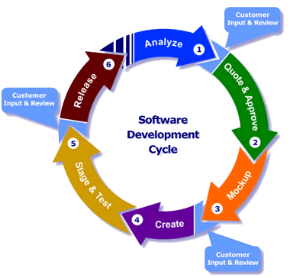
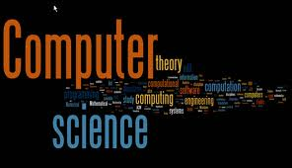
Computer Science Vs. Software Engineering
“Software Engineering is the process of utilizing our knowledge of computer science in effective production of software systems.”
Computer Science | Software Engineering
Computer science is concerned with the theories and methods that underlie computers and software system. | Software engineering is concerned with the practical problems of producing software.

Slide 11
What is the difference between Software Engineering and Computer Science?
“Computer science is concerned with theory and fundamentals; while software engineering is concerned with the practicalities of developing and delivering useful software”.
Computer science theories are still insufficient to act as a complete underpinning (supporting) for software engineering (unlike e.g. physics and electrical engineering).

Slide 12
A Software Engineering Framework
A quality focus
Any engineering approach must rest on organizational commitment to quality which fosters a continuous process improvement culture.
Process layer
The foundation for software engineering is the process layer
Deﬁnes a framework that must be established for effective delivery of software engineering technology
Establish a context where
Products (model, data, report, and forms) are produced
Milestones are established
Quality is ensured
Change is managed

Slide 13
A Software Engineering Framework
Methods
Provide the technical how-to for building software
Methods encompass a broad array of tasks
Communication , requirements analysis, design modeling, program construction, testing, and support
Tools
Provide automated or semi-automated support for the process and the methods
Integrated tools to support software development
Called computer aided software engineering

Slide 14
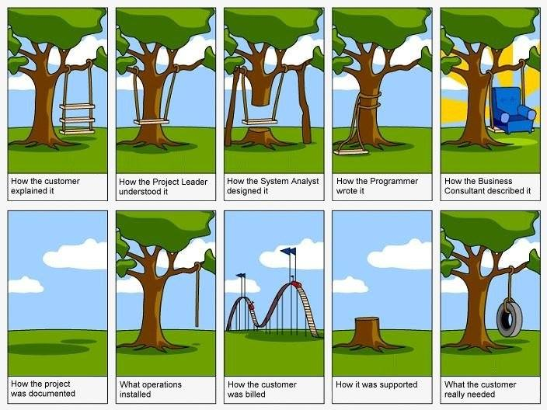
Importance of Software Engineering

Slide 15
What is a Software Process?
Software Process: “The systematic approach that is used in software engineering is sometimes called a software process.”
“A set of activities whose goal is the development or evolution of software”.
Generic activities in all software processes are:
Software specification
Software development:
Software validation:
Software evolution:

Slide 16
Activities in Software Process?
Generic activities in all software processes are:
Software Specification - what the system should do and its development constraints
where customers and engineers define the software that is to be produced and the constraints on its operation
Software Development - production of the software system
where the software is designed and programmed
Software Validation - checking that the software is what the customer wants
where the software is checked to ensure that it is what the customer requires.
Software Evolution - changing the software in response to changing demands
where the software is modified to reflect changing customer and market requirements.

Slide 17
What is a Software Process Model?
Software Process Model: “A simplified representation of a software process, presented from a specific perspective”.
Examples of process perspectives are:
Work flow ➔ what is done when? - sequence of activities;
Data flow ➔ which information flows where?
Role / action ➔ who does what?
Generic process models
Waterfall
Iterative development
Component-based software engineering.

Slide 18
What are Software Engineering Methods?
Software Engineering Methods: “Structured approaches to software development which include system models, notations, rules, design advice and process guidance".
Model descriptions
Descriptions of graphical models which should be produced
Rules
Constraints applied to system models
Recommendations
Advice on good design practice
Process guidance
What activities to follow

Slide 19
What is CASE? (Computer-Aided Software Engineering)
CASE: “Software systems that are intended to provide automated support for software process activities”.
CASE systems are often used for method support.
Upper-CASE
Tools to support the early process activities of requirements and design;
Lower-CASE
Tools to support later activities such as programming, debugging and testing.

Slide 20
What are the attributes of good Software?
The software should deliver the required functionality and performance to the user and should be maintainable, dependable and acceptable.
Maintainability
Software must evolve to meet changing needs
Dependability
Software must be trustworthy
Efficiency
Software should not make wasteful use of system resources
Acceptability
Software must accepted by the users for which it was designed. This means it must be understandable, usable and compatible with other systems.

Slide 21
What are the key challenges facing Software Engineering?
Key challenges are: Heterogeneity, delivery, trust and Legacy systems
Heterogeneity
Developing techniques for building software that can cope with heterogeneous platforms and execution environments.
Large-scale systems are often distributed and include a mix of hardware and software
Delivery
Developing techniques that lead to faster delivery of software.
There is increasing pressure for ever faster delivery of software
Trust
Developing techniques that demonstrate that software can be trusted by its users.
Legacy systems
Valuable existing systems must be maintained and updated

Slide 22
What are Stakeholders in Software Engineering?
Stakeholder: A stakeholder is anyone who has a stake in the successful outcome of the project
1. Users
Those who use the software
2. Customers
Those who pay for the software
3. Software developers
4. Development Managers
Note: All four roles can be fulfilled by the same person

Slide 23
What are Difficulties and Risks in Software Engineering?
• Complexity and large numbers of details
• Uncertainty about technology
• Uncertainty about requirements
• Uncertainty about software engineering skills
• Constant change
• Political risks

Slide 24
Web Software Engineering
The Web is now a platform for running application and organizations are increasingly developing web-based systems rather than local systems
Software reuse is the dominant approach for constructing web-based systems.
When building these systems, you think about how you can assemble them from pre-existing software components and systems.
Web-based systems should be developed and delivered incrementally.
It is now generally recognized that it is impractical to specify all the requirements for such systems in advance.
User interfaces are constrained by the capabilities of web browsers.
Technologies such as AJAX allow rich interfaces to be created within a web browser but are still difficult to use. Web forms with local scripting are more commonly used.

