Slide 1
Lecture 02 Process Models
Software Engineering

Slide 2
Objectives
To introduce software process models
To describe three generic process models and when they may be used
To describe outline process models for requirements engineering, software development, testing and evolution

Slide 3
What is a Software Process?
“A set of activities whose goal is the development or evolution of software”.
Generic activities in all software processes are:
Specification - what the system should do and its development constraints
where customers and engineers define the software that is to be produced and the constraints on its operation
Development - production of the software system
where the software is designed and programmed
Validation - checking that the software is what the customer wants
where the software is checked to ensure that it is what the customer requires.
Evolution - changing the software in response to changing demands.
where the software is modified to reflect changing customer and market requirements.

Slide 4
The Software Process (Simplified)
Feasibility and
Planning
Requirements
Design
Implementation
Operation and
Maintenance

Slide 5
Software Development Activities
Project Management
Requirement Engineering
Design
Coding
Testing
Software Quality Assurance
Software Configuration Management
Software Integration
Rest of the activities

Slide 6
Software Development Activities
Project planning and Management
Configuration Management
Quality Assurance
Installation and Training etc.
Management
Construction
Requirements
Design
Coding
Testing
Maintenance etc.

Slide 7
Software Process
Fundamental Assumption:
Good processes lead to good software
Good processes reduce risk
Good processes enhance visibility
Good processes enable teamwork
Variety of Software Processes
Software products are very varied. Therefore, there is no standard process for all software engineering projects
BUT successful software development projects always need to address similar issues. This creates a number of process steps that should be part of all software projects.

Slide 8
Process Step: Feasibility
A feasibility study precedes the decision to begin a project.
What is the scope of the proposed project?
Is the project technically feasible?
What are the projected benefits?
What are the costs, Numerable?
Are the resources available?
What are the risks and how can they be managed?
A feasibility study leads to a decision: go or no-­‐go.

Slide 9
Process Step: Requirements
Requirements define the function of the system from the client's viewpoint.
The requirements establish the system's functionality, constraints, and goals by consultation with the client, customers, and users.
They must be developed in a manner that is understandable by both the client and the development staff.

Slide 10
Process Step: Requirements
This step is occasionally divided into:
• Requirements Gathering
• Requirements Analysis
• Requirements Definition
• Requirements Specification
The requirements may be developed in a limited manner , or may emerge incrementally.
Failure to agree on the requirements and define them adequately is one of the biggest cause of software projects failing.

Slide 11
Process Step: System Design
Design describes the system from the software developers' viewpoint
System design:
Establish a system architecture, both hardware and software, that matches the requirements
Program design:
Represent the software functions in a form that can be transformed into one or more executable programs
Preliminary user testing is often carried out as part of the design step.
Models are used to represent the requirements, system architecture, and program design.

Slide 12
Process Step: Implementation
Implementation (coding)
The software design is realized as a set of programs or program units.
These software components may be written by the development team, acquired from elsewhere, or modified from existing components.
Program testing
Program testing by the development staff is an integral part of implementation.
Individual components are tested against the design.
The components are integrated and tested against the design as a complete system.

Slide 13
Process Step: Acceptance and Release
Acceptance testing
The system is tested against the requirements by the client, often with selected customers and users.
Delivery and release
After successful acceptance testing, the system is delivered to the client and released into production or marketed to customers.

Slide 14
Process Step: Operation and Maintenance
Operation:
The system is put into practical use.
Maintenance:
Errors and problems are identified and fixed.
Evolution:
The system evolves over time as requirements change, to add new functions, or adapt to a changing technical environment.
Phase out:
The system is withdrawn from service.
This is called the Software Life Cycle

Slide 15
Sequence of Process Steps
Major alternatives
We will look at three categories of software development processes:
Sequential:
As far as possible, complete each process step before beginning the next. Waterfall model.
Iterative:
Go quickly through all process steps to create a rough system, then repeat them to improve the system. Iterative refinement.
Incremental:
A variant of iterative refinement in which small increments of software are placed in production (sprints). Agile development.

Slide 16
Heavyweight and Lightweight Software Development
In a heavyweight process, the development team works through the process steps slowly and systematically, with the aim of fully completing each process step and deliverables for that step that will need minimal changes and revision.
Example: Modified Waterfall Model
In a lightweight process, the development team releases working software in small increments, and develops the plans incrementally, based on experience. Each increment includes all the process steps. There is an expectation that changes will be made based on experience.
Example: Agile Software Development

Slide 17
Deliverables
Deliverables
A deliverable is some work product that is delivered to the client.
In a heavyweight process, each process step creates a deliverable, usually documentation,
e.g., a requirements specification.
In a lightweight process, the deliverables are incremental working code, with minimal supporting documentation.

Slide 18
Software Life-Cycle Models
Life-cycle model (formerly, process model)
SDLC Model: A framework that describes the activities performed at each stage of a software development project.

Slide 19
What is a Software Process Model?
“A simplified representation of a software process, presented from a specific perspective”.
Generic process models:
Waterfall
Evolutionary development
Component-based software engineering
Iterative development

Slide 20
Process Models
Perspective Process Models
The Waterfall Model
Incremental Process Models
V-Shaped Model
Evolutionary Process Models
Prototyping
The Spiral Model
Concurrent Models
Specialized Process Models
Component-Based Development
The Formal Methods Model
Aspect-Oriented Software Development

Slide 21
Generic Software Process Models
Sequential Model: The waterfall model
Separate and distinct phases of specification and development.
Evolutionary development
Specification, development and validation are interleaved.
Component-based software engineering
The system is assembled from existing components.

Slide 22
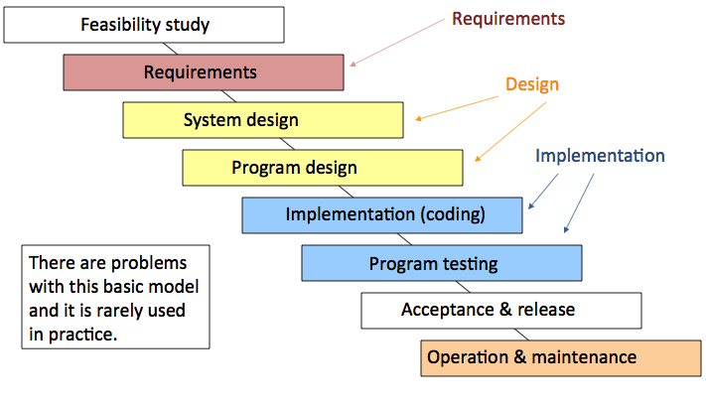
Sequential Model: Waterfall Model

Slide 23
Waterfall Model Phases
Requirements analysis and definition
System and software design
Implementation and unit testing
Integration and system testing
Operation and maintenance
The main drawback of the waterfall model is the difficulty of accommodating change after the process is underway. One phase has to be complete before moving onto the next phase.

Slide 24
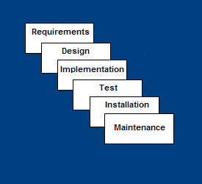
Waterfall Model
Requirements – defines needed information, function, behavior, performance and interfaces.
Design – data structures, software architecture, interface representations, algorithmic details.
Implementation – source code, database, user documentation, testing.

Slide 25
Waterfall Model
Test – check if all code modules work together and if the system as a whole behaves as per the specifications.
Installation – deployment of system, user-training.
Maintenance – bug fixes, added functionality (an on-going process).

Slide 26
Waterfall Strengths
Easy to understand, easy to use
Provides structure to inexperienced staff
Milestones are well understood
Sets requirements stability
Good for management control (plan, staff, track)

Slide 27
Waterfall Deficiencies
All requirements must be known upfront
Deliverables created for each phase are considered frozen – inhibits flexibility
Does not reflect problem-solving nature of software development – iterations of phases
Integration is one big bang at the end
Little opportunity for customer to preview the system (until it may be too late)

Slide 28
When to use Water Fall Model
Requirements are very well known
When it is possible to produce a stable design
E.g. a new version of an existing product
E.g. porting an existing product to a new platform.

Slide 29
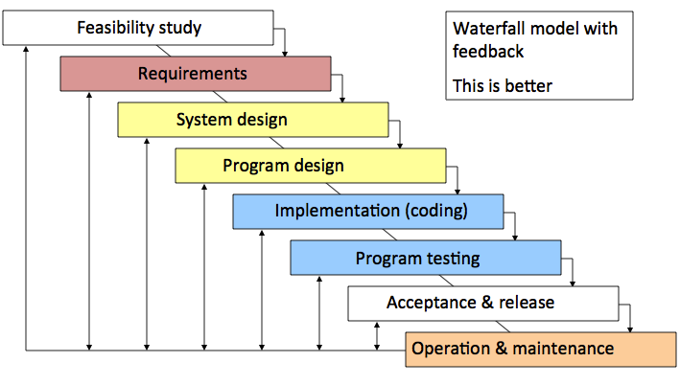
Modified Waterfall Model

Slide 30
Incremental Process Model
Combines elements of the waterfall model applied in an iterative fashion.
Incremental applies linear sequences as the calendar time progress.
Limited software functionalities and expands functionalities in later software release.

Slide 31
Incremental Model
Each linear sequence produces a deliverable increment of the software
E.g. Word processing software
First increment is often a core product
Basic requirements are addressed, but many supplementary remains undelivered.
Customers evaluate this core product and the next increment is planned based on suggestions and next set of features
The plan addresses the modification of core product and delivery of additional features and functionalities.
Process is repeated until complete product is produced.

Slide 32
Incremental Model Strengths
Develop high-risk or major functions first
Each release delivers an operational product
Customer can respond to each build
Uses “divide and conquer” breakdown of tasks
Lowers initial delivery cost
Initial product delivery is faster
Customers get important functionality early
Risk of changing requirements is reduced

Slide 33
Incremental Model Weaknesses
Requires good planning and design
Requires early definition of a complete and fully functional system to allow for the definition of increments
Well-defined module interfaces are required (some will be developed long before others)
Total cost of the complete system is not lower

Slide 34
When to use the Incremental Model
Risk, funding, schedule, program complexity, or need for early realization of benefits.
Most of the requirements are known up-front but are expected to evolve over time
A need to get basic functionality to the market early
On projects which have lengthy development schedules
On a project with new technology
Useful when
Staff is unavailable for complete implementation and deadline is tight
If core product is well received, additional staff can implement next increment
Increment can be planned to manage technical risks
Partial functionalities can be delivered to end – user without inordinate delay.

Slide 35
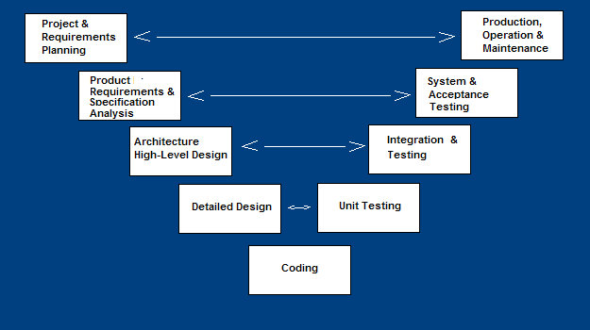
V-Shaped Process Model
A variant of the Waterfall that emphasizes the verification and validation of the product.
Testing of the product is planned in parallel with a corresponding phase of development

Slide 36
V-Shaped Steps
Project and Requirements Planning – allocate resources
Product Requirements and Specification Analysis – complete specification of the software system
Architecture or High-Level Design – defines how software functions fulfill the design
Detailed Design – develop algorithms for each architectural component
Coding – transform algorithms into software
Unit testing – check that each module acts as expected
Integration and Testing – check that modules interconnect correctly
System and acceptance testing – check the entire software system in its environment
Production, operation and maintenance – provide for enhancement and corrections

Slide 37
V-Shaped Strengths
Emphasize planning for verification and validation of the product in early stages of product development
Each deliverable must be testable
Project management can track progress by milestones
Easy to use

Slide 38
V-Shaped Weaknesses
Does not easily handle concurrent events
Does not handle iterations or phases
Does not easily handle dynamic changes in requirements

Slide 39
When to use the V-Shaped Model
Excellent choice for systems requiring high reliability – hospital patient control applications
All requirements are known up-front
When design is stable
Solution and technology are known

Slide 40
Evolutionary Process Model
These models are more suited to object oriented systems.
They are iterative.
They enable the software developer to develop increasingly more complex versions of the software
Like all complex systems, software evolves over a period of time and hence evolutionary models are more suited to software development.
Requirements change while software gets developed.

Slide 41
Evolutionary development
Exploratory development
Objective is to work with customers and to evolve a final system from an initial outline specification. Should start with well-understood requirements and add new features as proposed by the customer.
Throw-away prototyping
Objective is to understand the system requirements. Should start with poorly understood requirements to clarify what is really needed.

Slide 42
Evolutionary development

Slide 43
Evolutionary Development
Problems
Lack of process visibility;
Systems are often poorly structured;
Special skills (e.g. in languages for rapid prototyping) may be required.
Applicability
For small or medium-size interactive systems;
For parts of large systems (e.g. the user interface);
For short-lifetime systems.

Slide 44
Evolutionary Process Models
Evolutionary Process Models
Prototyping
The Spiral Model

Slide 45
Prototyping Model
Developers build a prototype during the requirements phase
Prototype is evaluated by end users
Developer may be unsure about efficiency of algorithm, adaptability of OS, or human-machine interaction
Users give corrective feedback
Developers further refine the prototype
When the user is satisfied, the prototype code is brought up to the standards needed for a final product.
Used as standalone Process model
Used as a technique implemented in any process model

Slide 46
Prototyping Steps
A preliminary project plan is developed
An partial high-level paper model is created
The model is source for a partial requirements specification
A prototype is built with basic and critical functions
The designer builds
the database
user interface
algorithmic functions
The designer demonstrates the prototype, the user evaluates for problems and suggests improvements.
This loop continues until the user is satisfied

Slide 47
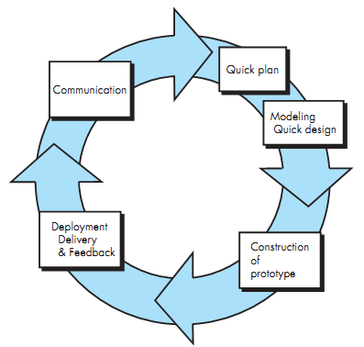
Prototype Model

Slide 48
Prototyping Strengths
Customers can “see” the system requirements as they are being gathered
Developers learn from customers
A more accurate end product
Unexpected requirements accommodated
Allows for flexible design and development
Steady, visible signs of progress produced
Interaction with the prototype stimulates awareness of additional needed functionality

Slide 49
Prototyping Weaknesses
Tendency to abandon structured program development for “code-and-fix” development
Bad reputation for “quick-and-dirty” methods
Overall maintainability may be overlooked
Process may continue forever (scope creep)
It is a thrown away prototype when the users are confused with it

Slide 50
When to use Prototyping
Requirements are unstable or have to be clarified
As the requirements clarification stage of a waterfall model
Develop user interfaces
New, original development

Slide 51
Spiral Model
Proposed by Barry Boehm - Evolutionary software process model
Couples Iterative nature of prototyping + waterfall model
Potential for rapid development of increasingly more complete version of software
Spiral Model - software is developed in a series of evolutionary releases.
Early iteration - Paper model / prototype (trial product)
Later increasingly more complete version of engineering software is produced

Slide 52
Spiral development
Process is represented as a spiral rather than as a sequence of activities with backtracking.
Each loop in the spiral represents a phase in the process.
No fixed phases such as specification or design - loops in the spiral are chosen depending on what is required.
Risks are explicitly assessed and resolved throughout the process.

Slide 53
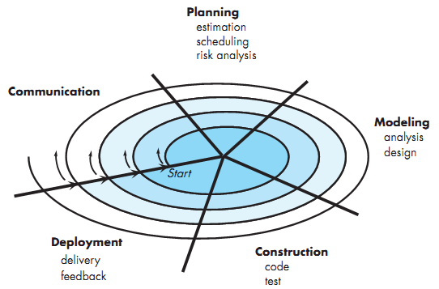
Spiral Model

Slide 54
Spiral model of the software process

Slide 55
Spiral Model Sectors
Objective setting
Specific objectives for the phase are identified.
Risk assessment and reduction
Risks are assessed and activities put in place to reduce the key risks.
Development and validation
A development model for the system is chosen which can be any of the generic models.
Planning
The project is reviewed and the next phase of the spiral is planned.

Slide 56
Spiral Model Strengths
Provides early indication of insurmountable risks, without much cost
Users see the system early because of rapid prototyping tools
Critical high-risk functions are developed first
The design does not have to be perfect
Users can be closely tied to all lifecycle steps
Early and frequent feedback from users
Cumulative costs assessed frequently

Slide 57
Spiral Model Weaknesses
Time spent for evaluating risks too large for small or low-risk projects
Time spent planning, resetting objectives, doing risk analysis and prototyping may be excessive
The model is complex
Risk assessment expertise is required
Spiral may continue indefinitely
Developers must be reassigned during non-development phase activities
May be hard to define objective, verifiable milestones that indicate readiness to proceed through the next iteration

Slide 58
When to use Spiral Model
When creation of a prototype is appropriate
When costs and risk evaluation is important
For medium to high-risk projects
Long-term project commitment unwise because of potential changes to economic priorities
Users are unsure of their needs
Requirements are complex
New product line
Significant changes are expected (research and exploration)

Slide 59
The Rational Unified Process
A modern process model derived from the work on the UML and associated process.
Normally described from 3 perspectives
A dynamic perspective that shows phases over time;
A static perspective that shows process activities;
A proactive perspective that suggests good practice.

Slide 60
RUP phase model

Slide 61
RUP phases
Inception
Establish the business case for the system.
Elaboration
Develop an understanding of the problem domain and the system architecture.
Construction
System design, programming and testing.
Transition
Deploy the system in its operating environment.

Slide 62
RUP good practice
Develop software iteratively
Manage requirements
Use component-based architectures
Visually model software
Verify software quality
Control changes to software

Slide 63
Component-based software engineering
Based on systematic reuse where systems are integrated from existing components or COTS (Commercial-off-the-shelf) systems.
Process stages
Component analysis;
Requirements modification;
System design with reuse;
Development and integration.
This approach is becoming increasingly used as component standards have emerged.

Slide 64
Reuse-oriented development

Slide 65
Corporate Processes
Large software development organizations have their own internal processes that are designed for their needs. For example:
• Amazon.com (Internet commerce) makes extensive use of sprints. Most software development is divided into increments of about four weeks elapsed time.
• SAP (business software) emphasizes the functionality that is seen by their business customers. Much of the development is suitable for a sequential process.
• Microsoft (PC software) places great emphasis on testing with a very wide variety of equipment and backward compatibility. Much of the development uses a spiral process.

Slide 66
Process iteration
System requirements ALWAYS evolve in the course of a project so process iteration where earlier stages are reworked is always part of the process for large systems.
Iteration can be applied to any of the generic process models.
Two (related) approaches
Incremental delivery
Spiral development.

Slide 67
Incremental delivery
Rather than deliver the system as a single delivery, the development and delivery is broken down into increments with each increment delivering part of the required functionality.
User requirements are prioritised and the highest priority requirements are included in early increments.
Once the development of an increment is started, the requirements are frozen though requirements for later increments can continue to evolve.

Slide 68
Incremental development

