Slide 1
Lecture 04 Requirements Engineering
Software Engineering

Slide 2
What is a Requirement?
It may range from a high-level abstract statement of a service or of a system constraint to a detailed mathematical functional specification.
This is inevitable as requirements may serve a dual function
May be the basis for a bid for a contract - therefore must be open to interpretation;
May be the basis for the contract itself - therefore must be defined in detail;
Both these statements may be called requirements.

Slide 3
Requirements Engineering
The requirements for a system are the descriptions of what the system should do
The process of establishing the services that the customer requires from a system and the constraints under which it operates and is developed.
The process of finding out, analyzing, documenting and checking these services and constraints is called requirements engineering (RE)

Slide 4
The Requirements Engineering Process

Slide 5
Requirements Engineering Process
The processes used for RE vary widely depending on the application domain, the people involved and the organisation developing the requirements.
However, there are a number of generic activities common to all processes
Requirements elicitation;
Requirements analysis;
Requirements Specification;
Requirements validation;
Requirements management.

Slide 6
Requirements Engineering
Requirements Engineering
Requirements Elicitation
Requirements Analysis
Requirements Specification
Requirements Verification
Requirements Management

Slide 7
Steps in Requirement Phase
The requirements part of a project can be divided into several stages:
Analysis to establish the system's services, constraints, and goals by consultation with client, customers, and users.
Modelling to organize the requirements in a systematic and comprehensible manner.
Define, record, and communicate the requirements.

Slide 8
Requirements Elicitation and Analysis
Sometimes called requirements elicitation or requirements discovery.
Involves technical staff working with customers to find out about the application domain, the services that the system should provide and the system’s operational constraints.
May involve end-users, managers, engineers involved in maintenance, domain experts, trade unions, etc. These are called stakeholders.

Slide 9
Requirements Elicitation and analysis
Software engineers work with a range of system stakeholders to find out about the application domain, the services that the system should provide, the required system performance, hardware constraints, other systems, etc.
Stages include:
Requirements discovery,
Requirements classification and organization,
Requirements prioritization and negotiation,
Requirements specification.

Slide 10
Problems of Requirements Analysis
Stakeholders don’t know what they really want.
Stakeholders express requirements in their own terms.
Different stakeholders may have conflicting requirements.
Organisational and political factors may influence the system requirements.
The requirements change during the analysis process. New stakeholders may emerge and the business environment change.

Slide 11
Process activities
Requirements discovery
Interacting with stakeholders to discover their requirements. Domain requirements are also discovered at this stage.
Requirements classification and organisation
Groups related requirements and organises them into coherent clusters.
Prioritisation and negotiation
Prioritising requirements and resolving requirements conflicts.
Requirements specification
Requirements are documented and input into the next round of the spiral.

Slide 12
Requirements and design
In principle, requirements should state what the system should do and the design should describe how it does this.
In practice, requirements and design are inseparable
A system architecture may be designed to structure the requirements;
The system may inter-operate with other systems that generate design requirements;
The use of a specific architecture to satisfy non-functional requirements may be a domain requirement.

Slide 13
Requirements Specification
The process of writing don the user and system requirements in a requirements document.
User requirements have to be understandable by end-users and customers who do not have a technical background.
System requirements are more detailed requirements and may include more technical information.
The requirements may be part of a contract for the system development
It is therefore important that these are as complete as possible.

Slide 14
Software Requirement Specification
A software requirements specification (SRS) is a complete description of the behavior of the system to be developed
A document that clearly and precisely describes, each of the essential requirements of the software and the external interfaces.
(functions, performance, design constraint, and quality attributes)
Each requirement is defined in such a way that its achievement is capable of being objectively verified by a prescribed method; for example inspection, demonstration, analysis, or test.

Slide 15
The Software Requirements Document
The software requirements document is the official statement of what is required of the system developers.
Should include both a definition of user requirements and a specification of the system requirements.
It is NOT a design document. As far as possible, it should set of WHAT the system should do rather than HOW it should do it.

Slide 16
Requirements Document Variability
Information in requirements document depends on type of system and the approach to development used.
Systems developed incrementally will, typically, have less detail in the requirements document.
Requirements documents standards have been designed e.g. IEEE standard. These are mostly applicable to the requirements for large systems engineering projects.
Discuss SRS document Template

Slide 17
Natural language specification
Requirements are written as natural language sentences supplemented by diagrams and tables.
Used for writing requirements because it is expressive, intuitive and universal. This means that the requirements can be understood by users and customers.

Slide 18
Guidelines for writing requirements
Invent a standard format and use it for all requirements.
Use language in a consistent way. Use should for desirable requirements.
Use text highlighting to identify key parts of the requirement.
Avoid the use of computer jargon.
Include an explanation (rationale) of why a requirement is necessary.

Slide 19
Problems with natural language
Lack of clarity
Precision is difficult without making the document difficult to read.
Requirements confusion
Functional and non-functional requirements tend to be mixed-up.
Requirements amalgamation
Several different requirements may be expressed together.

Slide 20
Example requirements for the insulin pump software system
3.2 The system will measure the blood sugar and deliver insulin, if required, every 10 minutes. (Changes in blood sugar are relatively slow so more frequent measurement is unnecessary; less frequent measurement could lead to unnecessarily high sugar levels.) 3.6 The system will run a self-test routine every minute with the conditions to be tested and the associated actions defined in Table 1. (A self-test routine can discover hardware and software problems and alert the user to the fact the normal operation may be impossible.)

Slide 21
Form-based specifications
Definition of the function or entity.
Description of inputs and where they come from.
Description of outputs and where they go to.
Information about the information needed for the computation and other entities used.
Description of the action to be taken.
Pre and post conditions (if appropriate).
The side effects (if any) of the function.

Slide 22
Types of Requirement (Context)
User Requirements
Statements in natural language plus diagrams of the services the system provides and its operational constraints. Written for customers.
System Requirements
A structured document setting out detailed descriptions of the system’s functions, services and operational constraints. Defines what should be implemented so may be part of a contract between client and contractor.

Slide 23
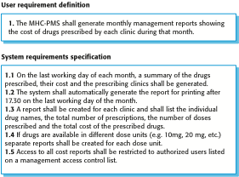
User and System Requirements

Slide 24
Domain Requirements
The system’s operational domain imposes requirements on the system.
For example, a train control system has to take into account the braking characteristics in different weather conditions.
Domain requirements be new functional requirements, constraints on existing requirements or define specific computations.
If domain requirements are not satisfied, the system may be unworkable.

Slide 25
Train protection system
This is a domain requirement for a train protection system:
The deceleration of the train will be computed as:
Dtrain = Dcontrol + Dgradient
where Dgradient is 9.81ms2 * compensated gradient/alpha and where the values of 9.81ms2 /alpha are known for different types of train.
It is difficult for a non-specialist to understand the implications of this and how it interacts with other requirements.

Slide 26
Types of Requirements: Functional and Non-Functional Requirements
Functional requirements
Statements of services the system should provide, how the system should react to particular inputs and how the system should behave in particular situations.
May state what the system should not do.
Non-Functional requirements
Constraints on the services or functions offered by the system such as timing constraints, constraints on the development process, standards, etc.
Often apply to the system as a whole rather than individual features or services.
In other words, a non-functional requirement will describe how a system should behave and what limits there are on its functionality.

Slide 27
Functional Requirements
What the system should do
Describe functionality or system services.
Depend on the type of software, expected users and the type of system where the software is used.
Functional user requirements may be high-level statements of what the system should do.
Functional system requirements should describe the system services in detail.

Slide 28
Functional Requirements for the MHC-PMS
A user will be able to search the appointments lists for all clinics.
The system will generate each day, for each clinic, a list of patients who are expected to attend appointments that day.
Each staff member using the system will be uniquely identified by his or her 8-digit employee number.

Slide 29
Non-functional requirements
These define system properties and constraints
e.g. reliability, response time and storage requirements.
Constraints on the system implementation
e.g. I/O device capability, data representations, etc.
Constrain characteristics of the system as a whole
such as performance, security, or availability
Non-functional requirements may be more critical than functional requirements. If these are not met, the system may be useless.
For example, if an aircraft system does not meet its reliability requirements, it will not be certified as safe for operation
if an embedded control system fails to meet its performance requirements, the control functions will not operate correctly

Slide 30
Non-functional requirements implementation
Non-functional requirements may affect the overall architecture of a system rather than the individual components.
For example, to ensure that performance requirements are met, you may have to organize the system to minimize communications between components.
A single non-functional requirement, such as a security requirement, may generate a number of related functional requirements that define system services that are required.
It may also generate requirements that restrict existing requirements.

Slide 31
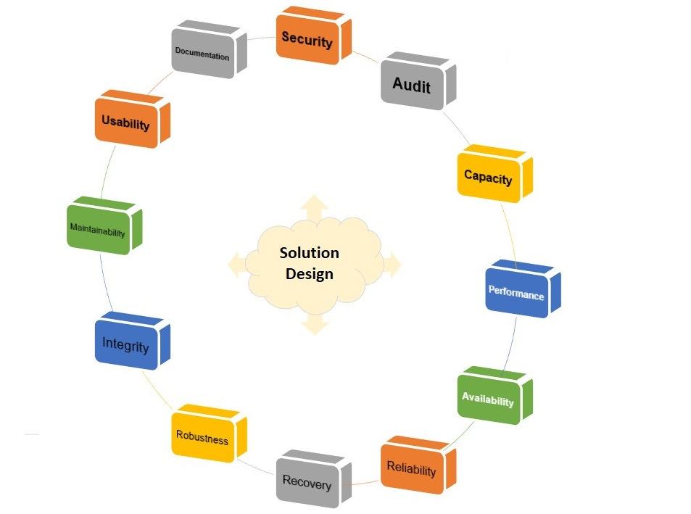
Non-functional Requirements

Slide 32
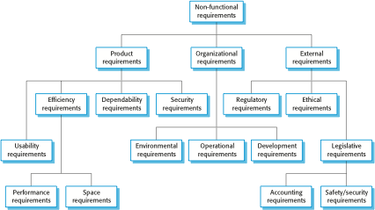
Types of Non-Functional Requirement

Slide 33
Non-Functional Requirement Classifications
Product requirements
Requirements which specify that the delivered product must behave in a particular way e.g. execution speed, reliability, etc.
Organisational requirements
Requirements which are a consequence of organisational policies and procedures e.g. process standards used, implementation requirements, etc.
External requirements
Requirements which arise from factors which are external to the system and its development process e.g. interoperability requirements, legislative requirements, etc.

Slide 34
Examples of non-functional requirements in the MHC-PMS
Product requirement The MHC-PMS will be available to all clinics during normal working hours (Mon–Fri, 0830–17.30). Downtime within normal working hours will not exceed five seconds in any one day. Organizational requirement Users of the MHC-PMS system will authenticate themselves using their health authority identity card. External requirement The system will implement patient privacy provisions as set out in HStan-03-2006-priv.

Slide 35
NFR- Goals and Requirements
A common problem with non-functional requirements is that users or customers often propose these requirements as general goals
Non-functional requirements may be very difficult to state precisely and imprecise requirements may be difficult to verify.
Goal
A general intention of the user such as ease of use.
Verifiable non-functional requirement
A statement using some measure that can be objectively tested.
Goals are helpful to developers as they convey the intentions of the system users.

Slide 36
Usability requirements
How a manager might express usability requirements as GOAL
The system should be easy to use by medical staff and should be organized in such a way that user errors are minimized. (Goal)
How the goal could be expressed as a ‘testable’ nonfunctional requirement
Medical staff will be able to use all the system functions after four hours of training.
After this training, the average number of errors made by experienced users will not exceed two per hour of system use. (Testable non-functional requirement)

Slide 37
Metrics for Specifying Non-Functional Requirements
Property | Measure
Speed | Processed transactions/second User/event response time Screen refresh time
Size | Mbytes Number of ROM chips
Ease of use | Training time Number of help frames
Reliability | Mean time to failure Probability of unavailability Rate of failure occurrence Availability
Robustness | Time to restart after failure Percentage of events causing failure Probability of data corruption on failure
Portability | Percentage of target dependent statements Number of target systems

Slide 38
Requirements Imprecision
Problems arise when requirements are not precisely stated.
Ambiguous requirements may be interpreted in different ways by developers and users.
Consider the term ‘search’ in requirement 1
User intention – search for a patient name across all appointments in all clinics;
Developer interpretation – search for a patient name in an individual clinic. User chooses clinic then search.

Slide 39
Requirements Completeness and Consistency
In principle, requirements should be both complete and consistent.
Complete
They should include descriptions of all facilities required.
Consistent
There should be no conflicts or contradictions in the descriptions of the system facilities.
In practice, it is impossible to produce a complete and consistent requirements document.

Slide 40
Requirements Characteristic
Good requirements should have the following characteristics:
Unambiguous
Testable (verifiable)
Clear (concise, terse, simple, precise)
Correct
Understandable
Feasible (realistic, possible)
Independent
Atomic
Necessary
Implementation-free (abstract)

Slide 41
Good and Bad Requirements
R1: Only authorized persons are allowed to enter the building.
R2: The doorbell button will be blue, round, and with a diameter of 20 mm.
R1 is a goal,
R2 is a detailed specification
R2 is in fact three different requirements.

Slide 42
Good and Bad Requirements - Example 2
R4: The system will play the sound ’alarm’ when the door is opened.
R4: The system will play the sound ’C:\alarm.wav’ once, at the highest volume setting in the main speaker for the building when the door opens.

Slide 43
Good and Bad Requirements - Example 3
R5: The system will respond quickly to user interaction.
R5: The system will respond to user interaction within maximum 2 seconds, minimum 0.2 seconds, average 1 second (with a CPU load of 0.5).

Slide 44
Good and Bad Requirements - Example 4
R6: There are four classes of users in the system: Maintainer, Administrator, Normal User, Guest.
R7: A Guest User is able to enter areas X1, X2, and X3.
R8: A Normal User is able to enter all areas in the building.
R9: An Administrator is a Normal User who also have the right to add/modify/delete users in the system.
R10: A Maintainer is a Guest who is also able to enter area X99 and perform backups, view system logs, and add/modify/delete users.

Slide 45
Example 4 cont…..
R6: Users and their access rights are listed in Table 1
User Class | Area X1 | ……….. | Area X99 | Add/modify/ delete users | Backups | View Logs
Guest | Yes |  | No | No | No | No
Normal user | Yes |  | Yes | No | No | No
Administrator | Yes |  | Yes | Yes | No | Yes
Maintainer | NO |  | Yes | Yes | Yes | Yes

Slide 46
Good and Bad Requirements - Example 5
R11: When a user enters a correct code, the door will open.
R11: When a user enters the code associated with him/her on keypad K2 the door D2 will unlock and remain unlocked for 30 seconds.

Slide 47
Good and Bad Requirements - Example 6
R12: When a user has entered the building, this will be registered in the entry log and the user’s computer will be booted.
R12: When a user has entered the building, this will be registered in the entry log.
R13: When a user has entered the building, the user’s computer will be booted.
R12: The system will register in the entry log when a user has entered the building.

Slide 48
Requirements Discovery
The process of gathering information about the required and existing systems and distilling the user and system requirements from this information.
Interaction is with system stakeholders from managers to external regulators.
Sources of information may include documentation, system stakeholders, and specifications of similar systems
Systems normally have a range of stakeholders.

Slide 49
Stakeholders in the MHC-PMS
Patients whose information is recorded in the system.
Doctors who are responsible for assessing and treating patients.
Nurses who coordinate the consultations with doctors and administer some treatments.
Medical receptionists who manage patients’ appointments.
IT staff who are responsible for installing and maintaining the system.

Slide 50
Techniques of Eliciting Requirements
Analysts can employ several techniques to elicit the requirements from the customer.
Survey/Questionnaire
Focus groups (requirements workshops) and creating requirements lists.
Naturalistic observation
Document Analysis
Interviews
Ethnography
Prototyping
Use cases
Brainstorming
Combination of these methods will be good choice.

Slide 51
Questionnaires
Questionnaires: Series of questions designed to elicit specific information from us. The questions may require different kinds of answers: some require a simple Yes/No, others ask us to choose from a set of pre-supplied answers.
SurveyMonkey
Popular solution to let you design and distribute questionnaires
Runs ‘in the cloud’
Lime Survey
A free online tool that can be installed directly onto the researcher’s system, thus avoiding storage of data in the cloud (better control of confidential data)

Slide 52
Focus groups and workshops
Focus groups and workshops: Interviews tend to be one on one, and elicit only one person’s perspective. It can be very revealing to get a group of stakeholders together to discuss issues and requirements.

Slide 53
Document Analysis
Studying documentation: Procedures and rules are often written down in a manual and these are a good source of data about the steps involved in an activity and any regulations governing a task.
Four types of useful documents
Written work procedures
Describes how a job is performed
Includes data and information used and created in the process of performing the job or task
Business form
Explicitly indicate data flow in or out of a system
Report
Enables the analyst to work backwards from the report to the data that generated it
Description of current information system

Slide 54
Interviewing
Interviews: Interviews involve asking someone a set of questions. Often interviews are face-to-face, but they don’t have to.
Formal or informal interviews with stakeholders are part of most RE processes.
Types of interview
Closed interviews based on pre-determined list of questions
Open interviews where various issues are explored with stakeholders.
Effective interviewing
Be open-minded, avoid pre-conceived ideas about the requirements and are willing to listen to stakeholders.
Prompt the interviewee to get discussions going using a springboard question, a requirements proposal, or by working together on a prototype system.

Slide 55
Ethnography
Ethnography is an observational technique that can be used to understand operational processes and help derive requirements for these processes. It helps discover the implicit system requirements that reflect the actual way that people work rather than formal processes defined by the organization.

Slide 56
Ethnography
Particularly useful for discovering the following two types of requirements:
Requirements that are derived from the way in which people actually work, rather than the way in which process definitions say they ought to work.
For example, air traffic controllers may switch off a conflict alert system that detects aircraft with intersecting flight paths, even though normal control procedures specify that it should be used. They deliberately put the aircraft on conflicting paths for a short time to help manage the airspace. Their control strategy is designed to ensure that these aircrafts are moved apart before problems occur and they find that the conflict alert alarm distracts them from their work.
Requirements that are derived from cooperation and awareness of other people’s activities.
For example, air traffic controllers may use an awareness of other controllers’ work to predict the number of aircrafts that will be entering their control sector. They then modify their control strategies depending on that predicted workload. Therefore, an automated ATC system should allow controllers in a sector to have some visibility of the work in adjacent sectors.

Slide 57
Scenarios
Scenarios are real-life examples of how a system can be used.
They should include
A description of the starting situation;
A description of the normal flow of events;
A description of what can go wrong;
Information about other concurrent activities;
A description of the state when the scenario finishes.

Slide 58
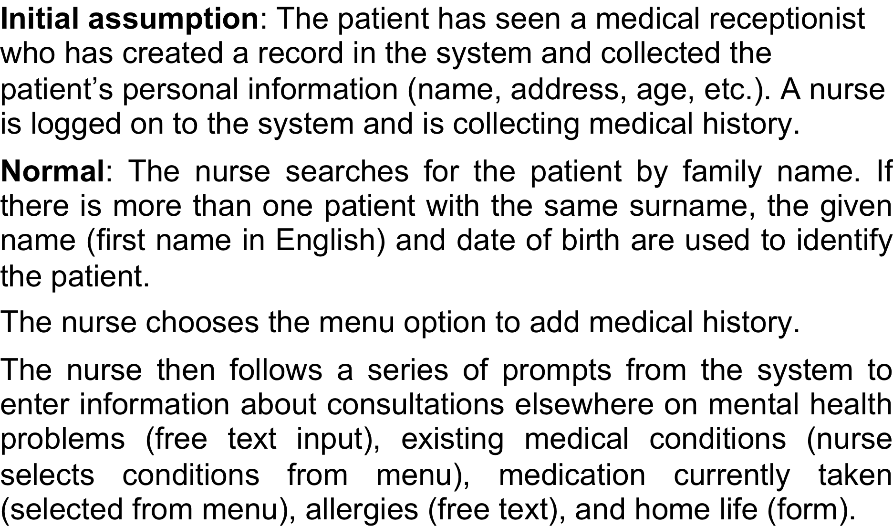
Scenario for collecting medical history in MHC-PMS

Slide 59
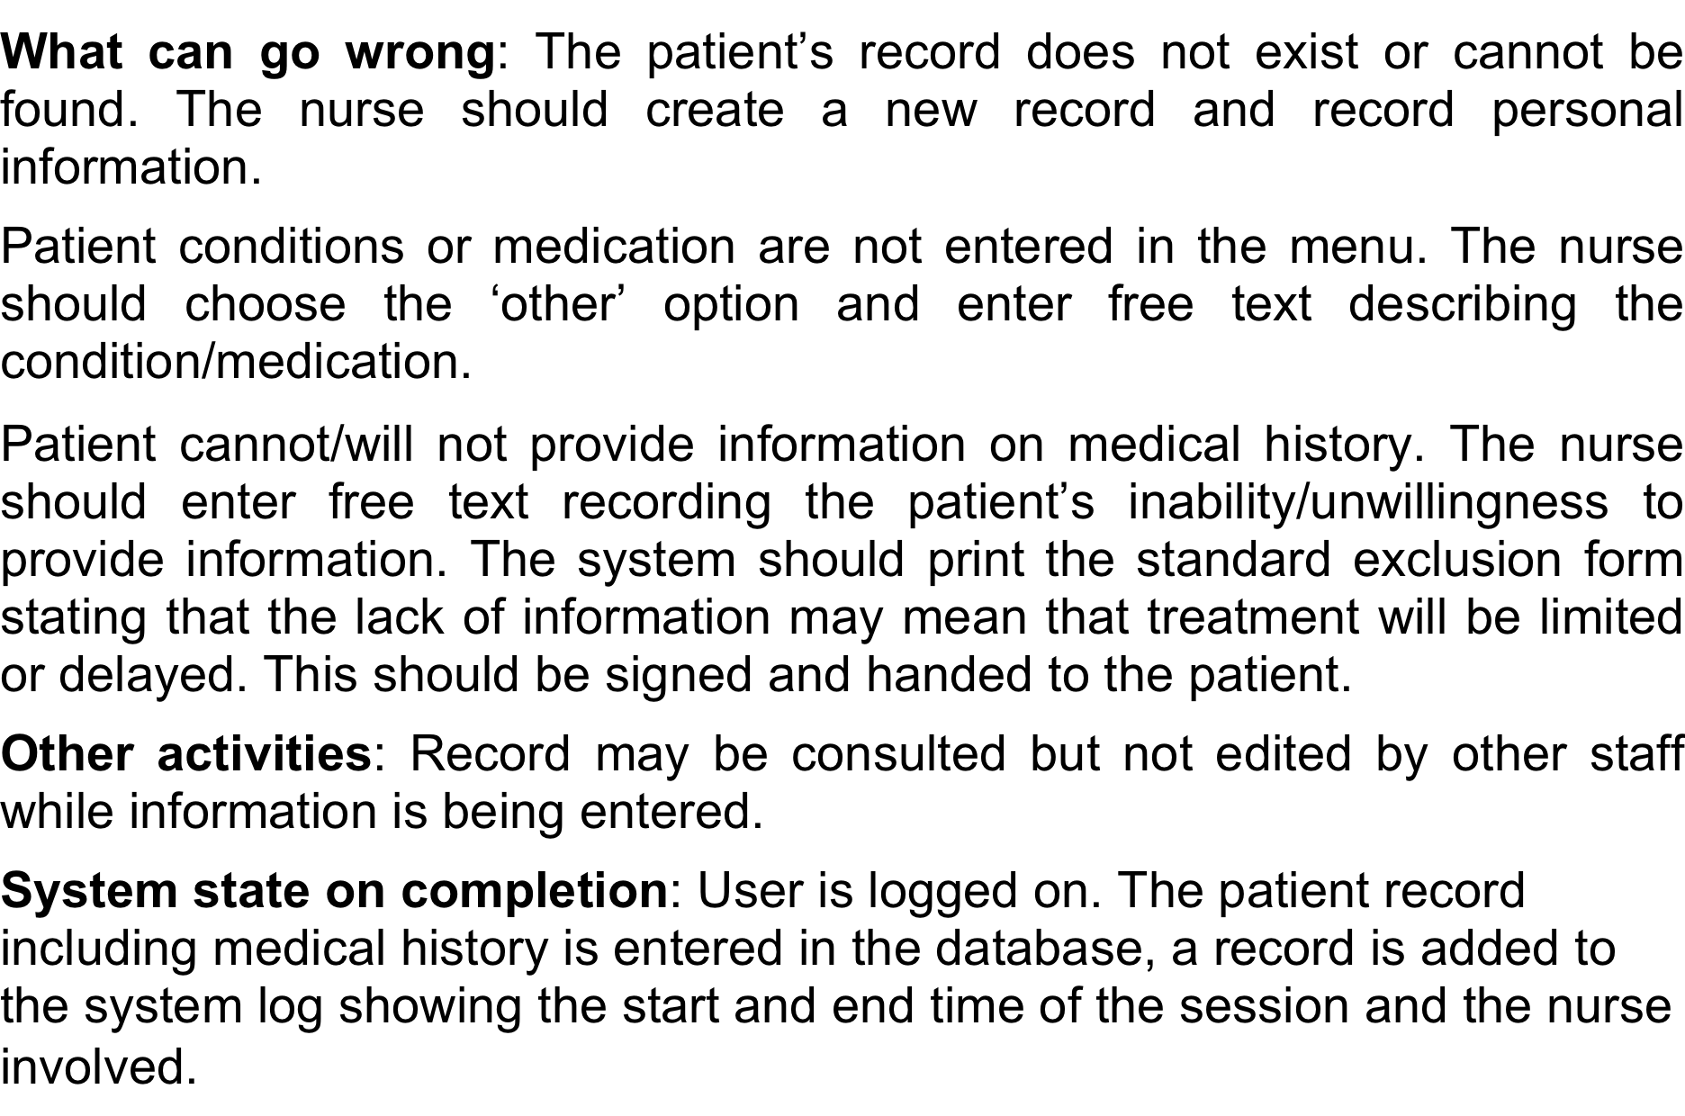
Scenario for collecting medical history in MHC-PMS

Slide 60
Functional Requirement – Example-1
Identifier | 1.2.1
Title | Edit Application
Requirement | The students must be able to access the main application tab so that they can edit their application and complete all the requirements of the application in order to apply to the universities they intends to
Source | Discover Your Future
Rationale | To ensure that the student provides all the necessary details required
Restrictions and Risk | All the fields of the application have to be full filled in order to submit an application
Dependencies | 1.1.1
Priority | High

Slide 61
Functional Requirement – Example-2
Identifier | 1.1.1
Title | Login/Register
Requirement | A student should be able to register and log in to the system
Source | Discover Your Future
Rationale | Without login or registration the student cannot use the system
Restrictions and Risk | The student must remember the credentials and keep it safe
Dependencies | 1.1.2
Priority | High

Slide 62
Requirements validation
Concerned with demonstrating that the requirements define the system that the customer really wants.
Requirements error costs are high so validation is very important
Fixing a requirements error after delivery may cost up to 100 times the cost of fixing an implementation error.

Slide 63
Requirements checking
Validity. Does the system provide the functions which best support the customer’s needs?
Consistency. Are there any requirements conflicts?
Completeness. Are all functions required by the customer included?
Realism. Can the requirements be implemented given available budget and technology
Verifiability. Can the requirements be checked?

Slide 64
Requirements Validation Techniques
Requirements reviews
Systematic manual analysis of the requirements.
Prototyping
Using an executable model of the system to check requirements.
Test-case generation
Developing tests for requirements to check testability.

Slide 65
Requirements Management
Requirements management is the process of managing changing requirements during the requirements engineering process and system development.
New requirements emerge as a system is being developed and after it has gone into use.
You need to keep track of individual requirements and maintain links between dependent requirements so that you can assess the impact of requirements changes. You need to establish a formal process for making change proposals and linking these to system requirements.

Slide 66
Requirements Management Planning
Establishes the level of requirements management detail that is required.
Requirements management decisions:
Requirements identification Each requirement must be uniquely identified so that it can be cross-referenced with other requirements.
A change management process This is the set of activities that assess the impact and cost of changes. I discuss this process in more detail in the following section.
Traceability policies These policies define the relationships between each requirement and between the requirements and the system design that should be recorded.
Tool support Tools that may be used range from specialist requirements management systems to spreadsheets and simple database systems.

Slide 67
Requirements Change Management
Deciding if a requirements change should be accepted
Problem analysis and change specification
During this stage, the problem or the change proposal is analyzed to check that it is valid. This analysis is fed back to the change requestor who may respond with a more specific requirements change proposal, or decide to withdraw the request.
Change analysis and costing
The effect of the proposed change is assessed using traceability information and general knowledge of the system requirements. Once this analysis is completed, a decision is made whether or not to proceed with the requirements change.
Change implementation
The requirements document and, where necessary, the system design and implementation, are modified. Ideally, the document should be organized so that changes can be easily implemented.

Slide 68
Requirements Management Planning
During the requirements engineering process, you have to plan:
Requirements identification
How requirements are individually identified;
A change management process
The process followed when analysing a requirements change;
Traceability policies
The amount of information about requirements relationships that is maintained;
CASE tool support
The tool support required to help manage requirements change;

Slide 69
Traceability
Traceability is concerned with the relationships between requirements, their sources and the system design
Source traceability
Links from requirements to stakeholders who proposed these requirements;
Requirements traceability
Links between dependent requirements;
Design traceability
Links from the requirements to the design;

Slide 70
A traceability matrix

Slide 71
CASE Tool Support
Requirements storage
Requirements should be managed in a secure, managed data store.
Change management
The process of change management is a workflow process whose stages can be defined and information flow between these stages partially automated.
Traceability management
Automated retrieval of the links between requirements.

Slide 72
Requirements Change management
Should apply to all proposed changes to the requirements.
Principal stages
Problem analysis. Discuss requirements problem and propose change;
Change analysis and costing. Assess effects of change on other requirements;
Change implementation. Modify requirements document and other documents to reflect change.

Slide 73
Requirements Change Management

Slide 74
Enduring and Volatile Requirements
Enduring requirements. Stable requirements derived from the core activity of the customer organisation. E.g. a hospital will always have doctors, nurses, etc. May be derived from domain models
Volatile requirements. Requirements which change during development or when the system is in use. In a hospital, requirements derived from health-care policy

