Slide 1
What is Software Architecture?
It may range from a high-level abstract statement of a service or of a system constraint to a detailed mathematical functional specification.
This is inevitable as requirements may serve a dual function
May be the basis for a bid for a contract - therefore must be open to interpretation;
May be the basis for the contract itself - therefore must be defined in detail;
Both these statements may be called requirements.

Slide 2
The Software Architecture
“The software architecture of a program or computing system is the structure or structures of the system, which comprise software components [and connectors], the externally visible properties of those components [and connectors] and the relationships among them.”
Software architecture defines the components that make up the system, but on the other hand, the properties and functionality of the components define the overall system functionality and behavior.

Slide 3
Role of the Software Architecture
❖The main uses of a software architecture are:
➢Assessment and evaluation
➢Configuration management
➢Dynamic software architectures

Slide 4
Assessment and Evaluation
Stakeholder-Based Assessment is concerned with determining whether the trade-offs between requirements in the software architecture match the actual stakeholder priorities of these requirements.
Expert-based Assessment a team of experienced architects and designers
Quality-Attribute Oriented Assessment aims at providing a quantitative prediction of one quality attribute (e.g. maintainability, performance, reliability or security)
QDR (Quality-Driven Re-engineering) Framework

Slide 5
Configuration Management
The software architecture is frequently used as a means to manage the configuration of the product.
5

Slide 6
Dynamic Software Architectures
The software architecture should reorganize itself in response to the dynamic change of the systems quality requirements.
Maintained even during run-time.
6

Slide 7
Architecture Design Process
Can be seen as a function that:
➢ Takes a requirement specification as input.
Generates an architectural design as output.
Is not an automated process, necessitating great effort and creativity from the involved software architects.
Is comprised of three steps:
Functionality-Based Design
Assessment of the Quality Attributes
➢ Architecture Transformation
7

Slide 8
Functionality-Based Design
The design process starts with functionality-based design and consists of four steps:
Defining the boundaries and context of the system.
Identification of archetypes.
Decomposition of the system into its main components.
The first validation of the architecture by describing a
number of system instances.
9

Slide 9
Assessment of the Quality Attributes
The second phase is the assessment of the quality attributes in which:
Each quality attribute is given an estimate:
scenario-based assessment, simulation, static analysis,
metrics-based models and expert-based assessment.
If all estimated quality attributes are as good or better than required, the architectural design process is finished
If not the third phase of software architecture design is entered: architecture transformation
10

Slide 10
Architecture Transformation
Is concerned with selecting design solutions to improve the quality attributes while preserving the domain functionality:
The design is again evaluated and the same process is repeated if necessary.
The transformations (i.e. quality attribute optimizing solutions) generally improve one or some quality attributes while they affect others negatively.

Slide 11

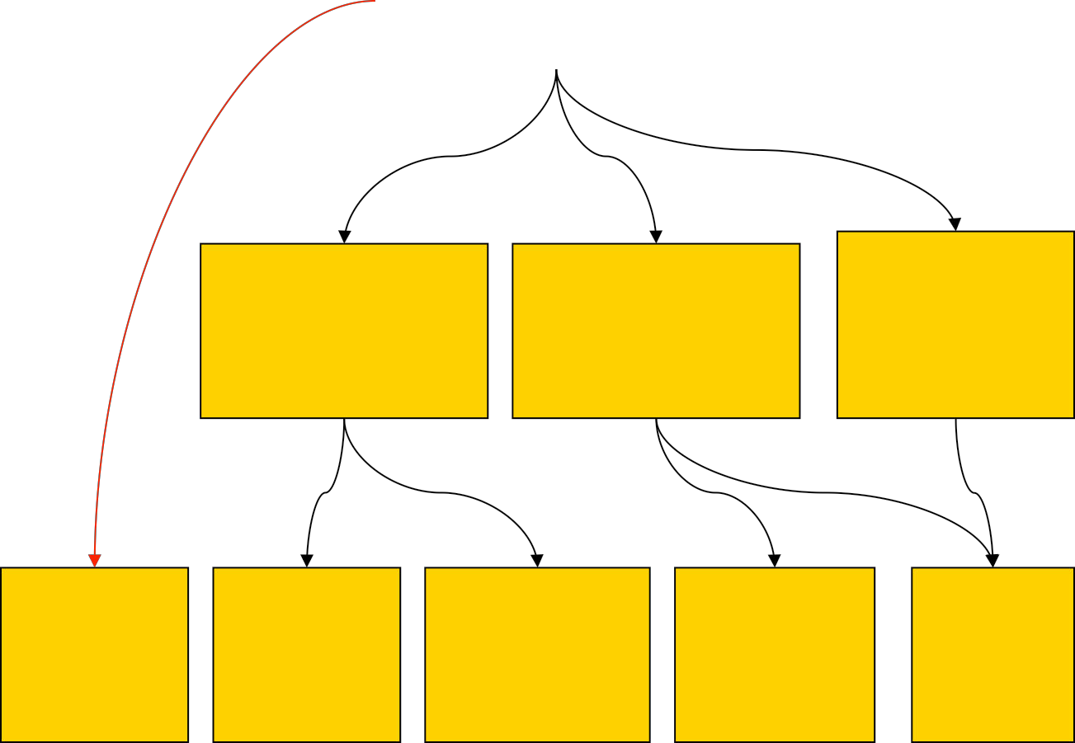
From Abstractions to Implementations
Abstract views (platform independent, Written in UML)
Abstract system architecture
Enterprise Middleware Architecture
Embedded System Architecture
Domain-specific Models
(Platform specific,
Written in UML with
extra notation)
Safety Critical Architecture
OO:
simple
Java: EJB, JMS, JSP
.NET: COM+, ASP
Implementations
CORBA
C
2

Slide 12

Semantics of Components
Unless components are bought off-the-shelf,
they still need to be implemented
An architecture should detail the semantics of components to be implemented
Semantics can be given by defining the finer-grain parts of a system that are to be used in the implementation of the components

Slide 13
Architectural Styles: Definitions
“Architectural styles are recurring patterns”.
“Established, shared understanding of common design forms is a mark of a mature engineering field”.
“Architectural style is an abstraction of recurring composition and interaction characteristics of a set of architectures”.
“Styles are key design idioms that enable exploitation of suitable structural and evolution patterns and facilitate component, connector, and process reuse”.

Slide 14
Basic Properties of Styles
A vocabulary of design elements
Component and Connector type:
(pipes, filters, clients, servers)
A set of configuration rules
Constraints that determine allowed compositions of
elements
(a component may be connected to at most two other components)
A semantic interpretation
Compositions of design elements have well-defined meanings
Explanation of what components are supposed to do in general
Explanation of how connections are meant to work

Slide 15
Benefits of Styles
Design reuse
well-understood solutions applied to new problems
Code reuse
shared implementations of invariant aspects of a style
Understandability of system organization
a phrase such as “client-server” conveys a lot of information
Interoperability
supported by style standardization
components can be independently developed with a particular
style in mind
Visualizations
style-specific depictions matching engineers’ mental models

Slide 16
Some Architectural Styles
Learning the following domain/platform-independent styles:
Pipes and Filters
2-Tiered (Client/Server)
N-Tiered
Layered
Blackboard
Model View Controller (MVC)
Object Oriented Style
Heterogeneous Styles
Pipes and filters were easy
The rest require a deeper understanding of connections

Slide 17
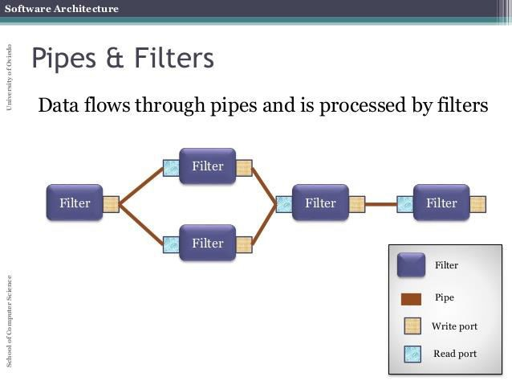
Style 1: Pipes and Filters
The pipe-and-filter architectural style has only one component and one connector type.
The component type is the filter and the connector type is the pipe.

Slide 18



Style 1: Pipes and Filters
Components are filters
transform input messages into output messages
All components of a pipe and filter architecture use the same interface
Input through provided interface
Output through required interface
Usually – one provided (input) interface and one required (output) interface
Connectors are pipes
simple connections between filters’ provided and required interfaces
Style invariants
filters are independent
a filter has no knowledge of up- and down-stream filters
Each filter exposes a very simple interface: it receives messages on the inbound pipe, processes the message, and publishes the results to the outbound pipe.
IFilter
IFilter
IFilter
Filter
Filter
Filter
20

Slide 19
Style 1: Pipes and Filters
Advantages
easy understanding of the system's behavior as the composition of filters
filter addition, replacement, and reuse
Disadvantages
batch organization of processing
interactive applications
lowest common denominator on data transmission
Commonly seen in
UNIX shells
Compilers
Signal Processing
But also useful style for Enterprise Systems

Slide 20

Style 1: PF Example
In many enterprise integration scenarios, a single event triggers a sequence of processing steps, each performing a specific function.
Consider an order processing system -- new orders
arrive from a client component in the form of a message.
Requirement 1: the message is encrypted to prevent eavesdroppers from spying on a customer's order.
Requirement 2: the messages contain authentication information in the form of a digital certificate to ensure that orders are placed only by trusted customers.

Slide 21

Style 1: PF Example
Consider an order processing system -- new orders arrive from a client component in the form of a message.
Requirement 3: duplicate messages could be sent from external parties (remember all the warnings on the popular shopping sites to click the 'Order Now' button only once?).
To avoid duplicate shipments and unhappy customers, we need to eliminate duplicate messages before subsequent order processing steps are initiated.
To meet these requirements, we need to transform a stream of possibly duplicated, encrypted messages containing extra authentication data into a stream of unique, simple plain-text order messages without the extraneous data fields.

Slide 22








Style 1: PF Example
Client
External client component – produces an order
message
IMessage
Decryption
Messages are input/ output using the same simple interface
–
transmit(msg:Object) is the method that transmits the message msg, typed
as an Object
<<Interface>>
IMessage
+transmit(msg:Object)
Deduplication
Authentication
IMessage
Order processing
system
OrderSystem

Slide 23





Style 1: PF Example
Pipes and filters lets us perform complex processing on a message while maintaining
flexibility
Because all components use the same external
composed into different solutions by connecting the components to different pipes
We can add new filters, omit existing ones or rearrange them into a new sequence -- all without having to change the filters themselves.
Client
Orders are no
Decryption
encrypted – but we want a log of each message
Logbook
Authentication
Deduplication
Better to authenticate
Deduplication
deduplicating
Authentication
OrderSystem

Slide 24


Style 2: 2-Tiered Client/Server
One of the most common styles in distributed systems
Components are clients and servers
Application logic is divided between clients and servers – two tiers
E.g., client could handle presentation logic, while the server handles business rules
and the database
Clients and servers may be composite
Constraints
Server provides services to the client, but doesn’t require
Clients require services of the server
A larger number of clients than servers
Semantics (meaning and implementation)
Servers do not know the number or identities of clients
Clients know server’s identity
Clients and servers are often distributed
Useful whenever there is a need to separate application logic into two tiers
Client
Server

Slide 25

Style 2: 2 Tiered Client/Server Example
Google offers its search engine as a webservice
A range of clients use SOAP to use the provided interface of the webservice
A webpage servlet client uses the webservice as part of its webpages
A .NET based b-2-c middleman application uses the webservice to search for best buys of products
Different clients have very different purposes – but the webservice server has the same functionality
It makes sense to keep web searching and client functionality separate – to both maximize on possible uses of the server and also to enable better maintenance
Multiplicities of usage are written on the sides of connected interfaces
In this example, the webservice can have many clients, so we put * on the clients’ required interfaces
Webpage (client)
*
Google webservice (server)
1
*
.NET
application
(client)

Slide 26
Style 3: N-Tiered
Similar to client/server, but with a set of components, acting as both clients and servers: servers can also be clients of other servers
Application logic is divided between the chain of components
e.g., client could handle presentation logic, while one server handles business rules, connected to another server that handles the database
Clients and servers may be composite
Constraints
Servers provides services to their clients, but doesn’t require
Clients require services of the server

Slide 27

Style 3: N-Tiered
Semantics
◻Servers do not know the number or identities
of their clients
◻ Clients know server’s identity
◻ Components are usually distributed
Useful whenever there is a need to separate application logic into software packages

Slide 28







3 Tiered Architecture
ClientView
Tier
CheckoutView
CatalogueView
Spamazon
<<delegate>>
OnlineBookstore
 | Checkout
Purchasing
Business Logic Tier
BookCatalogue
ElectronicCatalogue
LoyaltyProgram
<<delegate>>
<<delegate>>
Data
Tier
DBConnectivity
30

Slide 29

Style 3: N-Tiered
Advantages
◻Separation of concerns, divide and conquer approach to solving large scale software problem
◻ Maintenance
Disadvantages
◻Performance (especially if distributed components)

Slide 30
Style 4: Layered Architectures
Hierarchical system organization
“multi-level client-server”
Components are classified by layers
each layer exports an interface to be used by above layers
Constraints
Each layer acts as a 1-1 relation
Each layer communicates only with its neighbors below it
Connectors are protocols of layer interaction
Examples
Operating Systems
Network Communications

Slide 31




Style 4: Layered Architectures Example
HTTP – Protocol Stack
Each layer communicates to the next via an interface,
taking information according to a certain network
protocol
BrowserFunctions
Application Layer
HTTP
Request
ApplicationLayer
IHTTP
Transport Layer
Request
TCP
HTTP
TransportLayer
ITCP
Network
Layer
IP
TCP
HTTP
Request
NetworkLayer
IIP
Data Link Layer
Ethernet IP
TCP
HTTP
Request
DataLinkLayer
IEthernet
Physical Layer
PhysicalLayer

Slide 32

Style 4: Layered Architectures
Advantages
increasing abstraction levels
Maintainability – each layer’s role is defined
Reuse
Portability (replacing layers to work within a different context)
Disadvantages
not universally applicable – some components may be spread around different layers
Performance
determining the correct abstraction level
In practice – layer bridging may be required – a layer might need to communicate directly with a non- neighbour

Slide 33

Style 5: Blackboard (Repository)
Two kinds of components
Central data structure — blackboard or repository
Client components operate on and receive
information from the blackboard
System control is driven by the blackboard state
Constraints
One blackboard
1..n clients

Slide 34

A Closer Look at Connections
In UML 2, connections are understood as an architectural abstraction of usage between components
An abstraction of many possible implementations
Recall Java implementation of a connection: a reference to one component class A within another B
In such an implementation, the class object implementing A communicates with the object for B by calling methods on the B’s interface
This kind of communication is synchronous: if A calls a method on B and then A must waits for the method to finish computing and return before A can continue
A
B

Slide 35

Synchronous Communication
When we draw a connection in a UML 2 architecture, we could implement the connection as synchronous communication
UML 2 is completely implementation independent, so there is no native way to specify that a connection should correspond to synchronous communication
UML 2 lets us specify whatever
constraints we want via stereotypes
– <<synchronous>> stereotype to
denote that a connection should be implemented with synchronous semantics
:A
:B
Computation
Call to method
Computation
Method returns
Computation
A | <<sync
hronous>>
B

Slide 36

Asynchronous Communication
A can continue its computation immediately after invoking a method on B
:A
:B
Call from A does not require
that B return immediately
Computation
We use the
<<asynchronous>> stereotype to specify that a connector has this form of implementation semantics
Call to method
Computation
Computation
Possible method return
A | <<asyn
chronous>>
Computation
B

Slide 37
Style 5: Blackboard
Semantics
Client components encapsulate individual pieces of application functionality
Interaction between clients takes place only through the blackboard
Clients make changes to the blackboard that lead incrementally to a
desired outcome (e.g., solution to the application problem)
In an implementation, the blackboard is active -- state of the blackboard is a trigger for selecting processes to execute
Connections between components have a special semantics – “publish/ subscribe”
Clients subscribe to information provided by the blackboard,
registering the data they are interested in via required interfaces
The blackboard may publish a notification to clients when data of interest changes through provided interfaces
40

Slide 38
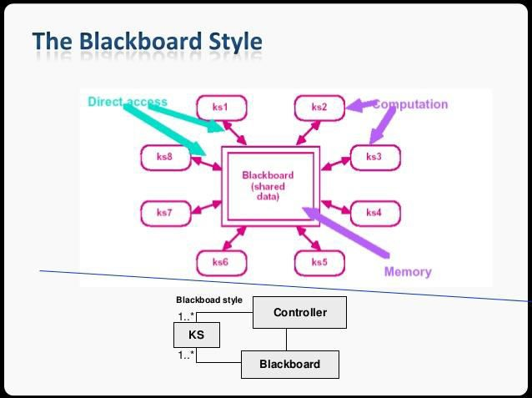
Style 5: Blackboard
The component types of the blackboard style are repositories and data processing components that use the repository.
The data processing elements interact with the repository by scanning the repository for required inputs, and by writing to the repository when appropriate.
41

Slide 39




Style 5: Blackboard Example 1
Examples
Often used for AI systems
Integrated software developments environments (e.g., Visual Studio,
Borland Development Environment, Eclipse)
Software development environment
One stateful repository component deals with the maintenance of a software
project’s code
Three stateless components present views on the code – a change in one will change the code in the repository – which will then result in parallel changes to the other views
Changing the class hierarchy (e.g., making one class now inherit from another) results in a change to code in the repository and consequent updates to the UML visual class structure and the code view
ClassHierarchyView
UMLView
RawCodeView
CodeRepository
<<publish-subscribe>>
50

Slide 40
Style 5: Blackboard Example 2
Holiday reservation system example: all reservations are ultimately stored on a database
Three components deal with different aspects of holiday reservation logic
Each component could connect to the database separately – especially as a change in one aspect (like date of air reservation) effects another aspect (like valid dates to book a hotel)
Solution: use an intermediate single
the database dealing with all data of a
user’s reservation
Three reservation logic components can change the blackboard
Components can also subscribe to be notified of important changes to the blackboard data
CarResView
HotelResView
AirResView
<<Publish/ Subscribe>>
ReservationState
DBConnectivity
Dates of aeroplane ticket changed –
ReservationState updated
ReservationState sends a notification if car reservation or hotel reservation dates do not lie within aeroplane dates
43

Slide 41

Style 5: Blackboard
Advantages
◻ Clients are relatively independent of each other
◻ Data store is independent of clients
Scalable (new clients can be added easily)
Modifiable, maintainable
◻ Data integration can be achieved through the
blackboard

Slide 42
Style 6: Model-View-Controller
Three different kinds of components
Model components are responsible for maintaining domain knowledge
View components are responsible for displaying information to the user
Controller components responsible for managing the sequence
of interactions with the user.
The model subsystems are designed such that they do not depend on any view or controller subsystems.
Changes in their states are propagated to the view
subsystems via a subscribe/notify protocol.

Slide 43

Style 6: Model-View-Controller
Semantics:
Model
encapsulates application state
exposes application functionality
Notifies View of changes (often implemented as publish/ subscribe)
View
Requests updates from models
Senders user gestures to controller
Allows controller to select view
Controller
Changes the state of the model
Maps user actions to model updates (often implemented as publish/subscribe)
Selects view for response
Model
State change
State query
Change
notification
View selection
View
Controller
User gestures

Slide 44
The Model-View-Controller (MVC)
Name | MVC (Model-View-Controller)
Description | Separates presentation and interaction from the system data. The system is structured into three logical components that interact with each other. The Model component manages the system data and associated operations on that data. The View component defines and manages how the data is presented to the user. The Controller component manages user interaction (e.g., key presses, mouse clicks, etc.) and passes these interactions to the View and the Model.
Example | Figure (next slide) shows the architecture of a web-based application system organized using the MVC pattern.
When used | Used when there are multiple ways to view and interact with data. Also used when the future requirements for interaction and presentation of data are unknown.
Advantages | Allows the data to change independently of its representation and vice versa. Supports presentation of the same data in different ways with changes made in one representation shown in all of them.
Disadvantages | Can involve additional code and code complexity when the data model and interactions are simple.

Slide 45
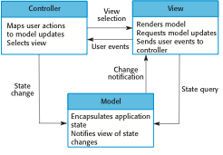
The organization of the Model-View-Controller

Slide 46
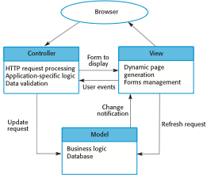
Web application architecture using the MVC pattern

Slide 47
Repository architecture
Sub-systems must exchange data. This may be done in two ways:
Shared data is held in a central database or repository and may be accessed by all sub-systems;
Each sub-system maintains its own database and passes data explicitly to other sub-systems.
When large amounts of data are to be shared, the repository model of sharing is most commonly used a this is an efficient data sharing mechanism.

Slide 48
The Repository pattern
Name | Repository
Description | All data in a system is managed in a central repository that is accessible to all system components. Components do not interact directly, only through the repository.
Example | Figure 6.9 is an example of an IDE where the components use a repository of system design information. Each software tool generates information which is then available for use by other tools.
When used | You should use this pattern when you have a system in which large volumes of information are generated that has to be stored for a long time. You may also use it in data-driven systems where the inclusion of data in the repository triggers an action or tool.
Advantages | Components can be independent—they do not need to know of the existence of other components. Changes made by one component can be propagated to all components. All data can be managed consistently (e.g., backups done at the same time) as it is all in one place.
Disadvantages | The repository is a single point of failure so problems in the repository affect the whole system. May be inefficiencies in organizing all communication through the repository. Distributing the repository across several computers may be difficult.

Slide 49
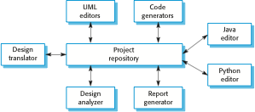
A repository architecture for an IDE

Slide 50

Heterogeneous Styles
Combining different architectural styles
Large architectures involving a combination of functionalities often entail a combination of styles in the best solution
Challenge: Ensure advantages of individual style choices are not
negated by their combination
Good practice: Apply styles compositionally. Complex problems should be decomposed into subsystems – apply single styles to independent subsystems (e.g., in a composite component) -- then we avoid style benefits being in conflict
Safe practice: Mix styles if they address combined issues. For instance, n-tiered style is used structure an overall architecture, while blackboard style is used for a specific kind of problem solving

Slide 51







Example: 4 Tiered BB Architecture
ReservationWebPageJSP
Presentation Tier
CarResServlet
Presentation Control tier
AirResServlet
HotelResServlet
<<Publish/ Subscribe>>
ReservationState Bean
Application Logic tier
DBConnectivity

Slide 52
Architectural Models and Styles
Architectural models are achieved in UML2 by:
Component-and-connector diagrams, to define
component relationships
Interface descriptions, consisting of:
method signatures (method names, input and output types)
a semantics that tells us how methods work
Architectural styles are defined in UML2 through:
Explaining the kinds of components that are used in a style
A semantics explaining how components and
connections should behave
Constraints telling us how the components are to be assembled
50

Slide 53
Architectural Style vs Architectural Pattern
In general, both terms are used interchangeably. For example, MSDN says that Architectural
Styles and Architectural Patterns are the same things.
However, there is a difference. The key difference is the scope.
An architectural pattern is a general, reusable solution to a commonly occurring problem in software architecture within a given context.
An Architectural Pattern is a way of solving a recurring architectural problem. MVC, for instance, solves the problem of separating the UI from the model. Sensor-Controller-Actuator, is a pattern that will help you with the problem of actuating in face of several input senses.
An Architectural Style, on the other hand, is just a name given to a recurrent architectural
design. Contrary to a pattern, it doesn't exist to "solve" a problem.
Pipe & filter doesn't solve any specific problem, it's just a way of organizing your code. Client/server, Main program & subroutine and Abstract Data Types / OO, the same.
An Architectural Style is the application design at the highest level of abstraction. An Architectural Pattern is a way to implement an Architectural Style;

Slide 54
Architectural Style vs Architectural Pattern
Architectural styles tell us, in very broad strokes, how to organise our code. It’s the highest leǀel of granularity and it specifies layers, high-level modules of the application and how those modules and layers interact with each other, the relations between them. Examples of Architectural Styles:
Component-based
Monolithic application
Layered
Pipes and filters
Event-driven
Publish-subscribe
Plug-ins
Client-server
Service-oriented
Architectural Patterns solve the problems related to the Architectural StǇle. For eǆaŵple, “ǁhat classes will we have and how will they interact, in order to implement a system with a specific set of laǇers“, or “ǁhat high-level modules will have in our Service-Oriented Architecture and how ǁill theǇ coŵŵuŶicate“, or “hoǁ ŵaŶǇ tiers ǁill our Client-serǀer Architecture haǀe“.
Architectural Patterns have an extensive impact on the code base, most often impacting the whole application either horizontally (ie. how to structure the code inside a layer) or vertically (ie. how a request is processed from the outer layers into the inner layers and back). Examples of Architectural Patterns:
Three-tier
Microkernel
Model-View-Controller
Model-View-ViewModel

Slide 55
Architecture-Driven
Component Development
The goal for the embodiment phase of design is
to either build or select components and connectors that possess the quality attributes identified during the architecting phase of development.
Three types of components:
Custom built components
Reusable components
Commercial components

Slide 56
Custom Components
Demands both time and money.
Are most likely to pay off in cases of software that are:
Very unusual
➢ Safety critical
Highly secure
The component assembly will possess the quality attributes it was designed around.

Slide 57
Pre-Existing Components
There
are two main
classes
of pre-existing
components:
Reusable components
Commercial components
Is a fundamentally different problem than custom design.
The requirements to use specific components and component frameworks drive the architecture.

Slide 58
Reusable Components
Can exist on a wide scale of reusable-ness within any organization.
Custom designed components can be adapted
In most cases it will be necessary to create adaptors, often referred to as glue code.
Are developed with reuse in mind.
These may be in the form of parameterized components that can readily be used in a variety of settings and with a variety of property values and interdependencies explicitly stated.

