Slide 1
Digital Logic Design
Lecture 05
Dr. Syed Zulqadar Hassan

Slide 2
NAND Gate
1 output
2 inputs
3 inputs
4 inputs
Multiple inputs

Slide 3
NAND Gate function
NOT-AND function
Input |  | Output
A | B | F
0 | 0 | 1
0 | 1 | 1
1 | 0 | 1
1 | 1 | 0

Slide 4
NAND Gate Timing Diagram

Slide 5
NOR Gate
1 output
2 inputs
3 inputs
4 inputs
Multiple inputs

Slide 6
NOR Gate function
NOT-OR function
Input |  | Output
A | B | F
0 | 0 | 1
0 | 1 | 0
1 | 0 | 0
1 | 1 | 0

Slide 7
NOR Gate Timing Diagram

Slide 8
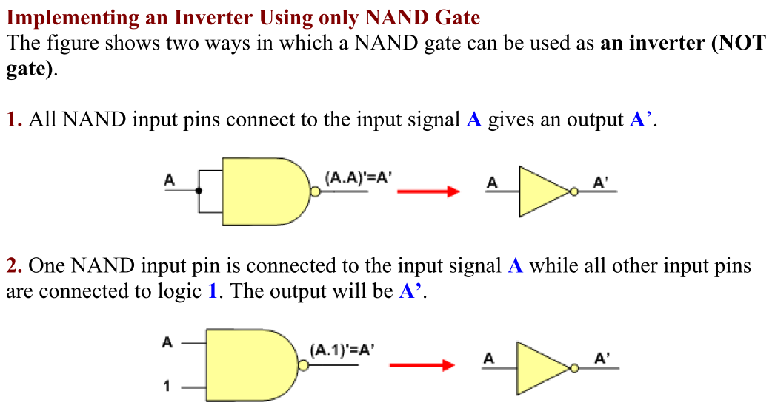
NAND Universal Gate
A universal gate is a gate which can implement any Boolean function without need to use any other gate type.

Slide 9
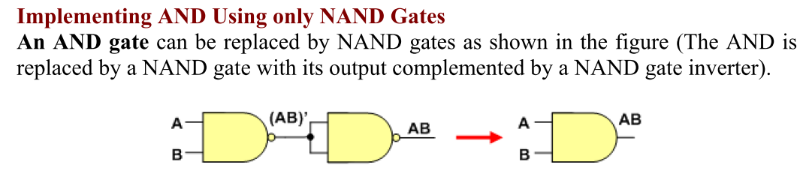
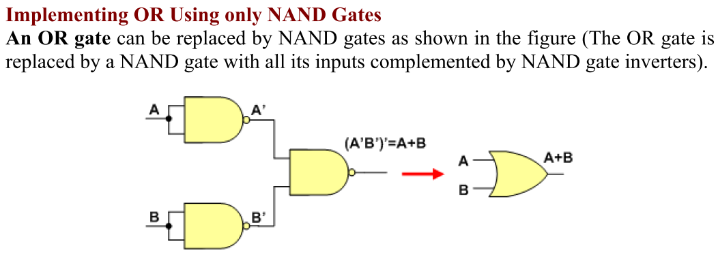
NAND Universal Gate

Slide 10
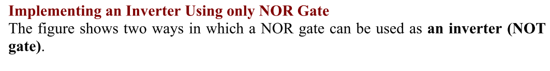
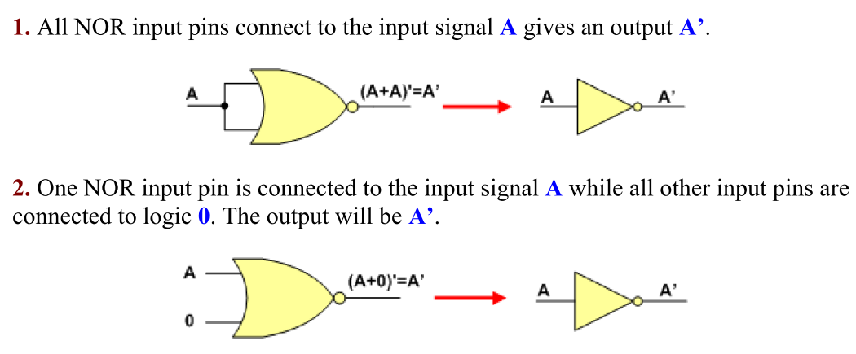
NOR Universal Gate

Slide 11
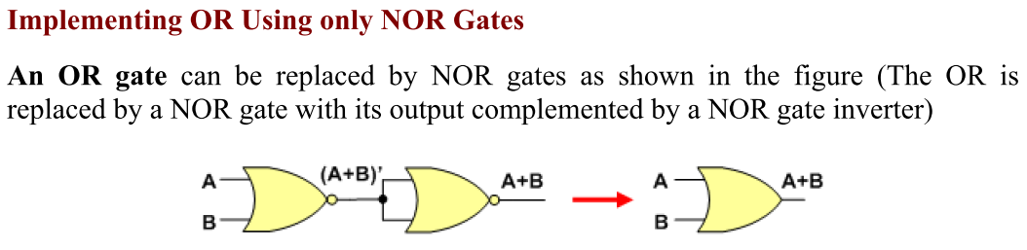
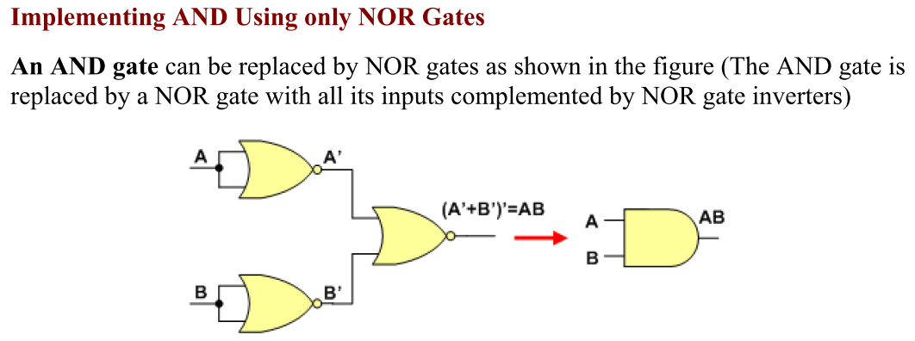
NOR Universal Gate

Slide 12
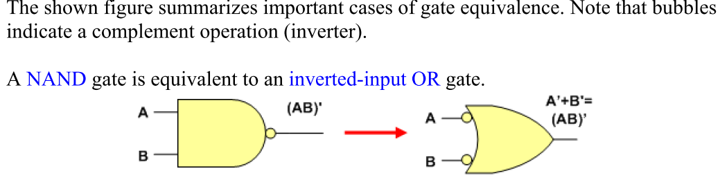
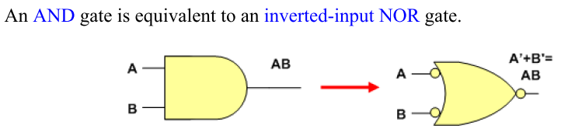
Equivalent Gates

Slide 13
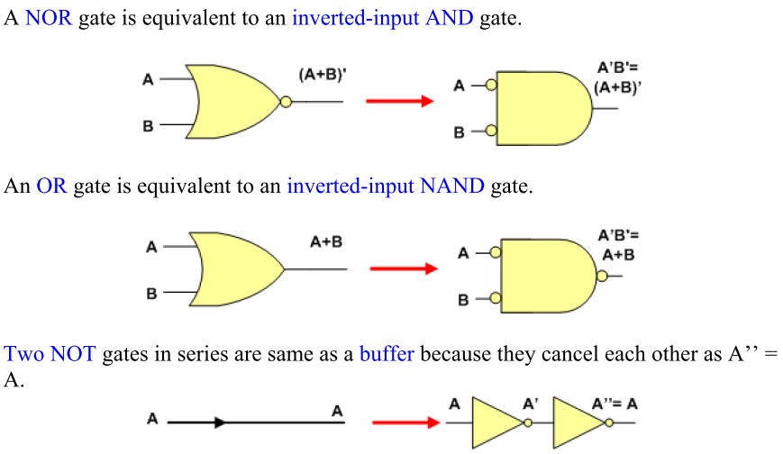
Equivalent Gates

Slide 14
NAND Gate Applications
Device Failure Alarm
Notes:
Toxic fumes produced by the chemicals are removed from the ware house and dispersed in the atmosphere through three exhaust fans.
When all fans are working the input to the NAND gate is 111 and the output is 0
When any one fan fails the output of NAND gate becomes 1 sounding an alarm connected tot the output of the NAND gate.

Slide 15
NOR Gate Applications
Washing Machine Controller
If the lid is open or the water is below the minimum level or the washing machine has been overloaded the appropriate sensor sets its output to 1
Notes:
Three sensors check for washing machine lid open, washing tub filled to minimum level and weight of cloths and water in the tub.
If the lid is open or the water is below the minimum level or the washing machine has been overloaded the appropriate sensor sets its output to 1. The NOR gate output is set to 0 switching off the washing machine.

Slide 16
XOR Gate
1 output
2 inputs
Multiple inputs

Slide 17
XOR Gate function
Input |  | Output
A | B | F
0 | 0 | 0
0 | 1 | 1
1 | 0 | 1
1 | 1 | 0

Slide 18
XOR Gate Timing Diagram

Slide 19
XNOR Gate
1 output
2 inputs
Multiple inputs

Slide 20
XNOR Gate function
Input |  | Output
A | B | F
0 | 0 | 1
0 | 1 | 0
1 | 0 | 0
1 | 1 | 1

Slide 21
XNOR Gate Timing Diagram

Slide 22
XOR Gate Applications
Detecting odd number of 1’s
Notes:
Consider the three XOR gate logic circuit which is used to detect odd number of 1’s in a 4-bit binary input combination
Consider the 4-bit binary number 0000 applied at the inputs A, B, C and D respectively of XOR gates 1 and 2.
The output of XOR Gates 1 and 2 is 0 and 0. The output of XOR gate 3 is also zero.
Consider the binary number 0011 applied at the inputs A, B, C and D respectively. The output of XOR gate 1 with inputs 00 is 0. The output of XOR gate 2 with inputs 11 is 0. The output of gate 3 is 0. Thus the output indicates that the binary number 0011 does not have odd number of 1’s
Consider the binary number 1011 applied at the inputs A, B, C and D respectively. The output of XOR gate 1 with inputs 10 is 1. The output of XOR gate 2 with inputs 11 is 0. The output of gate 3 is 1. Thus the output indicates that the binary number 1011 has odd number of 1’s

Slide 23
XNOR Gate Applications
Detecting even number of 1’s
Notes:
Consider the two XOR and a single XNOR gate based logic circuit used to detect even number of 1’s in a 4-bit binary input combination
Consider the 4-bit binary number 0000 applied at the inputs A, B, C and D respectively of XOR gates 1 and 2.
The output of XOR Gates 1 and 2 is 0 and 0. The output of XNOR gate 3 is a 1.
Consider the binary number 0011 applied at the inputs A, B, C and D respectively. The output of XOR gate 1 with inputs 00 is 1. The output of XOR gate 2 with inputs 11 is 1. The output of XNOR gate 3 is also a 1. Thus the output indicates that the binary number 0011 has even number of 1’s
Consider the binary number 1011 applied at the inputs A, B, C and D respectively. The output of XOR gate 1 with inputs 10 is 1. The output of XOR gate 2 with inputs 11 is 0. The output of XNOR gate 3 is 0 because of dissimilar inputs. Thus the output indicates that the binary number 1011 does not have even number of 1’s

Slide 24
THE END
Notes:
The second part of the first lecture on Number Systems ends here.
In this part we have discussed the decimal number system and looked at representing integers and fractions in decimal.
We have looked at a hypothetical base 5 caveman number system.
We have also discussed the binary number system used by digital systems.
We have learned to calculate decimal equivalents of base 5 caveman numbers and binary numbers by writing and solving expressions based on weights and base values.
We would be continuing with the discussion on number systems in the next lecture by looking at methods to convert from Decimal to Binary and Binary to Decimal number systems.
Please do try to practice writing numbers in caveman and binary number systems and calculating their decimal equivalents.
Khuda Hafiz and Asalam O Aleikum

