Slide 1
Digital Logic & Design
Lecture 11

Slide 2
Full-Adder
Full-Adder = Half-Adder + Half-Adder

Slide 3
Full-Adder based on Two Half-Adders

Slide 4
Parallel Binary Adder
Multiple Single bit Full-Adder connected in Parallel

Slide 5
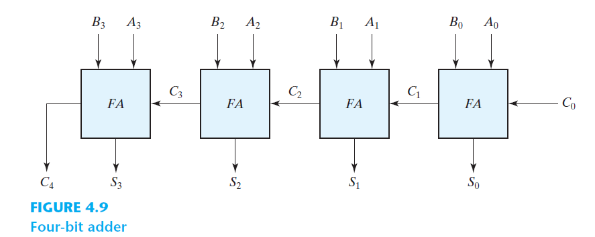
4-bit Parallel Adder

Slide 6
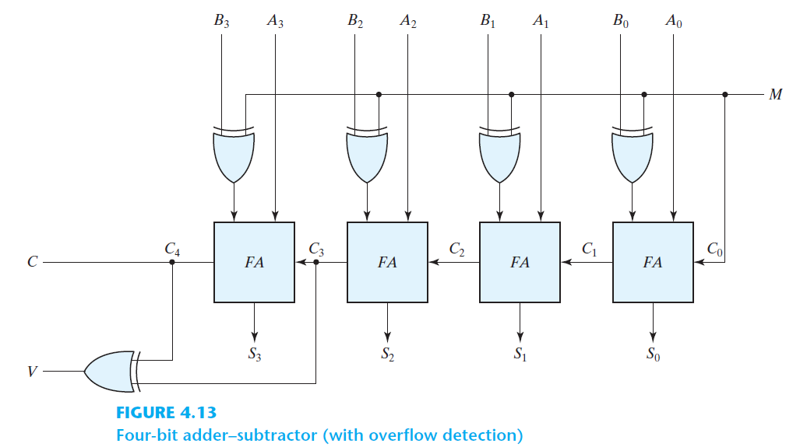
Four-bit adder–subtractor

Slide 7
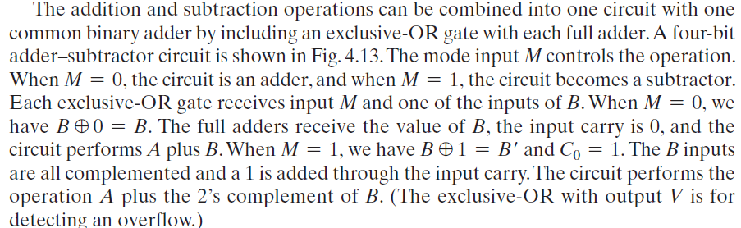
Four-bit adder–subtractor

Slide 8
Active low/high inputs/outputs
Active output state represented by 1 or 0
Active input state represented by 1 or 0
A bubble at output represents active low output
A bubble at input represents active low input
Notes:
BCD to 7-Segmnet display circuit sets segment output to 1
Comparator circuit sets A>B, A=B, A< B output to 1
Odd-Prime Number Detector Circuit
Adjacent 1s detector sets output to 1 when it detects adjacent 1s

Slide 9
Active low/high inputs/outputs
Notes:
AND gate performs AND operation on two active high inputs to result in an active high output
NAND gate performs AND operation on two active high inputs resulting in an active low output
OR gate performs OR operation on two active high inputs to result in an active high output
NOR gate performs OR operation on two active high inputs to result in an active low output

Slide 10
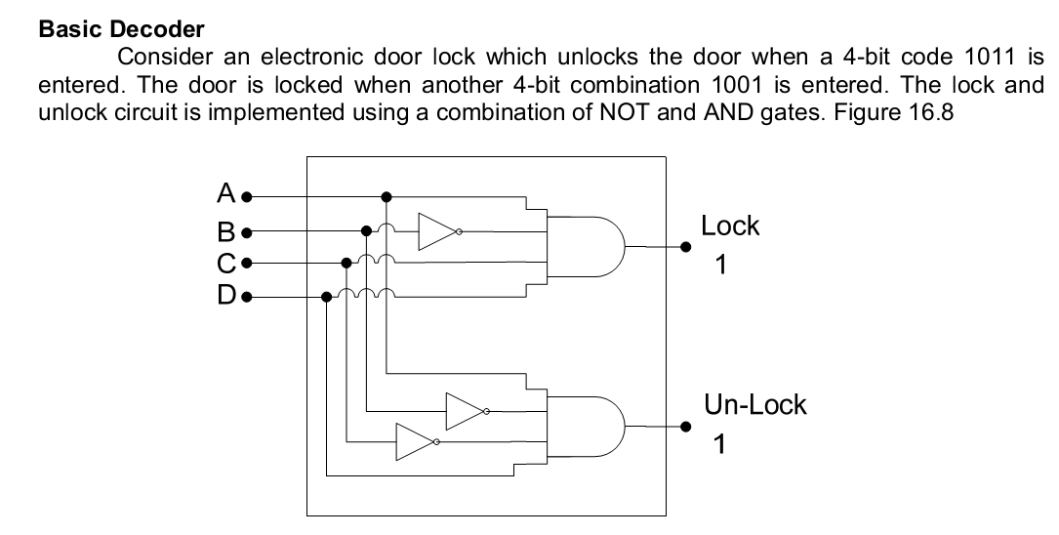
DECODER
A decoder is a circuit that converts binary information from
the n coded inputs to a maximum of 2^{n} unique outputs
Multiple Inputs and Multiple Outputs

Slide 11
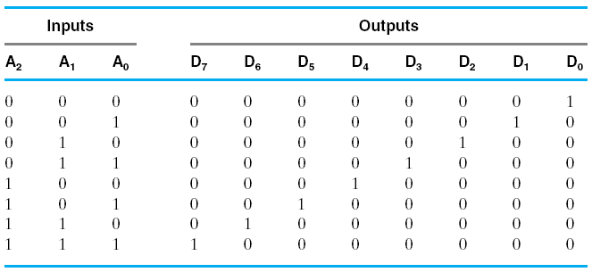
Example: 3 to 8 line decoder

Slide 12
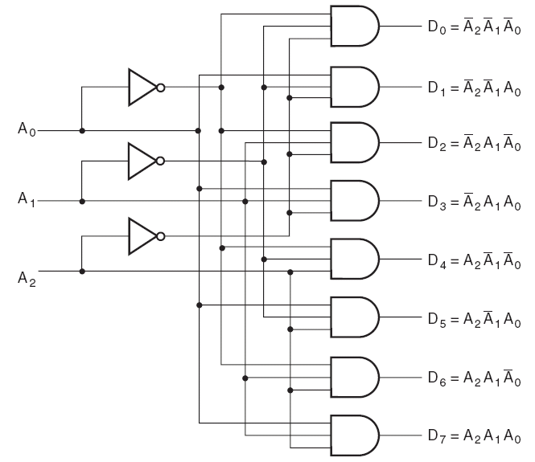
DECODERS

Slide 13
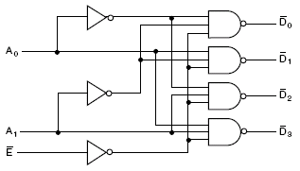


DECODER
Example: 2 to 4 line decoder

Slide 14
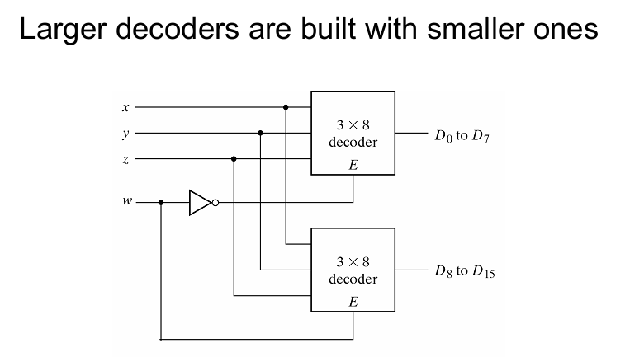
LARGE DECODERS

Slide 15
Function Implementation via Decoder
Full Adder
Input |  |  | Output
A | B | Carry In (C) | Sum | Carry Out
0 | 0 | 0 | 0 | 0
0 | 0 | 1 | 1 | 0
0 | 1 | 0 | 1 | 0
0 | 1 | 1 | 0 | 1
1 | 0 | 0 | 1 | 0
1 | 0 | 1 | 0 | 1
1 | 1 | 0 | 0 | 1
1 | 1 | 1 | 1 | 1

Slide 16

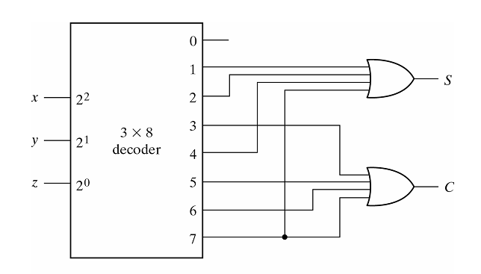
Function Implementation via Decoder

Slide 17
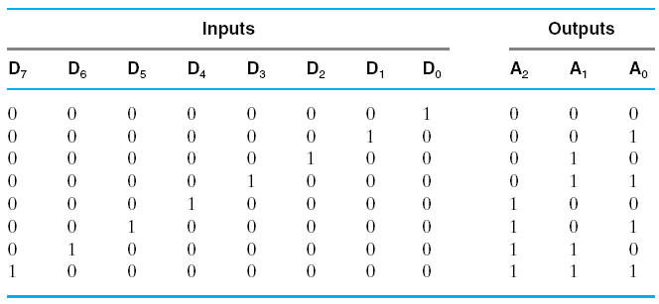
ENCODERS
An encoder has 2^{n} or fewer input lines and n output values
Opposite of the decoder function
The output lines generate the binary code corresponding to
the input value
A2=D4+D5+D6+D7;
A1=D2+D3+D6+D7;
A0=D1+D3+D5+D7
Example:

Slide 18
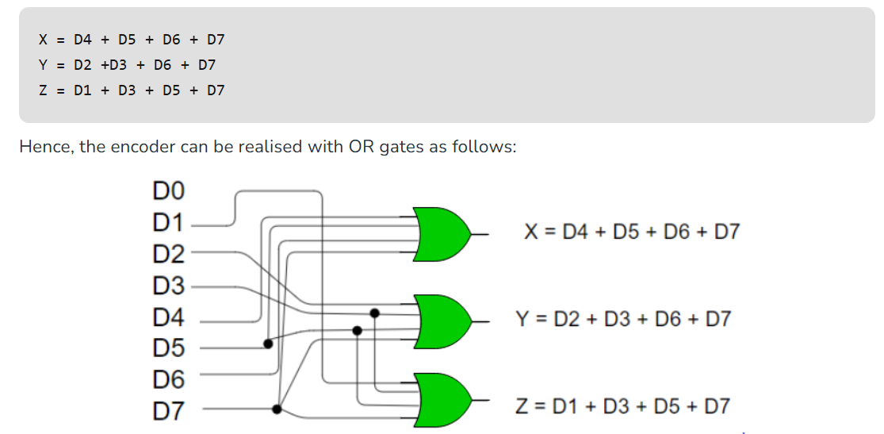
ENCODERS

Slide 19
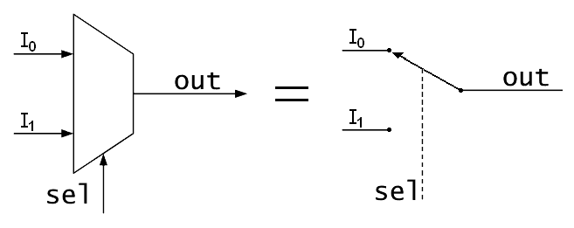
MULTIPLEXERS
a multiplexer selects one of several input signals
and forwards the selected input into a single line
n inputs, one output and s select inputs (2^s = n)

Slide 20
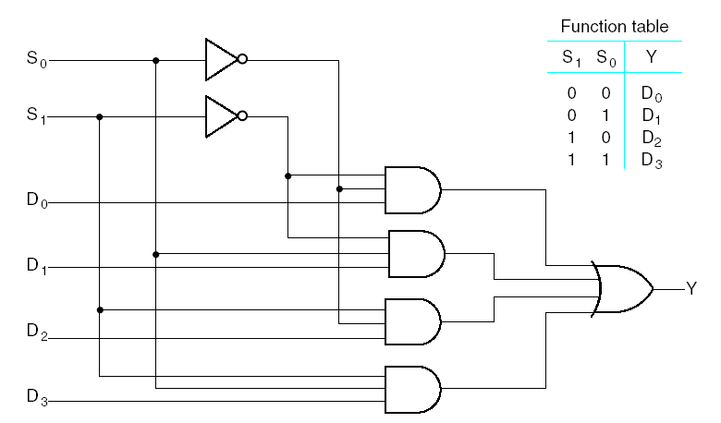
MULTIPLEXERS
Selection Inputs: Input variables which control the selection of
input lines. For 2^{n} input lines we need n selection inputs
An 2^{n} input, m output multiplexer is called 2^{n}-to-m line MUX
A 4-to-1 line MUX is shown above

Slide 21
MULTIPLEXERS
Enable Input
An enable input controls the operation of the unit
It is useful for combining two or more multiplexers into a
single large multiplexer
Multiple Bits Selection
Multiplexer blocks can be combined in parallel to perform
selection on multiple bit quantities
These have common selection and enable lines

Slide 22
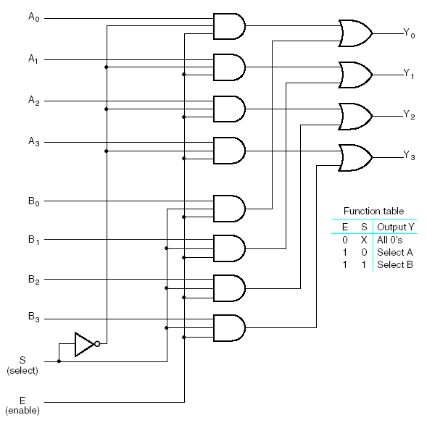
MULTIPLEXERS
Quadruple
2-to-1 line MUX
It has 4 multiplexers
each capable of
selecting one of two
input lines
The circuit may also
be viewed as a
selector of one of two
sets of data lines,
where each set has
4 lines

Slide 23
MULTIPLEXERS
Selection Inputs: Input variables which control the selection of
input lines. For 2^{n} input lines we need n selection inputs
An 2^{n} input, m output multiplexer is called 2^{n}-to-m line MUX
A 4-to-1 line MUX is shown above

Slide 24
MULTIPLEXERS
Boolean Function Implementation
We can implement a Boolean function of n variables with a
multiplexer with n-1 selection inputs
The first n-1 variables of the function are connected to the
selection inputs of the multiplexer and the remaining
n^{th} variable is used for data inputs

Slide 25
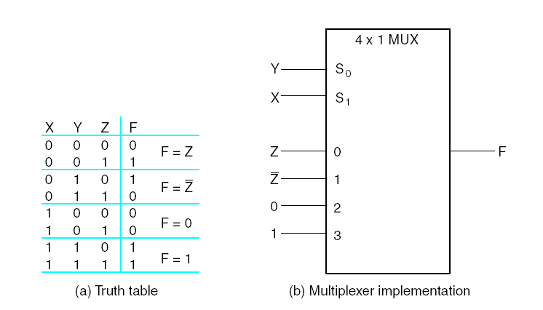
MULTIPLEXERS
Boolean Function Implementation
F = Σm(1,2,6,7)

Slide 26
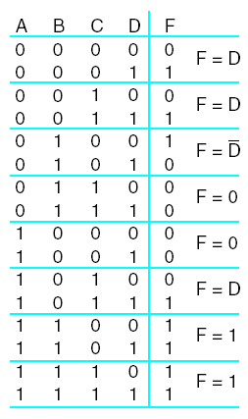
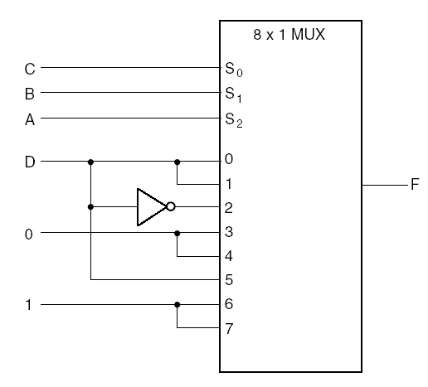
MULTIPLEXERS
Boolean Function Implementation
F = Σm(1,3,4,11,12,13,14,15)

Slide 27
MULTIPLEXERS
Boolean Function Implementation
F = Σm(2,3,5,6,8,9,12,14)

Slide 28
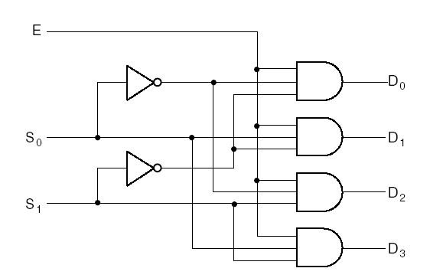
MULTIPLEXERS
Demultiplexers
A demultiplexer receives information from a single line and
transmits it to one of 2^{n} output lines
A 1-to-4 line demultiplexer:

Slide 29
Thanks

