Slide 1
DLD Lecture 12 Sequential Circuits
Chapter 5

Slide 2
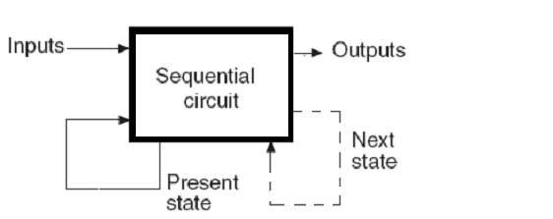
SEQUENTIAL CIRCUITS
The output is a function of the Inputs and the Present State of
the circuit
The Present State of the circuit changes to the Next State
according to the Inputs and the Present State

Slide 3
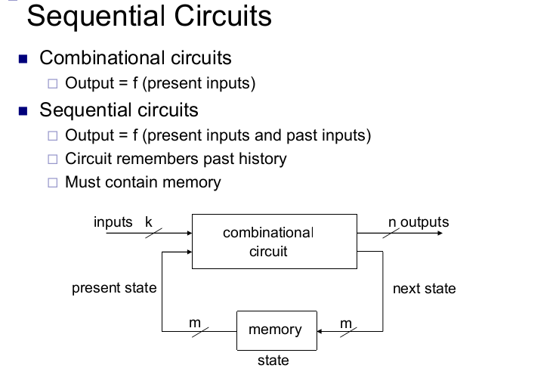

Slide 4
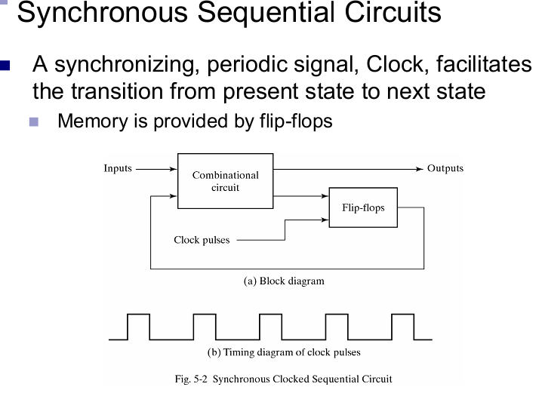

Slide 5
Latches
Latch circuits are level-triggered, meaning their output changes as long as the control signal (or input) is active (e.g., high or low).
Flip-flops, on the other hand, are edge-triggered, changing their output only when the clock signal transitions from one state to another (e.g., rising or falling edge).

Slide 6
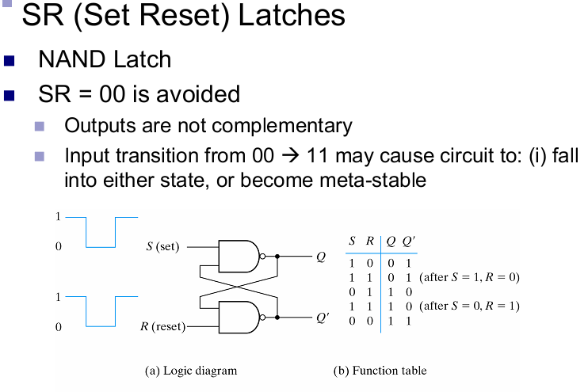

Slide 7
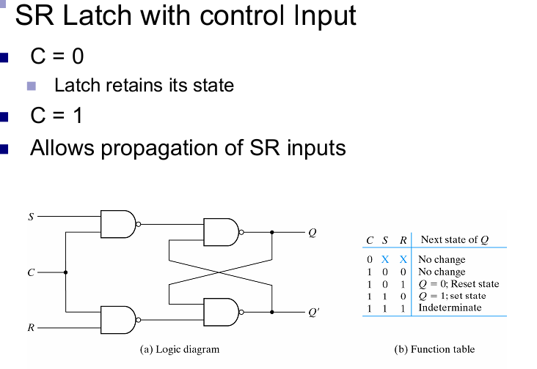
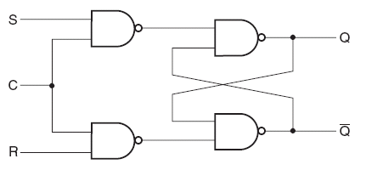
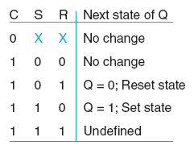
SR Latch with Control Input
Due to the first NAND gates,
the circuit again becomes an
SR latch, instead of S’R’

Slide 8
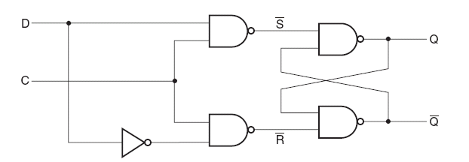
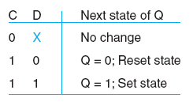
D LATCH
Called D latch because it stores a bit of data (D)
The stored data may be changed only when the control input
is “1”. When the control input is “0”, the data bit stored
is available at the output

Slide 9
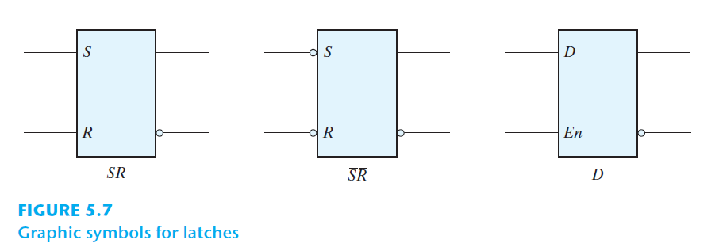
D LATCH

Slide 10
FLIP FLOPS
Any change in the data input will change the state of the
latch, as long as its control input (trigger) is 1
- In other words latches are transparent (there inputs
can be seen from their outputs)
Usually the latches are connected in cascade & driven by
the same trigger
- During one trigger it is assumed that each latch will
change its state according to its current inputs
- But if the previous latch changes its state soon enough
& the trigger is still available, then the next
latch may change its state a 2nd time
In a flip flop, two latches are connected in such a way that
the input of the flip flop is not transparent from the
output

Slide 11
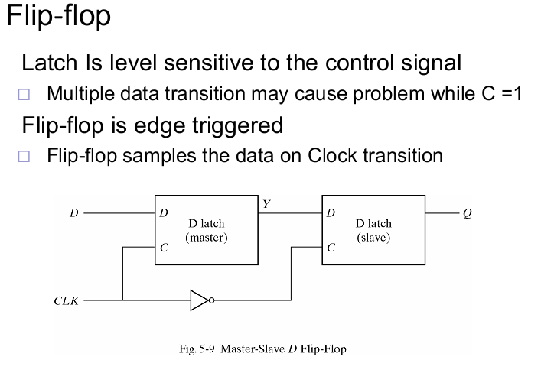
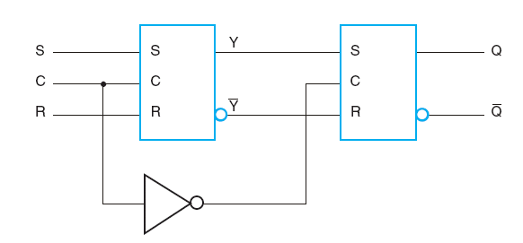
Master Slave Flip Flop

Slide 12
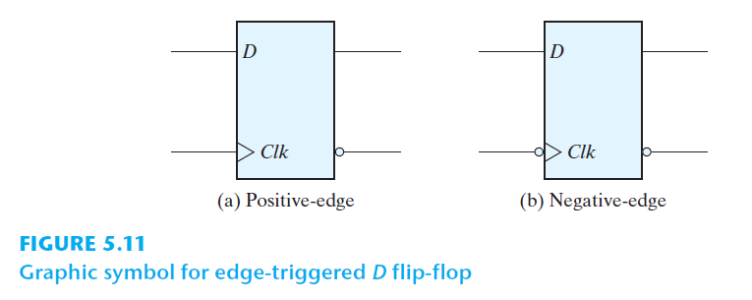
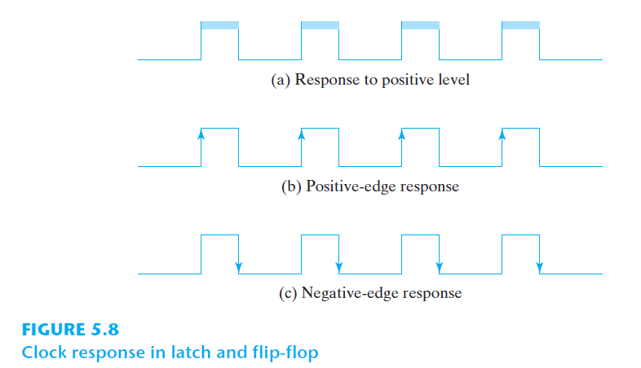

Slide 13
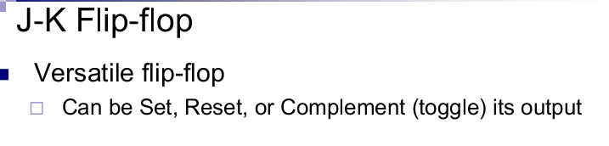
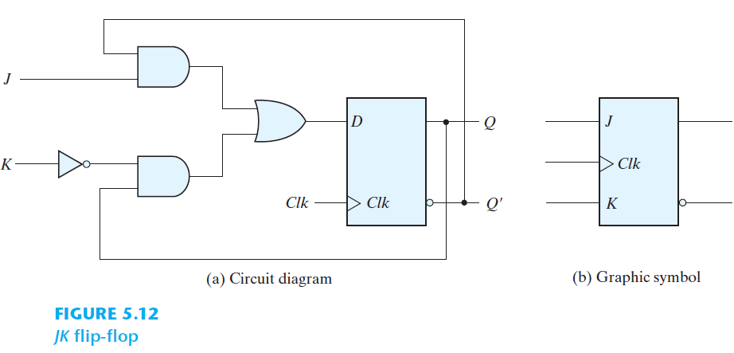

Slide 14
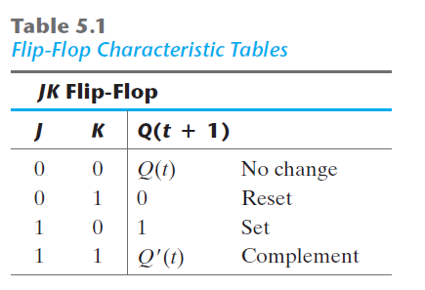
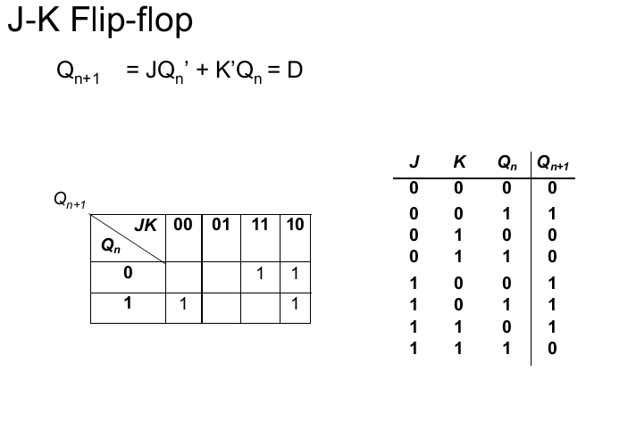

Slide 15
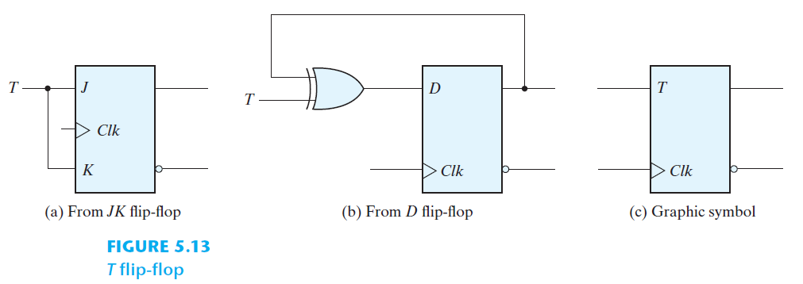
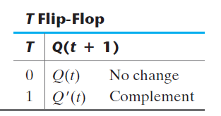
Toogle FlipFlop

Slide 16
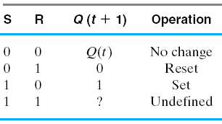
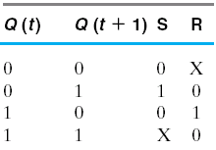
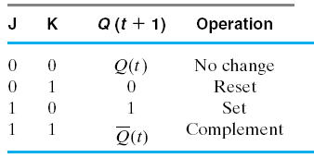
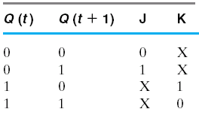
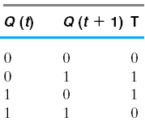
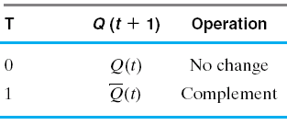
SEQUENTIAL CIRCUIT DESIGN
Excitation Tables

Slide 17
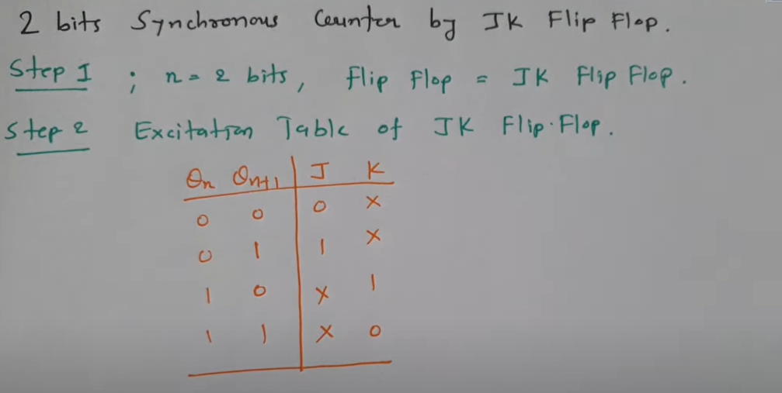
2 Bit Synchronous Counter

Slide 18
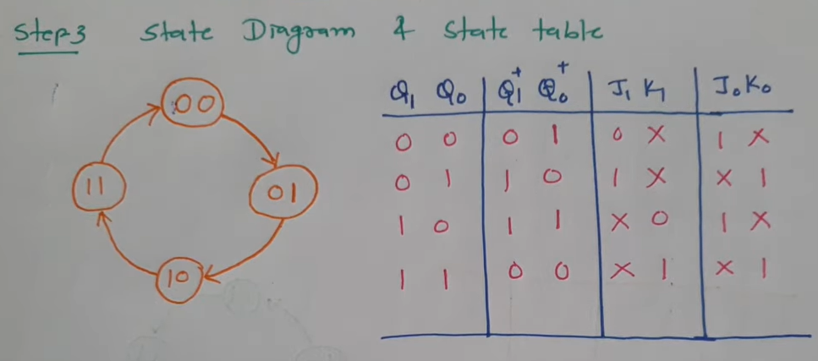
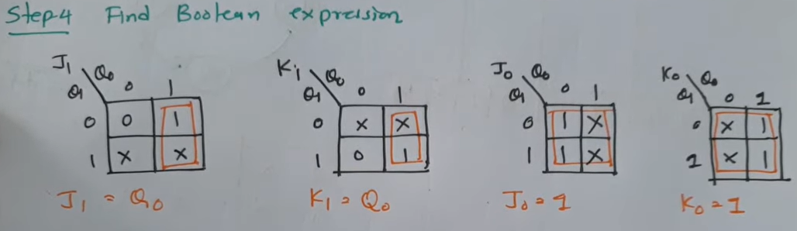
SEQUENTIAL CIRCUIT DESIGN

Slide 19
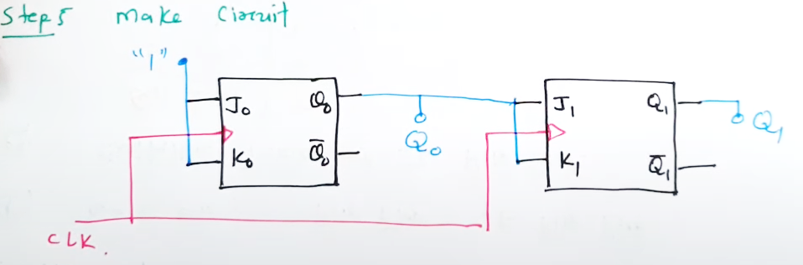
SEQUENTIAL CIRCUIT DESIGN

Slide 20
Thanks

